Slide 1
Building Smart Workflows
Automating Administrative, Maintenance And Workflow Tasks With QuickBase Using jQuery
Dan Diebolt, Netelier
Ann Arbor, Michigan
(734) 985-0721 Google Voice
dandiebolt@yahoo.com
Originally Presented
Wednesday October 28th, 2009
as Part of Intuit’s QuickBase Tech Fest 2009

Slide 2
Agenda
Goal: Demonstrate How to Use jQuery with QuickBase to Build Smart Workflows
  Automating Administrative, Maintenance, & Workflow Tasks
Introductions
Live Demo: Smart Workflows
jQuery Introduction
jQuery Conventions and Idioms
Questions and Comments

Slide 3

Introductions
Electrical And Computer Engineer, MSEE & MBA
30 Years Design And Development Experience in Automotive, Defense, Semiconductor, Design Automation, Computer Industries
QuickBase User Since ~ 2001
Frequent Contributor to QuickBase Community Forum
Interest Areas: DataMining, Scripting & Automation, Integration, MashUps & WebApps, Database, Data Interchange and Conversion, Demographics, Collective Intelligence Algorithms
Tools: I Use An Arsenal Of Open Source Tools, Scripts, Add-Ons, Utilities & Web Services With QuickBase

Slide 4
Live Demo: Class Roster Database
In the Live Demo We will use jQuery to Automatically Create Records to Initialize a Classroom Roster to a Given Capacity
  Tech Fest 2009 jQuery Application
  https://www.quickbase.com/db/beuhd75zn
  OR
  http://tinyurl.com/qbtechfest
Problem 1: Initialize Records for Seating Capacity
  https://www.quickbase.com/db/beuhd75zn
  ?act=dbpage
  &pagename=QBU_PopulateClassRoom.html
  &capacity=12
  &name=“QuickBase+jQuery”

Slide 5

Live Demo: Class Roster Database
Problem 2: Import Data From 2nd Domain (Mashup)
  https://www.quickbase.com/db/beuhd75zn
  ?act=dbpage
  &pagename=QBU_ImportCSVFromNetelier.html
  &csvfile=“students091028.csv”
The Design Pattern We are Presenting can be Applied in a Wide Range of Smart Workflows And Can Replace Manual Processing

Slide 6
Tech Fest 2009 jQuery Application
Order | Field | Type | Fid | Notes
1st | Name | Text | 6 | Class Name
2nd | Number | Numeric | 7 | Student Number
3rd | First | Text | 8 | Student First Name
4th | Last | Text | 9 | Student Last Name
5th | Code | Numer | 10 | Student Password

Slide 7
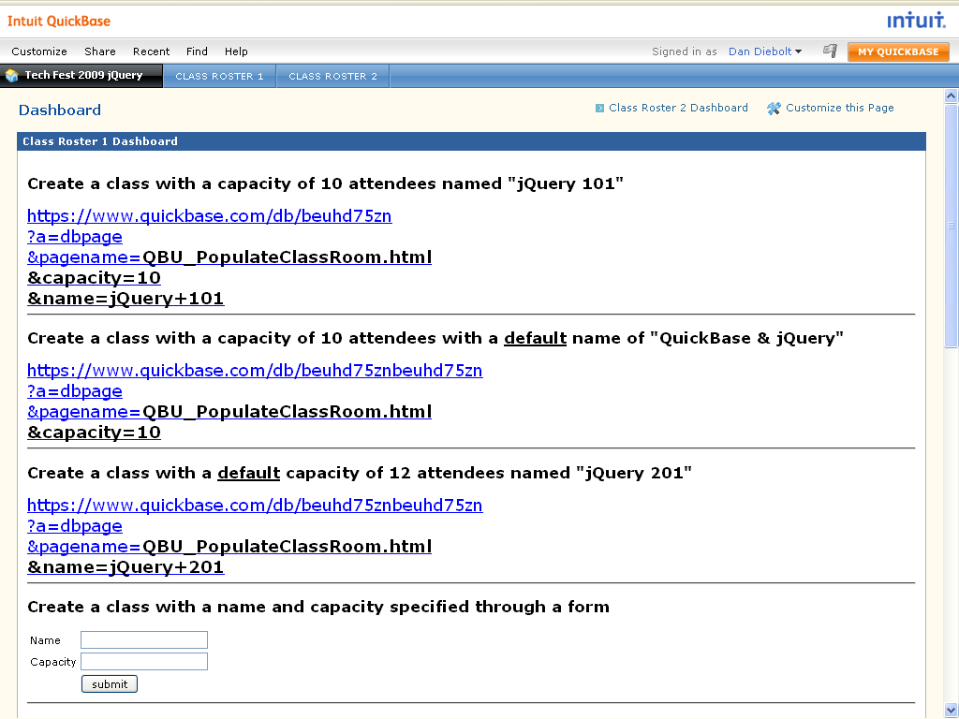
Live Demo Problem 2 Screen Shot

Slide 8
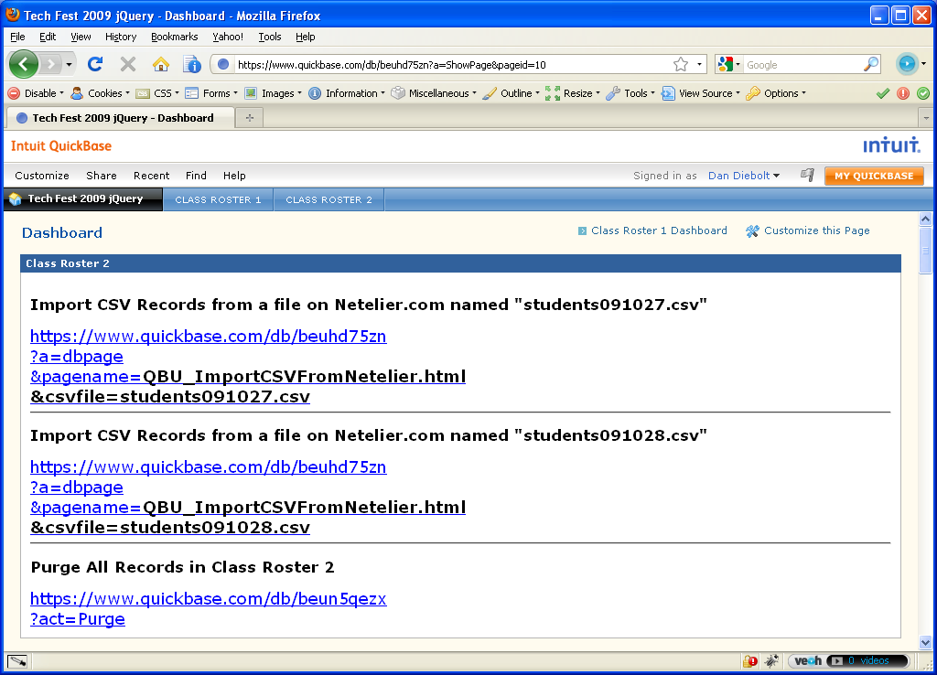
Live Demo Problem 2 Screen Shot

Slide 9

Introduction to jQuery
jQuery Released Circa January, 2006
Lightweight JavaScript Library for Dynamic Manipulation of HTML Web Pages
Cross Browser, Standards Compliant
Free, Open Source Under MIT & GPL License
Developed by Mozilla’s JavaScript Man - John Resig

Slide 10

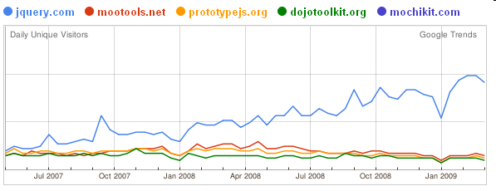
jQuery Preliminaries
Download From Google Code (ver 1.3.2 latest):
  http://code.google.com/p/jqueryjs/
  Normal & Minimized Source
jQuery Plugins Repository (3,503 as of 10/21/09)
  http://plugins.jquery.com/
jQuery’s Popularity - jQuery Is Way Ahead!
  http://blog.ekini.net/2009/04/15/jquerys-popularity/

Slide 11

QuickBase/jQuery Party Time
Technologies Involved
  AJAX, CSS, Functional Programming, HTML, HTTP, JavaScript, jQuery, Object Oriented Programming, Security, SGML, XML, XPATH, XSLT, etc.
Difficult to Master All These Technologies
jQuery Moto: “Write Less, Do More”
In Reality, jQuery Code is Short, Concise and Reads More Like a Configuration File than a Script
Use Design Patterns, Best Practices and Reusable Templates to Solve Classes of Problems
Encourage More QuickBase User Community Contributions

Slide 12
QBU_PopulateClassRoom.html (abridged)
<html>
<head>
<script src="beuhd75zn?a=dbpage&pagename=jquery-1.3.2.min.js"></script>
<script src="beuhd75zn?a=dbpage&pagename=jquery.url.packed.js"></script>
<script src="beuhd75zn?a=dbpage&pagename=qbu.js"></script>
<script type="text/javascript">
$(document).ready(function() {
var name=$.url.param("name") || "QuickBase & jQuery";
var capacity=$.url.param("capacity") || 12;
for (var i=0; i<capacity; i++) {
$.ajax({
url: "https://www.quickbase.com/db/beuh98tms?act=API_AddRecord",
data: {
fnm_name: name,
fnm_number: i+1,
fnm_code: Math.floor(Math.random()*1000)
}
});
}
$("#message").html("<h1>Message Goes Here</h1>").fadeOut(5000,function() {
window.close();
});
});
</script>
</head>
<body>
<div id="message"></div>
</body>
</html>

Slide 13
JavaScript and jQuery Conventions
Object Literal:
  var a = {
  dbid: “befe2yy7d”,
  act: “API_DoQuery”,
  query: “{0.CT.foo}”
  }
Anonymous Function (A function without a name!)
  function (){
  //do something
  }
The jQuery Object $
  Think of $ as merely the 27’th letter of the Alphabet and the Default variable name for the jQuery object
  All operation manipulate the jQuery object $ and return the same jQuery object

Slide 14
jQuery Coding Idioms I
Select All DOM Nodes in the Current Document Matching A Specified CSS Selector
  Format:
  $(selector)
  Examples:
  $(“a”) // selects all anchor elements
  $(“#myid”) // selects all elements with id=myid
  $(“.myclass”) //select all elements with class=myclass
Manipulate the Selected Elements
  $(“#myid”).hide() // hides all elements with id=myid
  $(“.myclass”).css("color","red") // add color=red to class=myclass
jQuery Supports Full CSS2 and Partial CSS3 Selectors (Way Ahead of Browsers)
XPATH Selectors Deprecated in 1.3.2 (Plugin Available)

Slide 15
jQuery Coding Idioms II
Select DOM Nodes in the Specified Document Matching the Specified Selector
  Format:
  $(selector, context)
  Examples:
  $(“record”,xmldoc) // selects all record nodes in the XML Response
Context is a Second Document Other than the Current Document
The XML Response Document from the QuickBase HTTP API Response Will Often be the Context

Slide 16
jQuery Coding Idioms III
Call the Utility Method Attached to the jQuery Object
  Format:
  $.method()
  Example:
  $.ajax({
  type: "GET",
  url: "https://www.quickbase.com/db/dbid?a=q&qid=1&opts=xfl",
  dataType: "xml",
  success: function(xml) {
  alert("Your AJAX call was successful!");
  }
  });
Ajax Methods Take ANY url (not just API Method URLs) and Can Further Process Any Output Response Format (XML, Text, JSON, CSV …)
Ajax Callback Function Automatically Called on Successful HTTP Request

Slide 17
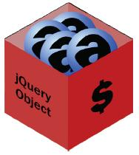
jQuery Coding Idioms IV
“You can think of a jQuery object $ like a bucket that holds DOM Elements” -Yehuda Katz, jQuery Author
jQuery Initializes when the DOM is defined (but not yet fully loaded):
  <script>
  $(document).ready(function() {
  //lets jQuery!
  }
  </script>
jQuery Object $ Supports Chaining of Methods
  $(selector).method1().method2() …
  Perform method1 on Every Element Matched by the Selector, then Perform method2 on Every Element Matched by the Selector …

Slide 18

Questions & Comments
+

