Slide 1

Barriers to Implementing a Just Culture
Understanding the Challenges to Creating a Fair and Learning-Focused Environment
Brian Preston CSD-380
7/13/2025

Slide 2
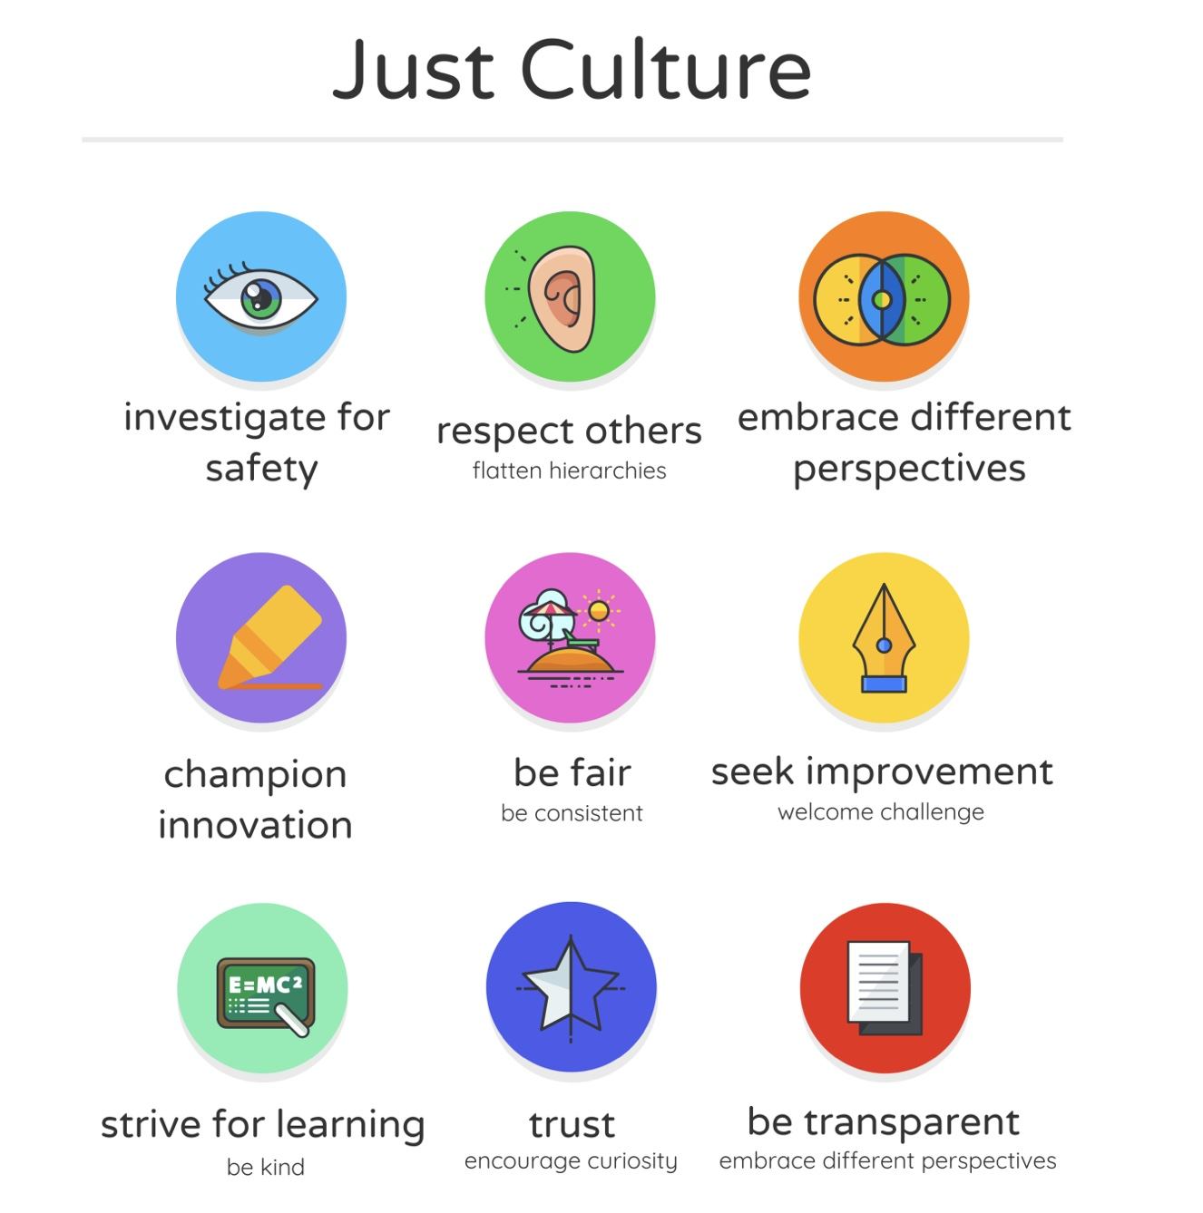
What Exactly Is a Just Culture?
A Just Culture focuses on learning and accountability, not blame.
It acknowledges that people can make mistakes but also aims to create an open environment to learn from them.
I believe Just Culture helps organizations improve safety and trust without punishing people for honest mistakes.
"At the heart of Just Culture lies a simple acknowledgment: we all make mistakes." — Shorrock (2024)

Slide 3
Barrier 1-Blame and Outcome Bias
Many organizations tend to blame individuals instead of looking at system flaws.
I think blame often overshadows learning and improvement opportunities.
Outcome bias makes people judge mistakes more harshly when the consequences are severe.
"Humans allow the outcome of a situation to influence the decision about what an appropriate response is for the people involved." — Health Quality Alberta (2024)

Slide 4
Barrier 2 — Lack of Trust and Transparency
Workers may fear sharing mistakes if they don't trust leadership to respond fairly.
Inconsistent assessment processes create uncertainty and fear.
From my experience, building trust takes time but can be lost quickly with one bad incident.
"Trust is fragile. It takes a long time to develop confidence that one will not be punished for mistakes that constitute normal human variability, and this trust is rapidly eroded." — Shorrock (2024)

Slide 5
Barrier 3 — Cultural and Professional Challenges
Different professions and departments often have unique expectations around what is “acceptable” conduct.
Deeply held professional values can make it difficult to create a shared, fair approach to mistakes and learning.
I feel that these cultural differences lead to misunderstandings and judgment between teams, which weakens trust.
Professionals often fear the judgment of their peers even more than punishment from leadership.
From my experience, even in well-intentioned organizations, different groups interpret policies and events differently, which can slow down progress toward a truly Just Culture.

Slide 6
Barrier 4 — Historical and Legal Influences
Past incidents and how they were handled create a lasting “organizational memory” that shapes how employees feel about reporting mistakes today.
I think employees look at how others were treated and use that to decide if it’s safe to be honest and open.
Legal systems and regulations sometimes require punishment even when mistakes are unintentional, creating additional fear and resistance.
I believe this fear can lead to underreporting or hiding errors, which goes against the spirit of continuous learning.
When someone is unfairly blamed, it can damage morale for years, like a “social oil spill” that affects new and old employees alike.
"When someone is blamed for an ‘honest mistake,’ it is like a social oil spill. The pollution sticks around for a long time." — Shorrock (2024)

Slide 7
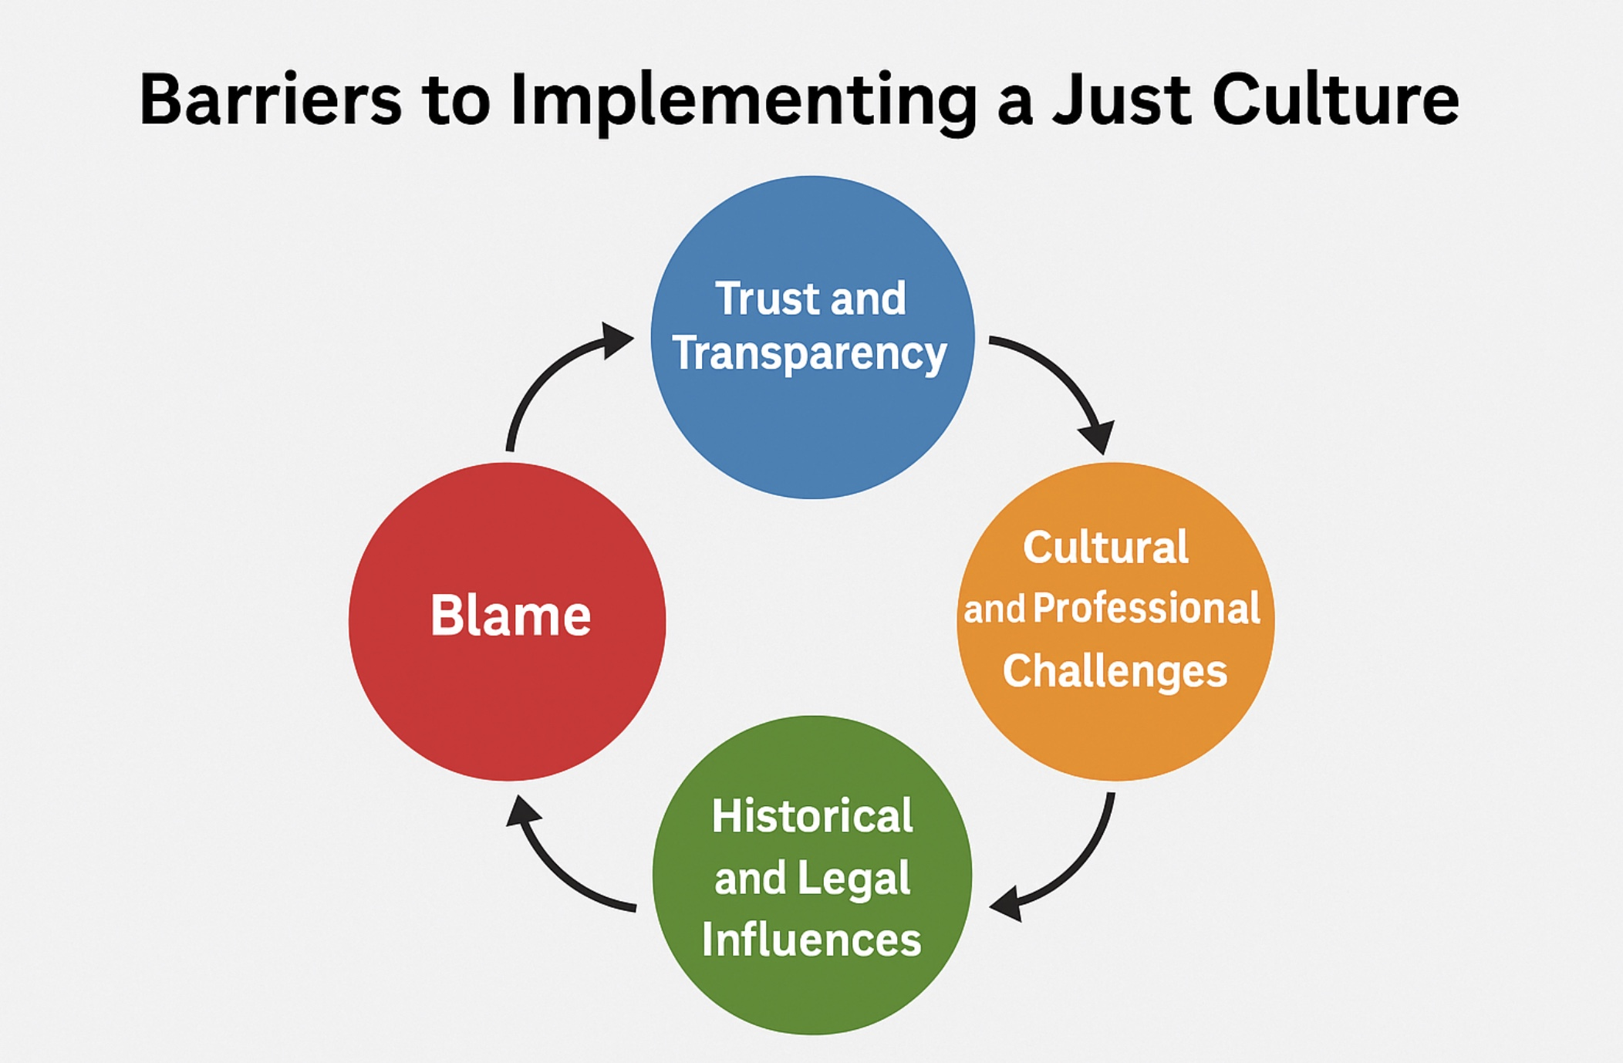
Visualizing the Barriers
Seeing the barriers laid out visually helps us understand how complex and interconnected these challenges really are.
Each barrier (Blame, Trust & Transparency, Cultural & Professional Challenges, Historical & Legal Influences) affects the others, creating a cycle that can be hard to break.
I feel it’s important to remember that overcoming these barriers isn’t about quick fixes — it requires commitment, patience, and a shift in mindset across all levels of an organization.
From my experience, when teams see these barriers visually, it sparks more open conversations and helps leaders and staff realize they aren’t alone in facing these challenges.

Slide 8
Moving Forward — Building a Just Culture
I believe building a Just Culture is an ongoing journey, not a one-time initiative.
Leaders need to actively model openness and fairness, and encourage learning from mistakes without fear.
Trust must be built slowly and maintained through consistent actions and communication.
I feel it’s important to engage all levels of the organization — from frontline staff to executives — to create shared understanding and values. Small steps, like transparent communication and fair incident reviews, can make a big difference over time. Together, we can create a safer, more supportive environment where everyone feels empowered to speak up and grow.

Slide 9
References
Health Quality Alberta. (2024). Overcoming barriers to a just culture. Health Quality Alberta Just Culture. https://justculture.hqa.ca/overcoming-barriers-to-a-just-culture/
Shorrock, S. (2024, November 2). Why is it just so difficult? barriers to “just culture” in the real world. Humanistic Systems. https://humanisticsystems.com/2023/10/18/why-is-it-just-so-difficult-barriers-to-just-culture-in-the-real-world/
Open Resources for Nursing (Open RN). (2023). 5.4 culture of safety. Nursing Fundamentals. https://openwa.pressbooks.pub/nursingfundamentals/chapter/5-4-culture-of-safety/

