Slide 1

Security Controls in Shared Source Code Repositories
By Brian Preston CSD 380 | July 20 2025

Slide 2

Why Code Security Is a Must
I believe source code is the core of any application, so protecting it should be a top priority.
Many belice only larger companies were targets, but now I understand that small teams are just as vulnerable. The rise in attacks shows we all need to take this seriously, no matter the project size.
“Source code leaks threaten your intellectual property, expose sensitive data, damage your public reputation, and destroy customer trust.” (Fernandes, 2025):

Slide 3
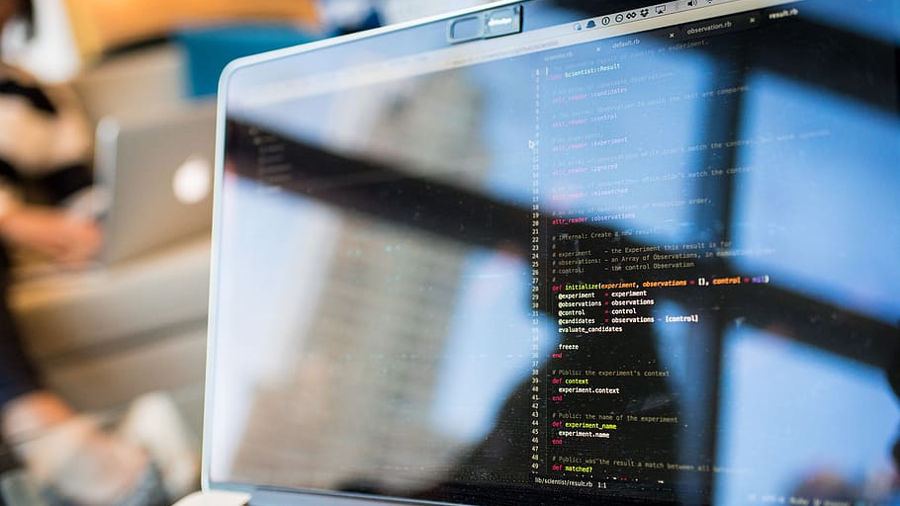
Common Vulnerabilities
Common Vulnerabilities I Didn’t Expect
When I first started learning about source code security, I honestly didn’t realize how basic mistakes could open huge doors for attackers. I think one of the most eye-opening things for me was learning how simple user input can lead to major attacks like SQL injection or Cross-Site Scripting (XSS).
SQL injection happens when developers don’t sanitize input, and an attacker sneaks malicious SQL commands into the system. For example, someone could input "Jim'; DROP TABLE users" and it could literally delete your user database.
XSS (Cross-site scripting) is another one that caught my attention. Instead of attacking the system directly, XSS injects code into a website that then runs in the browser of other users. That blew my mind — it turns your own app against your users.
Buffer overflows are low-level, but they still scare me. Especially in C/C++ programs, a simple unchecked input can crash your system or let someone run their own code.
I feel like if these types of attacks were better understood early on, developers could prevent a lot of them by simply validating and sanitizing inputs from the beginning.
“Injection attacks… allow an attacker to add SQL commands to input strings. Without proper sanitation, they can execute harmful code in your system.” (Ghalleb, 2024):

Slide 4
Access Control + Authentication
I believe that not everyone on a dev team needs full access to everything. That’s honestly a recipe for disaster. We should always apply “least privilege” principles—only give people access to what they absolutely need.
I used to think access was just about convenience, but now I understand it’s a major security layer.
Tools like GitHub and Assembla allow us to assign role-based access. I think that's critical, especially when collaborating with external contractors or freelancers.
Two-factor authentication (2FA) adds another layer of protection. It’s simple, but powerful. Even if someone gets your password, they still can’t get in without your device. I feel that combining 2FA with role-based access and session timeouts makes a huge difference in securing shared repositories.
For remote teams, 2FA should not be optional—it’s essential.

Slide 5
Remote Teams = Greater Risk
Working in the cosmetics industry, I collaborate with remote teams all the time—and I know how easily things can slip through the cracks.
I think remote development is amazing for flexibility, but it also increases risk: unsecured Wi-Fi, weak passwords, or outdated software can open doors for attacks.
I feel like the more distributed your team is, the more disciplined your security practices need to be.
According to the article I found from Fernandes, remote devices can expose your IP, assets, and sensitive data—that’s a scary thought.
This has made me rethink how companies onboard developers. I believe remote devs should get training on endpoint security, VPN use, and stronger passwords.
Using tools like location-based restrictions, endpoint detection, and device verification helps keep remote access locked down.

Slide 6

Encryption
I used to think encryption was just for large enterprise systems, but now I know it’s something that every project—big or small—should use.
Encryption at rest protects data stored in your system, and encryption in transit protects data as it moves between devices. Both are equally important.
I think hardcoded secrets are one of the easiest but most dangerous mistakes developers make.Copy/pasting API keys or passwords into your code might seem harmless during testing, but if that code ends up in a public repo... it’s game over.
I feel that using tools like HashiCorp Vault or environment-based secret managers should be a standard practice in every CI/CD workflow.
GitHub has made it easier to detect secrets, but I believe education is just as important as automation.
Encryption also makes me feel more confident that even if something gets intercepted, it won’t be readable to outsiders.
This Photo by Unknown Author is licensed under CC BY-NC-ND

Slide 7

The Power of Automation
I believe automation is one of the most effective ways to secure source code without slowing down developers.
With so many people working on a single repo, it’s impossible to manually review everything.
SAST (Static Application Security Testing) tools like SonarQube and Checkmarx can scan your code every time a new commit is made. That means you catch problems before they ever get deployed.
What I love about this is that it makes security feel more proactive rather than reactive.
Ghalleb explained how integrating these scans into your CI/CD pipeline creates a stronger safety net.
Personally, I like that this takes the pressure off individual developers to catch every issue. Instead, we build a safety system around them.I think all modern teams should treat code scanning like they treat spell check—always on, always running in the background.
“With static application security testing (SAST) as part of your CI/CD pipeline, you can be sure that nothing slips through the cracks.” (Ghalleb, 2024):
This Photo by Unknown Author is licensed under CC BY-NC-ND

Slide 8
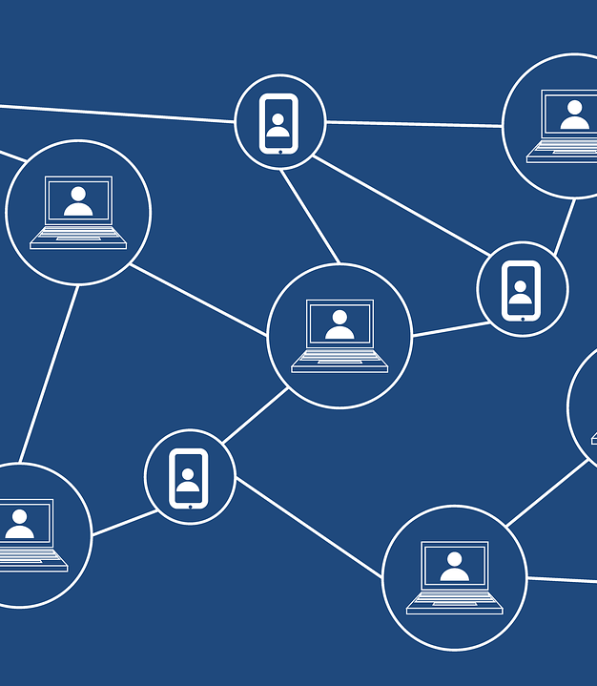
My Final Thoughts
I feel like this topic really changed how I view software development—not just as building things, but protecting them too.
Before diving into this research, I never realized how many layers go into securing source code: access control, encryption, scanning, remote policies—it all matters.
I think the biggest mindset shift for me was understanding that security is everyone’s job, not just the security team’s.
Whether it’s the first line of code or a last-minute commit, every developer has the power to either open a door or close it.
I now understand that a truly secure repository is built by combining tools, policies, training, and awareness. In the end, I believe the most powerful security tool is a well-informed and proactive team.
“Securing your source code is paramount to ensuring the integrity and security of your software.” (Fernandes, 2025):

Slide 9

References
Fernandes, C. (2025, June 24). Source code security best practices: A complete guide. Assembla. https://get.assembla.com/blog/source-code-security/
Ghalleb, Z. (2024, October 31). Source code security: Basics and best practices. Wiz. https://www.wiz.io/academy/source-code-security

