Slide 1

@beardaway

Slide 2
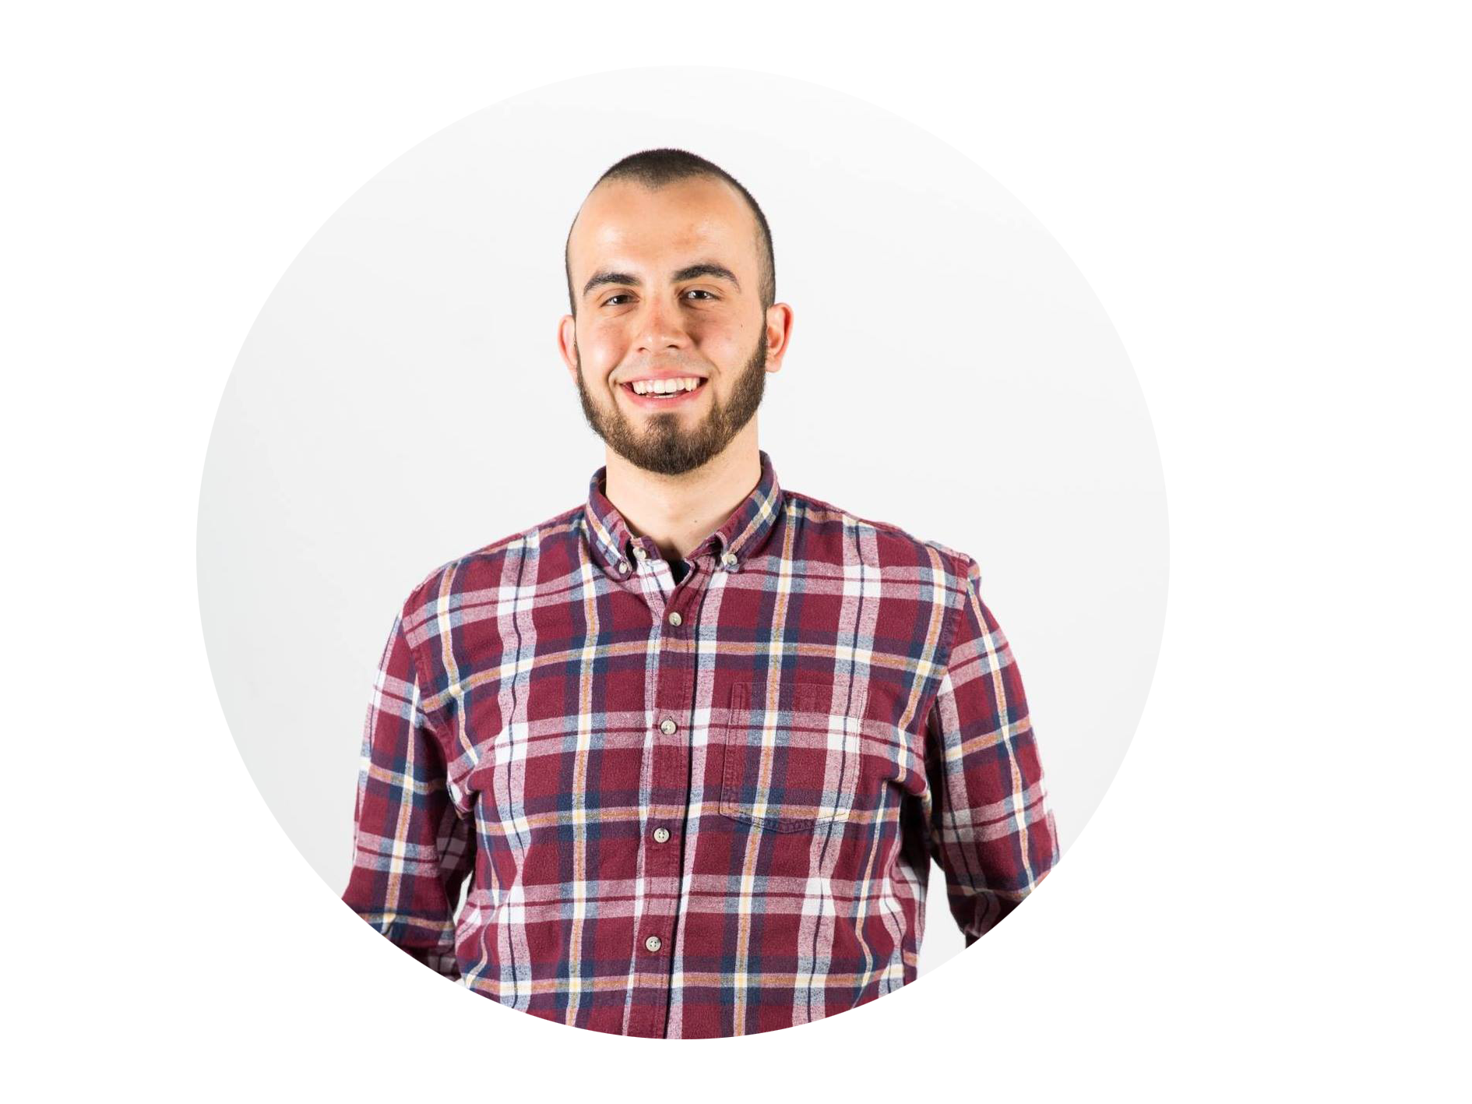
Yo!
I’m Conrad
Dev advocate by day. Hacker by night.
@beardaway

Slide 3
@beardaway

