Slide 1


Towards Intra-Vehicular Sensor Data Fusion
Paulo H. L. Rettore, Bruno P. Santos, André B. Campolina,
Leandro A. Villas, and Antonio A. F. Loureiro

Slide 2
Schedule
Introduction
Background
Vehicular Data
Case Study
Conclusion

Slide 3
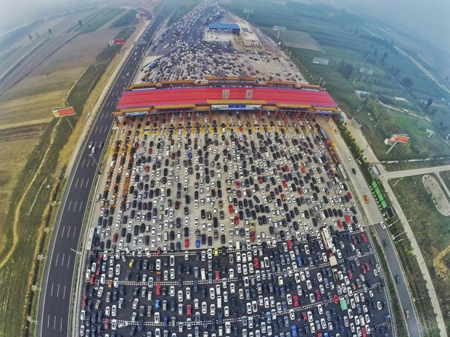
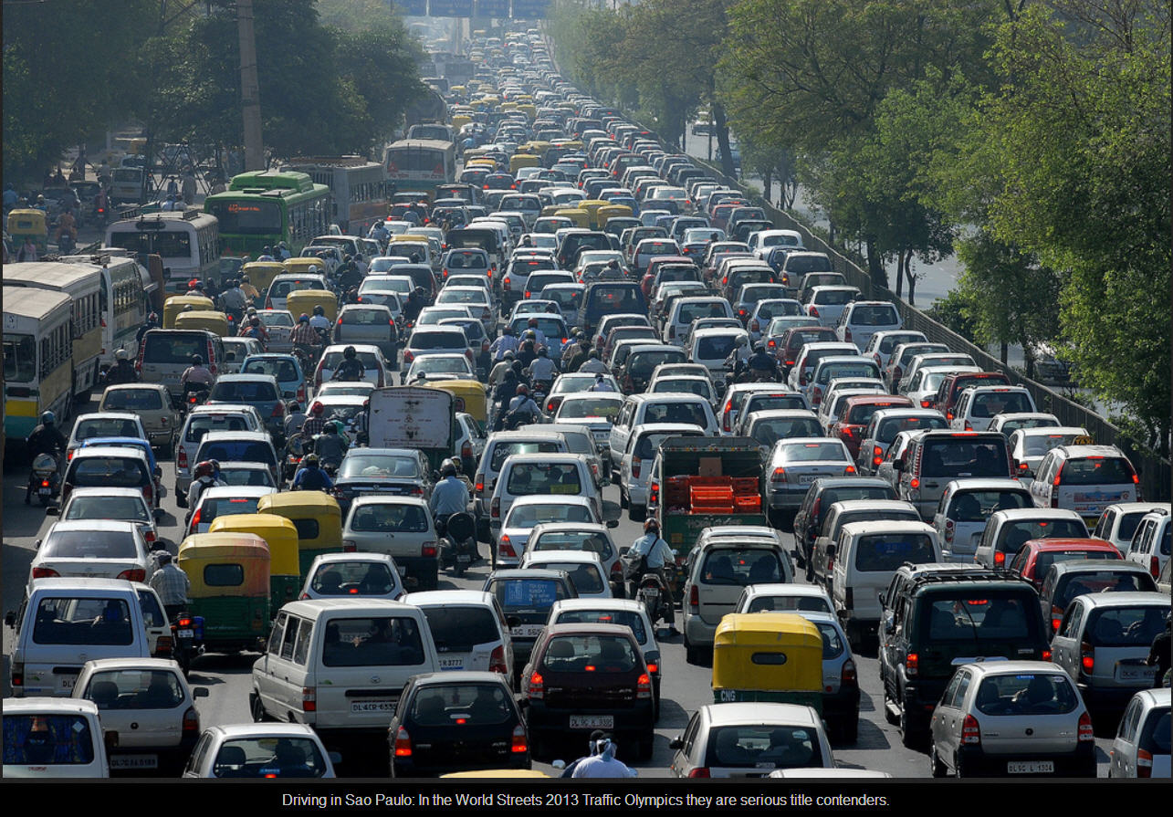
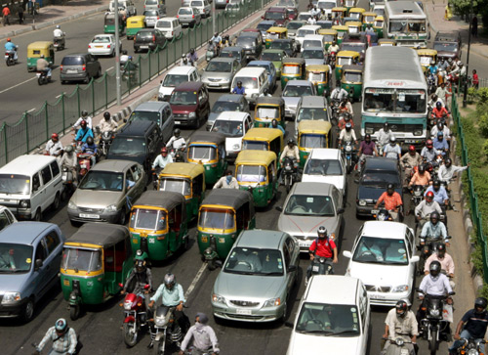
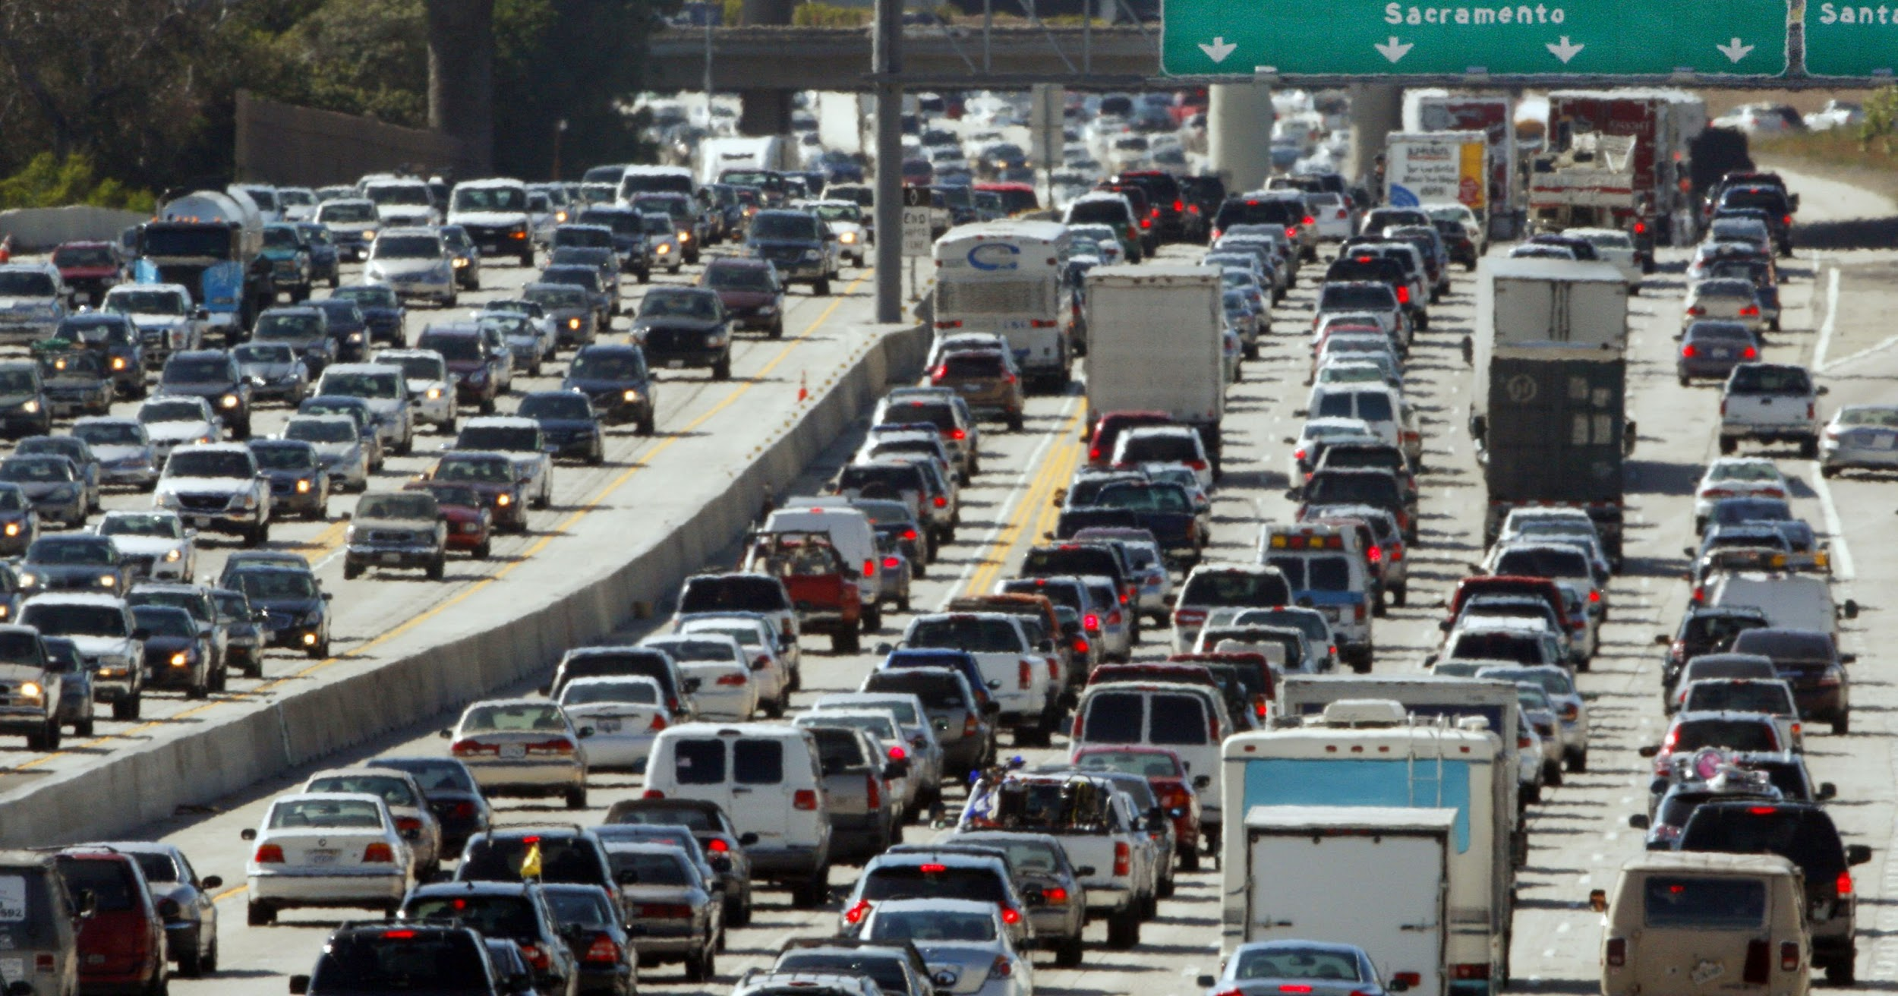
Introduction
The world’s population has increased
Over 50% live in huge cities
Issues related to transportation and traffic begin to grow:
Safety and quick mobility
Injuries and accidents causes:
Expensive cost medical
Decrease productivity
Brazil
China
USA
India

Slide 4
Introduction
Possible solutions?
Governments strategies
Rotating vehicles
Traffic restriction on selected regions
Monday | Last # 1 and 2
Tuesday | Last # 3 and 4
Wednesday | Last # 5 and 6
Thursday | Last # 7 and 8
Friday | Last # 9 and 0
Not scalable

Slide 5

Introduction
Possible solutions?
Governments strategies
Rotating vehicles
Traffic restriction on selected regions
Additional capacity

Slide 6
Introduction
Possible solutions?
Governments strategies
Rotating vehicles
Traffic restriction on selected regions
Additional capacity
Cost prohibitive

Slide 7
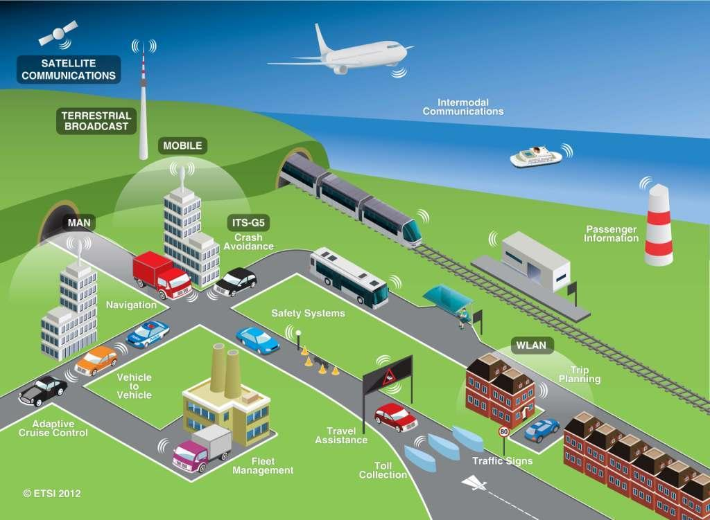
Introduction
Possible solutions?
Governments strategies
Rotating vehicles
Traffic restriction on selected regions
Additional capacity
Intelligent Transportation System (ITS)
Can be a feasible way
But ITS dependent of data and communication
We are interested in data for ITS.
Especially in car data

Slide 8
Background: ITS and Subsystems
ATMS
Advanced Transportation/Traffic Management Systems
To control and manage traffic devices (signals, monitoring and safety devices etc...)
ITS

Slide 9
Background: ITS and Subsystems
ATMS
Advanced Traveler Information Systems
To collect data and process it to improve understanding of traffic conditions
ITS
ATIS

Slide 10
Background: ITS and Subsystems
ATMS
Automatic Incident Detection
To automatically detect incidents as soon as possible to increase safety and reduce users perception of traffic disruption
ITS
ATIS
AID

Slide 11
Background: ITS and Subsystems
ATMS
Advanced Driver Assistance Systems
Apply technologies intended to improve driver experience and safety of the users
ADAS
ITS
ATIS
AID

Slide 12
Background: ITS and Data
ATMS
ADAS
ITS
ATIS
ITS are powered by data as much as possible
Traditional traffic sensors are ineffective for ITS requirements
Fortunately, There are available other data sources
Cameras, GPS, Smartphones, vehicles
Probe vehicles, Social Media ...
These sensors provides timely and precise information about traffic status
AID

Slide 13
Background: ITS and Data Fusion
ATMS
ADAS
ITS
ATIS
Data information is the heart of ITS
Usually the data is heterogeneous
Heterogeneous data fusion techniques are suitable in such situation
Inference, Estimation, Classification, Aggregation ...
AID

Slide 14
Background: ITS and Data Fusion
ATMS
ADAS
ITS
ATIS
Can we use directly data catch from sensors to ITS subsystems?
In general, NO
Data aspects make DF process a challenging task
Imperfection
Uncertainty
Outliers
Ambiguity
...
AID

Slide 15


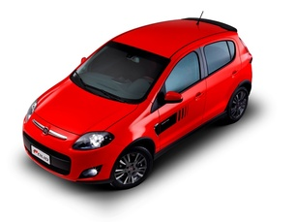
Vehicular Data
The sensors on a car, communicate with the Engine Control Unit (ECU)
The data they output is accessible using the On-Board-Diagnostics (OBD) interface
The information is collected from different sensors spread across different parts of the vehicle’s body in different measuring units
It can be considered Heterogeneous

Slide 16
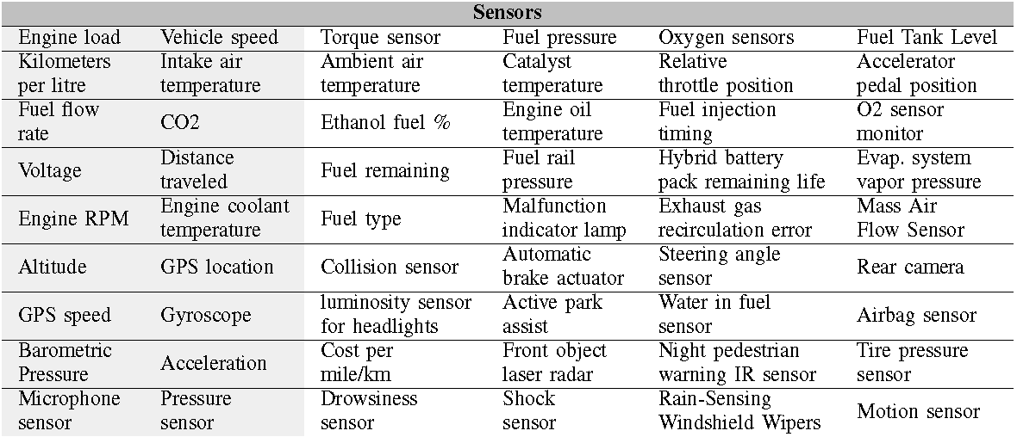
Vehicular Data
Notes:
Just for mentions the amounts of sensors and highlight the sensors available

Slide 17
Vehicular Data
Notes:
Just for mentions the amounts of sensors and highlight the sensors available

Slide 18
Case Study
Problems of heterogeneous data fusion
A practical and comprehensive data analyses in vehicular sensor data
We used an OBD Bluetooth adapter to collect data from a car
The logs of these vehicles consist of 55 trips of 40 km with an average time of 50 minutes each

Slide 19
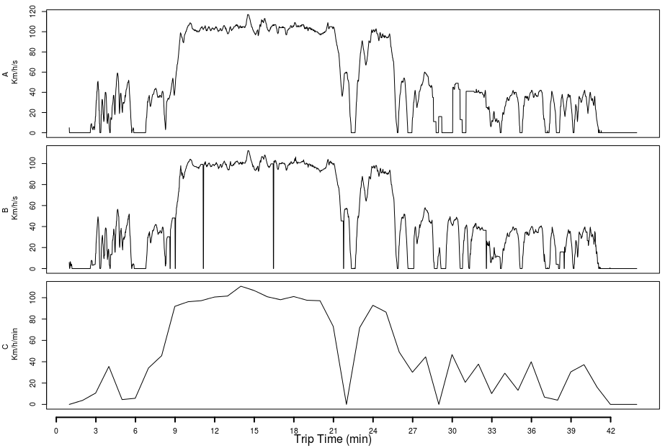
Case Study
Granularity
Is related to the ability to derive valuable information about entities of interest on a data set.
Vehicle Speed
GPS Speed
GPS Speed

Slide 20
Case Study
Granularity
Is related to the ability to derive valuable information about entities of interest on a data set.
Vehicle Speed
GPS Speed
1 seg
GPS Speed
60 seg
Lose Information

Slide 21
Case Study
Vagueness
Occurs in data sets where attributes are not well defined
Vehicle Speed
GPS Speed
GPS Speed

Slide 22
Case Study
Vagueness
Occurs in data sets where attributes are not well defined
Vehicle Speed
GPS Speed
FAST or SLOW ?
Depend on the context
GPS Speed

Slide 23
Case Study
Outlier
There are points whose data is incorrect
Vehicle Speed
GPS Speed
GPS Speed

Slide 24
Case Study
Outlier
There are points whose data is incorrect
Vehicle Speed
GPS Speed
GPS Speed
Distorter points with 0 (zero) values

Slide 25
Case Study
Conflict
Divergent specialists’ opinions or punctual errors in sensor readings happen and cause conflicts in data observations.
Vehicle Speed
GPS Speed
GPS Speed

Slide 26
Case Study
Conflict
Divergent specialists’ opinions or punctual errors in sensor readings happen and cause conflicts in data observations.
Vehicle Speed
GPS Speed
Points with 100 km/h
GPS Speed
Points with 0 km/h

Slide 27
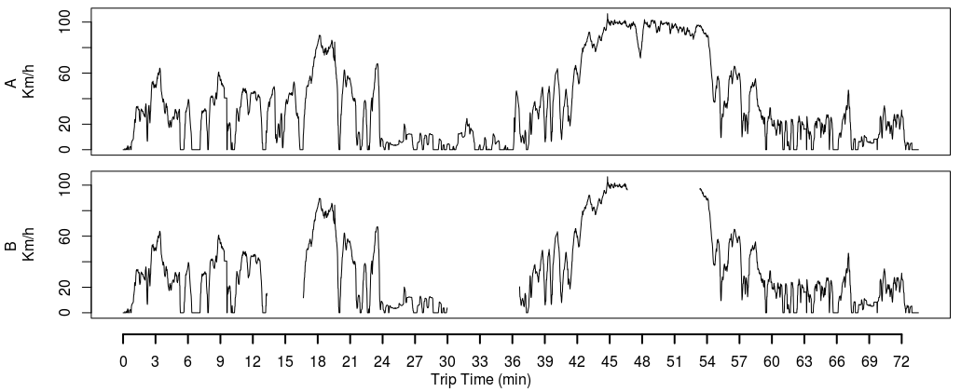
Case Study
Incompleteness
Data with missing parts
Vehicle Speed
GPS Speed

Slide 28
Case Study
Incompleteness
Data with missing parts
Vehicle Speed
GPS Speed
Barriers in the environment as tunnels

Slide 29
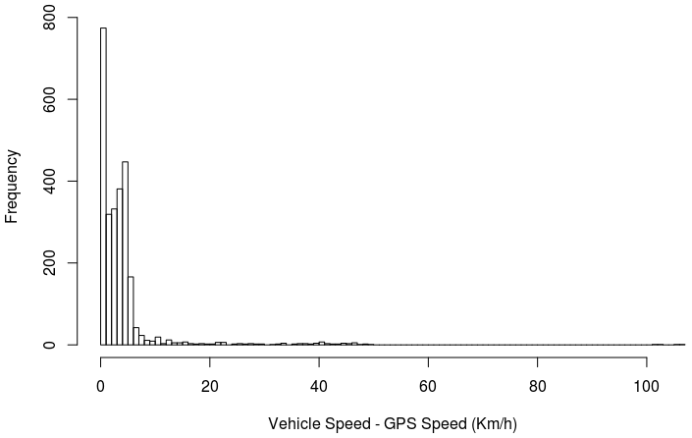
Case Study
Ambiguity
When occurrences in the data set are assumed to express the same information, however they differ from each other.

Slide 30
Case Study
Ambiguity
When occurrences in the data set are assumed to express the same information, however they differ from each other.
Vehicle Speed
-
GPS Speed
Both sensors collected the same speed
vehicle speed shows the current speed and GPS speed a different or
conflicted value

Slide 31
Case Study
Uncertainty
In the case of sensors, the uncertainty is always present, in other words, it is inherent a property of any sensor
Disorder
This problems is not common in our scenarios, because the process to data collect is synchronous

Slide 32
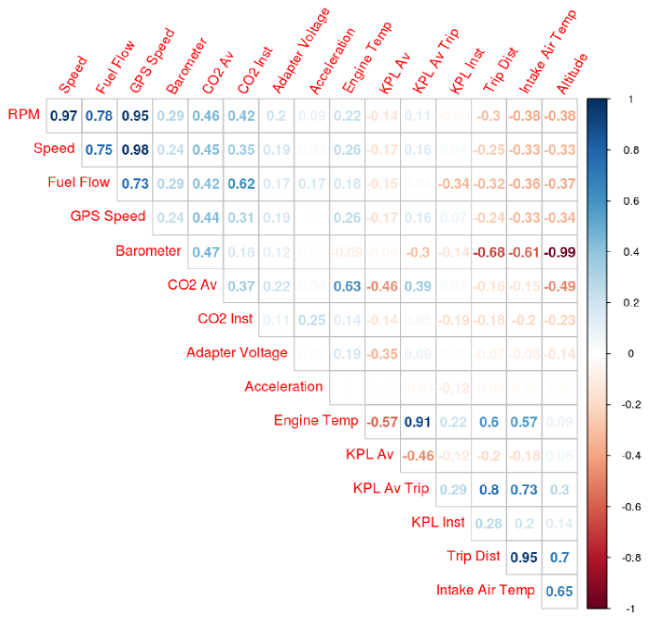
Case Study
Correlation
It is problematic since it can either enhance or attenuate some aspects due the data is fed multiple times in the data fusion system, multiplying its importance on the final result.

Slide 33
Case Study
Correlation
It is problematic since it can either enhance or attenuate some aspects due the data is fed multiple times in the data fusion system, multiplying its importance on the final result.
High correlations. So that, these data can be reduced to only one variable as Speed, for instance

Slide 34
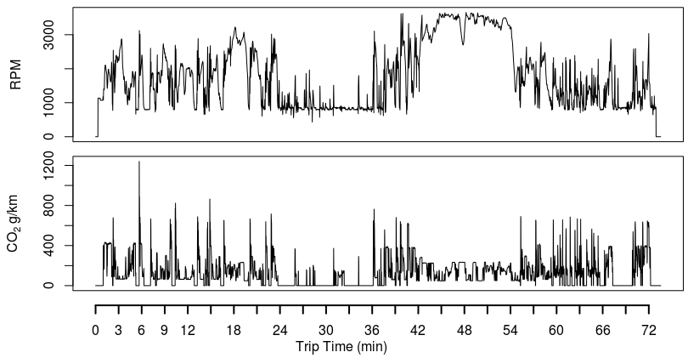
Case Study
Disparateness
It is inherently disparate, since there are sensors that assess different aspects in different units and scales.
RPM
CO₂

Slide 35
Case Study
Disparateness
It is inherently disparate, since there are sensors that assess different aspects in different units and scales.
RPM
CO₂
Dissimilarity between two sensors

Slide 36
Conclusion
ITS can be boosted by take in account heterogeneous data collected from several sources as much as possible
However, in general, the data comes with some issues making difficult heterogeneous data fusion process
Therefore they must be treated before fusion process
This work can guide beginner researchers to better understand the data, mainly in vehicular context, and some problems they possibly have to deal.

Slide 37
Thanks

