Slide 1

Matrix: Multihop Address Allocation and Dynamic Any-to-Any Routing for 6LoWPAN
Bruna S. Peres Otavio A. O. Souza Bruno P. Santos Edson R. A. Junior
Olga Goussevskaia Marcos A. M. Vieira Luiz F. M. Vieira Antônio A. F. Loureiro
MSWiM 2016
Malta, November 16th, 2016

Slide 2

6LoWPAN
IPv6 over Low-power Wireless Personal Area Networks
Even the smallest low-power devices should be able to run the Internet Protocol to become part of the Internet of Things

Slide 3














Problem
Internet
Routing lacks support for any-to-any communication or do not perform it in a efficient manner
Unstructured addresses that do not reflect the topology of the network
A
LBR-1
C
H
T
D
G
B
K
W
J
L
F
E
X

Slide 4

Motivation
Reliable any-to-any communication
Message and memory-efficient
New applications for the Internet of Things

Slide 5
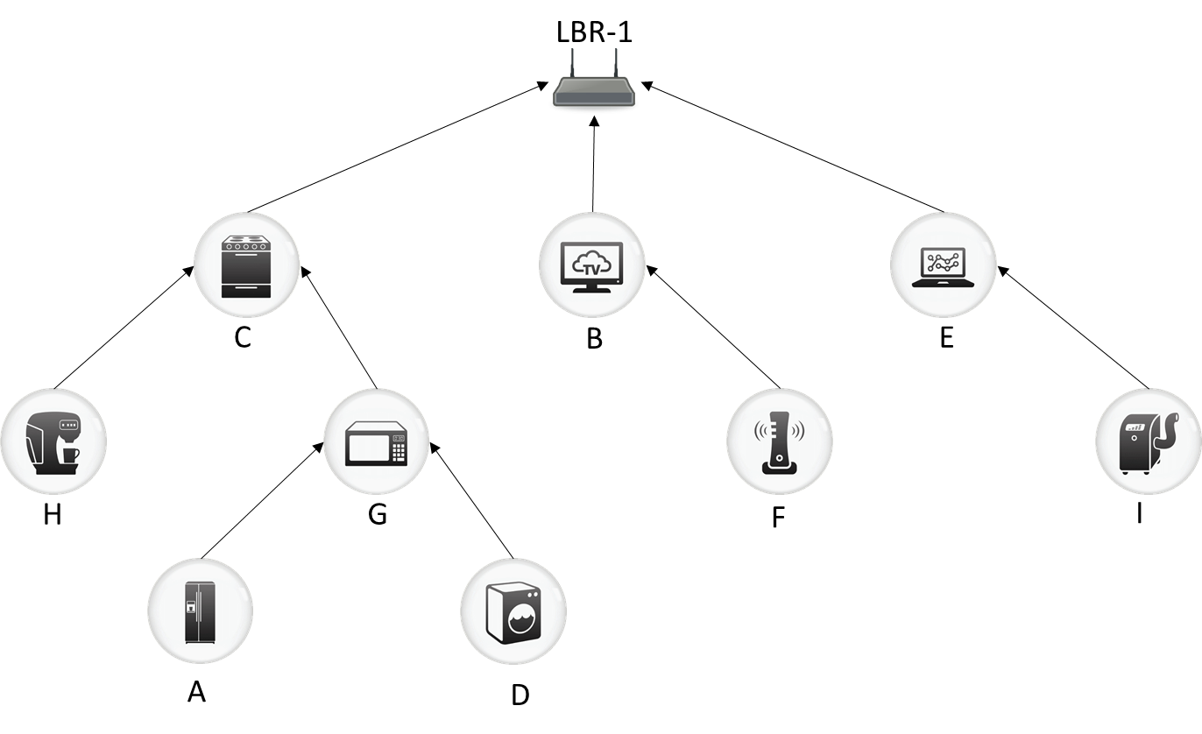
Collection Tree Protocol - CTP
Collection tree
Does not support top-down data traffic
No top-down data traffic!

Slide 6

RPL - IPv6 Routing Protocol for Low-Power and Lossy Networks
Distance vector routing protocol specifically designed for 6LoWPAN
Builds and maintains an acyclic network topology, directed at the root (DAG)
Defines two modes of operation for top-down data flows

Slide 7











Non-storing mode
Dst | Nxt-hop
A | C – G - A
B | B
C | C
D | C – G - D
E | E
F | B - F
G | C - G
H | C - H
I | E - I
LBR-1
C-G-D
To: D
Longer paths!
Root becomes a bottleneck!
C
B
E
To: D
H
G
F
I
A
D

Slide 8
Storing-mode
Dst | Nxt-hop
A | C
B | B
C | C
D | C
E | E
F | B
G | C
H | C
I | E
LBR-1
O(n)
Dst | Nxt-hop
A | G
D | G
G | G
H | H
C
B
E
Dst | Nxt-hop
A | A
D | D
Extensive routing tables!
To: D
H
G
F
I
A
D

Slide 9

Matrix
Internet
Hierarchical IPv6 address optimizing routing table size
Local broadcast mechanism to forward messages when persistent node or link failures occur
::0001 to ::2D17
::0000 to ::A7C0
::0020 to ::2D17
::0078 to ::2D17
::5427 to ::A7C0
::2D18 to ::5426
::5810 to :: 8001
::580F to ::A7C0
::2D62 to ::486E
::486F to ::5426
::83EA to ::A7C0
::2E4C to ::3539
:: 8002 to ::A7C0
::353A to ::486E
::4C6B to ::5426

Slide 10
Matrix
Multihop Address Allocation and Dynamic Any-to-Any Routing for 6LoWPAN
Underlying collection tree topology:
Nodes have static location
Links are dynamic

Slide 11


Matrix
Three simultaneous distributed trees:
Collection tree (Ctree)
IPv6 address tree (IPtree)
Reverse collection tree (RCtree)
5
1
6
2
8
7
4
3

Slide 12

Matrix
Three simultaneous distributed trees:
Collection tree (Ctree)
IPv6 address tree (IPtree)
Reverse collection tree (RCtree)
5EB8
0
$${IPtree=Ctree}^{R}$$
6ED9
199A
977D
7D5D
3F9E
2084

Slide 13

Matrix
Ctree
RCtree
Three simultaneous distributed trees:
Collection tree (Ctree)
IPv6 address tree (IPtree)
Reverse collection tree (RCtree)
5
0
5EB8
1
6
6ED9
2
199A
8
977D
7
7D5D
4
3F9E
3
2084
$${RCtree=Ctree}^{R}\backslash IPtree$$

Slide 14
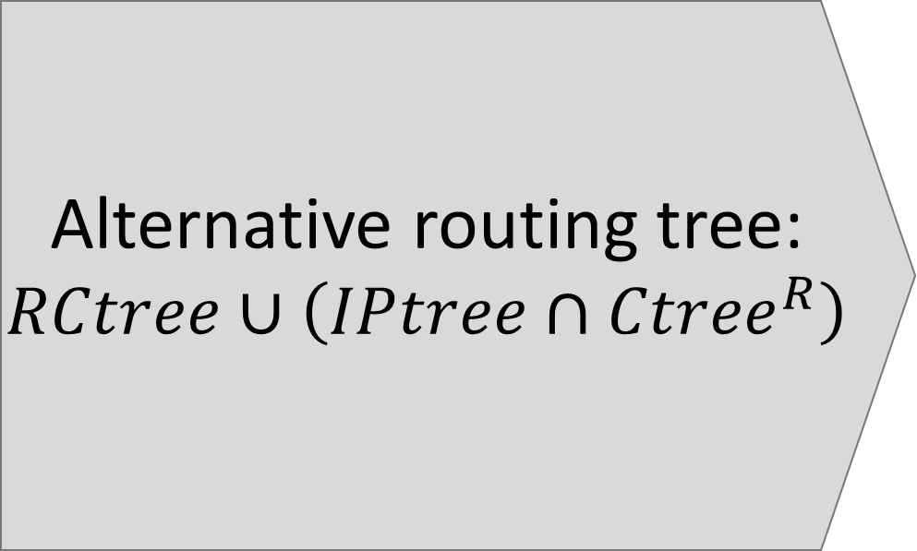
Matrix
Alternative routing tree:
$$RCtree∪\left(IPtree{∩Ctree}^{R}\right)$$
5EB8
0
6ED9
199A
977D
7D5D
3F9E
2084

Slide 15
IPv6 Multihop Host Configuration
Collection tree initialization

Slide 16
IPv6 Multihop Host Configuration
Descendants convergecast
5
2
2
1
3
1
1
1
1

Slide 17
IPv6 Multihop Host Configuration
A-Z
Z
saves
X-Y
For delayed connections
Address partitioning procedure
A-L
Q-V
M-P
A-B
C-H
M-N
Q-T
L
P
V
C-D
E-F
B
H
N
T
D
F

Slide 18
IPv6 Multihop Host Configuration
NEXT HOP
A-Z
Z
INIT | FINAL
A | L
M | P
Q | V
Standard routing
To: D
RANGE
L
A-L
M-P
Q-V
O(k)
L
P
V
A-B
C-H
Q-T
M-N
INIT | FINAL
A | B
C | H
B
H
N
T
C-D
E-F
D
F

Slide 19

What if....
A-Z
Z
A-L
M-P
Q-V
L
P
V
A-B
C-H
Q-T
M-N
B
H
N
T
C-D
E-F
D
F

Slide 20
Local Broadcast
Z
To: D
IParent(H)
Fault tolerance and network dynamics
Alternative top-down routing
V
L
CTparent(H)
H
T1
T2
D

Slide 21
Local Broadcast
Z
To: D
IParent(H)
Fault tolerance and network dynamics
Alternative top-down routing
V
L
CTparent(H)
H
T1
T2
D

Slide 22
Local Broadcast
INIT | FINAL
D | H
INIT | FINAL
T1.init | T2.final
T2.init | T2.final
Z
IParent(H)
Fault tolerance and network dynamics
Alternative top-down routing
CTparent(H)
V
L
CTparent(H)
To: D
To: D
To: D
To: D
To: D
To: D
H
T1
T2
D

Slide 23
Local Broadcast
Z
To: D
IParent(H)
Fault tolerance and network dynamics
Alternative top-down routing
CTparent(H)
V
L
H
T1
T2
D

Slide 24
Evaluation
Matrix was implemented as a subroutine of CTP in TinyOS and the experiments were run using the TOSSIM
We compare Matrix with RPL*, MHCL and CTP
We use the LinkLayerModel tool from TinyOS to generate the topology and connectivity model
*RPL was implemented in Contiki and simulated on Cooja

Slide 25
Simulation parameters
Parameter | Value
Base Station | 1 center
Number of Nodes | 100
Radio Range (m) | 100
Density (nodes/m²) | 10
Number of experiments | 10
Path Loss Exponent | 4.7
Power decay (dB) | 55.4
Shadowing Std Dev (dB) | 3.2
Simulation duration | 20 min
Application messages (node to root + ack) | 10 per node
Max. Routing table size | 20 entries

Slide 26
Faulty network scenarios
After every 60 seconds of simulation, each node shutdowns its radio with probability σ and keeps the radio off for a time interval uniformly distributed in [ε-5, ε+5] seconds
σ/ε | 10 sec. | 20 sec. | 40 sec.
1% | Scenario 2 | Scenario 3 | Scenario 4
5% | Scenario 5 | Scenario 6 | Scenario 7
10% | Scenario 8 | Scenario 9 | Scenario 10
5% chance to keep the radio off for [15,25] seconds

Slide 27
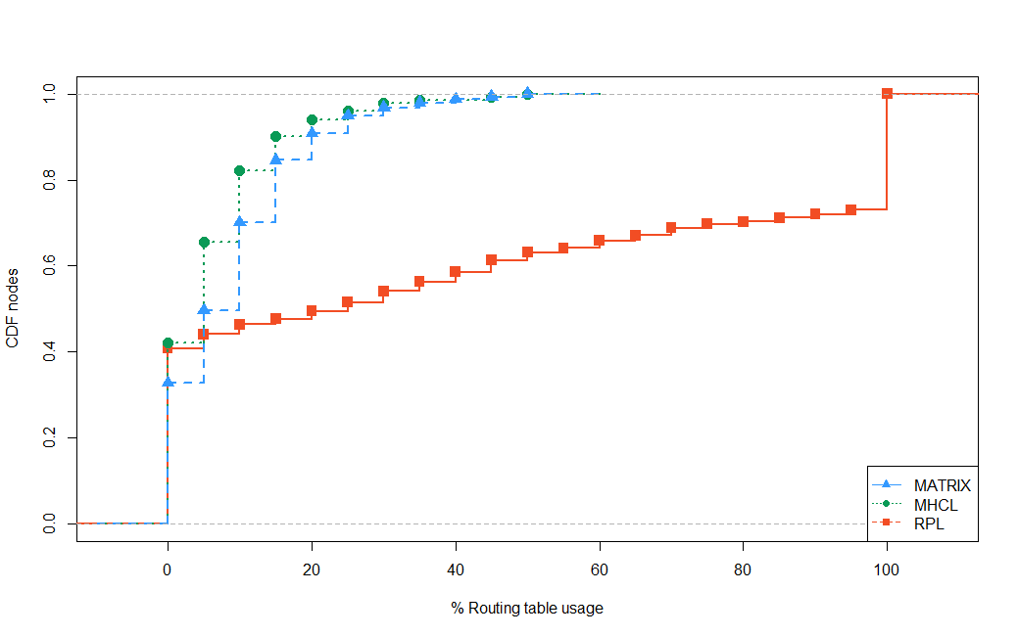
Routing table usage CDF
30%
RPL is the only protocol that uses 100% of table entries
> 35% of nodes are leaves

Slide 28
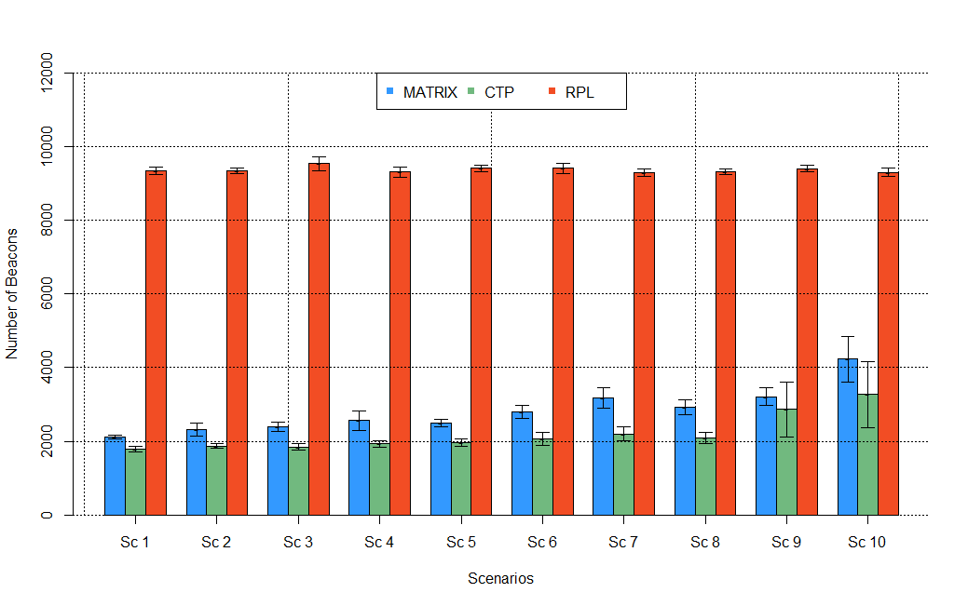
Number of control packets
2x more
More failures
MSiM 2016
Malta, November 16th

Slide 29
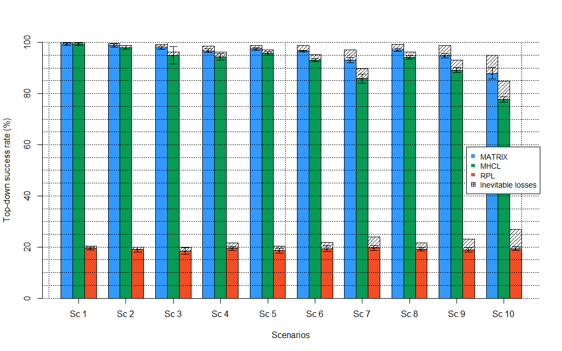
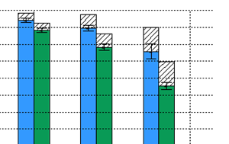
Top-down routing success rate
number of messages lost due to a failure of the destination node
20%
More failures

Slide 30

Top-down routing success rate
2/3 of otherwise lost messages succeed in reaching the final destination
number of messages lost due to a failure of the destination node
More failures

Slide 31
Matrix: Multihop Address Allocation and Dynamic Any-to-Any Routing for 6LoWPAN
Internet
Network initialization
Reliable any-to-any communication
::0000 to ::A7C0
::5427 to ::A7C0
::580F to ::A7C0
::5810 to :: 8001
::83EA to ::A7C0
:: 8002 to ::A7C0

Slide 32

Future direction
Experimentation

Slide 33
Future direction
Internet
Experimentation
Mobility
::0000 to ::A7C0
::5427 to ::A7C0
::580F to ::A7C0
::5810 to :: 8001
::83EA to ::A7C0
:: 8002 to ::A7C0

Slide 34

Matrix: Multihop Address Allocation and Dynamic Any-to-Any Routing for 6LoWPAN
Bruna S. Peres Otavio A. O. Souza Bruno P. Santos Edson R. A. Junior
Olga Goussevskaia Marcos A. M. Vieira Luiz F. M. Vieira Antônio A. F. Loureiro

