Slide 1
Mobile Matrix
A Multihop Address Allocation and Any-To-Any Routing in Mobile 6LoWPAN
Bruno P. Santos, Olga Goussevskaia, Luiz F. M. Vieira, Marcos A. M. Vieira,and Antonio A.F. Loureiro
Department of Computer Science – Universidade Federal de Minas Gerais (UFMG) – Brazil

Slide 2
Agenda
Introduction and Motivation
Design Overview
Handling Mobility
Complexity Analysis
Experiments
Related Works
Conclusions and Future Work

Slide 3
1.
Introduction and Motivation
Routing under mobility scenario

Slide 4
Introduction and Motivation
Mobility is a major factor present in everyday life
It makes life easier and applications more flexible
IoT can benefit from it
Routing and addressing standards for low-power devices (RPL, CTP, 6LoWPAN/IPv6)
They do not handle mobility
Routing under mobility scenario trade-offs
Memory
Control messages
Routing rules complexity

Slide 5
Introduction and Motivation
Mobile Matrix (𝜇Matrix)
Routing protocol for 6LoWPAN
Any-to-any routing enabled
It uses hierarchical address allocation
It enhances memory resource usage
Node Mobility Management
Nodes do not ever change its IPv6 address

Slide 6
Mobile Matrix (𝝻Matrix)
Low routing memory footprint
Adjustable control message overhead
Routing under mobility without changing nodes IPv6 Address

Slide 7
2.
Design overview
Architecture
Hierarchical Address allocation
Mobility management

Slide 8
Design Overview
𝝻Matrix Architecture
App. layer
Transport layer
𝝻Matrix
Link Layer
Physical layer

Slide 9
Design Overview
𝝻Matrix Architecture
Data Plane
Control Plane

Slide 10
Design Overview
𝝻Matrix Architecture
Data Plane
Control Plane
Upper
Layer interface
Forward engine
Below
Layer interface

Slide 11
Design Overview
𝝻Matrix Architecture
Data Plane
Control Plane
Upper
Layer interface
Forward engine
Routing engine
Below
Layer interface

Slide 12
Design Overview
𝝻Matrix Architecture
Data Plane
Control Plane
Upper
Layer interface
Forward engine
Routing engine
Below
Layer interface
Underlying data collection routing protocol

Slide 13
Design Overview
𝝻Matrix Architecture
Data Plane
Control Plane
Temporary routing table
Reverse routing table
Upper
Layer interface
Forward engine
Routing engine
Below
Layer interface
Underlying data collection routing protocol

Slide 14
Design Overview
𝝻Matrix Architecture
Data Plane
Control Plane
Temporary routing table
Reverse routing table
Upper
Layer interface
Forward engine
Routing engine
Mobile engine
Below
Layer interface
Underlying data collection routing protocol

Slide 15
Design Overview
𝝻Matrix Hierarchical Address allocation
A
B
D
C
E
F

Slide 16
Design Overview
𝝻Matrix Hierarchical Address allocation
A
Tree data collection
𝜇Matrix relies on an underlying data collection routing protocol
Ex: RPL or CTP
It takes O(n) control messages
B
D
C
E
F

Slide 17
Design Overview
𝝻Matrix Hierarchical Address allocation
A
Tree data collection
Aggregation phase
Each node informs the number of children
It takes O(n) control messages
70%
10%
B
D
20%
C
80%
20%
E
F

Slide 18
Design Overview
𝝻Matrix Hierarchical Address allocation
0 to 255
Tree data collection
Aggregation phase
Address allocation
Node receives from parent a range of available IPs proportionally
Nodes take one IP
A
0
70%
10%
B
D
20%
C
80%
20%
E
F

Slide 19

Design Overview
𝝻Matrix Hierarchical Address allocation
0 to 255
Tree data collection
Aggregation phase
Address allocation
Node receives from parent a range of available IPs proportionally
Nodes take one IP
A
0
16 to 183
208 to 255
70%
10%
B
16
184 to 207
D
208
20%
C
184
80%
20%
E
F

Slide 20
Design Overview
𝝻Matrix Hierarchical Address allocation
0 to 255
Tree data collection
Aggregation phase
Address allocation
Node receives from parent a range of available IPs proportionally
Nodes take one IP
Recursively distribute the remaining IPs
A
0
16 to 183
208 to 255
70%
10%
B
16
184 to 207
D
208
20%
C
184
27 to 151
80%
20%
152 to 182
E
27
F
152

Slide 21
Design Overview
𝝻Matrix Mobility management
0 to 255
What to do if B moves and the topology changes?
A
0
16 to 183
208 to 255
70%
10%
B
16
184 to 207
D
208
20%
C
184
27 to 151
80%
20%
152 to 182
E
27
F
152

Slide 22
Design Overview
𝝻Matrix Mobility management
0 to 255
What to do if B moves and the topology changes?
A
0
16 to 183
208 to 255
B
16
184 to 207
D
208
C
184
27 to 151
152 to 182
E
27
F
152

Slide 23
Design Overview
𝝻Matrix Mobility management
0 to 255
What to do if B moves and the topology changes?
A
0
16 to 183
208 to 255
184 to 207
D
208
C
184
27 to 151
152 to 182
E
27
F
152
B
16

Slide 24
Design Overview
𝝻Matrix Mobility management
0 to 255
What to do if B moves and the topology changes?
The reverse routing tree become outdated
A
0
X
16 to 183
208 to 255
184 to 207
D
208
X
C
184
X
27 to 151
152 to 182
E
27
F
152
B
16

Slide 25
Design Overview
𝝻Matrix Mobility management
IP | R | N
27 | 155 | C
16 | 0 | D
What to do if B moves and the topology changes?
𝜇Matrix Mobile engine redo the paths
A
0
IP | R | N
16 | 0 | B
D
208
IP | R | N
27 | 155 | F
C
184
E
27
F
152
B
16
IP | R | N
27 | 124 | E

Slide 26
Design Overview
𝝻Matrix Mobility management
Root
IP | R | N
27 | 155 | C
16 | 0 | D
Local table updates
Nodes
From B to A
A is the Least Common Ancestor (LCA) of B
From E/F to A
A
0
IP | R | N
16 | 0 | B
D
208
IP | R | N
27 | 155 | F
C
184
E
27
F
152
B
16
IP | R | N
27 | 124 | E

Slide 27
Design Overview
𝝻Matrix Mobility management
Root
IP | R | N
27 | 155 | C
16 | 0 | D
Local table updates
Nodes
From B to A
A is the Least Common Ancestor (LCA) of B
From E/F to A
We only need 1 entry IP for contiguous IP range (E and F)
A
0
IP | R | N
16 | 0 | B
D
208
IP | R | N
27 | 155 | F
C
184
E
27
F
152
B
16
IP | R | N
27 | 124 | E

Slide 28
3.
Handling Mobility
State machine
Mobility detection
Handle node mobility

Slide 29
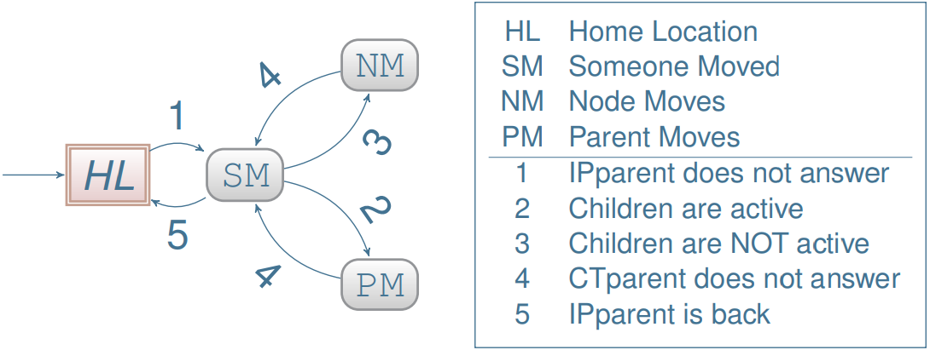
Handling Mobility
𝝻Matrix Mobile engine - State Machine

Slide 30
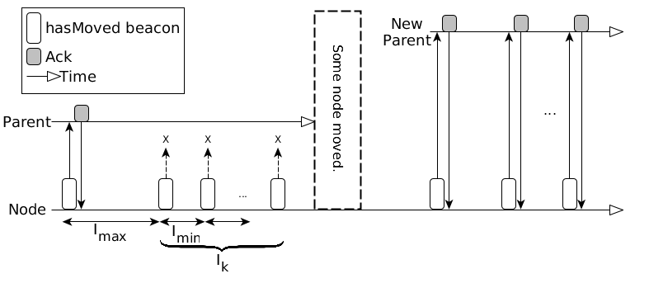
Handling Mobility
𝝻Matrix Mobile engine - Mobility detection

Slide 31
Handling Mobility
𝝻Matrix Mobile engine - Leaf node moves
Static situation
(nodes at HL state)
A
B

Slide 32
Handling Mobility
𝝻Matrix Mobile engine - Leaf node moves
Static situation
(nodes at HL state)
B moves
(B transits to NM)
A
A
B
B

Slide 33

Handling Mobility
𝝻Matrix Mobile engine - Leaf node moves
Static situation
(nodes at HL state)
B moves
(B transits to NM)
LCA(A, B)
A
A
B
B

Slide 34
Handling Mobility
𝝻Matrix Mobile engine - Non-Leaf node moves
B before moving
B after moving
(B transits to NM)
(C transits to PM)
LCA(A,B)
LCA(A, children(B))
B
TO: A
A
A
B
C
C
TO: A

Slide 35
Handling Mobility
𝝻Matrix Mobile engine - Non-Leaf node moves
B before moving
B after moving
(B transits to NM)
(C transits to PM)
LCA(A,B)
LCA(A, children(B))
B
TO: A
A
A
B
C
C
TO: A

Slide 36
4.
Complexity Analysis
Memory
Control messages

Slide 37
Complexity analysis
The memory footprint to manage the mobility of one node 𝜇Matrix is
Collection Tree

Slide 38
Complexity analysis
The memory footprint to manage the mobility of one node 𝜇Matrix is
The control message complexity of 𝜇Matrix to perform routing under mobility is
*Ctree = Collection tree
Collection Tree
Mobility detection cost
Route rebuild cost

Slide 39
Complexity analysis
The memory footprint to manage the mobility of one node 𝜇Matrix is
The control message complexity of 𝜇Matrix to perform routing under mobility is
m, n - mobile and static nodes respectively,
𝚫 - time away from home location.
I_{min}, I_{max}, I_{K}, 𝛿 - Reverse trickle param.
*Ctree = Collection tree
Collection Tree

Slide 40
5.
Experiments
Mobility model
Parameters
Results

Slide 41
Cyclical Random Waypoint Mobility Model
Entities has an initial home position
Entities move to random destinations and speeds as in RWP
When an entity arrives at the destination, it stops for a given time T_{pause}
After n chosen destinations, the mobile entity returns to its initial position.

Slide 42
Simulation parameters
Parameter | Value
% mobile nodes | Low | Moderate | High
 | 5% | 10 | 15%
Node speed | Constant 4 m/s
Tpause | Constant 300 s
# nodes stop | Uniform Dist. in [1, 3] stops
# nodes | 101
Application data packets | 20 pks/node, 1 pkt/min
Radio range | 50m UDGM constant loss
Deployment area | 400m x 400m
Reverse Trickle Timer | Imax= 60s,Imin= 1s, Ik= 3
RPL Trickle | Imax= 60s
keepRoute beacon period | 𝛿 = 60s
Mtable (temporary table) | Size = 20 entries, TTLmax= 90s

Slide 43
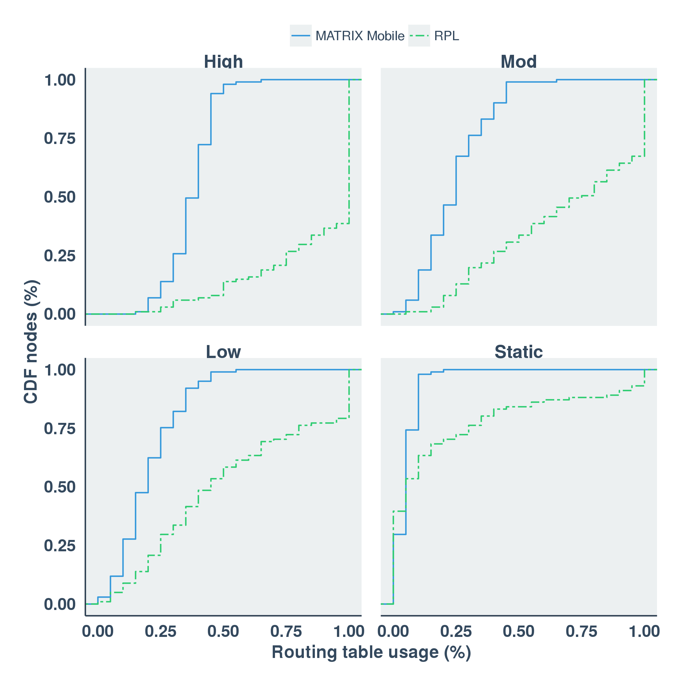
Results

Slide 44
Results
For 85% of nodes
RPL uses 55% of routing table,
𝜇MATRIX only 15%

Slide 45
Results
𝜇Matrix requires 50% of available route entries
RPL fails in routing due to full routing table

Slide 46
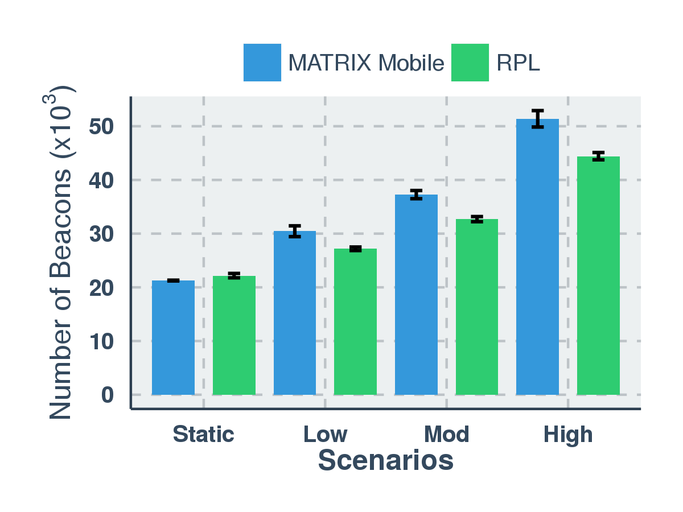
Results
RPL sends fewer control packets than μMatrix
but the difference does not exceed 7.4%

Slide 47
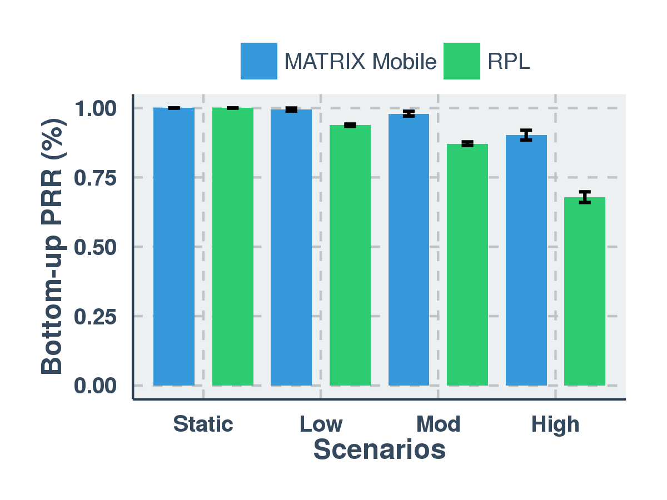
Results
𝜇Matrix detects mobility quickly, then it delivery more packets

Slide 48
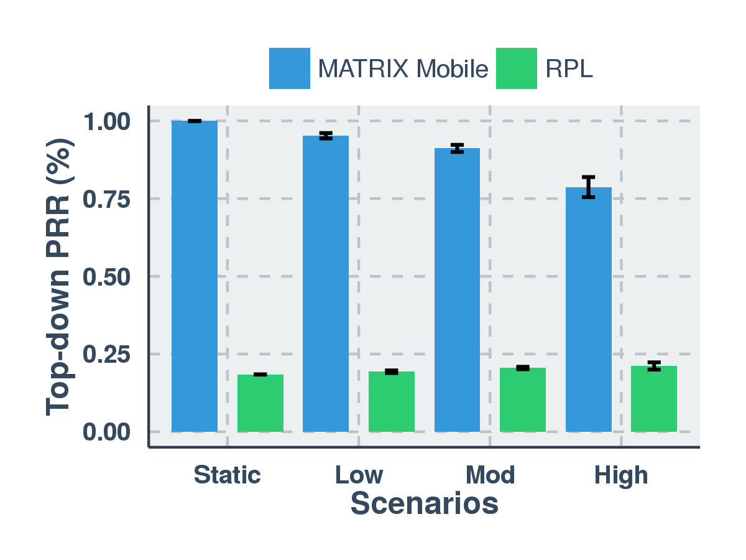
Results
𝜇Matrix 99.9% PRR in static scenario
𝜇Matrix > 75% in high mobility scenario
RPL suffers from poor reliability due a lack of memory

Slide 49
6.
Related work

Slide 50
Feature | 𝜇Matrix | RPL | Co-RPL | MMRPL | ME-RPL | mRPL | DMR | Hydro | XCTP
Bottom-up | ✔ | ✔ | ✔ | ✔ | ✔ | ✔ | ✔ | ✔ | ✔
Top-down | ✔ | ✔ | ✔ | ✔ | ✔ | ✔ |  | ✔ | ✔
Any-to-any | ✔ | ✔ | ✔ | ✔ | ✔ | ✔ |  | ✔
Address Allocation | ✔
IPv6 support | ✔ | ✔ | ✔ | ✔ | ✔ | ✔ | ✔
Memory efficiency | ✔
Fault tolerance | ✔ |  |  |  |  |  |  |  | ✔
Local Repair | ✔
Topological Changes | Reverse Trickle | Trickle | Periodic fixed | Reverse Trickle-like | Trickle | Trickle | Trickle | Periodic fixed | Trickle
Constraints | Eventually nodes return to home |  |  | Need static nodes | Need static nodes | Need static nodes | Need static nodes | Need static nodes
Related work

Slide 51
7.
Conclusions

Slide 52
Final remarks
We presented 𝜇Matrix
An any-to-any routing protocol for 6LoWPAN
Allow mobile nodes
Hierarchical address allocation
Passive mobility detection
We introduce CRWP
Suited for scenarios with cyclical movement patterns
Future work
Extend experimental evaluation
Mobile models and traces

Slide 53
Thanks!
Any questions?
Bruno P. Santos, Olga Goussevskaia, Luiz F. M. Vieira, Marcos A. M. Vieira,and Antonio A.F. Loureiro
{bruno.ps, olga, lfvieira, mmvieira, loureiro}@dcc.ufmg.br

Slide 54
Instructions for use
EDIT IN GOOGLE SLIDES
Click on the button under the presentation preview that says "Use as Google Slides Theme".
You will get a copy of this document on your Google Drive and will be able to edit, add or delete slides.
You have to be signed in to your Google account.
EDIT IN POWERPOINT®
Click on the button under the presentation preview that says "Download as PowerPoint template". You will get a .pptx file that you can edit in PowerPoint.
Remember to download and install the fonts used in this presentation (you’ll find the links to the font files needed in the Presentation design slide)
More info on how to use this template at www.slidescarnival.com/help-use-presentation-template
This template is free to use under Creative Commons Attribution license. You can keep the Credits slide or mention SlidesCarnival and other resources used in a slide footer.

Slide 55
Hello!
I am Jayden Smith
I am here because I love to give presentations.
You can find me at @username

Slide 56
1.
Transition headline
Let’s start with the first set of slides

Slide 57
Quotations are commonly printed as a means of inspiration and to invoke philosophical thoughts from the reader.

Slide 58
This is a slide title
Here you have a list of items
And some text
But remember not to overload your slides with content
Your audience will listen to you or read the content, but won’t do both.

Slide 59
Big concept
Bring the attention of your audience over a key concept using icons or illustrations

Slide 60
You can also split your content
White
Is the color of milk and fresh snow, the color produced by the combination of all the colors of the visible spectrum.
Black
Is the color of coal, ebony, and of outer space. It is the darkest color, the result of the absence of or complete absorption of light.

Slide 61
In two or three columns
Yellow
Is the color of gold, butter and ripe lemons. In the spectrum of visible light, yellow is found between green and orange.
Blue
Is the colour of the clear sky and the deep sea. It is located between violet and green on the optical spectrum.
Red
Is the color of blood, and because of this it has historically been associated with sacrifice, danger and courage.

Slide 62

A picture is worth a thousand words
A complex idea can be conveyed with just a single still image, namely making it possible to absorb large amounts of data quickly.

Slide 63

Want big impact?
Use big image.

Slide 64
Use charts to explain your ideas
White
Gray
Black

Slide 65
And tables to compare data
 | A | B | C
Yellow | 10 | 20 | 7
Blue | 30 | 15 | 10
Orange | 5 | 24 | 16

Slide 66

Maps
our office

Slide 67
89,526,124
Whoa! That’s a big number, aren’t you proud?

Slide 68
89,526,124$
185,244 users
100%
That’s a lot of money
And a lot of users
Total success!

Slide 69
Our process is easy
first
second
last

Slide 70
Let’s review some concepts
Yellow
Is the color of gold, butter and ripe lemons. In the spectrum of visible light, yellow is found between green and orange.
Blue
Is the colour of the clear sky and the deep sea. It is located between violet and green on the optical spectrum.
Red
Is the color of blood, and because of this it has historically been associated with sacrifice, danger and courage.
Yellow
Is the color of gold, butter and ripe lemons. In the spectrum of visible light, yellow is found between green and orange.
Blue
Is the colour of the clear sky and the deep sea. It is located between violet and green on the optical spectrum.
Red
Is the color of blood, and because of this it has historically been associated with sacrifice, danger and courage.

Slide 71
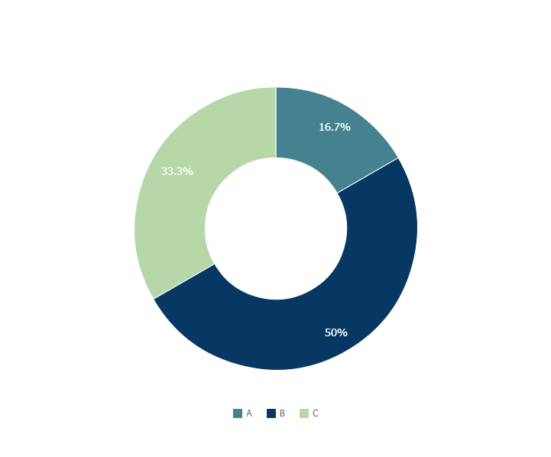
You can copy&paste graphs from Google Sheets

Slide 72
Place your screenshot here
Android project
Show and explain your web, app or software projects using these gadget templates.

Slide 73
Place your screenshot here
iPhone project
Show and explain your web, app or software projects using these gadget templates.

Slide 74
Place your screenshot here
Tablet project
Show and explain your web, app or software projects using these gadget templates.

Slide 75
Place your screenshot here
Desktop project
Show and explain your web, app or software projects using these gadget templates.

Slide 76
Thanks!
Any questions?
You can find me at
@username
user@mail.me

Slide 77
Credits
Special thanks to all the people who made and released these awesome resources for free:
Presentation template by SlidesCarnival
Photographs by Unsplash

Slide 78

Presentation design
This presentations uses the following typographies and colors:
Titles & Body copy: Montserrat
You can download the fonts on this page:
https://www.google.com/fonts#UsePlace:use/Collection:Montserrat:400,700
Click on the “arrow button” that appears on the top right
Grey #454f5b
Light grey #738498
Neon green #c7f464
Aqua #4ecdc4
You don’t need to keep this slide in your presentation. It’s only here to serve you as a design guide if you need to create new slides or download the fonts to edit the presentation in PowerPoint®

Slide 79
SlidesCarnival icons are editable shapes.
This means that you can:
Resize them without losing quality.
Change fill color and opacity.
Change line color, width and style.
Isn’t that nice? :)
Examples:

Slide 80
😉
Now you can use any emoji as an icon!
And of course it resizes without losing quality and you can change the color.
How? Follow Google instructions https://twitter.com/googledocs/status/730087240156643328
✋👆👉👍👤👦👧👨👩👪💃🏃💑❤😂😉😋😒😭👶😸🐟🍒🍔💣📌📖🔨🎃🎈🎨🏈🏰🌏🔌🔑 and many more...

