Slide 1
eXtend Collection Tree Protocol
Bruno P. Santos¹
with
Marcos A. M. Vieira¹
Luiz F. M. Vieira¹
¹Universidade Federal de Minas Gerais, Brazil.

Slide 2
Communication paradigms on wns many-to-one, one-to-many, and any-to-any
Anycast route to the sink(s)
Used to data collection from the network
Problem
Impossible check data delivery
Sink
Notes:
First two paradigms allow the collection and dissemination of data respectively. However, with routing on
only one direction, it is infeasible to build reliable mechanisms to ensure the delivery of data end-to-end.

Slide 3
Communication paradigms on wns many-to-one, one-to-many, and any-to-any
Propagating or Anycast routes from Sink to nodes
Used to data dissemination in the network
Reconfigure nodes
Problem
Impossible check data delivery
How create unicast routes for dissemination?
Sink
Notes:
First two paradigms allow the collection and dissemination of data respectively. However, with routing on
only one direction, it is infeasible to build reliable mechanisms to ensure the delivery of data end-to-end.

Slide 4
Communication paradigms on wns many-to-one, one-to-many, and any-to-any
Propagating or Anycast routes from Sink to nodes
Used to data dissemination in the network
Reconfigure nodes
Problem
Impossible check data delivery
How create unicast routes for dissemination?
Sink
Notes:
First two paradigms allow the collection and dissemination of data respectively. However, with routing on
only one direction, it is infeasible to build reliable mechanisms to ensure the delivery of data end-to-end.

Slide 5
Communication paradigms on wns many-to-one, one-to-many, and any-to-any
More generic paradigm
Enable unicast routes between any pair of nodes
Problem
Adds more complexity
Requires large amounts of memory to storage routes
sometimes impractical in wns
Sink

Slide 6
eXtend Collection Tree Protocol (XCTP)
An extension of the Collection Tree Protocol
XCTP create reverse path enabling
Sink to nodes
Nodes to sink
XCTP requires
Low storage of states
Very low overhead in packets
Sink

Slide 7
Prior work
One-to-many
(Dissemination)
Unreliable
Many-to-one
(Collection)
Unreliable
Directed Diffusion,
DRIP, DIP, DHV,
Deluge
CTP, MultiHopLQI,
MintRoute
XCTP
Collection
Reliable
Hydro, RPL. AODV, DSR, Dymo
Any-to-any
Reliable
Notes:
Directed Diffusion and DIP, DRIP, DHV are used for dissemination of small data packets in the network.
Deluge is a protocol that operates under the one-to-many paradigm, which has the objective to propagate large amount of data
CTP is the de-facto standard collection routing protocol for Wireless Sensor Network and his results are better the MultiHopLQI and MintRoute.
Hydro, RPL. AODV, DSR, and Dymo are P2P protocols.
Hydro and RPL use tables schemes to stoge routes for any node. RPL uses several messages types to create DAGs to routing messages. RPL uses requires control packets to create downward routes, XCTP
does not have this overhead since XCTP takes advantage of thedata packets.
AODV, DSR and Dymo floods the network with messages RREQ. DSR uses packet header to store the route path. AODV and DSR are keep routes in memory.
XCTP focus in creating unicast routes to exchange messages in both directions root-to-node and vice-versa. XCTP create the routes using DATA PACKETS instead CONTROL PACKETS.
XCTP also allows non utilized downward routes to be removed through TTL-based policy avoiding memory overhead to store states with peer-to-peer routes that are underutilized.

Slide 8
XCTP Architecture
Control plane
Data plane
Router
Forward table
Interface to upper layer
Link Estimator
Reverse table
Forwarder
Link Layer
Notes:
The XCTP architecture major changes are highlighted in yellow and bold font
To accomplish the task of forwarding packets also in the reverse direction of the standard CTP data flow, we had to modify CTP architecture by adding new features to the protocol rules as well as incrementing the packet format.
We also created a reverse flow table.
The CTP rules were modified at the data and control planes to react appropriately to the two main events:
Reverse flow: correct and efficient installation of the reverse flow rules;
Topological changes: nodes must appropriately react when loops occur or when CTP unicast routes change.
The Router module is responsible for filling the Forward and Reverse tables
The Forward module queries the Forward and Reverse tables, and determines any router inconsistencies to inform the Router module
Upper Layer module is the interface provided to implement components that utilizes XCTP.

Slide 9
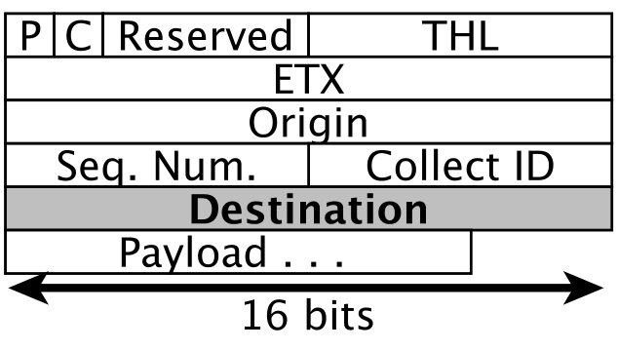
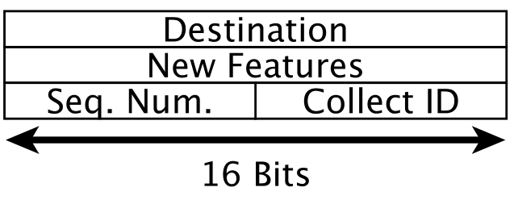
XCTP Packets
Data Packet
Acknowledgment Packet
Notes:
To allow the navigation of the reverse data packet, we added a 16 bits packet field to the data packet to represent the address of the message destination.
All fields are present in CTP data packet, except by “Destination” field
We created Acknowledgment packet type. The New Features field 16 bits is reserved for future features.

Slide 10
Outline
Collection Reliable
Reverse Flows
Topological Changes
Evaluation
Conclusion
Notes:
XCTP create rules in data and control planes to react

Slide 11
XCTP’s Reverse Flows
XCTP create reverse fluxes with
Data Packet or
Sink demand
Read tables to downward packets
Neighbor (from Link Layer), Reverse, and Forward
Fields Reverse Flow Table
addr dest (tree descendant 2+ hops distance)
next hop
Time To Live (TTL)

Slide 12
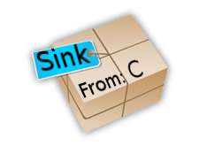
XCTP Reverse Flows (CRUD)
Tree to Sink
CTP create tree route
Table starts empty
Node C send a packet
Node A intercept a packet From C to Sink
Reverse route installed
A :Reverse Table
Dest | Next Hop | TTL
A :Reverse Table
Dest | Next Hop | TTL
C | B | 10
A
B
D
C

Slide 13
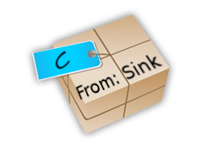
XCTP Reverse Flows (CRUD)
Tree to Sink
Sink send packet to C
Node A intercept the packet and read tables
Neighbor table (Not found)
Reverse Table (Found)
Forward table
Node A send uncast message to B
B delivery to C
A :Reverse Table
Dest | Next Hop | TTL
A :Reverse Table
Dest | Next Hop | TTL
C | B | 10
A
B
D
C

Slide 14
Outline
Collection Reliable
Reverse Flows
Topological Changes
Evaluation
Conclusion
Notes:
XCTP create rules in data and control planes to react

Slide 15
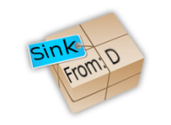
XCTP Reverse Flows (CRUD)
Tree to Sink
Data packets from D are routed by B
Occurs link changes
Route quality or broken links
Reverse table is out-dated
Update Next Hop to C
A :Reverse Table
Dest | Next Hop | TTL
D |  | 10
C
A
B
B
C
D

Slide 16
XCTP Reverse Flows (CRUD)
There is a link failure causing loop
The reverse table is out-dated
All entries are invalid
Actions
XCTP remove all entries
CTP ensure a new tree to sink
Reverse flows entries are reconstructed with new data packets
Tree to Sink
A :Reverse Table
Dest | Next Hop | TTL
A :Reverse Table
Dest | Next Hop | TTL
D | B | 10
. . . | . . . | . . .
Tree to Sink
A
B
C
D

Slide 17
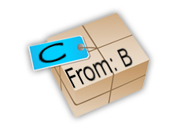
XCTP permits paradigm any-to-any
Tree to Sink
B wants to send data to C
There is not direct route
B send the packet in collect route
Node A query tables
Neighbor table (Not found)
Reverse Table (Found)
Forward table
Then downward the packets
In worst case, the packets will go to the sink and towards C
A :Reverse Table
Dest | Next Hop | TTL
C | X | 10
A
B
C

Slide 18
Transport layer over XCTP
We implement Transport Automatic Piggyback Protocol (TAP2)
TAP2 uses for error-control
Piggyback
Automatic Repeat-reQuest (ARQ)

Slide 19
Outline
Collection Reliable
Reverse Flows
Topological Changes
Evaluation
Conclusion
Notes:
XCTP create rules in data and control planes to react

Slide 20
XCTP experiments
We made comparisons with different protocols
AODV and CTP in TinyOS implementation
RPL in implementation Contiki
We run experiments on TOSSIM
10 different topologies
10 simulation in each scenario
Parameter | Value
Base station | 1 center
Number nodes | 100
Radio range (m) | 100
Density (nodes/m²) | 10
N# experiments | 100
Bytes transmitted | 1024
Path loss exponent | 4.7
Power decay (dB) | 55.4
Shadowing Std Dev (dB) | 3.5

Slide 21
XCTP evaluation goals
Reliable?
Packets delivery to sink
Robustness?
Presence of faults and Different topologies
Scalability?
Memory for routes
Control Traffic
Beacons to maintaining routes
Memory requirements
code and initial tables

Slide 22
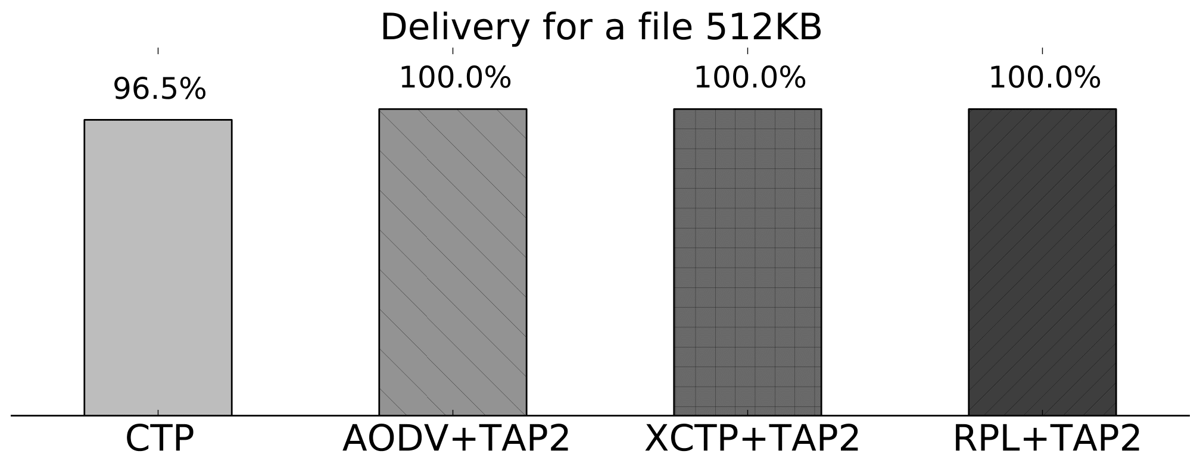
XCTP evaluation Reliable, Robustness, Scalability, Control, Memory

Slide 23
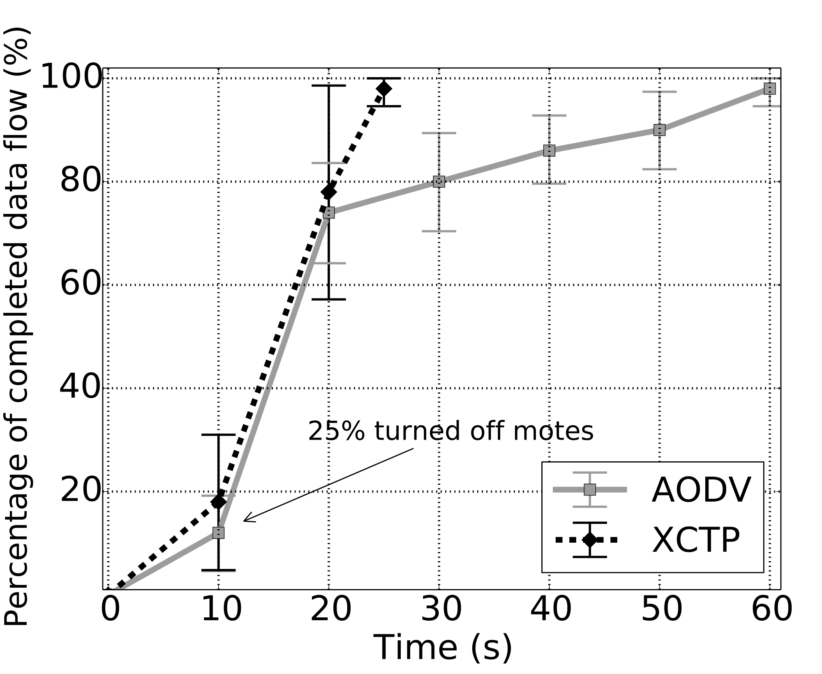
XCTP evaluation Reliable, Robustness, Scalability, Control, Memory
XCTP reacts quickly
finding new routes
Experiment 1#
Insert network failure
5 active flows
Disable 25% of the nodes
AODV presents long time to react
In some scenarios, ADOV took over 200s to finish
XCTP on average takes 25s to complete all transfers

Slide 24
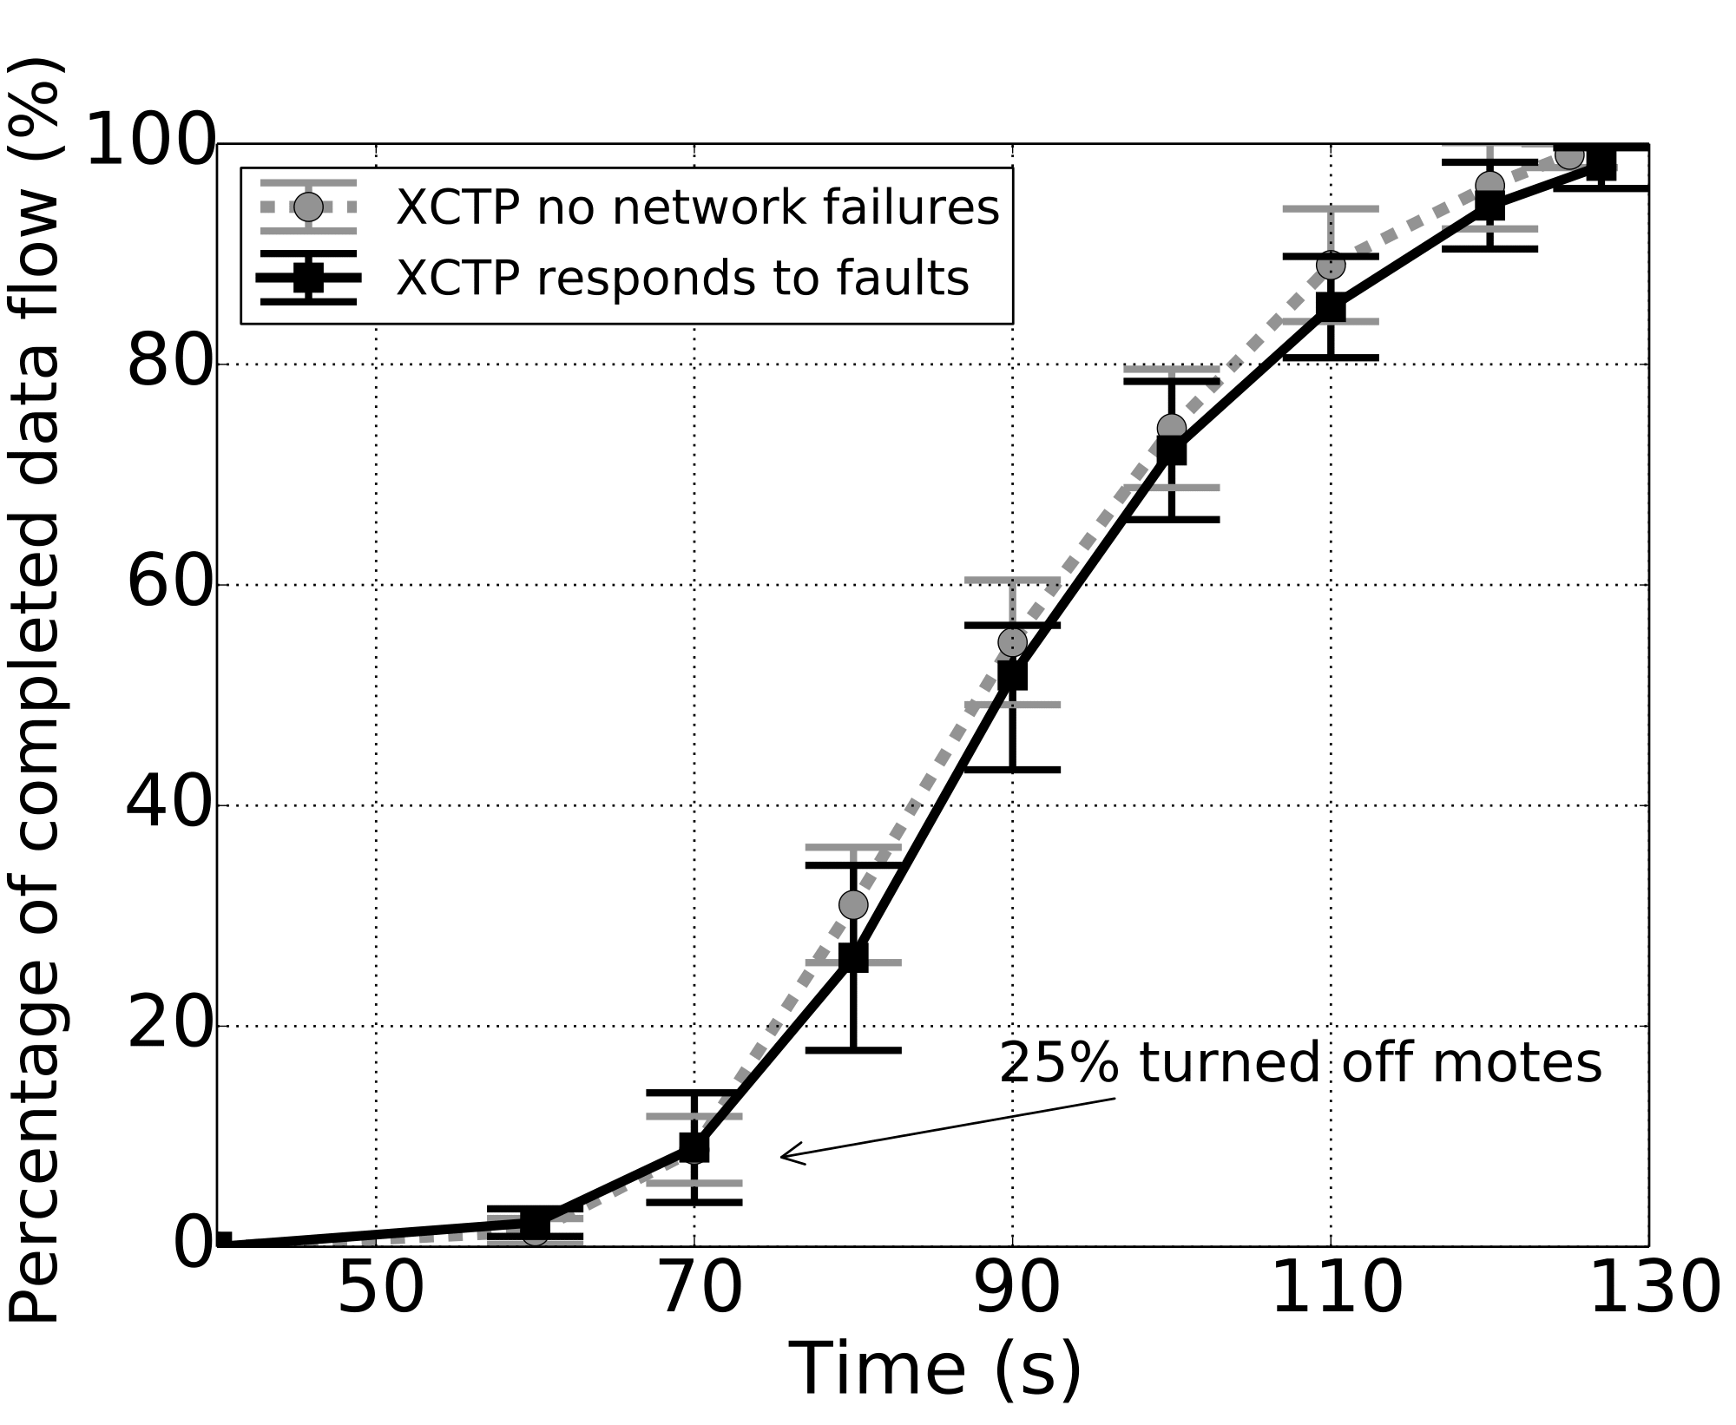
XCTP evaluation Reliable, Robustness, Scalability, Control, Memory
Experiment 2#
Insert network failure
50 active flows
Disable 25% of the nodes
XCTP presents low difference of the behavior with and without network failures.

Slide 25
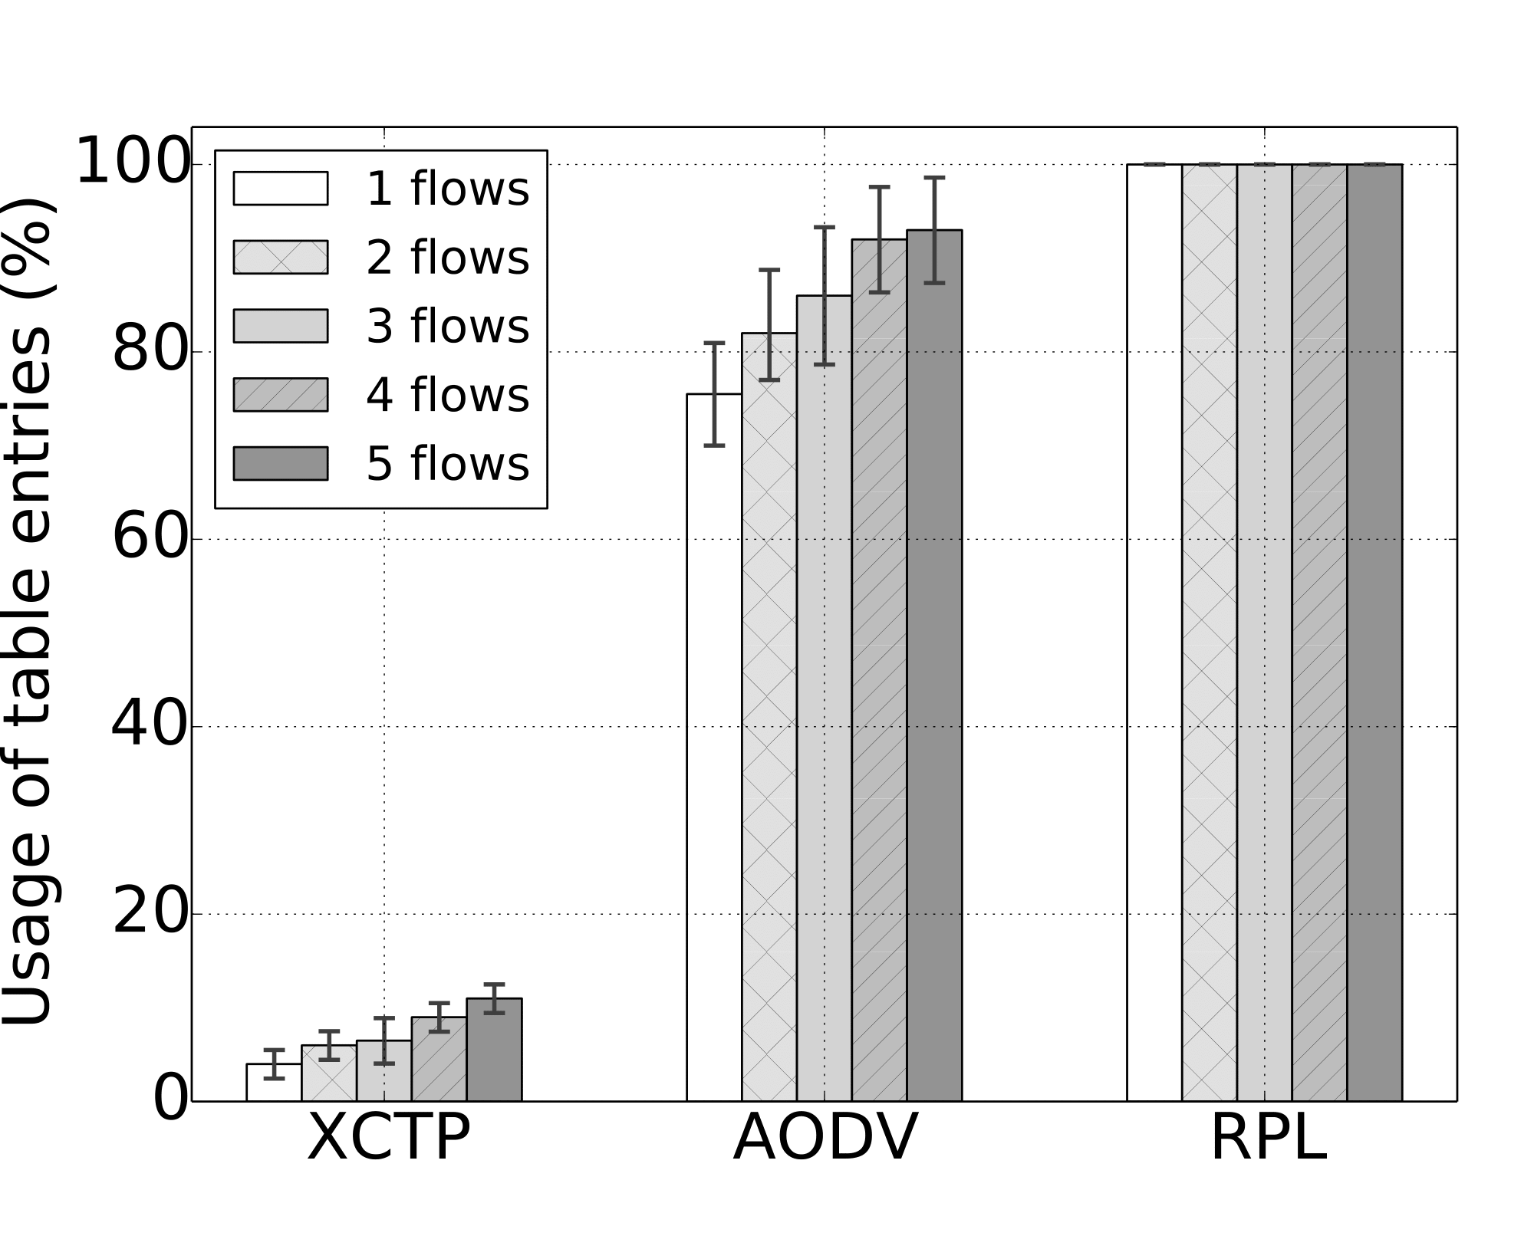
XCTP evaluation Reliable, Robustness, Scalability, Control, Memory
RPL always uses all entries in route table
Uses TTL to remove under-utilized routes
Dismiss requests for new routes
or
Disconnection between some routes
82% less from the table than AODV for the same amount of flows
5 flows AODV consumes almost 100% of the route table

Slide 26
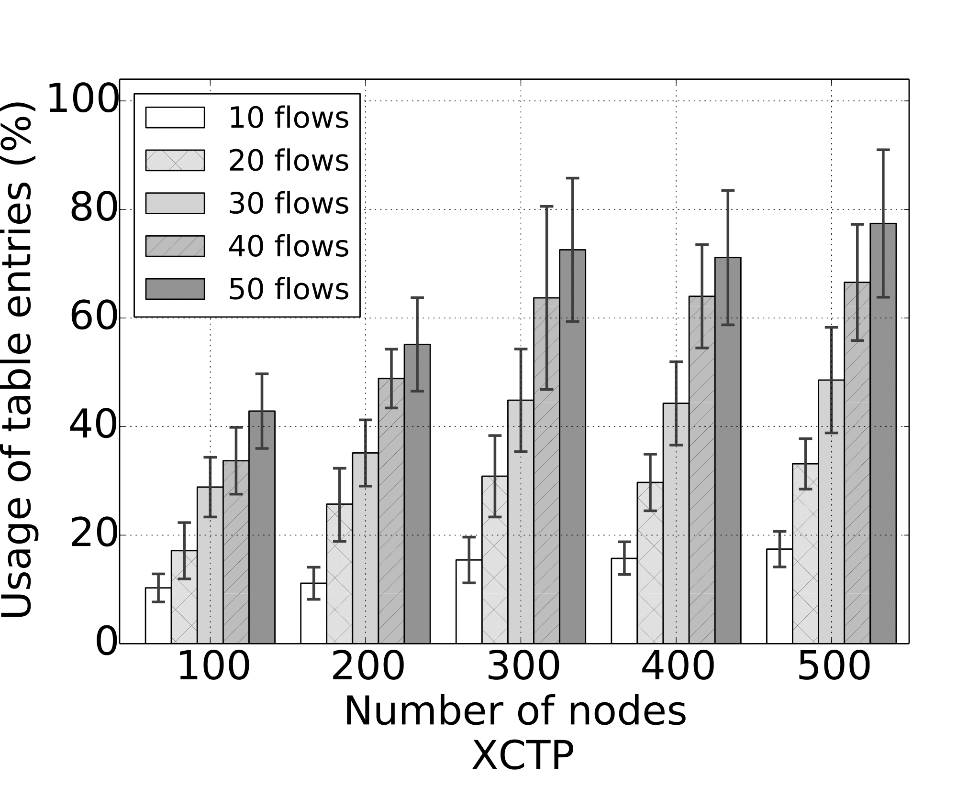
XCTP evaluation Reliable, Robustness, Scalability, Control, Memory
XCTP
operates under the Reverse Table limit
XCTP is robust and scalable

Slide 27
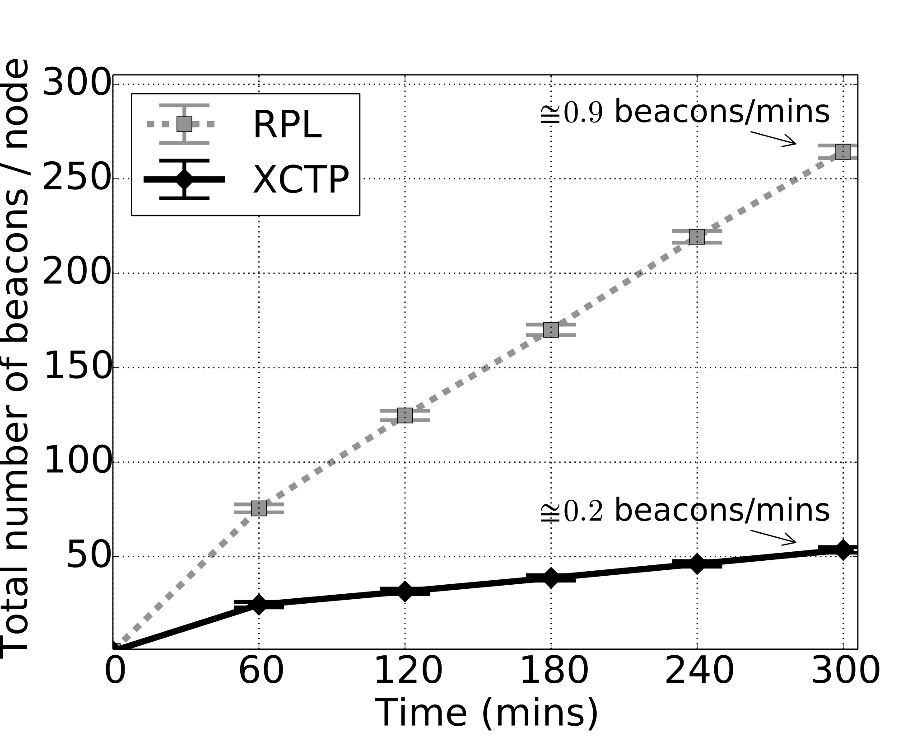
XCTP evaluation Reliable, Robustness, Scalability, Control, Memory
Control Traffic Overhead
Five-hours of experiments
XCTP sends fewer control packet than RPL
RPL needs additional beacons for create reverse routes

Slide 28
XCTP evaluation Reliable, Robustness, Scalability, Control, Memory
XCTP requires small amounts of RAM
than AODV and RPL
XCTP add few pieces of code in CTP
≈ 1KB
Using TAP2
ADOV < XCTP < RPL
 | CTP | RPL | XCTP | XCTP+TP2 | AODV | AODV + TAP2
RAM | 1505 | 6516 | 1812 | 1968 | 2119 | 2545
ROM | 16204 | 46454 | 17942 | 18435 | 13868 | 14562

Slide 29
Acknowledgment
We would like to thank for their financial support
CNPq
CAPES
Fapemig
LG

Slide 30
Acknowledgment
We would like to thank for their financial support.
Conselho Nacional de Desenvolvimento Científico e Tecnológico (CNPq)
Coordenação de Aperfeiçoamento de Pessoal de Nível Superior (CAPES)
Fundação de Amparo à Pesquisa do Estado de Minas Gerais (Fapemig)
LG

Slide 31
Conclusion
We present XCTP a protocol for WSN
Reliable, Robust, Scalable, Efficient
XCTP create anycast routes sink-to-nodes and nodes-to-sink
Lessons
It is possible save memory creating only necessary routes for WNS

