Slide 1
Enriching Traffic Information with a Spatiotemporal Model based on Social Media
Bruno P. Santos
Paulo H. L. Rettore
Heitor S. Ramos
Luiz F. M. Vieira
Antonio A. F. Loureiro

Slide 2
Agenda
Contextualization
Motivation
T-MAPS
A case Study
Introduction
Data Acquisition
T-Maps Modeling
Conclusão
Data sources
Spatiotemporal coverage
Twitter as a traffic sensor
Related work
Future directions

Slide 3
Introduction
The quality of life in a city is, in part, a reflection of the mobility which the city offers
It implies in the constant need for planning and management of the transportation system.

Slide 4
Introduction
Who are interested in?
Governments
Researchers
Industries
How are they studying and planning the Intelligent Transportation Systems (ITS)?
Using raw data sources
Inductive loops (velocity, density, and flow)
Traffic cameras
Origin-destination matrix
Notes:
The transport infrastructure might be able to promote people’s movement efficiently, but it also implies in the constant need for planning and management of the transportation
system. In this sense, understanding urban mobility (traffic and transit) has been the focus of governments, researchers,and industries.

Slide 5
Introduction
Who are interested in?
Governments
Researchers
Industries
How are they studying and planning the ITS?
Raw Data sources
Inductive loops (velocity, density, and flow)
Traffic camera
Origin-destination matrix
Unfortunately, the access to these data sources is, in general, limited to those who are connected to governmental entities or large corporations.
Notes:
Unfortunately, the access to these data sources is, in general, limited to those who are connected to governmental entities or large corporations, it covers a limited scope and
has a high financial cost to access and use it. This becomes a barrier to understand better urban mobility that asks for other solutions.

Slide 6
Introduction
The Location-Based Social Media (LBSM)
Ex: Twitter, Instagram, and Foursquare
LBSM as an alternative
Low cost
Users sharing their
Thoughts
Viewpoints
Their feelings
Traffic conditions
Notes:
In that way, the Location-Based Social Media (LBSM) (e.g.,Twitter, Instagram, and Foursquare) becomes an alternative data source to study urban mobility.
These platforms allowusers to share their thoughts, viewpoints, and activities related to their feelings about almost everything, which include traffic conditions.

Slide 7
Introduction
In this work, we investigated the traffic scenario from the lens of LBSM
We conducted a study to understand better the relationship between the real traffic scenario and the data provided by Twitter

Slide 8
Introduction
Goals
LBSM data collection and its characterization as a data source to describe the traffic scenario
Twitter MAPS (T-MAPS): we propose a low-cost spatiotemporal model to improve the description of traffic conditions based on tweets.

Slide 9
Data collection
Ordinary users X Specialist users

Slide 10
Data collection
Ordinary users X Specialist users
Acc name | # Tweets
@511NYC | 126925
@TotalTrafficNYC | 20267
@WazeTrafficNYC | 7850
... | ...
@NYC DOT | 3680
Total of 21 accs: | 655K
Notes:
Those accounts are maintained by departments of transport, specialists on traffic and transit reports such as news channels or dedicated companies.

Slide 11
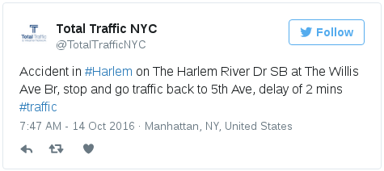

Slide 12
Traffic event description
Traffic condition

Slide 13
Location description. Some Tweets have geotag.

Slide 14
Tweet input hour

Slide 15
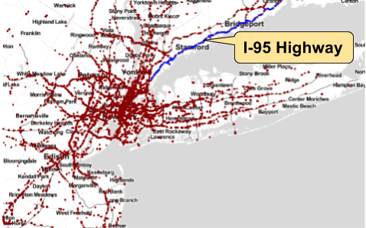
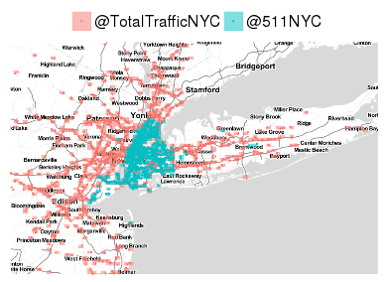
Data collection
Spatial coverage
Tweets in NY
Spatial coverage in NY of two specialist accs
Notes:
Most tweets are over the road network,
i.e., if we do zoom in, it is possible to see the I-95 highway
with tweets along its extension.

Slide 16
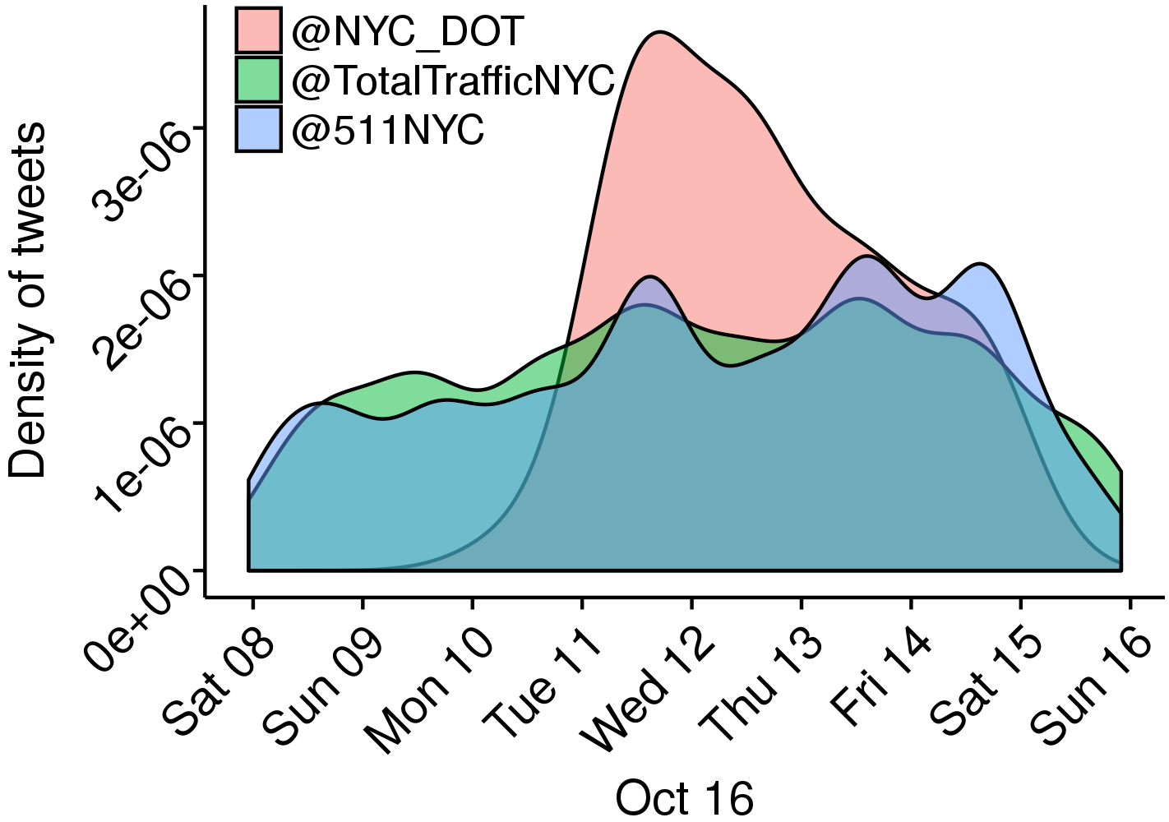
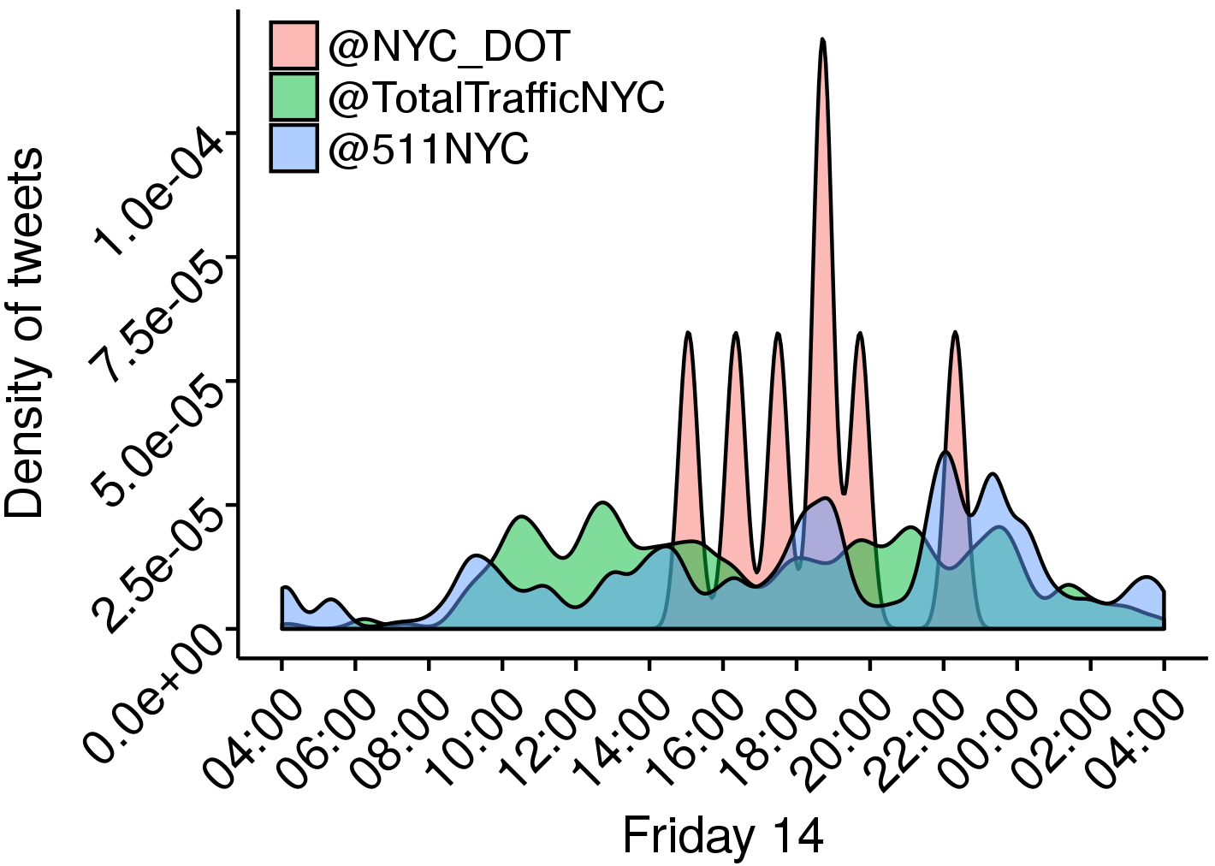
Data collection
Temporal coverage
Temporal coverage of three accs
Notes:
As expected, different accounts have disparate behavior in their posting rate.
@NYC_DOT posts mainly on working day
@TotalTrafficNYC and @511NYC do postages every day.

Slide 17
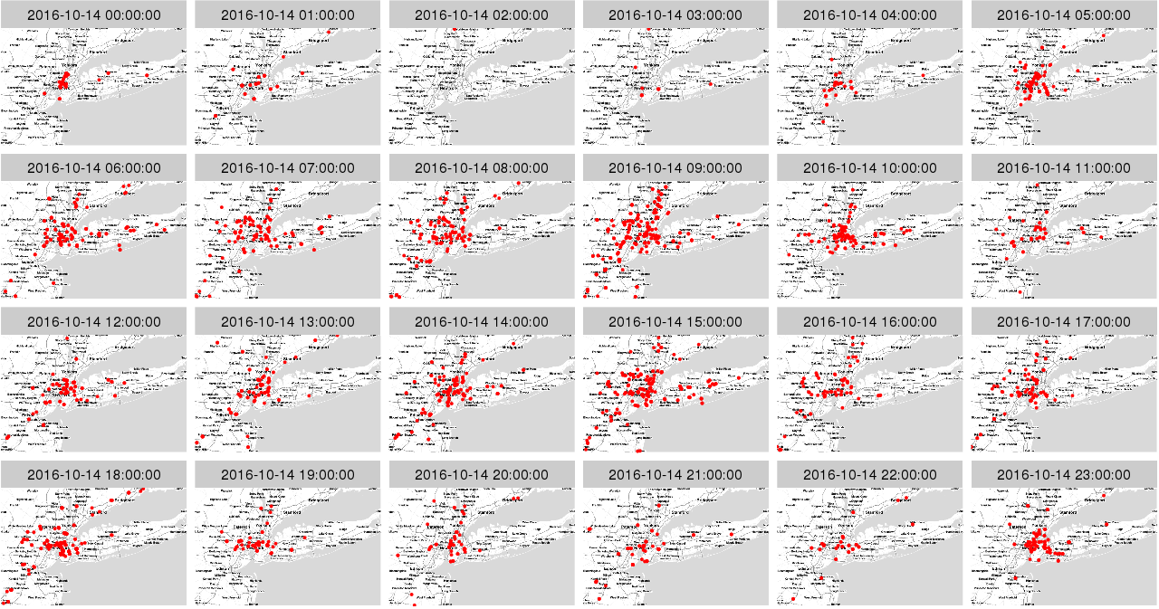

Slide 18
Twitter as a traffic sensor
How related are the tweets to the traditional traffic sensor?
Notes:
To reveal the potential of LBSM data to enhance and
complement the conventional ways to see traffic and transit, it
is fundamental the understanding of how related the tweets are
to the traditional traffic sensor.

Slide 19
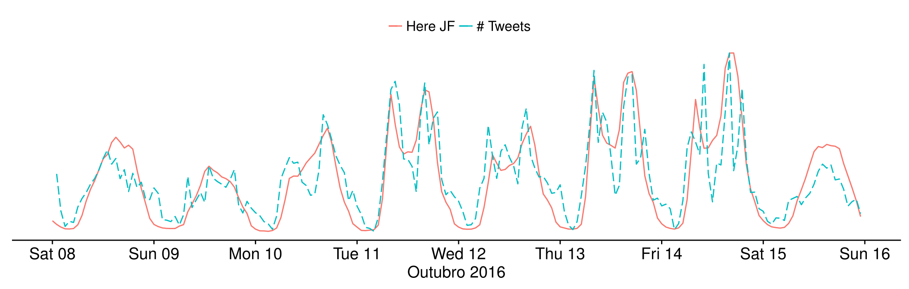
Twitter as a traffic sensor
Oct. 2016
Data:
Jam Factor (Here developer API)
# tweets
Notes:
Naturally, raw data holders perform some data fusion pro-
cess and present the result in their services or statistics. For
example, Google gathers heterogeneous data such as GPS
traces, cameras, and inductive loops. Thus it makes a data
fusion process and presents the results of traffic conditions
in colors over the map. In that way, companies like Google,
Here, and TomTom allow access to the resulting data fusion
process. In this work, we use the Jam Factor (JF) from HERE
API as aggregated traditional traffic sensor data. According to
the Here documentation, the JF is a fused representation of
traditional heterogeneous data. JF ranges from 0 to 1 (from
free to congested). We chose Here JF since no other company
provides such kind of data.
Fig. 4 shows the correlation between Here JF and tweets in
the dataset along a week in Oct. 2016.
We compute the Spearman’s rank (ρ) a nonparametric correlation coefficient to
identify relationships between two variables.
We apply Spearman’s rank in the time series resulting in
Ρ = +0.81. It is possible to interpret that the #tweets tend to increase when the JF
Increases.

Slide 20
Twitter as a traffic sensor
We apply Spearman’s rank in the time series resulting in
ρ = +0.81
Oct. 2016
Data:
Jam Factor (Here developer API)
# tweets
Notes:
Naturally, raw data holders perform some data fusion pro-
cess and present the result in their services or statistics. For
example, Google gathers heterogeneous data such as GPS
traces, cameras, and inductive loops. Thus it makes a data
fusion process and presents the results of traffic conditions
in colors over the map. In that way, companies like Google,
Here, and TomTom allow access to the resulting data fusion
process. In this work, we use the Jam Factor (JF) from HERE
API as aggregated traditional traffic sensor data. According to
the Here documentation, the JF is a fused representation of
traditional heterogeneous data. JF ranges from 0 to 1 (from
free to congested). We chose Here JF since no other company
provides such kind of data.
Fig. 4 shows the correlation between Here JF and tweets in
the dataset along a week in Oct. 2016.
We compute the Spearman’s rank (ρ) a nonparametric correlation coefficient to
identify relationships between two variables.
We apply Spearman’s rank in the time series resulting in
Ρ = +0.81. It is possible to interpret that the #tweets tend to increase when the JF
Increases.

Slide 21
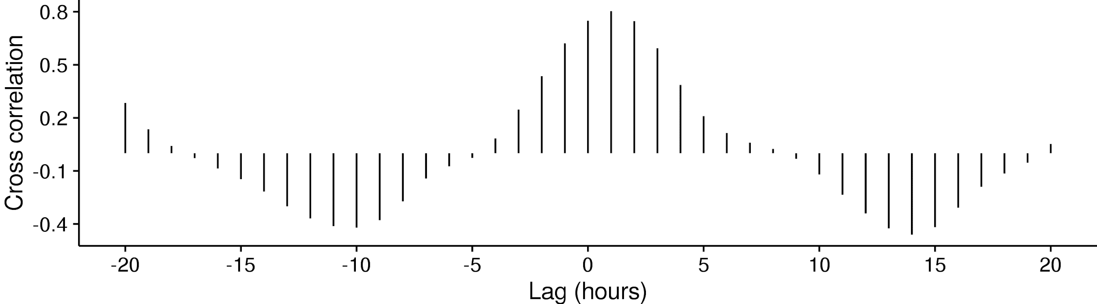
Twitter as a traffic sensor
Notes:
Applying the cross-correlation technique, it is possible to figure out where time series match. Fig. shows on the y-axis the cross-correlation between JF and \#tweets, and on the x-axis the lag between the time series, we use JF as the test waveform. The highest correlation (0.8) appears when the lag is +1 meaning that \#tweets curve is 1 hour ahead of JF. One can interpret that tweets appear on the platform before JF increases, but note that the time series were hourly aggregated.

Slide 22

Twitter as a traffic sensor
The highest correlation (0.8) appears when the lag is +1 meaning
#tweets curve is 1 hour ahead of JF
Notes:
Applying the cross-correlation technique, it is possible to figure out where time series match. Fig. shows on the y-axis the cross-correlation between JF and \#tweets, and on the x-axis the lag between the time series, we use JF as the test waveform. The highest correlation (0.8) appears when the lag is +1 meaning that \#tweets curve is 1 hour ahead of JF. One can interpret that tweets appear on the platform before JF increases, but note that the time series were hourly aggregated.

Slide 23
Twitter MAPS (T-MAPS)
Modeling Process
Data acquisition
Filtering and data fusion process
Metrics
Notes:
The T-MAPS is a low-cost spatiotemporal model which
aims to clarify traffic events through tweets. This model
allows the representation of the traffic scenario in different
aspects by considering instantaneous or historical data, and its
text mining.

Slide 24
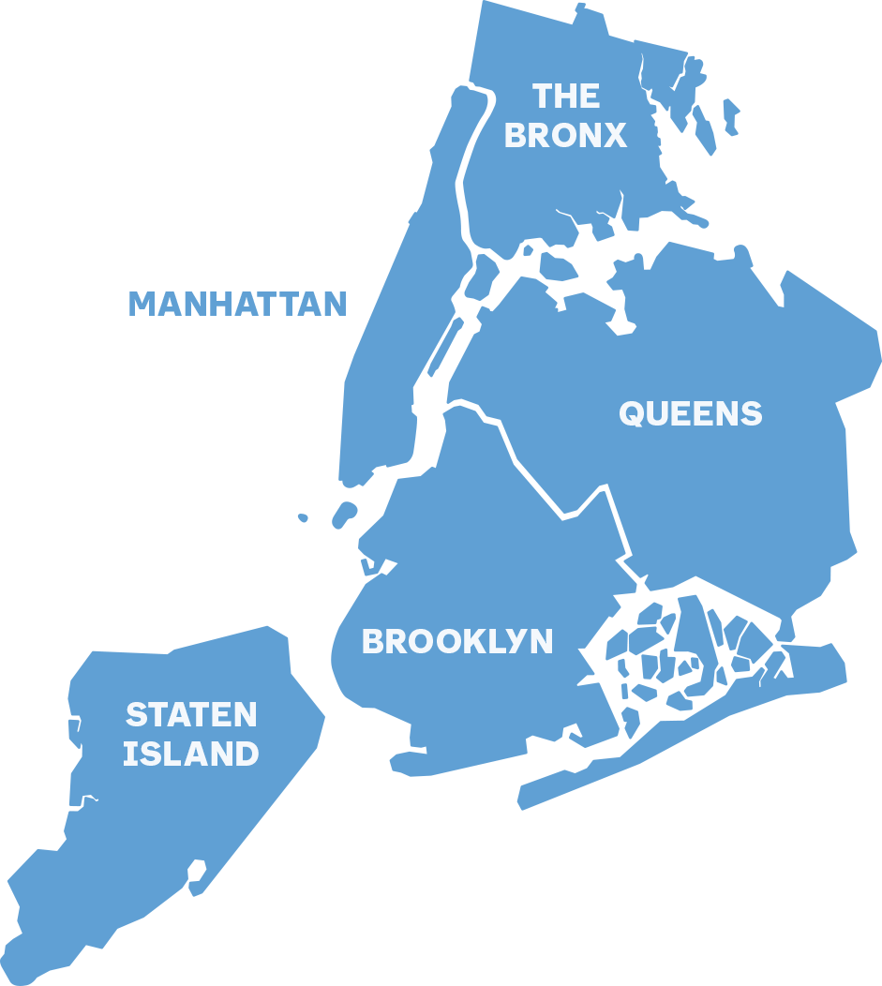
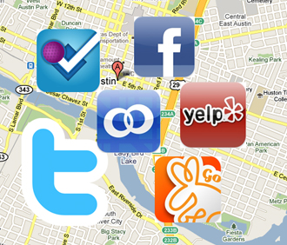
T-MAPS
Step 1 - Data Acquisition
New York City boundaries
Data from LBSM

Slide 25

T-MAPS
Step 2 - Filtering and Data fusion
G(V,E)
V(G) = map sub-regions
E(G) =adjacent regions
Spatiotemporal assignment
Filtering and bind data to regions
Remove data inconsistent

Slide 26

T-MAPS
Step 3 - Data Fusion and Metrics
Instant
Aggregation
1
1
100K
100K
10
3
3kk
70k
10
3
3kk
70k
10
3
3kk
70k
5
13k
5
5
13k
13k
8
1kk
Average
2.1
2.1
9.5
5.6
9.5
5.6
9.5
5.6
7
7
7
12.1

Slide 27
T-MAPS
Time Discretization - metric - instant
Instant
Instant
Instant
1
1
20
20
10
10
10
3
50
15
15
6
10
3
50
15
15
6
10
3
50
15
15
6
5
8
10
5
5
8
8
10
10
8
30
15
t
t + 1
t + 2...

Slide 28
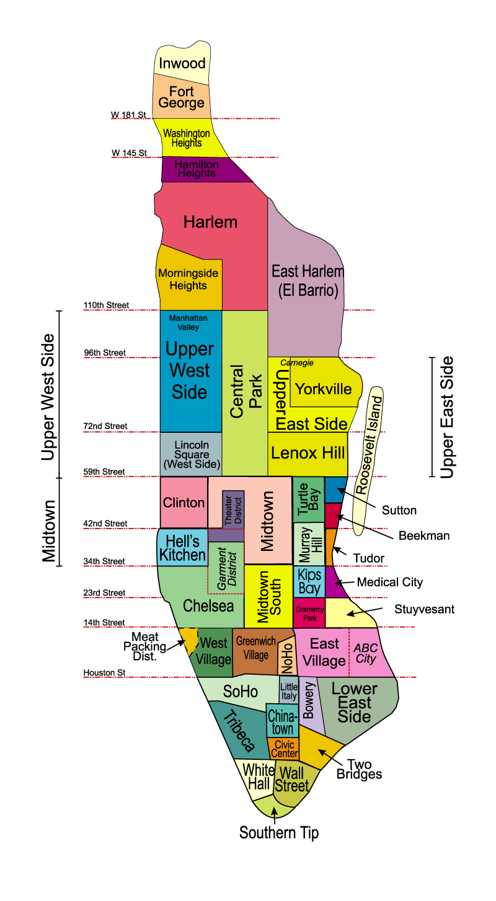
A Case Study - T-MAPS
Manhattan
29 official borough
21 specialist accounts from Twitter.
~ 280 K geotagged tweets
Oct - Dec 2016
T-MAPS
Shortest Path - Dijkstra Algorithm
Google Directions

Slide 29
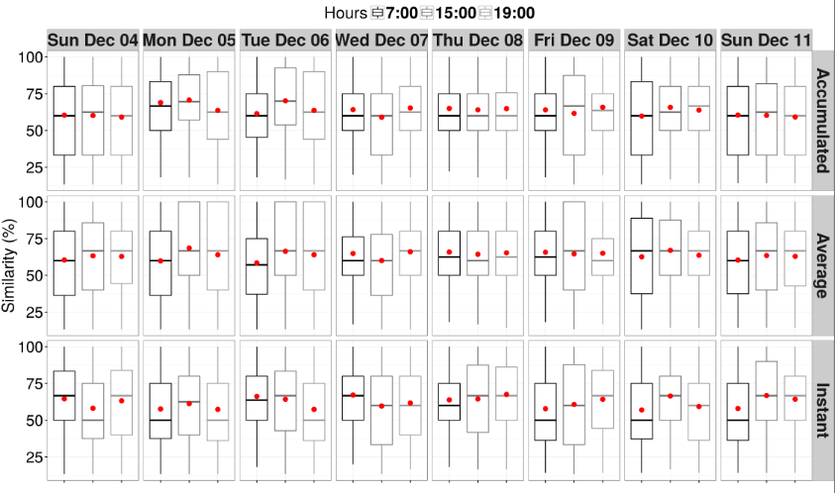
A Case Study
T-MAPS Applicability
Route similarity between T-MAPS and Google Directions (dots represent the mean)

Slide 30
A Case Study
T-MAPS Applicability
Median ranges from 50% to 60%
Route similarity between T-MAPS and Google Directions (dots represent the mean)

Slide 31
A Case Study
T-MAPS Applicability
Median ranges from 60% to 66%
Median ranges from 50% to 60%
Route similarity between T-MAPS and Google Directions (dots represent the mean)

Slide 32
A Case Study
T-MAPS Applicability
Median ranges from 60% to 66%
Median ranges from 63% to 67%
Median ranges from 50% to 60%
Route similarity between T-MAPS and Google Directions (dots represent the mean)

Slide 33
T-MAPS
ROUTE DESCRIPTION SERVICES
LBSM data collection
RM punctuation
RM stop words
‘/,.;*”?!/...
the, is, at, which…
R library:
[syuzhet, tm, stringr, wordcloud]

Slide 34
T-MAPS
ROUTE DESCRIPTION SERVICES
LBSM data collection
RM punctuation
RM stop words
Jamming, jammed → Jam
Ave, Av→ Avenue
St →Street
Stemming

Slide 35
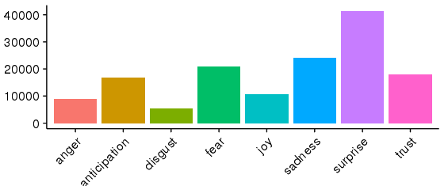
T-MAPS
ROUTE DESCRIPTION SERVICES
LBSM data collection
RM punctuation
RM stop words
Stemming
Score

Slide 36
T-MAPS
ROUTE DESCRIPTION SERVICES
LBSM data collection
RM punctuation
## Ang. Anticip. Disg. Fear Joy Sad. Surpri. Trust Neg. Pos. ## 1 0 1 0 0 1 0 0 1 0 1 ## 2 0 0 0 0 0 0 0 0 0 0 ## 3 0 0 0 0 0 0 0 0 0 0 ## 4 0 1 1 0 1 1 0 2 1 2 ## 5 0 1 0 0 1 0 1 2 0 2 ## 6 0 0 0 0 0 0 0 0 0 0
RM stop words
Stemming
Score
Pos ou Neg?

Slide 37
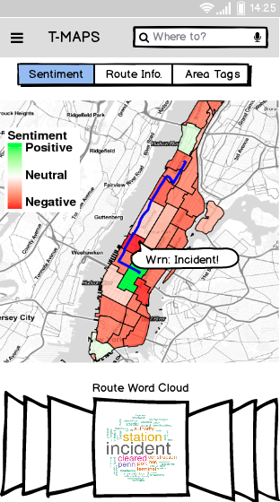
T-MAPS
ROUTE DESCRIPTION SERVICES
LBSM data collection
RM punctuation
RM stop words
Stemming
Score
Pos ou Neg?
Routes and Map

Slide 38
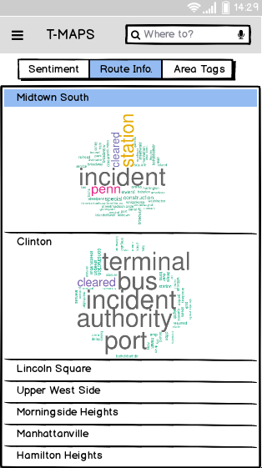
T-MAPS
ROUTE DESCRIPTION SERVICES
LBSM data collection
RM punctuation
RM stop words
Stemming
Score
Word cloud
Pos ou Neg?
Routes and Map

Slide 39
Conclusions
We presented the T-Maps, a low-cost spatiotemporal model to enhance traffic and transit navigation context, using tweets
Three route description services, Route Sentiment, Route Information, and Area' Tags.
The similarity reached 62%, and for a quarter of the evaluated trajectories, the similarity achieved up to 100%. Compared with Google Direction route recommendation

Slide 40
Conclusions
As future work
Extend the T-Maps applying strategies to process the data and offer more valuable information
Employ regular users accounts from LBSM and uses reputation models to handle conflicting information
Extend T-Maps to larger regions, taking into account the computational problem

Slide 41
Thanks!
Questions?
{bruno.ps, rettore, lfvieira, loureiro}@dcc.ufmg.br
heitor@ic.ufal.br

