Slide 1
Homework 3
Deadline: 2025/04/08 23:59:59

Slide 2
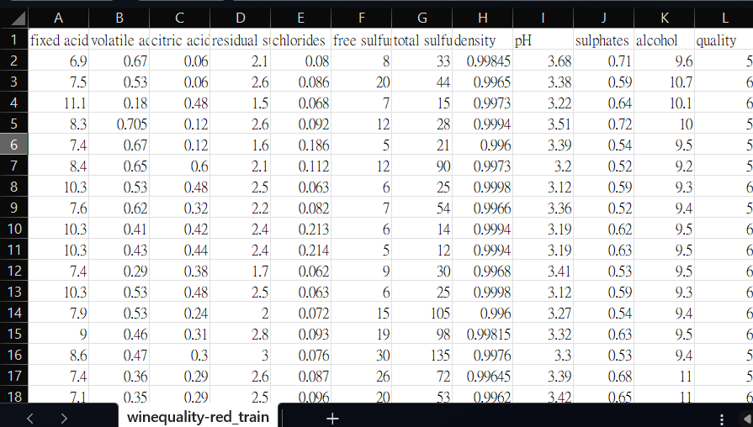
Regression Problem: Wine Quality Prediction

Slide 3
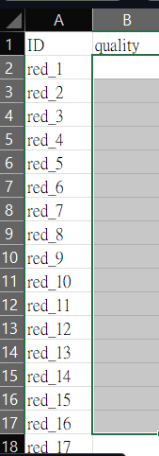
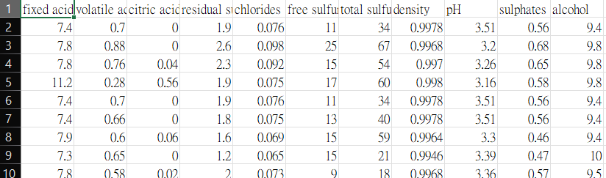
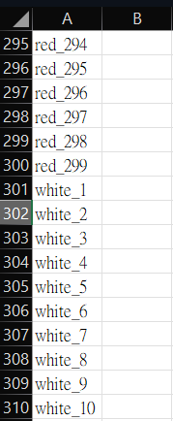
Kaggle competation

Slide 4
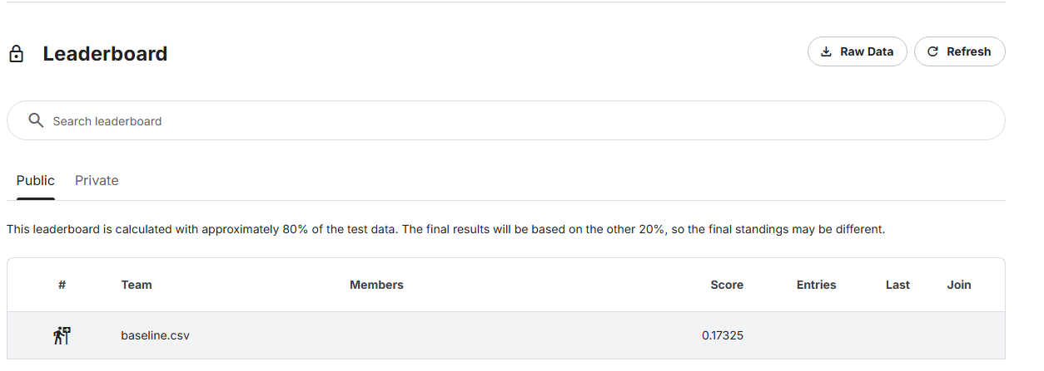
Kaggle competation
Set your team name as student ID and Upload your prediction csv.

Slide 5
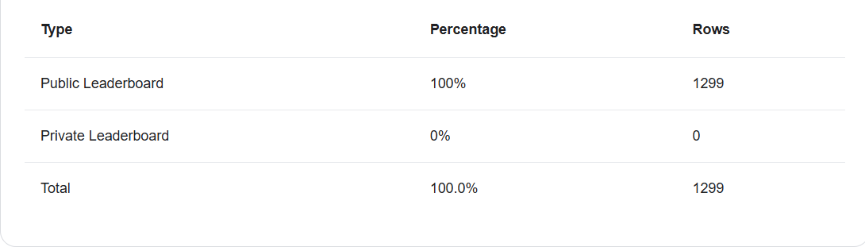
Kaggle competation

Slide 6
Grade
Report(20%)
Code Implementation(20%)
Leaderboard Ranking(20%)
Baseline(40%)

Slide 7
Report(20%)
Data Analysis & Preprocessing (5%)
Dataset Exploration :
Describe the dataset structure (train/test split, number of images per class).
Provide data visualization (class distribution, example images).

Slide 8
Report(20%)
Model Selection & Training (10%)
Model Architecture:
Describe the architecture details (number of layers, activation functions, optimizers).
why.
Loss Function & Optimization:
Justify your choice of loss function (e.g., cross-entropy loss).
Explain the optimizer and learning rate schedule used.
Training Process & Hyperparameters:
Describe the batch size, number of epochs, validation split.

Slide 9
Report(20%)
Experiment & Results (5%)
Model Performance:
Report your final accuracy on the test set.
Provide a confusion matrix to show model errors across different classes.
Comparison of Different Approaches:
If multiple models were tested, compare their performances.
Discuss strengths and weaknesses of your chosen model.
Error Analysis & Model Improvements:
Identify common misclassifications and suggest ways to improve them.
Discuss possible improvements (e.g., using pre-trained models, tuning hyperparameters).

Slide 10
Code Implementation(20%)
Finish
#### TODO

Slide 11
Leaderboard Ranking(10%)
Your final submission to Kaggle will be evaluated based on classification accuracy.
The top-ranked models will receive higher scores:
Top 10% of students: +20 points
The final ranking will be a weighted average of public and private

Slide 12
Moodle Requirements
學號_姓名_HW3
report.pdf:
code(folder): Python scripts, Jupyter Notebook, or .py files
fig(folder): Execution Logs / Screenshots
If the format does not match, 30 points will be deducted
Deadline: 2025/04/08 23:59:59
Kaggle Deadline: 2025/04/08 23:59:59
Link Kaggle
Colab Link Ref.

