Slide 1

Web Scraping and Topic Modeling with Data Science Job Postings
Ben Weckerle, Johnny Cagno, Devan Miller

Slide 2
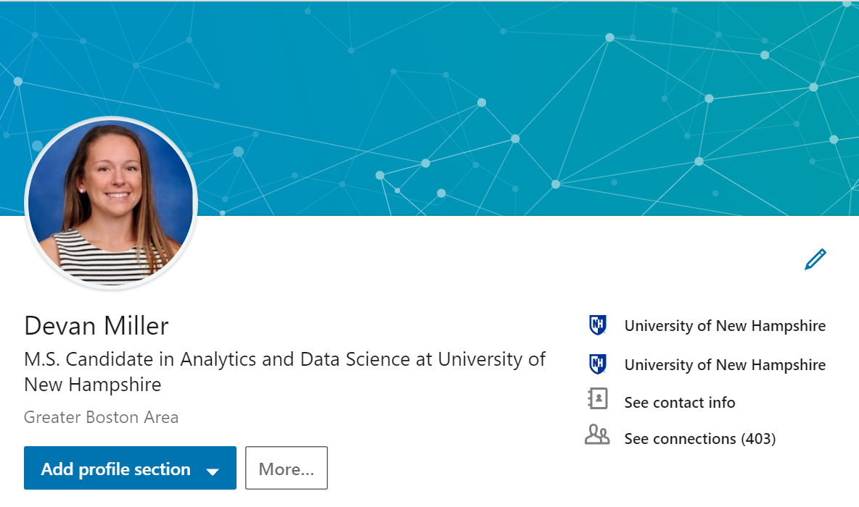
This is Devan
Graduate in May…time to begin looking for a job
Interested in data analyst positions in healthcare
Curious about what types of healthcare jobs are available in Boston, MA
Would like to know if her skillset is in demand in Boston, MA

Slide 3

Problem Definition
Job searching – where to begin?
LinkedIn, Indeed, Glassdoor, etc.
Challenges with these websites
Difficult and time consuming to scan and get a sense of the job market in certain areas

Slide 4
Solution
Use technology to crawl and scrape Indeed to gather Job posting data that is:
Specific to a job title, type or skill set
Specific to a country, state or city
Perform topic modeling to identify categories of positions open in certain areas
Gives a broad view of geographical job markets that could be useful in the early stages of job searching

Slide 5
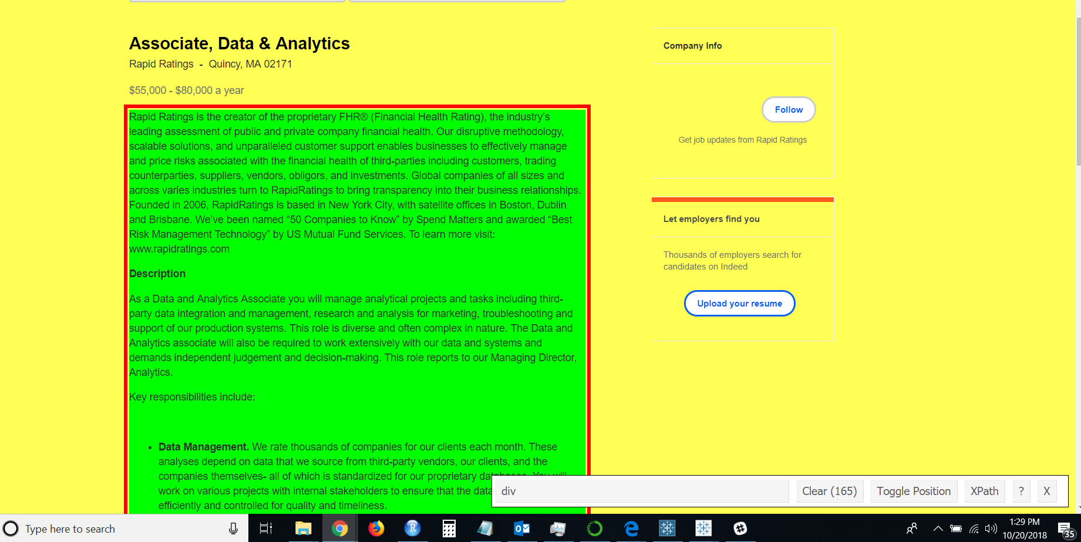
Web Scraping
Scraped the body of each individual job posting
mydivs = soup_obj.find("div", {"class":"jobsearch-JobComponent-description"})
Demonstration

Slide 6
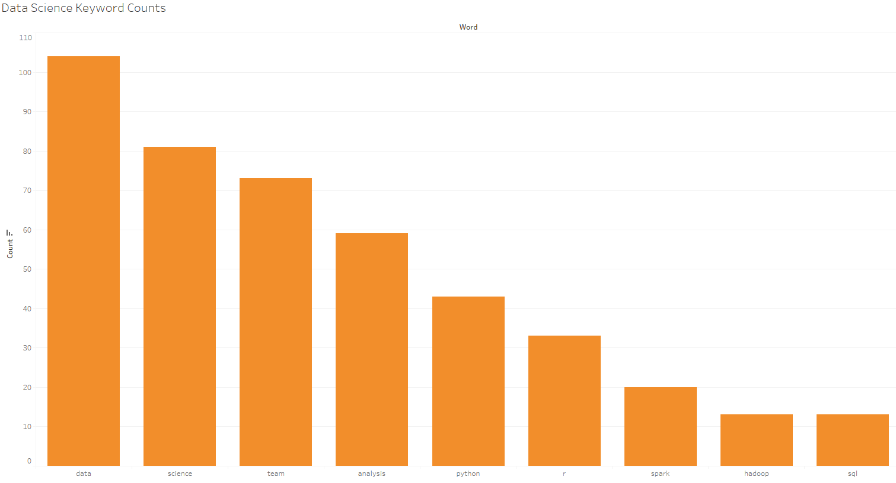

Slide 7
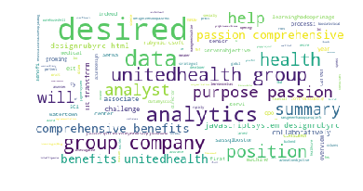
Search Terms: “Data Analytics” “Healthcare” “SQL”

Slide 8
Topic Modeling
Used on a large number of text documents or files
Compares the content of these documents and forms groups of words that frequently occur together
Allows user to extract broad meaning (in the form of topics) from word groups
Approaches
Latent Dirichlet Allocation (LDA) – Main approach
Non-zero Matrix Factorization (NFM) – For output comparison

Slide 9
LDA & NMF
LDA
Builds a topic per document model
Builds a words per topic model
Based on Dirichlet Distributions
Probability distribution sampling over a probability simplex
NMF
Used as a comparison model

Slide 10
Analysis
LDA Parameters
# of topics
Alpha – controls how unique the topics are
Beta – controls the number of words within the topics
Demonstration

Slide 11
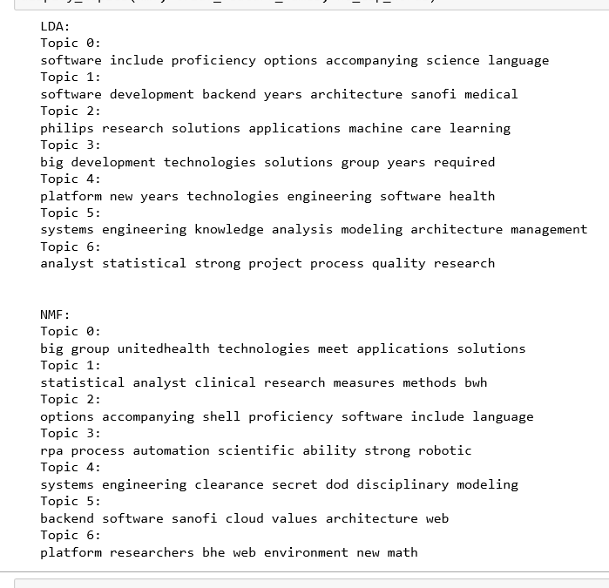
Implementation
Use topics to narrow job searches in Indeed, LinkedIn, etc.
Search company names and key words from topics
Gives a high level understanding of healthcare analytics job market in Boston, MA

Slide 12
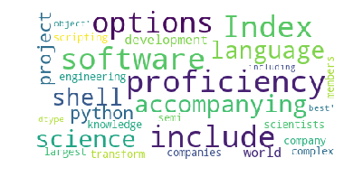
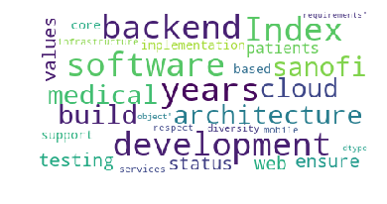
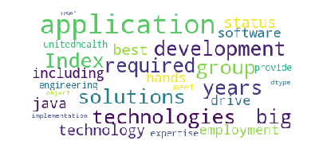
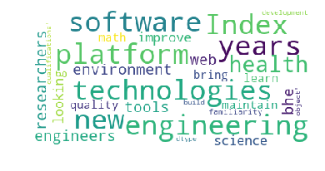
Topic 0
Topic 1
Topic 2
Topic 3

Slide 13
Thank You!

