Slide 1
Group 9 - efarm
Members :
Temesgen F., Agri. Economist
Evelynar B., M&E
Emmanuel A., Agri. Economist
Kevin B., Software Engineer
Brain W. Data analysist

Slide 2
Problem Low Income
Why?
80%
Yield gap …potential
Weak market
structure

Slide 3
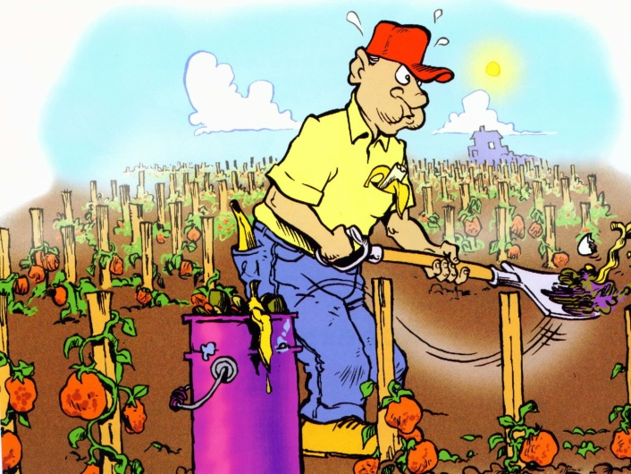


Information gap …
Poor agronomic practices
Unpredictable climate
Low price

Slide 4
This can be solved with
efarm!

Slide 5
Solution
Integrated platform Information on:
Agronomic practices …
Weather ….
Market …

Slide 6





The app…
Farmers
eFarm
Buyers
Price, weather, agronomy
Subscription
Registration farmers & produce
Where to get what…

Slide 7
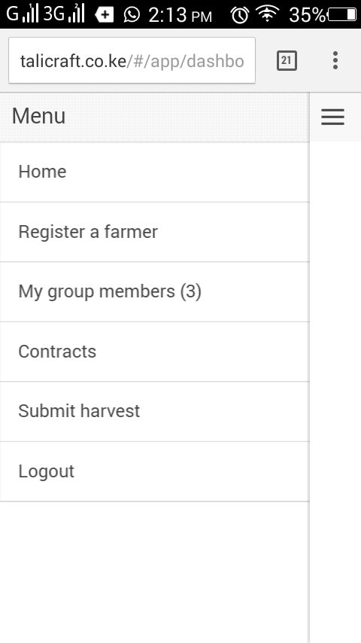
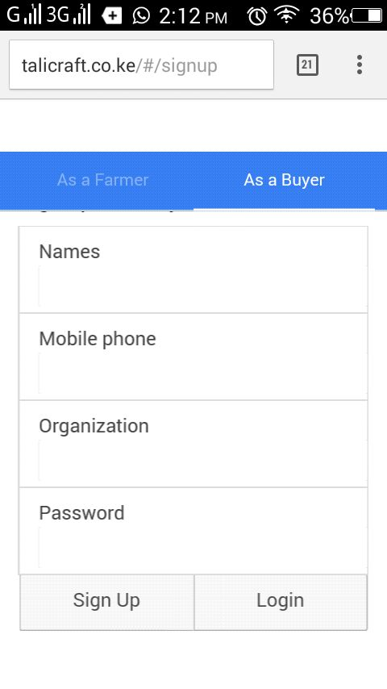
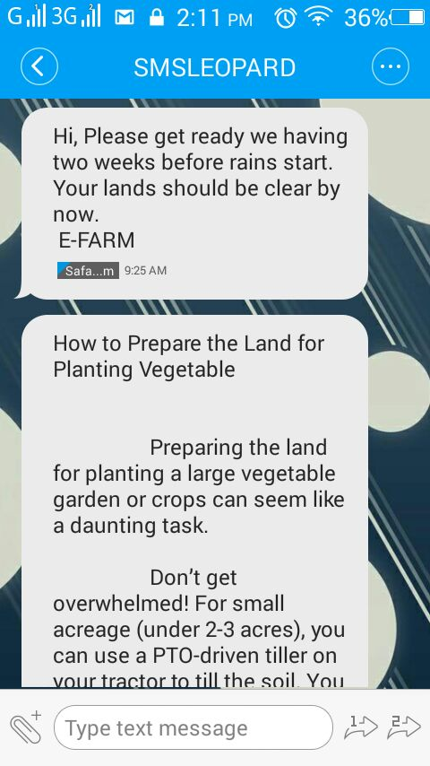

Slide 8
IMPACT Paths
Informed Decision Making
IMPROVED MARKET LINKAGE
INCREASED YIELD
INCREASED INCOME

Slide 9
Innovation
Integrated solution
Yield plus market
Farmers can increase the yield from small plots and
limited resources
Easy access to Market
Better barraging power
Improved income

Slide 10
Business module
Two way:
Initial stage using existing sources (Donners, NGO, Government)
Service charge after successful implementation

