Slide 1
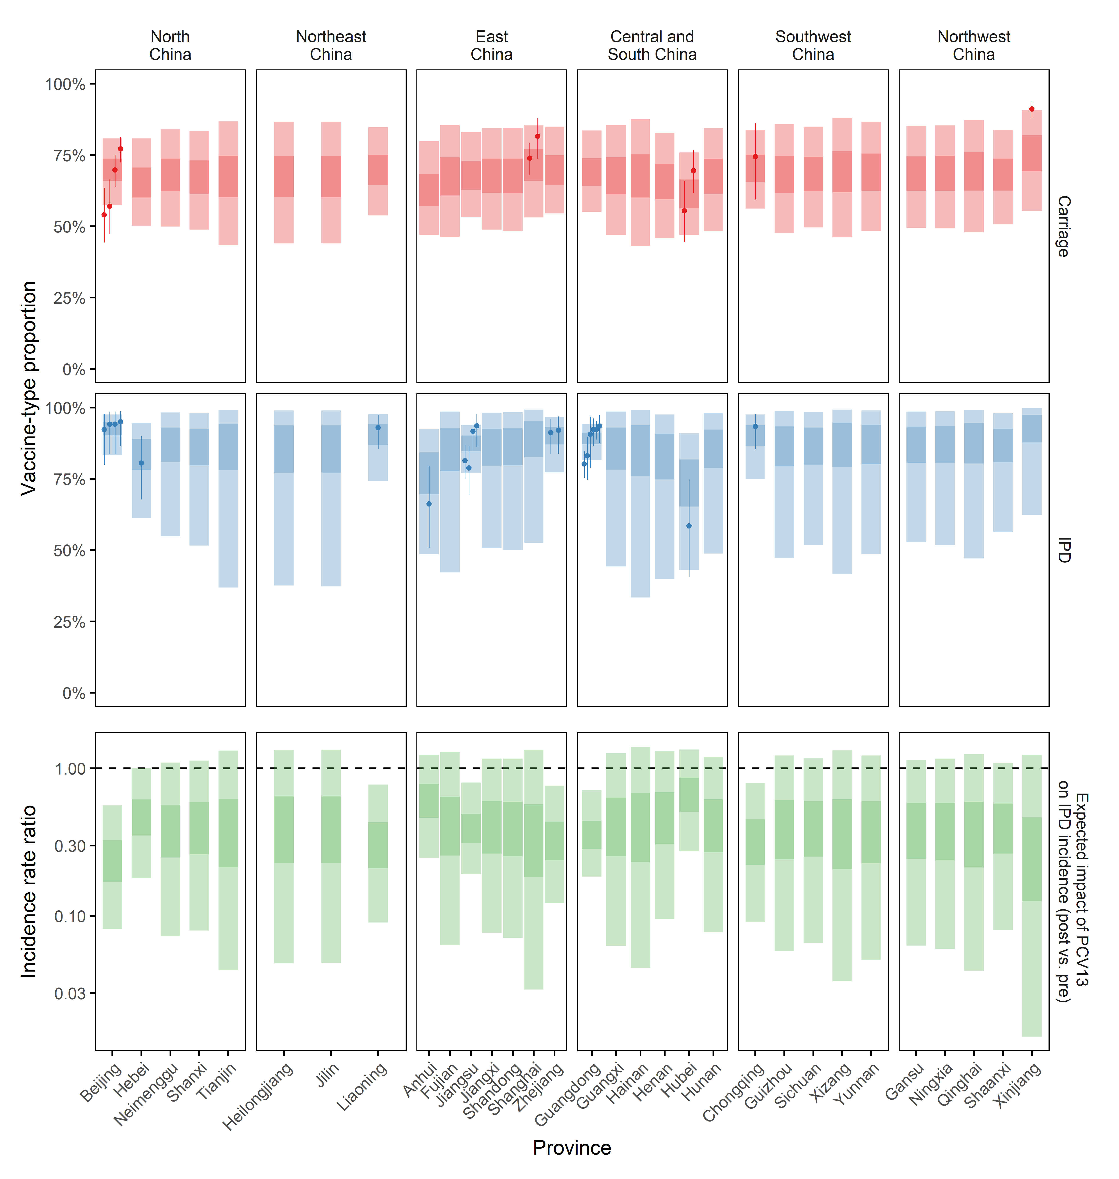




Estimating the impact of PCV13 on invasive pneumococcal disease incidence in mainland China: a spatial modelling study
Billy J Quilty¹, Yang Liu¹, Shuang Feng², Samuel Clifford¹, Kaile Chen², Charlie Diamond¹, Xin Tong², Hongjie Yu², Mark Jit¹, Tao Zhang², Stefan Flasche¹
1 Department of Infectious Disease Epidemiology, Faculty of Epidemiology and Population Health, London School of Hygiene and Tropical Medicine, London, UK
2 Department of Epidemiology, School of Public Health, Fudan University, Shanghai, China
Contact: Billy.Quilty@lshtm.ac.uk
Introduction
Introduction of pneumococcal conjugate vaccines (PCV) such as PCV13 can substantially reduce pneumococcal disease burden.
In mainland China, PCV13 is currently only available through the private market.
About 30,000 child deaths per year in mainland China may be preventable by PCVs¹, potentially largely in provinces where PCV private market uptake is minimal.
We estimate the potential impact of PCV13 introduction into the Chinese Expanded Programme of Immunisation on province-level invasive pneumococcal disease (IPD) incidence using a two-step Bayesian spatial and mathematical modelling framework.
Methods
The serotype distribution of 1687 carriage and 1594 IPD samples was extracted from 31 studies in 11 provinces².
We used a joint Bayesian spatial hierarchical model to estimate province-level PCV13-type proportion among carriers and IPD cases using JAGS.
We included socio-economic, geographic and health-related covariates in the model to inform estimates in provinces with sparse or no data.
We accounted for both structured and unstructured spatial random effects at the province level with an intrinsic CAR prior³.
We then modelled the likely impact of a mature PCV13 programme on IPD incidence in each province of mainland China, accounting for spatial heterogeneity in serotype distribution and complete replacement of vaccine-type IPD by non-vaccine types⁴.
Figure 1: Estimates of the proportion of PCV13-type serotypes in carriage (top) and invasive pneumococcal disease (middle), and estimated impact of PCV13 on IPD incidence (log₁₀-scale) (bottom) in the 31 provinces of mainland China. Study-level median and 95% high-density interval (HDI) estimates shown as small points and line-ranges respectively, and province-level 95% HDI (lighter) and 50% HDI (darker) estimates shown as thick bands.
Findings
We estimate that PCV13 would reduce long-term IPD incidence in mainland China by a median 33% in Hubei (95% HDI: -34 – 76%) to a median 76% in Beijing (95% HDI: 44 – 92%) (Figure 1).
All 95% credible intervals for province-level covariate effects contain zero for VT carriage and IPD, and as such the impact estimates in provinces with little or no serotype distribution data remain uncertain.
PCV13 is likely to reduce long-term IPD incidence in mainland China by a median 33% in Hubei (95% HDI: -34 – 76%) to a median 76% in Beijing (95% HDI: 44 – 92%).
Conclusions
We present a method of predicting PCV impact on the province-level in mainland China, accounting for spatial heterogeneity in pneumococcal epidemiology.
We predict that PCV13 introduction has the potential to reduce IPD incidence across mainland China, including likely reductions in lower-income, rural western provinces.
Additional studies, particularly in western provinces, would help increase the precision of impact estimates.
O’Brien KL, Wolfson LJ, Watt JP, Henkle E, Deloria-Knoll M, McCall N, Lee E, Mulholland K, Levine OS, Cherian T. Hib and Pneumococcal Global Burden of Disease Study Team. Lancet. 2009 Sep 12;374(9693):893-902.
Chen K, Zhang X, Shan W, Zhao G, Zhang T. Human vaccines & immunotherapeutics. 2018 Jun 3;14(6):1453-63.
Besag J, York J, Mollié A. Annals of the institute of statistical mathematics. 1991 Mar 1;43(1):1-20.
Flasche S, de Waroux OL, O’Brien KL, Edmunds WJ. PLoS computational biology. 2015 Apr 16;11(4):e1004173.
This research was funded by the National Institute for Health Research (NIHR) (EPIC) using UK aid from the UK Government to support global health research. The views expressed in this publication are those of the author(s) and not necessarily those of the NIHR or the UK Department of Health and Social Care.

