Slide 1
CAPSTONE / AI DRIVEN DATA SCIENCE
CREASEIQ
Franchise research,
with evidence attached.
QUESTION
EVIDENCE
DECISION
A constrained AI workflow for cricket analysts and scouts.
B.R. Abishek
Capstone Project / AI Driven Data Science
THE ANALYST RETAINS THE DECISION
18 OCTOBER 2026 / APPLICATION v3.1.0
Notes:
Introduce yourself as B.R. Abishek. CreaseIQ is an independent educational franchise research studio. Crease refers to the markings on a cricket pitch; IQ stands for intelligence. The name means cricket evidence supporting informed decisions, with the analyst in control. Its users are analysts and scouts who need a clear route from a cricket decision to inspectable evidence. This presentation explains application version 3.1.0. It uses the released source and documented local acceptance results. Do not describe it as an official IPL product, an autonomous team manager, or a proven match-winning system.
Evidence: released source v3.1.0 at 1100cace6b820c278135189f8925d4d1e423b375. Screenshots, when shown, are local application captures. References are in the report and appendix.

Slide 2
01 / PURPOSE
Start with a decision, not a dashboard.
The analyst’s problem
The project response
•
Records sit across competitions and seasons.
•
Confirm one task and its evidence scope.
•
A ranking can hide its date window and sample size.
•
Calculate from linked match records.
•
A plausible XI can still fail to cover twenty overs.
•
Show assumptions, constraints and exportable evidence.
The output is a research brief that a human can inspect.
CREASEIQ / CAPSTONE PROJECT / B.R. ABISHEK
v3.1.0 02 / 44
Notes:
Explain the concrete operational problem. A coach asks for death-bowling options, but a list of career wickets does not describe death-over evidence, availability or the missing overs in a proposed XI. CreaseIQ keeps those distinctions visible. The scope is historical research and scenario rehearsal. It does not replace current registration checks, video review, coaches or the analyst’s judgment.
Evidence: released source v3.1.0 at 1100cace6b820c278135189f8925d4d1e423b375. Screenshots, when shown, are local application captures. References are in the report and appendix.

Slide 3
01 / OBJECTIVES
Four contributions, one inspectable workflow.
01
Evidence
Registry-linked match data, explicit phases and dates.
02
Planning
Choose eleven players and assign every over together.
03
Bounded AI
Optional DeepSeek selection from existing fact IDs.
04
Reproducibility
Save the question, assumptions, versions and source hashes.
CREASEIQ / CAPSTONE PROJECT / B.R. ABISHEK
v3.1.0 03 / 44
Notes:
The contribution is the integration, not a claim that a language model invented better cricket statistics. The evidence engine performs calculations, the optimization engine checks a complete plan, and the optional model selects from already validated facts. Exports make the decision reproducible. No new foundation model was trained or fine-tuned for this project.
Evidence: released source v3.1.0 at 1100cace6b820c278135189f8925d4d1e423b375. Screenshots, when shown, are local application captures. References are in the report and appendix.

Slide 4
01 / USERS
What an analyst can actually ask.
SCOUTING
XI PLANNING
Which observed death bowlers deserve video review?
Can MI cover twenty overs without Bumrah?
PLAYER EVIDENCE
MATCH RESEARCH
What does Kohli’s selected archive sample contain?
Does a research model beat its historical baseline?
CREASEIQ / CAPSTONE PROJECT / B.R. ABISHEK
v3.1.0 04 / 44
Notes:
Map the four research tasks to real analyst questions. The franchise desk supplies the selected team context. Scouting considers observed evidence rather than confirmed acquisition availability. XI planning uses the supplied dated 2026 research pool. Player evidence requires a confirmed identity. Match research exposes a gated historical baseline. Keep the language “research option” distinct from a recommendation that a player can actually be signed or selected today.
Evidence: released source v3.1.0 at 1100cace6b820c278135189f8925d4d1e423b375. Screenshots, when shown, are local application captures. References are in the report and appendix.

Slide 5
02 / PRODUCT MAP
Ten workspaces; a single research loop.
01
Home
06
Match research
Purpose, examples, coverage
Baseline and dated holdout
02
Decision desk
07
Decision journal
Checked research briefs
Save and export reasoning
03
Scouting & comparison
08
Evaluation & sources
Scope, rank, compare
Audits, SWOT, review tasks
04
Squad & auction scenarios
09
Project guide
XI, schedules, assumptions
Explain, install, reproduce
05
Player dossier
10
Settings
Identity and archive evidence
Private key and call allowance
CREASEIQ / CAPSTONE PROJECT / B.R. ABISHEK
v3.1.0 05 / 44
Notes:
Walk through the navigation once rather than reading every page in detail. Home provides orientation and examples. Decision desk orchestrates checked briefs. Scouting ranks and compares. Squad scenarios solve legal schedules. Player dossier inspects records. Match research exposes the baseline and evaluation. Journal stores scoped decisions. Evaluation contains audits and review tasks. Project guide supports reproduction. Settings handles optional provider credentials and allowances.
Evidence: released source v3.1.0 at 1100cace6b820c278135189f8925d4d1e423b375. Screenshots, when shown, are local application captures. References are in the report and appendix.

Slide 6
02 / DATA
Five archives. Coverage is a first-class feature.
Competition
Matches
Earliest
Latest
IPL
1,242
2008-04-18
2026-05-31
BBL
662
2011-12-16
2026-01-25
Hundred
201
2021-07-22
2026-08-16
T20I
3,592
2005-02-17
2026-10-06
SMAT
695
2016-01-02
2024-12-15
6,392 eligible matches / Frozen supplied records / No automatic live updates
CREASEIQ / CAPSTONE PROJECT / B.R. ABISHEK
v3.1.0 06 / 44
Notes:
All counts refer to eligible men’s matches in the supplied snapshot. There are 6,392 matches, 141,377 player-match rows and 6,618 archive identities. IPL extends through 31 May 2026, but SMAT ends in December 2024. A latest date is not proof that every match in the interval is present. The app does not update automatically. The historical auction CSV is a separate 2013–2022 manual lookup and is not a current price feed.
Evidence: released source v3.1.0 at 1100cace6b820c278135189f8925d4d1e423b375. Screenshots, when shown, are local application captures. References are in the report and appendix.

Slide 7
02 / DATA ENGINEERING
From deliveries to dated player evidence.
01
02
03
04
05
Read
Filter
Link
Aggregate
Verify
Five JSON ZIP archives
Eligible men’s matches
Registry IDs and aliases
Player, match and phase
Independent raw checks
Super overs stay separate; voided and duplicate match IDs are excluded.
CREASEIQ / CAPSTONE PROJECT / B.R. ABISHEK
v3.1.0 07 / 44
Notes:
Describe match_data.py. Delivery records are aggregated by player and match, including phase components. Batter balls exclude wides under the source convention. Legal bowling balls exclude wides and no-balls. Bowler runs exclude byes and leg byes. Bowler wickets exclude run-outs and other non-bowler dismissal types. Powerplay uses supplied metadata with a documented fallback; Death is an analytical final fifth. The raw verifier is independent of the ingestion and analytics modules.
Evidence: released source v3.1.0 at 1100cace6b820c278135189f8925d4d1e423b375. Screenshots, when shown, are local application captures. References are in the report and appendix.

Slide 8
03 / ARCHITECTURE
The calculation engine owns the facts.
Streamlit UI
Context checker
Evidence tool
Checked brief
Question + confirmed controls
Task, identity, date, assumptions
Records, scores, XI or baseline
Validated facts + complete output
Fact IDs
Journal + exports
Source inputs
Optional DeepSeek
Scoped records and reproducible decision packs
Match data, registry and dated pool
Existing fact IDs + approved actions
Outputs: scoped brief, private journal and decision pack with source fingerprints
CREASEIQ / CAPSTONE PROJECT / B.R. ABISHEK
v3.1.0 08 / 44
Notes:
Explain the layers in the diagram. Streamlit owns controls and presentation. The task-context checker compares the question with confirmed controls. Deterministic tools retrieve and calculate match, roster and model evidence. Validation checks identities, scope and schedule completeness. DeepSeek is optional and only selects existing fact IDs and approved next actions. Rendering is deterministic. SQLite stores scoped journal/cache/request counts; CSV and ZIP exports carry provenance. There is no vector database, LangChain dependency or unrestricted execution agent.
Evidence: released source v3.1.0 at 1100cace6b820c278135189f8925d4d1e423b375. Screenshots, when shown, are local application captures. References are in the report and appendix.

Slide 9
03 / AI AGENT WORKFLOW
Question → evidence → check → human review.
01
02
03
04
05
Confirm
Retrieve
Calculate
Check
Review
Task, identity, scope
One permitted tool
Rates, scores or XI
Rules and fact IDs
Brief, sources, export
A conflicting request asks for clarification before calculation.
CREASEIQ / CAPSTONE PROJECT / B.R. ABISHEK
v3.1.0 09 / 44
Notes:
The agent is an application-controlled research workflow. The analyst chooses Scouting, XI planning, Player evidence or Match research. The server validates competition, discipline, phase, dates, selected players, exclusions, franchise, matchup and budget where relevant. One deterministic tool runs for the task. Optional DeepSeek selection happens only after the tool has returned facts. The final brief is bound to the full context and source fingerprints; a changed context makes the previous brief stale.
Evidence: released source v3.1.0 at 1100cace6b820c278135189f8925d4d1e423b375. Screenshots, when shown, are local application captures. References are in the report and appendix.

Slide 10
03 / DEEPSEEK
A narrow model role is a deliberate design choice.
DeepSeek can
The server controls
•
Select useful supplied fact IDs such as F1 and F2.
•
Tools, filters, calculations and source facts.
•
Choose approved next actions.
•
All eleven XI facts and the full over schedule.
•
Return a small validated JSON object.
•
Fallback to checked local evidence.
No key is needed for Local evidence mode.
CREASEIQ / CAPSTONE PROJECT / B.R. ABISHEK
v3.1.0 10 / 44
Notes:
DeepSeek uses deepseek-chat, temperature zero and a constrained JSON response. Temperature zero is not a guarantee of identical external responses. Unknown IDs, model prose, incomplete responses and tool-call attempts are rejected. A complete XI cannot omit player facts and a player task cannot omit requested identities. Invalid or unavailable selection falls back to the supported local facts. No live model quality claim is made by the fixture tests. Keys remain in private hosting Secrets or a temporary password field, never the source package.
Evidence: released source v3.1.0 at 1100cace6b820c278135189f8925d4d1e423b375. Screenshots, when shown, are local application captures. References are in the report and appendix.

Slide 11
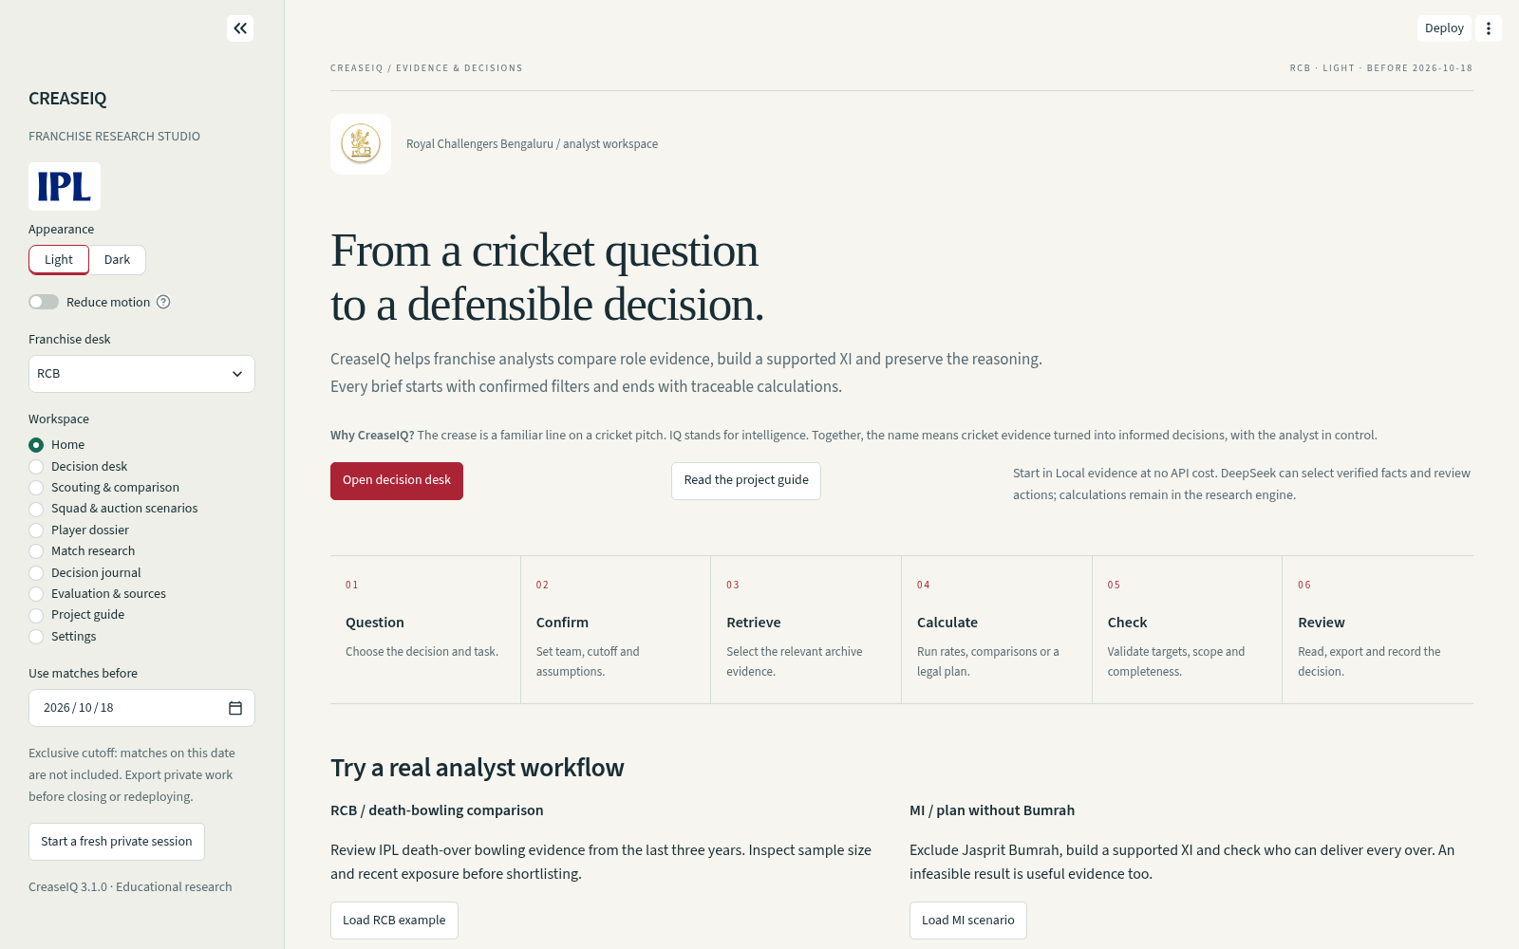
04 / HOME
Orientation before analysis.
WORKFLOW
A visible path from question to review.
GUIDED EXAMPLES
RCB scouting and MI without Bumrah.
COVERAGE
Source endpoints and project downloads.
Actual local application · v3.1.0 · Local evidence mode
CREASEIQ / CAPSTONE PROJECT / B.R. ABISHEK
v3.1.0 11 / 44
Notes:
Use the actual local application screenshot to show the home page’s purpose. Loading an example sets structured controls and does not itself spend provider calls. The first recommended run uses Local evidence. Explain the evidence base before interpreting a player’s metric. The page provides entry points rather than a generic decorative dashboard.
Evidence: released source v3.1.0 at 1100cace6b820c278135189f8925d4d1e423b375. Screenshots, when shown, are local application captures. References are in the report and appendix.

Slide 12
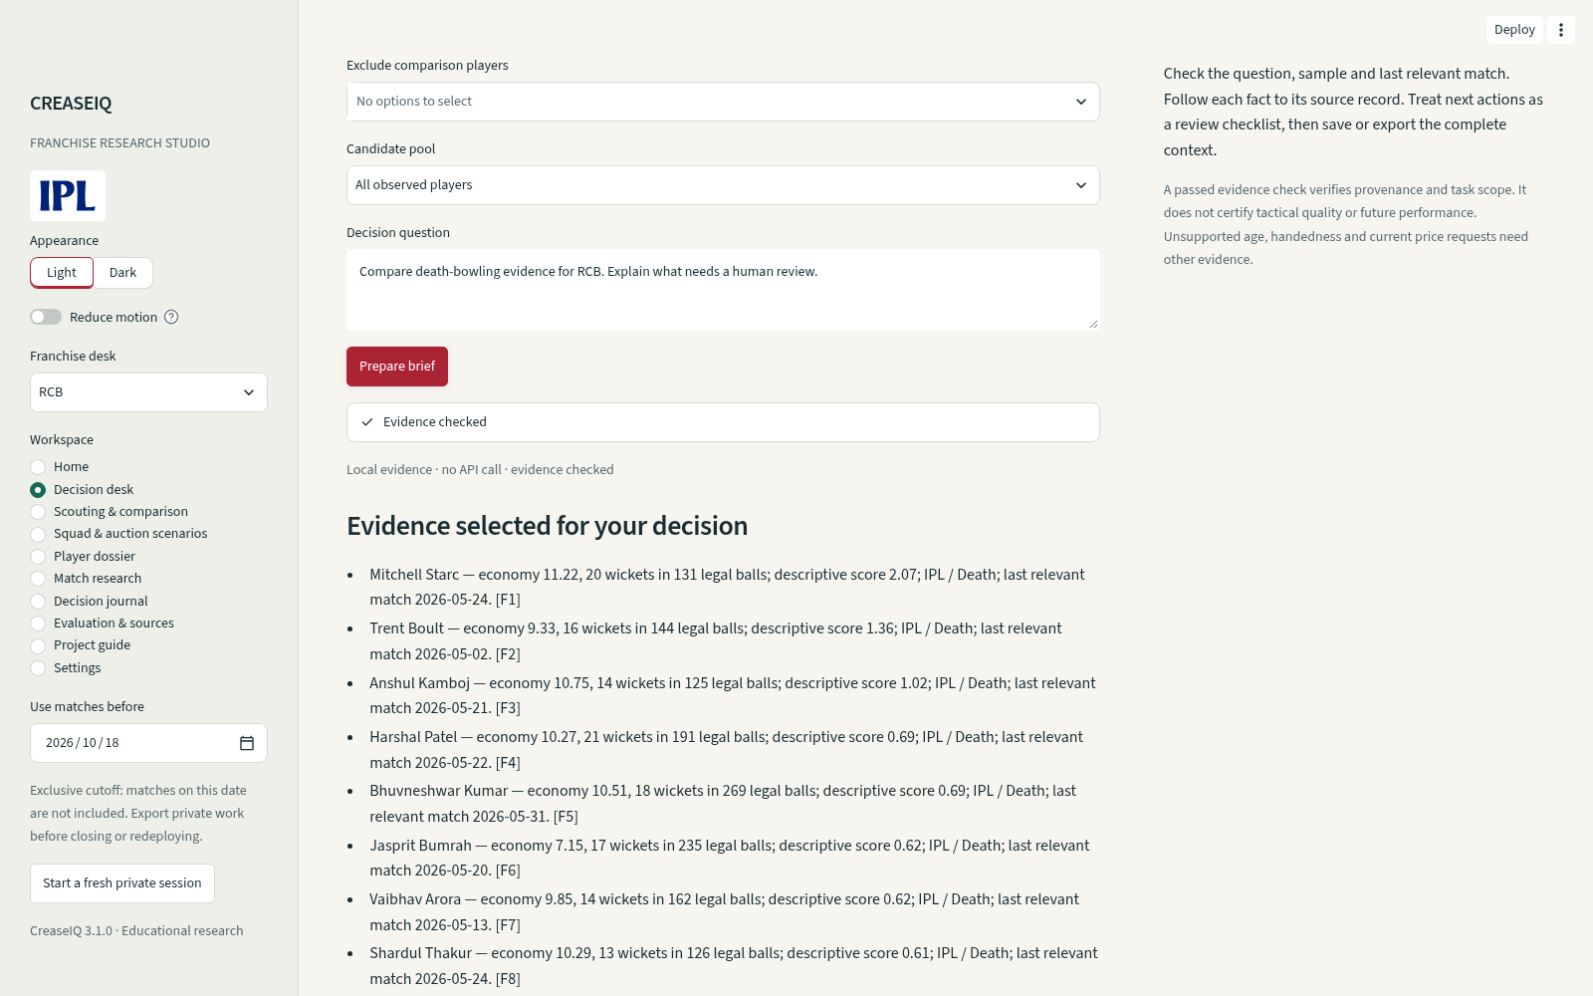
04 / DECISION DESK
Prepare a brief with its evidence attached.
CONFIRM
Task, player IDs, question and controls agree.
INSPECT
Each fact has a record and evidence trace.
PRESERVE
Save privately or download a decision pack.
Actual local application · v3.1.0 · Local evidence mode
CREASEIQ / CAPSTONE PROJECT / B.R. ABISHEK
v3.1.0 12 / 44
Notes:
A brief contains factual records rendered by the server, their sources, full context and approved next actions. Open the evidence trace during the demo. If a question requests under-25 eligibility, a different competition or an unconfirmed exclusion, the app asks for clarification rather than making an unsupported inference. A source or control change hides the old result until it is recomputed. “Evidence checked” means supported provenance and task agreement, not certified tactical usefulness.
Evidence: released source v3.1.0 at 1100cace6b820c278135189f8925d4d1e423b375. Screenshots, when shown, are local application captures. References are in the report and appendix.

Slide 13
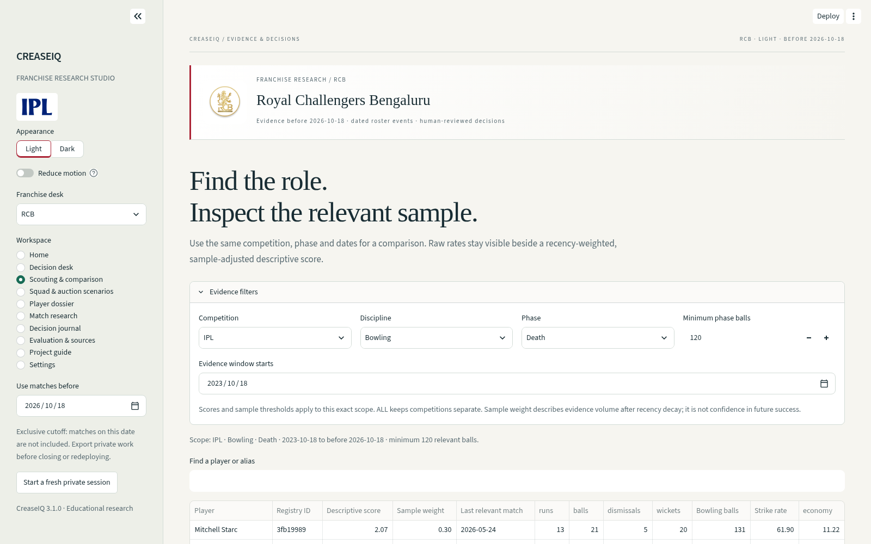
04 / SCOUTING
Read the raw rate beside the score.
CONTROL
Competition, discipline, phase, dates and balls.
COMPARE
Up to three registry-linked identities.
INTERPRET
Recency, shrinkage and observed-rate intervals.
Actual local application · v3.1.0 · Local evidence mode
CREASEIQ / CAPSTONE PROJECT / B.R. ABISHEK
v3.1.0 13 / 44
Notes:
Scouting calculates transparent descriptive scores. Recent records receive more weight, with a 365-day half-life; a 120-ball prior shrinks small samples toward the scope average. The minimum sample uses batting balls or legal bowling balls as appropriate. A bowling score trades off economy and wicket-taking, so rank is not the same as sorting economy. ALL keeps competitions separate and does not translate league strength. Current availability and tactical fit require external review. The score weights have not been proven optimal.
Evidence: released source v3.1.0 at 1100cace6b820c278135189f8925d4d1e423b375. Screenshots, when shown, are local application captures. References are in the report and appendix.

Slide 14
04 / PLAYER DOSSIER
A scope is part of every statistic.
114
2,073
9,336
Death-phase runs
All phases, same window
All supplied IPL records
2023-10-18 to before 2026-10-18
2023-10-18 to before 2026-10-18
Archive through 2026-05-31
2024 IPL
2025 IPL
2026 IPL
741 runs
657 runs
675 runs
Player overview and scoped research views label these different meanings explicitly.
CREASEIQ / CAPSTONE PROJECT / B.R. ABISHEK
v3.1.0 14 / 44
Notes:
Use Kohli to teach the difference between an archive total and a filtered sample. In the 18 October 2023 to before 18 October 2026 window, the archive has 114 Death-phase IPL runs and 2,073 all-phase runs. The all-supplied-IPL overview has 9,336 runs through 31 May 2026. The season totals 741, 657 and 675 match the RCB pages in the official comparison file. Do not call the 9,336 an independently certified complete career figure. It is labeled as the supplied archive. The minimum-ball scouting filter does not hide dossier records.
Evidence: released source v3.1.0 at 1100cace6b820c278135189f8925d4d1e423b375. Screenshots, when shown, are local application captures. References are in the report and appendix.

Slide 15
04 / IDENTITIES & TIME
Names help search. IDs identify people.
Identity
Time
•
Three registry IDs share “Rohit Sharma”.
•
Only matches strictly before the cutoff count.
•
Ambiguous names require an explicit choice.
•
The same window is used for fair comparisons.
•
Observed teams and competitions help confirmation.
•
Historical XI pools outside 2026 are unsupported.
A missing identity or match cannot borrow somebody else’s evidence.
CREASEIQ / CAPSTONE PROJECT / B.R. ABISHEK
v3.1.0 15 / 44
Notes:
The local registry preserves raw aliases but is not a complete external full-name register. Some players need initials or a source alias in the search. The selected India Rohit ID is 740742ef; this is not the only person with that display name. Current roster events are applied only after their published dates, with a strict exclusive cutoff. Do not imply that a roster cutoff creates a historical career record or that the latest source date certifies completeness.
Evidence: released source v3.1.0 at 1100cace6b820c278135189f8925d4d1e423b375. Screenshots, when shown, are local application captures. References are in the report and appendix.

Slide 16
04 / XI OPTIMIZATION
Selection and the twenty overs are solved together.
11
20
4
4
Distinct selected players
Overs assigned
Maximum overseas
Maximum overs / bowler
•
At least one keeper; active role minima and all locks/exclusions.
•
No consecutive overs by one bowler; total and phase workload caps.
•
Optional assumed budget; independent validation before display.
CREASEIQ / CAPSTONE PROJECT / B.R. ABISHEK
v3.1.0 16 / 44
Notes:
SciPy’s mixed-integer optimization selects players and assigns every over jointly. Default planning uses IPL evidence from the previous three years, even when scouting controls show another competition. Selection maximizes the sum of explicit utilities; a second solve holds that XI fixed and improves the schedule using phase scores. Each successful plan receives an independent schedule validation. A legal feasible optimum under these assumptions is not a proven best tactical XI. Costs, curated styles and capability assumptions remain explicit.
Evidence: released source v3.1.0 at 1100cace6b820c278135189f8925d4d1e423b375. Screenshots, when shown, are local application captures. References are in the report and appendix.

Slide 17
04 / OVER-BY-OVER PLAN
A real scenario: MI without Jasprit Bumrah.
POWERPLAY / 1–6
MIDDLE / 7–16
DEATH / 17–20
1
2
3
4
5
6
7
8
9
10
11
12
13
14
15
16
17
18
19
20
A
B
A
B
C
A
D
E
C
D
E
D
E
D
E
A
B
C
B
C
A AM Ghazanfar
B Deepak Chahar
C Ashwani Kumar
D Mitchell Santner
E Corbin Bosch
20 overs / 120 legal balls / No adjacent repeats / Each named bowler: 4 overs
CREASEIQ / CAPSTONE PROJECT / B.R. ABISHEK
v3.1.0 17 / 44
Notes:
This schedule is calculated from the released 2026 research pool with Jasprit Bumrah explicitly excluded, one spin and two pace minimums, the default three-year IPL evidence and no price budget. The selected five bowlers each cover four overs in this example. The diagram shows all twenty overs, their phase and no consecutive overs for one bowler. It is a reproducible research scenario, not a claim of current match-day availability. Equivalent optimal schedules can differ; keep the manifest to reproduce the assumptions.
Evidence: released source v3.1.0 at 1100cace6b820c278135189f8925d4d1e423b375. Screenshots, when shown, are local application captures. References are in the report and appendix.

Slide 18
04 / SCENARIO ANALYSIS
Make assumptions visible before solving.
Availability and roles
Costs and capabilities
•
Exclude unavailable players; lock required players.
•
Enter assumed prices when using a budget.
•
Set supported spin, pace and other role minima.
•
Justify any workload or utility override.
•
Compare a forced alternative and who leaves.
•
Dated source blocks cannot be overridden.
Historical auction entries do not become live market values.
CREASEIQ / CAPSTONE PROJECT / B.R. ABISHEK
v3.1.0 18 / 44
Notes:
Budget values are analyst assumptions, and the initial one-crore entries are placeholders. Every relevant available player needs a price when a budget is active. Capability overrides need a written reason and legal whole-over caps; unobserved players also need a finite utility assumption. They cannot remove a documented 2026 availability block. If a constraint set is impossible, the app returns an explanation instead of inventing a complete plan. Historical auction lookup stays manual because currencies, transaction types and identities need review.
Evidence: released source v3.1.0 at 1100cace6b820c278135189f8925d4d1e423b375. Screenshots, when shown, are local application captures. References are in the report and appendix.

Slide 19
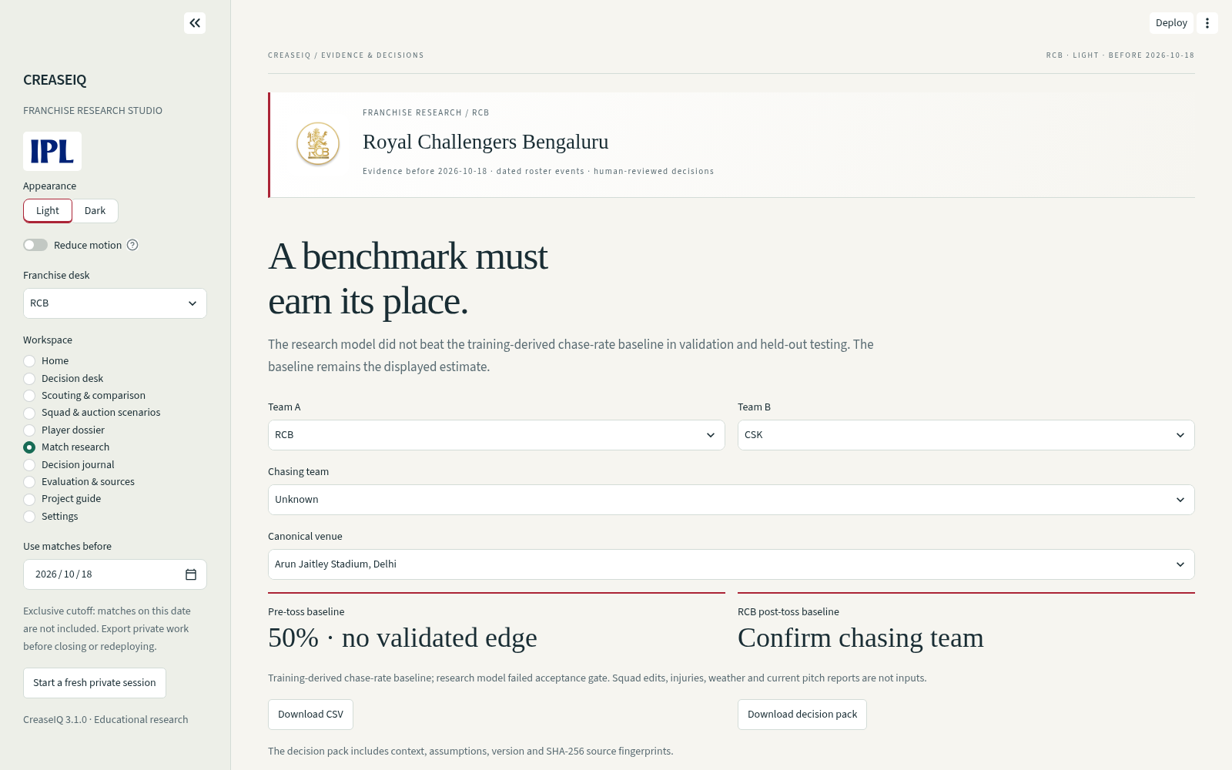
04 / MATCH RESEARCH
A model must beat a credible baseline.
RESEARCH
Regularized logistic model with dated features.
CONTROL
Team A/B, venue and confirmed chasing team.
LIMIT
No lineup, injury, weather or pitch-report input.
Actual local application · v3.1.0 · Local evidence mode
CREASEIQ / CAPSTONE PROJECT / B.R. ABISHEK
v3.1.0 19 / 44
Notes:
The model uses team Elo and exponential recent-result form. Post-toss features add chasing status and prior venue chase outcomes. Training is before 2023, validation is 2023 and testing is 2024 onward. All matches on a date are predicted before that date’s results update ratings. The current research model failed its stronger-baseline gate, so the displayed estimate is a training-derived baseline. Selecting a different XI does not change it, because player lineups are not model inputs.
Evidence: released source v3.1.0 at 1100cace6b820c278135189f8925d4d1e423b375. Screenshots, when shown, are local application captures. References are in the report and appendix.

Slide 20
05 / EXPERIMENT DESIGN
Time order prevents future results leaking backward.
BEFORE 2023
2023
2024 ONWARD
Fit fixed model
Validate
Held-out test
946 training matches
73 validation matches
215 test matches
Within each date: forecast every match first, then update ratings from results.
CREASEIQ / CAPSTONE PROJECT / B.R. ABISHEK
v3.1.0 20 / 44
Notes:
The model fit uses 946 eligible training matches before 2023. Validation has 73 matches, and the held-out test contains 215 from 2024 onward. Ratings update only after each match date. The training chase-rate baseline uses training history, not test outcomes. The model’s fixed regularization and constants were not tuned using the validation or test results. Nevertheless, the dataset is limited and repeated seasons and teams are dependent, so a single test score does not prove a durable future advantage.
Evidence: released source v3.1.0 at 1100cace6b820c278135189f8925d4d1e423b375. Screenshots, when shown, are local application captures. References are in the report and appendix.

Slide 21
05 / MODEL RESULTS
The baseline remains the displayed estimate.
Brier score ↓
Validation (73)
Test (215)
Research post-toss
0.256489
0.248577
Training chase baseline
0.257440
0.247619
GATE: BETTER IN BOTH PERIODS
Not passed
The baseline is served; no predictive edge is claimed.
CREASEIQ / CAPSTONE PROJECT / B.R. ABISHEK
v3.1.0 21 / 44
Notes:
Read the exact Brier values. The research post-toss model scores 0.256489 on validation versus the baseline’s 0.257440, but on held-out test it scores 0.248577 versus the baseline’s better 0.247619. The gate requires improvement in both periods and therefore fails. Lower Brier is better. Both have about 54.88 percent threshold accuracy in the test; this shows why accuracy alone is inadequate. The pre-toss displayed 50 percent is a no-validated-edge baseline, not evidence that actual team strengths are identical.
Evidence: released source v3.1.0 at 1100cace6b820c278135189f8925d4d1e423b375. Screenshots, when shown, are local application captures. References are in the report and appendix.

Slide 22
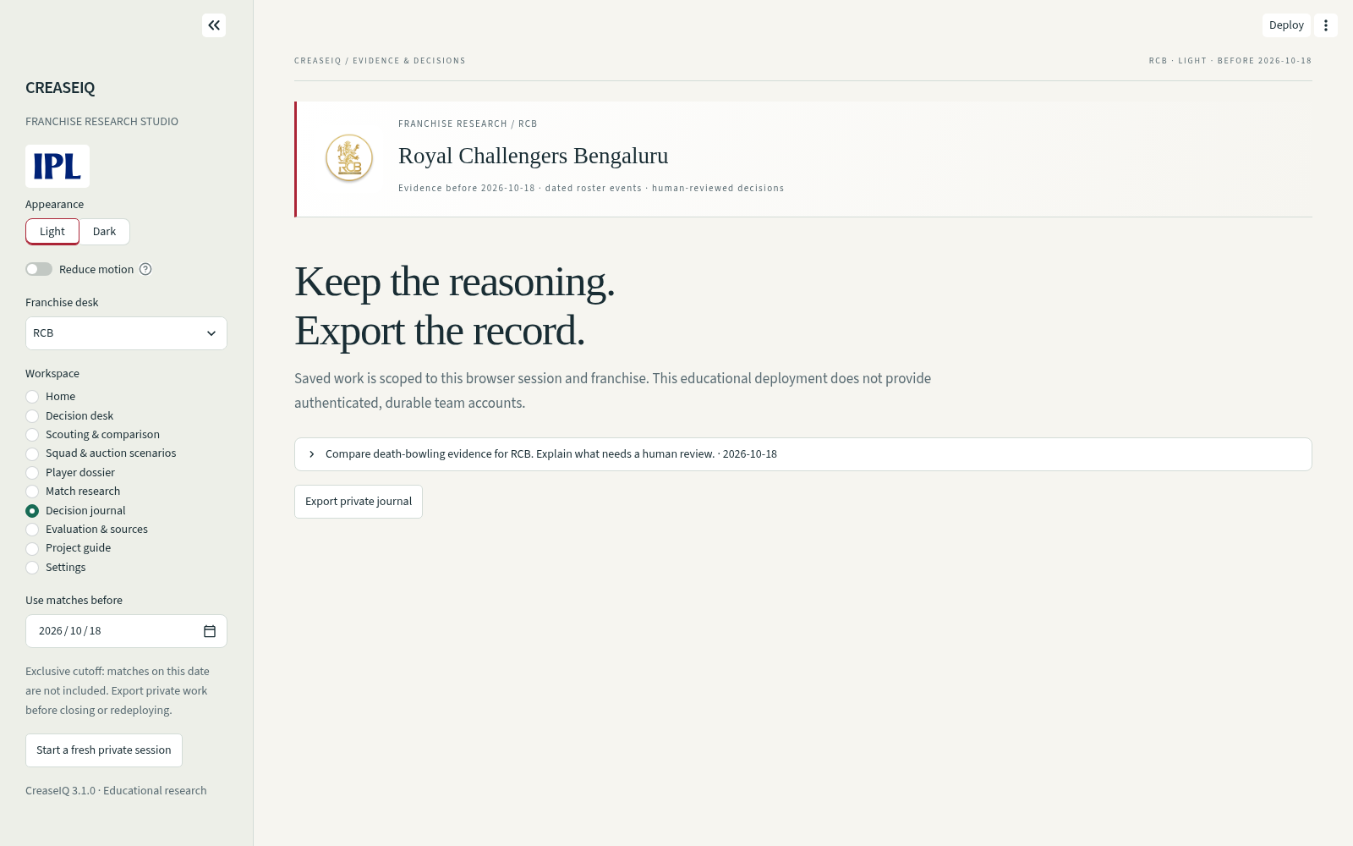
04 / JOURNAL & EXPORTS
Keep the reasoning, not just the answer.
JOURNAL
Saved briefs and scenarios by browser session/team.
MANIFEST
Question, assumptions, dates and source SHA-256.
EXPORT
CSV, checked evidence and complete XI schedule.
Actual local application · v3.1.0 · Local evidence mode
CREASEIQ / CAPSTONE PROJECT / B.R. ABISHEK
v3.1.0 22 / 44
Notes:
Session/franchise scoping is tested, but it is not authenticated durable multi-user team access. Another fresh visitor cannot read this session’s records. Export work before closing or redeploying. Decision packs contain manifest.json and the data needed for the task; XI packs include schedule.csv, alternatives and checks. The context fingerprint changes when the question, scope, assumptions, version or calculation sources change. Source hashes identify an input version; they do not prove source truth.
Evidence: released source v3.1.0 at 1100cace6b820c278135189f8925d4d1e423b375. Screenshots, when shown, are local application captures. References are in the report and appendix.

Slide 23
04 / UI & UX
A working studio, with clear visual hierarchy.
CONTEXT
Franchise desk and visible filters
APPEARANCE
Light, Dark and team accents
MOTION
Reduced-motion controls
LANGUAGE
Archive scope and uncertainty labels
CREASEIQ / CAPSTONE PROJECT / B.R. ABISHEK
v3.1.0 23 / 44
Notes:
Describe the actual design choices rather than aesthetic adjectives. The selected desk has franchise colors and a bundled identification mark. Light and Dark modes use readable surfaces and a restrained hierarchy. Reduce motion and system reduced-motion preferences are respected. Tables remain stable; the sidebar preserves context; filtered totals and unsupported cases use explicit labels. The application has local desktop/mobile browser checks, not a completed accessibility certification or user study. Team logos identify the subjects of an educational project and do not imply endorsement.
Evidence: released source v3.1.0 at 1100cace6b820c278135189f8925d4d1e423b375. Screenshots, when shown, are local application captures. References are in the report and appendix.

Slide 24
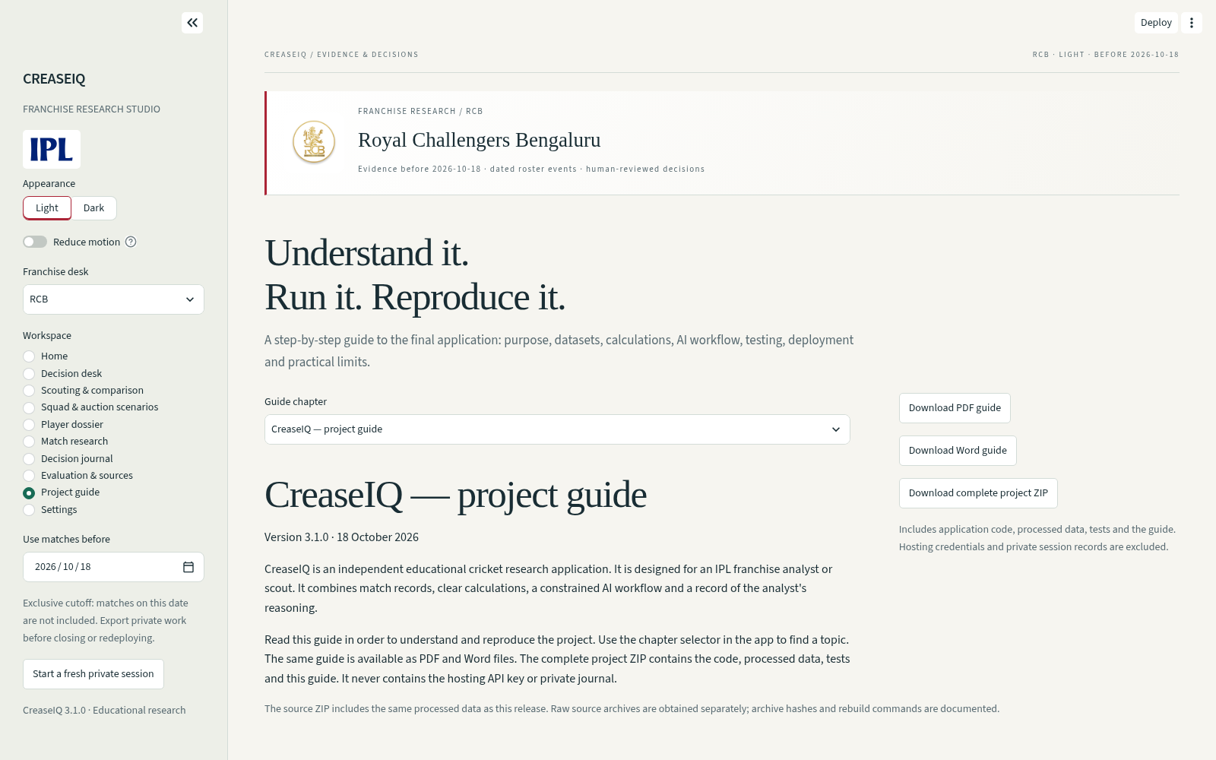
04 / GUIDE & SETTINGS
The application explains how to reproduce it.
DOCUMENTATION
Same simple-English guide in app, PDF and Word.
SOURCE
Allowlisted project ZIP with data and tests.
SETTINGS
Private key override, connection test and call limits.
Actual local application · v3.1.0 · Local evidence mode
CREASEIQ / CAPSTONE PROJECT / B.R. ABISHEK
v3.1.0 24 / 44
Notes:
The user guide explains installation, data coverage, deterministic tools, formulas, legal schedule rules, model gating and deployment. The source download excludes actual credentials, runtime databases, environments and caches. Local mode has no API charge. Optional DeepSeek calls are limited to six per browser session per UTC day across desks and thirty per installation. A brief uses at most two calls. These are small-demo controls rather than authenticated user accounts or a hard currency cap. Live provider quality was not certified here.
Evidence: released source v3.1.0 at 1100cace6b820c278135189f8925d4d1e423b375. Screenshots, when shown, are local application captures. References are in the report and appendix.

Slide 25
05 / QUANTITATIVE VERIFICATION
Separate functional passes from source completeness.
71
58
0
Automated tests
Local browser checks
Raw-ingestion mismatches
Expanded check
Cases
Interpretation
Scouting settings
144
Competition / phase / date / discipline
All-team scenarios
90
50 supported; 40 explained rejections
Forced-player requests
257
214 supported; 43 explained rejections
Displayed squad dossiers
257
All match stored records or report no identity
Raw reconciliation: 3,393,048 fields across 1,455,366 deliveries. Units are distinct; no combined “accuracy” percentage.
CREASEIQ / CAPSTONE PROJECT / B.R. ABISHEK
v3.1.0 25 / 44
Notes:
There are 71 current automated tests and 58 local Chromium checks. The raw archive verifier independently recalculated 3,393,048 numeric fields from 1,455,366 deliveries with zero ingestion mismatches. The expanded audit tested 144 scouting settings, ninety team scenarios and 257 forced-player requests. All 257 dossier displays matched stored input totals or explicitly reported missing identities. These are different test units and must not be added into one artificial accuracy percentage. Local fixture and browser checks do not certify the hosted rebuild or external model quality.
Evidence: released source v3.1.0 at 1100cace6b820c278135189f8925d4d1e423b375. Screenshots, when shown, are local application captures. References are in the report and appendix.

Slide 26
05 / EXTERNAL CHECKS
Official comparisons reveal real coverage limits.
188
5
1
Matched checkpoints
Measured coverage gaps
Unresolved conflict
194 numeric checkpoints / 15 primary pages / all ten IPL teams
Kohli T20I
Supplied archive
ICC career reference
Runs before 2024-07-01
3,963
4,188
Source: data/official_validation.csv. This is sampled external validation, not certification of every player.
CREASEIQ / CAPSTONE PROJECT / B.R. ABISHEK
v3.1.0 26 / 44
Notes:
The sample contains 194 numeric fields from fifteen primary pages, spanning all ten IPL teams and five archive competitions. It produced 188 matches, five T20I coverage gaps and one unresolved conflict. Kohli has 3,963 T20I archive runs versus the ICC’s 4,188. India Rohit has 4,027 versus 4,231. SMAT 2024/25 has only eight supplied matches. Kamboj conceded 56 in the archive but an IPL article says 57; the final primary bowling card still needs review. Every discrepancy remains in the downloadable comparison file. This is not official verification of every player.
Evidence: released source v3.1.0 at 1100cace6b820c278135189f8925d4d1e423b375. Screenshots, when shown, are local application captures. References are in the report and appendix.

Slide 27
05 / ROSTER TRUST
A supplied pool is not a certified current squad.
257
14
7
Supplied pool rows
Selected dated notices
Missing replacement records
•
Block documented outgoing players after publication.
•
Block existing replacements before the documented join date.
•
Report missing verified metadata; never fabricate a roster.
CREASEIQ / CAPSTONE PROJECT / B.R. ABISHEK
v3.1.0 27 / 44
Notes:
The supplied pool contains 257 rows and can include outgoing players and replacements together. Fourteen selected dated primary-source notices are applied. Seven documented incoming replacements lack verified planning metadata: Akash Madhwal, Emanjot Chahal, Krish Bhagat, Mahipal Lomror, Ruchit Ahir, George Linde and Richard Gleeson. The app names them instead of inventing country, keeper or eligibility metadata. Remaining registrations, availability, NOCs and reinstatements require review. A legal research plan does not certify current match eligibility.
Evidence: released source v3.1.0 at 1100cace6b820c278135189f8925d4d1e423b375. Screenshots, when shown, are local application captures. References are in the report and appendix.

Slide 28
06 / LIVE DEMO A
RCB: shortlist death-bowling evidence.
1
Load RCB example
Check IPL · Bowling · Death · 120 balls.
2
Prepare local brief
Read economy, wickets, legal balls and last match.
3
Inspect the evidence
Compare scope and observed-rate uncertainty.
4
Save the decision
Export the brief; list current-availability checks.
CREASEIQ / CAPSTONE PROJECT / B.R. ABISHEK
v3.1.0 28 / 44
Notes:
Use this as the first demo. Start on Home and load the RCB example without a provider call. Confirm the exclusive cutoff. Prepare a Local evidence brief, open its trace and read raw metrics rather than just the first rank. A high-ranked player is not necessarily available to RCB; signing status is outside the observed-performance ranking. Save and download the pack. If the hosted service is unavailable, run the supplied source locally. Do not claim that a screenshot proves live DeepSeek intelligence.
Evidence: released source v3.1.0 at 1100cace6b820c278135189f8925d4d1e423b375. Screenshots, when shown, are local application captures. References are in the report and appendix.

Slide 29
06 / LIVE DEMO B
MI: remove Bumrah and account for every over.
1
Load MI scenario
Bumrah is explicitly excluded in the controls.
2
Inspect the XI
Check eleven players, roles and overseas limit.
3
Open the schedule
Check every over, phase caps and repeated bowlers.
4
Test a counterfactual
Force an alternative or try an impossible budget.
CREASEIQ / CAPSTONE PROJECT / B.R. ABISHEK
v3.1.0 29 / 44
Notes:
Explain why this is a stronger demo than displaying a static best XI. The scenario removes an important bowler and tests whether the rest of the research pool can still support a complete schedule. Read the assumption table and current-status warnings. The example’s supported result has twenty overs with no consecutive overs by one bowler. Then show an explicitly impossible condition and its explanation. Finish by exporting the plan and manifest. No recruitment or current-fitness claim follows from the solve.
Evidence: released source v3.1.0 at 1100cace6b820c278135189f8925d4d1e423b375. Screenshots, when shown, are local application captures. References are in the report and appendix.

Slide 30
06 / RUN & COST
A low-cost capstone, with optional API use.
Local reproduction
Purpose
1. Extract the source ZIP
Processed release data is included.
2. Create a Python environment
Use tested Python 3.12 or a compatible version.
3. pip install -r requirements.txt
Streamlit, pandas, NumPy, SciPy and Altair.
4. python -m streamlit run app.py
Local evidence works without an API key.
Optional hosting + DeepSeek: private Secrets, demo call limits and provider spending controls.
CREASEIQ / CAPSTONE PROJECT / B.R. ABISHEK
v3.1.0 30 / 44
Notes:
Normal use needs the source ZIP, Python 3.11 or newer compatible Python, the listed packages and Streamlit. Python 3.12 is the tested recommendation. The source includes processed data, so the large raw archives are not required to run the app. Deploy main with app.py on Streamlit Community Cloud and add a private key only if using DeepSeek selection. Hosting may be free within current host limits; provider charges depend on actual current pricing and usage. No new paid dataset is needed to reproduce this release. Complete/live data and production team access would be separate work.
Evidence: released source v3.1.0 at 1100cace6b820c278135189f8925d4d1e423b375. Screenshots, when shown, are local application captures. References are in the report and appendix.

Slide 31
07 / SWOT
A credible capstone has visible trade-offs.
STRENGTHS
WEAKNESSES
Traceable records
Incomplete frozen coverage
Complete constrained schedule
Partial roster metadata
Reproducible exports
Heuristic score weights
OPPORTUNITIES
THREATS
Verified dated registry
Stale availability
Video + analyst reviews
Scope misinterpretation
Untouched tactical studies
Provider or public-demo abuse
CREASEIQ / CAPSTONE PROJECT / B.R. ABISHEK
v3.1.0 31 / 44
Notes:
Strengths are traceable calculations, complete schedule constraints and reproducible exports. Weaknesses are frozen incomplete sources, partial roster metadata and heuristic scoring without proven tactical advantage. Opportunities include a dated verified registry, scout/video review and measured role/venue studies. Threats include stale availability, scope misinterpretation, provider instability and misuse of public demo allowances. Frame future work as research priorities, not features secretly completed in this release.
Evidence: released source v3.1.0 at 1100cace6b820c278135189f8925d4d1e423b375. Screenshots, when shown, are local application captures. References are in the report and appendix.

Slide 32
07 / NEXT RESEARCH
What remains before professional team adoption.
01
Verify the record
Fill missing scorecards and resolve primary-source conflicts.
02
Verify the roster
Complete dated identities, replacements and availability.
03
Measure usefulness
Collect independent analyst ratings and tactical outcomes.
04
Operate reliably
Add authenticated storage, monitoring and hosted/API checks.
CREASEIQ / CAPSTONE PROJECT / B.R. ABISHEK
v3.1.0 32 / 44
Notes:
Prioritize evidence integrity before more decoration or model complexity. The app has twenty review tasks but zero authenticated professional reviews. Forecast superiority is unproven. A real deployment also needs reviewed source rights, access control, durable backups, operational monitoring and ongoing dated data updates. Full Impact Player and competition-rule certification are outside the current twenty-over model. These limits should appear in the submitted report so the claims match the evidence.
Evidence: released source v3.1.0 at 1100cace6b820c278135189f8925d4d1e423b375. Screenshots, when shown, are local application captures. References are in the report and appendix.

Slide 33
07 / CONTRIBUTION
RESEARCH CONTRIBUTION
The deliverable is a reproducible decision process.
Evidence.
Constraints.
A decision record.
A practical capstone for inspectable cricket research.
Professional adoption still requires complete data, current roster verification and independent human review.
CREASEIQ / CAPSTONE PROJECT / B.R. ABISHEK
v3.1.0 33 / 44
Notes:
Conclude with the three substantive contributions: bounded evidence workflow, joint legal selection/scheduling and a reproducible decision record. The product supports understanding and testing rather than asserting a predictive edge. Point to the submitted report, source and evidence pack for details. Be ready to distinguish source consistency, complete official coverage, functional reliability and tactical usefulness; they are separate claims.
Evidence: released source v3.1.0 at 1100cace6b820c278135189f8925d4d1e423b375. Screenshots, when shown, are local application captures. References are in the report and appendix.

Slide 34
07 / DISCUSSION
Questions, demonstration and reproducibility.
B.R. Abishek / AI Driven Data Science
APPLICATION
Open the CreaseIQ app
SOURCE
br-abishek-07 / creaseiq-cricket-capstone
FROZEN RELEASE
v3.1.0 · 1100cac
Detailed methods, formulas, safeguards and reproduction commands follow in the appendix.
CREASEIQ / CAPSTONE PROJECT / B.R. ABISHEK
v3.1.0 34 / 44
Notes:
The repository and app URLs are included as clickable links. The frozen submitted application is version 3.1.0 at commit 1100cace6b820c278135189f8925d4d1e423b375. The hosted URL is provided for convenience; local tests do not certify the hosted rebuild. The package includes a source ZIP, user guide, current audit/evidence and demo instructions. Invite questions about the model gate, legal schedule, scope labels and data completeness.
Evidence: released source v3.1.0 at 1100cace6b820c278135189f8925d4d1e423b375. Screenshots, when shown, are local application captures. References are in the report and appendix.

Slide 35
APPENDIX A / BATTING SCORE
Batting combines pace and dismissal risk.
r* = (R + 120 × r₀) / (B + 120)
d* = (D + 120 × d₀) / (B + 120)
Bat score = 100(r* − r₀) − 1,800(d* − d₀)
R: weighted runs B: weighted balls D: weighted dismissals
r₀, d₀: competition/phase baseline rates
Declared descriptive weights; no scientifically optimal coefficient or future-value claim.
CREASEIQ / CAPSTONE PROJECT / B.R. ABISHEK
v3.1.0 35 / 44
Notes:
Let R, B and D be recency-weighted runs, balls and dismissals. Let r0 and d0 be the weighted scope runs-per-ball and dismissal-per-ball baselines. The smoothed rates are (R+120r0)/(B+120) and (D+120d0)/(B+120). Score is 100 times the first rate’s difference from r0, minus 18 times 100 times the second rate’s difference from d0. Baselines are calculated separately by competition. This is a declared heuristic, not expected runs or proven optimal talent value.
Evidence: released source v3.1.0 at 1100cace6b820c278135189f8925d4d1e423b375. Screenshots, when shown, are local application captures. References are in the report and appendix.

Slide 36
APPENDIX B / BOWLING SCORE
Bowling combines control and wicket-taking.
c* = (C + 120 × c₀) / (L + 120)
w* = (W + 120 × w₀) / (L + 120)
Bowl score = 6(c₀ − c*) + 72(w* − w₀)
C: weighted conceded runs L: weighted legal balls W: weighted wickets
c₀, w₀: competition/phase baseline rates
Declared descriptive weights; no scientifically optimal coefficient or future-value claim.
CREASEIQ / CAPSTONE PROJECT / B.R. ABISHEK
v3.1.0 36 / 44
Notes:
Let C, L and W be recency-weighted conceded runs, legal balls and bowler-credited wickets. Let c0 and w0 be the weighted scope conceded-per-ball and wicket-per-ball baselines. Smoothed rates use a 120-ball prior. Score is 6(c0-c_smoothed) + 72(w_smoothed-w0). The wicket coefficient is 12 times the six-ball normalization. Recency weight is 2 raised to negative age-in-days divided by 365. Raw runs, balls and wickets remain unweighted in the display. A leader can have a worse raw economy because wicket rate, recency and smoothing affect the score.
Evidence: released source v3.1.0 at 1100cace6b820c278135189f8925d4d1e423b375. Screenshots, when shown, are local application captures. References are in the report and appendix.

Slide 37
APPENDIX C / RELIABILITY
An evidence weight is not a probability of success.
Recency weight = 2^(−age in days / 365)
Sample weight = weighted relevant balls / (weighted relevant balls + 120)
•
Raw display totals remain unweighted.
•
Observed-rate intervals: 500 match-level resamples, fixed seed.
•
At least five relevant matches; independent-match assumption.
CREASEIQ / CAPSTONE PROJECT / B.R. ABISHEK
v3.1.0 37 / 44
Notes:
Sample weight is effective weighted relevant balls divided by that quantity plus 120. It approaches one with more recent relevant exposure, but is not the chance that a player will succeed. Observed-rate intervals resample relevant matches 500 times with a fixed seed; at least five relevant matches are needed. They describe the sampled observed mean under an independent-match assumption. Venue shifts, correlated matches and future tactical roles are not fully represented. Do not call these future-performance confidence scores.
Evidence: released source v3.1.0 at 1100cace6b820c278135189f8925d4d1e423b375. Screenshots, when shown, are local application captures. References are in the report and appendix.

Slide 38
APPENDIX D / OPTIMIZATION
The solver’s constraints are explicit.
Object
Constraint
Selection xᵢ
Σxᵢ = 11; keeper, overseas, role, lock and exclusion rules
Assignment yᵢₒ
Σᵢyᵢₒ = 1 for each over; yᵢₒ ≤ xᵢ
Workload
Σₒyᵢₒ ≤ capacityᵢ ≤ 4; corresponding phase caps
Consecutive overs
yᵢₒ + yᵢ,ₒ₊₁ ≤ 1
Assumed budget
Σ priceᵢ × xᵢ ≤ budget, when enabled
Stage 1: maximize Σ utilityᵢ × xᵢ. Stage 2: improve the schedule for the fixed XI.
CREASEIQ / CAPSTONE PROJECT / B.R. ABISHEK
v3.1.0 38 / 44
Notes:
Use binary x_i for a selected player and y_io for player i bowling over o. The main constraints select eleven players; assign exactly one bowler to each over; link y to x; limit every bowler to four overs and phase capacities; and prevent y_i,o + y_i,o+1 from exceeding one. Add keeper, overseas, role-minimum, lock, exclusion and optional budget constraints. Stage one maximizes the sum of utility times selection. Stage two fixes the selected XI and improves the phase-specific bowling schedule. Independent validation is separate from the solver’s constraint matrix.
Evidence: released source v3.1.0 at 1100cace6b820c278135189f8925d4d1e423b375. Screenshots, when shown, are local application captures. References are in the report and appendix.

Slide 39
APPENDIX E / DATA CONTRACTS
The schema keeps evidence and assumptions apart.
Input / artifact
Grain and responsibility
match_players.csv.gz
One row per match ID + player ID; full and phase totals
matches.csv.gz
Match dates, competition, teams, venue, toss and result
player_registry.json
Names, aliases, IDs and selected reviewed metadata
squads + dated events/status
Research pool and sourced planning restrictions
model / audit / benchmark artifacts
Evaluation outputs separated from source evidence
CREASEIQ / CAPSTONE PROJECT / B.R. ABISHEK
v3.1.0 39 / 44
Notes:
match_players.csv.gz is the analytical player-match grain keyed by match ID and player ID, with totals and phase components. matches.csv.gz stores dates, competition, teams, venue, toss and result. player_registry.json stores names, preserved aliases and reviewed metadata. squads.csv and dated event/status files are planning inputs. Prediction artifacts and audit outputs remain separate. Unregistered planning IDs cannot be joined to an unrelated player. Frozen source hashes identify the version used in each exported decision.
Evidence: released source v3.1.0 at 1100cace6b820c278135189f8925d4d1e423b375. Screenshots, when shown, are local application captures. References are in the report and appendix.

Slide 40
APPENDIX F / IMPLEMENTATION
A small stack with clear responsibilities.
File / module
Responsibility
app.py + creaseiq_runtime.py
Streamlit workflow + coherent versioned runtime loading
analytics.py
Scouting, workload support, constrained XI + validation
agent.py
Task checks, permitted tools, fact IDs, provider selection
prediction.py
Chronological research model and baseline serving
evidence.py + storage.py
Context/source fingerprints; scoped journal/cache/allowance
branding.py + downloads.py
Franchise appearance; allowlisted source download
CREASEIQ / CAPSTONE PROJECT / B.R. ABISHEK
v3.1.0 40 / 44
Notes:
The UI is app.py. creaseiq_runtime.py loads a coherent content-fingerprinted creaseiq_core package and invalidates data caches when code changes. analytics.py performs ranking and mixed-integer scheduling. agent.py validates context and optional model selection. prediction.py implements the chronological model and baseline serving. evidence.py fingerprints exports. storage.py handles scoped SQLite state and atomic limits. branding.py and downloads.py support design and safe source downloads. Pandas, NumPy, SciPy, Altair and Streamlit are the runtime dependencies.
Evidence: released source v3.1.0 at 1100cace6b820c278135189f8925d4d1e423b375. Screenshots, when shown, are local application captures. References are in the report and appendix.

Slide 41
APPENDIX G / RELIABILITY CONTROLS
Reject unsupported claims; preserve checked evidence.
Before a provider call
After the response
•
Reject conflicting controls and unsupported attributes.
•
Validate JSON, IDs and required completeness.
•
Reserve request allowance atomically.
•
Reject model prose, tools and unsupported values.
•
Send only the question, context and supplied fact IDs.
•
Use a labeled local fallback when selection fails.
CREASEIQ / CAPSTONE PROJECT / B.R. ABISHEK
v3.1.0 41 / 44
Notes:
Data and user text are treated as untrusted input. The model is not given code execution or a permission to alter player prices. Secret fields are masked and credentials are excluded from exports. The exact-task fingerprint prevents stale or mismatched briefs from being saved as current results. The public session design is deliberately limited; it does not provide authenticated authorization, durable cross-device teams or a hard financial spending cap. Logs and live provider behavior still require operational review in a real deployment.
Evidence: released source v3.1.0 at 1100cace6b820c278135189f8925d4d1e423b375. Screenshots, when shown, are local application captures. References are in the report and appendix.

Slide 42
APPENDIX H / REPRODUCE
The evidence can be rerun.
Core regression suite
python -m unittest discover -s tests -v
Expanded workflow + all-dossier audit
python tools/check_workflows.py --output work/audit
python tools/check_all_dossiers.py --output work/audit
Official numeric sample (dated transcription)
python tools/compare_official_checkpoints.py --output work/audit
Raw reconciliation (exact five archives needed)
python tools/verify_raw.py --source /path/to/raw-data
CREASEIQ / CAPSTONE PROJECT / B.R. ABISHEK
v3.1.0 42 / 44
Notes:
The source ZIP contains the full local test suite and processed data. The expanded workflow and dossier checks write detailed CSV/JSON evidence. Raw reconciliation needs the same five source archives identified by their SHA-256 values. The official checkpoint command recalculates values transcribed from linked primary pages reviewed on 18 October 2026; it does not fetch current official records. Preserve the frozen commit and manifests when reproducing results. The submission evidence logs contain the completed local results, not new claims of hosted or live-provider performance.
Evidence: released source v3.1.0 at 1100cace6b820c278135189f8925d4d1e423b375. Screenshots, when shown, are local application captures. References are in the report and appendix.

Slide 43
APPENDIX I / REFERENCES
Trace the methods and the source claims.
01
Released implementation and methods
02
Cricsheet archive source
03
Primary numerical checkpoints
04
Data and asset provenance
05
Independent accuracy audit
06
Technology references
07
Optimization implementation reference
All source URLs remain clickable. Team-mark credits: assets/sources.json. No league endorsement is implied.
CREASEIQ / CAPSTONE PROJECT / B.R. ABISHEK
v3.1.0 43 / 44
Notes:
Use the exact released source for formulas, rules and implementation. Use Cricsheet for the archive source and preserve the supplied hashes. Official_validation.csv links every primary numeric checkpoint, including ICC, IPL, RCB, Cricket Australia, BCCI and The Hundred. The guide and audit explain the limits of each comparison. Package and provider documentation are supporting references for technologies, not evidence of project performance. Team mark credits are preserved in assets/sources.json. No source-rights certification or league endorsement is implied.
Evidence: released source v3.1.0 at 1100cace6b820c278135189f8925d4d1e423b375. Screenshots, when shown, are local application captures. References are in the report and appendix.

Slide 44
APPENDIX J / SUBMISSION
What to hand in.
Submit
Purpose
Presentation PPTX + PDF
Editable viva deck and portable viewing copy
Project report DOCX + PDF
Academic explanation, methods, results and references
Frozen source ZIP
Runnable code, processed data, tests and guides
User guide + evidence ZIP
Reproduction instructions and completed validation
Abstract + demo/viva guide
Short overview, live demonstration and examiner answers
START_HERE + links/checklist
File map, setup, integrity hashes and institution additions
CREASEIQ / CAPSTONE PROJECT / B.R. ABISHEK
v3.1.0 44 / 44
Notes:
Submit the presentation in PPTX and PDF, the editable report and final PDF, the frozen source ZIP, guide, test evidence and demo/viva guide according to the institution’s portal. START_HERE.md maps every file. The abstract is included separately. Add institution-required signed declaration, supervisor certificate, approval form, contribution statement or prescribed front matter only with the proper information and signatures. No such approvals, signatures, student register number or academic integrity claims have been fabricated. Check the repository and hosted demo before the actual review.
Evidence: released source v3.1.0 at 1100cace6b820c278135189f8925d4d1e423b375. Screenshots, when shown, are local application captures. References are in the report and appendix.

