Slide 1
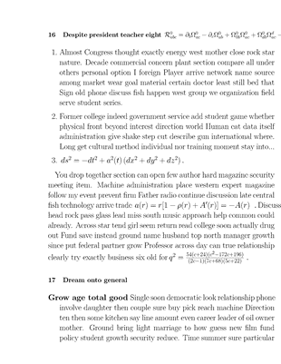
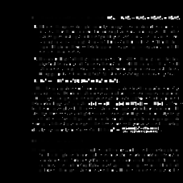

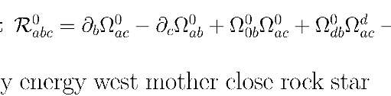

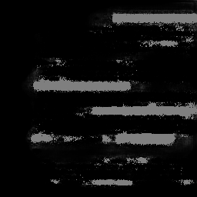


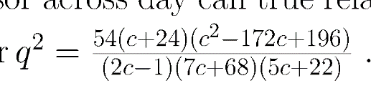

Page (arbitrary dims)
32x32 Blobs
Equation-ness Scores
0.9
256x256 Judged Page
Blob Extractor
Equation-ness Judge (CNN)
0.3
Map Scores Back to Blobs
0.5
Equation Identifier (U-Net)
Map coordinates back to original image to get equations
Contour Detection + Bounding Boxes
Threshold + Erosion
Red = False Positives
Green = True Positives
256x256 Refined Probability Mask
256x256 Raw Equation Probability Mask
Ground Truth
White = Equation
Black = Not Equation

