Slide 1
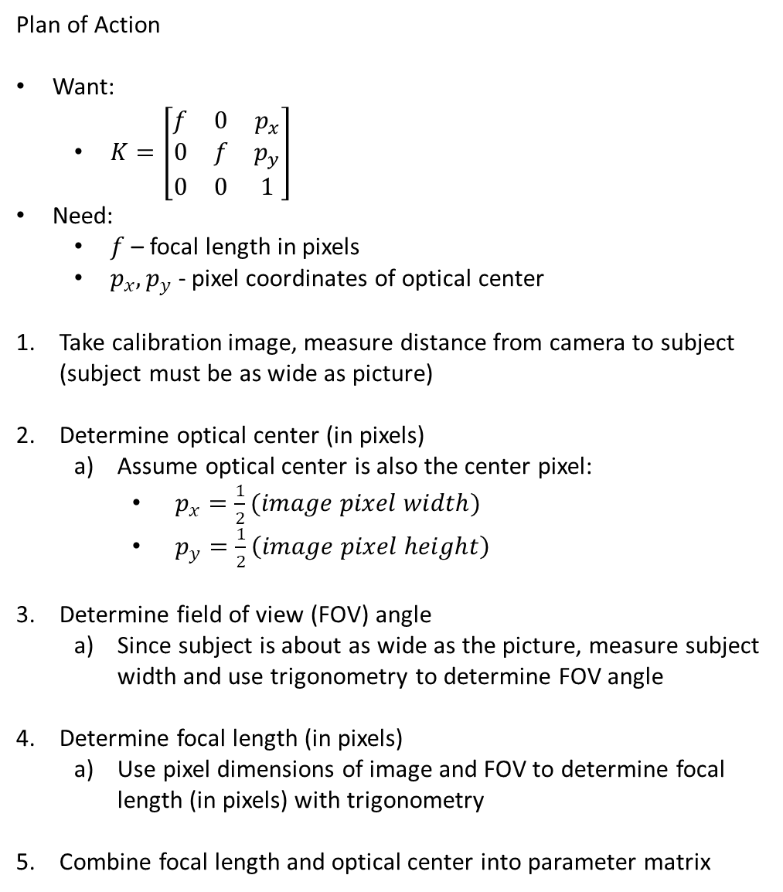
Question 3 : Determining Camera Parameter Matrix (Pixel 2XL)
Plan of Action
Want:
$K=\left[\begin{matrix}f & 0 & p_{x} \\ 0 & f & p_{y} \\ 0 & 0 & 1\end{matrix}\right]$
Need:
$f$ – focal length in pixels
$p_{x}, p_{y}$ - pixel coordinates of optical center
Take calibration image, measure distance from camera to subject (subject must be as wide as picture)
Determine optical center (in pixels)
Assume optical center is also the center pixel:
$p_{x}=\frac{1}{2}(image pixel width)$
$p_{y}=\frac{1}{2}\left(image pixel height\right)$
Determine field of view (FOV) angle
Since subject is about as wide as the picture, measure subject width and use trigonometry to determine FOV angle
Determine focal length (in pixels)
Use pixel dimensions of image and FOV to determine focal length (in pixels) with trigonometry
Combine focal length and optical center into parameter matrix

Slide 2
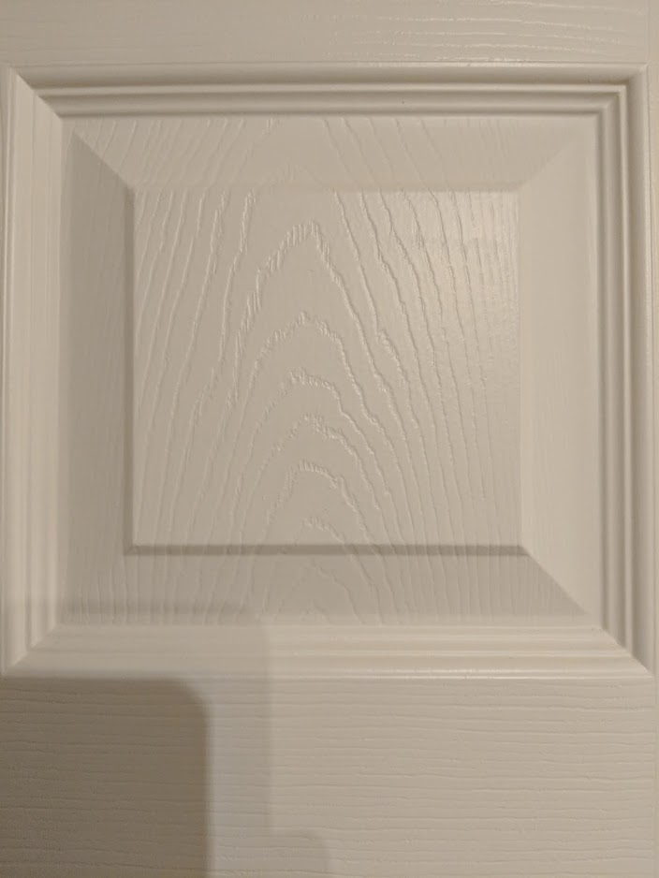
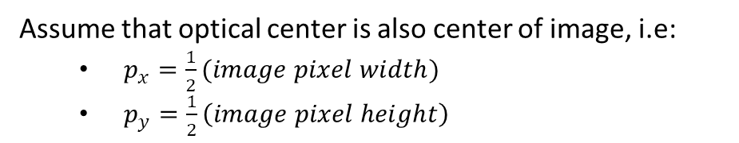
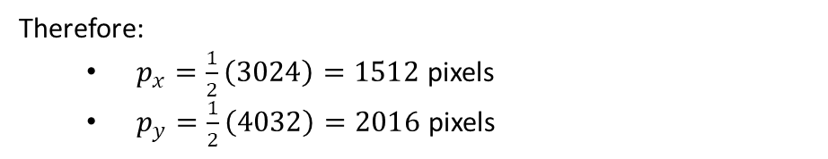
Calibration Image & Optical Center
Dimensions
Height: 4032px
Width: 3024px
Camera Distance: 23.5cm
22.5cm
Assume that optical center is also center of image, i.e:
$p_{x}=\frac{1}{2}(image pixel width)$
$p_{y}=\frac{1}{2}\left(image pixel height\right)$
Therefore:
$p_{x}=\frac{1}{2}\left(3024\right)=1512$ pixels
$p_{y}=\frac{1}{2}\left(4032\right)=2016$ pixels

Slide 3
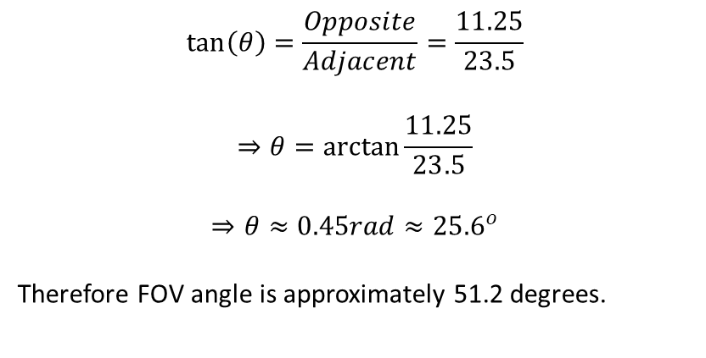

Determining FOV
Diagram of Calibration Image Setup
Camera
22.5cm
23.5cm
Reduction to Right Angle Triangle
11.25cm
23.5cm
$$θ$$
Solving for FOV using trigonometry
$$\tan\left(θ\right)=\frac{Opposite}{Adjacent}=\frac{11.25}{23.5}$$
$$⇒θ=\arctan{\frac{11.25}{23.5}}$$
$$⇒θ≈0.45rad≈{25.6}^{o}$$
Therefore FOV angle is approximately 51.2 degrees.

Slide 4





Determining Focal Length
Diagram of Camera Internals
FOV must also be the same inside the camera on the other side of the lens. However, the cone of light is as wide as the sensor.
3024px
$${51.2}^{o}$$
$$f$$
Reduction to Right Angle Triangle
1512px
$${25.6}^{0}$$
$$f$$
Solving for $f$ using trigonometry
$$\tan\left({25.6}^{o}\right)=\frac{1512}{f}$$
$$⇒f=\frac{1512}{tan⁡({25.6}^{o})}$$
$$⇒f≈3155.8px$$

Slide 5
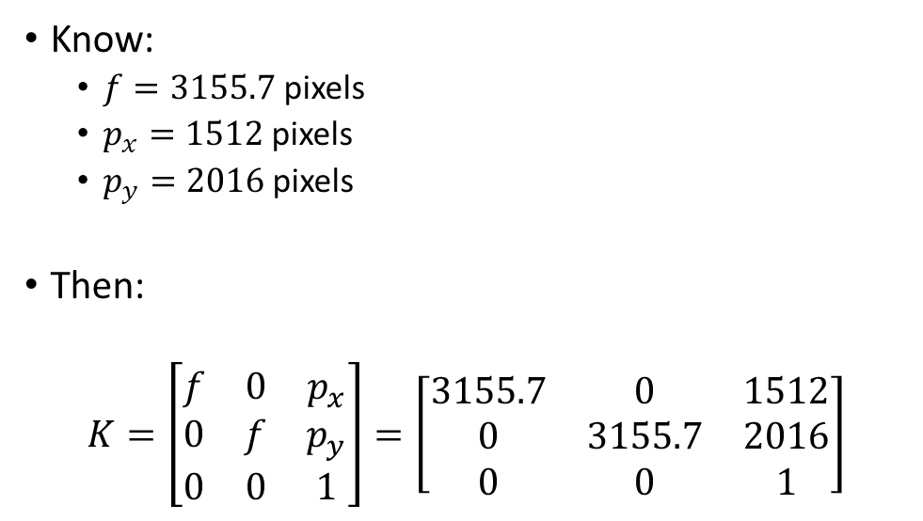

Combining Results into $K$
Know:
$f=3155.7$ pixels
$p_{x}=1512$ pixels
$p_{y}=2016$ pixels
Then:
$$K=\left[\begin{matrix}f & 0 & p_{x} \\ 0 & f & p_{y} \\ 0 & 0 & 1\end{matrix}\right]=\left[\begin{matrix}3155.7 & 0 & 1512 \\ 0 & 3155.7 & 2016 \\ 0 & 0 & 1\end{matrix}\right]$$

