Slide 1


Evaluation of Teamwork Quality and Individual Opportunity for Success in the Reality TV Show Survivor
School of Modeling, Simulation, and Training
University of Central Florida
The Survivors:
MICHAEL ALLEN
BRADLEY KRIZNAR
JESSICA WILLIAMS

Slide 3

Purpose Statement
Background
Context
Related Work
Research Methods
Hypothesis
Demonstration

Slide 4
This study will examine the relationship between attributes of whole-team teamwork quality and an individual’s likelihood to advance to the final stage of the winner-take-all reality TV show Survivor.
C1: Insight into potential individual placement within team structures in order to maximize individual opportunity for success
C2: Insight into which facets of collaborative effort to optimize in order to maximize team member/subgroup opportunity for success

Slide 5

Definitions
Teamwork Quality (TWQ) – A measure of collaboration as measured by the facets of communication, coordination, balance of member contributions, mutual support, effort, and cohesion [3]
Team Performance - the extent to which a team meets established objectives [3]
Opportunity for Success – Placing in the final 4
Individual Success – Winning*
*Note: this is significantly different than much of the current team performance literature

Slide 6
Teamwork occupies a huge space within the realm of human factors.
There is a large body of research dedicated to high-functioning teams - championship sports teams, $Billion companies, and elite military organizations.
‘Regular’ team environments can be much more diffusely organized and varied, with team members that are not specifically ‘trained’ to be entirely collaborative / invested in team success.
In the modern work force, project teams are often Ad hoc from individuals representing a variety of professional backgrounds and organizational interests.
In many ‘competitions’ (projects), there are project-adjacent singular rewards available to a single individual or subsection of the team (i.e. promotion, follow-on job opportunity, consideration for next grant…).

Slide 7

What is Survivor and how does it work?
Survivor is a game show where individuals compete with the goal of winning $1 million.
The first half of a Survivor season contains two to four teams that contestants are separated into.
Generally, each competition ‘round’ reduces the number of competitors by one – losing teams or the final group all vote one competitor off by simple majority.
Teams compete to advance to the next round without having to eliminate one of their own team members (immunity) and rewards.

Slide 8
The second half of Survivor consolidates all teams into one group, but temporary teams are ad-hoc formed or selected for competitions.
Only one competitor wins the final ‘round’, determined by previously voted off competitors in the second half of the game.
Teams that win immunity competitions can preserve a majority of allied competitor votes, which increase the size of a voting block.
Team reward competitions generally include food, valuable equipment, and tools needed to hunt / fish.
Team challenges often require coordination of individuals that combines physicality, skill, and/or mental skill.

Slide 9
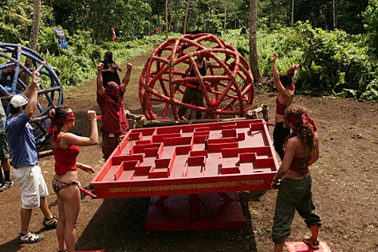
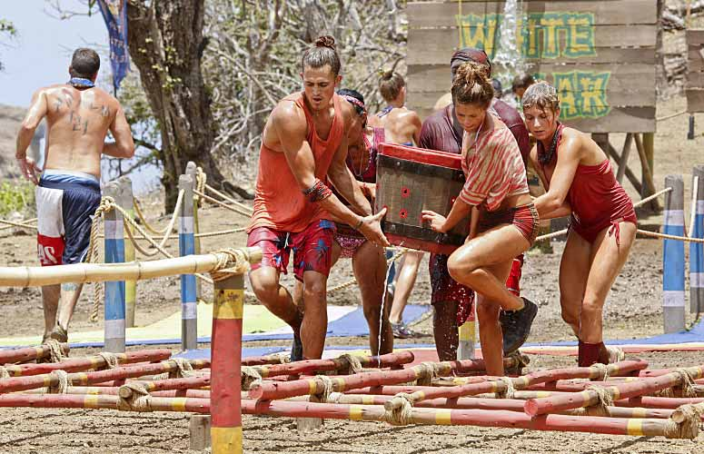
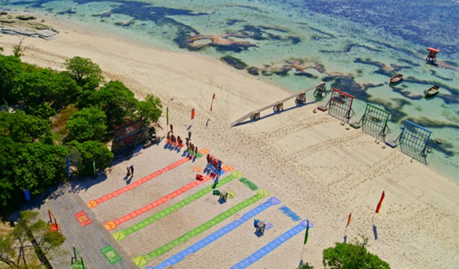

Clockwise from top left: ‘Roll With It!’, S20E04; ‘Crazy Is as Crazy Does’, S30E03; ‘We Got A Rat’, S31E03; ‘Quick On the Draw’, S40E06, [retrieved from CBS]

Slide 10
Competition
Competition
Competition
Merge
Team 1
Team 1
Team 1
Team 1
VS.
VS.
VS.
Merged Tribe
Team 2
Team 3
Team 2
Team 2
VS.
VS.
VS.
Team 3
Team 2
Team 3
Team 3
Player
voted off
Player
voted off
Player
voted off

Slide 11
Competition
Competition
Player 1
Player 2
Player 3
Player 4
Reward
Player 1
Player 2
Player 3
Player 4
Player 5
Player 6
Player 7
Player 8
Player 9
Player 10
Player 11
Player 12
Merged Tribe
Merged Tribe
Post Vote Tribe
Player 5
Player 6
Player 7
Player 8
Immunity
Player 9
Player 10
Player 11
Player 12
Player
voted off

Slide 12
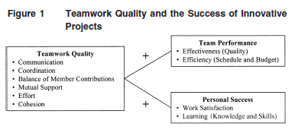
Organizational and Leadership literature has dedicated decades to evaluating the effect of individual performance on overall teamwork quality, but very little study has been done to determine what effect the quality of teamwork has on overall individual success. [2]
Much study has been given to determining if teams that display greater teamwork quality produce more positive results.
[3]

Slide 13
Past work
Several studies including a seminal work by Landers and Luschen inform the broader community that team cohesion is a critical variable for competitive co-actor success. [4]
Recent study has been conducted into individual satisfaction as it relates to teamwork, however, these studies focus on individual’s contributions to the team and perceived valuation of that effort within the team. [5]
The global sports community has also evaluated individual performance and team success, but these studies focus on individual performance within the broader team and measure individual contributions against overall team success. [1]

Slide 14
Current State
The body of work currently centers around well trained and integrated teams or those that already have established norms
The preponderance of the literature expresses that teams collaborate better produce better team results.
The bulk of this literature does not address individual opportunity for success or individual outcomes.

Slide 15
Questions to answer
What facet(s) of team collaboration are the best indicators of producing opportunity for success?
What relationship exists between the season top 4 placers and their team’s overall TWQ in early gameplay?
To what degree does overall TWQ indicate opportunity for individual success?

Slide 16
Why Survivor
Broad sample of American population
Ad hoc teams
Unfamiliar challenges of both a physical and cognitive nature
Inherent challenge of environment serves catalytic function for TWQ measures
Unique team play construct within larger individual competition

Slide 17
Approach
Martin Hoegl and Hans Georg Gemuenden presented the Teamwork Quality (TWQ) framework to quantitatively measure teamwork on several measures such as collaboration, cohesion, and effort [3].
The TWQ measurement tool evaluates six facets of team collaboration using a Likert scale for scoring.
This tool is commonly used in many industries to quantify “quality of teamwork.” [2]
In their seminal work, this tool was used to measure TWQ against team success but is not strictly limited to that dependent variable.

Slide 18
Measures and Sample:
Sample population: Four episodes of survivor containing two teams were scored using the TWQ. Additional "dummy" datasets were created in order to support an initial, example analysis of data.
Raters (in this pilot test, the researchers will act as raters) will watch pre-recorded episodes of Survivor and evaluate team's performance on challenges via a Qualtrics survey that contains the TWQ measures in accordance with the Hoegl and Gemuenden method.
Teams will be observed in challenges for the entirety of the season pre-merge (this might result in as few as 3 observations or as many as 7). Pilot test preliminary datasets will contain 16 sets of fabricated data, created using Microsoft Excel's [=randombetween(__:__)] function.

Slide 19
Protocol:
Raters will begin by viewing the randomly (by naivety) selected Survivor episodes to observe the static teams in several trials (episodes, challenges, etc.).
After each trial (episode), using a web-browser to access the Qualtrics survey, the rater scores each team's performance for that challenge via the TWQ measure.
In order to obtain more datapoints for the identified teams, the rater will then watch additional episodes, containing the same teams, to score their performance in another challenge.

Slide 20
Assessing the data
TWQ will be assessed based on overall TWQ scores. This score is found by first totaling episode's facet scores, then totaling all episode scores across the season.
Likelihood to produce a contestant in the top 4 will be assigned a value and weighted as a proportion (n/4).
Teams will then be evaluated in terms of the variables of their TWQ scores, facet scores, and likelihood to produce a top 4 contestant.
Data will be plotted on single variable and multivariable scatterplots to determine correlation, with weighting criteria applied based on ratio of individuals in the final four (total for the whole data set) and season winner percentage (total for whole dataset)

Slide 21
Possible analyses:
Teams will then be combined into categories based on TWQ and likelihood to produce a top 4 contestant.
Data will be plotted on single variable and multivariable scatterplots to determine correlation, with weighting criteria applied based on ratio of individuals in the final four (total for the whole data set) and season winner percentage (total for whole dataset).
Likelihood to produce a contestant in the top 4 will be assigned a value and weighted as a proportion (n/4).
Teams will then be evaluated in terms of the variables of their TWQ scores, facet scores, and likelihood to produce a top 4 contestant.
An independent T-test and a correlational matrix will be conducted to further evaluate the data.
Groups will be coded by whether a top 4 contestant is present (between-subjects)
These statistical tests will utilize aggregated scores across facets such that the team's average scores across the scores of all questions contained in each category.

Slide 22

H1: Teams that score higher in overall TWQ will produce more contestants in the final 4.
H2: Teams with high TWQ are more likely to produce season winners.
H3: Some facets of TWQ will be more significant indicators of opportunity for success than others

Slide 23
Recording Tool

Slide 24
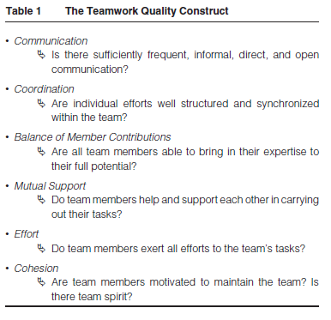
Six Facets of TWQ

Slide 25
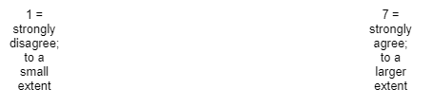
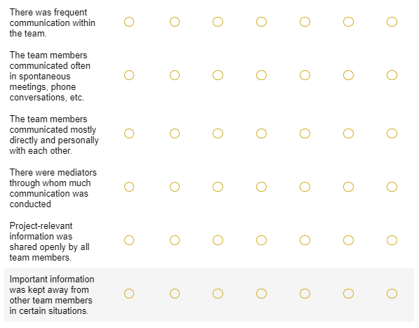
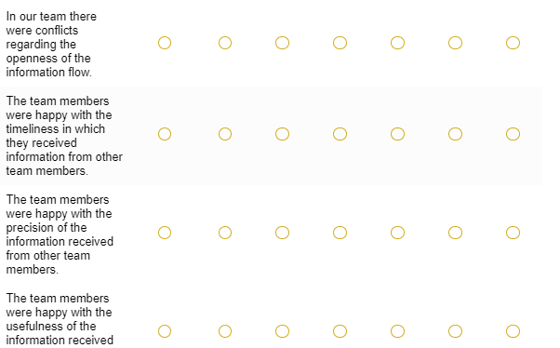
Communication

Slide 26
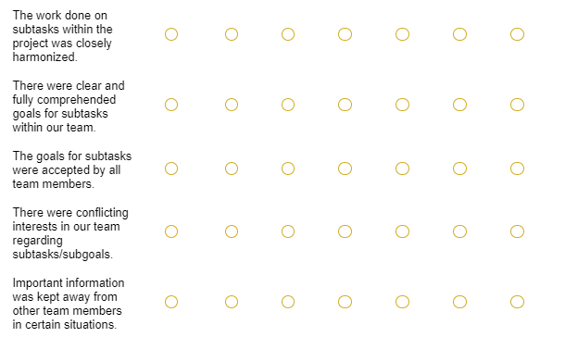
Coordination

Slide 27
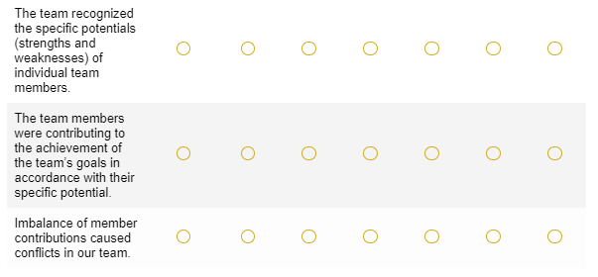
Balance of Member Contribution

Slide 28
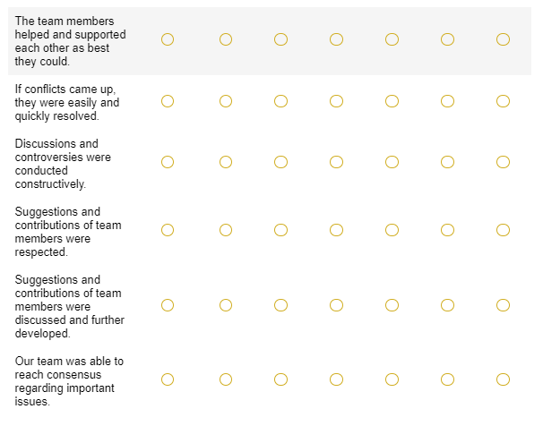
Mutual Support

Slide 29
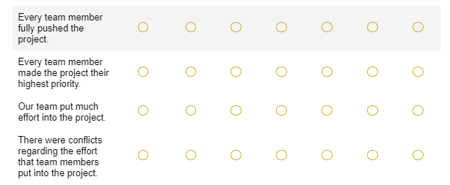
Effort

Slide 30
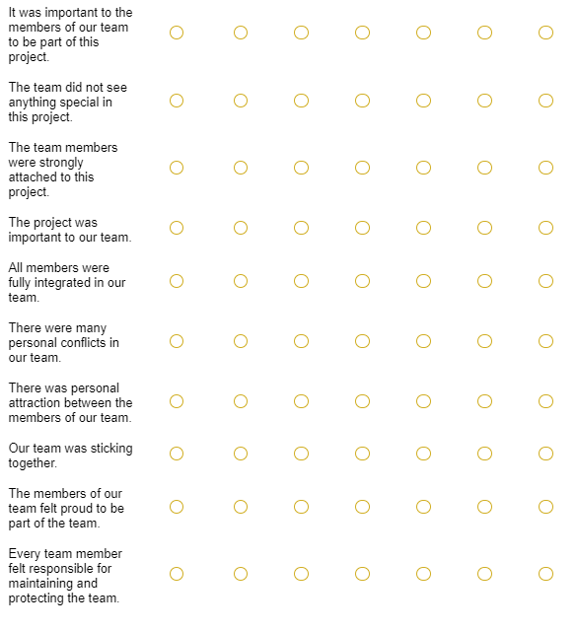
Cohesion

Slide 31
Assessment Methods

Slide 32
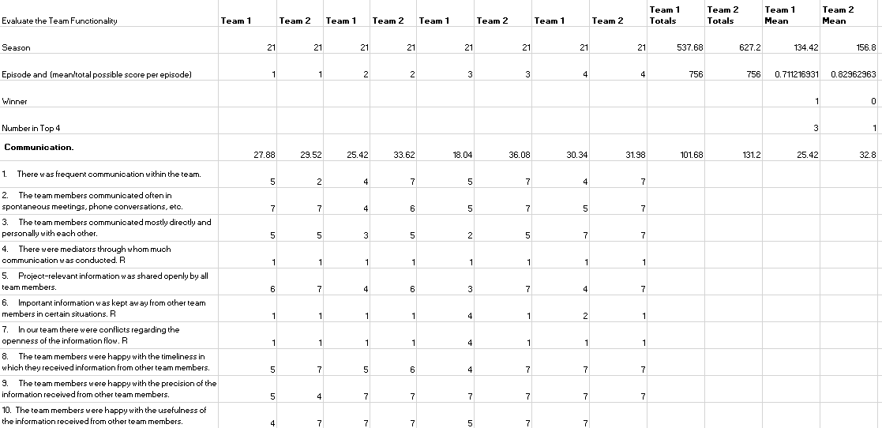
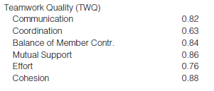
Denotes Reverse scoring
Weighted based on nature of questions and total points available for that section

Slide 33
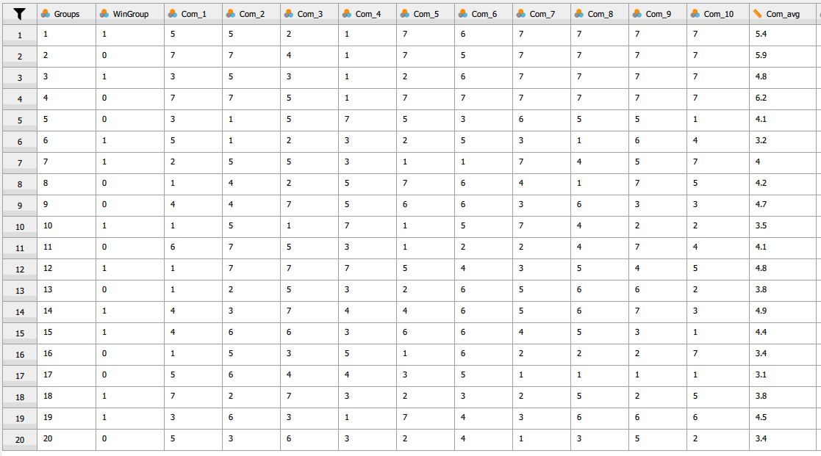
The TWQ measure likert data was cleaned, appropriate reverse coding was applied, and "dummy" data was created. Additionally, a "Winners Group" category was coded based on the presence of the winner of the season in that team. Once the data was cleaned, the averages of each section of the TWQ (e.g. Communication, Coordination, Balance of Member Contributions, Mutual Support, Effort, Cohesion) were taken and subsequently correlated with each other and the WinGroup (between-subjects variable).

Slide 34
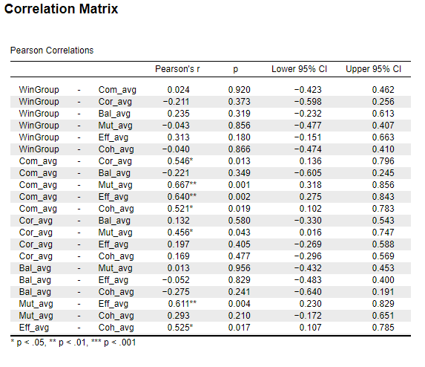
The table to the right depicts the resulting Pearson correlation.
Several highly significant correlations:
Communication is significantly correlated with Mutual Support (p = .001)
Communication is significantly correlated with Effort (p = .002)
Mutual Support is significantly correlated with Effort (p = .004)
Supports H3: Some facets of TWQ will be more significant indicators of opportunity for success than others

Slide 35
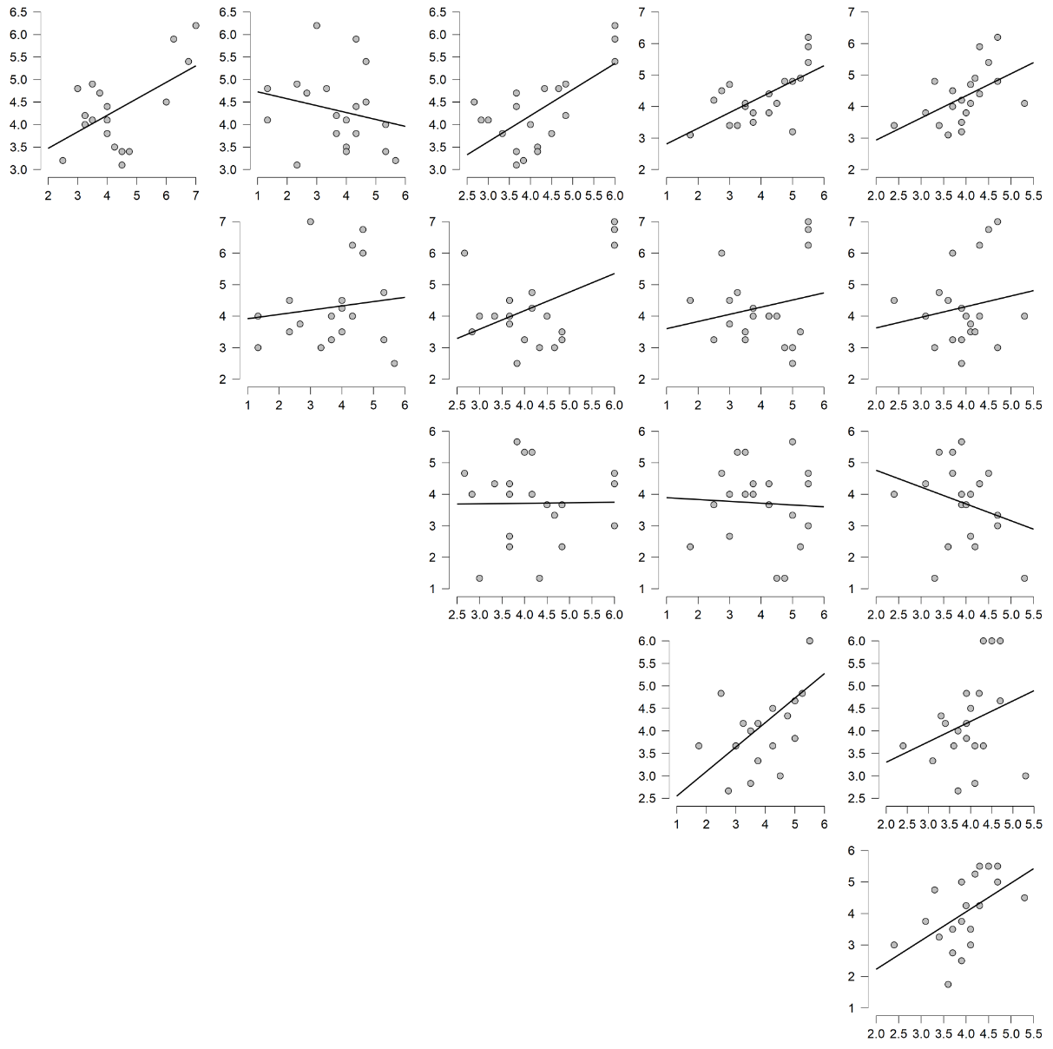
The graphs to the right depicts the resulting Pearson correlation.
Several highly significant correlations:
Communication is significantly correlated with Mutual Support (p = .001)
Communication is significantly correlated with Effort (p = .002)
Mutual Support is significantly correlated with Effort (p = .004)
Supports H3: Some facets of TWQ will be more significant indicators of opportunity for success than others

Slide 36


Slide 37

[1] -
Cust, E., Sweeting, A., Ball, K., Anderson, H., & Robertson, S. (2019). The relationship of team and individual athlete performances on match quarter outcome in elite women’s Australian Rules football. Journal of Science and Medicine in Sport, 22(10), 1157–1162.
[2] -
Goodwin, G., Blacksmith, N., & Coats, M. (2018). The science of teams in the military: Contributions from over 60 years of research. American Psychologist, 4(73), 322–333.
Hoegl, M., & Gemuenden, H. (n.d.). Teamwork Quality and the Success of Innovative Projects: A Theoretical Concept and Empirical Evidence. Organization Science, 12(4).
[3] -
[4] -
Landers, D., & Luschen, G. (1974). Team Performance Outcome and the Cohesiveness of Competitive Coating Groups. International Review of Sport Sociology, 9(2), 57–71.
[5] -
Mcewan, D. (2019). The Effects of Perceived Teamwork on Emergent States and Satisfaction With Performance Among Team Sport Athletes. Sport, Exercise, and Performance Psychology.

