Slide 1
Biologically motivated Computational models of the brain
Lisa Yang

Slide 2
Modeling natural processes
“algorithmic process”: any step-by-step procedure for solving a problem or accomplishing some end
Beyond those for solving mathematical problems, traditionally studied in CS
Church-Turing thesis: proposes the result of any physical process can be computed by a Turing machine
May be able to model physical process via a computational model, i.e. describe the physical/natural evolution from input to output
Processes in physics, evolution, human brain

Slide 3
Computational models of the brain
Cognitive process (mechanism) ~ neural activity
Model as a computation on information encoded by neurons
CS model: ``programming language’’ that describe cognitive processes?
How is information encoded via neurons (data type)?
How is computation performed on encoded information (systems level operations)?
How are these operations implemented via neurons?

Slide 4
Computational models of the brain
For abstract/mathematical computations, there exist nice universal languages (e.g. lambda calculus)
For natural computations, probably not…
Propose: Formulate a ”base language” based on neuroscience data.
Focus on a particular mechanism, and specialize building on the base language
Reasonable for cortex which large yet evolved recently suggesting there’s relatively simple set of rules underlying most of its activities
Apply to abstract concept representations
Mechanisms: structured concepts, relations, language, visual processing

Slide 5
A. Biologically motivated base model for cortex
Neural network model: Partitioning cortex into several brain areas, each modeled as a random graph of neurons. Connections between areas depend on anatomy.
Biology: cortex anatomically pretty uniform and areas can take on functions naturally performed by other areas
Data representation: neural assemblies, strongly intraconnected groups of neurons within a brain area, represent abstract concepts (The Assembly Hypothesis)
When accessing an abstract concept e.g. via perception or internal thought, the neurons in the assembly simultaneously fire

Slide 6
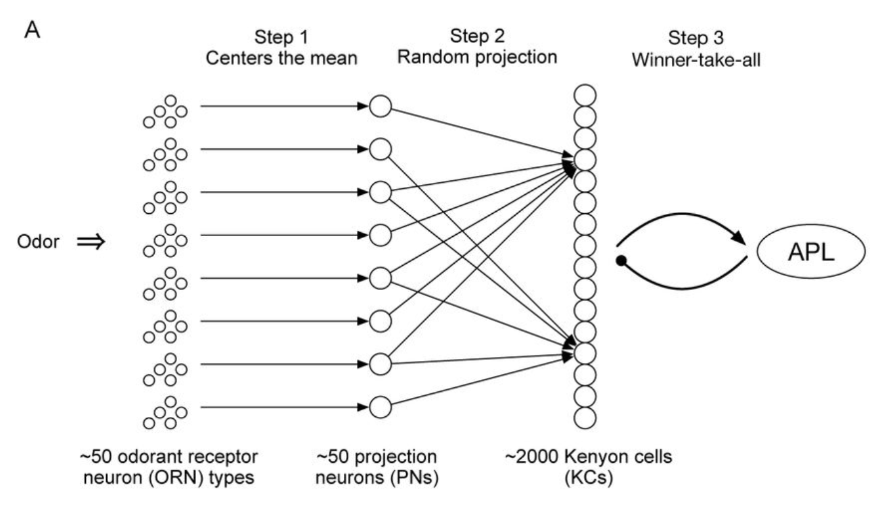
A. Biologically motivated base model for cortex: what are the base operations?
Formation of assembly

Slide 7
A. Biologically motivated base model for cortex: what are the base operations?
Projection: used to form first-order assemblies and to create copies of existing assemblies
Repeating the following: k neurons fire (e.g. due to external stimuli), potentials integrated by neurons in downstream area. WTA mechanism selects k most active neurons.
[PV19] shows this leads to creation of assembly in downstream area
Preserve similarity i.e. applying projection to representations with overlap results in projected assemblies with some overlap

Slide 8
A. Biologically motivated base model for cortex: what are the base operations?
Identified neurons in MTL responsive to stimuli
Presented stimuli simultaneously
Found neurons learned associations

Slide 9
A. Biologically motivated base model for cortex: what are the base operations?
Association: neurons in assemblies x and y that co-fire (e.g. following the simultaneous presentation of the two stimuli which they represent) will become responsive to each other’s stimuli
[LMPV18] show repeated co-firings lead to x and y responding to each other’s stimuli (several percent of neurons)
True association? if x is presented/fires, then y fires, and vice versa.

Slide 10
A. Biologically motivated base model for cortex: what are the base operations?
Ideally: biological evidence motivates a clear set of operations
Reality: work backwards and propose reasonable operations, based on functional observations
Guide the gathering of neuroscience data
Relaxation to biologically plausible theory: operations may underlie the brain’s algorithm for performing tasks
Consider implementation and analyze their use

Slide 11
A. Biologically motivated base model for cortex: what are the base operations?
Conjunction?
Repeated firing of assemblies x and y create assembly z, such that if x and y fire, then z fires.
Hierarchical concepts and structures e.g. syntax trees and visual processing hierarchies
Existing neuroscience data? Develop experiments to gather data?
Other operations / variants of these 3.
Note: don’t need to develop a ”complete” set to model cognitive tasks/mechanisms

Slide 12
B. mechanisms of personal interest
Learning and recognizing structured many-part concepts: any complex concept broken down into parts organized hierarchically [LMT]
Used in language, visual processing
Learning and using relational predicates [Val]
Used in reasoning
Mainly use conjunction operation

Slide 13
Thank you ☺

