Slide 1
Memorization and Association on a Realistic Neural Model Leslie G. Valiant
Quanquan C. Liu
3/19/2020

Slide 2
Model
Goal: Obtain a single data structure that simultaneously supports memorization and association

Slide 3
Model
Goal: Obtain a single data structure that simultaneously supports memorization and association
Constraints: neuron number, synapse number, synapse strengths, switching times

Slide 4
Model
Goal: Obtain a single data structure that simultaneously supports memorization and association
Constraints: neuron number, synapse number, synapse strengths, switching times
Neuron number: number of neurons

Slide 5
Model
Goal: Obtain a single data structure that simultaneously supports memorization and association
Constraints: neuron number, synapse number, synapse strengths, switching times
Neuron number: number of neurons
Synapse number: number of neurons with which each neuron synapses

Slide 6
Model
Goal: Obtain a single data structure that simultaneously supports memorization and association
Constraints: neuron number, synapse number, synapse strengths, switching times
Neuron number: number of neurons
Synapse number: number of neurons with which each neuron synapses
Synapse strength: strength of the synapses

Slide 7
Model
Goal: Obtain a single data structure that simultaneously supports memorization and association
Constraints: neuron number, synapse number, synapse strengths, switching times
Neuron number: number of neurons
Synapse number: number of neurons with which each neuron synapses
Synapse strength: strength of the synapses
Switching times: speed of response of a neuron

Slide 8
Model
Goal: Obtain a single data structure that simultaneously supports memorization and association
Constraints: neuron number, synapse number, synapse strengths, switching times
Neuron number: number of neurons
Synapse number: number of neurons with which each neuron synapses
Synapse strength: strength of the synapses
Switching times: speed of response of a neuron
Algorithms should work when using the typical values for these parameters in mammalian cortex

Slide 9

Biological Estimates
Neuron number: $1.6 ×{10}^{7}$ in mouse cortex, ${10}^{10}$ for human cortex

Slide 10

Biological Estimates
Neuron number: $1.6 ×{10}^{7}$ in mouse cortex, ${10}^{10}$ for human cortex
Synapse number (degree): 7800 in mouse cortex, 24,000 to 80,000 in human cortex—few multi-edges, effect of multiple synapsing between pair of neurons small

Slide 11
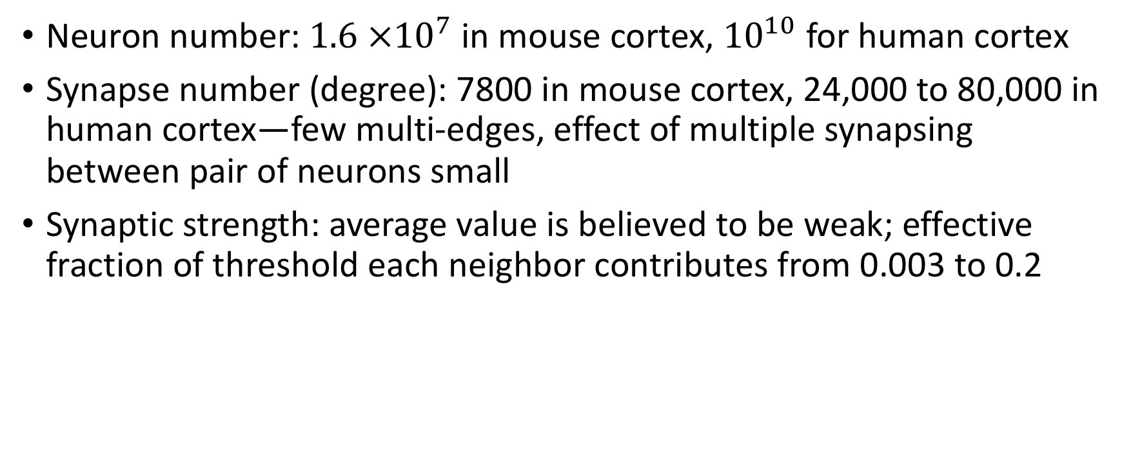
Biological Estimates
Neuron number: $1.6 ×{10}^{7}$ in mouse cortex, ${10}^{10}$ for human cortex
Synapse number (degree): 7800 in mouse cortex, 24,000 to 80,000 in human cortex—few multi-edges, effect of multiple synapsing between pair of neurons small
Synaptic strength: average value is believed to be weak; effective fraction of threshold each neighbor contributes from 0.003 to 0.2

Slide 12
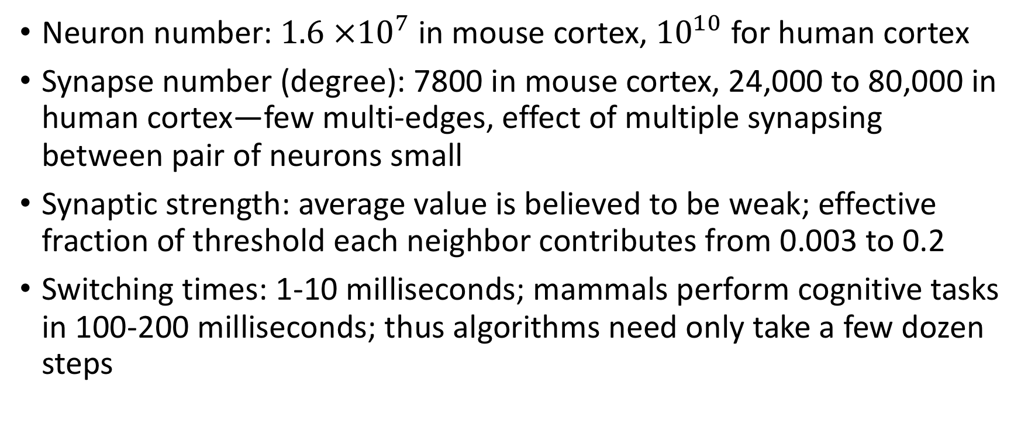
Biological Estimates
Neuron number: $1.6 ×{10}^{7}$ in mouse cortex, ${10}^{10}$ for human cortex
Synapse number (degree): 7800 in mouse cortex, 24,000 to 80,000 in human cortex—few multi-edges, effect of multiple synapsing between pair of neurons small
Synaptic strength: average value is believed to be weak; effective fraction of threshold each neighbor contributes from 0.003 to 0.2
Switching times: 1-10 milliseconds; mammals perform cognitive tasks in 100-200 milliseconds; thus algorithms need only take a few dozen steps

Slide 13
Random Graph Model of Network
Two variants

Slide 14

Random Graph Model of Network
Two variants
Variant 1:
Random graph $G$ with $n$ vertices

Slide 15
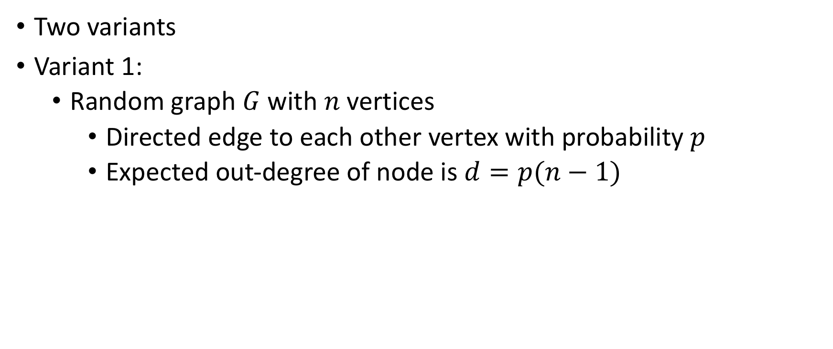
Random Graph Model of Network
Two variants
Variant 1:
Random graph $G$ with $n$ vertices
Directed edge to each other vertex with probability $p$
Expected out-degree of node is $d=p(n−1)$

Slide 16
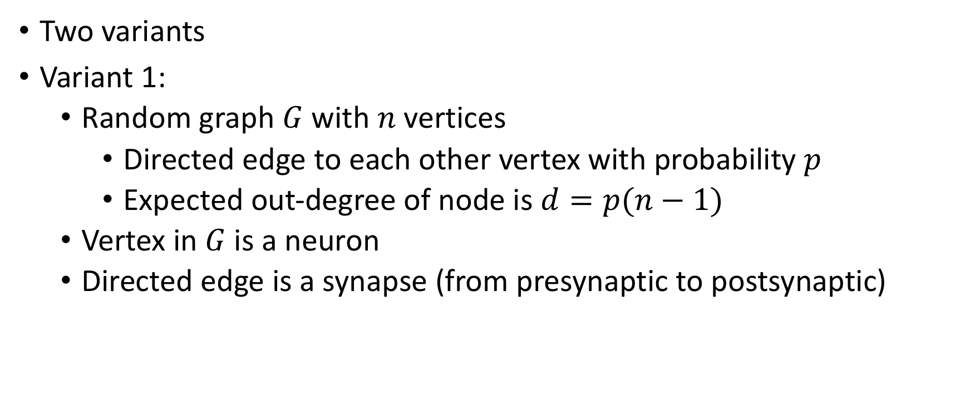
Random Graph Model of Network
Two variants
Variant 1:
Random graph $G$ with $n$ vertices
Directed edge to each other vertex with probability $p$
Expected out-degree of node is $d=p(n−1)$
Vertex in $G$ is a neuron
Directed edge is a synapse (from presynaptic to postsynaptic)

Slide 17
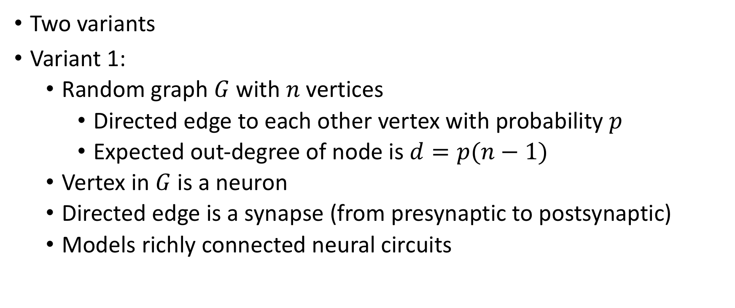
Random Graph Model of Network
Two variants
Variant 1:
Random graph $G$ with $n$ vertices
Directed edge to each other vertex with probability $p$
Expected out-degree of node is $d=p(n−1)$
Vertex in $G$ is a neuron
Directed edge is a synapse (from presynaptic to postsynaptic)
Models richly connected neural circuits

Slide 18

Random Graph Model of Network
Variant 2:
Bipartite graph with two vertex partitions $V_{1}$ and $V_{2}$

Slide 19

Random Graph Model of Network
Variant 2:
Bipartite graph with two vertex partitions $V_{1}$ and $V_{2}$
Every edge directed from vertex in $V_{1}$ to vertex in $V_{2}$
Models connections from one area of cortex to another distant, distinct area of cortex

Slide 20

Random Graph Model of Network
Assume for both variants:
Degree $d=np$

Slide 21

Random Graph Model of Network
Assume for both variants:
Degree $d=np$
Maximum synaptic strength: $\frac{1}{k}$ of threshold for some constant integer $k$

Slide 22
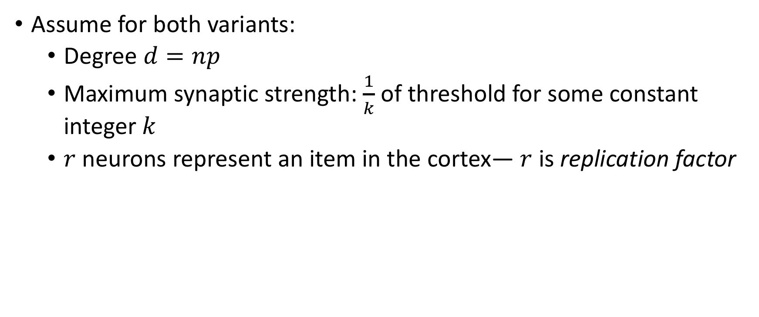
Random Graph Model of Network
Assume for both variants:
Degree $d=np$
Maximum synaptic strength: $\frac{1}{k}$ of threshold for some constant integer $k$
$r$ neurons represent an item in the cortex— $r$ is replication factor

Slide 23
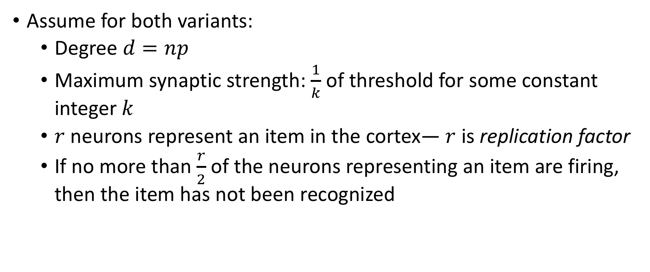
Random Graph Model of Network
Assume for both variants:
Degree $d=np$
Maximum synaptic strength: $\frac{1}{k}$ of threshold for some constant integer $k$
$r$ neurons represent an item in the cortex— $r$ is replication factor
If no more than $\frac{r}{2}$ of the neurons representing an item are firing, then the item has not been recognized

Slide 24
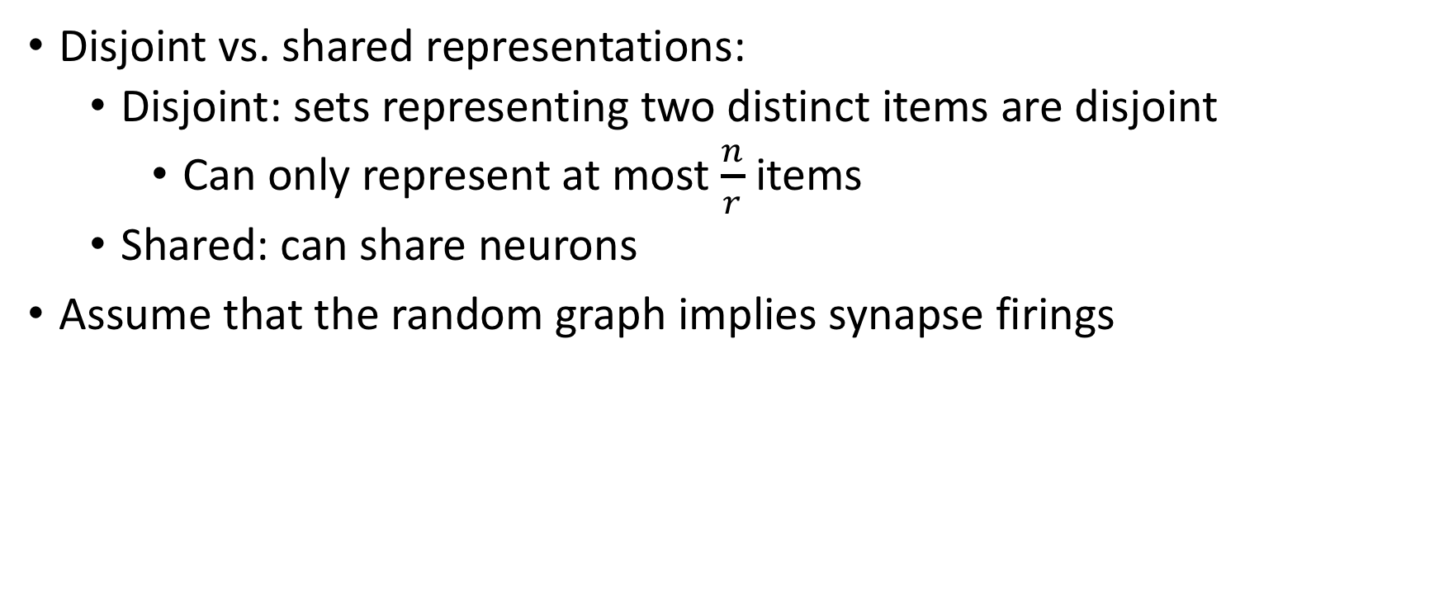
Random Graph Model of Network
Disjoint vs. shared representations:
Disjoint: sets representing two distinct items are disjoint
Can only represent at most $\frac{n}{r}$ items
Shared: can share neurons
Assume that the random graph implies synapse firings

Slide 25

Memory Formation for Disjoint Representations
JOIN(A, B): memory formation of a new item $C$ that fires iff both $A$ and $B$ are firing

Slide 26

Memory Formation for Disjoint Representations
JOIN(A, B): memory formation of a new item $C$ that fires iff both $A$ and $B$ are firing
Want to show: Given two subsets of nodes $A$ and $B$ of size $r$, the number of nodes to which there are at least $k$ edges directed from both A and B has expected value $r$.

Slide 27
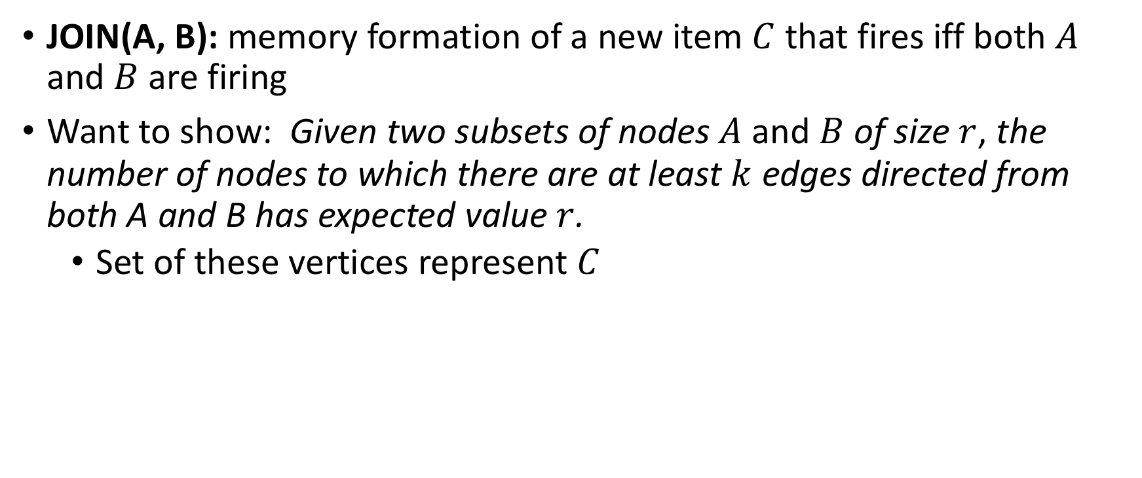
Memory Formation for Disjoint Representations
JOIN(A, B): memory formation of a new item $C$ that fires iff both $A$ and $B$ are firing
Want to show: Given two subsets of nodes $A$ and $B$ of size $r$, the number of nodes to which there are at least $k$ edges directed from both A and B has expected value $r$.
Set of these vertices represent $C$

Slide 28
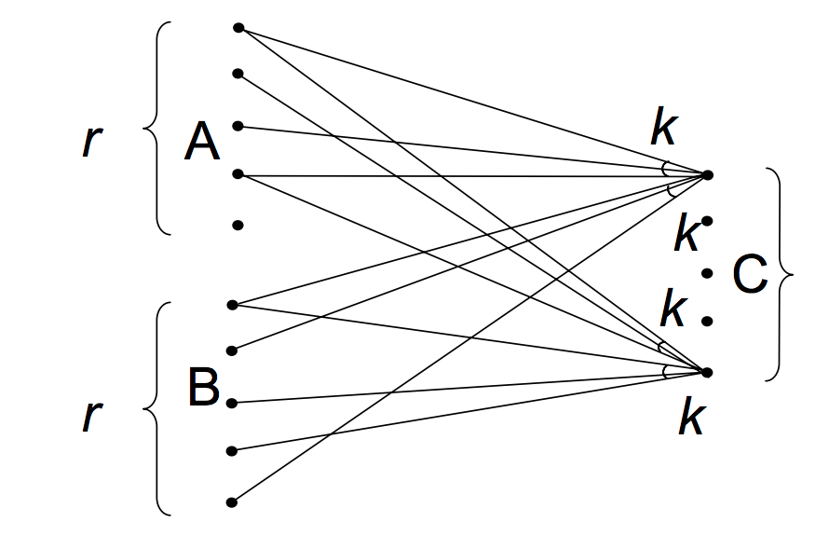
Memory Formation for Disjoint Representations
JOIN(A, B): memory formation of a new item $C$ that fires iff both $A$ and $B$ are firing
Want to show: Given two subsets of nodes $A$ and $B$ of size $r$, the number of nodes to which there are at least $k$ edges directed from both A and B has expected value $r$.
Set of these vertices represent $C$

Slide 29

JOIN in Disjoint Representations
Probability that any node has at least $k$ directed edges from $A$ and at least $k$ directed edges from $B$ is $ℬ{\left(r, p, k\right)}^{2}$
$ℬ\left(r, p, k\right)=\sum_{j=k}^{r}{\frac{r!}{j!\left(r−j\right)!}p^{j}{\left(1−p\right)}^{r−j}}$

Slide 30

JOIN in Disjoint Representations
Probability that any node has at least $k$ directed edges from $A$ and at least $k$ directed edges from $B$ is $ℬ{\left(r, p, k\right)}^{2}$
$ℬ\left(r, p, k\right)=\sum_{j=k}^{r}{\frac{r!}{j!\left(r−j\right)!}p^{j}{\left(1−p\right)}^{r−j}}$
The expected number of vertices that satisfy the above is $nℬ{\left(r, p, k\right)}^{2}$

Slide 31
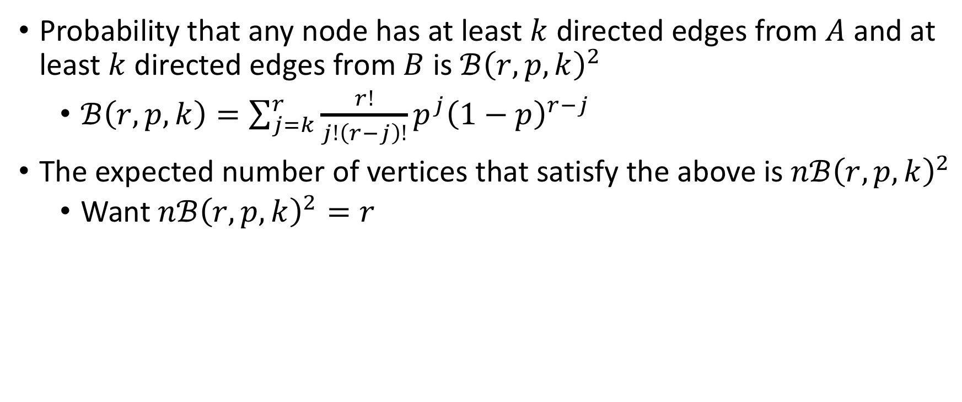
JOIN in Disjoint Representations
Probability that any node has at least $k$ directed edges from $A$ and at least $k$ directed edges from $B$ is $ℬ{\left(r, p, k\right)}^{2}$
$ℬ\left(r, p, k\right)=\sum_{j=k}^{r}{\frac{r!}{j!\left(r−j\right)!}p^{j}{\left(1−p\right)}^{r−j}}$
The expected number of vertices that satisfy the above is $nℬ{\left(r, p, k\right)}^{2}$
Want $nℬ{\left(r, p, k\right)}^{2}=r$

Slide 32
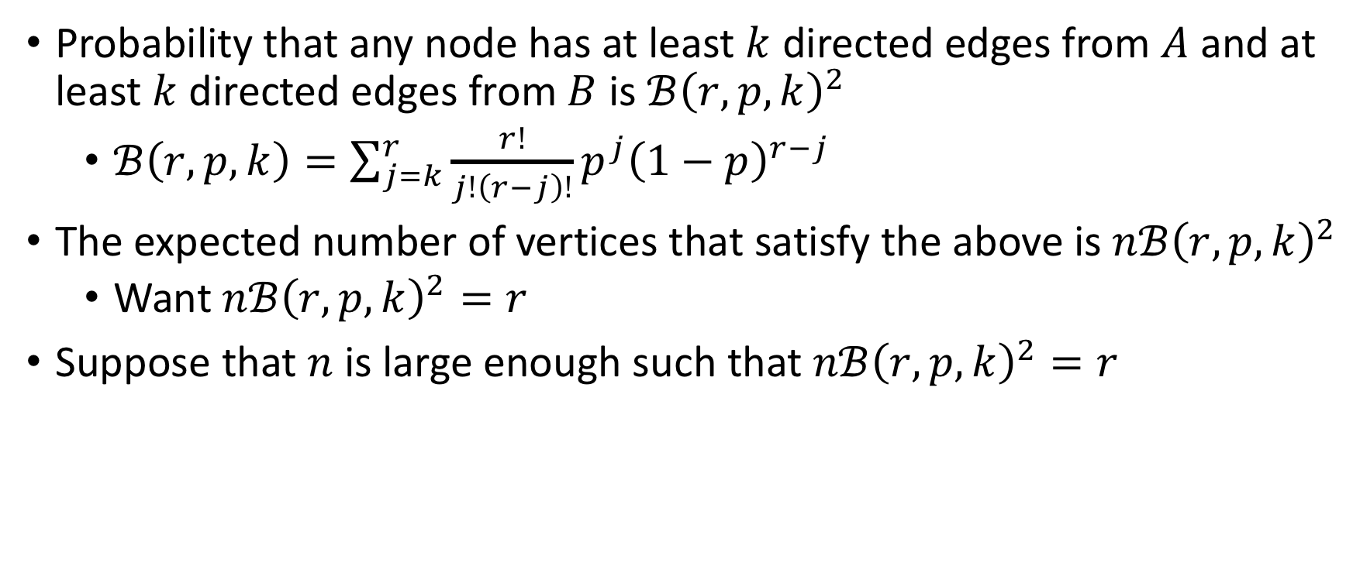
JOIN in Disjoint Representations
Probability that any node has at least $k$ directed edges from $A$ and at least $k$ directed edges from $B$ is $ℬ{\left(r, p, k\right)}^{2}$
$ℬ\left(r, p, k\right)=\sum_{j=k}^{r}{\frac{r!}{j!\left(r−j\right)!}p^{j}{\left(1−p\right)}^{r−j}}$
The expected number of vertices that satisfy the above is $nℬ{\left(r, p, k\right)}^{2}$
Want $nℬ{\left(r, p, k\right)}^{2}=r$
Suppose that $n$ is large enough such that $nℬ{\left(r, p, k\right)}^{2}=r$

Slide 33
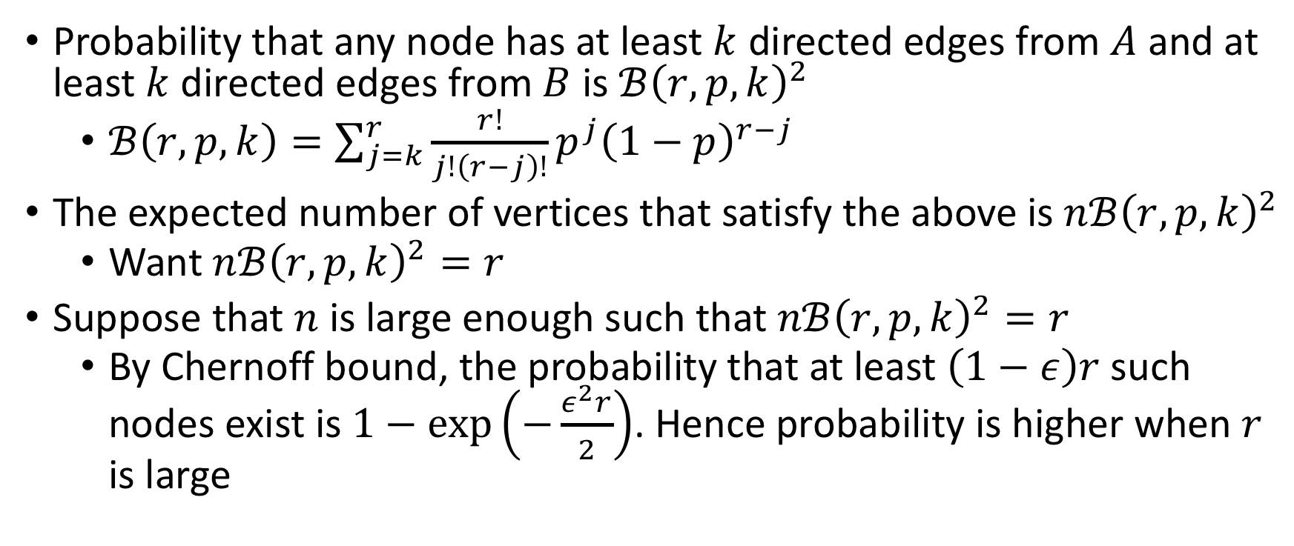
JOIN in Disjoint Representations
Probability that any node has at least $k$ directed edges from $A$ and at least $k$ directed edges from $B$ is $ℬ{\left(r, p, k\right)}^{2}$
$ℬ\left(r, p, k\right)=\sum_{j=k}^{r}{\frac{r!}{j!\left(r−j\right)!}p^{j}{\left(1−p\right)}^{r−j}}$
The expected number of vertices that satisfy the above is $nℬ{\left(r, p, k\right)}^{2}$
Want $nℬ{\left(r, p, k\right)}^{2}=r$
Suppose that $n$ is large enough such that $nℬ{\left(r, p, k\right)}^{2}=r$
By Chernoff bound, the probability that at least $\left(1−ε\right)r$ such nodes exist is $1−exp\left(−\frac{ε^{2}r}{2}\right)$. Hence probability is higher when $r$ is large

Slide 34

JOIN in Disjoint Representations
Need to ensure that if either half of $A$ or $B$ is not firing, then $C$ does not fire

Slide 35

JOIN in Disjoint Representations
Need to ensure that if either half of $A$ or $B$ is not firing, then $C$ does not fire
$C$ may not exactly be $r$ nodes. Furthermore, $C$ might contain denser connections from certain parts of $A$ or $B$

Slide 36
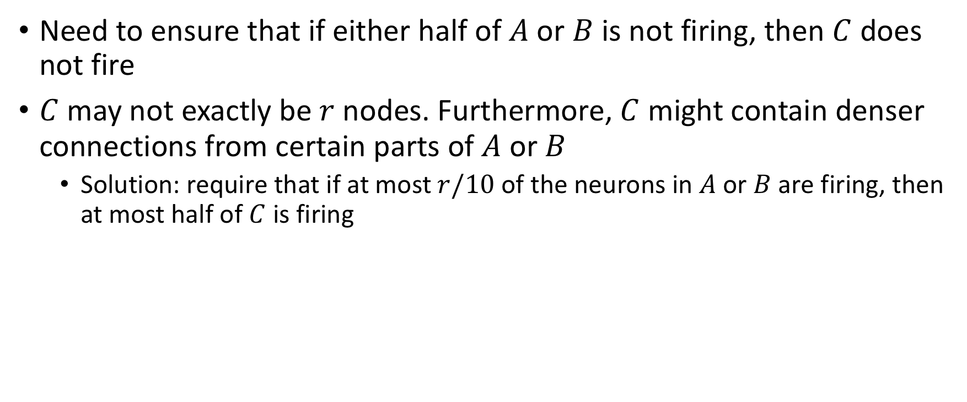
JOIN in Disjoint Representations
Need to ensure that if either half of $A$ or $B$ is not firing, then $C$ does not fire
$C$ may not exactly be $r$ nodes. Furthermore, $C$ might contain denser connections from certain parts of $A$ or $B$
Solution: require that if at most $r/10$ of the neurons in $A$ or $B$ are firing, then at most half of $C$ is firing

Slide 37
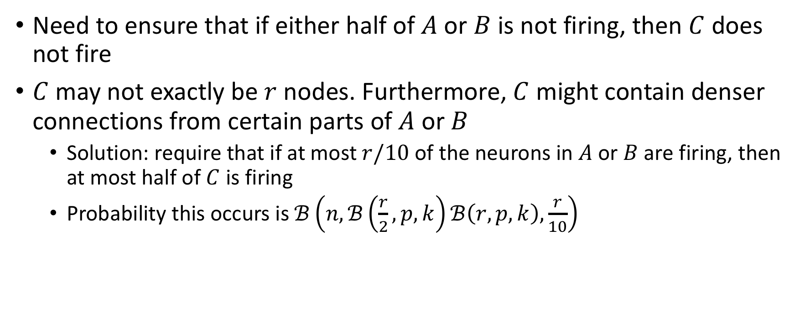
JOIN in Disjoint Representations
Need to ensure that if either half of $A$ or $B$ is not firing, then $C$ does not fire
$C$ may not exactly be $r$ nodes. Furthermore, $C$ might contain denser connections from certain parts of $A$ or $B$
Solution: require that if at most $r/10$ of the neurons in $A$ or $B$ are firing, then at most half of $C$ is firing
Probability this occurs is $ℬ\left(n, ℬ\left(\frac{r}{2},p, k\right)ℬ\left(r, p, k\right),\frac{r}{10}\right)$

Slide 38
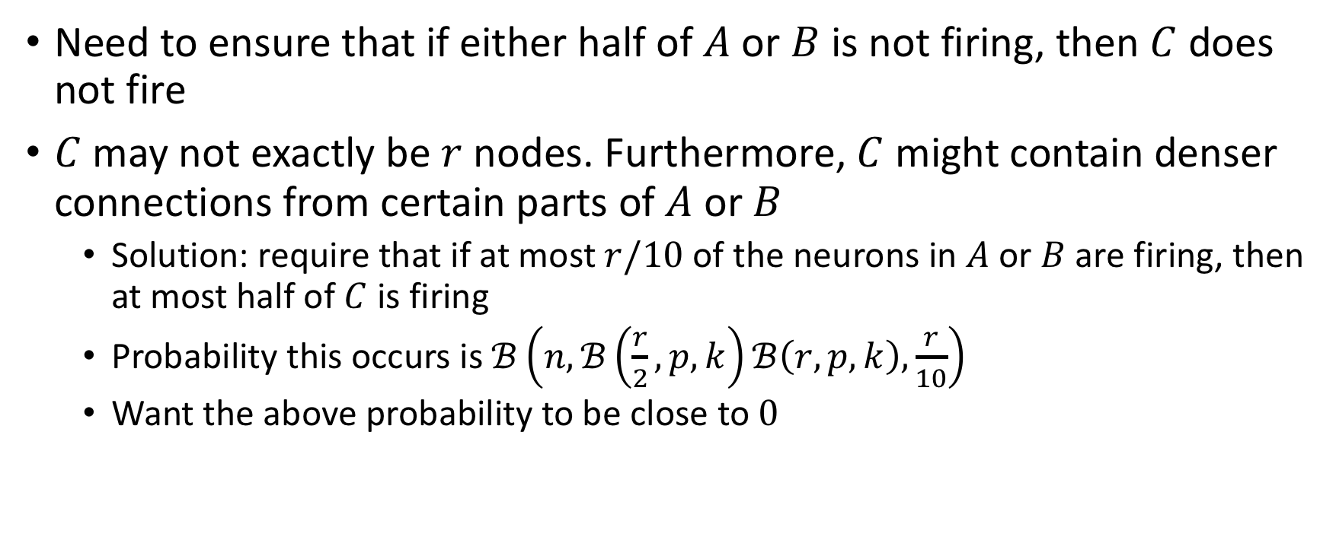
JOIN in Disjoint Representations
Need to ensure that if either half of $A$ or $B$ is not firing, then $C$ does not fire
$C$ may not exactly be $r$ nodes. Furthermore, $C$ might contain denser connections from certain parts of $A$ or $B$
Solution: require that if at most $r/10$ of the neurons in $A$ or $B$ are firing, then at most half of $C$ is firing
Probability this occurs is $ℬ\left(n, ℬ\left(\frac{r}{2},p, k\right)ℬ\left(r, p, k\right),\frac{r}{10}\right)$
Want the above probability to be close to $0$

Slide 39

Interference
Firing of $C$ depends on firings of $A$ and $B$ and not of $A$ and $D$

Slide 40

Interference
Firing of $C$ depends on firings of $A$ and $B$ and not of $A$ and $D$
Works if number of nodes in $C$ allocated to $A$ and $B$ and *not* to $A$ and $D$ is at least $2r/3$

Slide 41

Interference
Firing of $C$ depends on firings of $A$ and $B$ and not of $A$ and $D$
Works if number of nodes in $C$ allocated to $A$ and $B$ and *not* to $A$ and $D$ is at least $2r/3$
If $C$ has size at most $4r/3$, then firing of $A$ and $D$ will not cause $C$ to fire

Slide 42
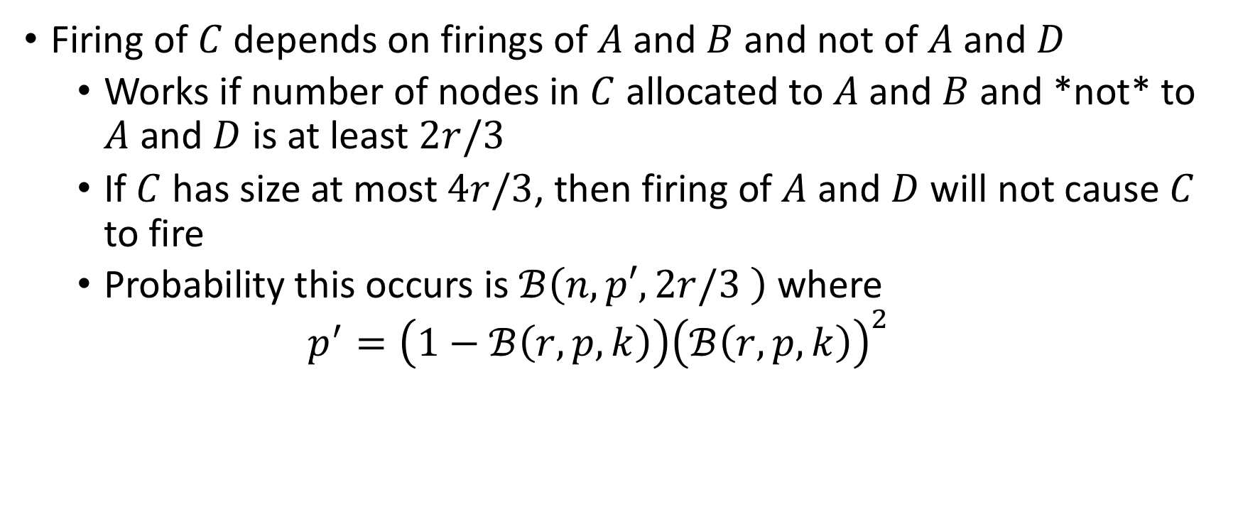
Interference
Firing of $C$ depends on firings of $A$ and $B$ and not of $A$ and $D$
Works if number of nodes in $C$ allocated to $A$ and $B$ and *not* to $A$ and $D$ is at least $2r/3$
If $C$ has size at most $4r/3$, then firing of $A$ and $D$ will not cause $C$ to fire
Probability this occurs is $ℬ\left(n, p′,2r/3 \right)$ where
$$p^{′}=\left(1−ℬ\left(r, p, k\right)\right){\left(ℬ\left(r, p, k\right)\right)}^{2}$$

Slide 43
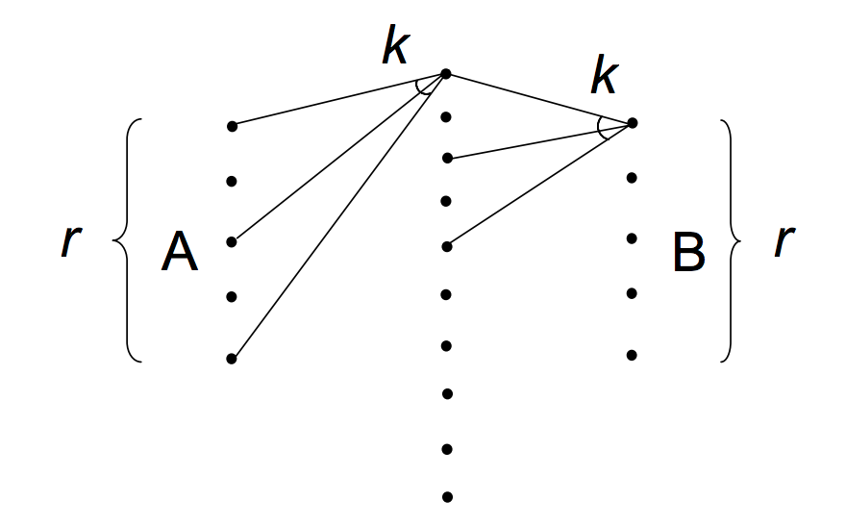

Association for Disjoint Representations
LINK(A, B): whenever $A$ fires, $B$ also fires
Want to show: Given two sets $A$ and $B$ of $r$ nodes, for each $B$ vertex $u$with high probability, the following occurs: the number of (relay) vertices from which there is a directed edge to $u$ and to which there are at least $k$ edges directed from $A$ nodes is at least $k$.

Slide 44

LINK in Disjoint Representations
Probability that a vertex has $k$connections from $A$ and also a connection to $u$ is $pℬ\left(r, p, k\right)$.
Want the number of such relay nodes to be at least $k$

Slide 45

LINK in Disjoint Representations
Probability that a vertex has $k$connections from $A$ and also a connection to $u$ is $pℬ\left(r, p, k\right)$.
Want the number of such relay nodes to be at least $k$
Want $ℬ\left(n, pℬ\left(r, p, k\right), k\right)$ to be large

Slide 46

LINK in Disjoint Representations
Want: at most half of $A$ fire, then with high probability, fewer than half of $B$ fire

Slide 47

LINK in Disjoint Representations
Want: at most half of $A$ fire, then with high probability, fewer than half of $B$ fire
Assume independence of $u$
Want $ℬ\left(r, ℬ\left(n, pℬ\left(\frac{r}{2}, p, k\right), k\right),\frac{r}{2}\right)$ to be small

