Slide 1
The Hippocampus as a Stable Memory Allocator for Cortex
By Leslie G. Valiant
Presented by Jiajia Zhao

Slide 2
Memory Allocation by Hippocampus
Cortex: information storage
Hippocampus: organizer
Chunking: making new items (i.e. concepts) out of a conjunction of existing but separate items
Indexing that facilitates information storage
This paper: Hippocampus identifies the set of neurons representing a new item, and enables them.
First requirement is stability: The # of neurons allocated to a new item (chunk) is controlled within a range
Stable Memory Allocator, or SMA

Slide 3
Requirements of SMA
Stability
Continuity (tolerating faulty neurons)
Orthogonality (neuron sets representing different items should be substantially different)
With the bio-plausible constrains on…
Neuron numbers
Synapse numbers
Synaptic strengths
Activity level / density representation
Ratio of inhibition to excitation

Slide 4
Chunking in Neuroidal Model
An item is represented by a set S of neurons.
S is being accessed if more than a fraction y of the neurons are firing
S is NOT being accessed if less than a fraction x of the neurons are firing
One paper estimated x = 30% and y = 88%
The system is configured such that the fraction firing in the intermediate range is extremely rare

Slide 5
What’s the problem
JOIN(A,B): memory formation of a new item C that fires iff both A and B are firing
May allocate unstable amount of neurons at a memory structure of higher depth
Solution: limit the depth needed for memory allocation, since it’s the only one with stability problems.
Stability: circuits that generate a fixed output spiking pattern of stable size in a few steps

Slide 6
Circuit Design
m input neurons and n output neurons, both large (10⁶) and for simplicity, often equal.
f(u): unique for a circuit. Input vector u of m 0/1 bits generate output vector of n 0/1 bits
Dense(u): density as a measure of activity level in a certain time step. Fraction of 1’s.
Ham(u,v): hamming distance. The # of bits on which u and v of the same length differ.
a: fraction of bits at which u_{j} = v_{j} = 0
b: fraction of bits at which u_{j} = 0, v_{j} = 1
c: fraction of bits at which u_{j} = 1, v_{j} = 0
d: fraction of bits at which u_{j} = v_{j} = 1
a + b + c + d = 1

Slide 7
SMA Properties Technical Definitions
ε - Stability:
For Dense(u) in a wide range [q, s], want Dense(f(u)) to be in a narrow range [p-ε, p+ε] (e.g. [0.002,0.025] => [0.01-0.001, 0.01+0.001]).
γ – Continuity
If Ham(u, v) is small, say in range [q, s], want Ham(f(u), f(v)) ≤ γHam(u,v). (e.g. 10⁻³≤10×10⁻⁴)
δ – Orthogonality
If Ham(u, v) is large, say in range [q, s], want Ham(f(u), f(v)) ≥ δHam(u,v).

Slide 8
Realizing Memory Allocation
Supervised Memorization: C fires iff A and B both fire.
Set of all neurons is the input and output layer. Firing neuron sets A and B will cause a stable set of neurons D to fire in the output layer.
Hence, SMA identifies a stable set of neurons D and gives a way of causing D to fire (when A and B fire).
Reduce problem to the simpler SM problem Here, D is the proxy or estimation of C.

Slide 9
Algorithm and Analysis
Consider a bipartite graph network with m input nodes and n = m output nodes. Each output node is connected to 4 input node, chosen independently at random and allowing repetitions.
Threshold function at each output node, for example x+y+z-2t >= 1.

Slide 10
Updating the Density
p: fraction of 1’s in all the inputs. Density.
h(p) = Prob(output=1 given p) = (1-p)(1-(1-p)³)+p⁴
Because of the construction, the output of the (i-1)^{th} layer is the input of the i^{th} layer. So now we have an updated value for p.

Slide 11
Convergence to Stability
Input layer density: p
Output layer density: h(p) = 4p³-6p²+3p
Want: density to stabilize to a fixed point p*
p* = h(p*)
α = |h’(p*)| < 1 => proves ε-stability by making |p-p*| increasingly smaller for p in certain range, and after enough iterations it’ll converge to 0
With this circuit, p* = ½. α(p*) = 0 < 1. For p in [q, s] where 0 < q < 0.5 < s < 1, we can achieve ε-stability.
Another circuit that conveys stability: x+y-t ≥1
p* = ½ , α(p*) = ½ < 1 => convergence, but at a slower rate

Slide 12
3-Continuity and 1.5-Orthogonality
Consider the j^{th} position in the input vectors u, v, the pair (u_{j}, v_{j})
four possible combinations of values: 00,01,10,11.
Circuit: x+y+z-2t ≥ 1. An output i has 4 connections, each belongs to one of the 4 regions above. So there’s a total of 4⁴=256 possible combinations.
For each of the 256 combinations, let U=1 iff circuit fires at output i for u, and let V=1 iff it does for v.

Slide 13
Continuity and Orthogonality – cont.
X = Prob(U ≠ V).
D = (b+c) => disagreement, Ham(u,v)/m.
E = X/D => expansion, multiplicative increase in disagreement.
Can calculate X by case analysis, and also E. We will end up with algebraic expressions such as E = 1+2(a³+d³+D³-D²+3bc(1-D)).
With constraints on D, can prove an upper bound for E: E ≤ 3.
Similar techniques, can prove E ≥ 0.719 for all values of D, and some tighter bounds if we make more assumptions on D.

Slide 14
New constraint: Arbitrarily Low Density and Inhibition
In real brain… p* << 0.5
Consider a circuit with threshold function x+y+z-2(t₁+t₂+…+t_{k}) ≥ 1.
Can be proven that this solves the problem of arbitrarily small p with k ≈ (ln3)/p.
But this requires the total inhibitory weight to grow linearly with 1/p. Not realistic.

Slide 15
Solution
t = 1 iff t₁+t₂+…+t_{k} ≥ 1, which is entirely excitatory. This t however is used as a inhibitory signal in the circuit.
Strictly speaking, this is two layers, but we don’t consider it that way here.
Follow the same style of stability, continuity and orthogonality proof above.

Slide 16
Simulation Results
In the range of input densities [0.002, 0.025], using circuit x+y+z-2t ≥ 1, where t=1 iff (t₁+t₂+…+t_{k} ≥ 1). k = 109 used to appximate the equilibrium density p = 0.01. With 3 layers, simulation shows all 3 qualities
0.01-stability: For p=0.01. So output density is within range [0.0099, 0.0101]
18-Continuity: For any two inputs with D = b+c, the output differs by at most 18D in expectation.
0.93-Orthogonality: For any two inputs differing in a fraction y of the bits with c = 0 (one bio-plausible assumption that makes tight bounds), the outputs differ by at least 0.93y in expectation.
Notes:
Continuity: If density 0.01 items are regarded to be the same as items within 0.001 (10%) from 0.01, then an error rate of 0.001/18 = 0.00055 in the firing probability of the input neurons can be tolerated.

Slide 17
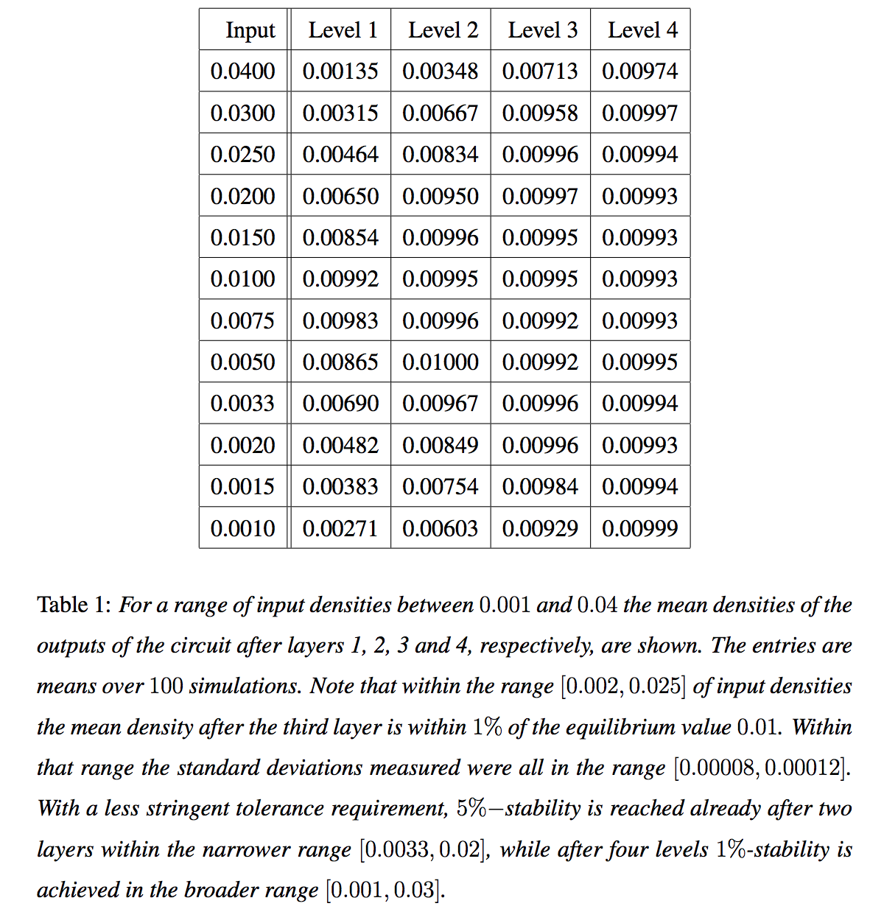

Slide 18
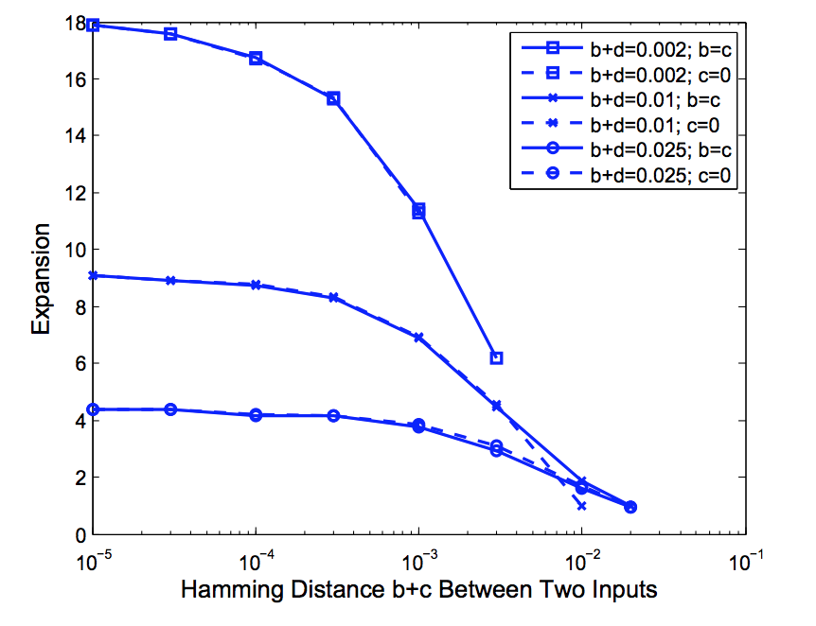

Slide 19
Conclusion
0.01-stability within 3 layers
Valid for any number of neurons above 10k
Tolerant to widely different ratios of inhibitory to excitatory connections
Resistant to noise
Adaptive to any density – the illustration only showed for p=0.01

Slide 20
Fractional Synaptic weights
The circuit construction requires strong synaptic weights, meaning single neurons firing at one level have significant influence on the neurons at the next level.
What if we only have weak synapses?
Have not found a general construction to solve this. Some simulations show success in a more limited parameter ranges. Don’t know if arbitrarily low activity and synapses can be consistent with noise tolerance.

Slide 21
Future Work
Weak Synapses
Apply cortical functions such as JOIN using the circuit construction, with arbitrary depth
More functions of hippocampus, besides identifying neurons in cortex.
For example, store information to be used when consolidating memories at those neurons over a period.

