Slide 1
Human Centric Data Mining WP2 “Compressed sensing”
July 21st 2016

Slide 2
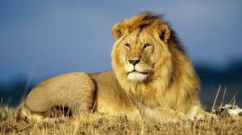

DNN Compressed sensing – The project
Retrieve High Resolution Image
Compressed Sensing
Fast DNN based Image recovery
Pattern Recognition in compressed domain
This is a lion
Two main topics:
Fast DNN based image recovery
Pattern Recognition in compressed domain
We are currently looking at DNN based image recovery

Slide 3













Input Data
CS Sensor acquires image in a block-wise fashion
For each block $X_{i,j}∈ℝ^{B×B}$, we compute CS measurements as $y_{i,j}=Φ⋅vec\left\{X_{i,j}\right\}∈ℝ^{C}$
CS measurements can be nicely arranged in a 3D tensor format
CS meas.
$$X_{1,1}$$
$$X_{1,2}$$
$$⋯$$
$$X_{2,1}$$
$$⋯$$
Compressed Sensing
Reshaping
$$⋯$$
$$⋯$$
blocks
$$y_{i,j}=Φ⋅vec\left\{X_{i,j}\right\}$$
$$y_{1,1}$$
$$y_{\frac{M}{B},\frac{N}{B}}$$
blocks
Original image (Grayscale)
$$M×N$$
CS Measurements
“CS Tensor” $$\frac{M}{B}×\frac{N}{B}×C$$

Slide 4
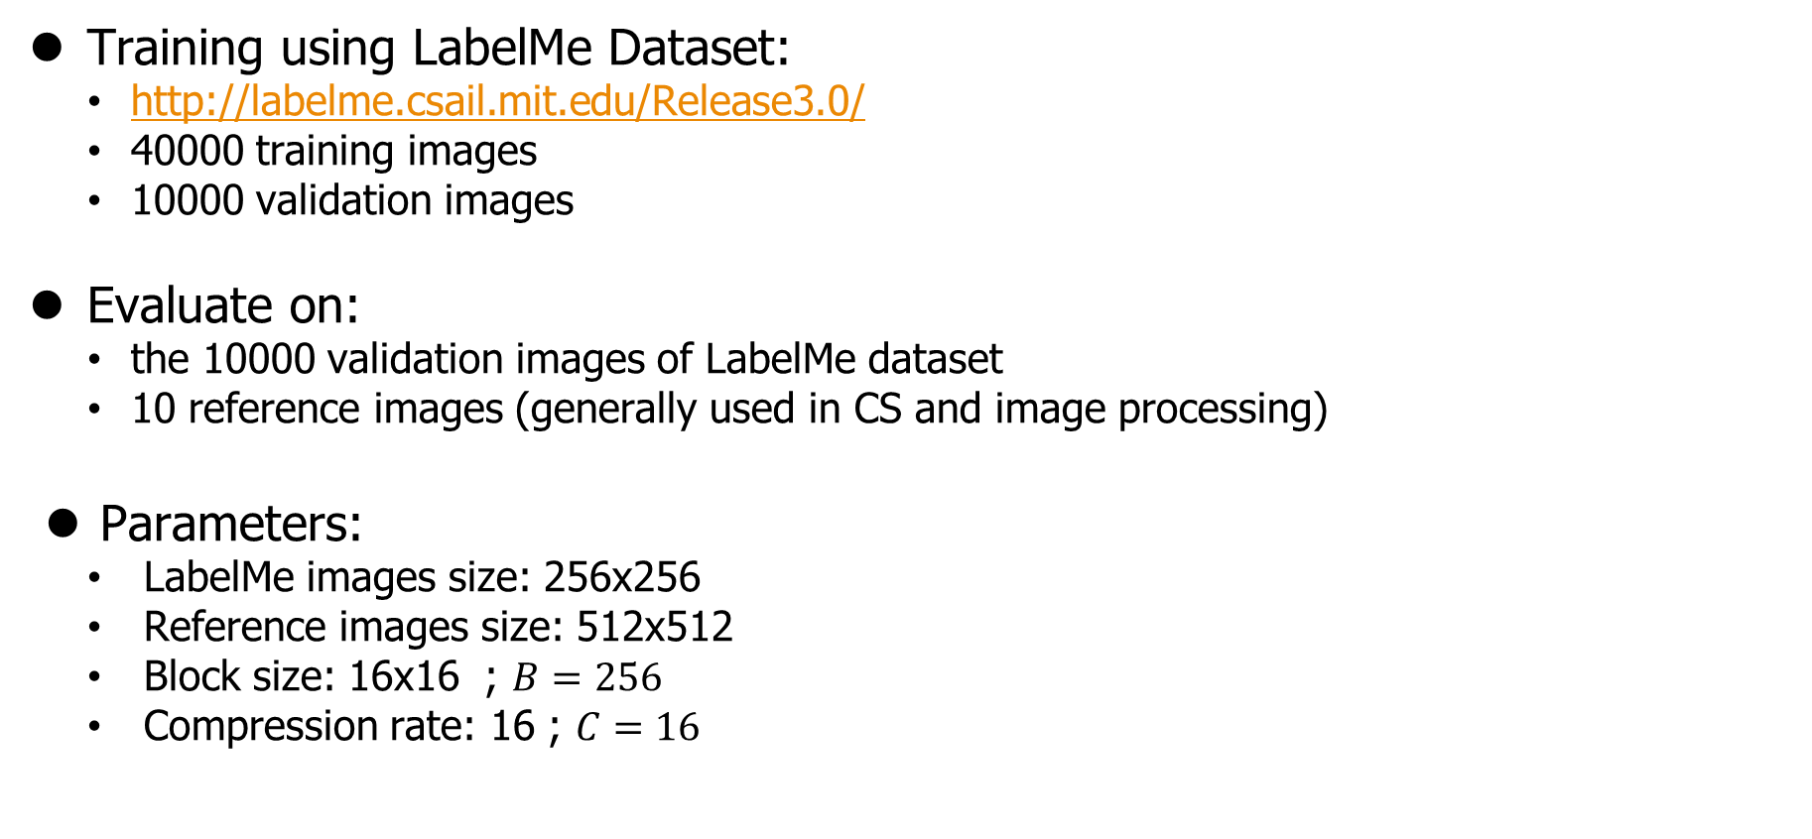
Experiments
Training using LabelMe Dataset:
http://labelme.csail.mit.edu/Release3.0/
40000 training images
10000 validation images
Evaluate on:
the 10000 validation images of LabelMe dataset
10 reference images (generally used in CS and image processing)
Parameters:
LabelMe images size: 256x256
Reference images size: 512x512
Block size: 16x16 ; $B=256$
Compression rate: 16 ; $C=16$

Slide 5



CNN Approach – Fixed Measurement Matrix $φ$
B pixels = output maps
CS meas. = input maps
Fully convolution network
No pooling, no affine, border_mode=‘same’
blocks
blocks
blocks
blocks
“CS Tensor” $$\frac{M}{B}×\frac{N}{B}×C$$
“Reconstructed Image Tensor” $$\frac{M}{B}×\frac{N}{B}×B$$
Reconstructed image (Grayscale)
$$M×N$$

Slide 6
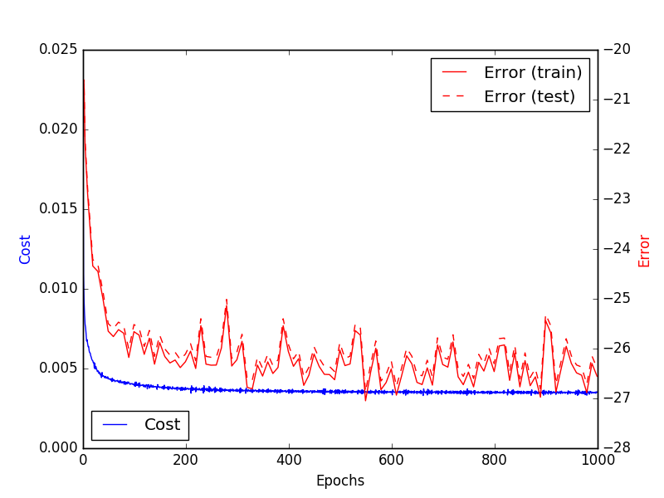


Results – Fixed Measurement Matrix $φ$
Small network:
3 Convolutions: {64,128,256} maps
Kernels 3x3
Cost function = MSE
Random $φ$
Average PSNR on “LabelMe” validation set: 26.8 dB
Average PSNR on 10 reference images: 24.6 dB
$$Error=−PSNR$$

Slide 7
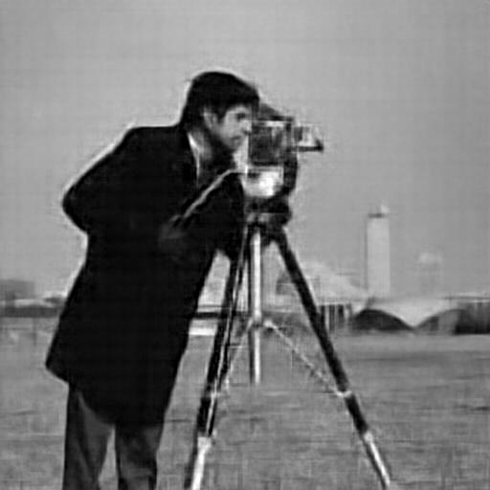
Results – Fixed Measurement Matrix $φ$
PSNR = 26.68

Slide 8


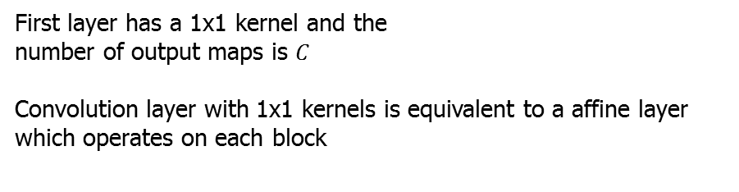
CNN Approach – Trained Measurement Matrix $φ$
CS meas.
blocks
“CS Tensor” $$\frac{M}{B}×\frac{N}{B}×C$$
B pixels = output maps
B pixels = input maps
1st Layer
Fully convolution network
(No pooling, no affine, border_mode=‘same’)
blocks
blocks
blocks
blocks
“Reconstructed Image Tensor” $$\frac{M}{B}×\frac{N}{B}×B$$
Reconstructed image (Grayscale)
$$M×N$$
“Reconstructed Image Tensor” $$\frac{M}{B}×\frac{N}{B}×B$$
First layer has a 1x1 kernel and the number of output maps is $C$
Convolution layer with 1x1 kernels is equivalent to a affine layer which operates on each block

Slide 9
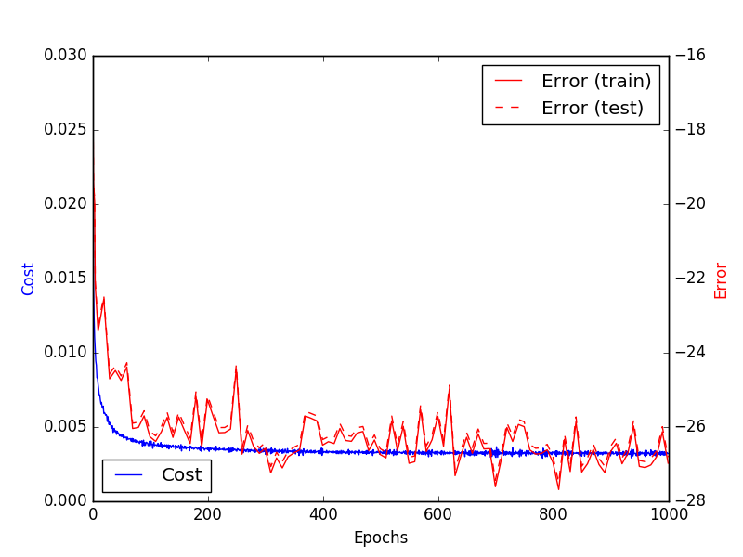

Results – Trained Measurement Matrix $φ$
Small network:
3 Convolutions: {64,128,256} maps
Kernels 3x3
Cost function = MSE
Trained $φ$
Average PSNR on “LabelMe” validation set: 27.49 dB
Average PSNR on 10 reference images: 26.57 dB
$$Error=−PSNR$$

Slide 10
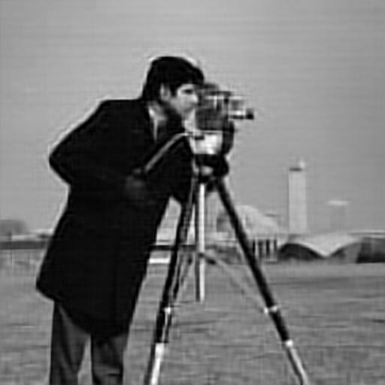
Results – Trained Measurement Matrix $φ$
PSNR = 26.94

Slide 11
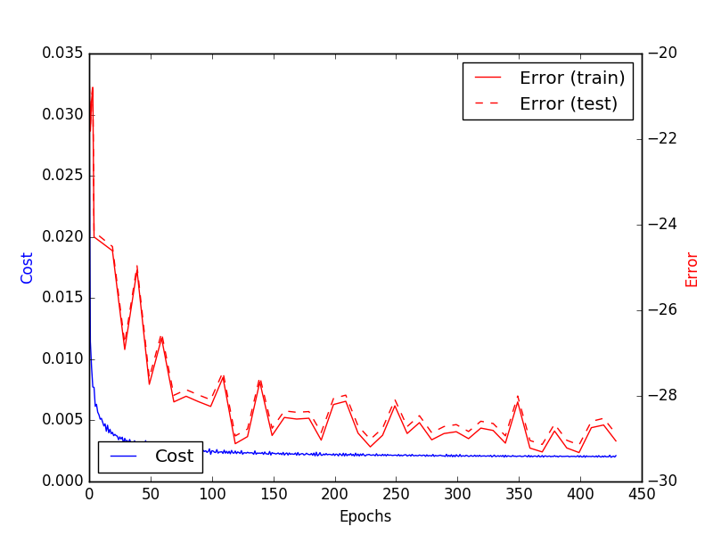

Preliminary Results – Trained Measurement Matrix $φ$
Large network:
3 Convolutions: {2048,2048,2048} maps
1x1 Kernels
Cost function = MSE
Trained $φ$
Average PSNR on “LabelMe” validation set: 29.14 dB
Average PSNR on 10 reference images: 27.80 dB
The network architecture is motived by the following paper Adler, Amir, et al. "A Deep Learning Approach to Block-based Compressed Sensing of Images.“ arXiv preprint arXiv:1606.01519 (2016).
$$Error=−PSNR$$

Slide 12

Preliminary Results – Trained Measurement Matrix $φ$
PSNR = 28.92

Slide 13
Possible Next Steps
Evaluation:
Compare to baselines
Also measure structural similarity (SSIM)
Evaluate effect of noise
On the input image
On the CS measurements
Model training:
Investigate other structures (number of layers, kernel size, etc.)
Structure similarity based cost function
Training with larger Dataset (e.g. ImageNet)
Working with Video:
SSS is mainly interested in video compressed sensing
Image Classification in compressed domain
Directly in compressed domain
From reconstructed image

Slide 14
Appendix

Slide 15
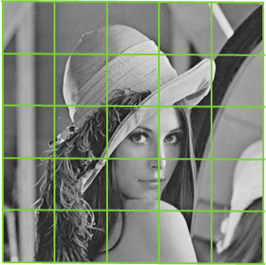
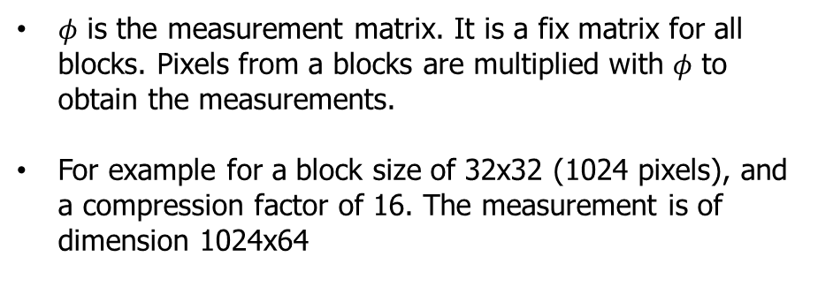
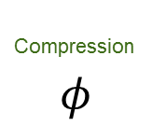
Current Approaches
Simulation of measurements from image:
Compression
$$φ$$
…
Vertical Blocks
Measurements
Horizontal Blocks
$φ$ is the measurement matrix. It is a fix matrix for all blocks. Pixels from a blocks are multiplied with $φ$ to obtain the measurements.
For example for a block size of 32x32 (1024 pixels), and a compression factor of 16. The measurement is of dimension 1024x64

