Slide 1
Introduction Compressive Sensing
April 27st 2016
Luis Bracamontes

Slide 2
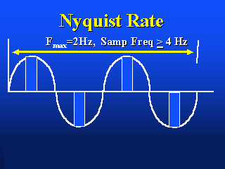

Nyquist-Shannon Theorem
SIGNAL PROCESSING TENET
Sample twice as often as the highest frequency you want to capture.
Notes:
This section should explain some key technical elements in a concise way.

Slide 3
Compressive Sensing
What is CS?
Around 2004, Emmanuel Candès, Terence Tao, and David Donoho proved that given knowledge about a signal's sparsity, the signal may be reconstructed with even fewer samples than the sampling theorem requires.
An emerging mathematical approach that permits to sample at sub-Nyquist rate.
Exactly reconstructs sparse signals in some transform domain.
Approximate reconstruction when signal is compressible in some transform domain.
Notes:
This section should explain some key technical elements in a concise way.

Slide 4
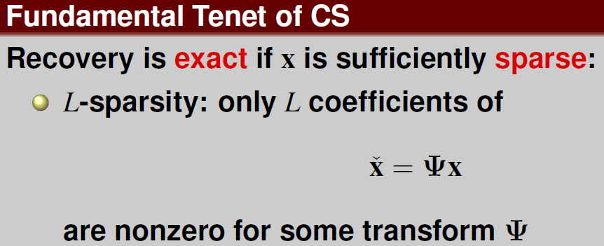
Compressive Sensing
Notes:
This section should explain some key technical elements in a concise way.

Slide 5
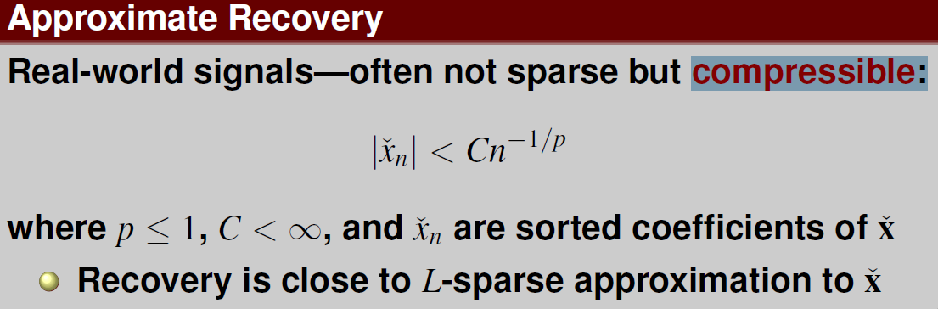
Compressive Sensing
Notes:
This section should explain some key technical elements in a concise way.

Slide 6
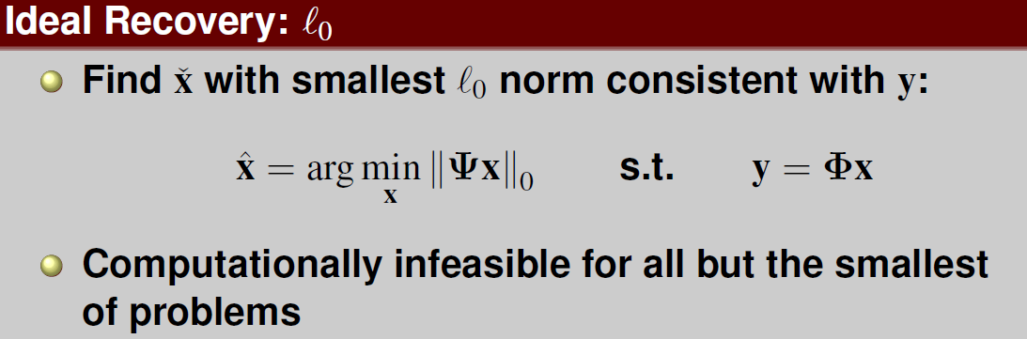
Compressive Sensing
Notes:
This section should explain some key technical elements in a concise way.

Slide 7
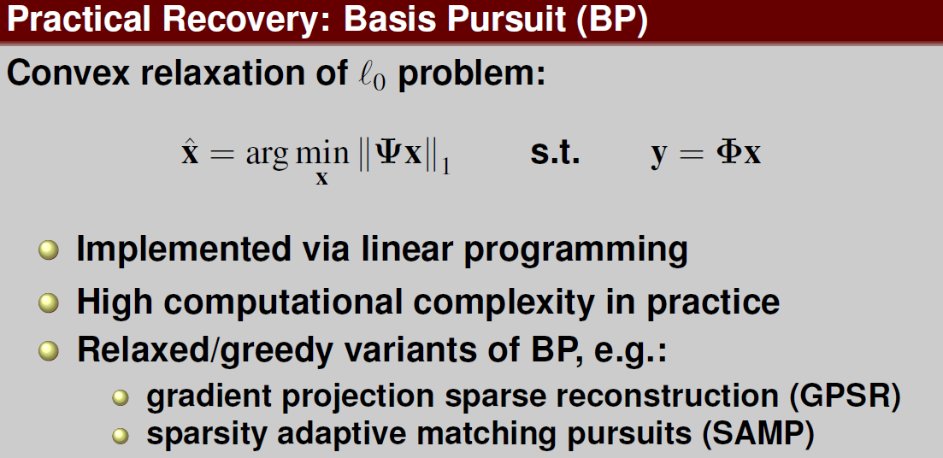
Compressive Sensing
Notes:
This section should explain some key technical elements in a concise way.

Slide 8
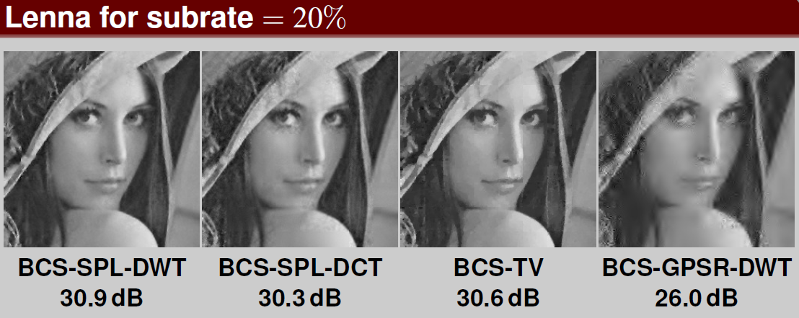
Compressive Sensing
Notes:
This section should explain some key technical elements in a concise way.

Slide 9
Compressive Sensing and CNN
Train a CNN to learn sensing matrix.
Image reconstruction will be more accurate?
Once network is learnt reconstruction will be better and faster than other algorithms?

Slide 10
References
Candès, Emmanuel J.; Romberg, Justin K.; Tao, Terence (2006). "Stable signal recovery from incomplete and inaccurate measurements" (PDF). Communications on Pure and Applied Mathematics 59 (8): 1207–1223.
Donoho, D.L. (2006). "Compressed sensing". IEEE Transactions on Information Theory 52 (4): 1289–1306.
Block-Based Compressed Sensing of Images and Video. James E. Fowler. Department of Electrical & Computer Engineering. Geosystems Research Institute. Mississippi State University. March 2010.

Slide 11
End of Document

