Slide 1
Compressive Sensing Round 2
June 1st 2016
Luis Bracamontes

Slide 2
Compressive Sensing
What is CS?
Compressive sensing (CS) is an emerging field that provides a framework for image recovery using sub-Nyquist sampling rates. The CS theory shows that a signal can be reconstructed from a small set of random projections, provided that the signal is sparse in some basis.
Is a signal processing technique for efficiently acquiring and reconstructing a signal, by finding solutions to underdetermined linear systems.
Notes:
This section should explain some key technical elements in a concise way.

Slide 3
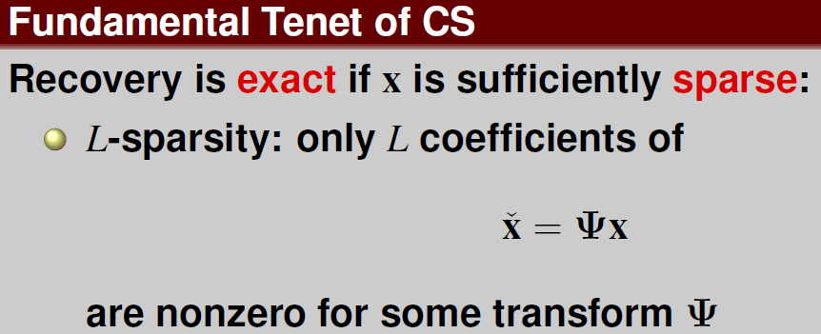
Compressive Sensing
Notes:
This section should explain some key technical elements in a concise way.

Slide 4
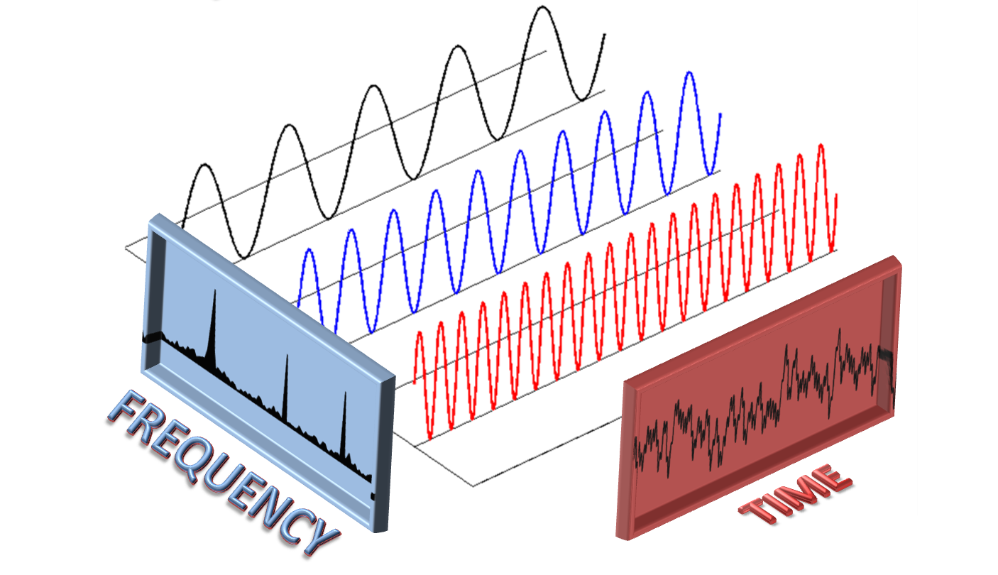





Compressive Sensing
Notes:
This section should explain some key technical elements in a concise way.

Slide 5
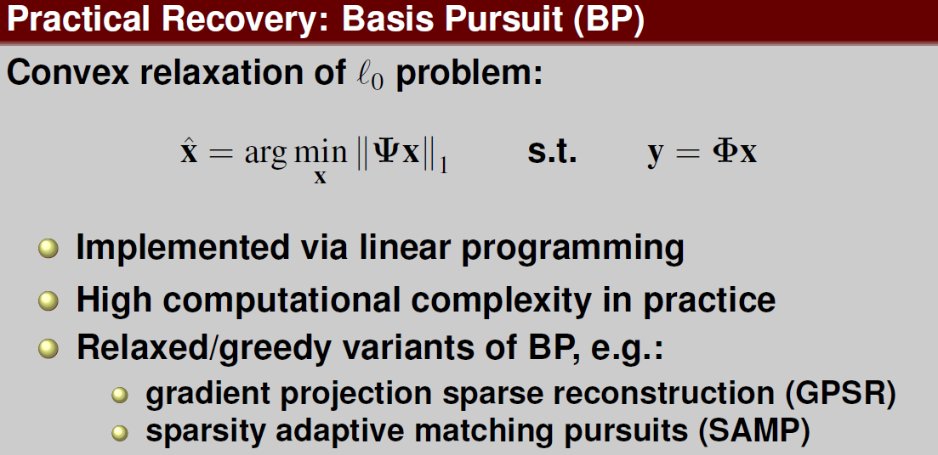
Compressive Sensing
Notes:
This section should explain some key technical elements in a concise way.

Slide 6
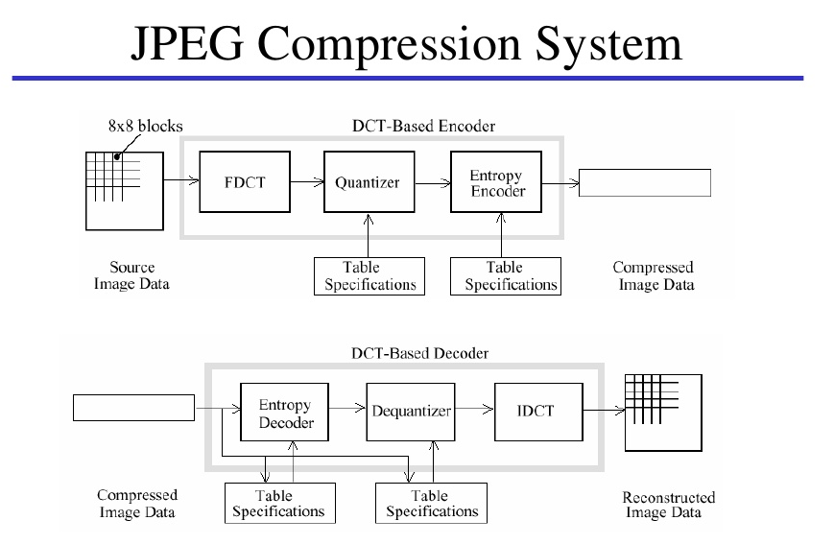
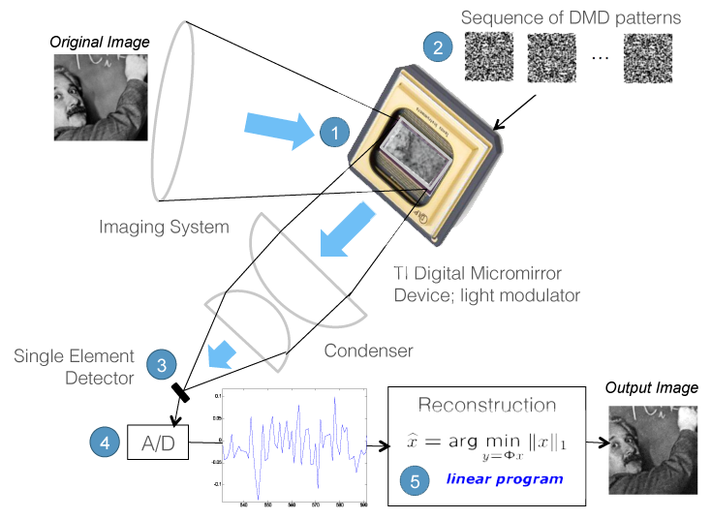
CS vs PCA and JPEG

Slide 7

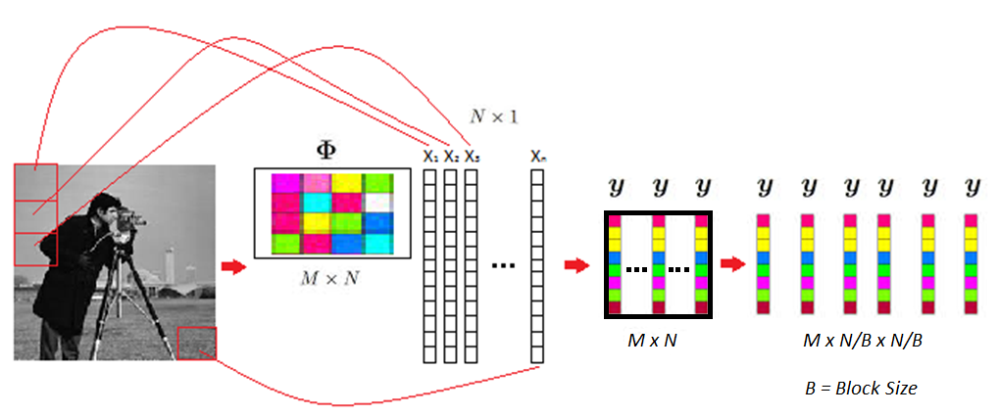
Compressive sensing recovery using CNN
Data preparation using BCS
Notes:
This section should explain some key technical elements in a concise way.

Slide 8
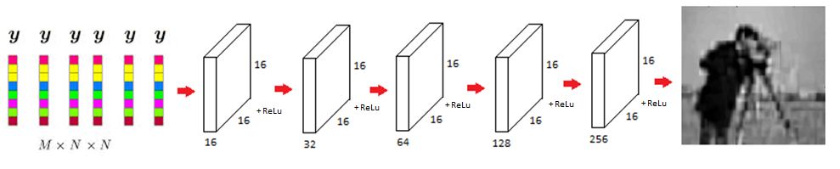
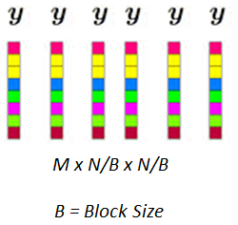

Network Architecture
Use Convolutional Neural Network (CNN) to reconstruct images.
Notes:
This section should explain some key technical elements in a concise way.

Slide 9
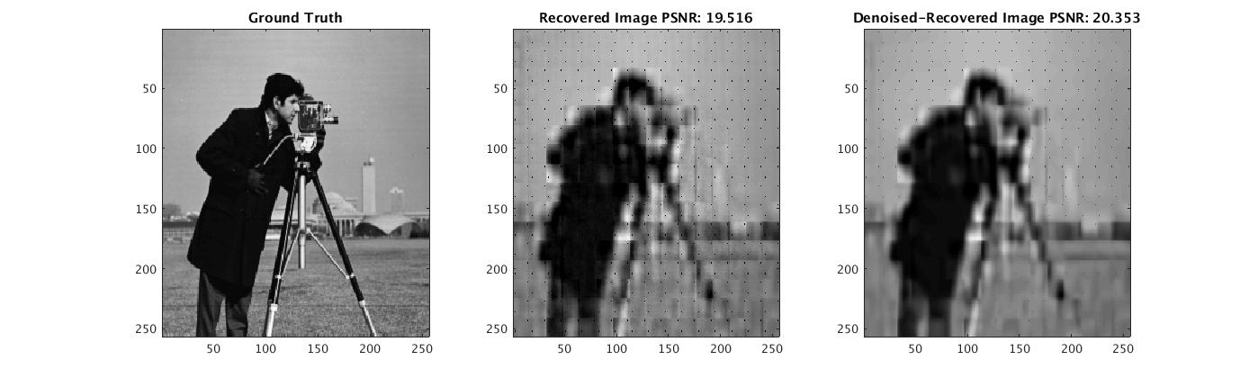
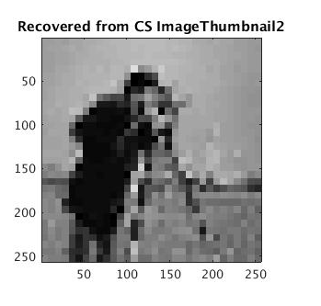
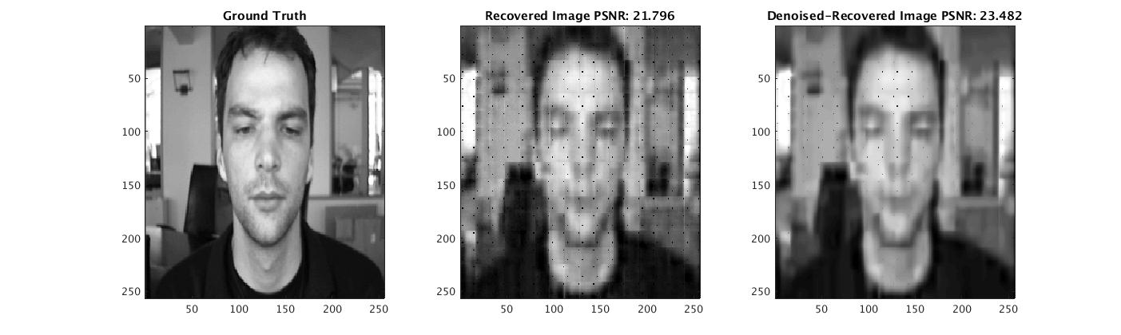
First try (0,0625)
Notes:
This section should explain some key technical elements in a concise way.

Slide 10
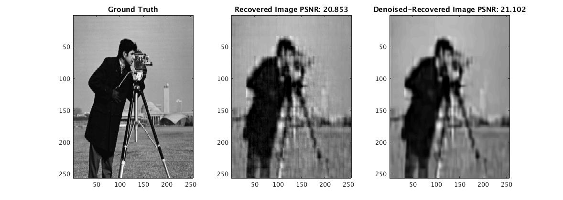
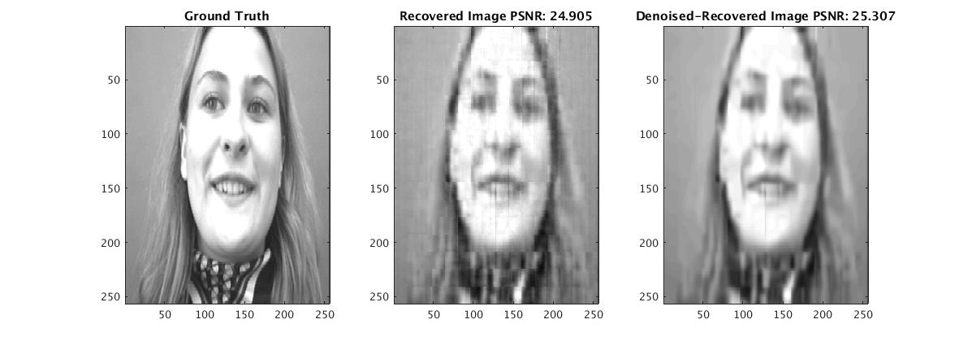
After some training (0,0625 subrate)
Notes:
This section should explain some key technical elements in a concise way.

Slide 11

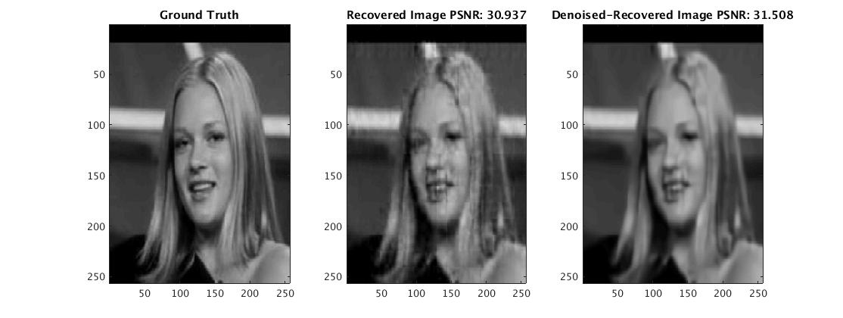
Different dataset(0,0625 subrate)
Notes:
This section should explain some key technical elements in a concise way.

Slide 12
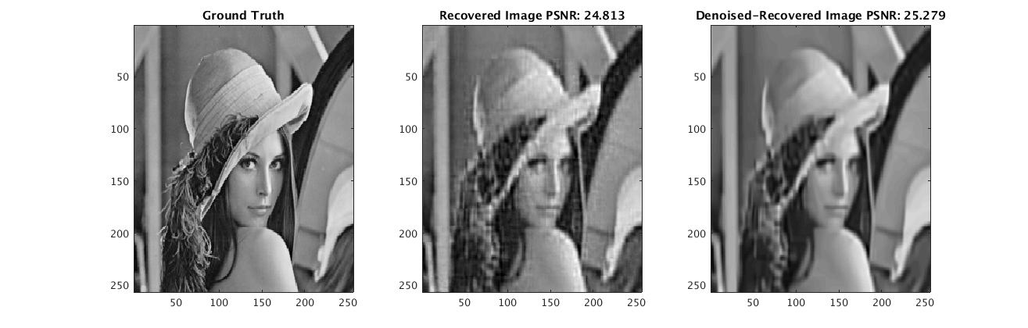
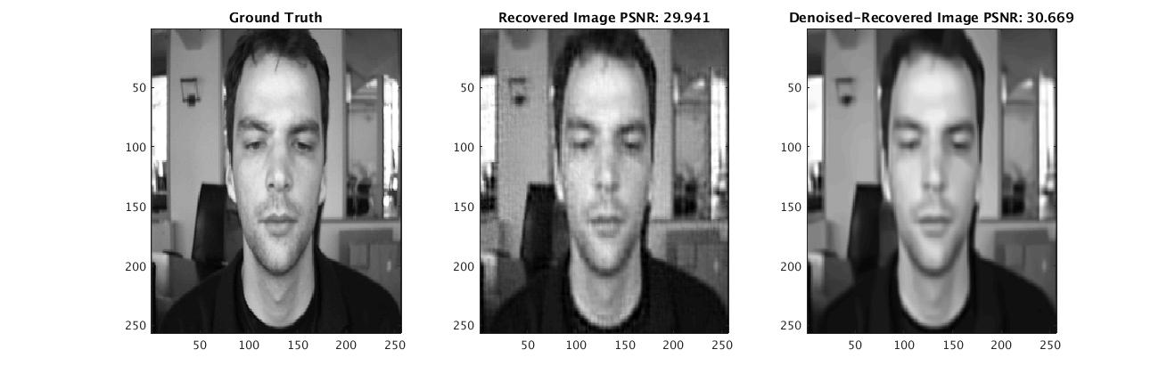
First try(0,25 subrate)
Notes:
This section should explain some key technical elements in a concise way.

Slide 13
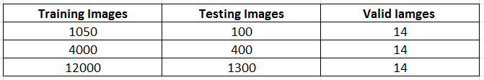
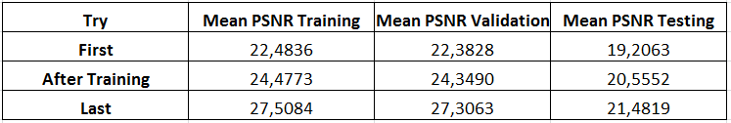
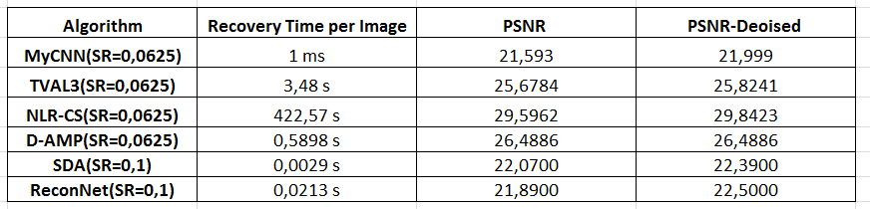
Mean Values on all Datasets and Timing
Notes:
This section should explain some key technical elements in a concise way.

Slide 14
What is next?
Explore other architectures to reduce parameter number.
Expand dataset.
Optimize training.
Add noise to measurement and test robustness.
Use solution as a first estimation for better algorithms.
Compare different measurement rates.
Extend to video?
Notes:
This section should explain some key technical elements in a concise way.

Slide 15
End of Document

