Slide 1
Image Reconstruction from Compressive Sensing Measurements Using Deep Learning
September 28th 2016
Luis Bracamontes

Slide 2
Agenda
CS Introduction
CS Reconstruction Problem
CNN Approach
Data Pre and Proprocessing
Results
Conclusions
Notes:
This section should explain some key technical elements in a concise way.

Slide 3
CS Introduction
Compressed sensing is mathematical theory that deals with the problem of recovering a signal from a small number of measurements, the number of measurements is less than the minimum number of samples defined by Shanon-Nyquist theorem (sampling acquisition must be done at least twice the highest frequency in the signal).
Compressed sensing heavily relies on two principles: sparsity of the signal, and incoherence, which refers to sampling/sensing representation.
Notes:
This section should explain some key technical elements in a concise way.

Slide 4


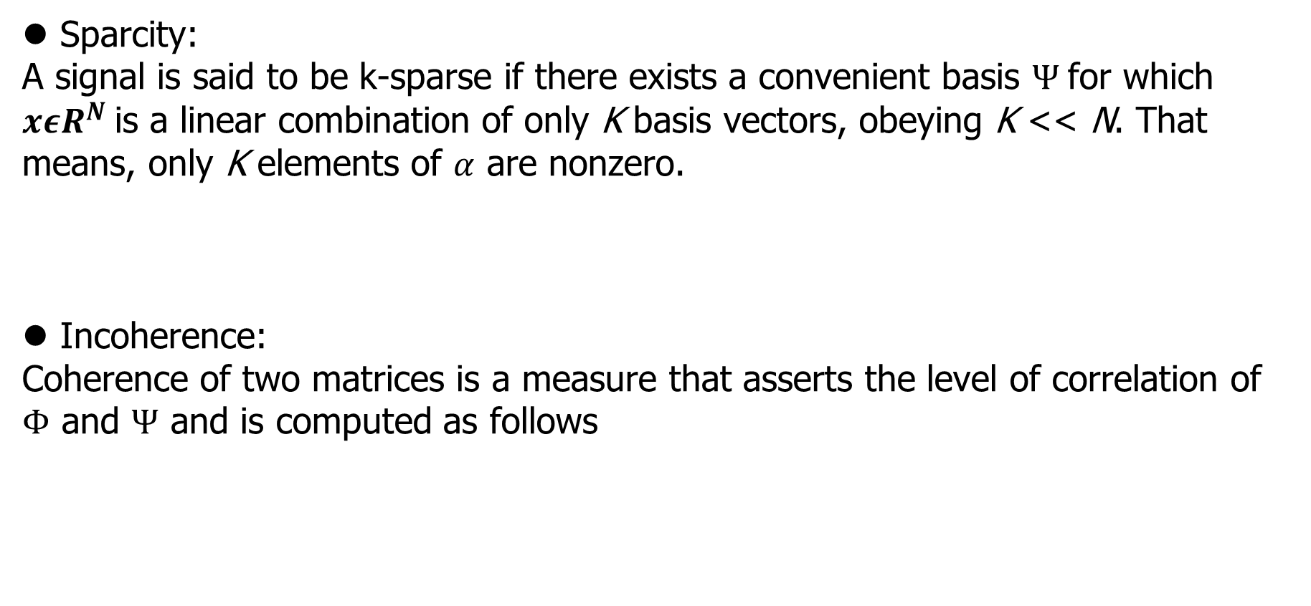
CS Introduction
Sparcity:
A signal is said to be k-sparse if there exists a convenient basis $Ψ$for which ${xεR}^{N}$is a linear combination of only K basis vectors, obeying K << N. That means, only K elements of $α$ are nonzero.
Incoherence:
Coherence of two matrices is a measure that asserts the level of correlation of $Φ$ and $Ψ$ and is computed as follows
Notes:
This section should explain some key technical elements in a concise way.

Slide 5
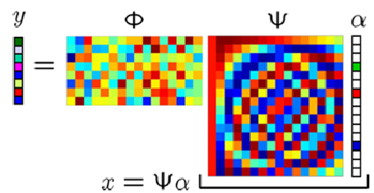

CS Introduction
Measurement Process:
Measurements in CS are obtained by using a linear operator that takes M < N inner products between x and the columns of $Φ$.
$Φ$ is an iid Gaussian matrix, since it was proved to yield high probability for the reconstructing process.
Notes:
This section should explain some key technical elements in a concise way.

Slide 6
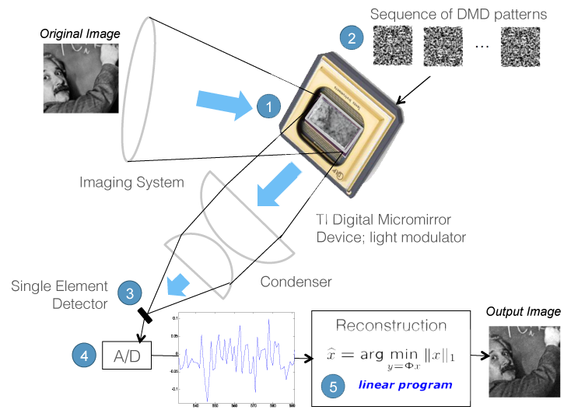
CS Reconstruction Problem

Slide 7
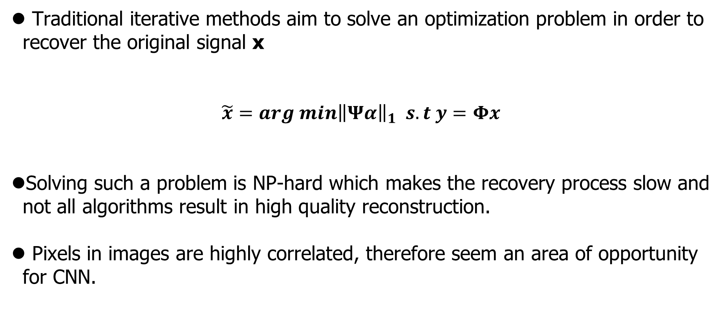
CS Reconstruction Problem
Traditional iterative methods aim to solve an optimization problem in order to recover the original signal x
$$\tilde{x}=arg min{\left\|Ψα\right\|}_{1} s.t y=Φx$$
Solving such a problem is NP-hard which makes the recovery process slow and not all algorithms result in high quality reconstruction.
Pixels in images are highly correlated, therefore seem an area of opportunity for CNN.
Notes:
This section should explain some key technical elements in a concise way.

Slide 8
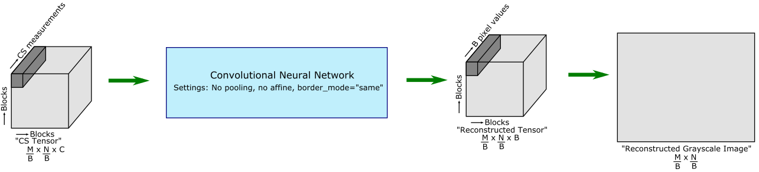

CNN Approach
CNN’s were inspired by the organization of animal visual cortex and have proved to be very efficient at many image processing task (denoising, classification, localization, etc). We aim to solve the problem of recovering original images from measurements using a deep CNN and constant $Φ$.
Notes:
This section should explain some key technical elements in a concise way.

Slide 9
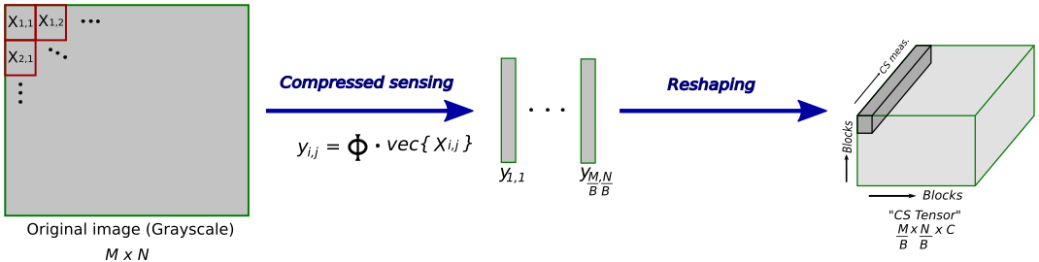

Data preparation supervised approach
Simulate BCS by fixing the size of $Φ$and dividing the image in smaller portions (Blocks). M = 256, N = 256, B =16, C = 16
CS measurements $y_{i,j} ε R^{C}$
Notes:
This section should explain some key technical elements in a concise way.

Slide 10
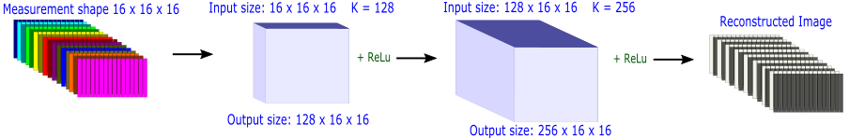

CNN Approach
We propose two different networks for reconstructing images alpha and beta network.
Supervised Alpha network: Constant $Φ,$Learned $Φ$, kernel size 3x3
Notes:
This section should explain some key technical elements in a concise way.

Slide 11
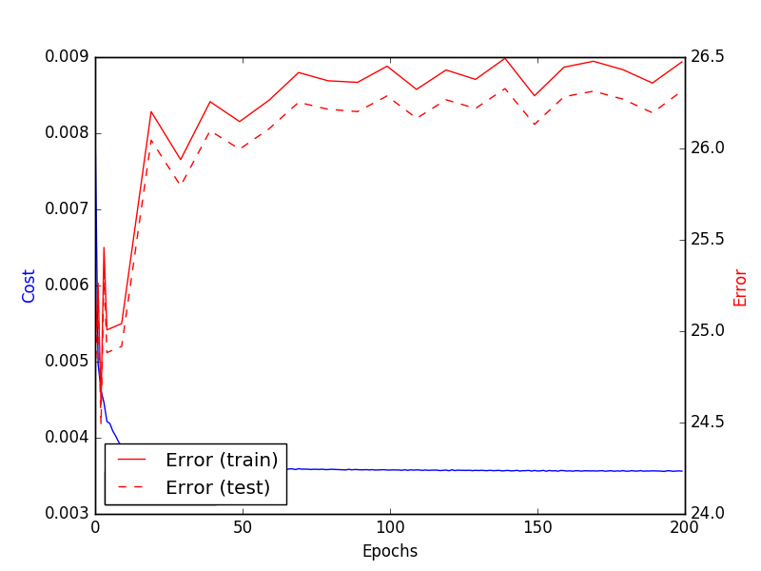
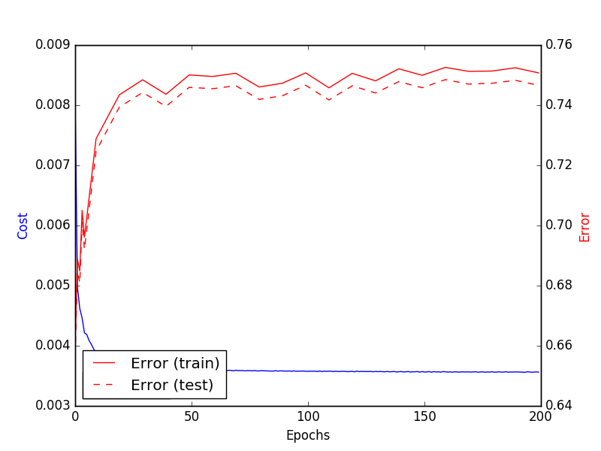
CNN Approach
Supervised Alpha Network training with LabelMe dataset after 200 epochs:
PSRN = 26.47 dB SSIM = 0.75
Notes:
This section should explain some key technical elements in a concise way.

Slide 12
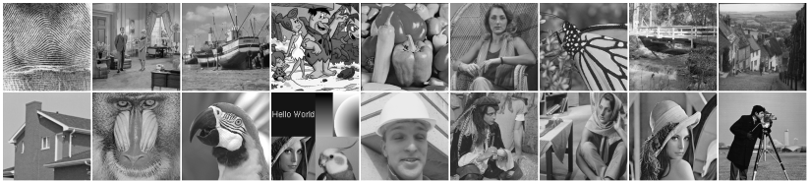
CNN Approach
Alpha Network results with testing dataset:
Notes:
This section should explain some key technical elements in a concise way.

Slide 13
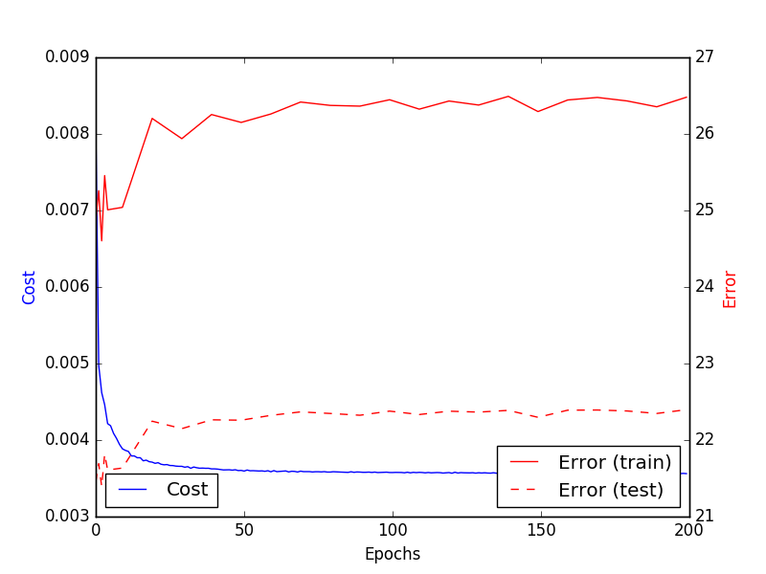
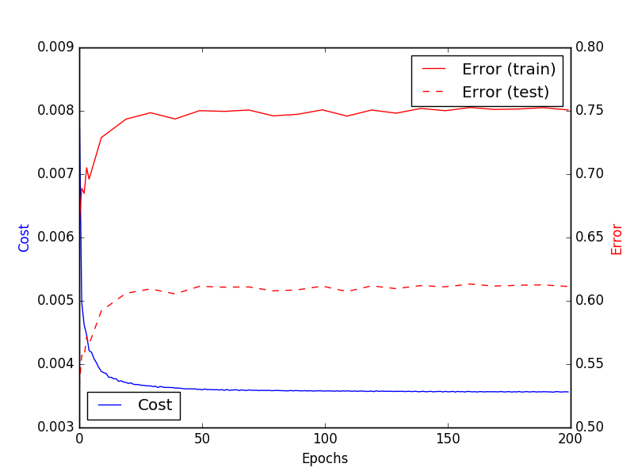
CNN Approach
Alpha Network training results with testing dataset:
PSRN = 22.39 dB SSIM = 0.61
Notes:
This section should explain some key technical elements in a concise way.

Slide 14
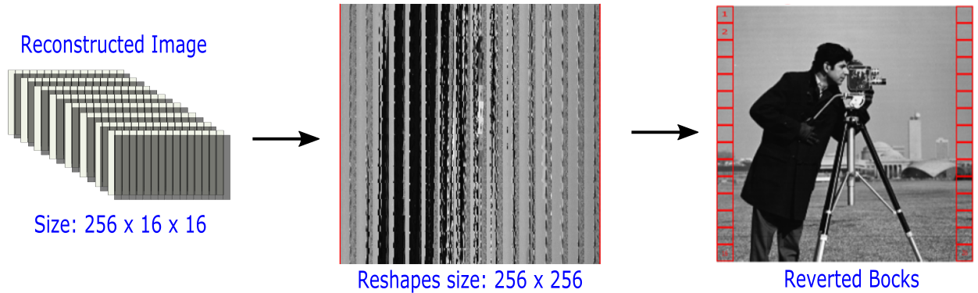
Data postprocessing
The output of the network is a 3D tensor that needs to be converted back to the original image shape and afterwards revert the blocks.
Notes:
This section should explain some key technical elements in a concise way.

Slide 15
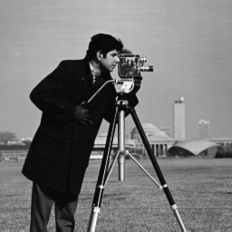
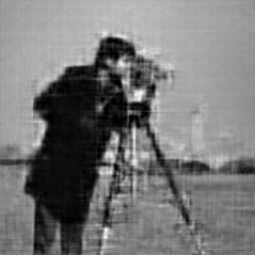
CNN Approach
Alpha Network training results with testing dataset:
Ground Truth PSRN = 22.31 dB SSIM = 0.6782
Notes:
This section should explain some key technical elements in a concise way.

Slide 16
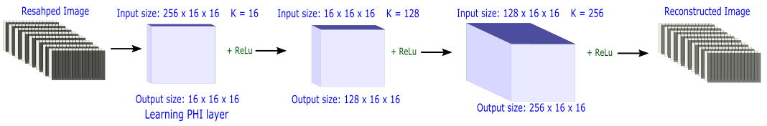

CNN Approach
Unsupervised Alpha network: Learned $Φ.$
Notes:
This section should explain some key technical elements in a concise way.

Slide 17
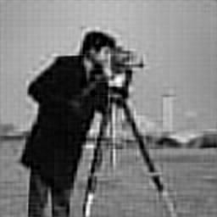
CNN Approach
Alpha Network training results with testing dataset:
Ground Truth PSRN = 23.84 dB SSIM = 0.7180
Notes:
This section should explain some key technical elements in a concise way.

Slide 18
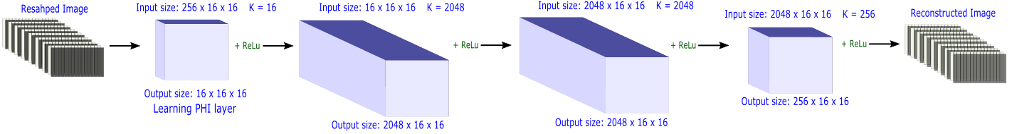

CNN Approach
Unsupervised Beta network: Learned $Φ$, kernel size 3x3
Notes:
This section should explain some key technical elements in a concise way.

Slide 19

CNN Approach
Alpha Network training results with testing dataset:
Ground Truth PSRN = 24.58 dB SSIM = 0.7550
Notes:
This section should explain some key technical elements in a concise way.

Slide 20
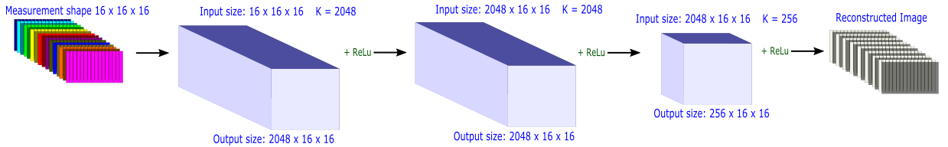

CNN Approach
Supervised Beta network: Constant $Φ$:
Notes:
This section should explain some key technical elements in a concise way.

Slide 21
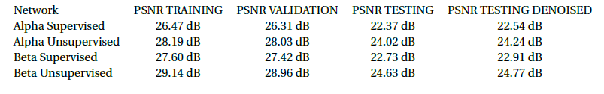
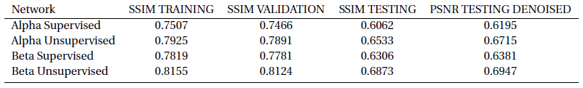
CNN Approach
Training summary
Notes:
This section should explain some key technical elements in a concise way.

Slide 22
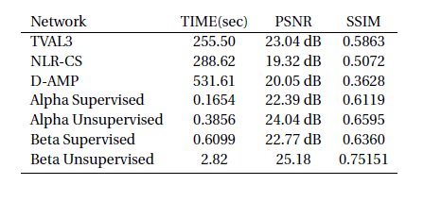
CNN Approach
Computational reconstruction time and quality comparison against traditional methods
Notes:
This section should explain some key technical elements in a concise way.

Slide 23
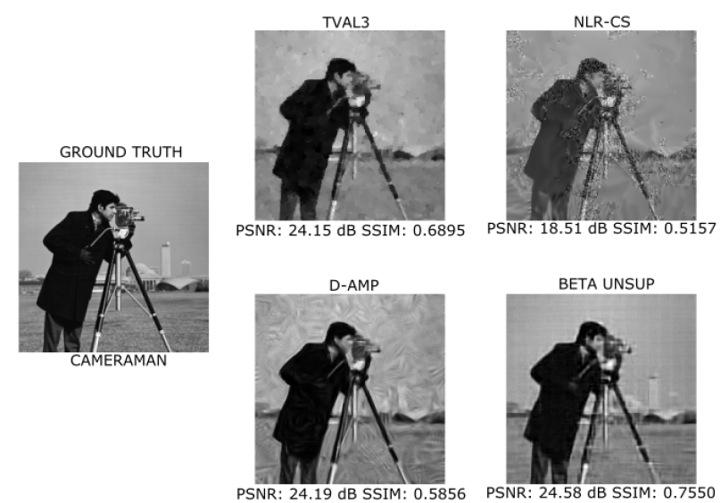
CNN Approach
Cameraman example
Notes:
This section should explain some key technical elements in a concise way.

Slide 24
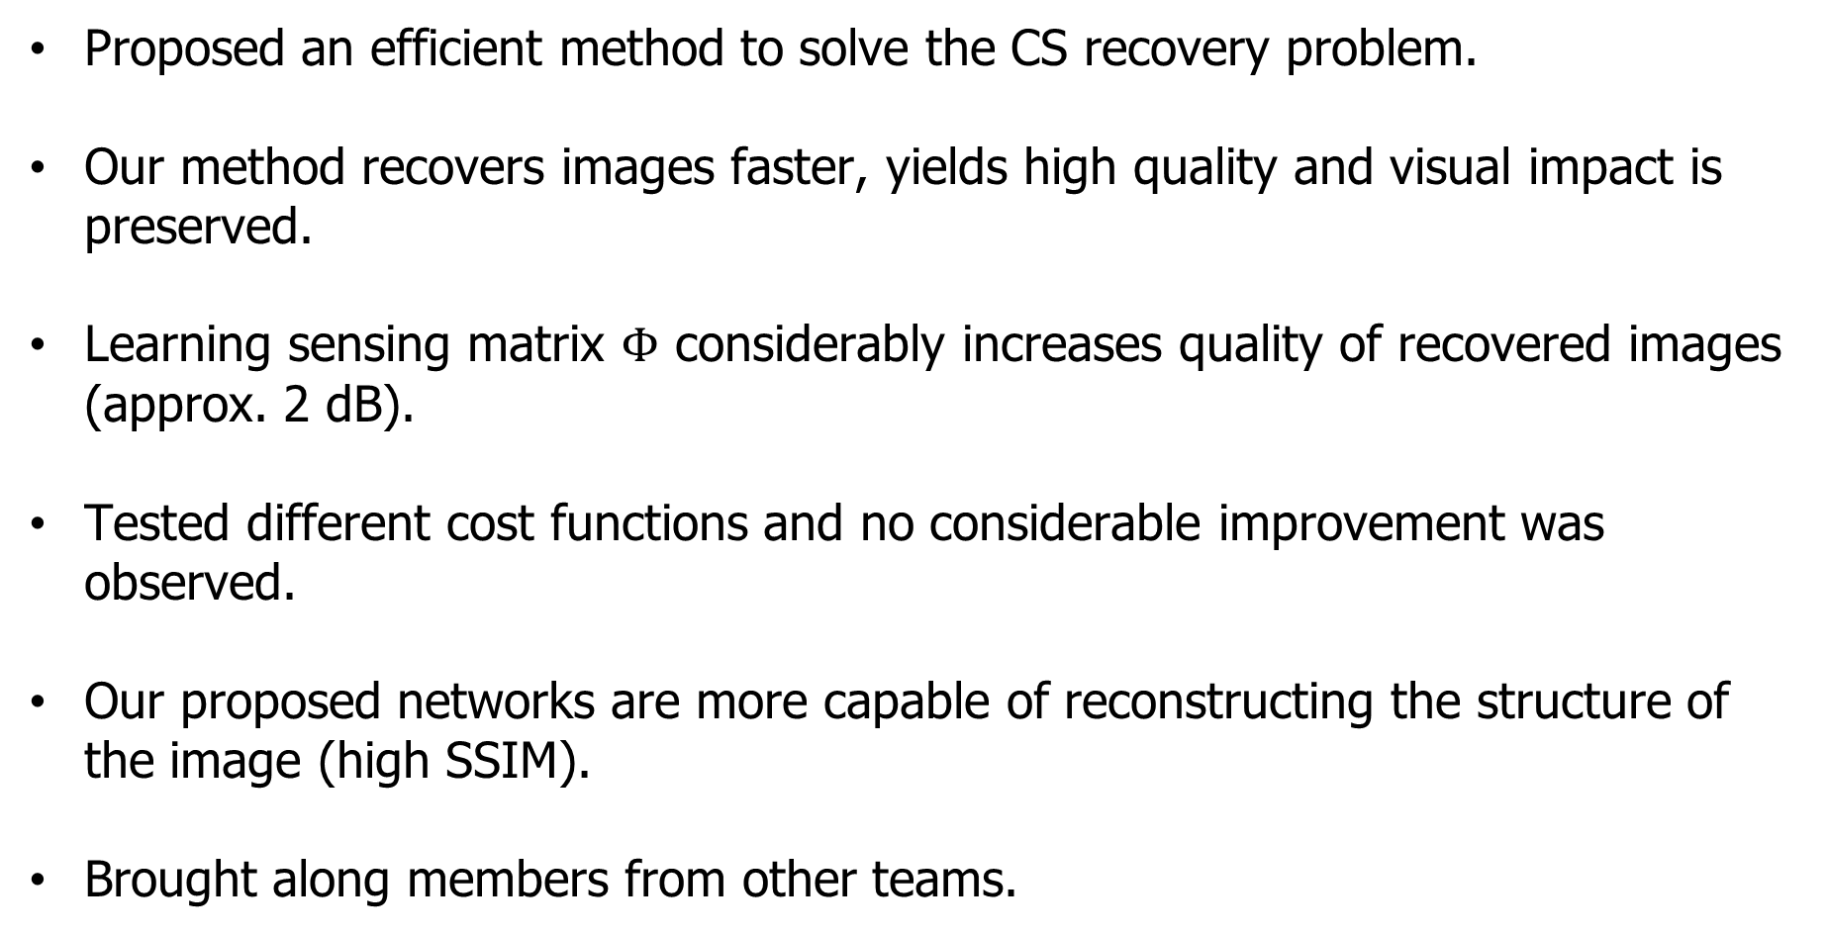
Closing comments
Proposed an efficient method to solve the CS recovery problem.
Our method recovers images faster, yields high quality and visual impact is preserved.
Learning sensing matrix $Φ$ considerably increases quality of recovered images (approx. 2 dB).
Tested different cost functions and no considerable improvement was observed.
Our proposed networks are more capable of reconstructing the structure of the image (high SSIM).
Brought along members from other teams.
Notes:
This section should explain some key technical elements in a concise way.

Slide 25
Areas of opportunity
Test larger dataset.
Expand approach to binary sensing matrices.
Test on HD images.
Notes:
This section should explain some key technical elements in a concise way.

Slide 26
End of Document

