Slide 1
Compressive Sensing Round 3
July 20 2016
Luis Bracamontes

Slide 2
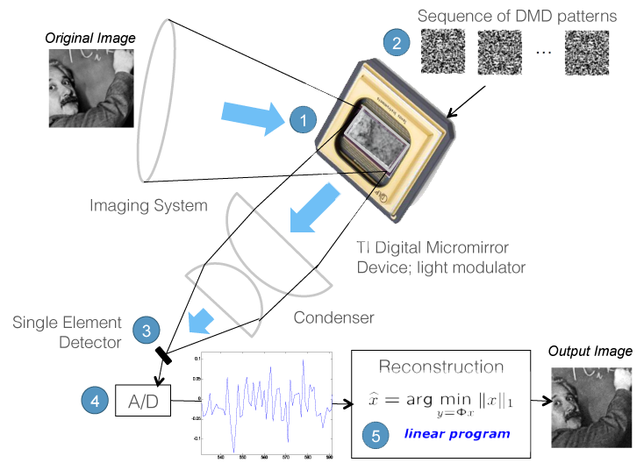
CS Remainder

Slide 3
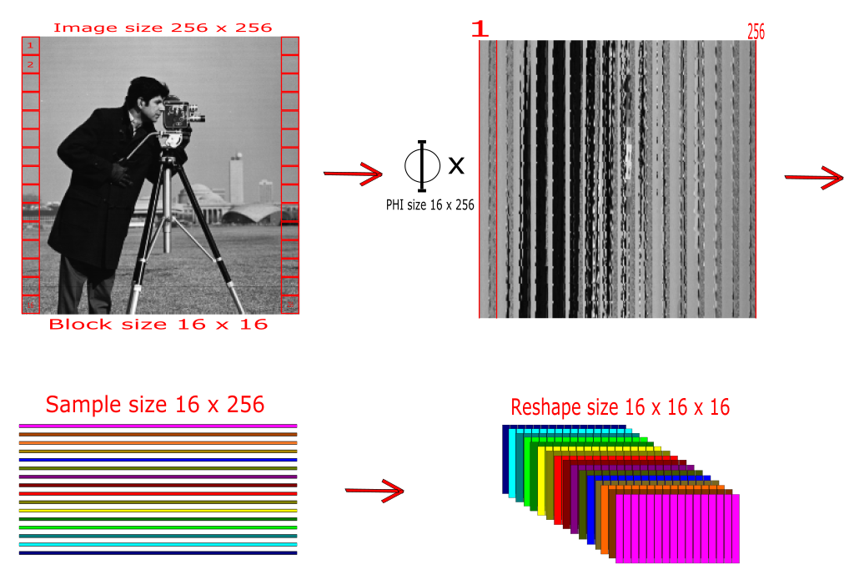

Remainder Data Preparation
Notes:
This section should explain some key technical elements in a concise way.

Slide 4
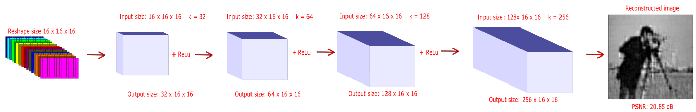
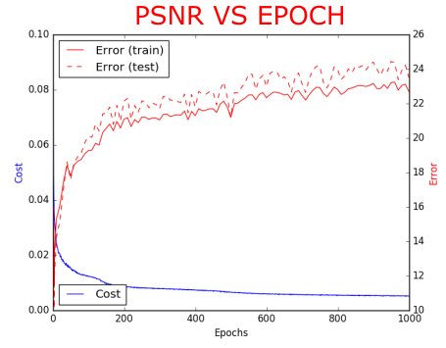
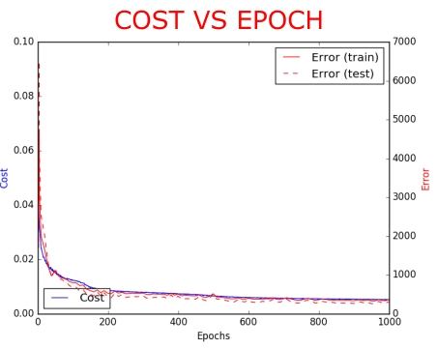
Comparison of Network Architectures
Notes:
This section should explain some key technical elements in a concise way.

Slide 5
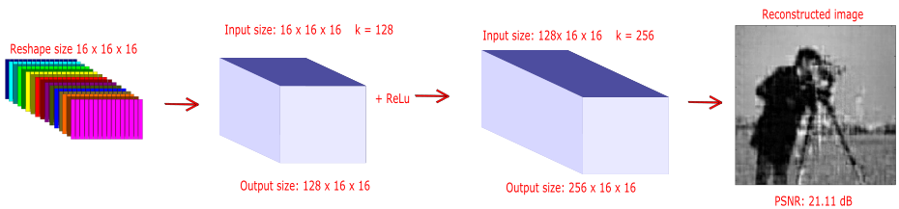
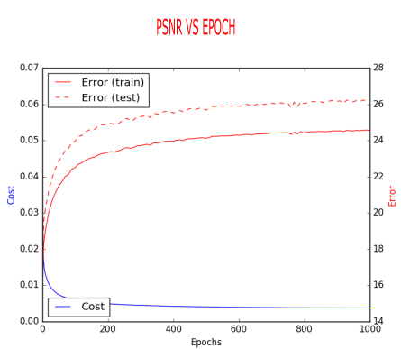
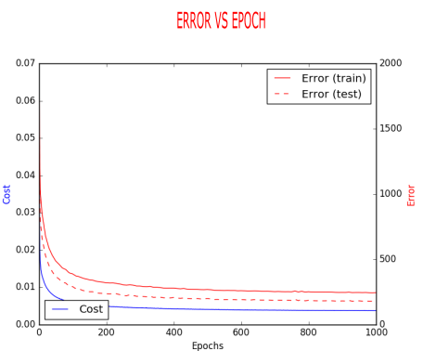
Comparison of Network Architectures
Notes:
This section should explain some key technical elements in a concise way.

Slide 6
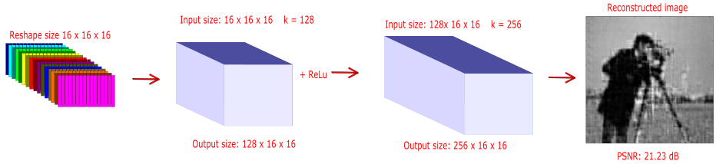

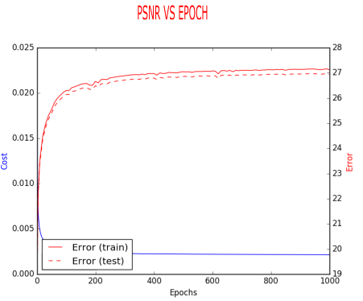
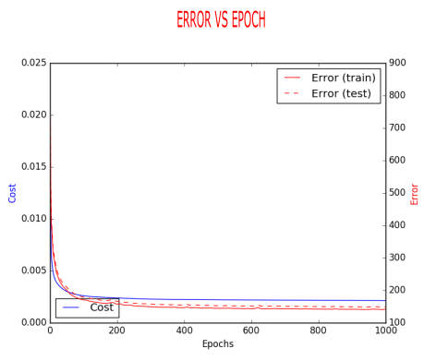
Comparison of Network Architectures
Notes:
This section should explain some key technical elements in a concise way.

Slide 7
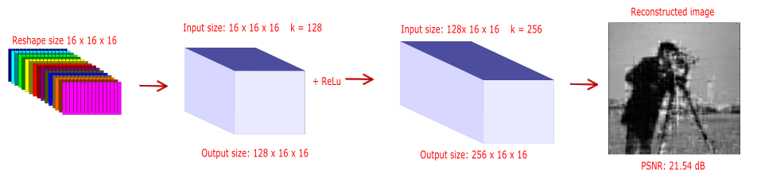

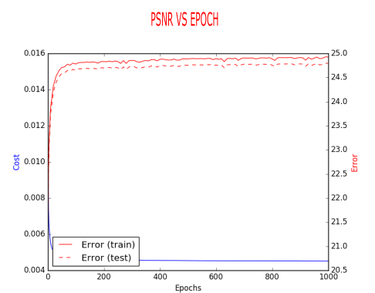
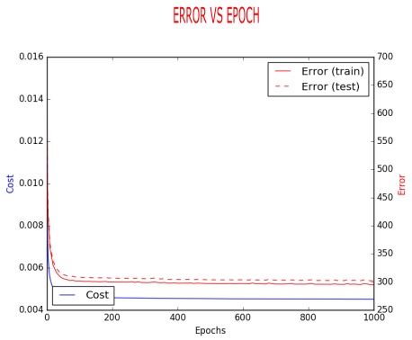
Comparison of Network Architectures
Notes:
This section should explain some key technical elements in a concise way.

Slide 8

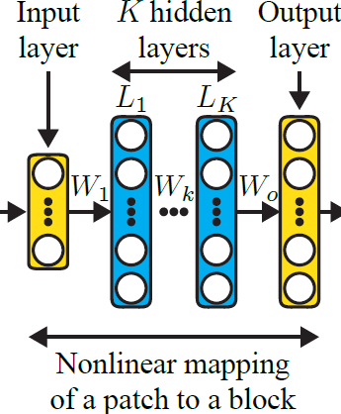
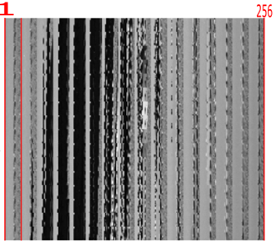





Autoencoder approach
Notes:
This section should explain some key technical elements in a concise way.

Slide 9
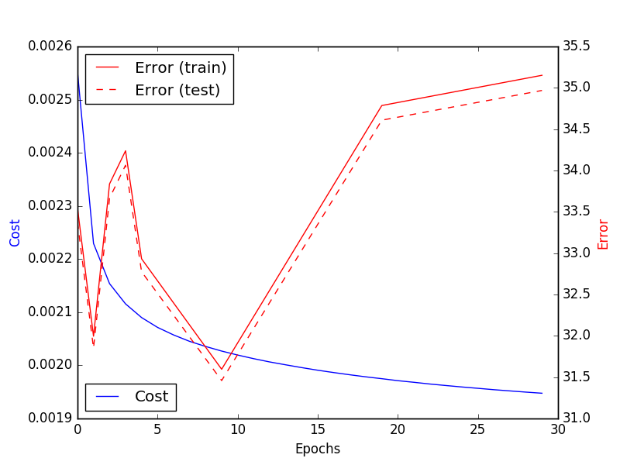
Autoencoder approach training
Notes:
This section should explain some key technical elements in a concise way.

Slide 10

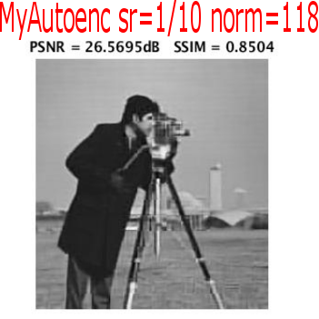
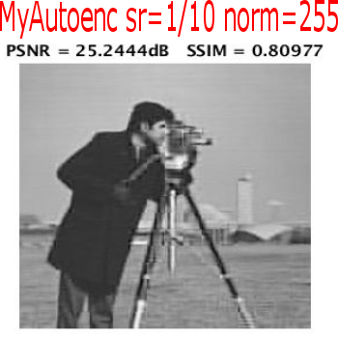
Autoencoder approach results
Notes:
This section should explain some key technical elements in a concise way.

Slide 11
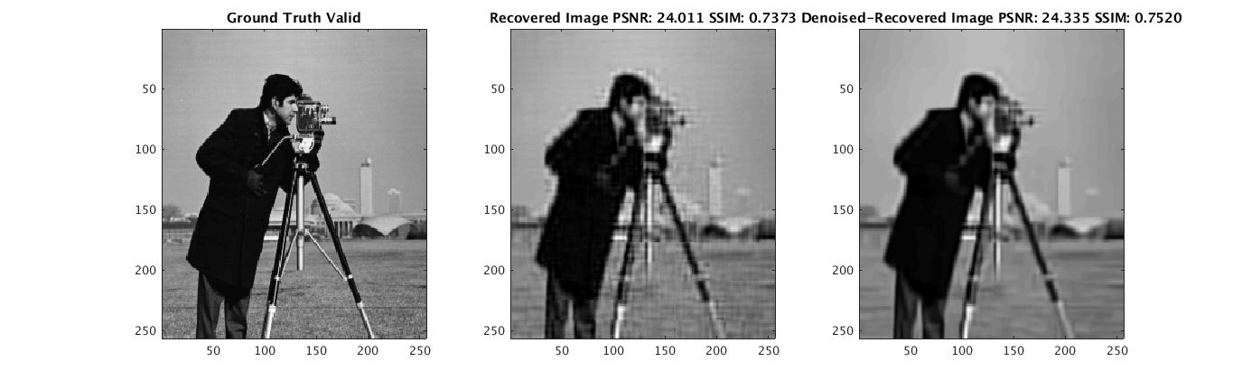
Autoencoder approach results
Notes:
This section should explain some key technical elements in a concise way.

Slide 12
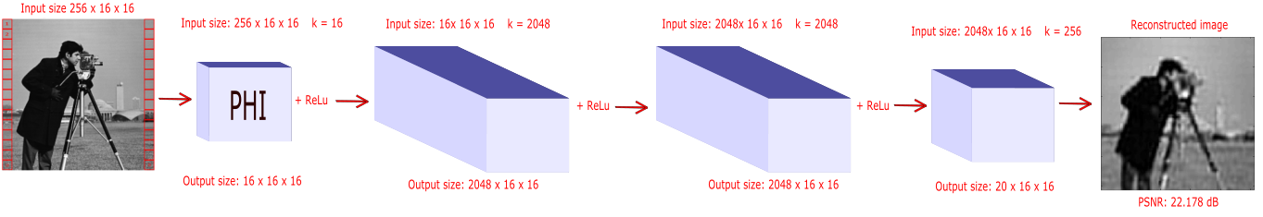

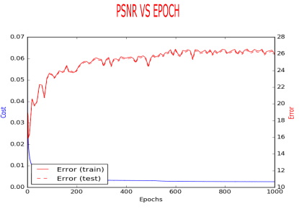
Autoencoder ideas for CNN
Notes:
This section should explain some key technical elements in a concise way.

Slide 13
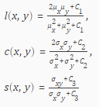

Structural Similarity Index
An image quality metric that assesses the visual impact of three characteristics of an image: luminance, contrast and structure.
Notes:
This section should explain some key technical elements in a concise way.

Slide 14
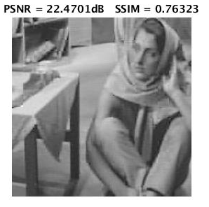
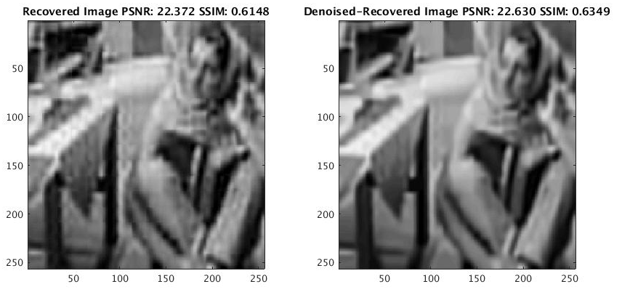
Structural Similarity Index in Practice
Notes:
This section should explain some key technical elements in a concise way.

Slide 15
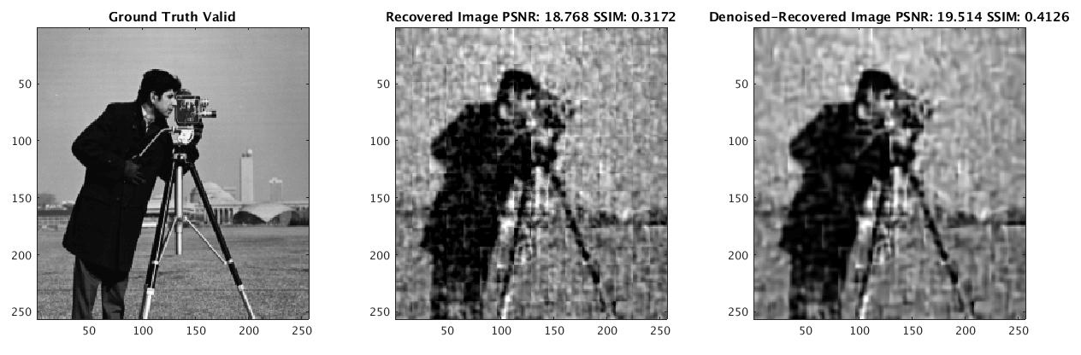
Noise Robustness
Notes:
This section should explain some key technical elements in a concise way.

Slide 16
Conclusions
Autoencoders yield much better quality.
Image patches can be treated as individual labels.
CNN gives almost same PSNR but visual impact is not the same.
Very sensitive to noise.
Put more emphasis in ssim.
Notes:
This section should explain some key technical elements in a concise way.

Slide 17
End of Document

