Slide 1
PSNR vs SSIM
July 27 2016
Luis Bracamontes

Slide 2


Peak Signal Noise Ratio (PSNR)
PURE NUMERICAL COMPARISON DOES NOT TAKE INTO ACCOUNT PHYSICAL FACTORS THAT HAVE HIGH IMPORANCE IN VISUAL IMPACT!!!!!!

Slide 3
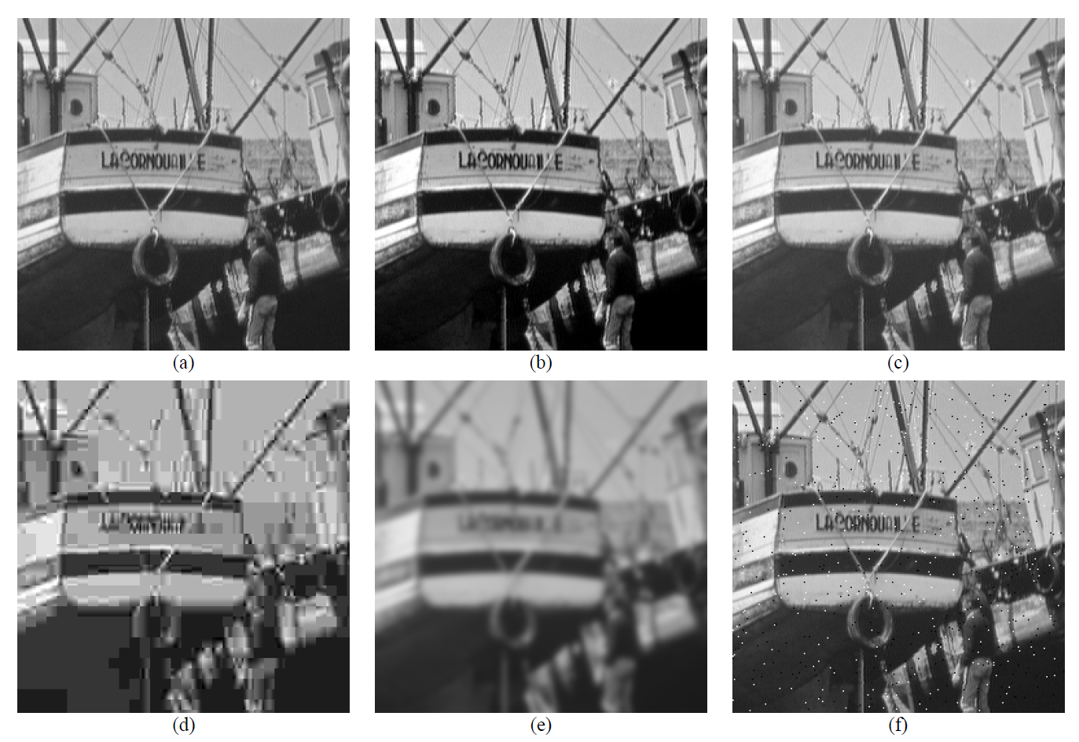
Peak Signal Noise Ratio (PSNR)

Slide 4

Structural Similarity Index (SSIM)
An image quality metric that assesses the visual impact of three characteristics of an image: luminance, contrast and structure.
Notes:
This section should explain some key technical elements in a concise way.

Slide 5
Luminance, Contrast and Structure
Luminance: Is a photometric measure of the luminous intensity per unit area traveling in a given direction. Describes the amount of light that passes through, is emmited or reflected from a particular area, and falls within a given solid angle. (candela per square metre, cd/m^2).
Contrast is the difference in luminance or colour that makes an object (or its representation in an image or display) distinguishable. The human visual system is more sensitive to contrast than absolute luminance.
Structure is the geometric comparison and correlation between two images.
Notes:
This section should explain some key technical elements in a concise way.

Slide 6






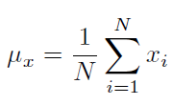
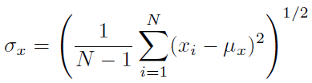

Structural Similarity Index (SSIM)
Notes:
This section should explain some key technical elements in a concise way.

Slide 7
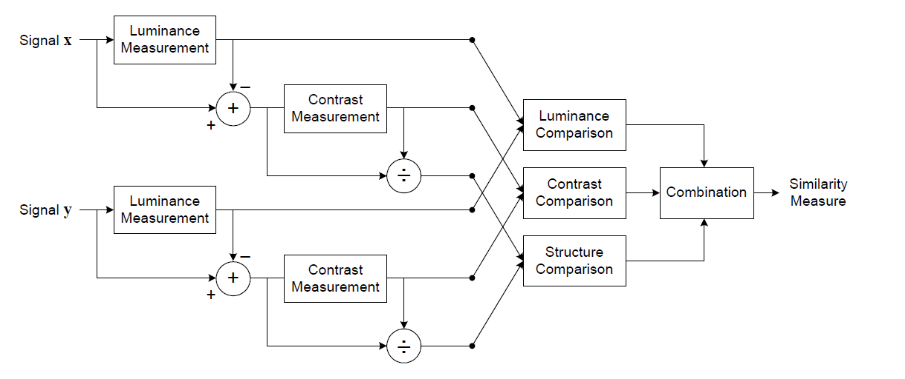

Structural Similarity Index (SSIM)
Notes:
This section should explain some key technical elements in a concise way.

Slide 8
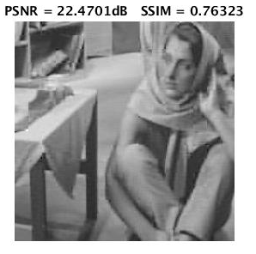
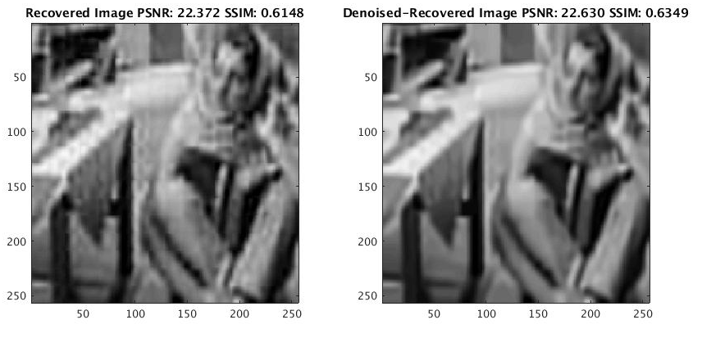
Structural Similarity Index in Practice
Notes:
This section should explain some key technical elements in a concise way.

Slide 9
End of Document

