Slide 1
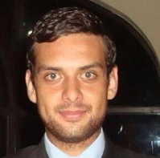
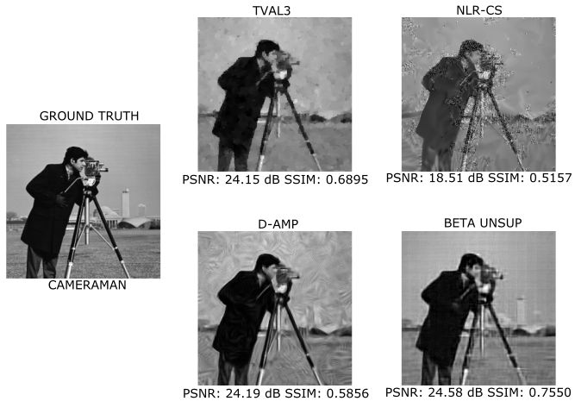
Image reconstruction from compressive sensing measurements using deep learning
Outline
Name: LUIS BRACAMONTES
Type: Master Thesis
Institute: University of Stuttgart
Duration: 01.04.2016-30.09.2016
Mentor: Javier Alonso
Prof.: Prof. Marc Toussaint
Explanation an Results:
Our approach consists of training a CNN, its input is compressed measurements and the output is the image. Unlike, traditional CS methods we do not used any optimization method to solve our task. Because of that we can recover images much faster, up to 188x, when compared to some state-of-the-art traditional algorithms. The following picture shows the result we obtained for recovering cameraman. As it can be observed, our proposed network produces better images.
Abstract:
In this thesis we addressed the problem of reconstructing images from compressive sensing measurements using a deep learning approach. We proposed a Convolutional Neural Network (CNN) that proved to successfully recover images. Our approach is able to perform faster while maintaining a high quality and good visual impact.

