Slide 1
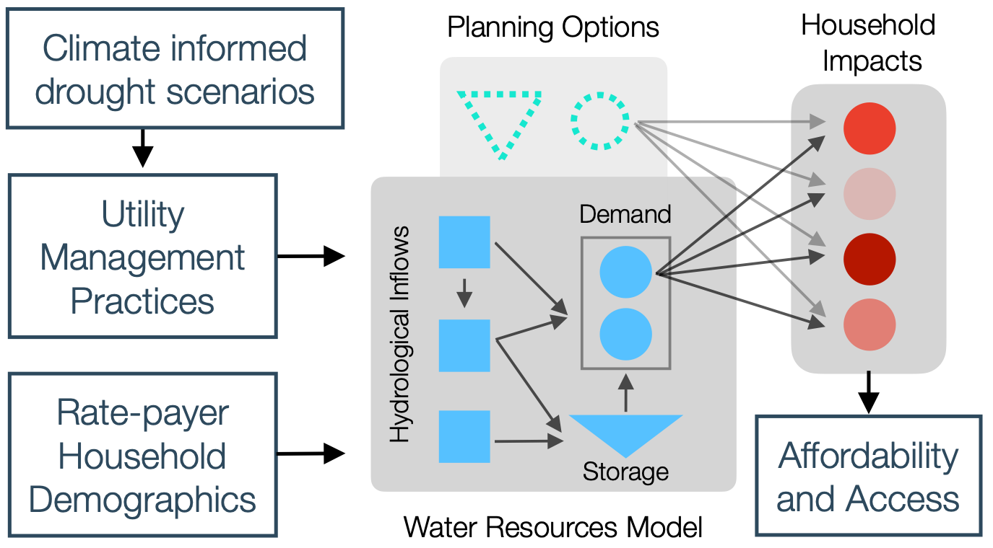
How do a utility’s water supply planning impact household water access and affordability in California?
Methods
Drought mitigation measures (e.g. investing in new supplies, asking people to conserve) increase water rates, and reduce access to water for the most vulnerable.
Numerical water systems models
Decision making and long-term planning under uncertainty
Climate-informed drought scenarios
Household-impact model schematic
Working to develop metrics of water affordability & access which reflect community needs
Affordability:
$$\frac{\text{Monthly Water Bill}}{\text{Monthly Household Income}}≤\text{0.02}$$
Access:
$$\text{Monthly Water Use}≥\text{6 ccf}$$

