Slide 1
Research Updates
Water Affordability &
Access in California Santa Cruz
Lab Meeting: 05/20/21
B. Rachunok

Slide 2

Previously,

Slide 3
Water Affordability & Accessibility
Over 1,000,000 people in California lack access to clean, affordable drinking water
Likely worsened by droughts
Additional stress on water systems and utilities
Notionally
Sourcing additional water is more expensive --> costs passed on to rate-payers
Mitigation actions (particularly demand-side) reduce water access below acceptable minimums

Slide 4
Drought Mitigation Actions
Presently focusing on drought mitigation
E.g. Available water supply <= water demand
Supply Side Examples
Demand Side Examples
Building new infrastructure
Buying water on the spot-market
Transfer water from other utilities/wholesalers
Residential water conservation
Turf replacement
Progressive rate structures

Slide 5
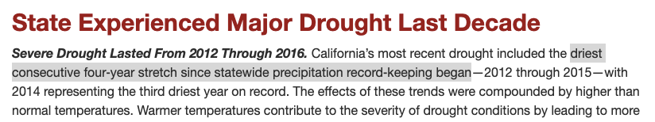


To start: retrospective of 2012-2016 drought

Slide 6
To start: retrospective of 2012-2016 drought
$115 million USD spent on emergency drinking water needs
$311 million USD spent on improving drinking water infrastructure
State intervention led to curtailment of water withdrawal in
Curtailment of water rights in the watersheds of the San-Joaquin River, Sacramento River, Yuba River, American River, Feather River, Scott River, Merced River, Deer Creek, Antelope Creek, Russian River, Mill Creek etc....

Slide 7
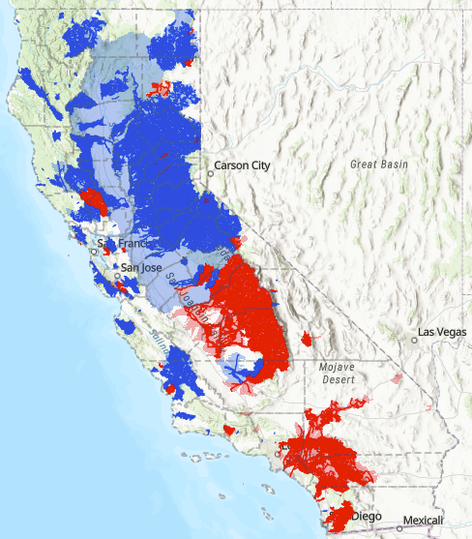
To start: retrospective of 2012-2016 drought
Last updated in 1998 when California had 20% less people
Many more shortfalls unadjudicated
There wasn’t enough water but the water rights holders didn’t ask the state to step in
Fully Appropriated Stream Systems (FASS) mean the ‘average’ streamflow ≈ total water rights
Red: No new water rights can be issued
Blue: No new summer water rights can be issued

Slide 8
To start: retrospective of 2012-2016 drought
“Santa Cruz and Santa Barbara were forced to implement mandatory water conservation by lack of water.” (Lund 2018)
Q: How did the 2012-2016 drought (and associated mitigation decisions) impact household level affordability and access to water?

Slide 9
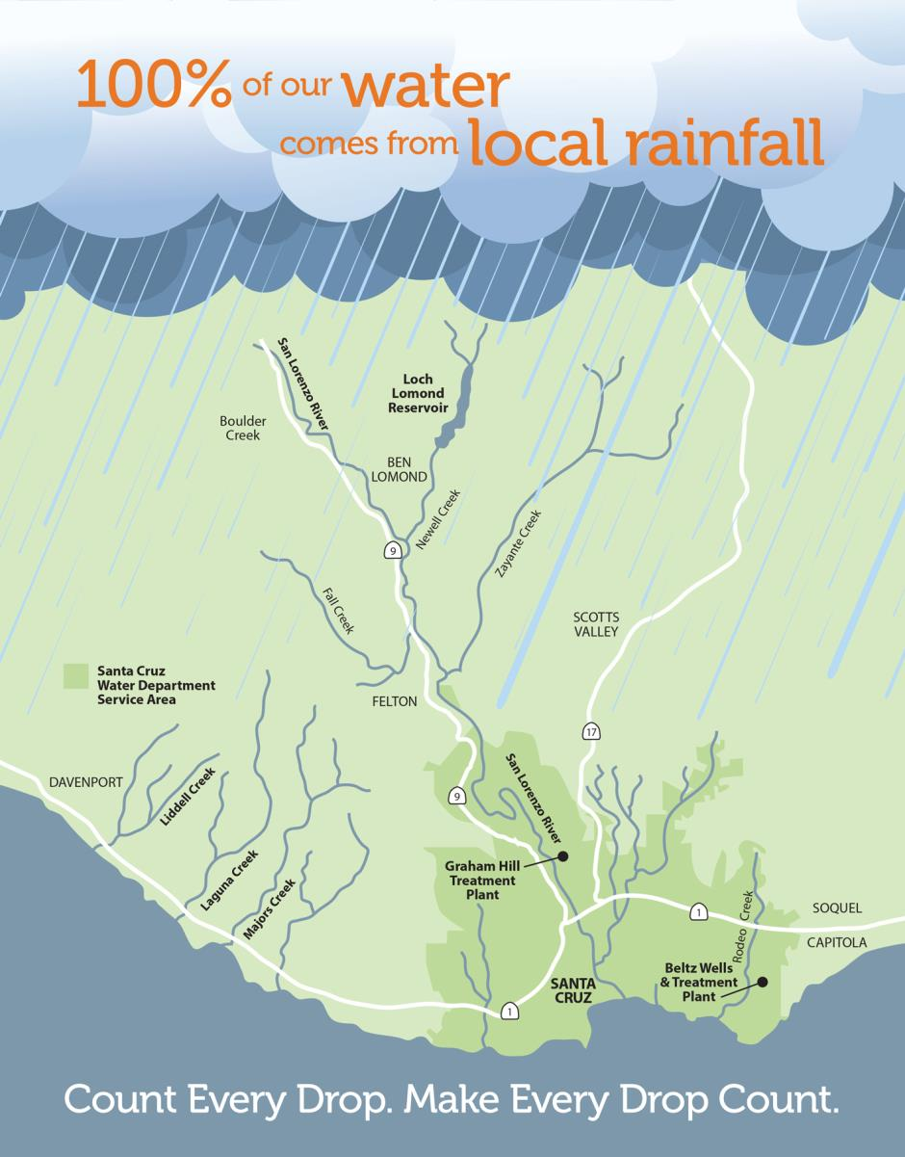
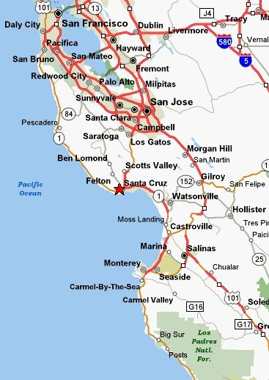
Santa Cruz
Population ~100,000
95% surface water, 5% groundwater
City controlled reservoir with maximum capacity of 2,810 mg
Surface water
Diversions from 3 coastal streams and a spring (26% of total supply)
Primary surface water river 55% supply
Reservoir 14% of supply
5% groundwater

Slide 10
Santa Cruz
Water Resources
Newell Creek
Loch Lomond
(2,810 mg)
Felton
Diversion
San Lorenzo River
Tait Street Diversion
City of Santa Cruz Demand
North Coast Creeks
Groundwater

Slide 11
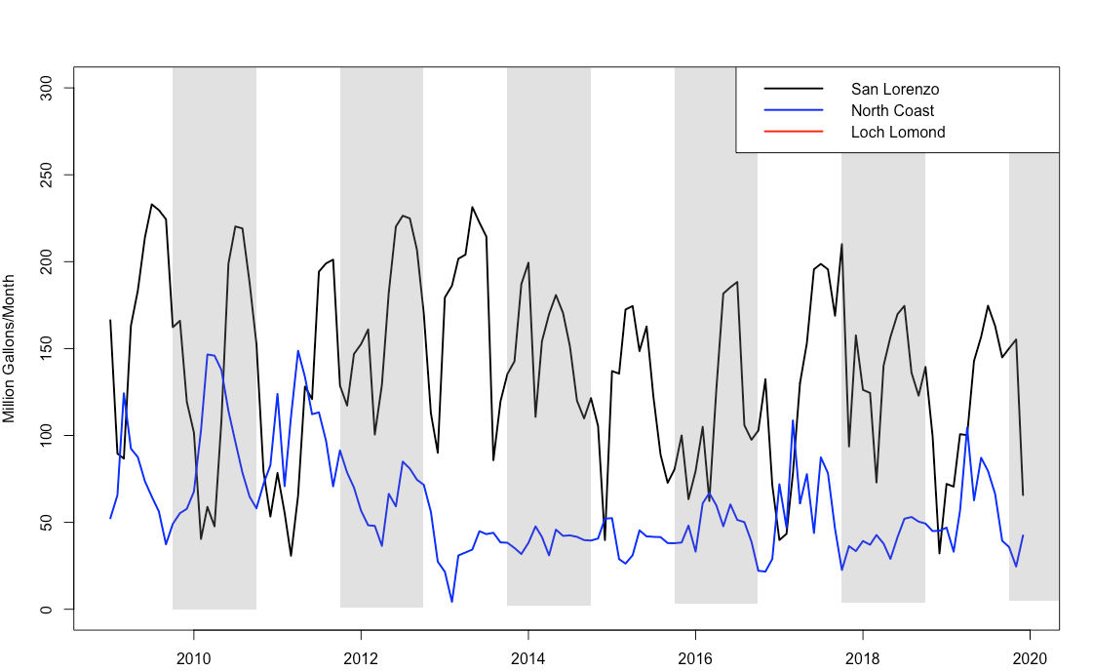
Santa Cruz Water Resources
Amount withdrawn from water rights
Limited by availability of water in the stream
Groundwater is 12mg/month every month

Slide 12
Santa Cruz Water Demand
Focus on household water costs/access
Need to model household-level water use
What contributes to household water use?
Currently considering
Month-to-month changes
Household use as a function of household size
Household use as a function of household income
Demand changes in response to prices signals (price elasticity)
Any conservation

Slide 13
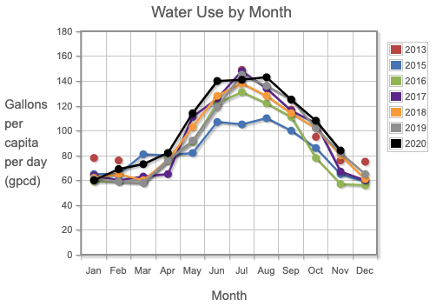
Household water demand
Unit of measure for residential demand is household
Start with median per-person-per-month water consumption in non-drought years
Reported by SWRCB
From: https://pacinst.org/gpcd/table/#

Slide 14
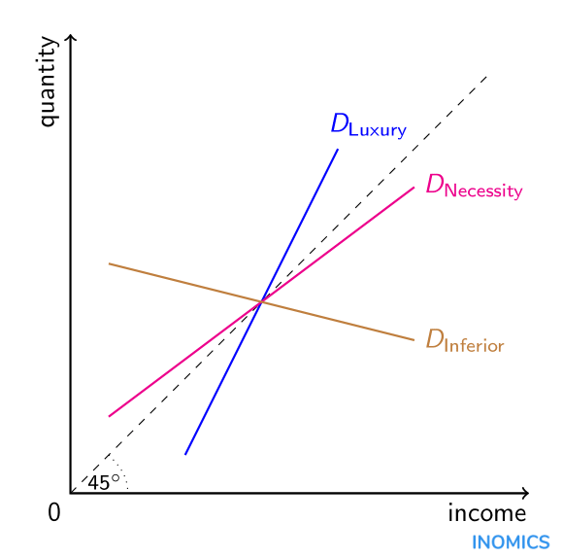
Household water demand
Adjust baseline water use based on household income
Using price elasticity of water demand
“Given a 1% increase in my income, how much more water do I consume?”
Lots of work by our friends in the economics world trying to estimate this value. We use 0.41
Elasticity value is slope of the line

Slide 15
Household water demand
EXAMPLE
Water use for median income: 100G/month
What’s the water use for someone making 150% of median income?
Elasticity value is slope of the line

Slide 16
Household water demand
EXAMPLE
Water use for median income: 100G/month
What’s the water use for someone making 150% of median income?
50% increase in income
Change in Income x Income Elasticity = Change in Quantity
50% increase x 0.41 = 20.5% increase in water use
= 120.5 G /month
Elasticity value is slope of the line

Slide 17
Household water demand
Use this to adjust water uses for 16 different income classes:
Household incomes of $7,500/yr all the way to up to $250,000+/yr
Calculate average size of households in each income class
Multiply income-adjusted per-person water use by household size to get a household water use
Elasticity value is slope of the line

Slide 18
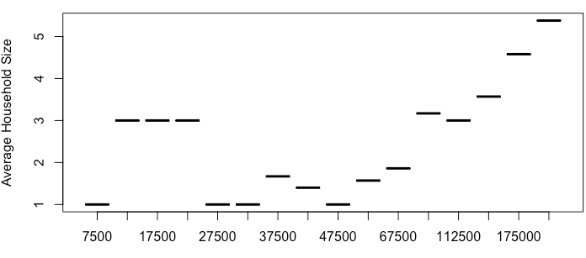
Household Size Trends for Santa Cruz
Data from the American Community Survey

Slide 19
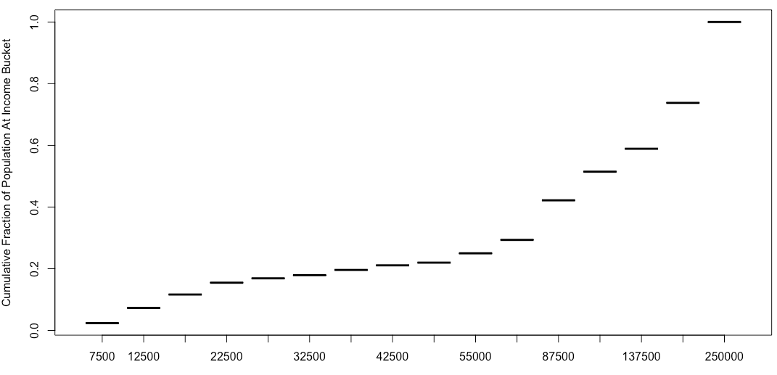
Income Trends for Santa Cruz
Data from the American Community Survey

Slide 20
Water Rates
Residential Bill = 13.55 + 1(CCF) + 9.03(0-5CCF) + 10.86(6-7CCF) + 12.78(8-9CCF) + 15.74(CCF 10+ )
Yellow: Fixed Charge or Ready to Serve Charge
Orange: Volumetric Charge
6 CCF (considered bare minimum for a family of 3) $78.54
10 CCF (Normal by some sources for a median family) $134.70

Slide 21
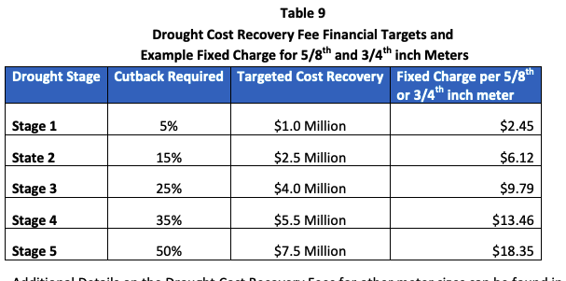
How do water rates change when conservation is enacted?
Conservation requirements mean less water used, less revenue for utilities
Revenue recovery accomplished through drought surcharges (right)
Flat rate increase to fixed charge
Over half of drought surcharges work this way (Feinstein 2018)
Surcharges (right column) for droughts in Santa Cruz

Slide 22
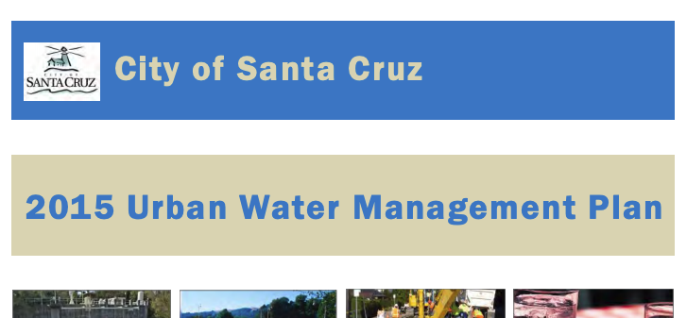
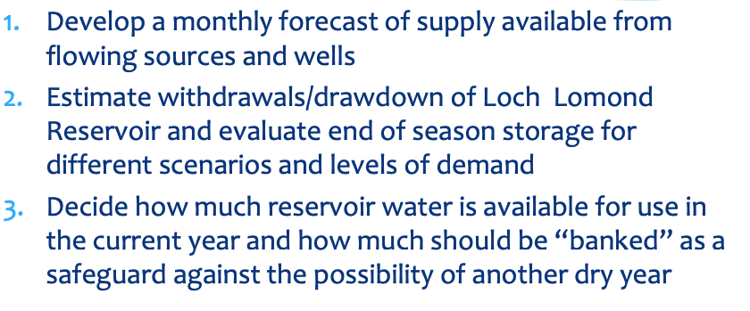
Conservation Decisions in the most recent drought

Slide 23
Starting point for alternative strategies
Historical Conservation Decisions 2012-2016
5% reduction
25% reduction

Slide 24
Starting point for alternative strategies
Historical Conservation Decisions 2012-2016
5% reduction
25% reduction
Baseline conservation results in a total volume reduced of 1143 mg over the approximately 3 year period
Averages to a 12.2% supply reduction

Slide 25
Starting point for alternative strategies
Historical Conservation Decisions 2012-2016
5% reduction
25% reduction
15% reduction
VS
Baseline conservation results in a total volume reduced of 1143 mg over the approximately 3 year period
Averages to a 12.2% supply reduction
Alternative conservation scenario is to use the same drought triggers and issue a 15% reduction the entire time
Total volume reduced: 1281 mg

Slide 26
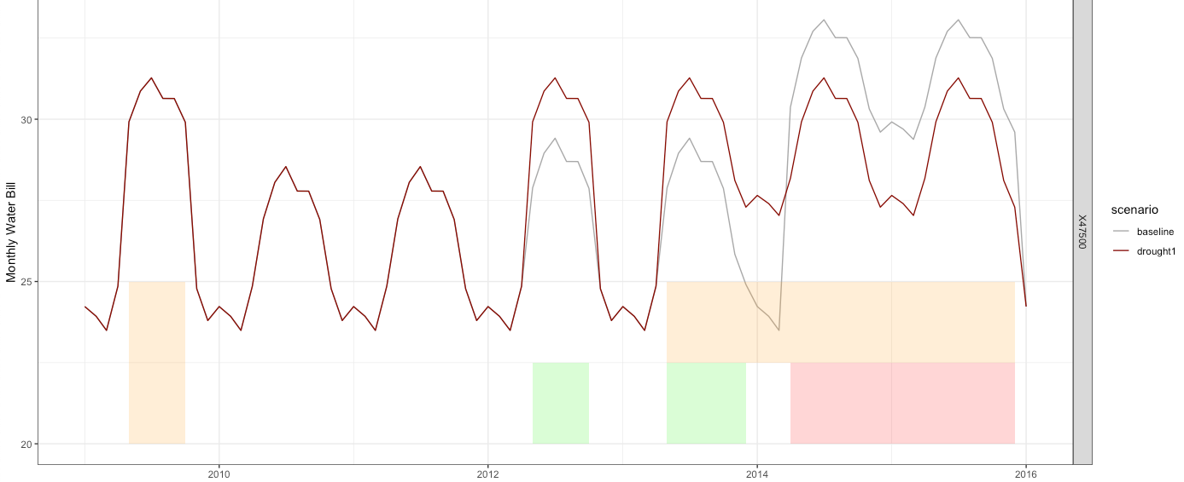
Household income of $47,500
15%
drought1
15%
15%
15%
Baseline
5%
5%
25%

Slide 27
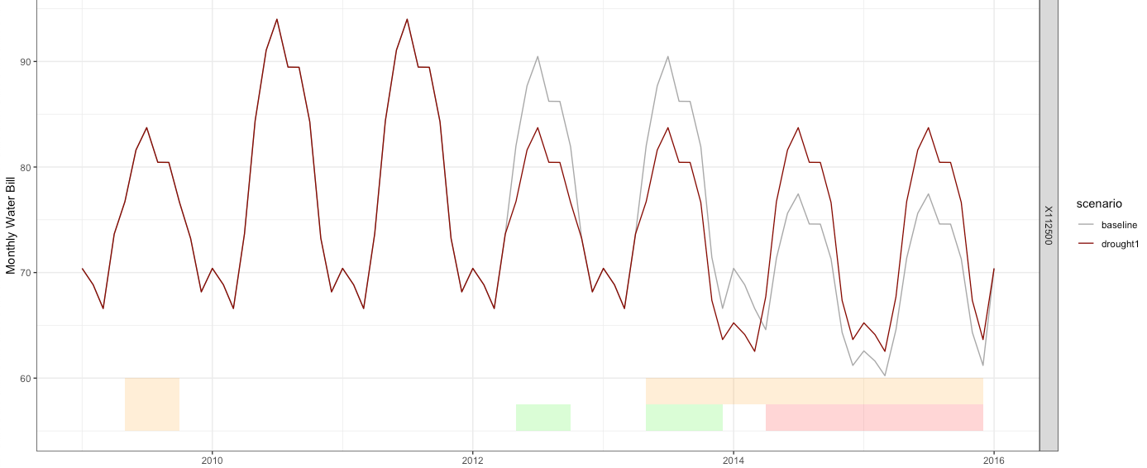
Household income of $112,500

Slide 28
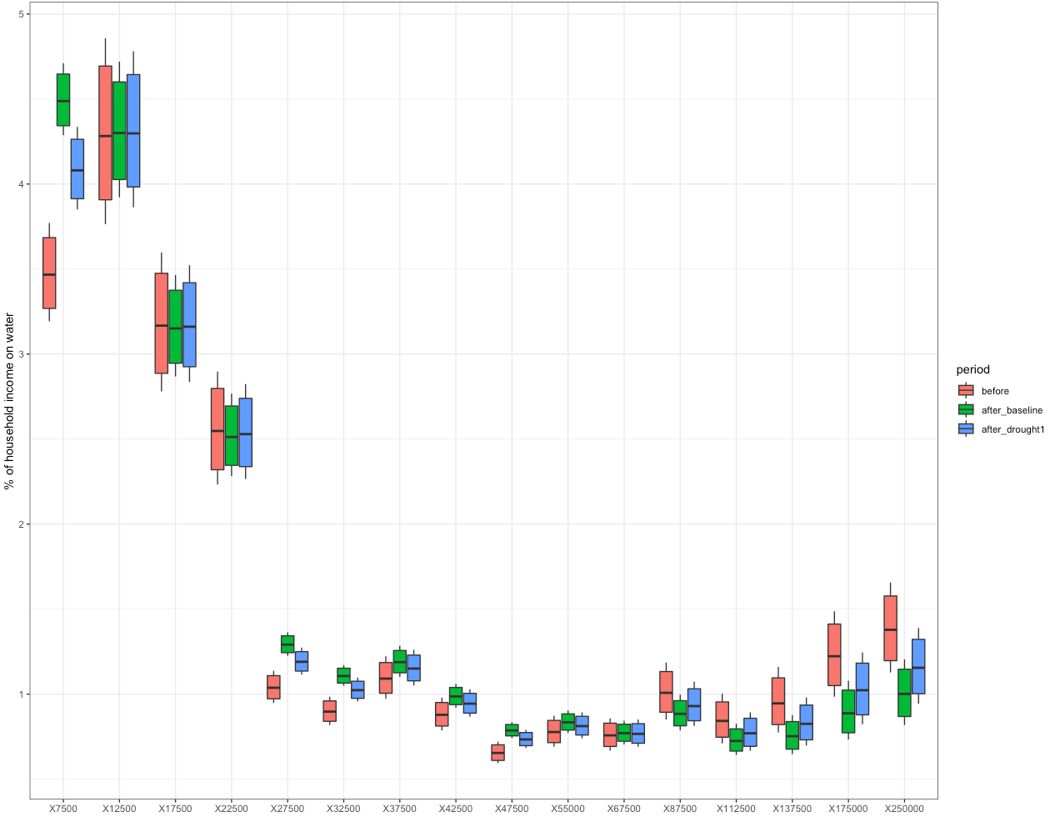
How much of a household’s income was spent on water before/after a drought?
Lowest income households have highest water rates relative to income
Highest income population still pays a high %age of income on water
Some income classes have water rates increase due to drought, some have decrease

Slide 29
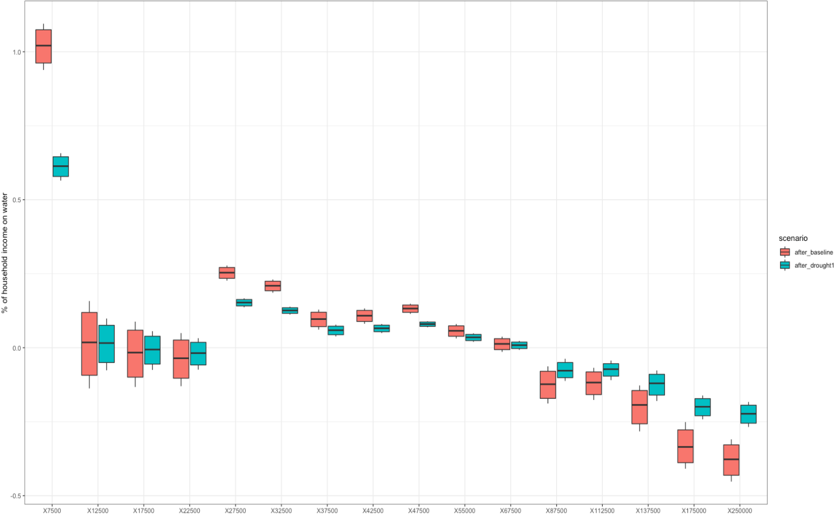
How much did the conservation decisions increase water bills as a percentage of income?
Note: these are differences in percentage points, not percent changes
Household size again appears as a large contributor
MHI ~ 61k/yr
Houses making above MHI saw bills decrease, below saw mixed results depending on household size

Slide 30
How much did the conservation decisions increase water bills as a percentage of income?
Note: these are differences in percentage points, not percent changes
Household size again appears as a large contributor
MHI ~ 61k/yr
Houses making above MHI saw bills decrease, below saw mixed results depending on household size

Slide 31
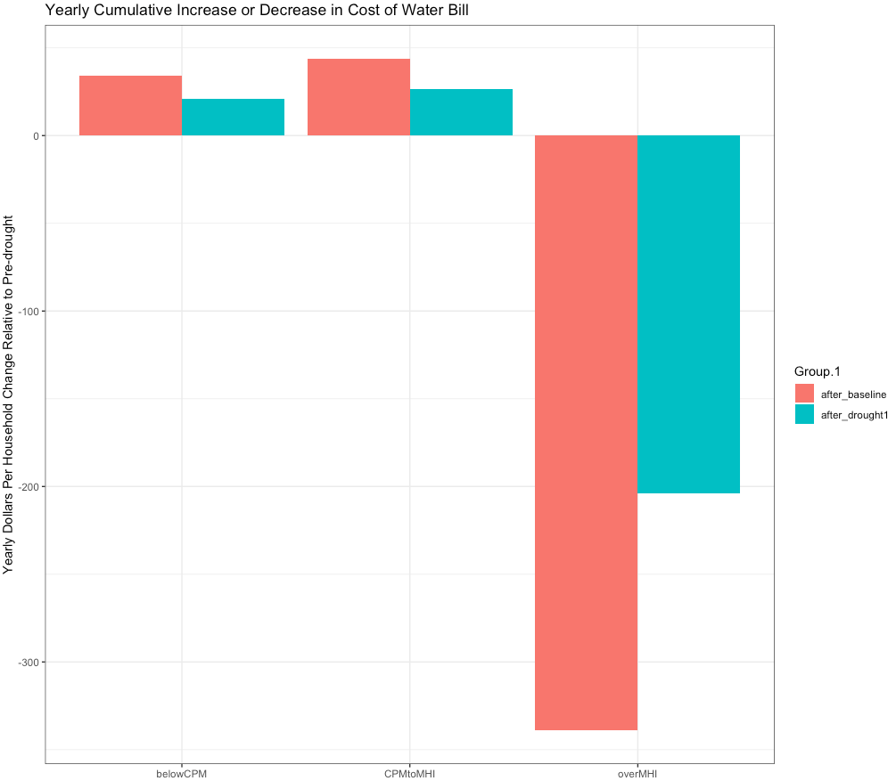
How to compare these values
BelowCPM: households making less than $34,000/yr (region-adjusted poverty line calculated by PPIC/Stanford Center on Poverty & Inequality)
CPMtoMHI: households making $34,000-$61,000/yr ($61,000/yr is MHI for the county)
overMHI: households making over $61,000/yr
Paints a relatively clear picture of affordability is changing, and for whom
Alternative conservation policies have the ability to limit affordability impacts of droughts

Slide 32
Questions?
Next Steps
Add a hypothetical, pre-drought infrastructure investment as an option
Expand the model to other cities in the state
Change the drought characteristics
Changing household size trends based on race, ethnicity, familial dynamics

Slide 33
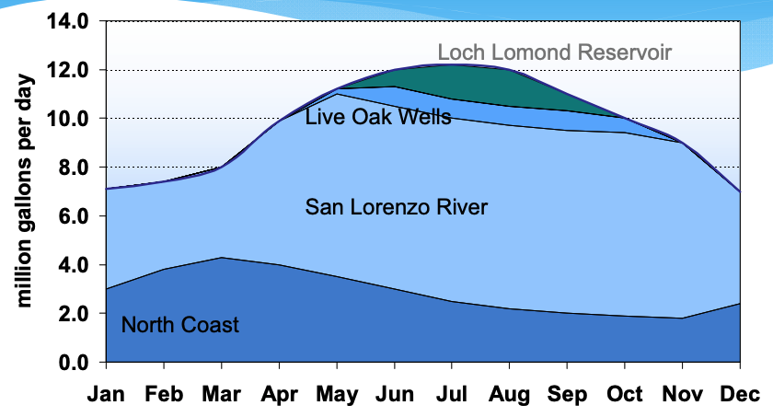
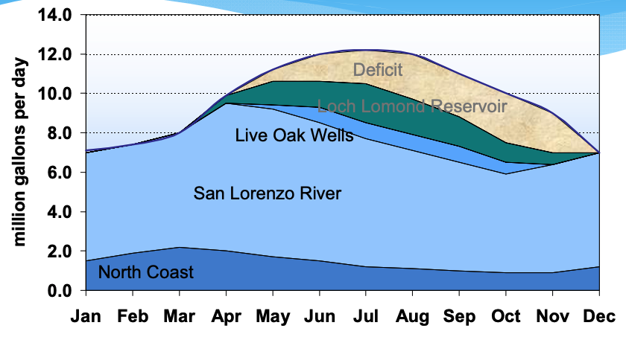
Operational Policies
Daily Dispatch Order
North Coast Surface Water
San Lorenzo Surface Water
Live Oak Wells (groundwater)
Reservoir

Slide 34
Water Balance For Santa Cruz
Natural inflow to reservoir
Net Reservoir Evaporation
Spillage (if necessary)
Volume of water stored at t+1
Surface Water Sources
Groundwater
Volume of water stored at t
Demand (adjusted)
Environmental outflow

Slide 35
How to sum this up as consistent policy:
Starting in October, natural reservoir inflows and a secondary river diversion are used to fill reservoir as much as possible
In March/April, forecasts for Apr-Oct total surface water availability and demand are generated
If (Reservoir Volume) - 2(Apr-Oct Demand) + (total Apr-Oct surface water availability this year) + (total Apr-Oct Surface water availability, worst case) > 1100MG
-> Drawdown reservoir to meet demand
ELSE
Implement conservation measures this year to get the above inequality to equality then drawdown reservoir to meet demand.

Slide 36
Model Validation -> total residential water use
UWMP annual total water demand: 2,450-3,252mg (range from 2015 to 2020)
Modeled total annual water demand: 2,939mg
UWMP annual residential demand (normal year): 2,049 mg
Modeled total annual residential water demand : 2,153 mg

Slide 37
Model Validation -> utility/household revenue/cost changes
Rate Study Drought Surcharges
Our calculations of lost revenue are in the ballpark of the cost recoveries listed (1.5 million, 3 million, 6 million)
They also draw from cash reserves to meet the revenue gap, meaning the cost recovery listed (left) is less than their total revenue loss
We estimate 33,000 homes in the water district using census data vs the utility’s reported 37,003, again just adding slight variation in the calculations
Ours
$1.75
$5.54
$9.26
Rate study was performed in 2014 in which their tiered rates were different, accounting for under-estimation

