Slide 1
Data Structures and Algorithms
Instructor: Dr. Hao Qin（秦浩）
E-mail: hao.qin@scupi.cn
My Office: Room 514, SCUPI (North)

Slide 2
Course Policies
General:
No cheating
Each student is expected to do his/her own work. All code submitted should be written by you unless explicitly allowed by the course instructor.
Attendance
Students are expected to all synchronous lectures while tutorials are optional.
Backup
Students are expected to have a backup disk (or storage somewhere) for every assignment they turn in. Data loss is NOT excusable.

Slide 3

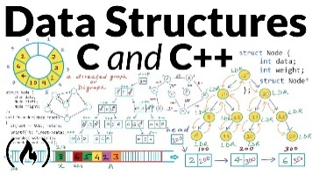
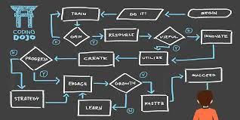


What You’ll Learn
Advanced C++ Topics
Object Oriented Programming and C++ language features
Data Structures
The most useful data structures (e.g., lists, trees, hash tables)
Algorithms
The most useful algorithms (e.g., sorting, searching)
Building Big Programs
How to write large programs (1000+ lines)

Slide 4
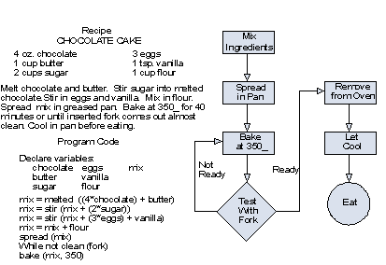
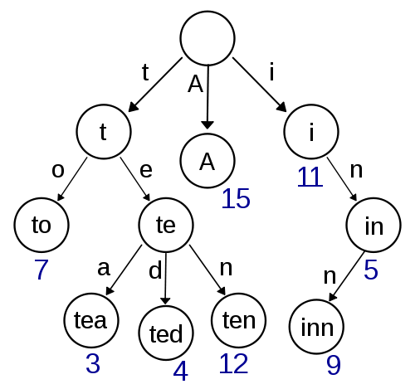
Let’s learn about…
Algorithms
Data Structures

Slide 5



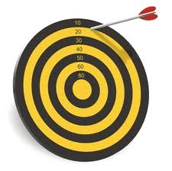
What is an Algorithm
An algorithm is a set of instructions/steps that solves a particular problem.
Each algorithm operates on input data.
42
Each algorithm produces an output result.
Each algorithm can be classified by how long it takes to run on a particular input.
Each algorithm can be classified by the quality of its results.

Slide 6
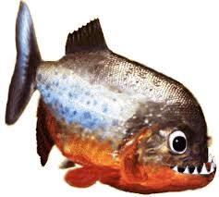
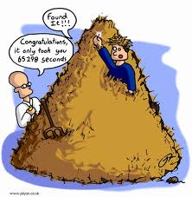
Algorithm Comparison “Guess My Word”
Let’s say you’re building a word guessing game.
The user secretly picks a random word from the dictionary.
ichthyology
Our program then must discover the word the user picked as quickly as possible.
Let’s consider two different algorithms…

Slide 7
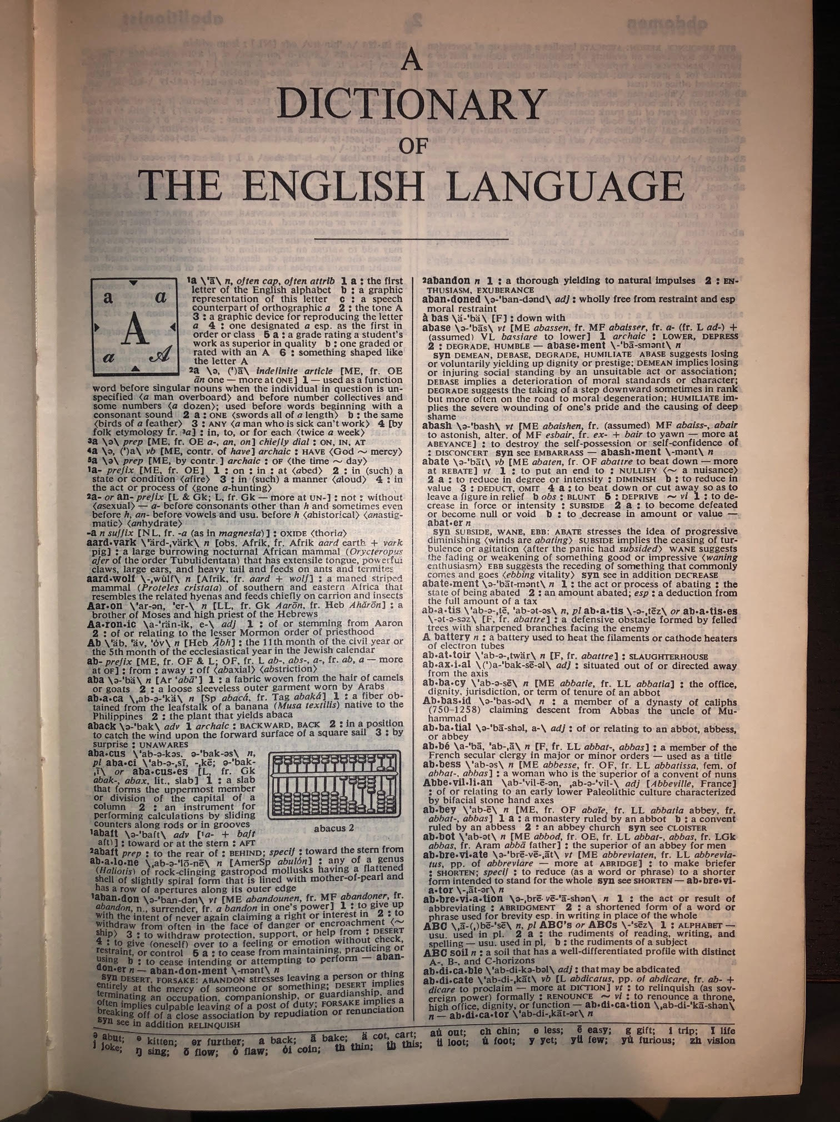
Algorithm #1: Linear Search
Let’s try a simple algorithm…
1. Ask the user to think of a random word
2. Start at the first word in the dictionary
3. While we haven’t found the user’s word:
a. Ask: “Is that your word?”
b. If not, advance to the next word
Question: If there are 100,000 total words in our dictionary, on average, how many guesses will our algorithm require?
Ok, let’s try it.
Notes:
Answer: Roughly N/2 guesses, on average, to guess the user’s word

Slide 8

Algorithm #2: Binary Search
Alright, for our second strategy let’s try a more intelligent approach called binary search:
1. Print: "Think of a random word"
2. While we haven’t found the word:
a. Pick the middle word in the dictionary
b. Ask: “Does your word come before or after that word?”
c. If their word comes before, throw away the 2nd half of the dictionary
d. If their word comes after, throw away the 1st half of the dictionary
A
B
C
D
E
F
G
H
I
J
K
L
M
N
O
P
Q
R
S
T
U
V
W
X
Y
Z
Question: If there are 100,000 total words in our dictionary, on average, how many guesses will our Binary Search algorithm require?
Ok, let’s try it.
Notes:
Answer, log (n) (that’s log with a base of 2)
2

Slide 9
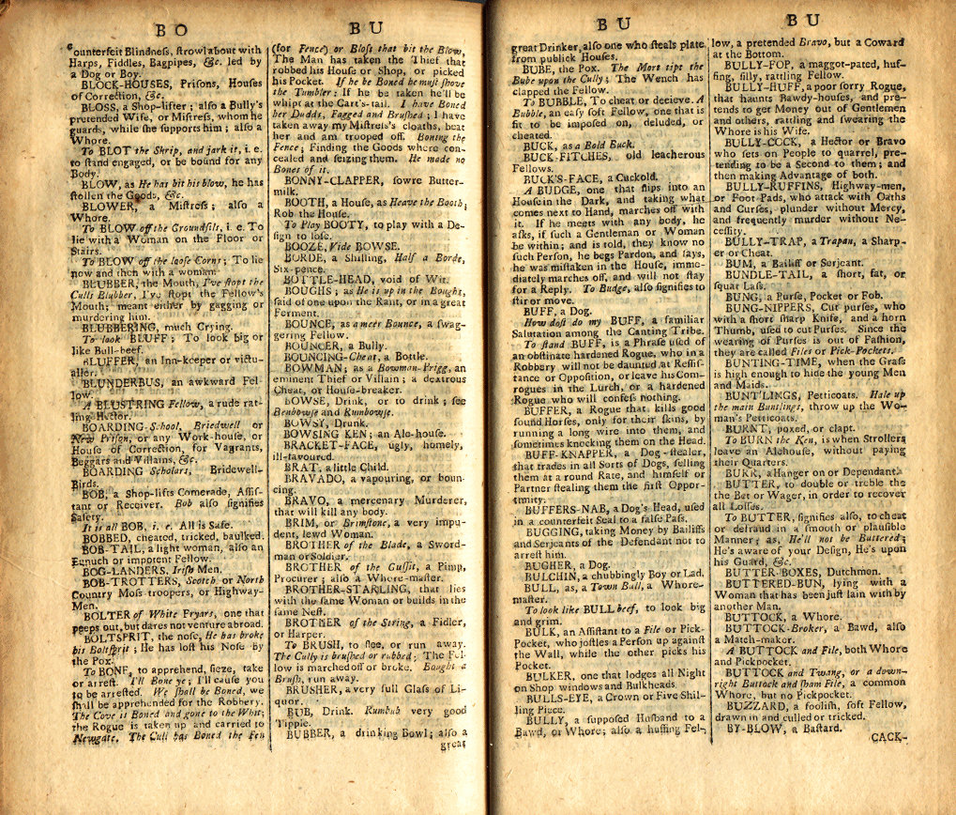
Binary Search: How Many Guesses?
We keep on dividing our search area in half until we finally arrive at our word.
In the worst case, we must keep halving our search area until it contains just a single word – our word!
If our dictionary had 16 words, how many times would we need to halve it until we have just one word left?
16
8
4
2
1
It would take 4 steps
Ok, what if our dictionary had 131,072 words?
131072
65536
32768
16384
8192
4096
2048
1024
512
256
128
64
32
16
8
4
2
1
It would take just 17 steps!!! WOW!

Slide 10
Wow! That’s Significant!
Linear search requires ~50,000 steps to guess a word from a 100k word dictionary.
But our binary search algorithm requires just 17 steps, on average, to guess the user’s secret word!
In this course, you’ll learn:
all the major algorithms,
how to analyze them, and
how to pick the best one

Slide 11
Data Structures
A data structure is the set of variable(s) that an algorithm uses to solve a problem.
Let's consider a data structure to efficiently store millions of DNA sequences so they can be searched.
DNA is made up of four bases:
Adenine, Cytosine, Guanine and Thymine

Slide 12
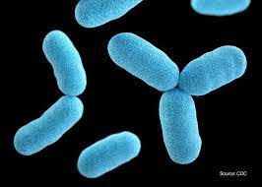
A Data Structure For DNA
If I wanted to store millions of bacterial DNA sequences, each with 10 bases:
atggacatct
acattaacga caccctcacc
accgtagaat
caccccagct
caccgaaatt
...
Corynebacterium diphtheriae
What simple data structure might I use?
Notes:
Corynebacterium diphtheriae 白喉杆菌

Slide 13
A Data Structure For DNA
Right! You could use a sorted array of strings!
string dna_seq[10000000];
dna_seq
[0]
[1]
[2]
[3]
[4]
[5]
...
acattaacga
accgtagaat
atggacatct
caccccagct
caccctcacc
caccgaaatt
...
Not bad. Given a new sequence, I could use binary search to determine if its is held in our data structure.

Slide 14
A Data Structure For DNA
Are there any drawbacks of the array data structure?
dna_seq
[0]
[1]
[2]
[3]
[4]
[5]
...
acattaacga
accgtagaat
atggacatct
caccccagct
caccctcacc
caccgaaatt
...
atgaacatct
Right! If we wanted to add even one new sequence, we'd have to move millions of items, and that'd be slow.

Slide 15
A Data Structure For DNA
Are there any other drawbacks of the array data structure?
dna_seq
[0]
[1]
[2]
[3]
[4]
[5]
...
acattaacga
accgtagaat
atggacatct
caccccagct
caccctcacc
caccgaaatt
...
Right! Arrays have a fixed capacity, so we're limited in how many DNA sequences we can add!

Slide 16
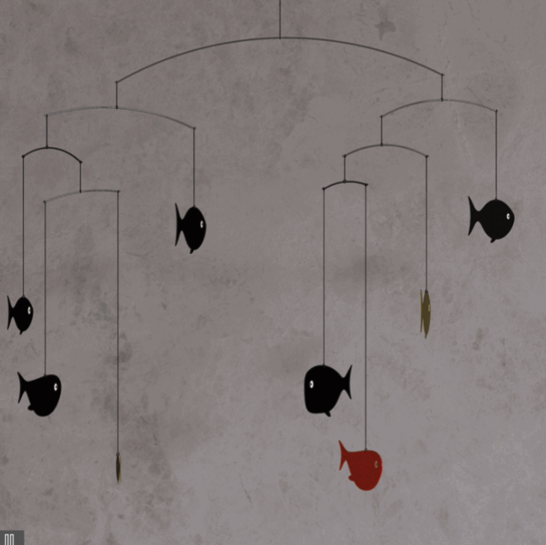
A Better Data Structure for DNA
Instead of an array, let's use a Trie data structure.
A Trie is just like a balanced mobile.
Let's see!

Slide 17

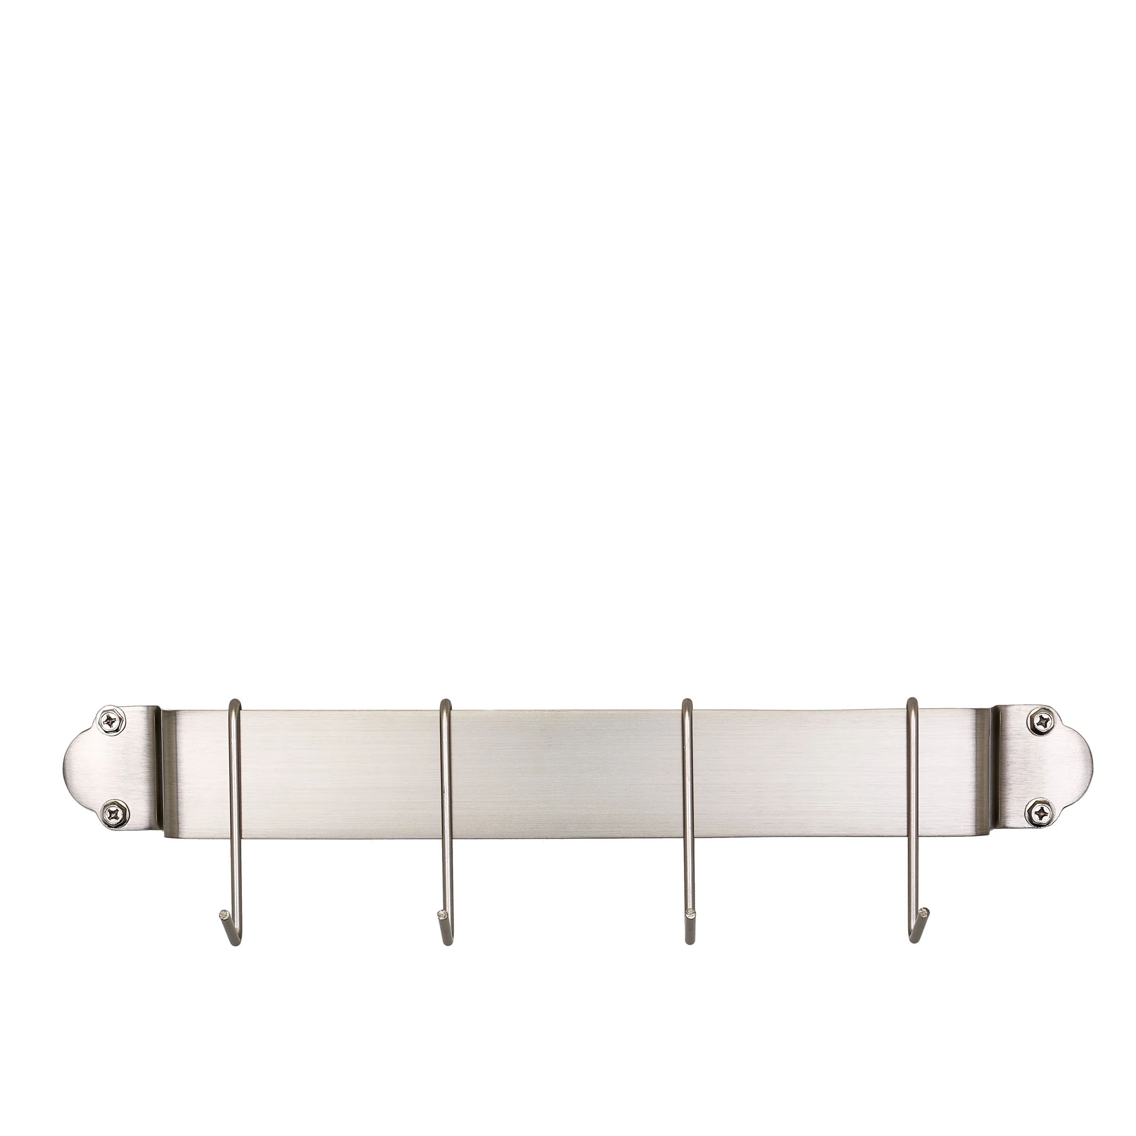

A Trie for DNA
atggacatct
a
c
g
t
Imagine each DNA sequence dangling from ten linked chains.
a
c
g
t
a
t
Now imagine a hanging bar with four hooks, one hook for A, one for C, one for G and one for T.
g
g
a
Starting with the first base of the sequence, hang its chain from the proper hook...
c
a
t
Add a new bar under the chain.
c
Repeat for all bases.
t

Slide 18

aacacgacta
Ok, let's add a second DNA sequence!
If we already have a chain hanging in the right spot, we can just use it.
a
a
a
a
t
Now, to search if a sequence is in our Trie, we just start at the top and follow the chains!
t
c
g
a
g
Is "atgattacgt" in our Trie?
a
c
g
g
a
a
c
c
t
a
a

Slide 19
A Trie for DNA
Enough analogies with chains!
Here's what our Trie might look like in RAM with real data structures.
Start
And it goes without saying that we'll need algorithms to process our data structure too...
a
c
void Trie::ins_helper(string key) {
// start from the root node
Trie* curr = this;
for (int i = 0; i < key.length(); i++) {
// create a new node if the path doesn't exist
if (curr->character[key[i]] == nullptr) {
curr->character[key[i]] = new Trie();
}
// go to the next node
curr = curr->character[key[i]];
}
...
bool Trie::src_primitive(string key) {
// return false if Trie is empty
if (this == nullptr) { return false; }
Trie* curr = this;
for (int i = 0; i < key.length(); i++) {
// go to the next node
curr = curr->character[key[i]];
// if the string is invalid (reached end of a path)
if (curr == nullptr) {
return false;
...
bool Trie::del_nodes(Trie*& curr, string key)
{
// return if Trie is empty
if (curr == nullptr) { return false; }
// if the end of the key is not reached
if (key.length()) {
if (curr != nullptr &&
curr->character[key[0]] != nullptr &&
deletion(curr->character[key[0]], key.substr(1)) && curr->isLeaf == false)
{
if (!haveChildren(curr))
...
c
t
a
a
c
g
c
t
g
g
c

Slide 20
A Trie for DNA
Question:
If each sequence is ten bases long, how many total levels deep is our Trie?
Start
a
c
Answer:
At most ten levels deep!
c
t
a
How many levels deep?
a
c
g
c
t
g
g
c

Slide 21
A Trie for DNA
Question:
How many steps would it take to find if a DNA sequence is held in our Trie?
Start
a
c
Answer:
At most ten steps!
c
t
a
a
c
g
c
t
g
g
c

Slide 22
A Trie for DNA
Question:
If we had to add a new DNA sequence, how many steps would it take?
Start
Answer:
At most ten steps!
a
c
c
t
a
a
c
g
c
t
g
g
c

Slide 23
Sorted Array vs. Trie
Sorted Array | Trie
Limited capacity | Infinitely expandable
Need to move millions of items every time we add an item | Just ten steps to add a new item!
Searchable in dozens of steps | Searchable in ten steps every time
Easy to implement | More complex to implement

Slide 24
Data Structures
As we can see, the right data structure can make your algorithms far more efficient!
So in this course, we'll also learn all of the most efficient data structures!

Slide 25
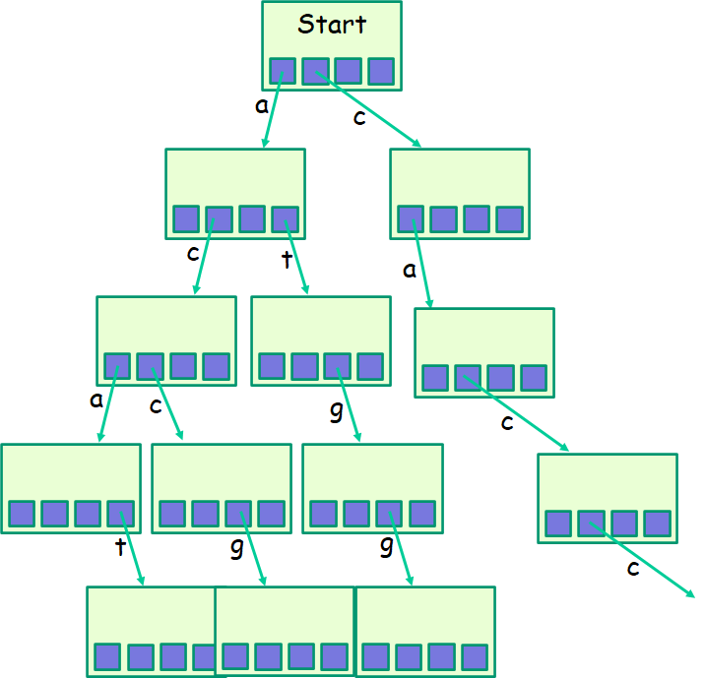

Data Structures + Algorithms = Confusion!
Without having to understand any of the confusing details!
As we've seen, your data structures and algorithms can get quite complex.
void Trie::ins_helper(string key) {
// start from the root node
Trie* curr = this;
for (int i = 0; i < key.length(); i++) {
// create a new node if the path doesn't exist
if (curr->character[key[i]] == nullptr) {
curr->character[key[i]] = new Trie();
}
// go to the next node
curr = curr->character[key[i]];
}
...
bool Trie::src_primitive(string key) {
// return false if Trie is empty
if (this == nullptr) { return false; }
Trie* curr = this;
for (int i = 0; i < key.length(); i++) {
// go to the next node
curr = curr->character[key[i]];
// if the string is invalid (reached end of a path)
if (curr == nullptr) {
return false;
...
bool Trie::del_nodes(Trie*& curr, string key)
{
// return if Trie is empty
if (curr == nullptr) { return false; }
// if the end of the key is not reached
if (key.length()) {
if (curr != nullptr &&
curr->character[key[0]] != nullptr &&
deletion(curr->character[key[0]], key.substr(1)) && curr->isLeaf == false)
{
if (!haveChildren(curr))
...
Such a collection of simple functions is called an “interface.”
If you gave your code to another programmer, they would have no idea how to use it!
So it always helps to also create a few simple functions that hide the gory details…
An interface lets any programmer use your code…
int main()
{
addSequence(“tgaccagact”);
if (findSequence(“gcgttaacac”) == true) cout << “This is a known DNA snippet!\n”;
}
bool findSequence(string dna_sequence);
void addSequence(string dna_sequence);
void deleteSequence(string dna_sequence);

Slide 26
The Abstract Data Type (ADT)
In CS, we call a coordinated group of
data structures, algorithms and interface functions
an Abstract Data Type.
Abstract Data Type (for DNA searching)
void Trie::ins_helper(string key) {
// start from the root node
Trie* curr = this;
for (int i = 0; i < key.length(); i++) {
// create a new node if the path doesn't exist
if (curr->character[key[i]] == nullptr) {
curr->character[key[i]] = new Trie();
}
// go to the next node
curr = curr->character[key[i]];
}
...
+
bool Trie::src_primitive(string key) {
// return false if Trie is empty
if (this == nullptr) { return false; }
Trie* curr = this;
for (int i = 0; i < key.length(); i++) {
// go to the next node
curr = curr->character[key[i]];
// if the string is invalid (reached end of a path)
if (curr == nullptr) {
return false;
...
+
bool Trie::del_nodes(Trie*& curr, string key)
{
// return if Trie is empty
if (curr == nullptr) { return false; }
// if the end of the key is not reached
if (key.length()) {
if (curr != nullptr &&
curr->character[key[0]] != nullptr &&
deletion(curr->character[key[0]], key.substr(1)) && curr->isLeaf == false)
{
if (!haveChildren(curr))
...
bool findSequence(string sequence);
void addSequence(string sequence);
void deleteSequence(string sequence);
In an ADT, the data structures and algorithms are secret.
The ADT provides an interface (a simple set of functions) to enable the rest of the program to use it.
Typically, we build programs from a collection of ADTs, each of which solves a different sub-problem.

Slide 27
ADTs in C++
In C++, we use classes to define ADTs in our programs!
Each C++ class holds data structures, algorithms and interface functions!
Once we’ve defined our class, the rest of our program can use it trivially.
All our program needs to do is call the functions in our class’s public interface!
The rest of the program can ignore the details of how our class works and just use its features!
// A C++ DNA sequencer class…
// (this is really an ADT!)
class DNADatabase
{
public:
private:
};
int main()
{
DNADatabase d;
d.addSequence(“gagagtcaca”);
d.addSequence(“tcaggacata”);
…
string dna_seq;
cout << "Enter a 10-base sequence: ";
cin >> dna_seq;
if (d.findSequence(dna_seq) == true)
cout << "This bacteria is known!";
}
// our interface functions go here
void findSequence(…);
void addSequence(…);
...
// secret algorithms go here
…
// secret data structures go here
…

Slide 28

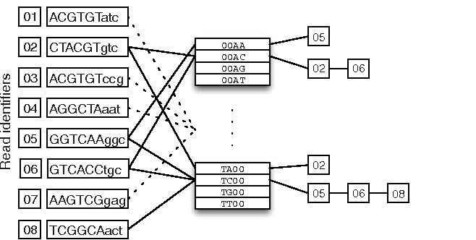
ADTs in C++
void Hash::search(int key) {
// get the hash index of key
int index = hashFunction(key);
// find the key in (index)th list
list <int> :: iterator i;
for (i = table[index].begin();
i != table[index].end(); i++) {
if (*i == key) break;
}
// if key is found in hash table, remove it
if (i != table[index].end())
table[index].erase(i);
}
void Trie::ins_helper(string key) {
// start from the root node
Trie* curr = this;
for (int i = 0; i < key.length(); i++) {
// create a new node if the path doesn't exist
if (curr->character[key[i]] == nullptr) {
curr->character[key[i]] = new Trie();
}
// go to the next node
curr = curr->character[key[i]];
}
...
void Hash::delete(int key) {
// get the hash index of key
int index = hashFunction(key);
// find the key in (index)th list
list <int> :: iterator i;
for (i = table[index].begin();
i != table[index].end(); i++) {
if (*i == key) break;
}
// if key is found in hash table, remove it
if (i != table[index].end())
table[index].erase(i);
}
bool Trie::src_primitive(string key) {
// return false if Trie is empty
if (this == nullptr) { return false; }
Trie* curr = this;
for (int i = 0; i < key.length(); i++) {
// go to the next node
curr = curr->character[key[i]];
// if the string is invalid (reached end of a path)
if (curr == nullptr) {
return false;
...
void Hash::insert(int key) {
// get the hash index of key
int index = hashFunction(key);
// find the key in (index)th list
list <int> :: iterator i;
for (i = table[index].begin();
i != table[index].end(); i++) {
if (*i == key) break;
}
// if key is found in hash table, remove it
if (i != table[index].end())
table[index].erase(i);
}
bool Trie::del_nodes(Trie*& curr, string key)
{
// return if Trie is empty
if (curr == nullptr) { return false; }
// if the end of the key is not reached
if (key.length()) {
if (curr != nullptr &&
curr->character[key[0]] != nullptr &&
deletion(curr->character[key[0]], key.substr(1)) && curr->isLeaf == false)
{
if (!haveChildren(curr))
...
int main()
{
DNADatabase d;
d.addSequence(“gagagtcaca”);
d.addSequence(“tcaggacata”);
…
string dna_seq;
cout << "Enter a 10-base sequence: ";
cin >> dna_seq;
if (d.findSequence(dna_seq) == true)
cout << "This bacteria is known!";
}
Now what if I wanted to improve my class’s implementation?
Let’s say I made a radical change to my data structures & algorithms…
Would the user need to change any part of their program?
No! Because these details are hidden from the rest of our code!

Slide 29
ADTs in C++
void Hash::search(int key) {
// get the hash index of key
int index = hashFunction(key);
// find the key in (index)th list
list <int> :: iterator i;
for (i = table[index].begin();
i != table[index].end(); i++) {
if (*i == key) break;
}
// if key is found in hash table, remove it
if (i != table[index].end())
table[index].erase(i);
}
void Trie::ins_helper(string key) {
// start from the root node
Trie* curr = this;
for (int i = 0; i < key.length(); i++) {
// create a new node if the path doesn't exist
if (curr->character[key[i]] == nullptr) {
curr->character[key[i]] = new Trie();
}
// go to the next node
curr = curr->character[key[i]];
}
...
void Hash::delete(int key) {
// get the hash index of key
int index = hashFunction(key);
// find the key in (index)th list
list <int> :: iterator i;
for (i = table[index].begin();
i != table[index].end(); i++) {
if (*i == key) break;
}
// if key is found in hash table, remove it
if (i != table[index].end())
table[index].erase(i);
}
bool Trie::src_primitive(string key) {
// return false if Trie is empty
if (this == nullptr) { return false; }
Trie* curr = this;
for (int i = 0; i < key.length(); i++) {
// go to the next node
curr = curr->character[key[i]];
// if the string is invalid (reached end of a path)
if (curr == nullptr) {
return false;
...
void Hash::insert(int key) {
// get the hash index of key
int index = hashFunction(key);
// find the key in (index)th list
list <int> :: iterator i;
for (i = table[index].begin();
i != table[index].end(); i++) {
if (*i == key) break;
}
// if key is found in hash table, remove it
if (i != table[index].end())
table[index].erase(i);
}
bool Trie::del_nodes(Trie*& curr, string key)
{
// return if Trie is empty
if (curr == nullptr) { return false; }
// if the end of the key is not reached
if (key.length()) {
if (curr != nullptr &&
curr->character[key[0]] != nullptr &&
deletion(curr->character[key[0]], key.substr(1)) && curr->isLeaf == false)
{
if (!haveChildren(curr))
...
int main()
{
DNADatabase d;
d.addSequence(“gagagtcaca”);
d.addSequence(“tcaggacata”);
…
string dna_seq;
cout << "Enter a 10-base sequence: ";
cin >> dna_seq;
if (d.findSequence(dna_seq) == true)
cout << "This bacteria is known!";
}
This is a huge benefit of Abstract Data Types!
We can break up our programs into small, self-contained ADTs...
And combine these smaller parts together to solve bigger problems.

Slide 30

What is Object Oriented Programming?
Object Oriented Programming (OOP) is simply a programming model based on the Abstract Data Type (ADT) concept we just learned!
In OOP, programs are constructed from multiple self-contained classes.
Each class holds a set of data structures and algorithms - we then access the class using a set of interface functions!
Classes talk to each other only by using public interface functions – each class knows nothing about how the others work inside.

Slide 31


C++ Class Review
As we’ve seen, a “class” is a self-contained problem solver that contains:
Data structures
Algorithms
Interface functions
Since you’ve probably forgotten everything about classes…
Let’s do a quick review of classes by defining our own Nerd class!

Slide 32
Defining a New Class
class
Nerd
{
}
First, we write the outer shell of our class and give it a name.
public:
Nerd(int stink, int IQ) { myStinkiness = stink; myIQ = IQ; }
Then we define our class’s public interface functions…
void study(int hours) { myStinkiness += 3*hours; myIQ *= 1.01; }
Then we define our class’s private variables and functions…
int getStinkyLevel() { int total_stink = myIQ * 10 +
myStinkiness;
return total_stink;
}
Our class defines an entirely new data type, like int or float, that we can now use in our program.
private:
Alert: Nerd is not a variable! It’s a new C++ data type!
void takeShower()
{ myStinkiness /= 2; }
int myStinkiness, myIQ;
;

Slide 33
Using a New Class
nerd.h
class Nerd
{
public:
Nerd(int stink, int IQ) { myStinkiness = stink; myIQ = IQ; }
void study(int hours) { myStinkiness += 3*hours; myIQ *= 1.01; }
…
private:
int myStinkiness, myIQ;
};
Once we define a new class, like Nerd, we can use it to define variables like any traditional data type.
You typically define each new class in its own .h file (“header file”) and put the file in the same folder as your .cpp files.
To use your new class, simply include its header file using “quotation marks”…
main.cpp
#include “nerd.h”
Just as num_nerds is an integer variable…
And then define variables with it throughout your program.
int main()
{
int num_nerds = 1;
Nerd david(30, 150);
david.study(10);
}
When we define a new object, we can specify parameters to initialize it.
david is a Nerd variable.
Class variables are also called "objects" or "instances."

Slide 34
Using a New Class
nerd.h
class Nerd
{
public:
Nerd(int stink, int IQ) { myStinkiness = stink; myIQ = IQ; }
void study(int hours) { myStinkiness += 3*hours; myIQ *= 1.01; }
…
private:
int myStinkiness, myIQ;
};
Think of a constructor function as an initializer, e.g.:
Nerd david;
david.initialize(30,150);
Alright, let’s see our class in action!
Nerd(int stink, int IQ) { myStinkiness = stink; myIQ = IQ; }
void study(int hours) { myStinkiness += 3*hours; myIQ *= 1.01; }
…
num_nerds
1
30
150
david
Our constructor and other member functions have access to david’s private member variables!
myStinkiness
myIQ
As soon as the variable is created, C++ immediately calls the constructor function inside the variable to initialize its state.
-79342
12338
main.cpp
#include “nerd.h”
And so on...
Note: A class’s primitive member variables (e.g. int’s, doubles) all start out with random values!
int main()
{
int num_nerds = 1;
Nerd david(30, 150);
david.study(10);
}
When you define your david variable, it gets its own copy of all of the functions and member variables defined in your class!
30
150
10

Slide 35
Other Details
nerd.h
class Nerd
{
public:
Nerd(int stink, int IQ) { myStinkiness = stink; myIQ = IQ; }
void study(int hours) { myStinkiness += 3*hours; myIQ *= 1.01; }
…
private:
int myStinkiness, myIQ;
};
You use member variables to store permanent attributes of your class.
Stinkiness and IQ are inherent attributes of every Nerd.
So we make these member variables.
int getStinkyLevel() { int total_stink = myIQ * 10 + myStinkiness;
return total_stink;
}
total_stink
On the other hand, we use local variables for temporary computations.
main.cpp
#include “nerd.h”
int main()
{
int num_nerds = 1;
Nerd david(30, 150);
david.study(10);
}

Slide 36
Other Details
nerd.h
class Nerd
{
public:
Nerd(int stink, int IQ) { myStinkiness = stink; myIQ = IQ; }
void study(int hours) { myStinkiness += 3*hours; myIQ *= 1.01; }
…
private:
int myStinkiness, myIQ;
};
So they can only be accessed by your class’s member functions.
C++ strictly enforces class privacy!
All functions in the public section can be used by all parts of your program.
However, these members are private.
main.cpp
#include “nerd.h”
int main()
{
int num_nerds = 1;
Nerd david(30, 150);
david.study(10);
}
Code outside your class can’t directly access them, however.
For instance, here we see our main() function using Nerd’s public study() function!
cout << david.myStinkiness;
ERROR!

