Slide 1
Data Structures and Algorithms
Instructor: Dr. Hao Qin（秦浩）
E-mail: hao.qin@scupi.cn
My Office: Room 514, SCUPI (North)

Slide 2
Outline
Part 1: Basic C++ Concepts
Constructors
Destructors
Class Composition
Composition with Initializer Lists
Part 2: On-your-own Study Topics
Learning how to use the Visual C++/Xcode debuggers
A few topics you need to know to do real projects

Slide 3


Constructors and Destructors
What’s the big picture?
A constructor function is used to reset an object’s member variables when the object is first created; otherwise they’d be random!
Constructors
class SomeClass {
public:
void blah() { cout << v; } // random value!
private:
int v; // uninitialized if no constructor!
};
An object will often reserve memory slots from the operating system while it runs.
Uses:
Constructors and destructors are required for virtually every correct C++ class.
Destructors
A destructor function guarantees that reserved memory is freed when an object goes away.
If you don’t free this memory, your program will eventually run out of memory and crash.

Slide 4
Constructor Basics
Has 2 Params!
class Gassy
{
public:
Gassy(int age, bool ateBeans
{
m_age = age;
m_ateBeans = ateBeans;
}
int getFartsPerHr()
{
if(m_ateBeans == true)
return(100);
return(3 * m_age);
}
private:
int m_age;
bool m_ateBeans;
};
Here’s our Gassy class…. It represents gassy people.
)
Our Gassy class has a constructor that takes two parameters to initialize it.
If a constructor has parameters, then you must pass values in to them!
Requires two args!
int main() {
}
Gassy betty(18,true);
Gassy alan;
// error!

Slide 5
goes to this constructor, since it has matching parameters.
Constructor Basics
class Gassy
{
public:
Gassy(int age, bool ateBeans)
{
m_age = age;
m_ateBeans = ateBeans;
}
private:
int m_age;
bool m_ateBeans;
};
Gassy()
{
m_age = 0;
m_ateBeans = false;
}
Your class can have many different constructors…
goes to this constructor, since it requires no parameters.
The only requirement is that each one has different parameters and/or types.
int getFartsPerHr()
{
if(m_ateBeans == true)
return(100);
return(3 * m_age);
}
This is called constructor overloading.
This variable initialization…
and this initialization…
int main() {
}
Gassy betty(18,true);
Gassy alan;
// error!
// OK!!!

Slide 6
Constructor Basics
If you don’t define any constructors at all…
class Gassy
{
public:
Then C++ generates an implicit, default constructor for you.
Gassy() // generated by compiler
{
// I don’t init primitive member // variables… So be careful!!!
}
int getFartsPerHr()
{
if(m_ateBeans == true)
return(100);
return(3 * m_age);
}
private:
int m_age;
bool m_ateBeans;
};
Why would it do this? Well, we’ll see why in a bit. ☺
But this default constructor won’t initialize your object’s primitive member variables!
So be careful!
Primitive variables include native C++ types like int, float, double, bool, etc. Non-primitives include string, Gassy, etc.
int main() {
Gassy carey;
}
These variables will have random values!
cout << carey.getFartsPerHr(); //??

Slide 7
When Constructors are Called
A constructor is called any time you create a new variable of a class.
A constructor is called any time you create a new variable for a class.
int main()
{
}
A constructor is called N times (once for each array element) when you create an array of size N.
Gassy carey(45,false), bill;
Gassy arr[52];
Gassy *ptr = new Gassy(1,false);
A constructor is called when you use new to dynamically allocate a new variable.
for (int i=0; i < 10; ++i) {
Gassy temp;
...
}
If a variable is declared in a loop, it is newly constructed during EVERY iteration!
Gassy *justAPtr;
The constructor is not called when you just define a pointer variable!

Slide 8
Destructors
Just as every class has a constructor, every class also has a destructor function (it may have only one of these).
The job of the destructor is to de-initialize or destruct a class variable when it goes away.
Here’s how we define a destructor for our class…
To define a destructor function, place a tilde ~ character in front of the name of the class.
Destructors must NOT have any parameters.
class Gassy
{
public:
private:
…
};
~Gassy()
{
}
It looks just like a constructor function except for the tilde ~ which identifies it as a destructor.
for (int i=0;i < 5;++i) cout << “pffffttt!\n”;
// your destructor // code goes here
Destructors must NOT return a value either.

Slide 9
Destructors
class Gassy
{
public:
If you don’t define your own destructor for a class…
Gassy()
{
m_age = 0;
m_ateBeans = false;
}
int getNerdScore()
{
if(m_ateBeans == true)
return(100);
return(3 * m_age);
}
Then C++ will define an implicit one for you…
This ensures that objects of your class properly go away when they go out of scope.
private:
int m_age;
bool m_ateBeans;
};
~Gassy() // generated by compiler
{
}

Slide 10
Why Do We Need Destructors?
We reserve 100MB of disk space when we construct a new Spotify object.
class SpotifyPlayer
{
public:
SpotifyPlayer()
{
// Reserve 100MB of disk space to temporarily
// cache downloaded MP3 music files.
reserveSpaceOnDisk(100000000);
}
};
Can anyone see what the problem is?
play
But nothing in our class ever frees this disk space!
play
void playSong(string songURL)
{
// First download song to reserved space on disk.
downloadMP3ToReservedSpace(songURL);
// Then play the song that was saved to our disk.
playMP3InReservedSpace();
}
So every time we create a new object, we waste another 100MB!
int main()
{
// Obsessively play k-pop music!
for (int i = 0; i < 100; ++i)
{
SpotifyPlayer a;
a.playSong(“http://spotify.com/dad.mp3”);
}
}
+200MB
+100MB
+300MB

Slide 11
Why Do We Need Destructors?
class SpotifyPlayer
{
public:
SpotifyPlayer()
{
// Reserve 100MB of disk space to temporarily
// cache downloaded MP3 music files.
reserveSpaceOnDisk(100000000);
}
};
Now every time we construct we reserve 100MB…
Can anyone see what the problem is?
So how do we fix our code???
And every time we destruct we free our 100MB!
Let’s add a destructor, of course!
~SpotifyPlayer()
{
// Free the reserved space on disk.
freeReservedSpace();
}
void playSong(string songURL)
{
// First download song to reserved space on disk.
downloadMP3ToReservedSpace(songURL);
// Then play the song that was saved to our disk.
playMP3InReservedSpace();
}
int main()
{
// Obsessively play k-pop music!
for (int i = 0; i < 100; ++i)
{
SpotifyPlayer a;
a.playSong(“http://spotify.com/dad.mp3”);
}
}
+100MB
+100MB

Slide 12

When must you have a destructor?
Any time a class allocates a system resource…
Your class must have a destructor that…
Reserves memory using the new command
Frees the allocated memory with the delete command
Opens a disk file
Closes the disk file
Connects to another computer over the network
Disconnects from the other computer
Don’t forget or you’ll FAIL!

Slide 13
Destructors
Local objects defined in a function are destructed when they “go out of scope.”
So when is a destructor called anyway?
void Dingleberry()
{
}
SomeClass a;
Local variables defined in a block are destructed when the block finishes.
for (int j=0;j<10;j++)
{
SomeClass b;
// do something
}
b’s destructor is called each time we hit the end of the block
Dynamically allocated variables (e.g., allocated using the new command) are destructed when delete is called, before the memory is actually freed by the OS.
MP3Player *m = new MP3Player;
m->getSong(“www.music.com/x.wav”);
m->playSong();
delete m;
m’s destructor is called here (if you don’t use delete, m’s d’tor is never called – not even when the program ends!)
a’s destructor is called here

Slide 14
Class Composition
What’s the big picture?
Class composition is when a class contains one or more member variables that are also classes.
class Player { … };
class Enemy { … };
The important thing to watch out for in the next set of slides is the process/syntax C++ uses to initialize these member variables.
Uses:
Class composition is required in most C++ classes – you build classes using other classes!
class VideoGame {
...
private:
Player user_hero;
Enemy enemies[10];
};
Class Composition

Slide 15



Class Composition
class Stomach {
public:
Stomach() { myGas = 0; } void eat() { myGas ++; }
};
So how does construction work when we use class composition?
…
Let’s look at three classes…
class Brain {
public:
Brain() { myIQ = 100; }
void think() { myIQ += 10; }
};
COMPOSITION
CONSTRUCTION RULE:
…
C++ always constructs member variables first.
class HungryNerd {
public:
private:
};
Then C++ runs the outer class’s constructor!
Then C++ constructs the overall/outer object last.
HungryNerd()
{
myBelly.eat(); myBrain.think(); }
#2
#3
C++ constructs members first, from top to bottom.
Stomach myBelly; Brain myBrain;
#1

Slide 16
class Stomach {
public:
Stomach() { myGas = 0; } void eat() { myGas ++; }
};
Default constructor (Has no parameters)
How does this actually work?
When an outer object contains member objects…
…
C++ secretly adds code to the outer class’s constructor to FIRST call the DEFAULT constructors of all the member objects…
class Brain {
public:
Brain() { myIQ = 100; }
void think() { myIQ += 10; }
};
Default constructor (Has no parameters)
…
And then AFTER they’re constructed, C++ runs the body of the outer object’s constructor.
This code is automagically added by the compiler!
class HungryNerd {
public:
HungryNerd()
{
myBelly.eat(); myBrain.think(); }
carey
₁
Call ‘s default constructor
myBelly
myGas
₀
Call ‘s default constructor
₁₁₀
myBrain
₁₀₀
myIQ
private:
Stomach myBelly; Brain myBrain;
};
Member objects
int main()
{
HungryNerd carey;
…
}
myBelly
myBrain

Slide 17
class Stomach {
public:
Stomach() { myGas = 0; } void eat() { myGas ++; }
};
OK, what about destruction?
At the time when our object (carey) goes out of scope, C++ automatically calls its destructor.
…
~Stomach() { cout << “Fart!\n”; }
class Brain {
public:
Brain() { myIQ = 100; }
void think() { myIQ += 10; }
};
DESTRUCTION RULE:
C++ always runs the outer class’s destructor first.
…
~Brain() { cout << “Argh!\n”; }
Then C++ runs the destructors of the member variables (in reverse order).
class HungryNerd {
public:
C++ runs the outer destructor first!
~HungryNerd() { myBelly.eat(); // last meal
myBrain.think(); // last thought }
HungryNerd()
{
myBelly.eat(); myBrain.think(); }
carey
₁
myBelly
myGas
myBrain
₁₁₀
Then C++ destructs member variables (in reverse order)!
myIQ
private:
Stomach myBelly; Brain myBrain;
};
int main()
{
HungryNerd carey;
…
}
C++ calls carey’s destructor

Slide 18

Multi-level Composition Construction/Destruction
class Food {
public:
Food() { … }
~Food() { … } };
Here’s the order the c’tors will run for three levels of classes…
#1
And here’s the order the destructors will run…
#3
class Stomach {
public:
Stomach() { … }
~Stomach() { … }
private:
Food myFood; };
david_s
myStomach
#2
myFood
#3
“Turkey”
#2
#2
class Nerd {
public:
Nerd() { … }
~Nerd() { … }
private:
Stomach myStomach; };
#1
#3
int main()
{
Nerd david_s;
}
#1
…

Slide 19
Advanced Class Composition
Of course, things are never quite so simple…
Let’s look at a slightly more complex class composition example.
Let’s change the constructor of our Stomach class so it REQUIRES the user to specify the amount of gas each stomach starts with.

Slide 20
Advanced Class Composition
Ok, so now our new Stomach constructor REQUIRES us to pass in a value…
And here’s how we create a new Stomach variable…
class Stomach
{
public:
Stomach() { myGas = 0; }
int main()
{
Stomach a(5); // 5 farts
a.eat(); // 6 farts
...
}
Stomach(int startGas)
{
myGas = startGas;
}
~Stomach() { cout << “Fart!\n”; }
void eat() { myGas ++; }
private:
int myGas;
};
Stomach b; // ???
Now, what happens if we want to use our new Stomach class in our HungryNerd class?

Slide 21
Advanced Class Composition
class Stomach
{
public:
class HungryNerd
{
public:
HungryNerd()
{
myBelly.eat(); myBrain.think(); }
private:
Brain myBrain;
};
Stomach(int startGas)
{
myGas = startGas;
}
~Stomach() { cout << “Fart!\n”; }
void eat() { myGas ++; }
private:
int myGas;
};
...
Stomach myBelly;
Will our HungryNerd class still compile?
NO!

Slide 22
Advanced Class Composition
Because our new Stomach class REQUIRES you to pass a value in to its constructor.
class Stomach
{
public:
class HungryNerd
{
public:
HungryNerd()
private:
Brain myBrain;
};
Stomach(int startGas)
{
myGas = startGas;
}
{
myBelly.eat(); myBrain.think(); }
Call myBelly‘s default constructor
Call myBrain‘s default constructor
~Stomach() { cout << “Fart!\n”; }
void eat() { myGas ++; }
private:
int myGas;
};
...
But our auto-generated C++ code always calls the default constructor, which takes NO parameters!
Stomach myBelly;
But our Stomach class doesn’t have a default (parameter-less) constructor anymore!
Why not?
So this results in a C++ compilation error!

Slide 23
Advanced Class Composition
And pass in a value so it can be properly constructed!
Well, our HungryNerd constructor needs to somehow explicitly call myBelly’s constructor...
class Stomach
{
public:
class HungryNerd
{
public:
HungryNerd()
private:
Brain myBrain;
};
Stomach(int startGas)
{
myGas = startGas;
}
Call myBelly’s default constructor
Call myBrain‘s default constructor
~Stomach() { cout << “Fart!\n”; }
void eat() { myGas ++; }
private:
int myGas;
};
{
myBelly.eat(); myBrain.think(); }
Stomach myBelly;
Ok, so how can we fix our HungryNerd class so it works with our new Stomach class?

Slide 24
Advanced Class Composition
whose constructor requires parameters!
We’re no longer going to let C++ call myBelly’s default constructor for us…
class Stomach
{
public:
class HungryNerd
{
public:
HungryNerd()
private:
Brain myBrain;
};
This is called an “initializer list”.
Stomach(int startGas)
{
myGas = startGas;
}
: myBelly(10)
Call myBelly‘s default constructor
Call myBrain‘s default constructor
Call myBrain‘s default constructor
~Stomach() { cout << “Fart!\n”; }
void eat() { myGas ++; }
private:
int myGas;
};
{
myBelly.eat(); myBrain.think(); }
Instead, we’ll add our own C++ code to explicitly call myBelly’s constructor with a parameter.
Stomach myBelly;
We use it to initialize an embedded object…
Alright, let’s see the “exciting” C++ syntax!

Slide 25
Advanced Class Composition
You must add an initializer list to all of your outer class’s constructor(s).
class Stomach
{
public:
class HungryNerd
{
public:
HungryNerd()
private:
Brain myBrain;
};
The initializer list sits between the constructor’s prototype .
Stomach(int startGas)
{
myGas = startGas;
}
and its body.
: myBelly(10)
Call myBrain‘s default constructor
~Stomach() { cout << “Fart!\n”; }
void eat() { myGas ++; }
private:
int myGas;
};
{
myBelly.eat(); myBrain.think(); }
It starts with a colon,
followed by one or more member variables
Stomach myBelly;
and their parameters in parentheses.
So here’s what your revised C++ code looks like (without the C++ magic).
Any time you have a member variable (e.g., myBelly) that requires a parameter for construction…

Slide 26
Advanced Class Composition
This line calls myBelly’s constructor with a parameter value of 10!
class Stomach
{
public:
class HungryNerd
{
public:
HungryNerd()
private:
Brain myBrain;
};
class Brain {
public:
Brain() { myIQ = 100; }
void think() { myIQ += 10; }
};
Stomach(int startGas)
{
myGas = startGas;
}
10
: myBelly(10)
Call myBrain‘s default constructor
~Stomach() { cout << “Fart!\n”; }
void eat() { myGas ++; }
private:
int myGas;
};
{
myBelly.eat(); myBrain.think(); }
Of course, C++ is still happy to implicitly construct any embedded objects with default constructors for us!
Finally, once all of our embedded objects have been constructed, C++ will run the outer constructor’s body!
Stomach myBelly;
OK – let’s see our new HungryNerd and Stomach classes in action!
int main()
{
HungryNerd carey;
...
}
carey
myGas
myBelly
10
myBrain
myIQ
100

Slide 27
Advanced Class Composition
Our new initializer list explicitly calls both Stomach’s and Brain’s constructors with parameters!
So C++’s implicit call to the default constructor will no longer work!
Let’s fix it!
class Stomach
{
public:
class HungryNerd
{
public:
HungryNerd()
private:
Brain myBrain;
};
class Brain {
public:
Brain() { myIQ = 100; }
void think() { myIQ += 10; }
};
Stomach(int startGas)
{
myGas = startGas;
}
10
150
: myBelly(10)
, myBrain(150)
Call myBrain‘s default constructor
~Stomach() { cout << “Fart!\n”; }
void eat() { myGas ++; }
private:
int myGas;
};
{
myBelly.eat(); myBrain.think(); }
We just separate each member object and its parameters with a comma.
So now our Brain class requires a constructor parameter too!
carey
myGas
Finally, once all of our embedded objects have been constructed, C++ will run the outer constructor’s body!
myBelly
10
class Brain {
public:
Brain(int startIQ) { myIQ = startIQ; }
void think() { myIQ += 10; }
};
Stomach myBelly;
myBrain
myIQ
150
We can also use the initializer list for more than just one embedded variable!
int main()
{
HungryNerd carey;
...
}

Slide 28
Initializer Lists
If you like, you may also use the initializer list to initialize your primitive member variables too.
You may do it here in your initializer list…
class HungryNerd
{
public:
HungryNerd()
{
}
private:
Belly myBelly;
Brain myBrain;
int myAge;
};
: myBelly(10), myBrain(150)
( )
Feel free to use the initializer list for primitives if you like, but it’s not required either way.
,
myBelly.eat();
myAge
=
19
;
This will initialize your primitive variable(s) before the body of your constructor runs.
Instead of initializing your primitive variables here in your constructor body…

Slide 29
Advanced Class Composition
We don’t need to have constants here!
class Stomach
{
public:
class HungryNerd
{
public:
HungryNerd(
private:
Brain myBrain;
};
Stomach(int startGas)
{
myGas = startGas;
}
75
)
int startingGas
startingGas
: myBelly(
startingGas*4)
10
)
Call myBrain‘s default constructor
~Stomach() { cout << “Fart!\n”; }
void eat() { myGas ++; }
private:
int myGas;
};
{
myBelly.eat(); myBrain.think(); }
Now we’ll initialize our myBelly member with whatever the user passes in to the HungryNerd constructor!
And these can even be more interesting expressions!
Stomach myBelly;
Finally, there’s no reason why the parameters to your initializer list have to be constants…
int main()
{
HungryNerd carey(75);
...
}
carey
myGas
myBelly
75
75
300
myBrain
myIQ
100

Slide 30
A Few Topics
Let’s talk about four topics that you’ll need in order to solve your projects…

Slide 31
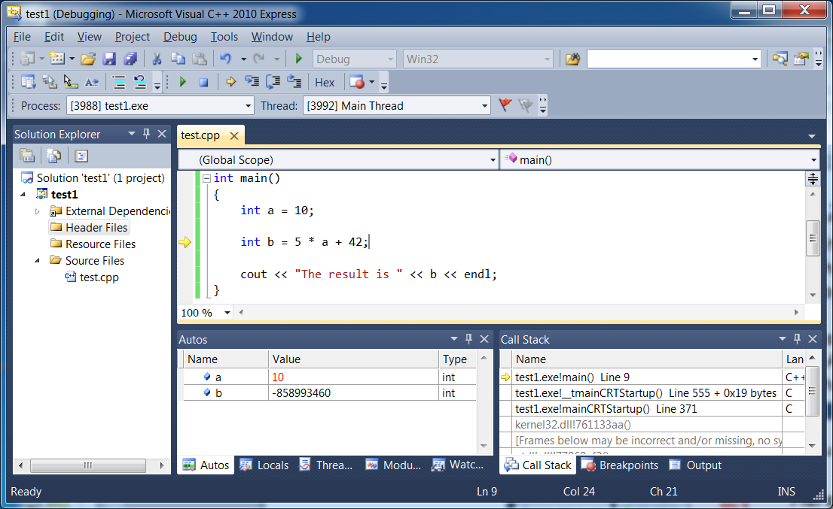
Learning to Use the C++ Debugger What’s the big picture?
Visual Studio/Xcode debuggers help you find bugs 10x faster!
You can trace programs line-by-line and see the value of every variable (like we do in slides)!
Uses:
Use the debugger to quickly figure out why your code is crashing, hanging or giving the wrong result.
It takes about 10 mins to learn how the Visual Studio/Xcode debuggers work, so get going!

Slide 32
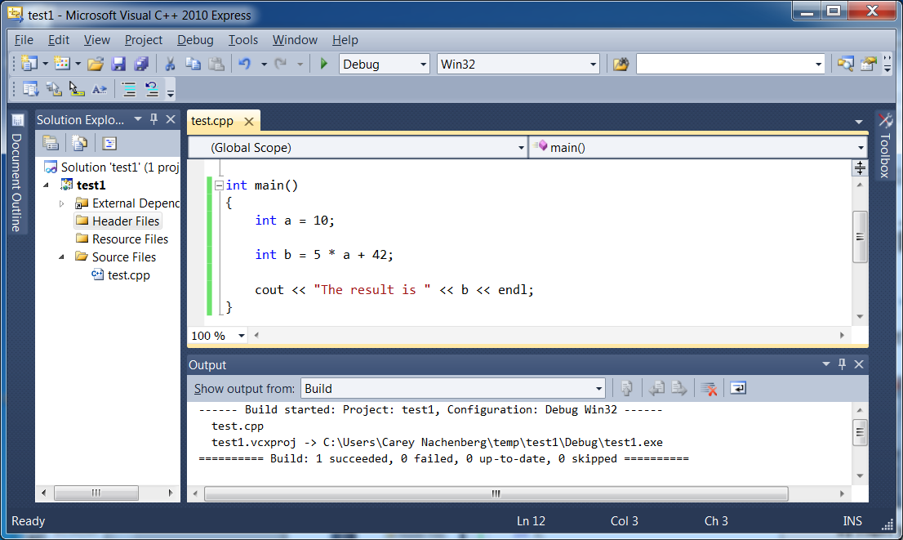
Debugging
By default, Visual Studio compiles all programs in “debug mode” so you can use the debugger with them right away.
When you compile your program, you should see “Configuration: Debug Win32” in the Output window.

Slide 33
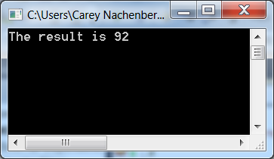
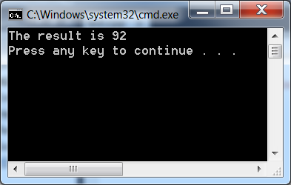
Debugging
You can run your program from start to finish by hitting either F5 or Ctrl-F5.
If you run your program by hitting F5, Visual Studio will immediately close the debug window after your program finishes.
If you run by hitting Ctrl-F5, Visual Studio will print “Press any key to continue…” and leave the debug window on the screen when your program completes.

Slide 34
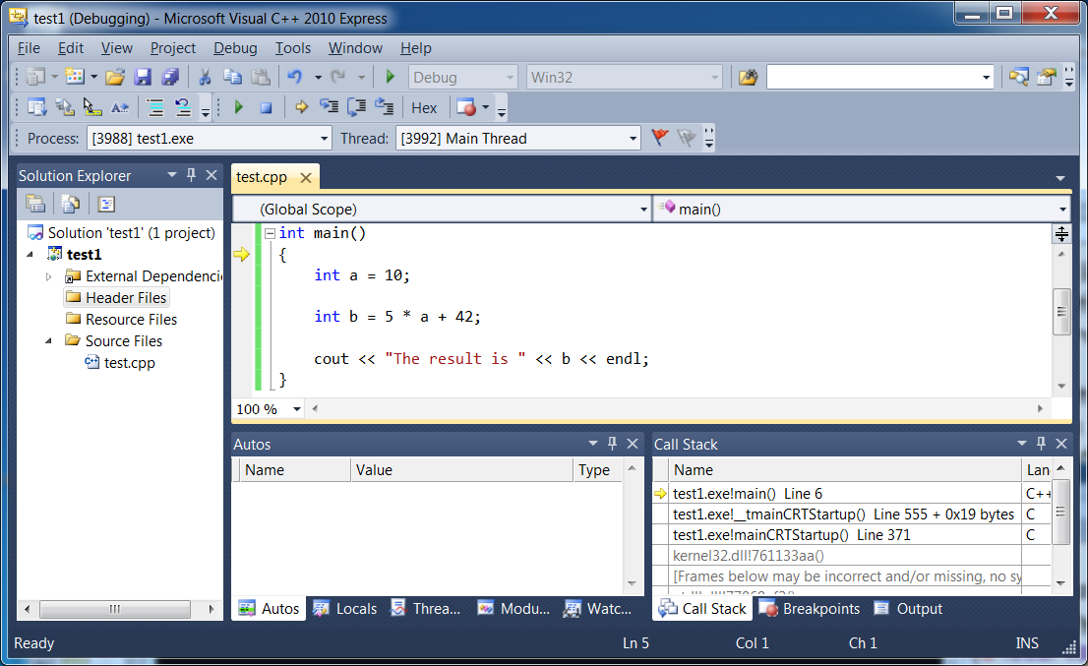

Debugging
You’ll see this little yellow arrow next to the first line of your program.
The arrow points to the line of code that’s ABOUT to execute.
You can step through your program one line at a time using the F10 and F11 keys.
To start your program and debug one line at a time, hit F10 after you finish compiling it.
Notice that the value of variable a has changed. Visual Studio shows this and highlights the changed value in red!
Also notice that variable b is now active. Since we haven’t run the current line of code yet to initialize its value, it is currently random.
Visual Studio has a sub-window where it displays the values of your active local variables – these are called “auto” variables.
Here we can see that variable a currently has a random value since it hasn’t been initialized yet.
To run the current line of code, hit F10 or F11. Let’s do that now.
Let’s hit F10 again and trace over another line.

Slide 35

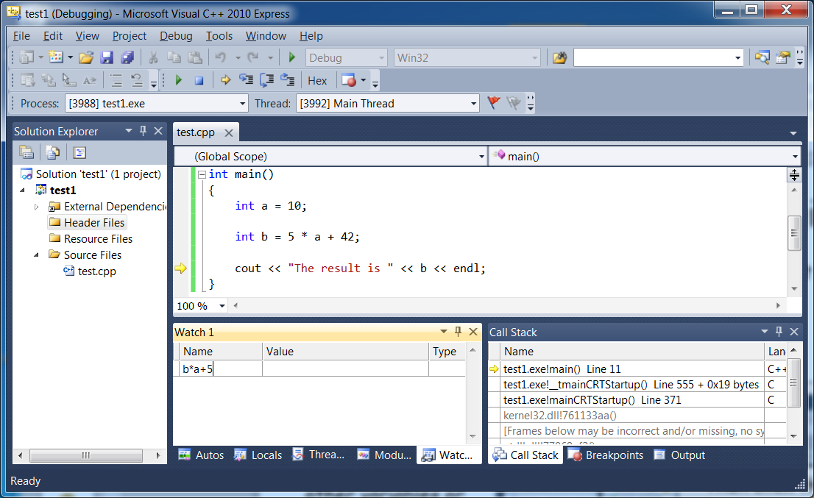
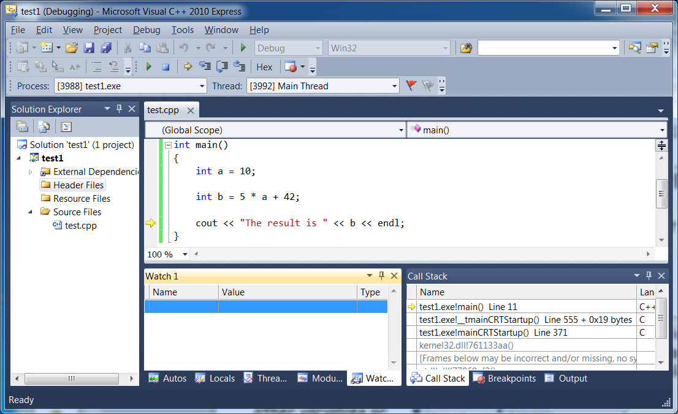
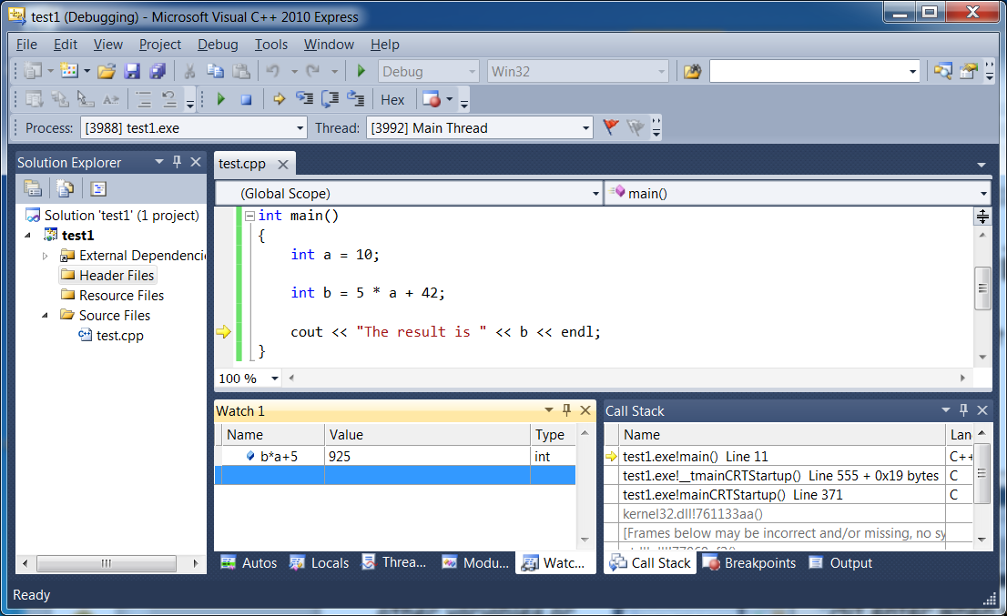
Debugging
You can step through your program one line at a time using the F10 and F11 keys.
Let’s hit F10 again and trace over another line.
Now variable b has changed as well and, as such, its new value is highlighted in red.
If you want to watch other variables or expressions, you can do that in the “watch” sub-window.
And Visual Studio will display the value of your variable or expression in the “watch” window!
Then click the mouse on the blue line and type in a variable name or expression to watch.
Hit enter when you’re done typing in the variable or expression you want to watch.
Click here to activate the “watch” sub-window.

Slide 36
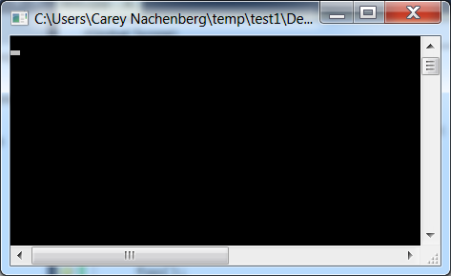
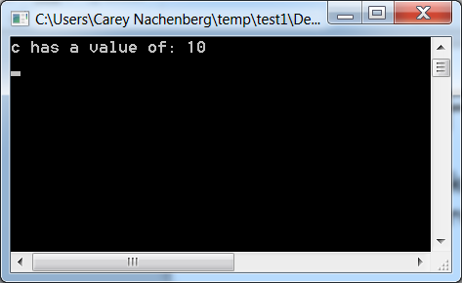
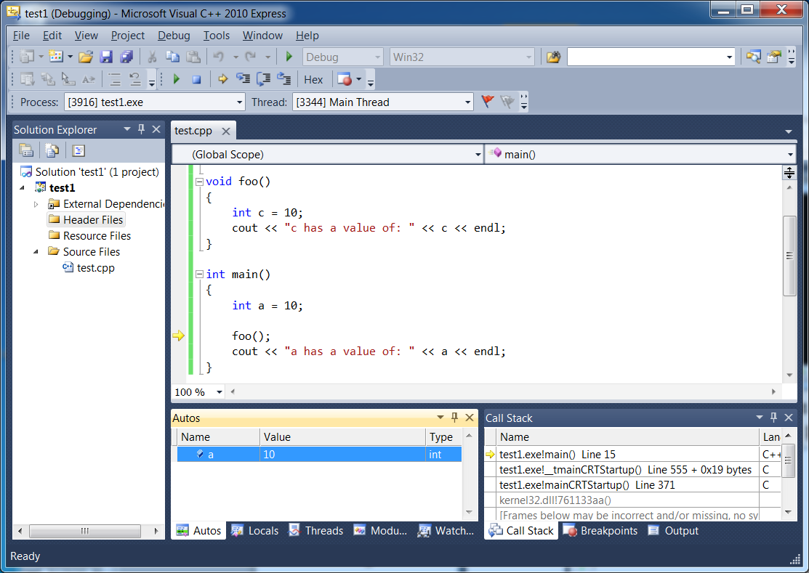
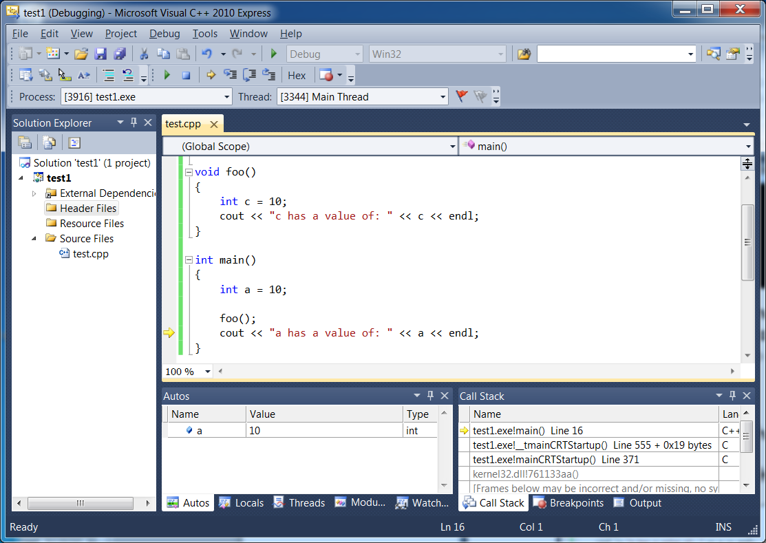
Debugging
The F10 and F11 keys actually do slightly different things…
Notice that Visual Studio ran the entire foo() function from start to finish…
If you hit F10 while on a function call line, Visual Studio will run the entire function in one step. You won’t be able to trace line-by-line through it.
Let’s imagine we’ve been tracing a program and are about to execute this line:
foo();
And now our cursor is on the line after the function call.
And then we hit F10...
This is what you’d see next.
So F10 lets you quickly run a line of code without delving into the details.

Slide 37
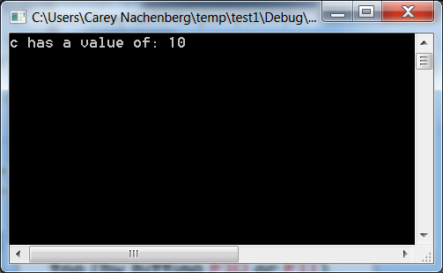
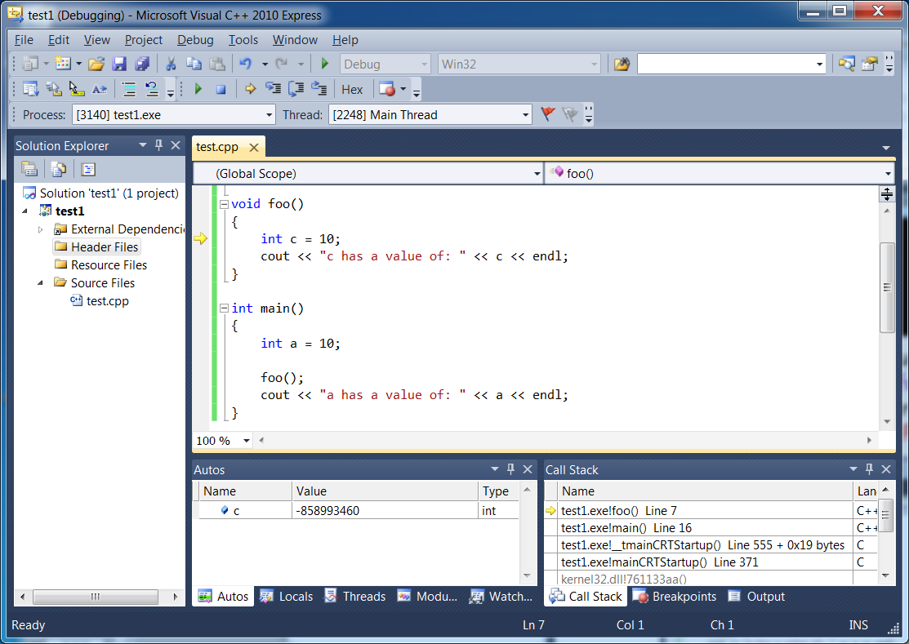
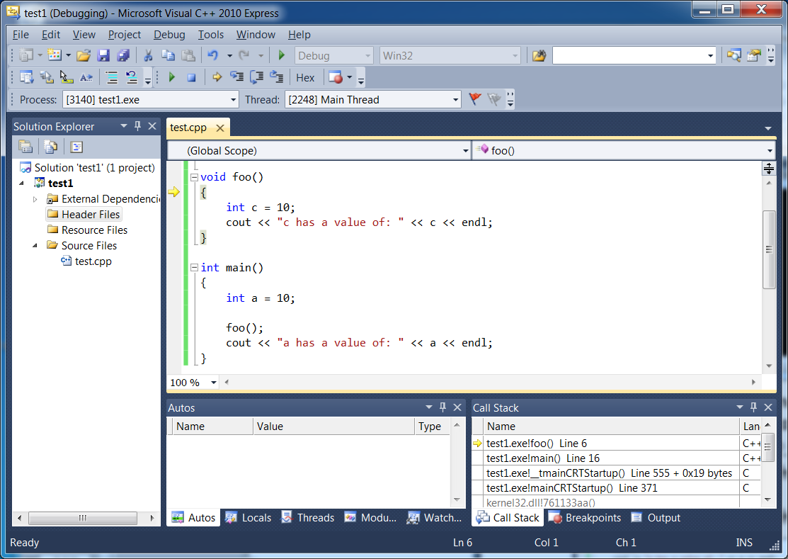
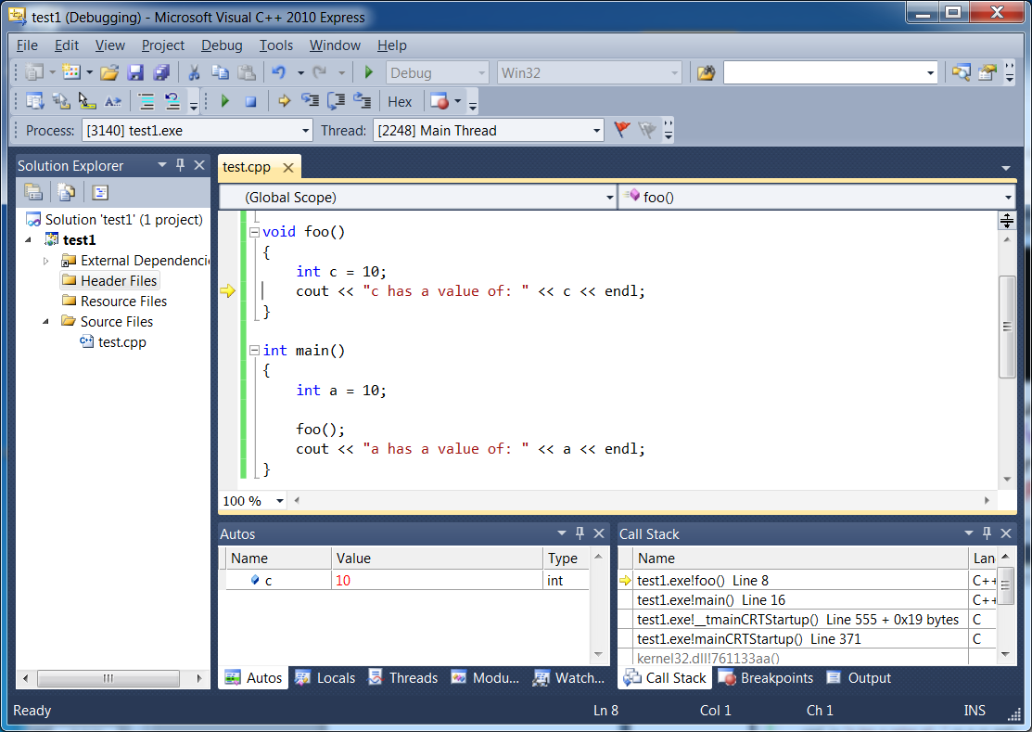
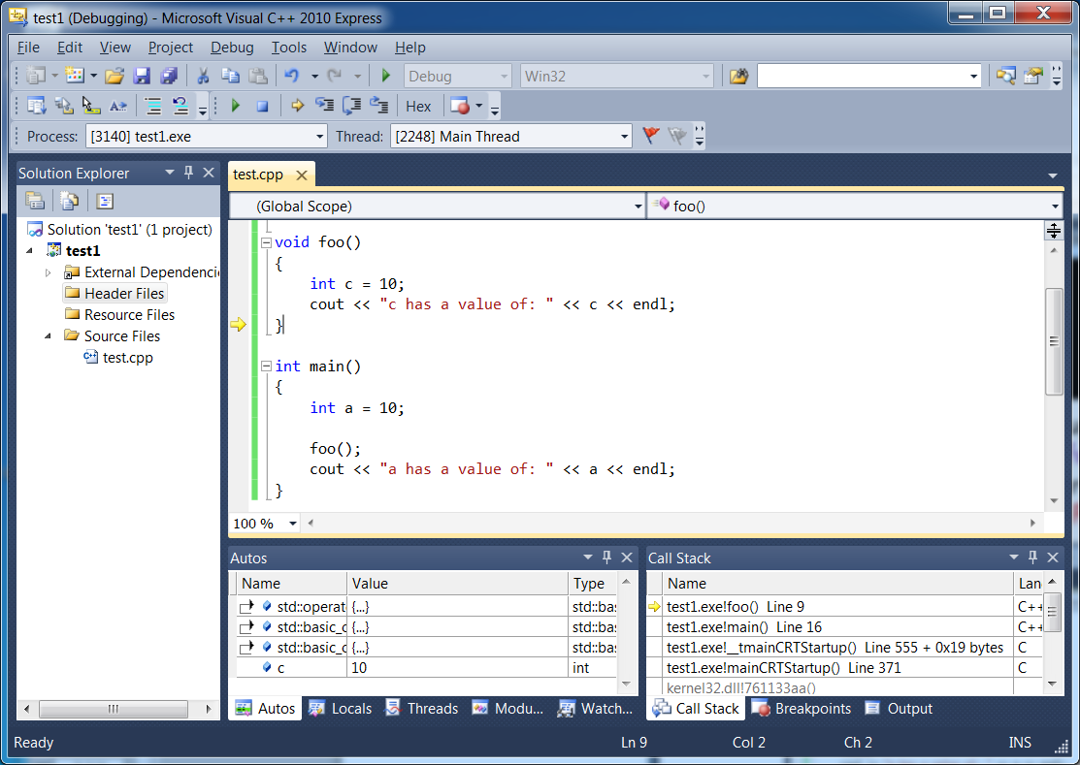
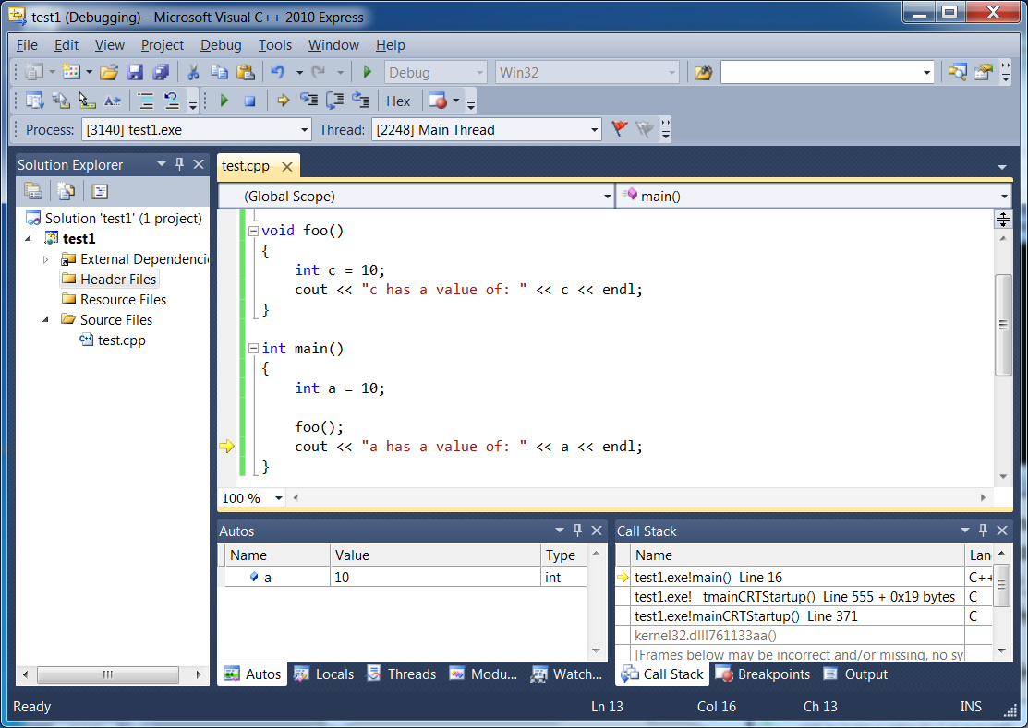
Debugging
If you hit F11 while on a function call line, Visual Studio will let you step into that function and trace through it a line at a time.
Let’s imagine we’ve been tracing a program and are about to execute this line:
foo();
And then we hit F11...
This is what you’d see next.
So F11 lets you dive into a function call and trace through it line by line as well.
Notice our debug cursor has moved into the foo() function. Now we trace through its code too (by hitting F10 or F11)…

Slide 38
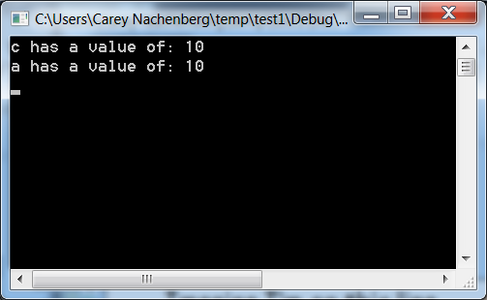
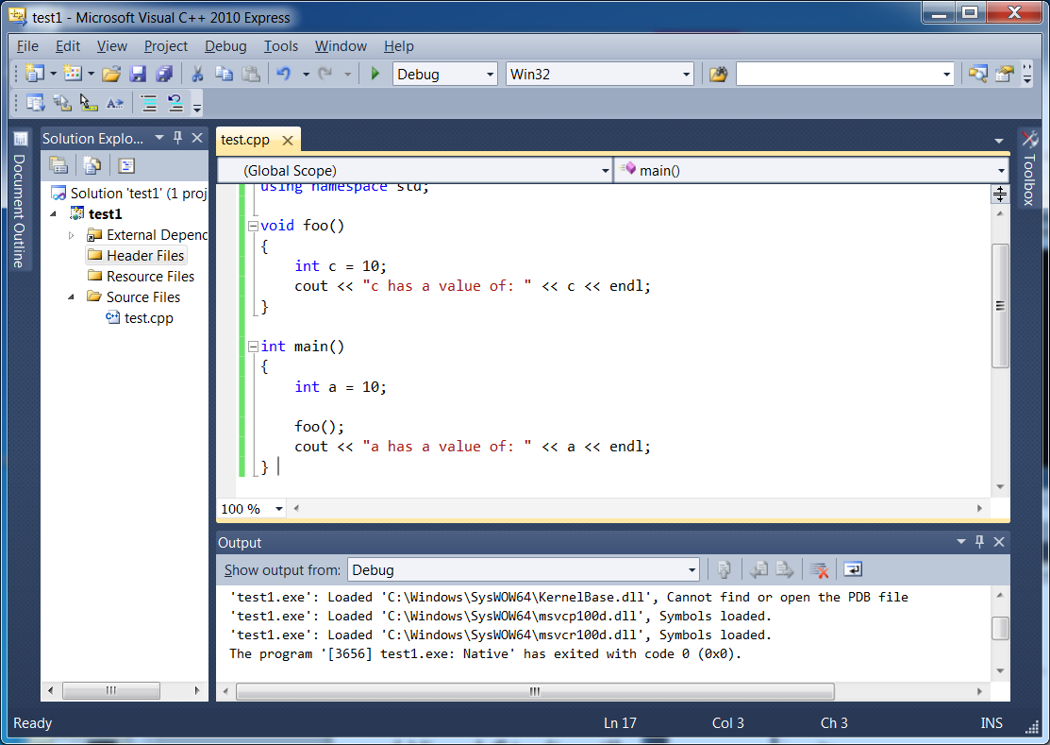
Debugging
If at any time while you’re tracing line-by-line you want to stop tracing line-by-line…
Imagine I’m on this line and I hit F5…
And your output window will immediately disappear after the program finishes running.
And simply let the rest of your program run normally…
Just hit F5 and Visual Studio will run your program until completion!
Visual Studio will run my program until completion without any more stepping.

Slide 39
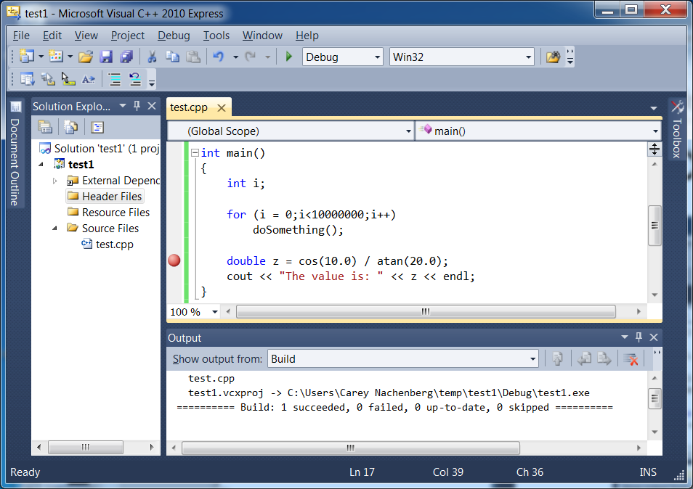
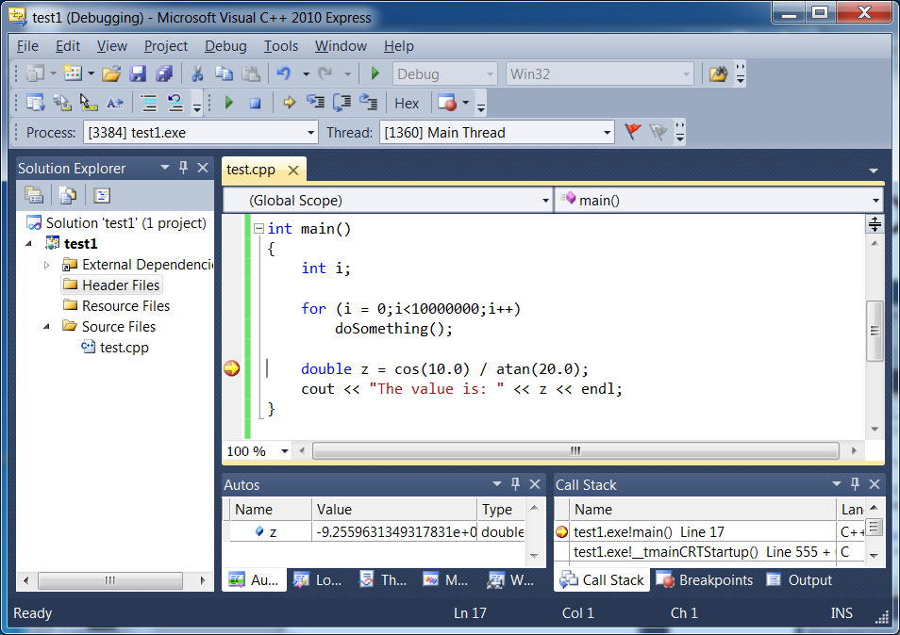
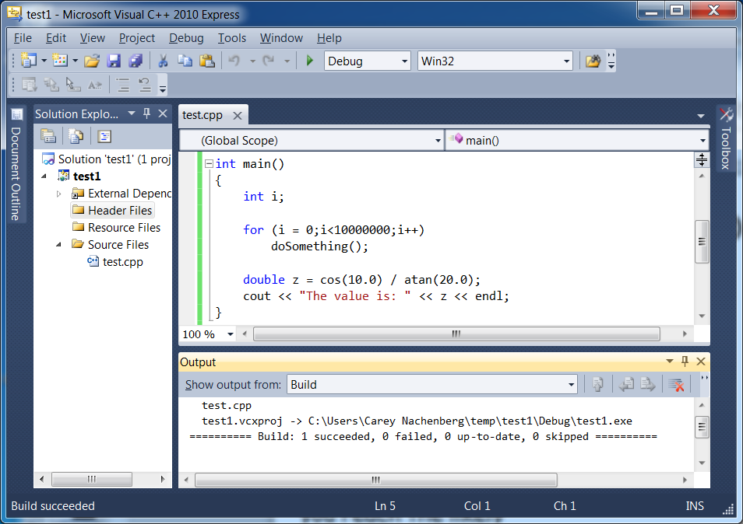
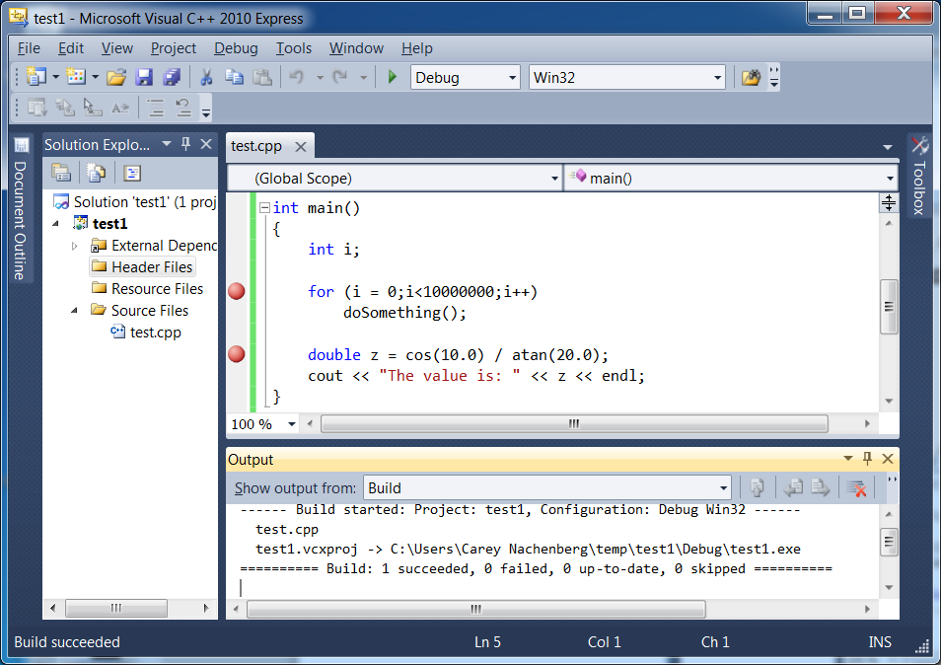
Debugging
For example, let’s say I want to start stepping line-by-line through my code here.
If I stepped (with F10/F11) through each line ‘til I reached the right spot, it’d take years!
Your program will run until it hits the breakpoint. Then the debugger stops the program and lets you trace line-by-line… Or if you like, hit F5 again and your program will run until it hits the breakpoint again.
Oh, and you can add as many breakpoints as you like… Not just one!
This adds a “breakpoint” into your code on this line.
Sometimes you’ll want to start debugging deep within your program.
You don’t want to trace through millions of lines to reach the likely location of a bug.
What should you do?
Answer: Create a breakpoint!
Go to the line where you’d like to start debugging and hit the F9 key.
Then just hit the F5 key (not Ctrl-F5) to run your program until it reaches that line!

Slide 40

Debugging with Xcode
The SUPERIOR IDE ☺

Slide 41
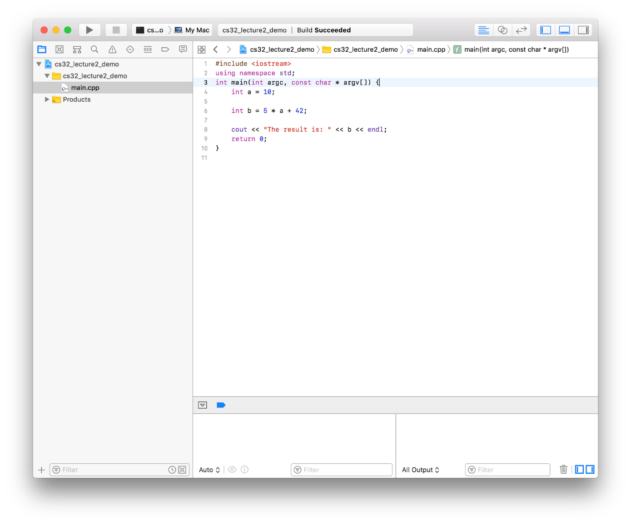
Debugging with Xcode
This is Xcode’s code editor. Xcode is an IDE created by Apple, specifically for iOS, macOS, tvOS, and watchOS development, but it also comes fully loaded with C and C++ support.
The “Auto” means that the sub-window will automatically track and show new variables.
When you compile your program, you’ll see an empty debug output window…
As well as an empty variable “watcher”.

Slide 42
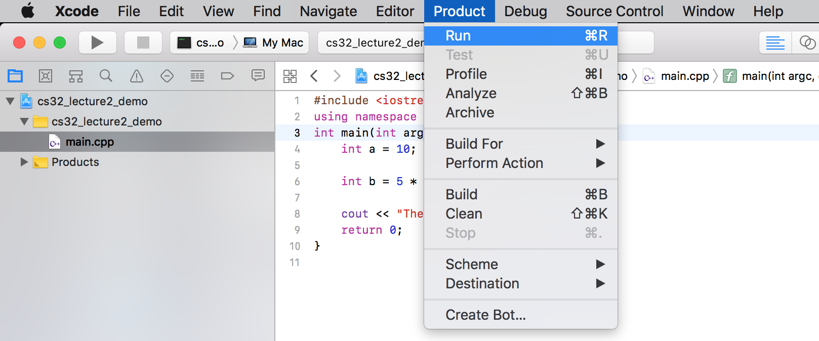
Debugging with Xcode
You can run your program from start to finish by going to:
Product > Run
Xcode also has shortcuts ☺

Slide 43
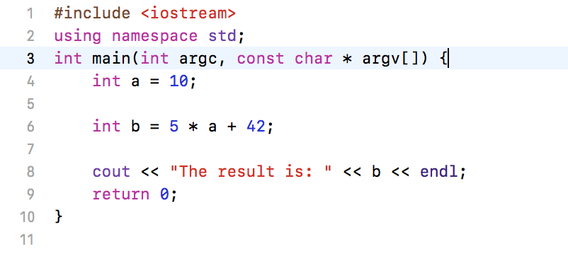
Debugging with Xcode
You can also step through your program, one line at a time.
Let’s insert a breakpoint at line 3.
Just tap on the gray space next to the 3.

Slide 44
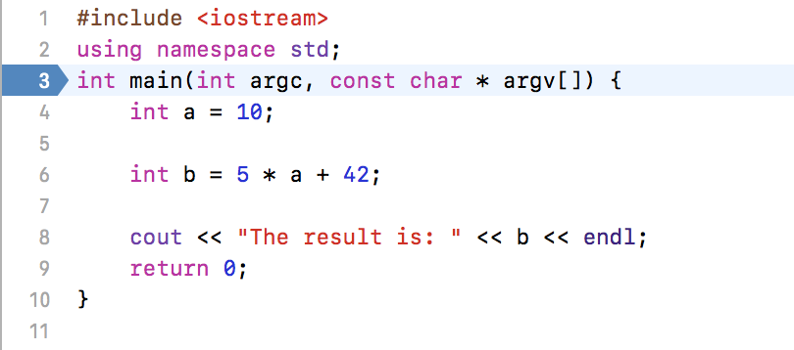
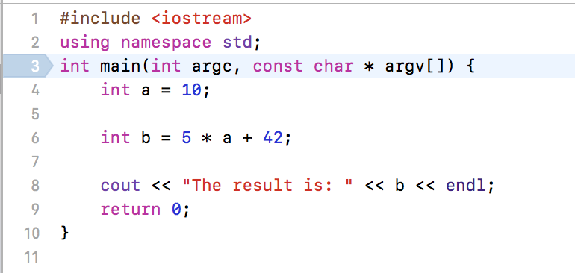
Debugging with Xcode
You can also step through your program, one line at a time.
Let’s insert a breakpoint at line 3.
The blue arrow on line 3 shows that our breakpoint is active.
If we click on the breakpoint again, we deactivate it, but Xcode remembers that we had a breakpoint there and will let us turn it back on. Neat!

Slide 45
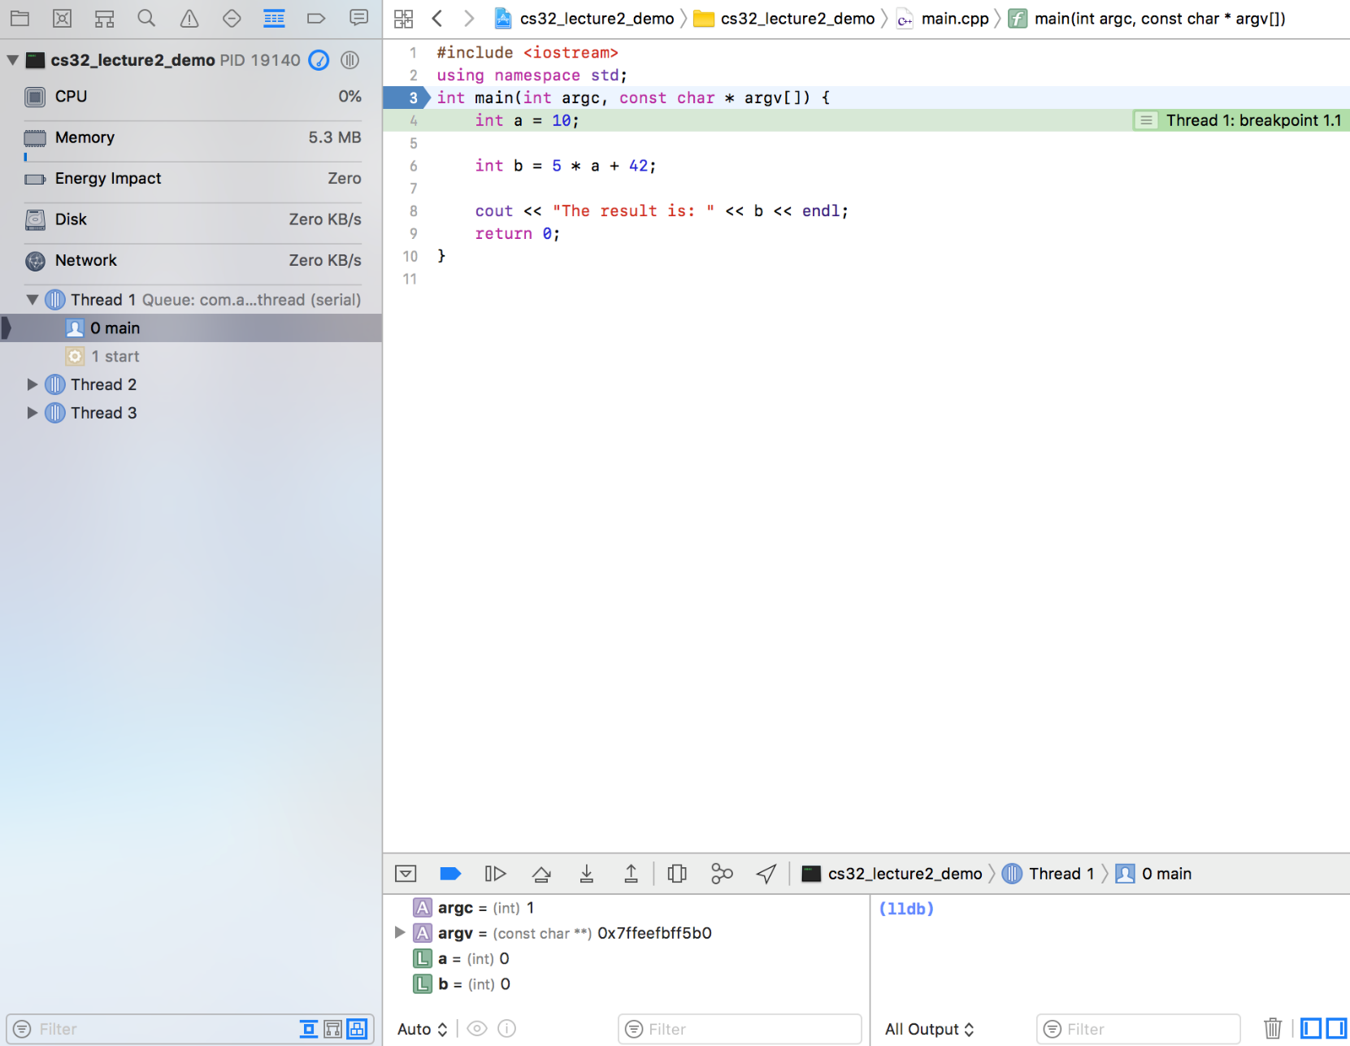
Debugging with Xcode
Because we set a breakpoint at main(), we can debug 1 line at a time.
This screenshot to the right shows what an Xcode debugging session looks like.
The left pane is showing resource usage.
The right pane is the code being run.
Xcode has stopped execution right after entering main().
The green-highlighted line is the line of code that’s ABOUT to execute.

Slide 46
Debugging with Xcode
Because we set a breakpoint at main(), we can debug 1 line at a time.
This window is our debug output. As we run cout statements, we’ll see that output in this window.
Note: “lldb” is Xcode’s command-line debugger. Ignore it for now.
Our variable “watcher” has also indicated values for a and b.
The a and b variables appear to be initialized, but in C++ you can’t depend upon that to be the case. Always assume primitive values are uninitialized.

Slide 47
Debugging with Xcode
Let’s run the current line of code.
This is the “Step Over” button (more on that later). For now, just tap on that to run the current line of code.

Slide 48
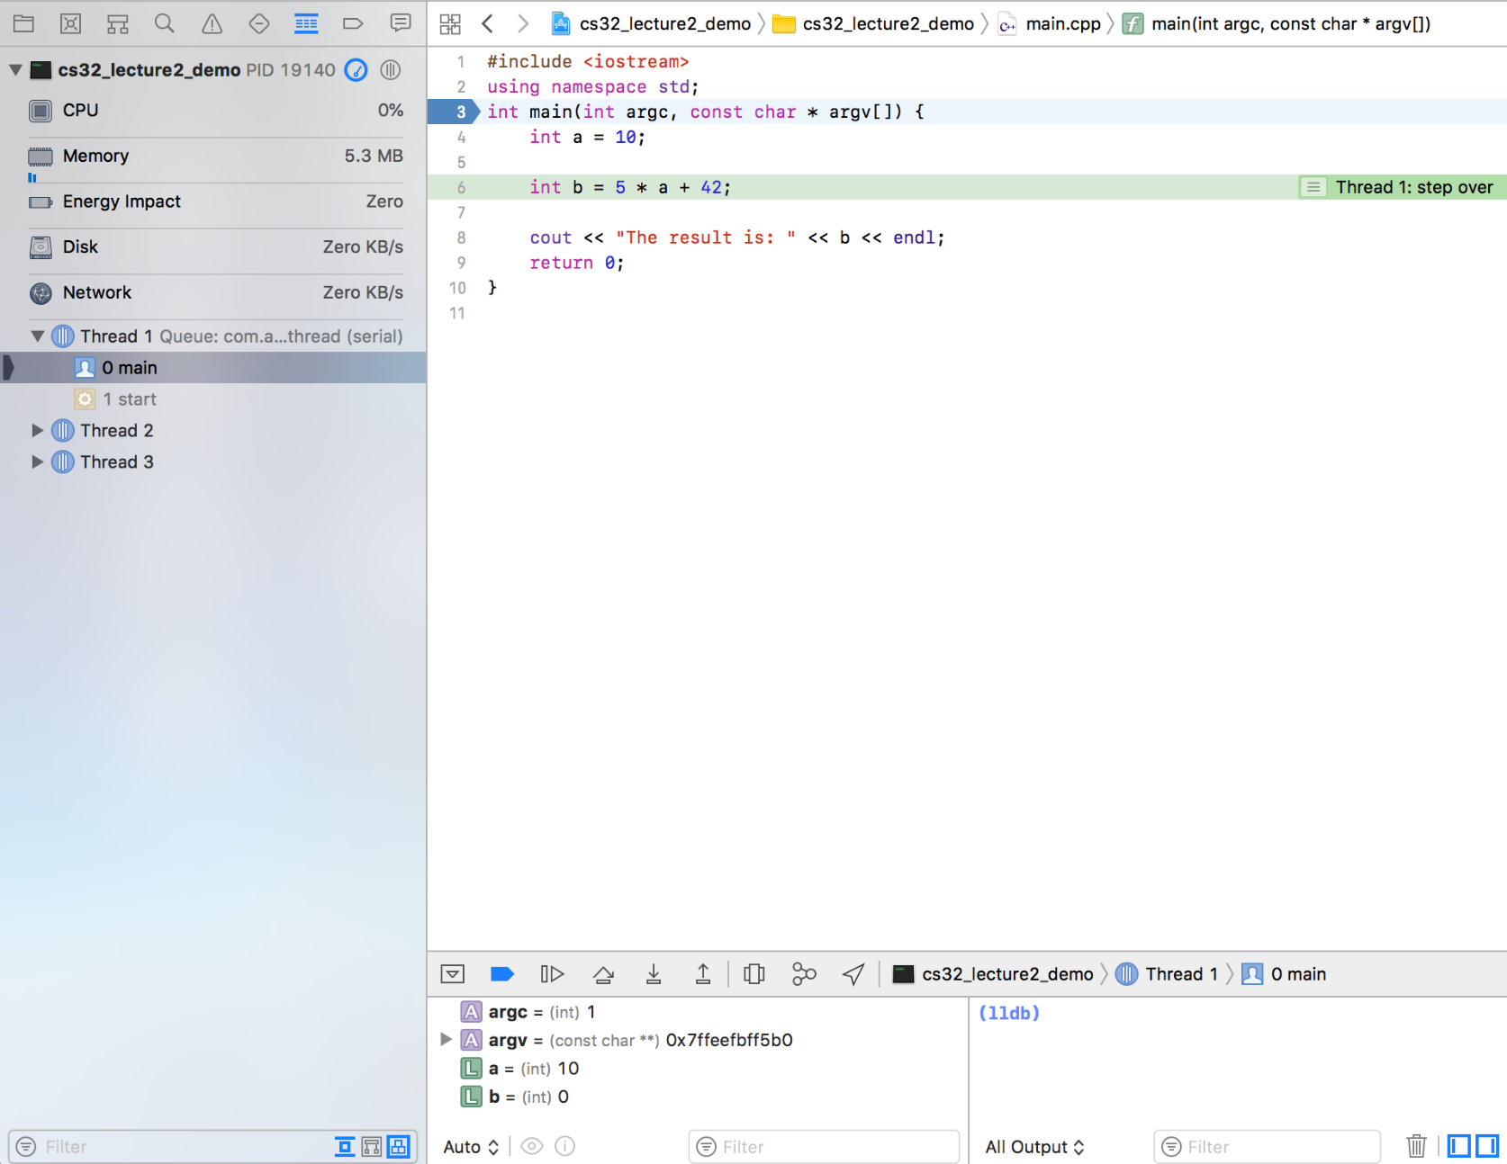
Debugging with Xcode
Let’s run the current line of code.
But b hasn’t changed yet. Let’s press the “Step Over” button again.
Check this out! The value for a has changed because we just executed the line of code to set a’s value.

Slide 49
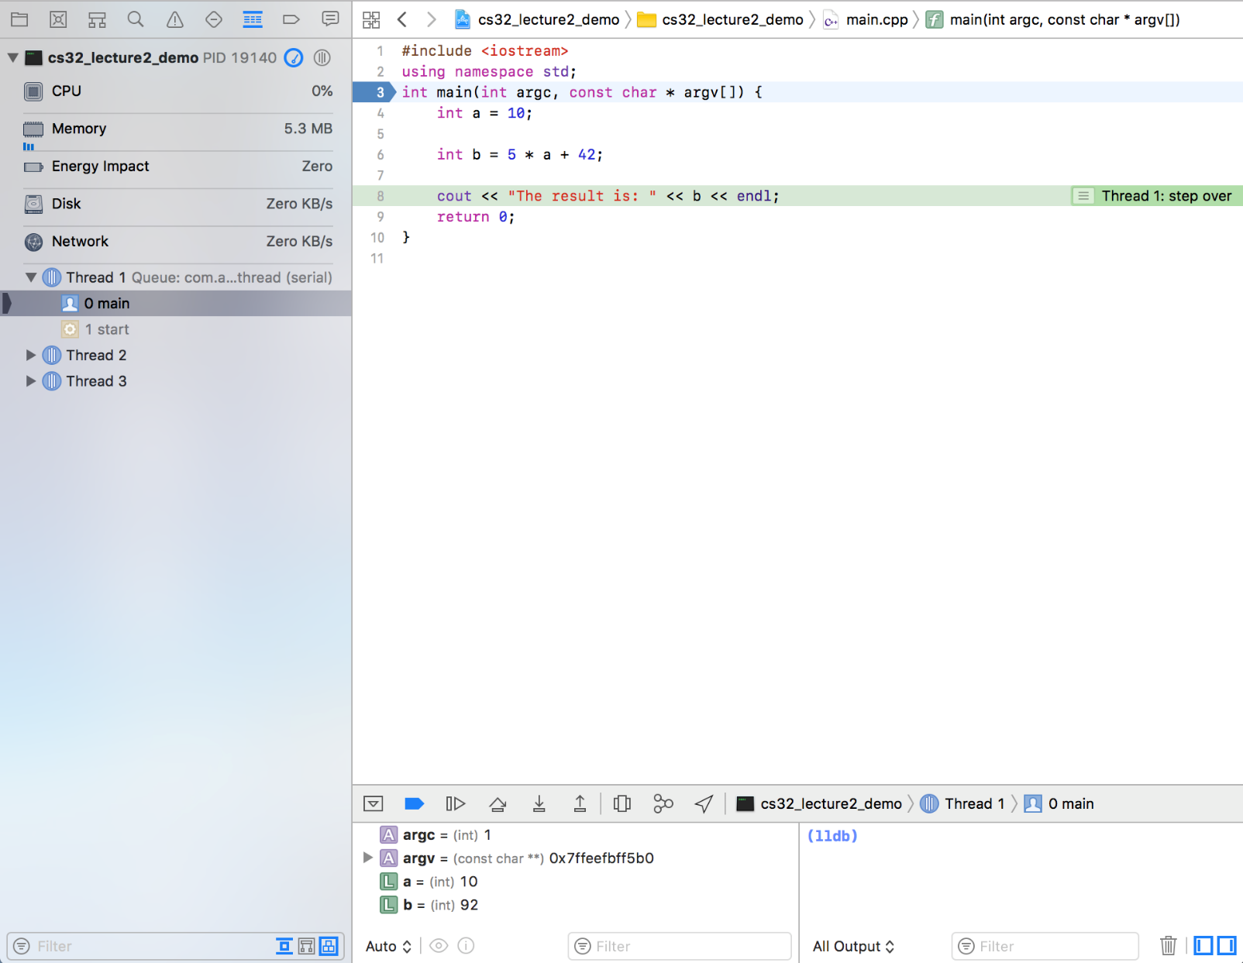
Debugging with Xcode
Let’s run the current line of code.
Now b has been updated, just as we expected!
Tap on the “Step Over” button again to see the cout output.

Slide 50
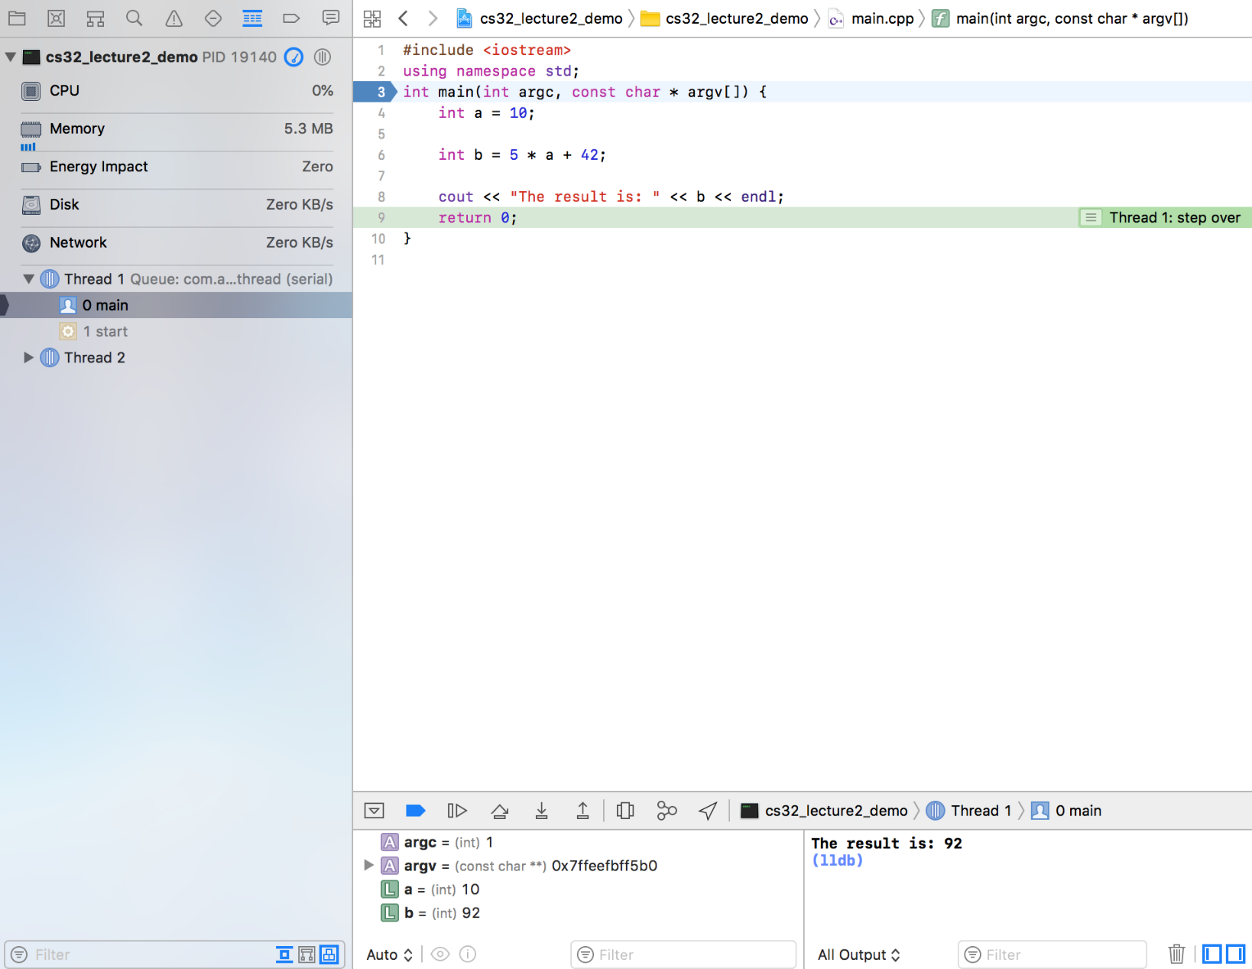
Debugging with Xcode
Let’s run the current line of code.
Notice that the debug output window now has the cout statement’s result.
BTW, this window can also be used for accepting user input!

Slide 51
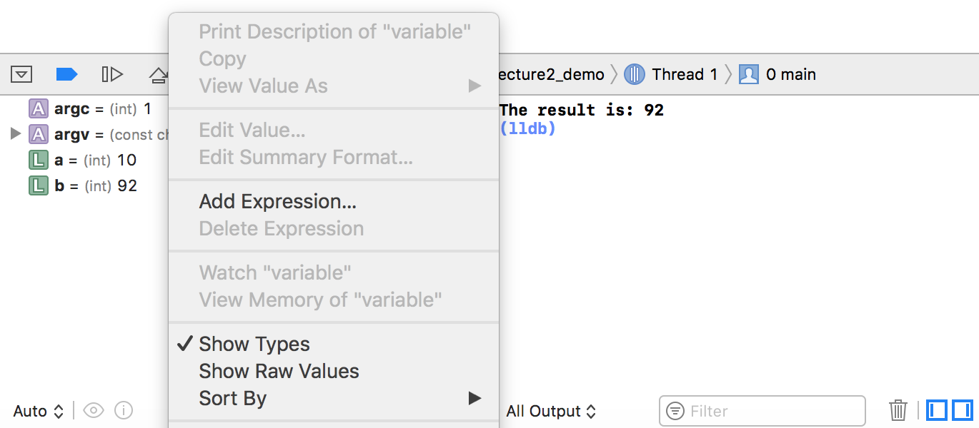
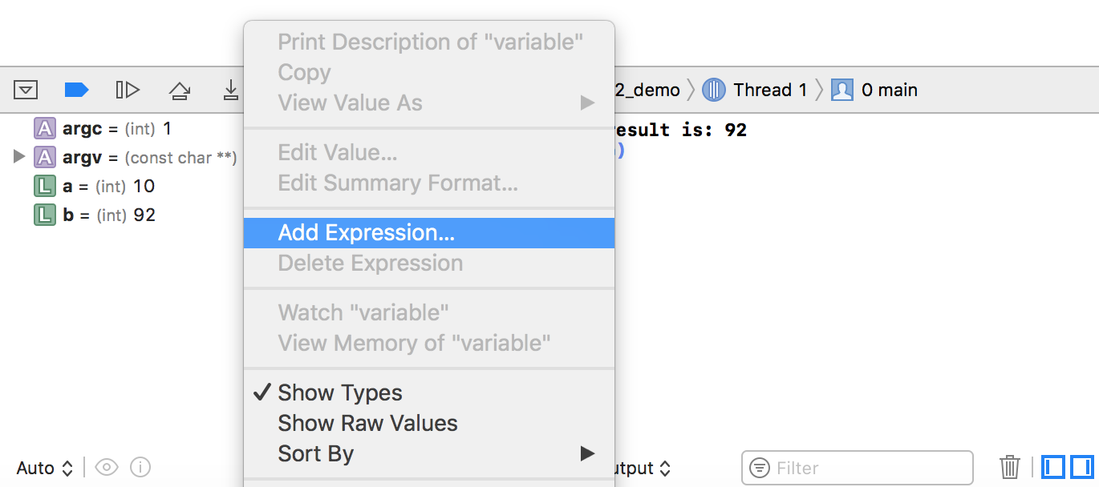
Debugging with Xcode
Let’s use the Watch window to add an expression.
Right-Click anywhere in the Watch window.
Now click on Add Expression…

Slide 52
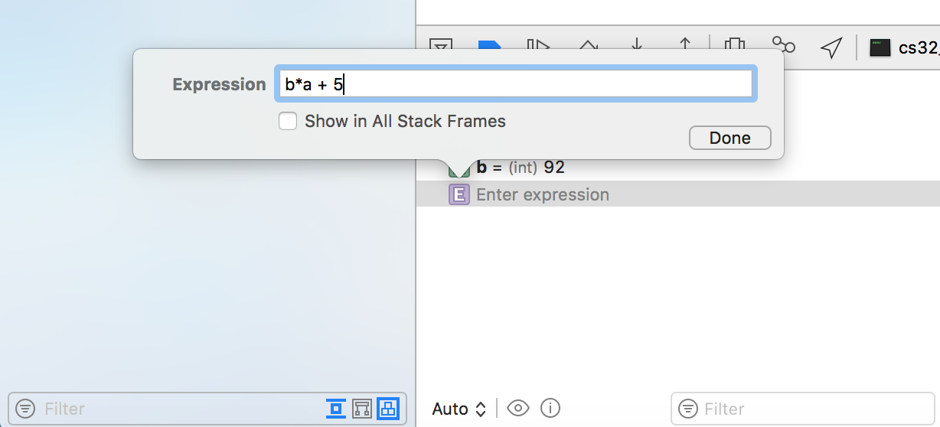
Debugging with Xcode
Add an expression to watch
Hit “Done”
Then type in a variable name or expression to watch.

Slide 53
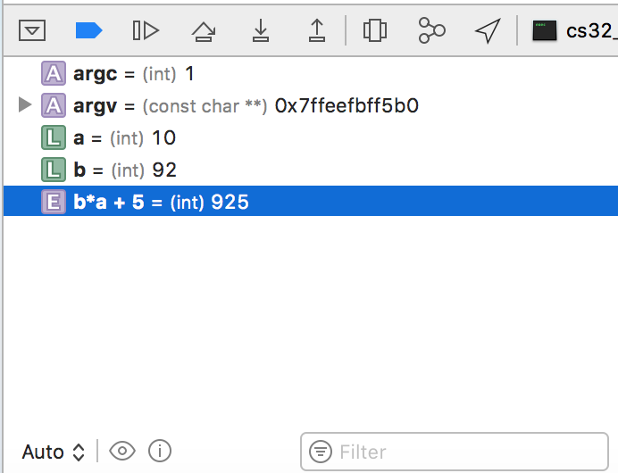
Debugging with Xcode
Add an expression to watch
And Xcode will display the value of your variable or expression in the “watch” window!

Slide 54

Debugging with Xcode
Let’s revisit the “Step Over” button. Note the other button right next to it.
This is the “Step Over” button (the button we have been using so far).
The “Step Over” and “Step Into” buttons do slightly different things. Let’s see an example.
This is the “Step Into” button.

Slide 55
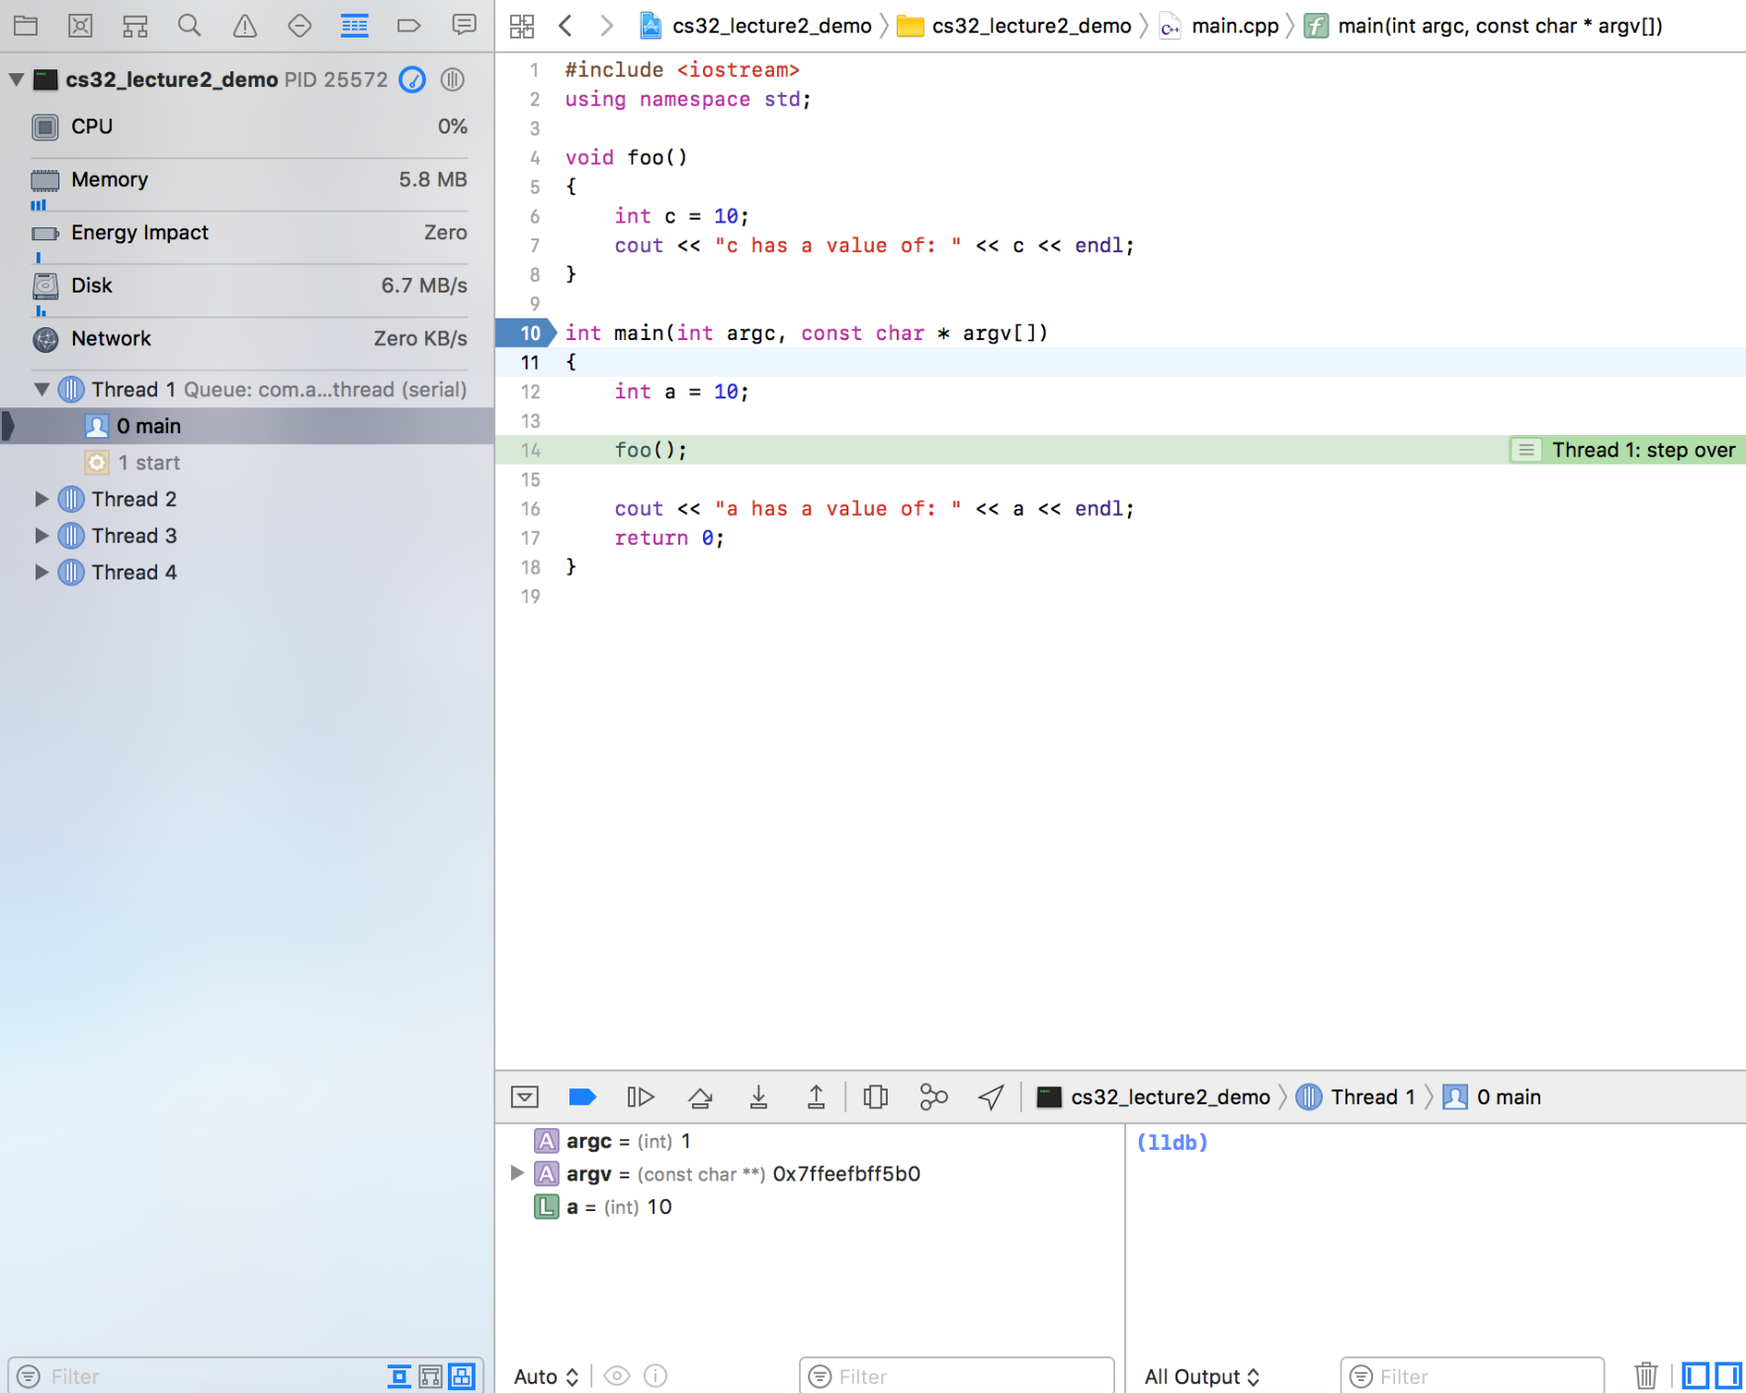
Debugging with Xcode
“Step Over”

Slide 56
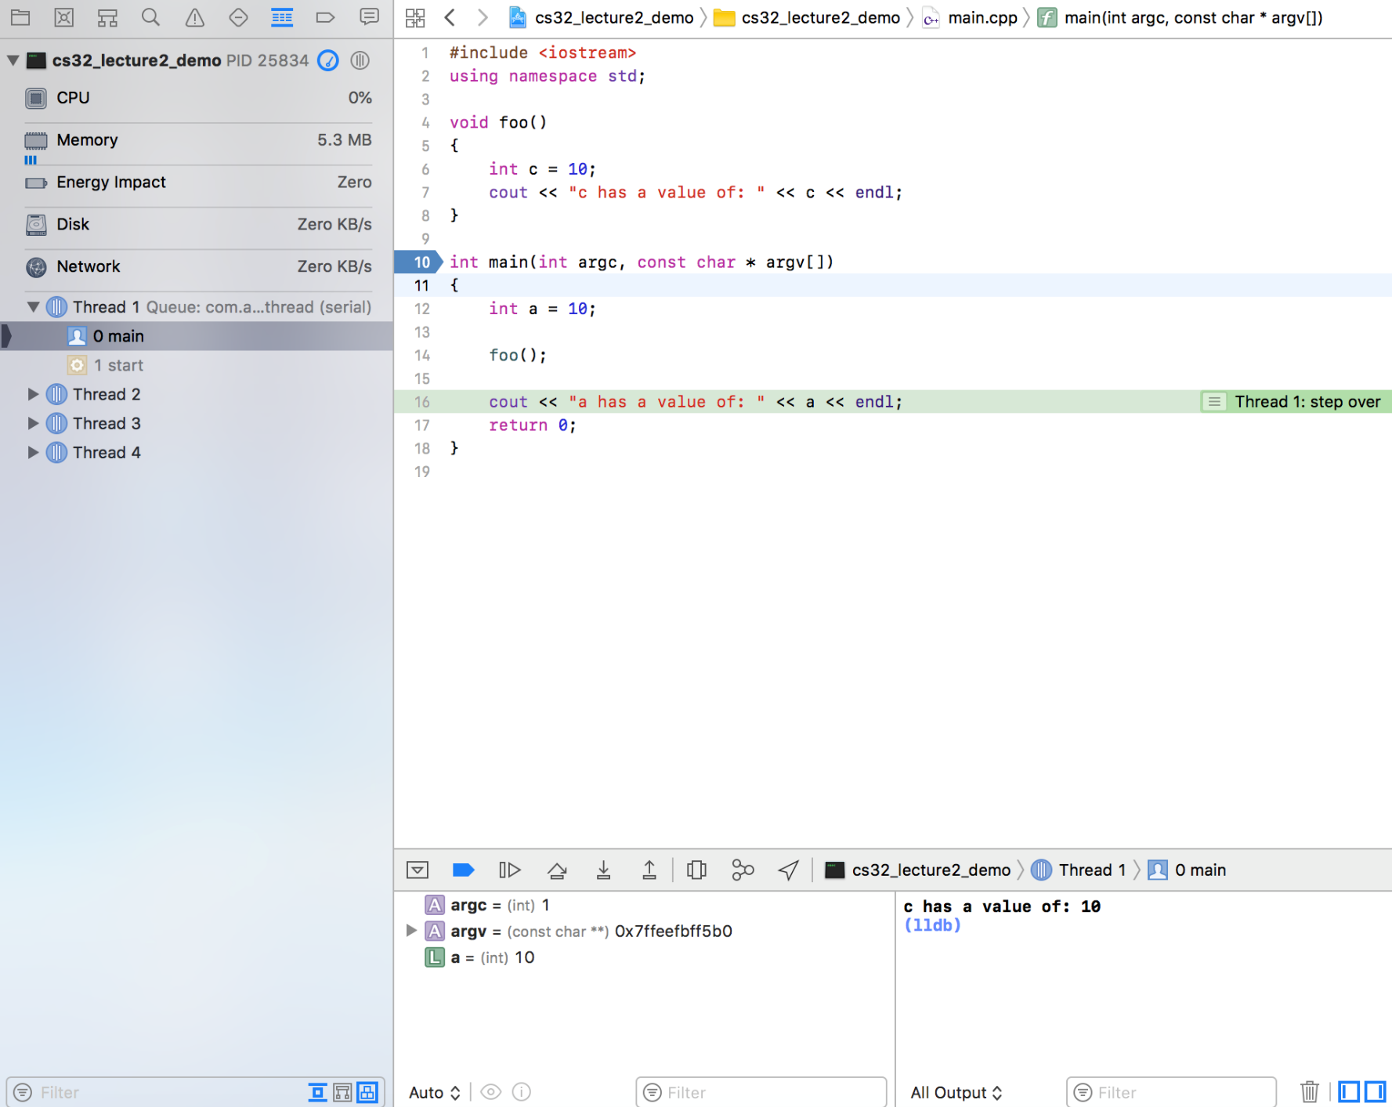
Debugging with Xcode
Notice that Xcode ran the entire foo() function from start to finish…
“Step Over”
And now our cursor is on the line after the function call.

Slide 57

Debugging with Xcode
Summary:
If you hit “Step Over” while on a function call line, Xcode will run the entire function in one step. You won’t be able to trace line-by-line through it.
So “Step Over” lets you quickly run a line of code without delving into the details.

Slide 58
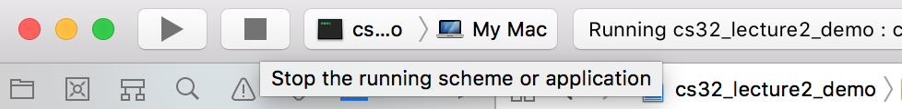
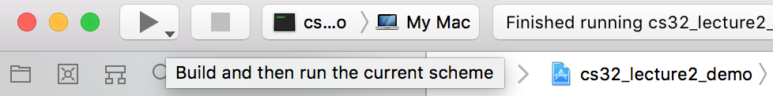
Debugging with Xcode
Let’s restart the debugger and use the “Step Into” button instead of “Step Over”.
Just tap on the Stop button to stop the current debugging session.
Then tap on the Run button to re-build and run the code.

Slide 59
Debugging with Xcode
“Step Into”

Slide 60
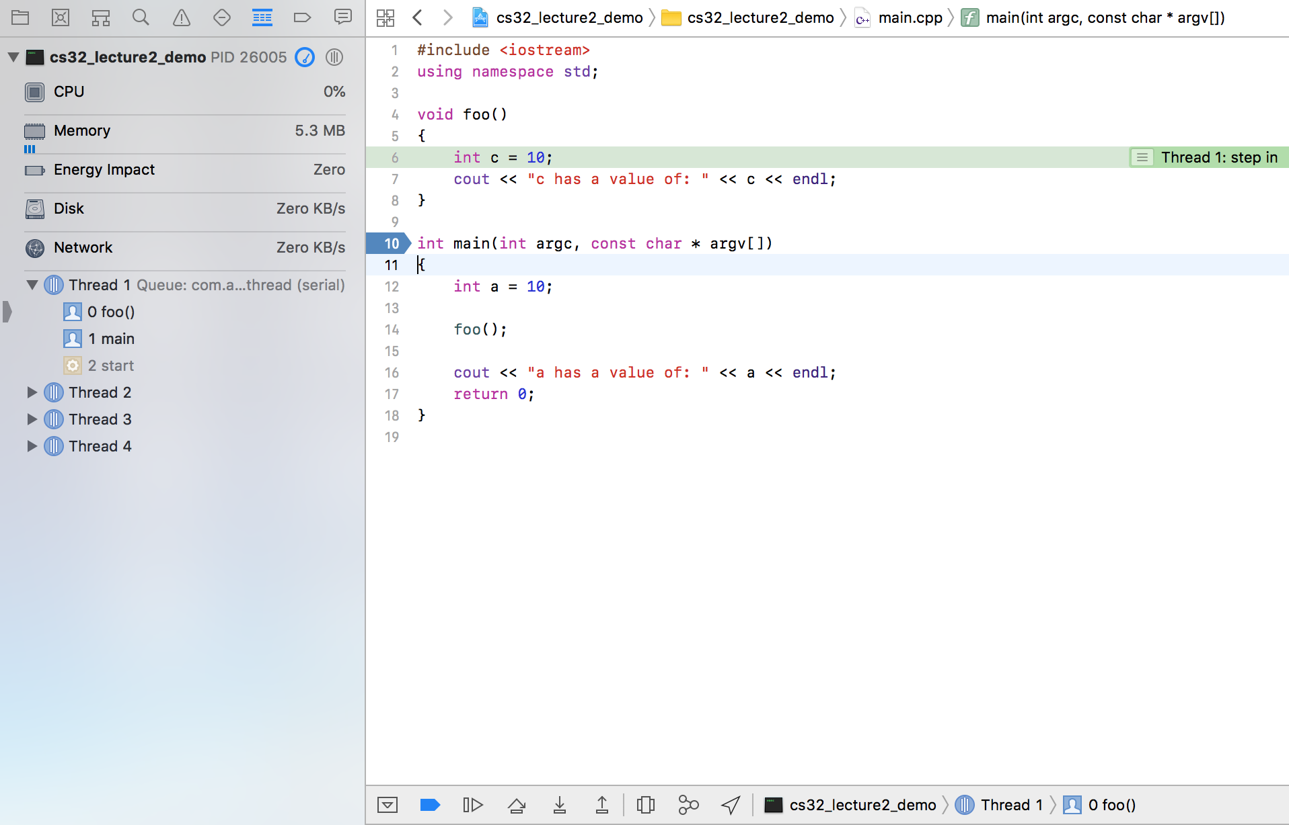
Debugging with Xcode
If you ever want to stop debugging line-by-line and just let your program run normally, then tap on this guy!
This is the “Continue” button.
Notice our debug cursor has moved into the foo() function. Now we trace through its code too (by hitting “Step Over” or “Step Into”)…

Slide 61
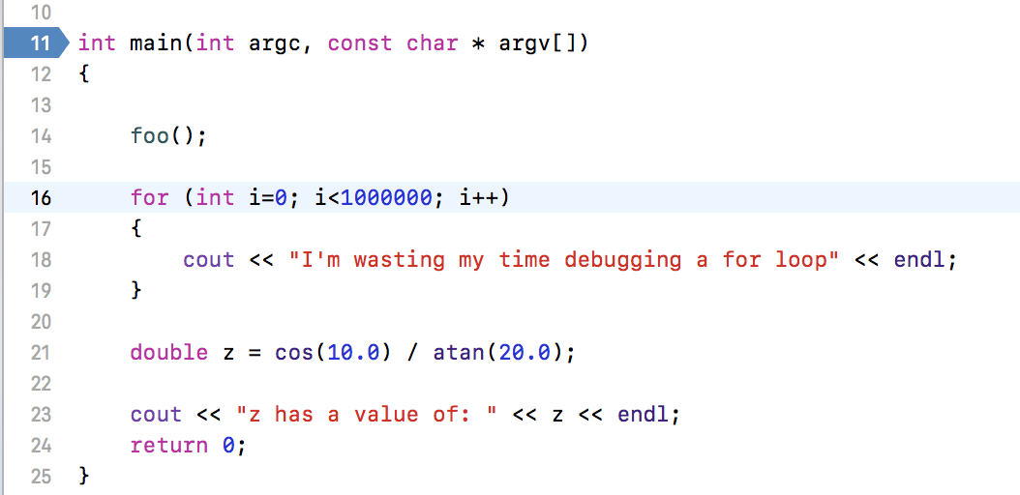
Debugging with Xcode
Quick note on breakpoints:
We already used breakpoints in our debugging examples, but there’s 1 case where you really want to use them.
Do I really need to step through this for loop?! That would take years!!!!
What if I want to start debugging at this line?

Slide 62


Debugging with Xcode

Slide 63
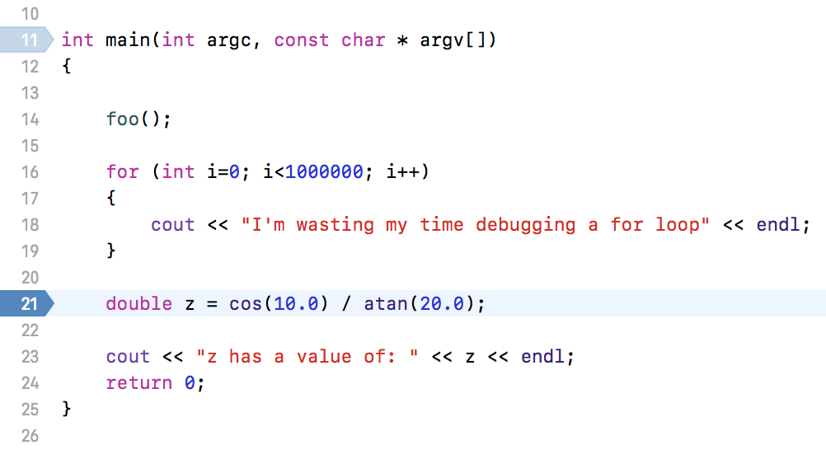
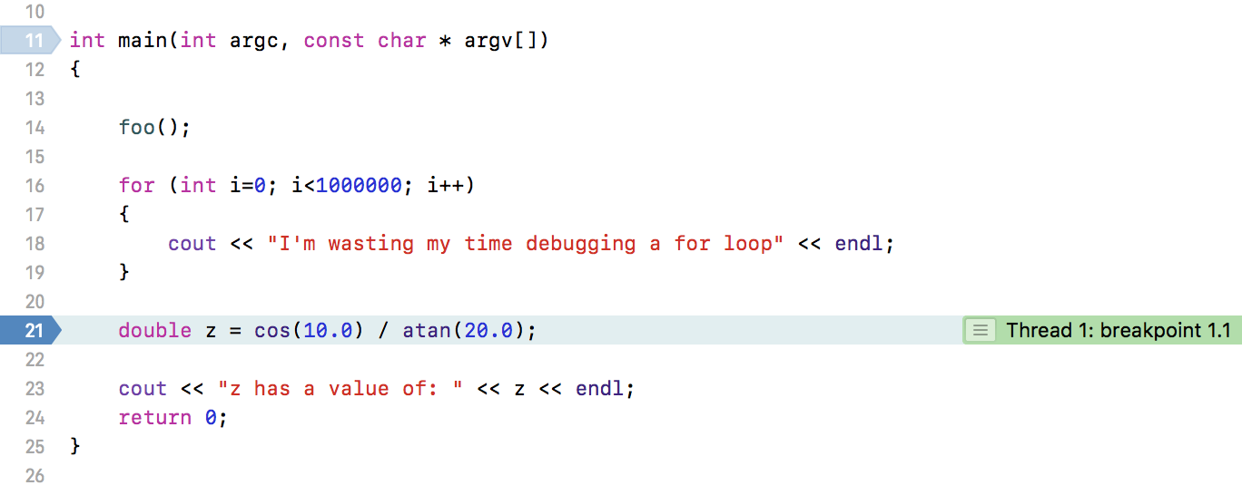
Debugging with Xcode
Just add a breakpoint!
After printing out a million of these lines ☺
After pressing Run, Xcode will stop at that line…

Slide 64
Debugging
Learn how to use the debugger!
It can drastically speed up the programming process!
and more time doing the things you love!
Which means less frustration

Slide 65
Topic #1: Include Etiquette
A. Never include a CPP file in another .CPP or .H file.
file1.cpp
You’ll get linker errors.
void someFunc()
{
cout << “I’m cool!”;
}
Only include .H files within a .CPP file.
file2.cpp
#include “file1.cpp”
void otherFunc()
{
cout << “So am I!”;
someFunc();
}
// bad!

Slide 66
Topic #1: Include Etiquette
B. Never put a “using namespace” command in a header file.
So this is bad…
someHeader.h
#include <iostream>
This is called “Namespace Pollution”
using namespace std;
Why? The .H file is forcing CPP files that include it to use its namespace.
hello.cpp
#include “someHeader.h”
int main()
{
cout << “Hello world!”;
}
// BUT I DON’T WANT THAT // NAMESPACE! YOU BASTARD!
And that’s just selfish.
Instead, just move the “using” commands into your C++ files.

Slide 67
Topic #1: Include Etiquette
alcohol.h
class Alcohol
{
...
};
And in fact, this works right now, because student.h does include alcohol.h.
C. Never assume that a header file will include some other header file for you.
student.h
class Student
{
...
private:
};
#include “redbull.h”
#include "alcohol.h"
Now your main.cpp file will compile correctly regardless of what’s contained in the other header files it uses!
But what happens if the author of student.h decides to change its implementation?
What can you do?
Always DIRECTLY include the header files you need RIGHT where you need them.
In this case, main.cpp has a Student variable and an Alcohol variable. So it should include both of their header files.
RedBull bottles[5];
Alcohol bottles[5];
main.cpp
main.cpp defines an Alcohol variable but it doesn’t #include"alcohol.h".
Why? It assumes that student.h will just include alcohol.h for it.
Utoh! Now main.cpp no longer compiles! ☹ Why? Because it doesn’t include alcohol.h but it defines an Alcohol variable!
#include “student.h”
int main()
{
Student larry;
Alcohol vodka;
cout << larry << “ is drinking “ << vodka;
}
#include "alcohol.h"

Slide 68
Topic #2: Preprocessor Directives
C++ has several special commands which you sometimes need in your programs.
Command 1: #define
You can use the #define command to define new constants:
file.cpp
#define PI 3.14159
void someFunc()
{
cout << PI;
}
#define FOOBAR
You can also use #define to define a new constant without specifying a value! Why you ask? We’ll see!

Slide 69
Preprocessor Directives
Command 2: #ifdef and #endif
Since FOOBAR was defined I’ll compile the code until #endif.
Since FOOBAR was NOT defined I’ll ignore the code until #endif.
You can use the #ifdef command to check if a constant has been defined already…
The compiler only compiles the code between the #ifdef and the #endif if the constant was defined.
file.cpp
#define FOOBAR
#ifdef FOOBAR
void someFunc()
{
cout << PI;
}
#endif
/*
*/

Slide 70
Preprocessor Directives
Command 2: #ifndef and #endif
Since FOOBAR was NOT defined I’ll compile the code until #endif.
Since FOOBAR was defined I’ll ignore the code until #endif.
You can use the #ifndef command to check if a constant has NOT been defined already…
The compiler only compiles the code between the #ifndef and the #endif if the constant was NOT defined.
file.cpp
#define FOOBAR
#ifndef FOOBAR
void someFunc()
{
cout << PI;
}
#endif
/*
*/

Slide 71
Separate Compilation
student.h
Can anyone see what the problem is?
calc.h
class Calculator
{
public:
int compute();
...
};
#include “calc.h”
class Student
{
public:
void study();
...
private:
Calculator myCalc;
};
calc.cpp
#include “calc.h”
int Calculator::compute()
{
...
}
main.cpp
student.cpp
#include “student.h”
#include “calc.h”
int main()
{
Student grace;
Calculator hp;
...
grace.study();
hp.compute();
}
#include “student.h”
void Student::study()
{
cout << myCalc.compute();
}
main.cpp
#include “student.h”
int main()
{
Student grace;
...
grace.study();
}
When using class composition, it helps to define each class in a separate pair of .cpp/.h files.
Now – something interesting (and bad) happens if I use both classes in my main program. Let’s see!
Then you can use them like this in your main program…

Slide 72
Separate Compilation
main.cpp
calc.h
student.h
#include “student.h”
So what’s the problem?
Well, since main.cpp and student.h both included calc.h, we ended up with two definitions of Calculator! That’s bad!
class Calculator
{
public:
void compute();
...
};
#include “calc.h”
class Student
{
public:
void study()
...
private:
Calculator myCalc;
};
#include “calc.h”
class Calculator
{
public:
void compute();
...
};
class Calculator
{
public:
void compute();
...
};
int main()
{
Student grace;
Calculator hp;
...
grace.study();
hp.compute();
}
calc.cpp
This can result in a compiler error!
#include “calc.h”
int Calc::compute()
{
...
}
#include “calc.h”
main.cpp
class Student
{
public:
void study()
...
private:
Calculator myCalc;
};
So how do we fix it, you ask?
Here’s how…
#include “student.h”
#include “calc.h”
int main()
{
Student grace;
Calculator hp;
...
grace.study();
hp.compute();
}
student.cpp
#include “student.h”
void Student::study()
{
cout << myCalc.compute();
}
main.cpp
#include “student.h”
int main()
{
Student grace;
...
grace.study();
}
Your main program first includes student.h…
Then student.h then includes calc.h!
…and finally, main.cpp includes calc.h… again!

Slide 73
Separate Compilation
main.cpp
#ifndef STUDENT_H
#define STUDENT_H
#ifndef CALC_H
#define CALC_H
class Calculator
{
public:
void compute();
};
#endif // for CALC_H
class Student
{
public:
void study()
private:
Calculator myCalc;
};
#endif // for STUDENT_H
#ifndef CALC_H
#define CALC_H
class Calculator
{
public:
void compute();
};
#endif // for CALC_H
int main()
{
Student grace;
Calculator hp;
...
grace.study();
hp.compute();
}
calc.h
Once the compilation is done, the compiler discards all of the # commands...
Now, when the compiler compiles this code, it will ignore the redefined definitions!
Compiler:
Compiler: Since no one’s defined STUDENT_H, I’ll keep compiling.
#ifndef CALC_H
class Calculator
{
public:
void compute();
...
};
Compiler: The user has defined STUDENT_H. I’ll remember that!
class Calculator
{
public:
void compute();
};
class Student
{
public:
void study()
private:
Calculator myCalc;
};
#define CALC_H
Compiler: Since no one’s defined CALC_H, I’ll keep compiling.
Compiler: The user has defined CALC_H. I’ll remember that!
student.h
And you can see that only one copy of each definition is now included!
Compiler: Ok, I just finished with the #ifndef CALC_H block of code…
#ifndef STUDENT_H
STUDENT_H has been defined!
#include “calc.h”
class Student
{
public:
void study()
...
private:
Calculator myCalc;
};
#define STUDENT_H
CALC_H has been defined!
#endif // for CALC_H
Compiler: Ok, I just finished with the #ifndef CALC_H block of code…
Compiler: Ok, I just finished with the #ifndef STUDENT_H block of code…
Make sure you do this any time you define header files from now on…
It makes your code safer!
Compiler: The CALC_H constant was already defined. I’ll ignore the code until the #endif!
An include guard is a special check that prevents duplicate header inclusions.
So what would our fully-compiled program look like now?
Add “include guards” to each header file.
#endif // for STUDENT_H

Slide 74
Last Topic: Knowing WHEN to Include .H Files
alcohol.h
class Alcohol
{
public:
void drink() { cout << “glug!”; }
};
You might think that any time you refer to a class, you should include its .h file first… Right?
student.h
class Student
{
public:
void beIrresponsible();
...
private:
Alcohol *myBottle;
};
#include “alcohol.h”
So I need to include alcohol.h, right?
Well, not so fast!
I use the Alcohol class (which is defined in alcohol.h)
to define a member variable

Slide 75
Last Topic: Knowing WHEN to Include .H Files
A.h
class FirstClass
{
public:
void someFunc() { ... }
};
Here are the rules…
B.h
You must include the header file (containing the full definition of a class)
class SecondClass
{
public:
void otherFunc()
{
}
private:
};
#include “A.h”
Why? Because C++ needs to know the class’s details in order to define actual variables with it or to let you call methods from it!
Any time…
1. You define a regular variable of that class’s type, OR
FirstClass y;
FirstClass b[10];
2. You use the variable in any way (call a method on it, return it, etc).
y.someFunc();
return(y);
FirstClass x;
FirstClass a[10];
On the other hand…

Slide 76
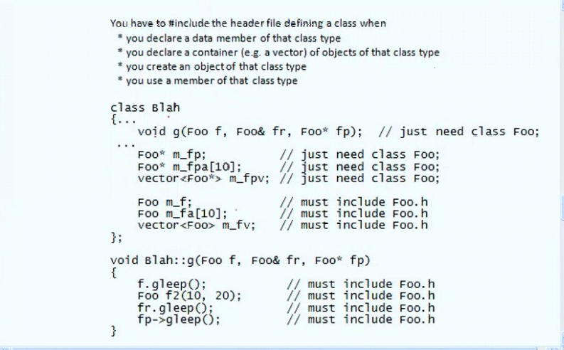
Last Topic: Knowing WHEN to Include .H Files
A.h
class FirstClass
{
public:
void someFunc() { ... }
};
This line tells C++ that your class exists, but doesn’t actually define all the gory details.
If you do NONE of the previous items, but you…
Since none of this code actually uses the “guts” of the class (as the code did on the previous slide), this is all C++ needs to know!
B.h
class SecondClass
{
public:
private:
};
class FirstClass; // enough!
1. Use the class to define a parameter to a function, OR
2. Use the class as the return type for a func, OR
void goober(FirstClass p1);
FirstClass hoober(int a);
3. Use the class to define a pointer or reference variable
void joober(FirstClass &p1);
void koober(FirstClass *p1);
void loober()
{
FirstClass *ptr;
}
Then you DON’T need to include the class’s .H file.
(You may do so, but you don’t need to)
Instead, all you need to do is give C++ a hint that your class exists (and is defined elsewhere).
FirstClass *ptr1, *z[10];
Here’s how you do that:

Slide 77
Last Topic: Knowing WHEN to Include .H Files
A.h
class FirstClass
{
… // thousands of lines
… // thousands of lines
};
class FirstClass
{
public:
void someFunc() { ... }
};
Wow – so confusing!
B.h
Why not just always use #include to avoid the confusion?
class SecondClass
{
public:
private:
};
#include “A.h”
// really slow!
There are two reasons:
1. If a .h file is large (thousands of lines), #including it when you don’t strictly need to slows down your compilation!
2. If two classes refer to each other, and both classes try to #include the other’s .H file, you’ll get a compile error.

Slide 78
Students and Classrooms
Every student knows what class he/she is in…
Every class has a roster of its students…
ECE 0302
Kerry
Kerry
Cyril
Cyril
CS 0445
Lydia
Hal
Lydia
Hal
These type of cyclical relationships cause #include problems!

Slide 79
Last Topic: Self-referential Classes
And here we have the Student class. Note that each Student knows which classroom he or she is in…
Since our ClassRoom class refers to the Student class it includes Student.h
Since our Student class refers to the classroom class, it includes ClassRoom.h…
Here we have a ClassRoom class that holds a bunch of Students…
Do you see the problem?
Student.h
ClassRoom.h
#include “ClassRoom.h”
class Student
{
public:
...
private:
ClassRoom *m_myRoom;
};
#include “Student.h”
class ClassRoom
{
public:
...
private:
Student m_studs[100];
};
Student.cpp
ClassRoom.cpp
#include “Student.h”
void Student::printMyClassRoom()
{
cout <<“I’m in Boelter #” << m_myRoom->getRmNum();
}
#include “ClassRoom.h”
void ClassRoom::printRoster()
{
for (int i=0;i<100;i++)
cout << m_studs[i].getName();
}

Slide 80
Last Topic: Self-referential Classes
main.cpp
Student.h
int main()
{
Student david;
…
}
#include “Student.h”
#include “ClassRoom.h”
class Student
{
public:
...
private:
ClassRoom *m_myRoom;
};
class Student
{
public:
...
private:
ClassRoom *m_myRoom;
};
#include “ClassRoom.h”
class Student
{
public:
...
private:
ClassRoom *m_myRoom;
};
#include “ClassRoom.h”
The compiler will keep going forever!!!!!
(oh, and adding Include Guards doesn’t solve the underlying
problem either!)
ClassRoom.h
#include “Student.h”
class ClassRoom
{
public:
...
private:
Student m_studs[100];
};
#include “Student.h”
class ClassRoom
{
public:
...
private:
Student m_studs[100];
};

Slide 81
So how do we solve this cyclical nightmare?
Step #1: Look at the two class definitions in your .h files. At least one of them should NOT need the full #include.
Question: Which of our two classes doesn’t need the full #include? Why?
This class JUST defines a pointer to a ClassRoom. It does NOT hold a full ClassRoom variable and therefore doesn’t require the full class definition here!!!
This class defines actual Student variables… It therefore requires the full class definition to work!
Student.h
ClassRoom.h
#include “ClassRoom.h”
class Student
{
public:
...
private:
ClassRoom *m_myRoom;
};
#include “Student.h”
class ClassRoom
{
public:
...
private:
Student m_studs[100];
};

Slide 82
So how do we solve this cyclical nightmare?
Step #2: Take the class that does NOT require the full #include (forget the other one) and update its header file:
Replace the #include “XXXX.h” statement with the following: class YYY;
Where YYY is the other class name (e.g., ClassRoom).
The Compiler says:
“Alright smartypants, I’ll trust you.
But if you won’t tell me about ClassRoom’s functions and variables
…then you can’t define any actual variables with it
or call any member functions on it.”
Student.h
X
This line tells the compiler:
“Hey Compiler, there’s another class called ‘ClassRoom’ but we’re not going to tell you exactly what it looks like just yet.”
ClassRoom.h
The Programmer says:
“I think I’ll have a little fun! Let’s see what the compiler says if I define a full variable!”
#include “ClassRoom.h”
class Student
{
public:
...
private:
ClassRoom *m_myRoom;
};
The Compiler replies:
“Wanna play nasty? Ok. Here are 9000 SYNTAX ERRORS for you to deal with!”
class ClassRoom;
#include “Student.h”
class ClassRoom
{
public:
...
private:
Student m_studs[100];
};
, haha;

Slide 83
So how do we solve this cyclical nightmare?
All you need is this class declaration; line to give the compiler a heads-up.
Step #3: Almost done. Now update the CPP file for this class by #including the other header file normally.
Since this .H file JUST has a pointer to a ClassRoom (but no code in this file that uses or defines a full ClassRoom variable)…
This line tells the compiler:
“Hey Compiler, since my CPP file is going to actually use ClassRoom’s functionality, I’ll now tell you all the details about the class.”
So you must #include its header file here!
Student.h
You’re calling a member function of ClassRoom here…
#include “ClassRoom.h”
class Student
{
public:
...
private:
ClassRoom *m_myRoom;
};
class ClassRoom;
The Compiler says:
Ah, ok, now I can see the full definition of what a ClassRoom variable really is…
Feel free to call its getRmNum() method if you like!
Student.cpp
#include “Student.h”
void Student::printMyClassRoom()
{
cout <<“I’m in Boelter #” << m_myRoom->getRmNum();
}
#include “ClassRoom.h”
The compiler is happy as long as you #include the class definition before you actually use the class in your functions…

Slide 84
So how do we solve this cyclical nightmare?
The Compiler says:
Hey! Wait a second, you’re calling the getRmNum( ) function but you haven’t defined the full class. No WAY!
Fix it or DIE!
Step #4: Finally, make sure that your class doesn’t have any other member functions that violate our #include vs class rules…
Student.h
#include “ClassRoom.h”
class Student
{
public:
…
private:
ClassRoom *m_myRoom;
};
class ClassRoom;
void beObnoxious() { cout << m_myRoom->getRmNum() << “ sucks!”; }
void beObnoxious();
If you have defined one or more functions DIRECTLY in your class definition AND they use your other class in a significant way, then you must MOVE them to the CPP file.
The Compiler says:
Alright. That’s better.
Don’t let it happen again.
Student.cpp
#include “Student.h”
void Student::printMyClassRoom()
{
cout <<“I’m in Boelter #” << m_myRoom->getRmNum();
}
#include “ClassRoom.h”
void Student::beObnoxious() { cout << m_myRoom->getRmNum() << “ sucks!”; }

Slide 85
So how do we solve this cyclical nightmare?
Now let’s look at both of our classes… Notice, we no longer have a cyclical reference! Woohoo!
Student.h
ClassRoom.h
#include “ClassRoom.h”
class Student
{
public:
...
private:
ClassRoom *m_myRoom;
};
class ClassRoom;
#include “Student.h”
class ClassRoom
{
public:
...
private:
Student m_studs[100];
};
Student.cpp
ClassRoom.cpp
#include “Student.h”
void Student::printMyClassRoom()
{
cout <<“I’m in Boelter #” << m_myRoom->getRmNum();
}
#include “ClassRoom.h”
void ClassRoom::printRoster()
{
for (int i=0;i<100;i++)
cout << m_studs[i].getName();
}
#include “ClassRoom.h”

Slide 86


Default Arguments!
void poop(string name, int numberOfWipes)
{
cout << name << “ just pooped.\n”;
cout << “They wiped “ << numberOfWipes <<
“ times.\n”;
}
...
int main()
{
poop(“Phyllis”,2);
poop(“Astro”,2);
poop(“Sylvia”,2);
poop(“Carey”,3);
poop(“David”,0);
poop(“Sergey”,2);
poop(“Larry”,2);
poop(“Devan”,2);
}
So what do you notice about the following code?
void poop(string name, int numberOfWipes)
{
cout << name << “ just pooped.\n”;
cout << “They wiped “ << numberOfWipes <<
“ times.\n”;
}
...
int main()
{
poop(“Phyllis”,2);
poop(“Astro”,2);
poop(“Sylvia”,2);
poop(“Carey”,3);
poop(“David”,0);
poop(“Sergey”,2);
poop(“Larry”,2);
poop(“Devan”,2);
}
(other than David really needs to wipe)
Right! Most of the time, people wipe exactly twice!
Wouldn’t it be nice if we could simplify our program by taking this into account?

Slide 87
Default Arguments!
= 2
2
void poop(string name, int numberOfWipes
{
cout << name << “ just pooped.\n”;
cout << “They wiped “ << numberOfWipes <<
“ times.\n”;
}
...
int main()
{
poop(“Phyllis”,2);
poop(“Astro”,2);
poop(“Sylvia”,2);
poop(“Carey”,3);
poop(“David”,0);
poop(“Sergey”,2);
poop(“Larry”,2);
poop(“Devan”,2);
}
)
We can! Let’s see how!
C++ lets you specify a default value for a parameter… like this…
Now, when you call the function, you can leave out the parameter if you just want the default…
“Phyllis”
);
// defaults to passing in 2
);
Note: We still need to pass in the value any time we don’t want the default!
);
“David”
0
// ignores the default value!
and C++ will automagically pass in that default value!
);
);
);

Slide 88

Default Arguments!
void fart(int length = 10, int volume = 50)
{
cout << “I just farted for “ << length
<< “ seconds, and it was“
<< volume << “ decibels loud.\n”
}
int main()
{
fart(20,5); // long but not so loud
fart(5); // short violent burst!
fart(); // medium and pretty loud
}
You can have more than one default parameter if you like, and C++ will figure out what to do!
10
50
50
But you can’t do something like this!
20
5
5
Why not? Good question – ask the C++ language designers. ☺
fart(,30); // NOT ALLOWED

Slide 89
Default Arguments: One other thing
If the j^{th} parameter has a default value, then all of the following parameters (j+1 to n) must also have default values.
// INVALID! Our 1st param is default, but 2nd and 3rd aren’t!
bool burp(int length = 5, int loudness, int pitch)
{
...
}
// INVALID! Our first 2 params are default, but 3rd isn’t!
bool burp(int length = 5, int loudness = 12, int pitch)
{
...
}
// INVALID! Our 1st param is default, but 2nd isn’t!
bool burp(int length = 5, int loudness, int pitch = 60)
{
...
}
// PERFECT! All parameters are default
bool burp(int length = 5, int loudness = 5, int pitch = 60)
{
...
}
// PERFECT! All default parameters come after non-defaults
bool burp(int length, int loudness = 5, int pitch = 60)
{
...
}
Notes:
If the j^{th} parameter has a default value, then all of the following parameters (j+1 to n) must also have default values.

Slide 90
Challenge #1
Write a class called Quadratic which represents a second-order quadratic equation, e.g.: 4x²+3x+5
When you construct a Quadratic object, you pass in the three coefficients (e.g., 4, 3, and 5) for the equation.
The class also has an evaluate method which allows you pass in a value for x. The function will return the value of f(x).
The class has a destructor which prints out “goodbye”.
Notes:
class Quadratic
{
public:
Quadratic(int coeff1, int coeff2, int coeff3)
{
c1 = coeff1;
c2 = coeff2;
c3 = coeff3;
}
double evaluate(double x)
{
return c1*(x*x) + c2*x + c3;
}
~Quadratic()
{
cout << “goodbye” << endl;
}
private:
int c1, c2, c3;
};

Slide 91
Challenge #2
Write a class called MathNerd which represents a math nerd. Every MathNerd has his own special quadratic equation!
When you construct a MathNerd, he always wants you to specify the first two coefficients (for the x² and x) for his equation.
The MathNerd has a getMyValue function which accepts a value for x and should return f(x) for the nerd’s QE.
Notes:
class MathNerd
{
public:
MathNerd(int c1, int c2, int c3=0)
: QE(c1, c2, c3)
{
}
~MathNerd()
{
}
double getMyValue(double x)
{
return QE.evaluate(x);
}
private:
Quadratic QE;
};

