Slide 1
Data Structures and Algorithms
Instructor: Dr. Hao Qin（秦浩）
E-mail: hao.qin@scupi.cn
My Office: Room 514, SCUPI (North)

Slide 2
Trees
A Tree is a special linked list-based data structure that has many uses in Computer Science:
To organize hierarchical data
A Family Tree
“carey”
“leon”
“andrea”
“sheila”
“simon”
“martha”
“milton”
NULL
NULL
NULL
NULL
NULL
NULL
NULL
NULL

Slide 3
Trees
A Tree is a special linked list-based data structure that has many uses in Computer Science:
To organize hierarchical data
To make information easily searchable
A Binary Search Tree
“marty”
“harry”
“rich”
“alan”
“jacob”
“nancy”
“zai”
NULL
NULL
NULL
NULL
NULL
NULL
NULL
NULL

Slide 4
Trees
A Tree is a special linked list-based data structure that has many uses in Computer Science:
To organize hierarchical data
To make information easily searchable
To simplify the evaluation of mathematical expressions
An Expression Tree
+
*
+
32
17
-42
4
NULL
NULL
NULL
NULL
NULL
NULL
NULL
NULL

Slide 5
Trees
A Tree is a special linked list-based data structure that has many uses in Computer Science:
A Decision Tree
To organize hierarchical data
To make information easily searchable
To simplify the evaluation of mathematical expressions
To make decisions
Does the patient have a fever?
yes
no
Does he/she have spots on
his/her face?
Does he/she have a sore throat?
yes
…
He has COOTIES!

Slide 6
Basic Tree Facts
Trees are made of nodes (just like linked list nodes).
2. Every tree has a "root" pointer.
root ptr
root ptr
Empty tree
3. The top node of a tree is called its "root" node.
NULL
4. Every node may have zero or more “children” nodes.
2 children
Root node
5
5. A node with 0 children is called a “leaf” node.
6. A tree with no nodes is called an “empty tree.”
-33
17
1 child
NULL
struct node
{
int value; // some value
node *left, *right;
};
53
91
-115
0 children
NULL
NULL
NULL
NULL
NULL
NULL
node *rootPtr;

Slide 7
Tree Nodes Can Have Many Children
A tree node can have more than just two children:
struct node
{
int value; // node data
node *pChild1, *pChild2, *pChild3, …;
};
root ptr
struct node
{
int value; // node data
node *pChildren[26];
};
3
NULL
7
4
15
NULL
NULL
NULL
NULL
NULL
NULL
NULL
NULL
NULL
NULL
NULL

Slide 8
Binary Trees
A binary tree is a special form of tree. In a binary tree, every node has at most two children nodes:
A left child and a right child.
struct BTNODE // binary tree node
{
string value; // node data
BTNODE *pLeft, *pRight;
};
A Binary Tree
“carey”
“leon”
“andrea”
“sheila”
“simon”
“martha”
“milton”
NULL
NULL
NULL
NULL
NULL
NULL
NULL
NULL

Slide 9
Binary Tree Subtrees
We can pick any node in the tree…
And then focus on its “subtree” - which includes it and all of nodes below it.
This subtree includes four different nodes… It has the “leon” node as its root.
“carey”
like this node…
“leon”
“andrea”
“sheila”
“simon”
“martha”
“milton”
NULL
NULL
NULL
NULL
NULL
NULL
NULL
“ziggy”
NULL
NULL

Slide 10
Binary Tree Subtrees
If we pick a node from our tree…
we can also identify its left and right sub-trees.
like this node…
“carey”
Carey’s right subtree
Carey’s left subtree
“leon”
“andrea”
“sheila”
“simon”
“martha”
“milton”
NULL
NULL
NULL
NULL
NULL
NULL
NULL
“ziggy”
NULL
NULL

Slide 11
Operations on Binary Trees
The following are common operations that we might perform on a Binary Tree:
enumerating all the items
searching for an item
adding a new item at a certain position on the tree
deleting an item
deleting the entire tree (destruction)
removing a whole section of a tree (called pruning)
adding a whole section to a tree (called grafting)
We’ll learn about many of these operations over the next two classes.

Slide 12
A Simple Tree Example
struct BTNODE // node
{
int value; // data
BTNODE *left, *right;
};
temp
1200
1100
main()
{
BTNODE *temp, *pRoot;
pRoot = new BTNODE;
pRoot->value = 5;
temp = new BTNODE;
temp->value = 7;
temp->left = NULL;
temp->right = NULL;
pRoot->left = temp;
temp = new BTNODE;
temp->value = -3;
temp->left = NULL;
temp->right = NULL;
pRoot->right = temp;
// etc…
pRoot
1000
1000
value
5
left
right
1200
1100
temp->
1200
value
7
temp->
1100
left
right
value
-3
NULL
NULL
left
right
NULL
NULL
And of course, later we’d have to delete our tree’s nodes.

Slide 13
Binary Tree Traversals
Just as we can traverse through linked lists, we can also traverse through the nodes of a tree.
root
All tree traversals start with the root node.
“A"
“B"
“C"
NULL
NULL
NULL
NULL
There are four common ways to traverse a tree – and each visits the tree's nodes in a different order:
Pre-order
Traversal
In-order
Traversal
Post-order
Traversal
Level-order
Traversal
These traversals all use recursion, and are nearly identical algorithms.
L.O.T. uses a breadth-first-search to visit nodes.

Slide 14
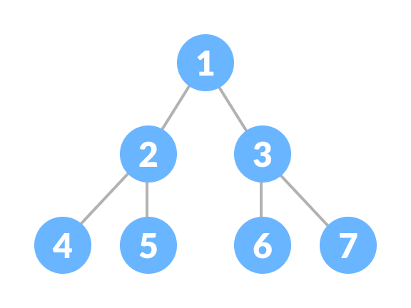
Pre-order, In-order and Post-order
Let's see the code for simple pre-, in-, and post-order traversals!
void preorder(Node *p)
{
if (p == nullptr)
return;
cout << p->value;
preorder(p->left);
preorder(p->right);
}
Then we "process" the current node's value.
First we handle the base case – an empty tree.
Finally, we fully process the right subtree of the current node using recursion.
Then we fully process the left subtree of the current node using recursion.
p
#1
Eat
#2
Rats
Are
#3
For
They
Tasty
Treats

Slide 15
Pre-order, In-order and Post-order
Let's see the code for simple pre-, in-, and post-order traversals!
void preorder(Node *p)
{
if (p == nullptr)
return;
cout << p->value;
preorder(p->left);
preorder(p->right);
}
p
Eat
Rats
Are
For
They
Tasty
Treats

Slide 16
Pre-order, In-order and Post-order
Let's see the code for simple pre-, in-, and post-order traversals!
void preorder(Node *p)
{
if (p == nullptr)
return;
cout << p->value;
preorder(p->left);
preorder(p->right);
}
void inorder(Node *p)
{
if (p == nullptr)
return;
inorder(p->left);
cout << p->value;
inorder(p->right);
}
Next let's see the in-order traversal!
How's it different from the pre-order traversal?
p
#2
But with in-order, we process the current node in between processing its left and right subtrees.
In pre-order, we process the current node first, then process its left and right subtrees.
Eat
#1
Rats
Are
#3
For
They
Tasty
Treats

Slide 17
Pre-order, In-order and Post-order
Let's see the code for simple pre-, in-, and post-order traversals!
void preorder(Node *p)
{
if (p == nullptr)
return;
cout << p->value;
preorder(p->left);
preorder(p->right);
}
First we fully process the left subtree of the current node using recursion.
void inorder(Node *p)
{
if (p == nullptr)
return;
inorder(p->left);
cout << p->value;
inorder(p->right);
}
void postorder(Node *p)
{
if (p == nullptr)
return;
postorder(p->left);
postorder(p->right);
cout << p->value;
}
Then we fully process the right subtree of the current node using recursion.
#3
Finally, after everything else, we "post-process" the current node's value.
p
Eat
Finally, let's see the post-order traversal!
#1
Rats
Are
#2
For
They
Tasty
Treats

Slide 18
Pre-order, In-order and Post-order
Let's see the code for simple pre-, in-, and post-order traversals!
void preorder(Node *p)
{
if (p == nullptr)
return;
cout << p->value;
preorder(p->left);
preorder(p->right);
}
void inorder(Node *p)
{
if (p == nullptr)
return;
inorder(p->left);
cout << p->value;
inorder(p->right);
}
void postorder(Node *p)
{
if (p == nullptr)
return;
postorder(p->left);
postorder(p->right);
cout << p->value;
}
Notice that the only difference is placement of the processing step!
But that small change results in major differences in the order the nodes are processed!
Ok, let's trace through our pre-order traversal!

Slide 19
The Pre-order Traversal
cur
USC
root
"USC"
Output:
cur
kids
"clue"
"kids"
NULL
NULL
cur
nullptr
cur
have
"no"
"have"
Our base case checks to see if cur points at an empty sub-tree.
If so, there’s nothing to process and we’re done!
NULL
NULL
NULL
NULL
void preorder(Node *cur)
{
if (cur == nullptr) // if empty, return…
return;
cout << cur->value; // Process the current node.
preorder(cur->left); // Process nodes in left sub-tree.
preorder(cur->right); // Process nodes in right sub-tree.
}
Otherwise we “process” the value in the current node…
void preorder(Node *cur)
{
if (cur == nullptr) // if empty, return…
return;
cout << cur->value; // Process the current node.
preorder(cur->left); // Process nodes in left sub-tree.
preorder(cur->right); // Process nodes in right sub-tree.
}
void preorder(Node *cur)
{
if (cur == nullptr) // if empty, return…
return;
cout << cur->value; // Process the current node.
preorder(cur->left); // Process nodes in left sub-tree.
preorder(cur->right); // Process nodes in right sub-tree.
}
void preorder(Node *cur)
{
if (cur == nullptr) // if empty, return…
return;
cout << cur->value; // Process the current node.
preorder(cur->left); // Process nodes in left sub-tree.
preorder(cur->right); // Process nodes in right sub-tree.
}
main()
{
Node *root;
…
preorder(root);
}

Slide 20
The Pre-order Traversal
cur
"USC"
root
Output:
USC
kids have
cur
"kids"
"clue"
cur
nullptr
NULL
NULL
cur
"have"
"no"
NULL
NULL
NULL
NULL
void preorder(Node *cur)
{
if (cur == nullptr) // if empty, return…
return;
cout << cur->value; // Process the current node.
preorder(cur->left); // Process nodes in left sub-tree.
preorder(cur->right); // Process nodes in right sub-tree.
}
void preorder(Node *cur)
{
if (cur == nullptr) // if empty, return…
return;
cout << cur->value; // Process the current node.
preorder(cur->left); // Process nodes in left sub-tree.
preorder(cur->right); // Process nodes in right sub-tree.
}
void preorder(Node *cur)
{
if (cur == nullptr) // if empty, return…
return;
cout << cur->value; // Process the current node.
preorder(cur->left); // Process nodes in left sub-tree.
preorder(cur->right); // Process nodes in right sub-tree.
}
void preorder(Node *cur)
{
if (cur == nullptr) // if empty, return…
return;
cout << cur->value; // Process the current node.
preorder(cur->left); // Process nodes in left sub-tree.
preorder(cur->right); // Process nodes in right sub-tree.
}
main()
{
Node *root;
…
preorder(root);
}

Slide 21
The Pre-order Traversal
cur
"USC"
root
Output:
USC
kids have
cur
"kids"
"clue"
NULL
NULL
cur
"have"
"no"
NULL
NULL
NULL
NULL
void preorder(Node *cur)
{
if (cur == nullptr) // if empty, return…
return;
cout << cur->value; // Process the current node.
preorder(cur->left); // Process nodes in left sub-tree.
preorder(cur->right); // Process nodes in right sub-tree.
}
void preorder(Node *cur)
{
if (cur == nullptr) // if empty, return…
return;
cout << cur->value; // Process the current node.
preorder(cur->left); // Process nodes in left sub-tree.
preorder(cur->right); // Process nodes in right sub-tree.
}
void preorder(Node *cur)
{
if (cur == nullptr) // if empty, return…
return;
cout << cur->value; // Process the current node.
preorder(cur->left); // Process nodes in left sub-tree.
preorder(cur->right); // Process nodes in right sub-tree.
}
main()
{
Node *root;
…
preorder(root);
}

Slide 22
The Pre-order Traversal
cur
"USC"
root
Output:
USC
kids have
cur
"kids"
"clue"
NULL
NULL
no
"have"
"no"
cur
NULL
NULL
NULL
NULL
void preorder(Node *cur)
{
if (cur == nullptr) // if empty, return…
return;
cout << cur->value; // Process the current node.
preorder(cur->left); // Process nodes in left sub-tree.
preorder(cur->right); // Process nodes in right sub-tree.
}
void preorder(Node *cur)
{
if (cur == nullptr) // if empty, return…
return;
cout << cur->value; // Process the current node.
preorder(cur->left); // Process nodes in left sub-tree.
preorder(cur->right); // Process nodes in right sub-tree.
}
void preorder(Node *cur)
{
if (cur == nullptr) // if empty, return…
return;
cout << cur->value; // Process the current node.
preorder(cur->left); // Process nodes in left sub-tree.
preorder(cur->right); // Process nodes in right sub-tree.
}
main()
{
Node *root;
…
preorder(root);
}

Slide 23
The Pre-order Traversal
cur
"USC"
root
Output:
USC
kids have
no
cur
"kids"
"clue"
NULL
NULL
"have"
"no"
NULL
NULL
NULL
NULL
void preorder(Node *cur)
{
if (cur == nullptr) // if empty, return…
return;
cout << cur->value; // Process the current node.
preorder(cur->left); // Process nodes in left sub-tree.
preorder(cur->right); // Process nodes in right sub-tree.
}
void preorder(Node *cur)
{
if (cur == nullptr) // if empty, return…
return;
cout << cur->value; // Process the current node.
preorder(cur->left); // Process nodes in left sub-tree.
preorder(cur->right); // Process nodes in right sub-tree.
}
main()
{
Node *root;
…
preorder(root);
}

Slide 24
The Pre-order Traversal
cur
"USC"
root
Output:
USC
kids have
no
clue
"kids"
cur
"clue"
NULL
NULL
"have"
"no"
NULL
NULL
NULL
NULL
void preorder(Node *cur)
{
if (cur == nullptr) // if empty, return…
return;
cout << cur->value; // Process the current node.
preorder(cur->left); // Process nodes in left sub-tree.
preorder(cur->right); // Process nodes in right sub-tree.
}
void preorder(Node *cur)
{
if (cur == nullptr) // if empty, return…
return;
cout << cur->value; // Process the current node.
preorder(cur->left); // Process nodes in left sub-tree.
preorder(cur->right); // Process nodes in right sub-tree.
}
main()
{
Node *root;
…
preorder(root);
}

Slide 25
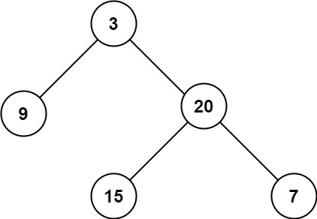
Practice1: Maximum Depth of Binary Tree
Given a binary tree, find its maximum depth. The maximum depth is the number of nodes along the longest path from the root node down to the farthest leaf node.
Example:
Input: root = [3,9,20,null,null,15,7] Output: 3

Slide 26
Solution of Practice1
#include <iostream>
using namespace std;
struct TreeNode {
int val;
TreeNode *left;
TreeNode *right;
TreeNode(int x) : val(x), left(nullptr), right(nullptr) {}
};
int maxDepth(TreeNode* root) {
if (root == nullptr) return 0;
int leftDepth = maxDepth(root->left);
int rightDepth = maxDepth(root->right);
return 1 + max(leftDepth, rightDepth);
}
int main() {
TreeNode* root = new TreeNode(3);
root->left = new TreeNode(9);
root->right = new TreeNode(20);
root->right->left = new TreeNode(15);
root->right->right = new TreeNode(7);
cout << "Maximum Depth: " << maxDepth(root) << endl;
return 0;
}

Slide 27
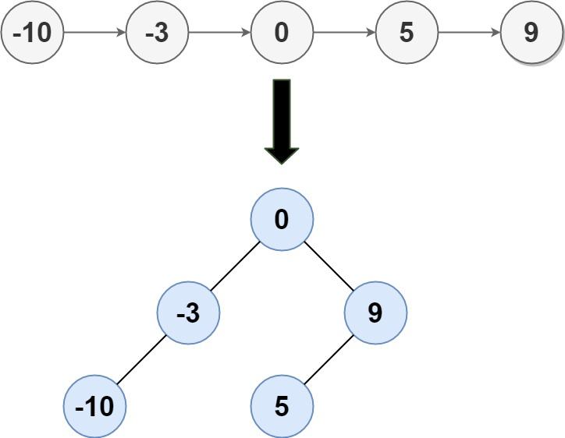
Practice2: Convert Sorted List to Binary Search Tree
Given the head of a singly linked list where elements are sorted in ascending order, convert it to a height-balanced binary search tree (BST). A height-balanced binary tree is defined as a binary tree in which the depth of the two subtrees of every node never differ by more than one.
Example:
Input: head = [-10,-3,0,5,9] Output: [0,-3,9,-10,null,5]

Slide 28
#include <iostream>
using namespace std;
struct ListNode {
int val;
ListNode *next;
ListNode(int x) : val(x), next(nullptr) {}
};
struct TreeNode {
int val;
TreeNode *left;
TreeNode *right;
TreeNode(int x) : val(x), left(nullptr), right(nullptr) {}
};
ListNode* findMiddle(ListNode* head) {
ListNode* slow = head;
ListNode* fast = head;
ListNode* prev = nullptr;
while (fast && fast->next) {
prev = slow;
slow = slow->next;
fast = fast->next->next;
}
if (prev) {
prev->next = nullptr;
}
return slow;
}
TreeNode* sortedListToBST(ListNode* head) {
if (!head) return nullptr;
ListNode* middle = findMiddle(head);
TreeNode* root = new TreeNode(middle->val);
if (head == middle) return root;
root->left = sortedListToBST(head);
root->right = sortedListToBST(middle->next);
return root;
}
Solution of Practice2
void printTree(TreeNode* root) {
if (!root) return;
cout << root->val << " ";
printTree(root->left);
printTree(root->right);
}
int main() {
ListNode* head = new ListNode(-10);
head->next = new ListNode(-3);
head->next->next = new ListNode(0);
head->next->next->next = new ListNode(5);
head->next->next->next->next = new ListNode(9);
TreeNode* root = sortedListToBST(head);
printTree(root);
cout << endl;
// Clean up allocated nodes
delete head->next->next->next->next;
delete head->next->next->next;
delete head->next->next;
delete head->next;
delete head;
return 0;
}

