Slide 1
Lab 05 Stepper Motor
Operating Principle of Stepper Motor

Slide 2
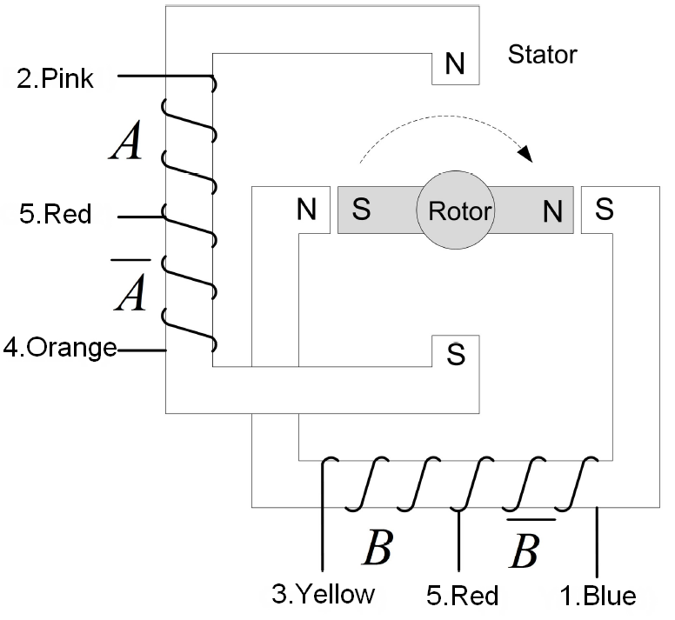
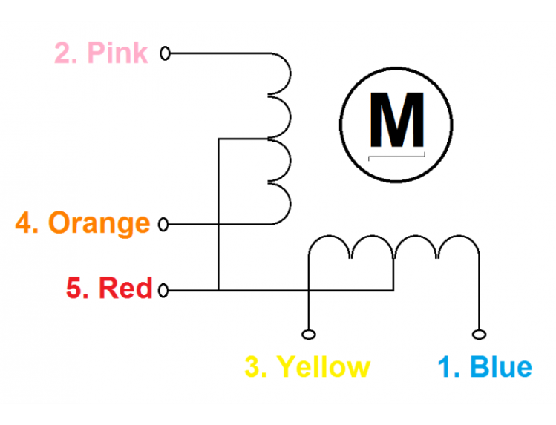
Inner Structure

Slide 3
Inner Structure

Slide 4
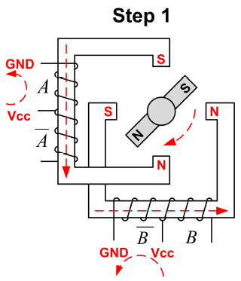
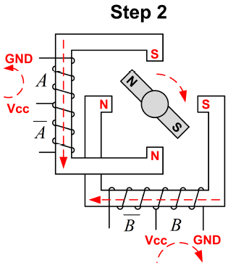
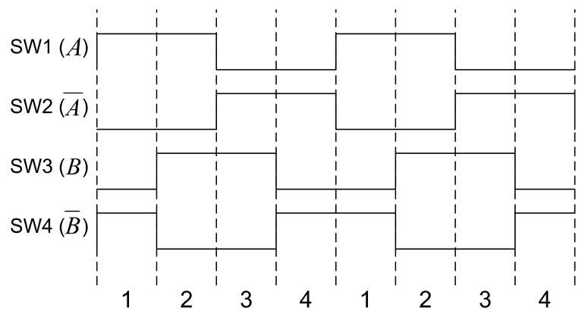
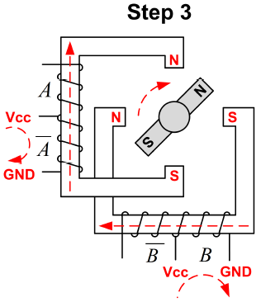
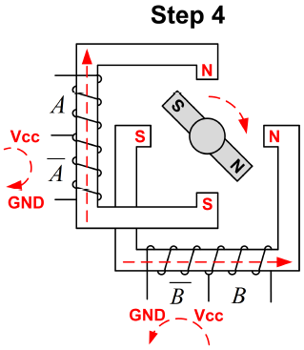

Full-Stepping
Coil activation sequence: $A\overline{B,}AB,\overline{A}B,\overline{A}\overline{B}$

Slide 5
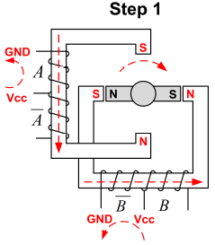
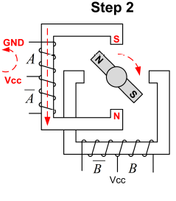
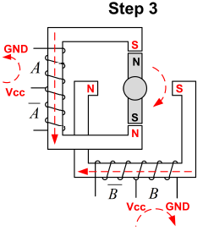
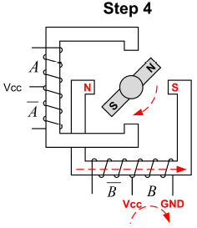
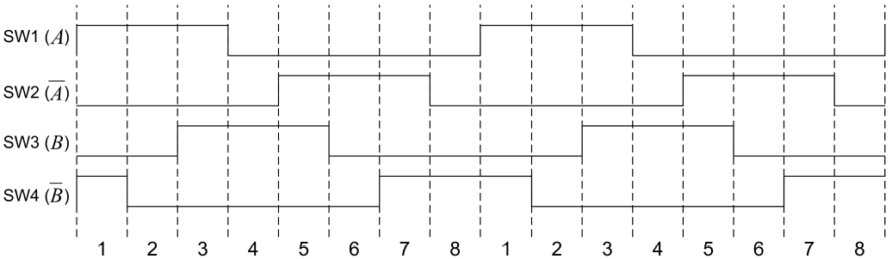

Half-Stepping
$$A\overline{B,}AB,\overline{A}B,\overline{A}\overline{B}$$
Coil activation sequence: $A\overline{B,}A,AB,B,\overline{A}B,\overline{A},\overline{A}\overline{B},\overline{B}$

Slide 6
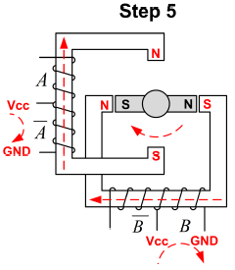
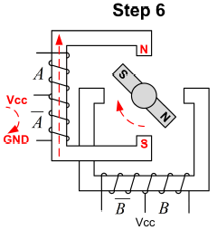
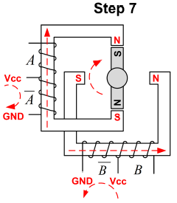
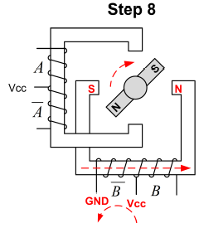
Half-Stepping
Coil activation sequence: $A\overline{B,}A,AB,B,\overline{A}B,\overline{A},\overline{A}\overline{B},\overline{B}$

Slide 7
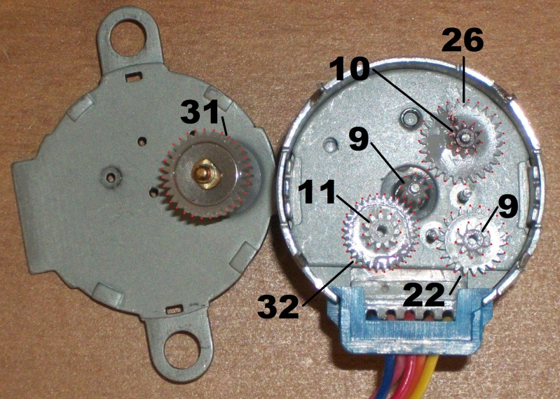
Number of Steps for a Revolution

Slide 8
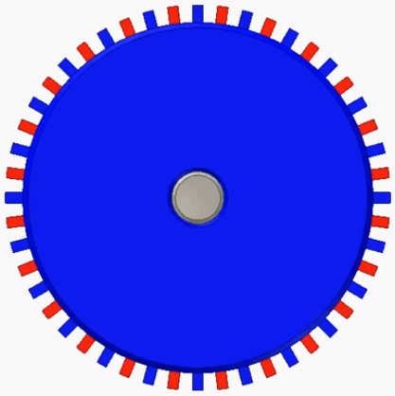
Number of Steps for a Revolution
Rotor
8 pairs of poles, not 1 pair.
Full-stepping
Internal motor: 4*8=32 steps per revolution
Gear ratio: 64
Total: 32*64=2048 steps per revolution
Half-stepping
Internal motor: 8*8=64 steps per revolution
Gear ratio: 64
Total: 64*64=4096 steps per revolution

Slide 9
Inner Structure

