Slide 1
CSE 220
Data Structures
Lecture 03:
Singly Linked Lists – Node Removal and Rotation
Anwarul Bashir Shuaib [AWBS]
Lecturer
Department of Computer Science and Engineering
BRAC University

Slide 2
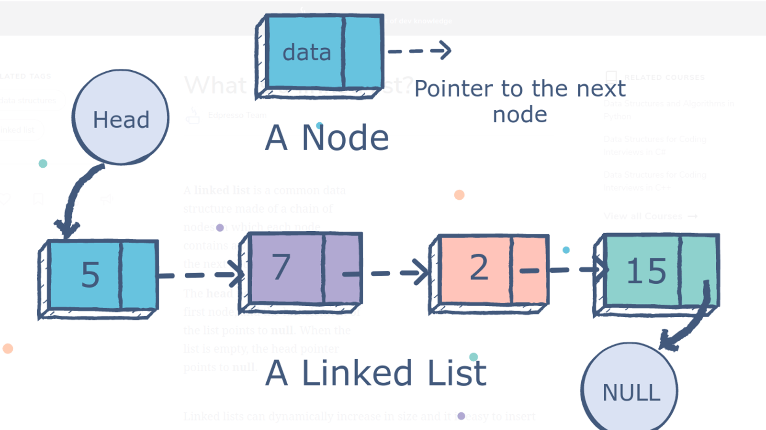
Review: Linked Lists
Collection of nodes
Each node contains two things:
  Data
  A reference to the next node
This version is also known as “Singly Linked Lists (SLL)” as each node only contains the reference to the next node.

Slide 3
Review: Arrays vs. Linked Lists
Arrays:
  Fixed size (static).
    Insertion/deletion is expensive (requires shifting elements).
    Random access is fast ⇒ O(1).
Linked Lists:
  Dynamic size (grows/shrinks as needed).
    Insertion/deletion is efficient ( O(1) at head/tail).
    Sequential access (no random access, O(n) for traversal).

Slide 4
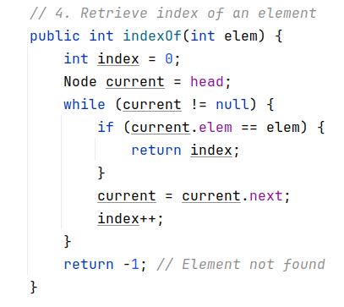

Review: Index of Element
50
60
40
20
30
10
NULL
Find the index of 30

Slide 5
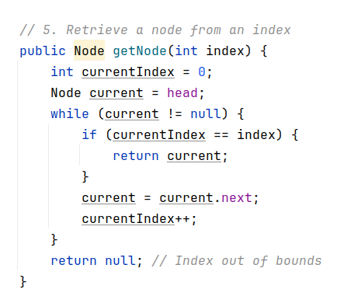
Review: Get Node at Index
50
60
40
20
30
10
NULL
Get the node at index 3

Slide 6
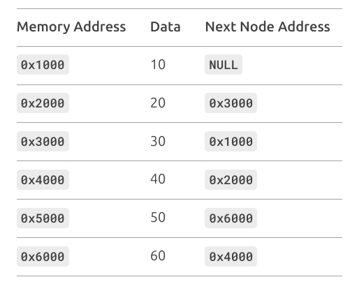
Exercise: Linked List Construction
Construct the linked list from the given table

Slide 7
Exercise: Linked List Construction
Step 1: Write down all nodes with their corresponding address.

Slide 8
Exercise: Linked List Construction
10
NULL
0x1000
20
0x3000
0x2000
30
0x1000
0x3000
40
0x2000
0x4000
50
0x6000
0x5000
60
0x4000
0x6000

Slide 9
Exercise: Linked List Construction
Step 2: Identify links between nodes and connect

Slide 10
Exercise: Linked List Construction
NULL
10
NULL
0x1000
20
0x3000
0x2000
30
0x1000
0x3000
40
0x2000
0x4000
50
0x6000
0x5000
60
0x4000
0x6000

Slide 11
Exercise: Linked List Construction
NULL
10
NULL
0x1000
20
0x3000
0x2000
30
0x1000
0x3000
40
0x2000
0x4000
50
0x6000
0x5000
60
0x4000
0x6000

Slide 12
Exercise: Linked List Construction
NULL
10
NULL
0x1000
20
0x3000
0x2000
30
0x1000
0x3000
40
0x2000
0x4000
50
0x6000
0x5000
60
0x4000
0x6000

Slide 13
Exercise: Linked List Construction
NULL
10
NULL
0x1000
20
0x3000
0x2000
30
0x1000
0x3000
40
0x2000
0x4000
50
0x6000
0x5000
60
0x4000
0x6000

Slide 14
Exercise: Linked List Construction
NULL
10
NULL
0x1000
20
0x3000
0x2000
30
0x1000
0x3000
40
0x2000
0x4000
50
0x6000
0x5000
60
0x4000
0x6000

Slide 15
Exercise: Linked List Construction
NULL
10
NULL
0x1000
20
0x3000
0x2000
30
0x1000
0x3000
40
0x2000
0x4000
50
0x6000
0x5000
60
0x4000
0x6000

Slide 16
Exercise: Linked List Construction
Step 3: Identify the head

Slide 17
Exercise: Linked List Construction
NULL
10
NULL
0x1000
20
0x3000
0x2000
30
0x1000
0x3000
40
0x2000
0x4000
No node points to the head
50
0x6000
0x5000
60
0x4000
0x6000

Slide 18
Exercise: Linked List Construction
Step 4: Traverse the list link by link from head and flatten it

Slide 19
Exercise: Linked List Construction
NULL
10
NULL
0x1000
20
0x3000
0x2000
30
0x1000
0x3000
40
0x2000
0x4000
50
0x6000
0x5000
60
0x4000
50
0x6000

Slide 20
Exercise: Linked List Construction
NULL
10
NULL
0x1000
20
0x3000
0x2000
30
0x1000
0x3000
40
0x2000
0x4000
50
0x6000
0x5000
60
0x4000
50
60
0x6000

Slide 21
Exercise: Linked List Construction
NULL
10
NULL
0x1000
20
0x3000
0x2000
30
0x1000
0x3000
40
0x2000
0x4000
50
0x6000
0x5000
60
0x4000
50
60
40
0x6000

Slide 22
Exercise: Linked List Construction
NULL
10
NULL
0x1000
20
0x3000
0x2000
30
0x1000
0x3000
40
0x2000
0x4000
50
0x6000
0x5000
60
0x4000
50
60
40
20
0x6000

Slide 23
Exercise: Linked List Construction
NULL
10
NULL
0x1000
20
0x3000
0x2000
30
0x1000
0x3000
40
0x2000
0x4000
50
0x6000
0x5000
60
0x4000
50
60
40
20
30
0x6000

Slide 24
Exercise: Linked List Construction
NULL
10
NULL
0x1000
20
0x3000
0x2000
30
0x1000
0x3000
40
0x2000
0x4000
50
0x6000
0x5000
60
0x4000
50
60
40
20
30
10
0x6000

Slide 25
Exercise: Linked List Construction
NULL
10
NULL
0x1000
20
0x3000
0x2000
30
0x1000
0x3000
40
0x2000
0x4000
50
0x6000
0x5000
60
0x4000
50
60
40
20
30
10
0x6000
NULL

Slide 26
Exercise: Linked List Construction
NULL
10
NULL
0x1000
Computers don’t use the neat arrows and boxes we draw—this is how linked lists actually look under the hood.
20
0x3000
0x2000
30
0x1000
0x3000
40
0x2000
0x4000
50
0x6000
0x5000
60
0x4000
50
60
40
20
30
10
0x6000
NULL

Slide 27

Element Removal (Front)
Remove the front element (head)
head
tail
50
60
40
99
20
30
10
NULL

Slide 28
Element Removal (Front)
Remove the front element (head)
head
tail
50
60
40
99
20
30
10
NULL

Slide 29
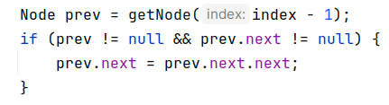
Element Removal (Anywhere)
Remove the element (30) at index 3
head
tail
60
40
99
20
30
10
NULL

Slide 30
Element Removal (Anywhere)
Remove the element (30) at index 3
head
tail
60
40
99
20
30
10
NULL

Slide 31
Element Removal (Anywhere)
Remove the element (30) at index 3
head
tail
60
40
99
20
30
10
NULL

Slide 32
Element Removal (Anywhere)
Remove the element (30) at index 3
head
tail
60
40
99
20
10
NULL

Slide 33
Element Removal (Anywhere)
Remove the element (30) at index 3
head
tail
60
40
99
20
10
NULL

Slide 34
Element Removal (Anywhere)
Can we optimize the tail removal?
head
tail
60
40
99
20
10
NULL

Slide 35
Element Removal (Anywhere)
Can we optimize the tail removal?
  No, we must be able to access the node before the last node in order to remove the last node.
head
tail
60
40
99
20
10
NULL

Slide 36
List Rotation (Left)
Rotate the list left by 1 element
head
tail
60
40
99
20
30
10
NULL

Slide 37
List Rotation (Left)
Rotate the list left by 1 element
head
tail
60
40
99
20
30
10

Slide 38
List Rotation (Left)
Rotate the list left by 1 element
head
tail
60
40
99
20
30
10

Slide 39
List Rotation (Left)
Rotate the list left by 1 element
tail
head
60
40
99
20
30
10

Slide 40
List Rotation (Left)
Rotate the list left by 1 element
tail
head
60
40
99
20
30
10
NULL

Slide 41
List Rotation (Left)
Rotate the list left by 1 element
head
tail
60
40
99
20
30
10
NULL
tail
head
60
40
99
20
30
10
NULL

Slide 42
List Rotation (Left)
Rotate the list left by 2 elements
head
tail
60
40
99
20
30
10
NULL
tail
head
60
40
99
20
30
10
NULL

Slide 43
List Rotation (Left)
Rotate the list left by 3 elements
head
tail
60
40
99
20
30
10
NULL
tail
head
60
40
99
20
30
10
NULL

Slide 44
List Rotation (Left)
Rotate the list left by 4 elements
head
tail
60
40
99
20
30
10
NULL
tail
head
60
40
99
20
30
10
NULL

Slide 45
List Rotation (Left)
Rotate the list left by 5 elements
head
tail
60
40
99
20
30
10
NULL
head
tail
60
40
99
20
30
10
NULL

Slide 46
List Rotation (Left)
Rotate the list left by 6 elements
head
tail
60
40
99
20
30
10
NULL
tail
head
60
40
99
20
30
10
NULL

Slide 47
List Rotation (Left)
Rotate the list left by 6 elements == Rotating by 1 element
head
tail
60
40
99
20
30
10
NULL
tail
head
60
40
99
20
30
10
NULL

Slide 48
List Rotation (Left)
Rotate the list left by 6 elements == Rotating by 6 % 5 element
head
tail
60
40
99
20
30
10
NULL
tail
head
60
40
99
20
30
10
NULL

Slide 49
List Rotation (Left)
Observations:
  Rotation by k ⇒ Rotation by k % size
  (k-1)th element becomes the new tail
  kth element becomes the new head

Slide 50
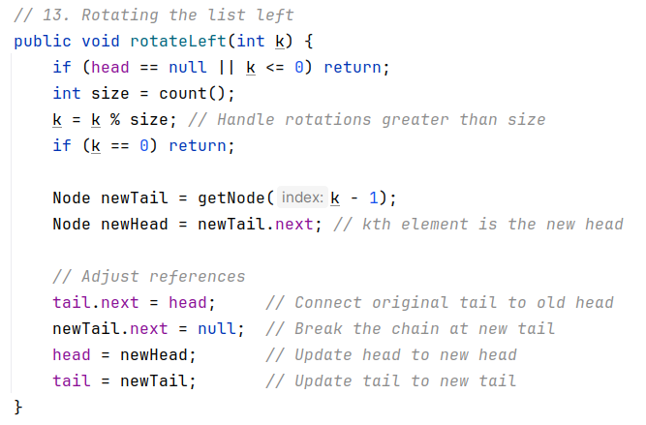
List Rotation (Left) Code Walkthrough
Rotate the list left by 3 elements
head
tail
60
40
99
20
30
10
NULL

Slide 51
List Rotation (Left) Code Walkthrough
Rotate the list left by 3 elements
head
tail
60
40
99
20
30
10
NULL

Slide 52
List Rotation (Left) Code Walkthrough
Rotate the list left by 3 elements
head
newTail
tail
60
40
99
20
30
10
NULL

Slide 53
List Rotation (Left) Code Walkthrough
Rotate the list left by 3 elements
head
newTail
newHead
tail
60
40
99
20
30
10
NULL

Slide 54
List Rotation (Left) Code Walkthrough
Rotate the list left by 3 elements
head
newTail
newHead
tail
60
40
99
20
30
10

Slide 55
List Rotation (Left) Code Walkthrough
Rotate the list left by 3 elements
head
newTail
newHead
tail
60
40
99
20
30
10
NULL

Slide 56
List Rotation (Left) Code Walkthrough
Rotate the list left by 3 elements
newTail
head
tail
60
40
99
20
30
10
NULL

Slide 57
List Rotation (Left) Code Walkthrough
Rotate the list left by 3 elements
tail
head
60
40
99
20
30
10
NULL

Slide 58
List Rotation (Left) Code Walkthrough
Rotate the list left by 3 elements
tail
head
60
40
99
20
30
10
NULL

Slide 59
List Rotation (Right)
Rotate left by 4 elements
head
tail
60
40
99
20
30
10
NULL
tail
head
60
40
99
20
30
10
NULL

Slide 60
List Rotation (Right)
Rotate left by 4 elements == Rotate right by 1 element
head
tail
60
40
99
20
30
10
NULL
tail
head
60
40
99
20
30
10
NULL

Slide 61
List Rotation (Right)
Rotate left by 4 elements == Rotate right by (5 - 4) element
head
tail
60
40
99
20
30
10
NULL
tail
head
60
40
99
20
30
10
NULL

Slide 62
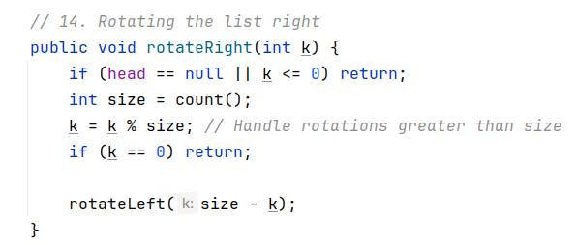
List Rotation (Right)
Observations:
  Left rotate by k == Right rotate by (size - k)
  Right rotate by k == left rotate by (size - k)

Slide 63
When to Use Linked Lists?
Use linked lists:
  When you need frequent insertions/deletions (e.g., implementing a queue or stack).
  When the size of the data is unknown or changes frequently.
Do not use linked lists:
  Random access is needed (Arrays ⇒ O(1), Linked lists ⇒ O(n)
Practical usage:
  In xv6, the freelist refers to a linked list of free memory pages
  Each free page contains a pointer to the next free page.

Slide 64
Exercise
Practice easy Singly Linked List problems from Leetcode
https://leetcode.com/problems/merge-two-sorted-lists/description/?envType=problem-list-v2&envId=linked-list
https://leetcode.com/problems/delete-node-in-a-linked-list/description/?envType=problem-list-v2&envId=linked-list
https://leetcode.com/problems/remove-duplicates-from-sorted-list/description/?envType=problem-list-v2&envId=linked-list
https://leetcode.com/problems/linked-list-cycle/description/?envType=problem-list-v2&envId=linked-list
https://leetcode.com/problems/intersection-of-two-linked-lists/description/?envType=problem-list-v2&envId=linked-list

