Slide 1
CSE 220
Data Structures
Lecture 04:
Doubly Linked Lists
Anwarul Bashir Shuaib [AWBS]
Lecturer
Department of Computer Science and Engineering
BRAC University

Slide 2
Review: Singly Linked Lists
Collection of nodes
Each node contains two things:
  Data
  A reference to the next node
This version is also known as “Singly Linked Lists (SLL)” as each node only contains the reference to the next node.
head
tail
60
40
20
10
NULL

Slide 3
Doubly Linked Lists
Each node contains three things:
  Data
  A reference to the next node
  A reference to the previous node
This version is also known as “Doubly Linked Lists (DLL)” as each node contains the reference to both the next node and the previous node.
NULL
head
tail
60
40
20
10
NULL

Slide 4
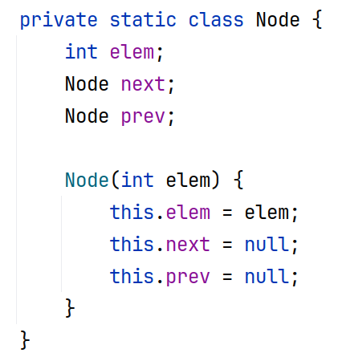
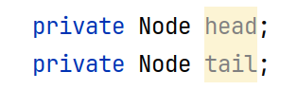
Node in DLLs
Doubly Linked List

Slide 5
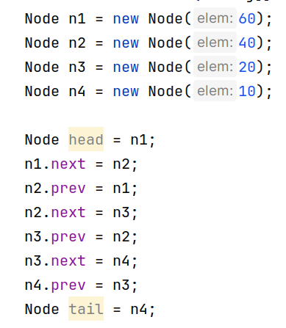
DLL Creation
NULL
NULL
NULL
NULL
60
40
20
10
NULL
NULL
NULL
NULL

Slide 6
DLL Creation
NULL
NULL
NULL
NULL
head
60
40
20
10
NULL
NULL
NULL
NULL

Slide 7
DLL Creation
NULL
NULL
NULL
NULL
head
60
40
20
10
NULL
NULL
NULL

Slide 8
DLL Creation
NULL
NULL
NULL
head
60
40
20
10
NULL
NULL
NULL

Slide 9
DLL Creation
NULL
NULL
head
60
40
20
10
NULL
NULL

Slide 10
DLL Creation
NULL
head
60
40
20
10
NULL

Slide 11
DLL Creation
NULL
head
tail
60
40
20
10
NULL

Slide 12
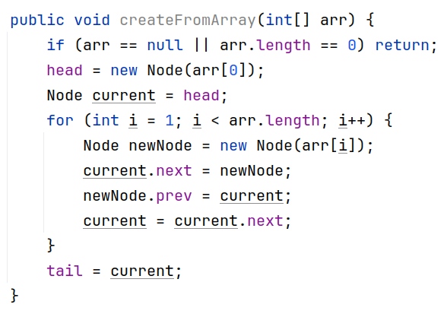

DLL Creation from Array
arr = [60, 40, 20, 10]
Only this part is absent in SLL

Slide 13
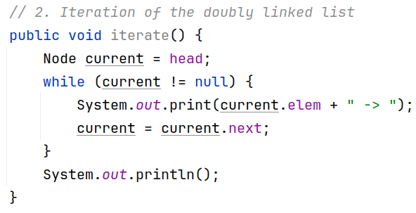
Sequential Traversal of DLL
Same as SLL

Slide 14
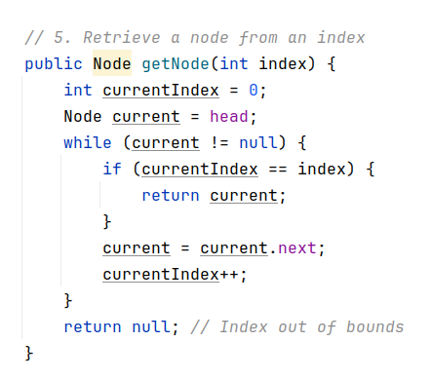
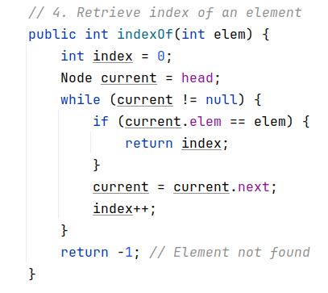
Element Access
Same as SLL

Slide 15



Slide 16
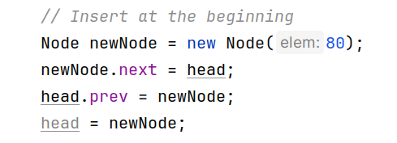
Element Insertion (At the beginning)
Prepend 80 to the list
NULL
head
tail
60
40
20
10
NULL

Slide 17
Element Insertion (At the beginning)
Prepend 80 to the list
NULL
NULL
head
tail
80
60
40
20
10
NULL
NULL

Slide 18
Element Insertion (At the beginning)
Prepend 80 to the list
NULL
NULL
head
tail
80
60
40
20
10
NULL

Slide 19
Element Insertion (At the beginning)
Prepend 80 to the list
NULL
head
tail
80
60
40
20
10
NULL

Slide 20

Element Insertion (At the beginning)
Prepend 80 to the list
NULL
head
tail
80
60
40
20
10
NULL

Slide 21
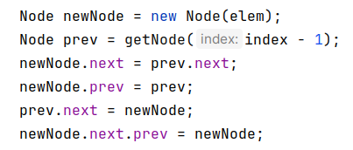
Element Insertion (Middle)
Insert 50 at index 2
NULL
head
tail
80
60
40
20
10
NULL

Slide 22
Element Insertion (Middle)
NULL
50
Insert 50 at index 2
NULL
NULL
head
tail
80
60
40
20
10
NULL

Slide 23
Element Insertion (Middle)
NULL
50
Insert 50 at index 2
NULL
NULL
head
tail
80
60
40
20
10
NULL

Slide 24
Element Insertion (Middle)
NULL
50
Insert 50 at index 2
NULL
head
tail
80
60
40
20
10
NULL

Slide 25
Element Insertion (Middle)
50
Insert 50 at index 2
NULL
head
tail
80
60
40
20
10
NULL

Slide 26
Element Insertion (Middle)
50
Insert 50 at index 2
NULL
head
tail
80
60
40
20
10
NULL

Slide 27
Element Insertion (Middle)
50
Insert 50 at index 2
NULL
head
tail
80
60
40
20
10
NULL

Slide 28
Element Insertion (Middle)
50
Insert 50 at index 2
NULL
head
tail
80
60
40
20
10
NULL
NULL
head
tail
80
60
50
40
20
10
NULL

Slide 29
General Rule
Better to connect the new node with the linked list first
Less risk of breaking the list or losing references to other nodes
Think: what would happen if prev.next = newNode was executed first?

Slide 30
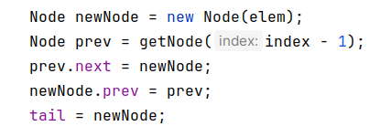
Element Insertion (Tail)
NULL
head
tail
80
60
50
40
20
10
NULL
Insert 35 at the end of the list

Slide 31
Element Insertion (Tail)
NULL
35
NULL
head
tail
NULL
80
60
50
40
20
10
NULL
Insert 35 at the end of the list

Slide 32
Element Insertion (Tail)
NULL
35
NULL
head
tail
NULL
80
60
50
40
20
10
NULL
Insert 35 at the end of the list

Slide 33

Element Insertion (Tail)
35
NULL
head
tail
NULL
80
60
50
40
20
10
NULL
Insert 35 at the end of the list

Slide 34
Element Insertion (Tail)
35
NULL
head
tail
NULL
80
60
50
40
20
10
Insert 35 at the end of the list

Slide 35
Element Insertion (Tail)
tail
35
NULL
head
NULL
80
60
50
40
20
10
Insert 35 at the end of the list

Slide 36
Element Insertion (Tail)
tail
35
NULL
head
NULL
80
60
50
40
20
10
Can we optimize tail insertions?

Slide 37

Element Insertion (Tail)
tail
35
NULL
head
NULL
80
60
50
40
20
10
Can we optimize tail insertions?

Slide 38
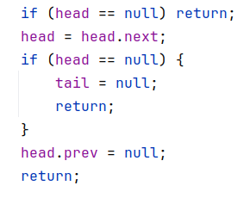
Node Removal (Head)
NULL
head
tail
80
60
50
40
20
10
NULL

Slide 39
Node Removal (Head)
NULL
head
tail
80
60
50
40
20
10
NULL

Slide 40
Node Removal (Head)
NULL
head
tail
80
60
50
40
20
10
NULL

Slide 41
Node Removal (Head)
NULL
NULL
head
tail
80
60
50
40
20
10
NULL

Slide 42
Node Removal (Head)
NULL
NULL
head
tail
80
60
50
40
20
10
Garbage collected
NULL

Slide 43
Node Removal (Head)
NULL
head
tail
60
50
40
20
10
Garbage collected
NULL

Slide 44
Node Removal (Head)
NULL
head
tail
60
50
40
20
10
NULL
Special case when list becomes empty

Slide 45
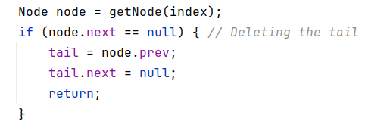
Node Removal (Tail)
NULL
head
tail
60
50
40
20
10
NULL

Slide 46
Node Removal (Tail)
NULL
head
tail
60
50
40
20
10
NULL

Slide 47
Node Removal (Tail)
NULL
head
tail
60
50
40
20
10
NULL

Slide 48
Node Removal (Tail)
NULL
head
tail
60
50
40
20
10
NULL
NULL

Slide 49
Node Removal (Tail)
NULL
Garbage collected
head
tail
60
50
40
20
10
NULL
NULL

Slide 50
Node Removal (Tail)
NULL
Garbage collected
head
tail
60
50
40
20
NULL

Slide 51
Node Removal (Tail)
NULL
head
tail
60
50
40
20
NULL
Can we optimize tail deletions?

Slide 52
Node Removal (Tail)
NULL
head
tail
60
50
40
20
NULL
Can we optimize tail deletions?
tail = tail.prev;
tail.next = null;

Slide 53

Node Removal (Middle)
Delete the node at index 2
NULL
head
tail
60
50
40
20
10
NULL

Slide 54
Node Removal (Middle)
Delete the node at index 2
NULL
head
tail
60
50
40
20
10
NULL

Slide 55
Node Removal (Middle)
Delete the node at index 2
NULL
head
tail
60
50
40
20
10
NULL

Slide 56
Node Removal (Middle)
Delete the node at index 2
NULL
head
tail
60
50
40
20
10
NULL

Slide 57
Node Removal (Middle)
Delete the node at index 2
NULL
head
tail
60
50
40
20
10
NULL
Garbage collected

Slide 58
Node Removal (Middle)
Delete the node at index 2
NULL
head
tail
60
50
20
10
NULL

Slide 59
Note
Implementations may differ, but the general idea is same.

Slide 60
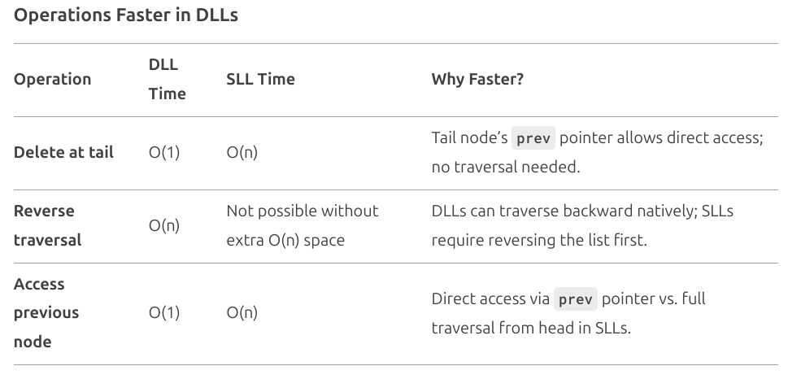
Operations Faster in DLLs

Slide 61

Advantages over SLL
Bidirectional Traversal: Can traverse both forward and backward.
Easier Implementation of Complex Data Structures: Useful in undo/redo operations, navigation systems (e.g., Browsers, File Explorers).
More Flexibility in Insertion/Deletion: Can insert/delete from both ends efficiently. abcd

Slide 62
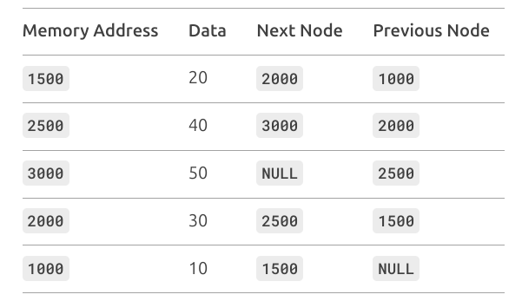
Exercise: Linked List Construction
Construct the linked list from the given table

Slide 63
Exercise: Doubly Linked List Construction
Construct the linked list from the given table
← 10 <-> 20 <-> 30 <-> 40 <-> 50 →

