Slide 1
CSE 220
Data Structures
Lecture 05:
Dummy Headed Circular DLLs
Anwarul Bashir Shuaib [AWBS]
Lecturer
Department of Computer Science and Engineering
BRAC University

Slide 2
Review: Doubly Linked Lists
Each node contains three things:
  Data
  A reference to the next node
  A reference to the previous node
This version is also known as “Doubly Linked Lists (DLL)” as each node contains the reference to both the next node and the previous node.
NULL
head
tail
60
40
20
10
NULL

Slide 3
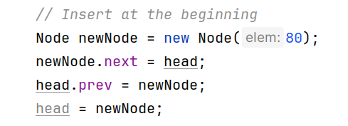

Review: Element Insertion (At the beginning)
Prepend 80 to the list
NULL
head
tail
80
60
40
20
10
NULL

Slide 4
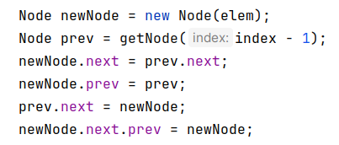

Review: Element Insertion (Middle)
50
Insert 50 at index 2
NULL
head
tail
80
60
40
20
10
NULL
NULL
head
tail
80
60
50
40
20
10
NULL

Slide 5
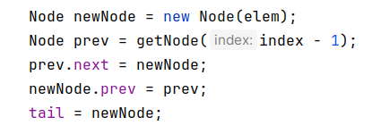


Review: Element Insertion (Tail)
tail
35
NULL
head
NULL
80
60
50
40
20
10
Can we optimize tail insertions?

Slide 6
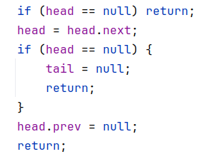
Review: Node Removal (Head)
NULL
head
tail
60
50
40
20
10
NULL
Special case when list becomes empty

Slide 7

Review: Node Removal (Middle)
Delete the node at index 2
NULL
head
tail
60
50
40
20
10
NULL
Garbage collected

Slide 8
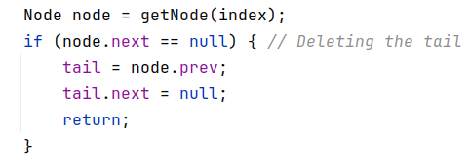
Review: Node Removal (Tail)
NULL
head
tail
60
50
40
20
NULL
Can we optimize tail deletions?
tail = tail.prev;
tail.next = null;

Slide 9
Doubly Linked Lists – Continued
DLLs provide efficient node insertions and deletions on the head and tail. But…
Problem in Traditional DLLs:
If head is null, insertions and deletions require extra handling.
When inserting at the beginning, head must be updated explicitly.
Edge cases exist when deleting the first or last node.

Slide 10
Dummy Headed Circular DLLs
Almost same as DLLs, except:
  The DLL has a dummy head (a head containing null as the element)
  head.prev points to tail, and tail.next points to head.
NULL
head
tail
NULL
60
40
20
10
NULL

Slide 11
Dummy Headed Circular DLLs
Almost same as DLLs, except:
  The DLL has a dummy head (a head containing null as the element)
  head.prev points to tail, and tail.next points to head.
head
tail
NULL
60
40
20
10
NULL

Slide 12
Dummy Headed Circular DLLs
Almost same as DLLs, except:
  The DLL has a dummy head (a head containing null as the element)
  head.prev points to tail, and tail.next points to head.
head
tail
NULL
60
40
20
10
Some implementations use -1 instead of NULL as the dummy head element

Slide 13
Dummy Headed Circular DLLs
Almost same as DLLs, except:
  The DLL has a dummy head (a head containing null as the element)
  head.prev points to tail, and tail.next points to head.
head
tail
-1
60
40
20
10
Some implementations use -1 instead of NULL as the dummy head element

Slide 14
Dummy Headed Circular DLLs
head
Why called “Circular”?
NULL
10
tail
60
40
20
head
tail
NULL
60
40
20
10

Slide 15
Dummy Headed Circular DLLs
Advantage of Dummy Head:
The dummy node always exists, so head is never null.
Insertions at the start don’t need to update head separately.
Deletions are uniform—no need to check if the node is the first or last.

Slide 16
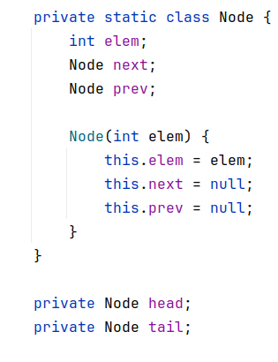
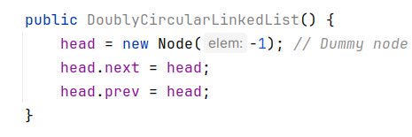
Dummy Headed DLL Class
DLL Class
Optional

Slide 17
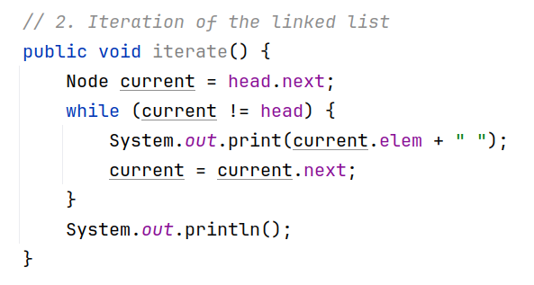
Iteration
head
tail
NULL
60
40
20
10

Slide 18
Iteration
head
tail
NULL
60
40
20
10

Slide 19
Iteration
head
tail
NULL
60
40
20
10

Slide 20
Iteration
head
tail
NULL
60
40
20
10
60

Slide 21
Iteration
head
tail
NULL
60
40
20
10
60 40

Slide 22
Iteration
head
tail
NULL
60
40
20
10
60 40 20

Slide 23
Iteration
head
tail
NULL
60
40
20
10
60 40 20 10

Slide 24
Iteration
head
tail
NULL
60
40
20
10
Termination
60 40 20 10

Slide 25
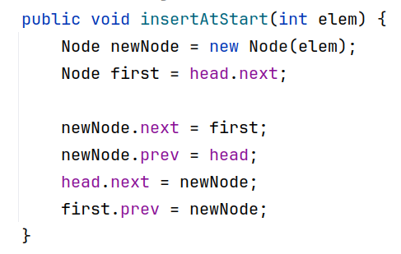
InsertAtStart
Insert 30 at start
head
tail
NULL
60
40
20
10

Slide 26
InsertAtStart
30
Insert 30 at start
head
tail
NULL
60
40
20
10

Slide 27
InsertAtStart
30
Insert 30 at start
head
tail
NULL
60
40
20
10

Slide 28
InsertAtStart
30
Insert 30 at start
head
tail
NULL
60
40
20
10

Slide 29
InsertAtStart
30
Insert 30 at start
head
tail
NULL
60
40
20
10

Slide 30
InsertAtStart
30
Insert 30 at start
head
tail
NULL
60
40
20
10

Slide 31
InsertAtStart
30
Insert 30 at start
head
tail
NULL
60
40
20
10

Slide 32
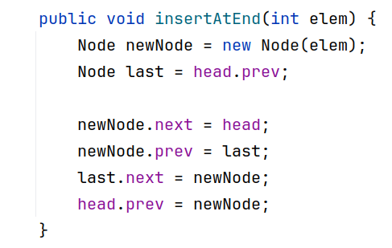
InsertAtEnd
head
NULL
60
40
20
10
80
Insert 80 at end

Slide 33
InsertAtEnd
head
NULL
60
40
20
10
80
Insert 80 at end

Slide 34
InsertAtEnd
head
NULL
60
40
20
10
80
Insert 80 at end

Slide 35
InsertAtEnd
head
NULL
60
40
20
10
80
Insert 80 at end

Slide 36
InsertAtEnd
head
NULL
60
40
20
10
80
Insert 80 at end

Slide 37
InsertAtEnd
head
NULL
60
40
20
10
80
Insert 80 at end

Slide 38
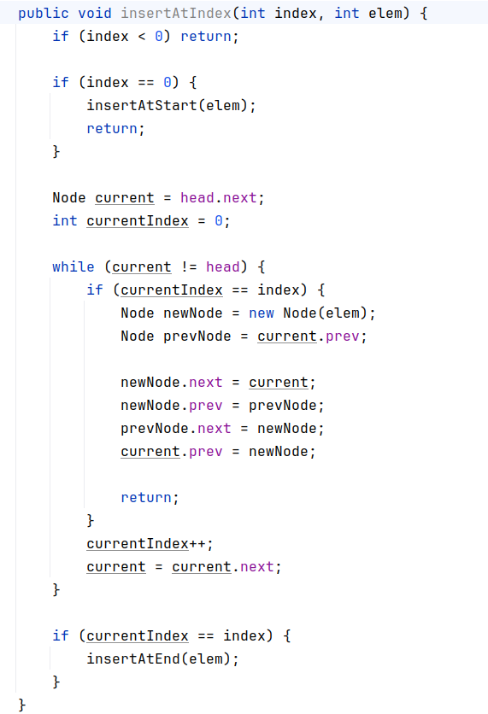
Insert Anywhere

Slide 39
Insert Anywhere
Similar to DLLs

Slide 40
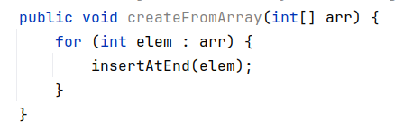
Creation

Slide 41
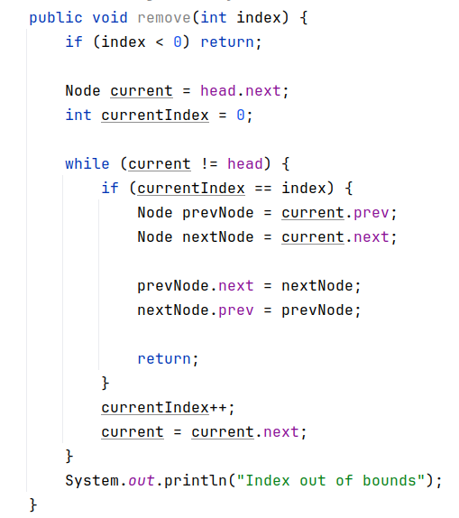
Removal

Slide 42
Exercise
Reverse a dummy headed circular DLL
Detect cycles (hint: hare and tortoise algorithm)

Slide 43
Practice Problems
Browser history design: https://leetcode.com/problems/design-browser-history
Authentication manager: https://leetcode.com/problems/design-authentication-manager

