Slide 1
NER SOFTWARE · AI TOOLING
Delphi
One home for our AI context: organized by org chart, checked out like a repo.

Slide 2
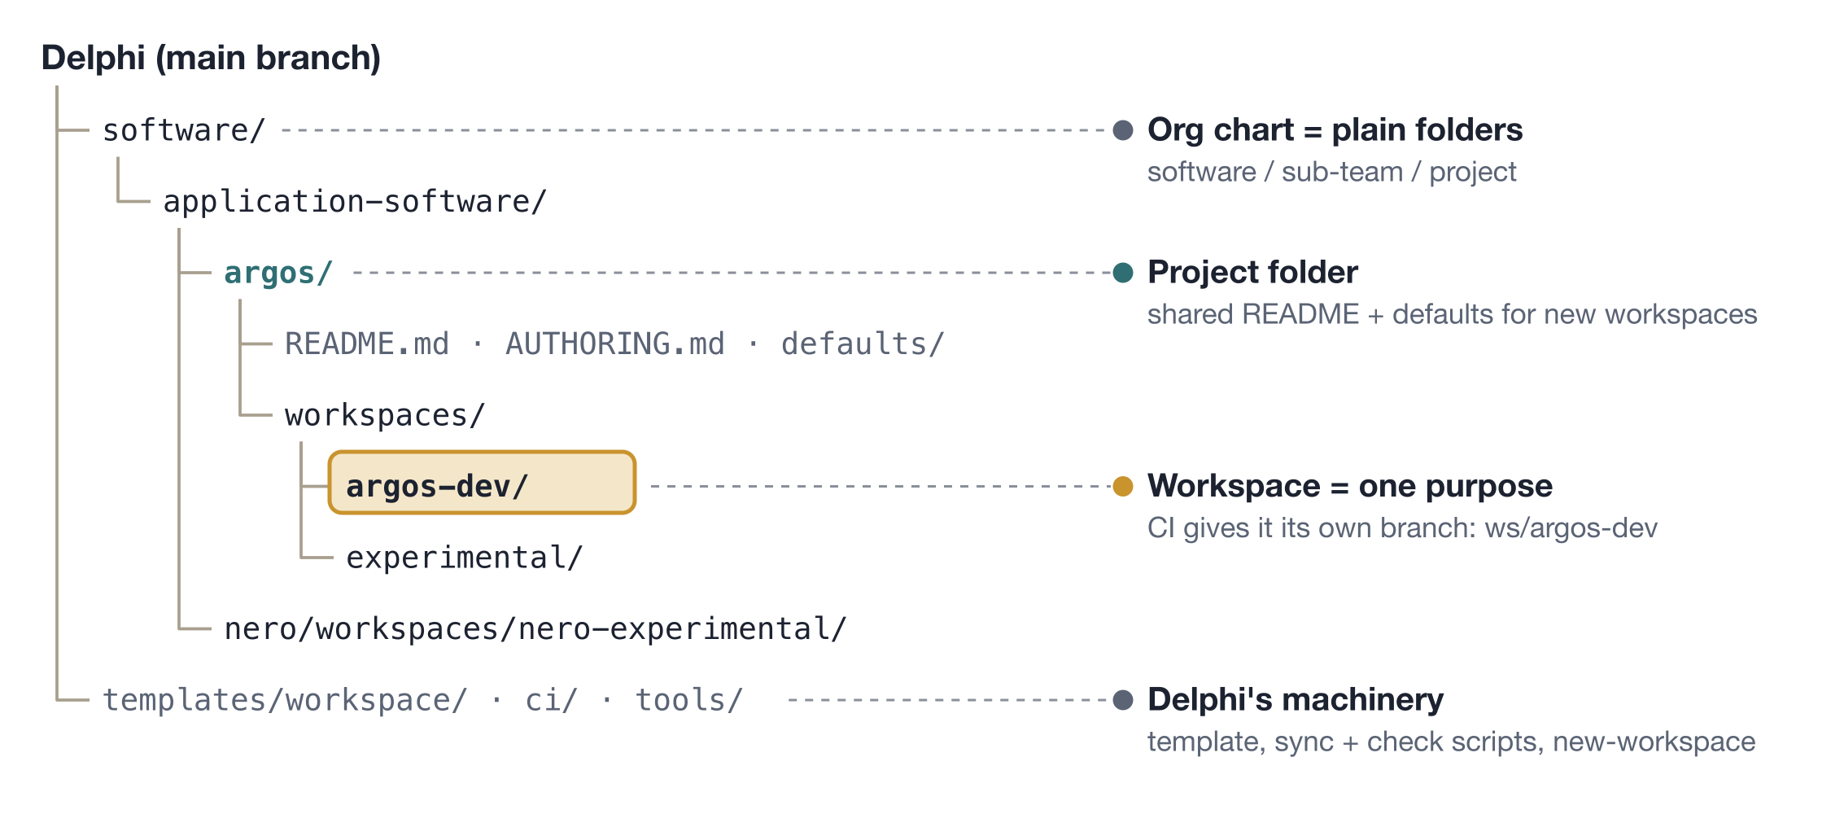
OVERVIEW
Everything lives in one repo, by org chart

Slide 3
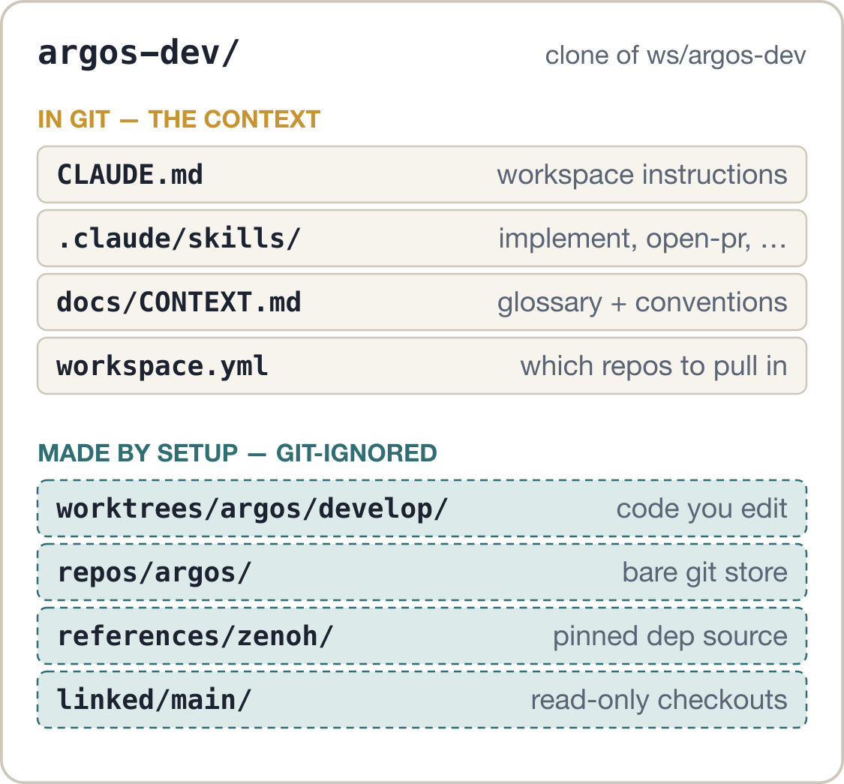
OVERVIEW
Check out a workspace, get a ready agent
1
Clone the workspace branch
git clone -b ws/argos-dev <Delphi>
2
Run setup once
.delphi/setup.sh
3
Open Claude Code at the root
skills, glossary and repos are all there
Edits to the context go back as a PR into ws/argos-dev. Code changes stay in the code repo's own PRs.

Slide 4
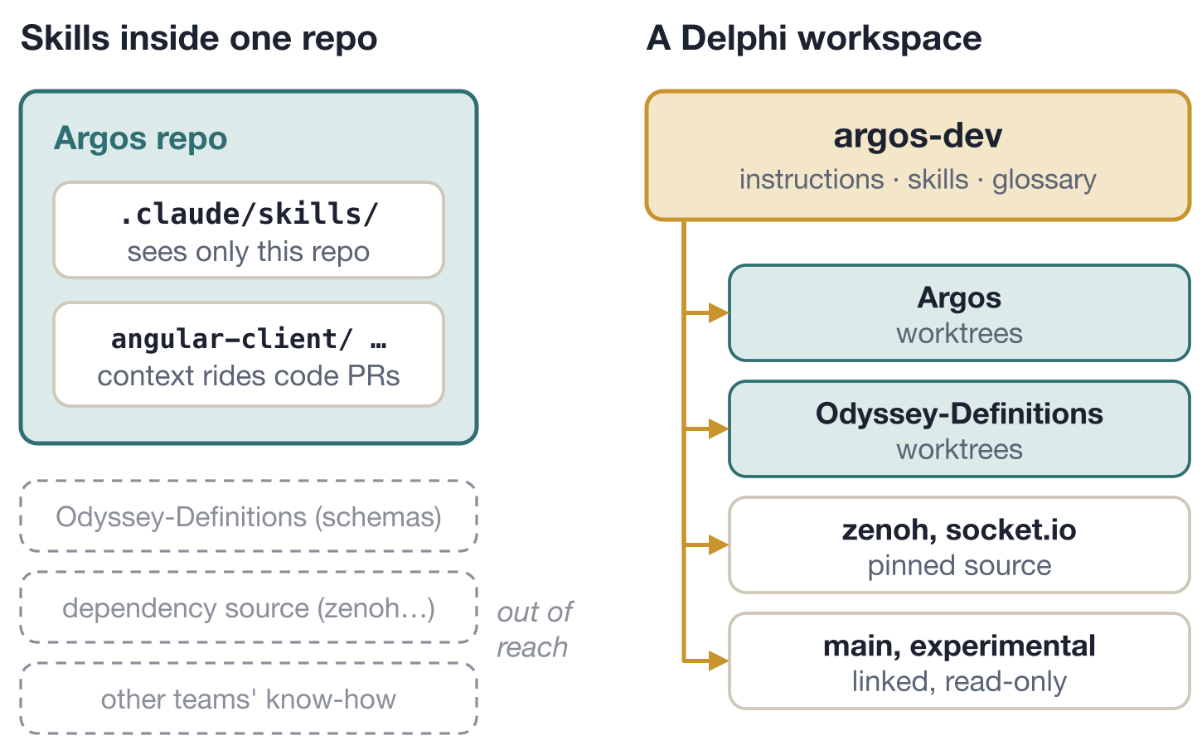
WHY WE BUILT IT
Real workflows outgrow single-repo skills
Work crosses repos
An Argos ticket needs Odyssey-Definitions schemas and the real source of its dependencies.
One workspace per purpose
argos-dev and experimental share code but carry different skills.
Fixes flow back to everyone
A better skill merges into Delphi with no code PR; the next clone has it.

Slide 5
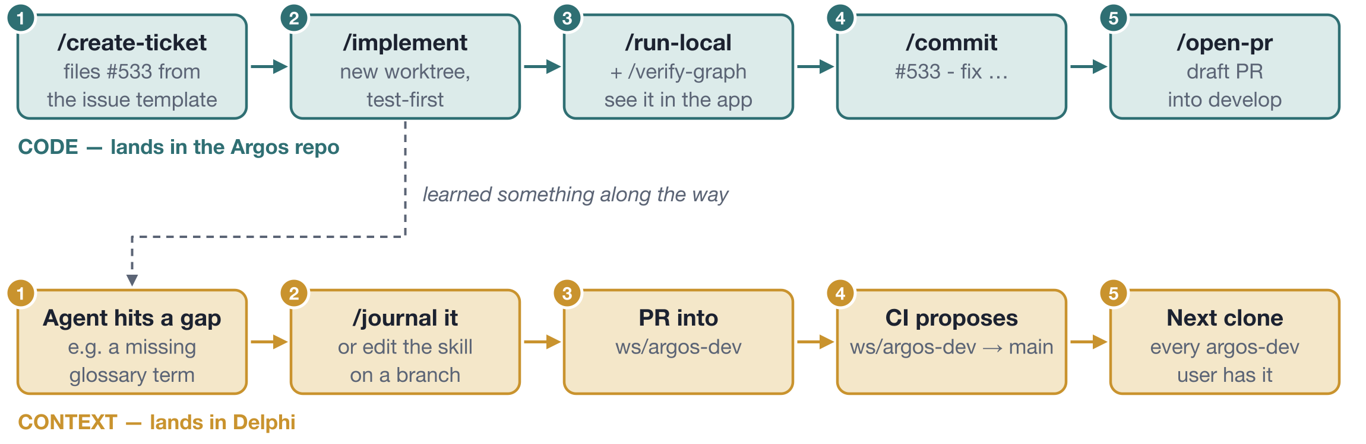
EXAMPLE WORKFLOW
One ticket, two things get better
Code ships through Argos PRs. What the agent learned ships through Delphi, so the next ticket starts smarter.

Slide 6
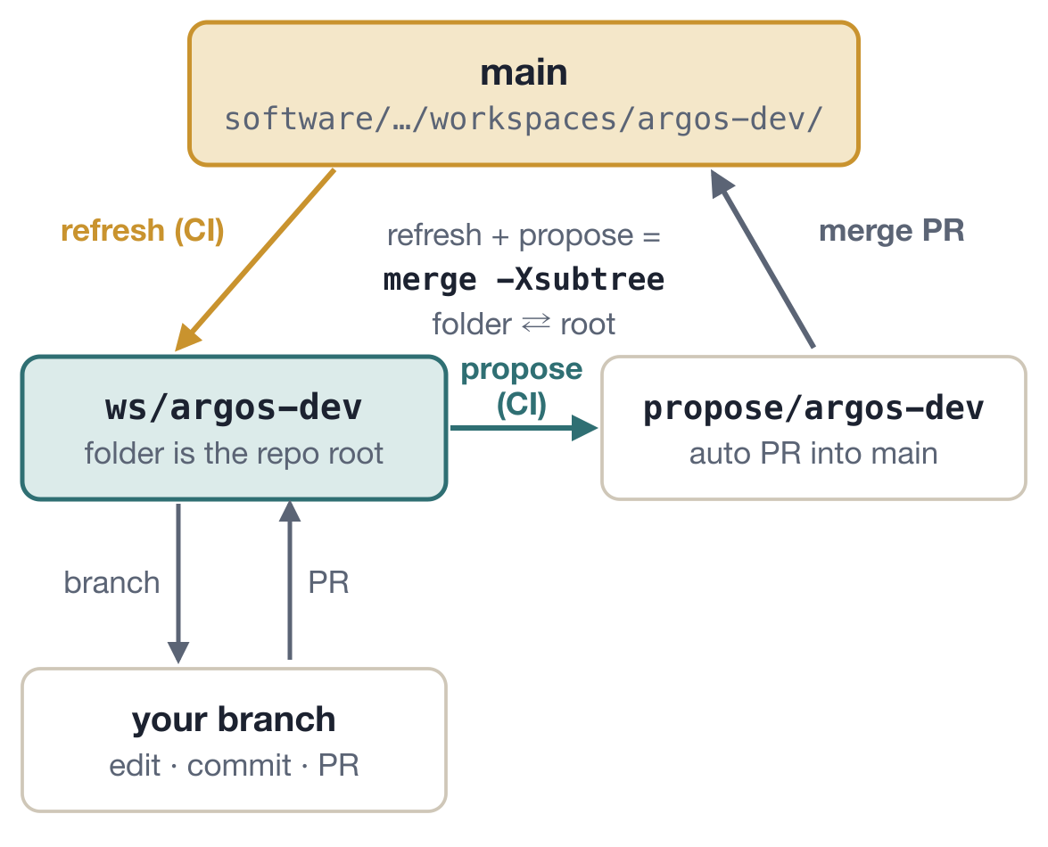
INTERNALS · 1 / 3
Sync: a folder on main, a branch for you
Refresh
Each push to main is merged into every ws/<name>, folder becoming root.
Propose
Merged workspace changes become a PR to main from propose/<name>, after check.sh passes.
Histories stay joined
Subtree merges, so edits on both sides meet in a normal 3-way merge.
Conflicts are reported
CI lists the files, skips that workspace, and a person resolves it.

Slide 7
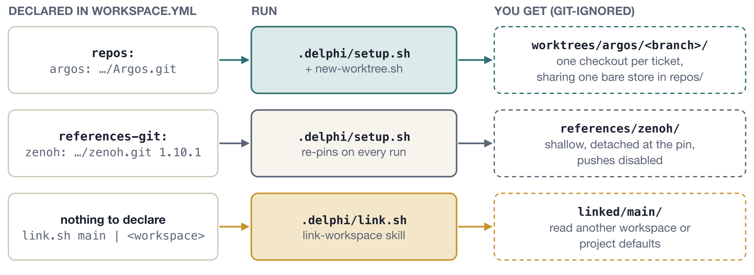
INTERNALS · 2 / 3
setup.sh: one manifest, three checkouts
Code is only edited in worktrees. Everything setup makes is git-ignored, so it never shows up as a workspace change. Runs on macOS bash 3.2 and Git Bash.

Slide 8
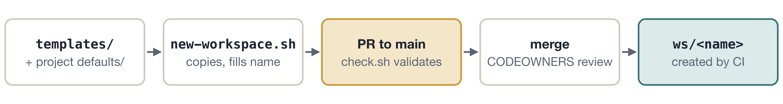
INTERNALS · 3 / 3
New workspaces, and keeping it all valid
PRs only
check.sh
No CLI to install
Sandbox-tested
Nobody pushes to main or ws/* directly, except CI's own sync.
Validates manifests and names, and that managed scripts match the template.
git, gh, and a few short shell scripts. That's the whole runtime.
tests/e2e.sh drives every flow against a local bare origin and stub gh.

Slide 9
TRY IT
Three commands to a ready agent
git clone -b ws/argos-dev \
https://github.com/Northeastern-Electric-Racing/Delphi.git argos-dev
cd argos-dev && .delphi/setup.sh
claude # then: /implement, /open-pr, …
Read more on main: README.md · docs/design.md · docs/goals.md

