Slide 1

Thank you for visiting the DETECT pilot study repository. We are still cleaning up and organizing many of the files. We appreciate your patience.

Slide 2
2015 MedStar Compliance Data
N = 49
DETECT Pilot Screenings
N = 1,248
APS Investigations
N = 747
No matching APS investigation
N = 1,181
Analysis: Number of reports over time
N = 49
Investigation date prior to screening date
N = 21
DETECT screenings matched to APS investigations
N = 46

Slide 3


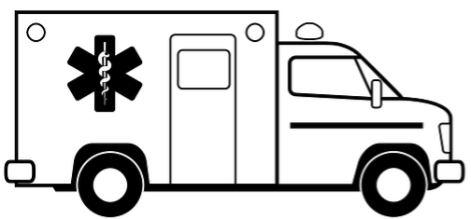
3. A single record is created in MedStar’s ePCR for this person at this incident. It is then assigned an incident PCR number. There can be only one DETECT screening per incident PCR number.
2. An ambulance is dispatched to the scene.
This is considered an incident and assigned and incident/response number.
1. A 911 Call is made
Mary Smith
Incident PCR Number = 15000001
911
John Smith
Incident PCR Number = 15000002
4. If there is more than one patient at the incident, each one is given a separate record, and a unique incident PCR number, in MedStar’s ePCR.

Slide 4
Notes:
APS Response

