Slide 1

Topic
Epidemiology III

Slide 2
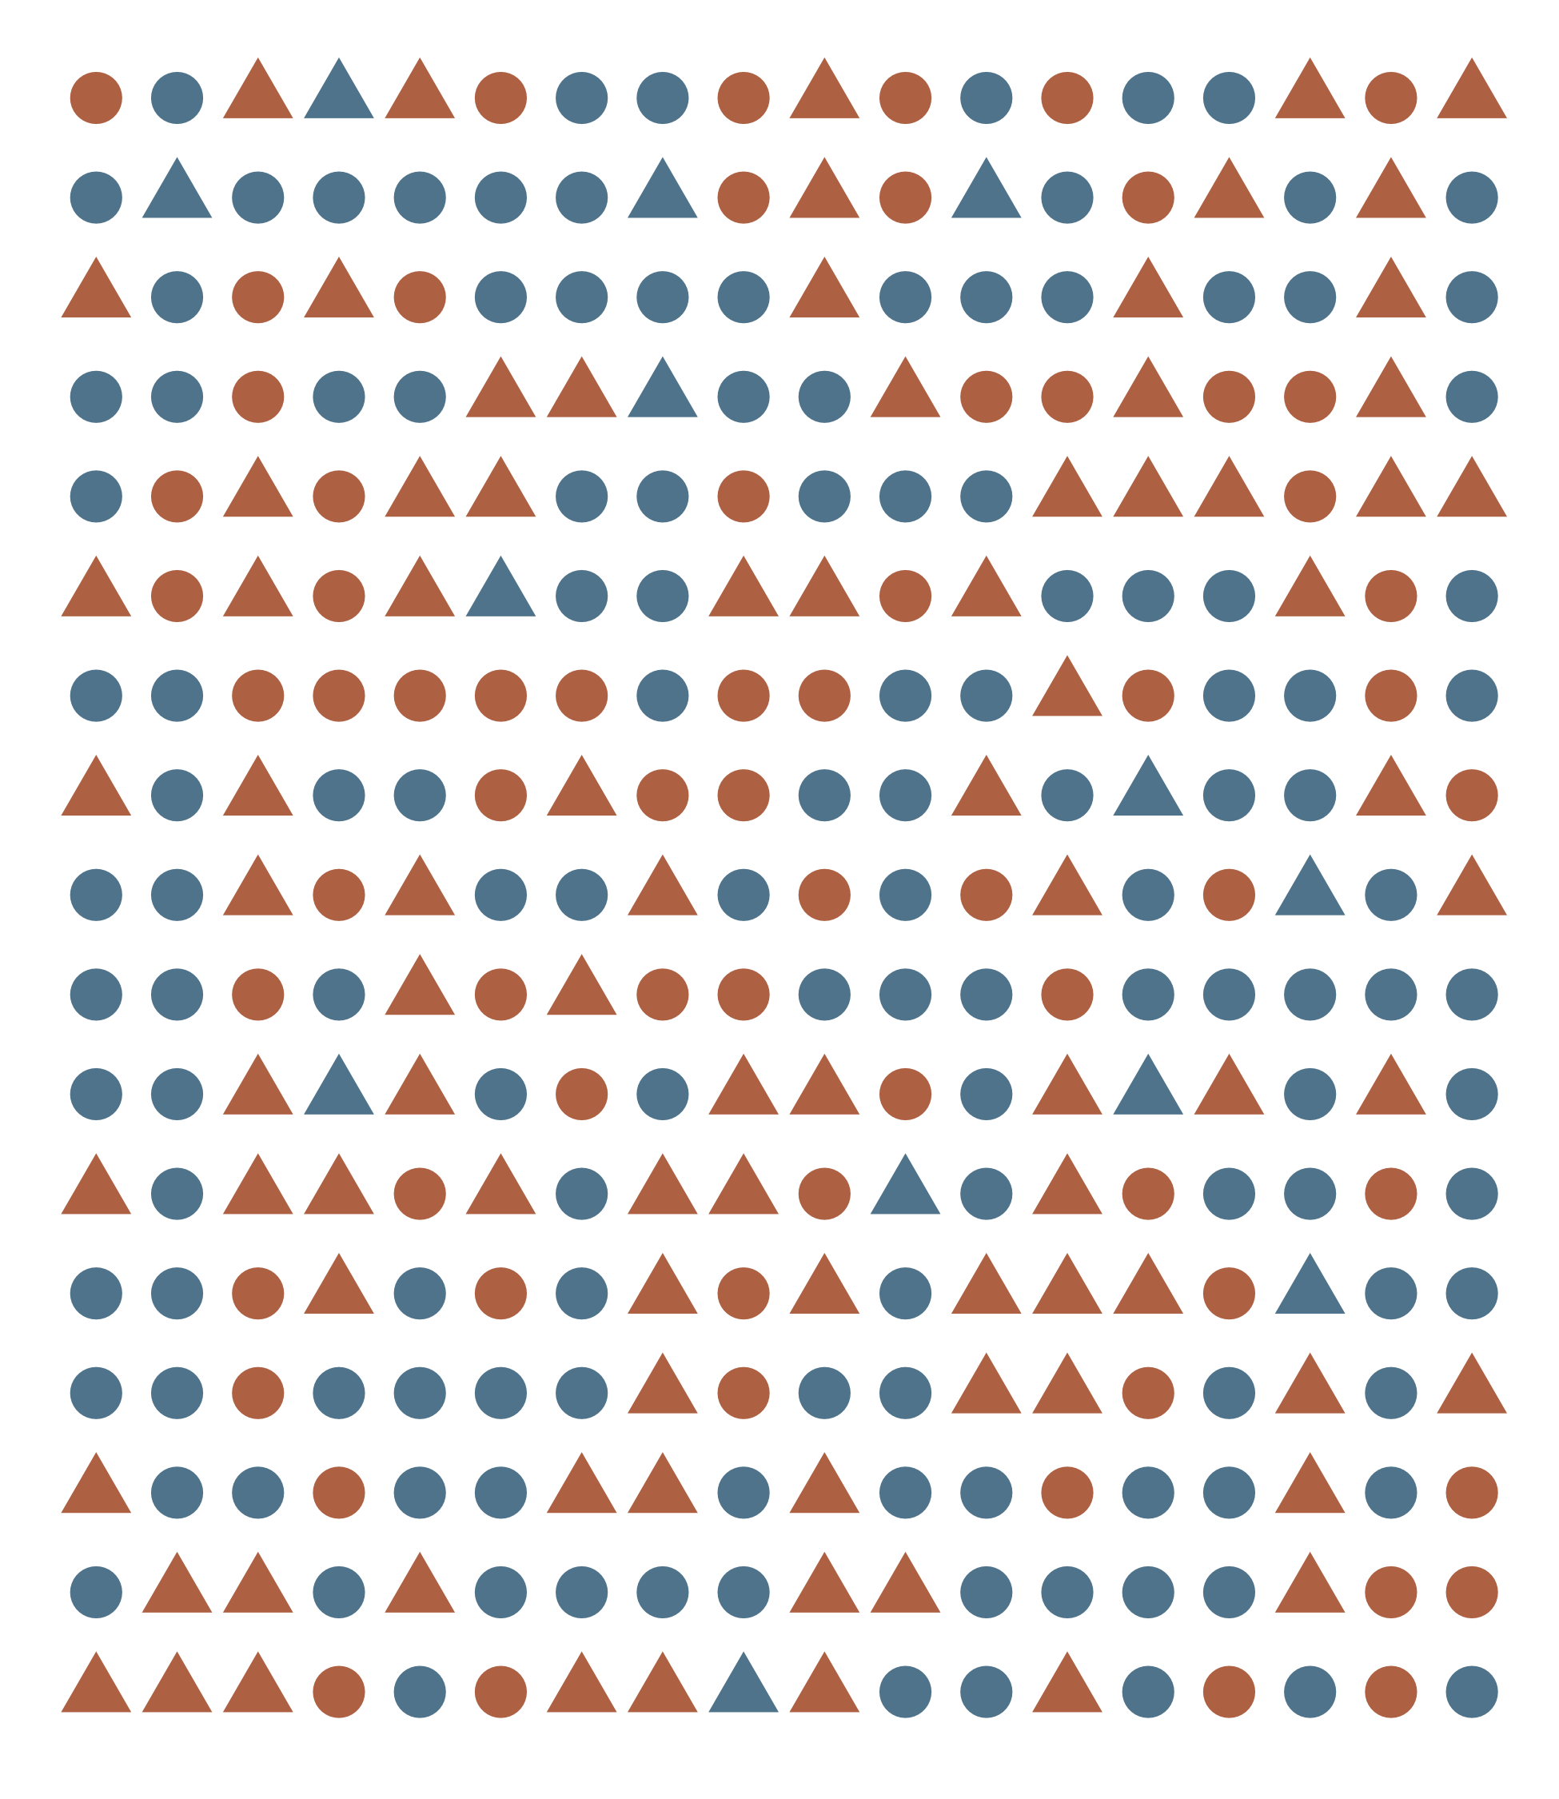
Topic
Epidemiology III

Slide 3
Branding
UTHealth fonts
Garamond
Crimson Pro
Times New Roman
Univers
Avenir
Helvetica
Arial
Calibri
UTHealth Colors
Primary
University orange
University blue
University gray
Secondary
Gulf blue
Mustard gold
Dark sage
Dusty lavender
Neutral
Light sage
Sand
Notes:
I got the UTHealth fonts from here: https://www.uth.edu/brand-standards/visual-identity/type.
Some of them I had to Google and download.
Double click on the tff file and it opens “font book” on mac. Click install. Restart PowerPoint. Is should be available.
To get the colors, I used the built-in color picker tool and grabbed the colors from here: https://www.uth.edu/brand-standards/visual-identity/color
To customize the color theme
Click the design tab
In the second set of themes to pick from, click the down arrow that appears when you hover your mouse
Click colors, customize colors
Change the colors, name, and save the palette

Slide 4
Branding
Orange and Blue fonts
Billion Dreams
Franklin Gothic
Georgia
UTHealth Colors
Primary
Core orange
Core blue
Notes:
I got the UTHealth fonts from here: https://brandcenter.ufl.edu/typography/
I had to Google Billion Dreams and download it.
Double click on the tff file and it opens “font book” on mac. Click install. Restart PowerPoint. Is should be available.
To get the colors, I used the built-in color picker tool and grabbed the colors from here: https://brandcenter.ufl.edu/colors/
To customize the color theme
Click the design tab
In the second set of themes to pick from, click the down arrow that appears when you hover your mouse
Click colors, customize colors
Change the colors, name, and save the palette

Slide 5

Source: https://www.r-project.org/logo/
Notes:
Insert this slide for live R demonstrations.

Slide 6



Measurement
Uncertainty
Study Design

Slide 7
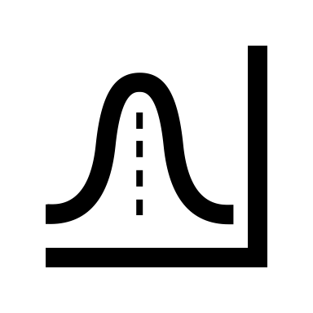
X | Y | Z
1 | A | 1
2 | B | 0
3 | C | 1
Data
Statistics
Data

Slide 8
Description
Association/Prediction
Explanation

Slide 9
Description
Causation
Prediction

Slide 10
Closed vs. Open Populations
Person
1
2
3
4
0
1
2
3
4
Week (Calendar Time)
Notes:
The distinction between closed and open populations depends in part on the time axis used to describe the population, as well as on how membership is defined. All persons who ever used a particular drug would constitute a closed population if time is measured from the start of their use of the drug. These persons would, however, constitute an open population in calendar time because new users might accumulate over a period of time. If, as in this example, membership in the population always starts with an event such as initiation of treatment and never ends thereafter, the population is closed along the time axis that marks this event as the index time for each member because all new members enter only when they experience this event. The same population will, however, be open along most other time axes. If membership can be terminated by later events other than death, the population is open along any time axis.

Slide 11
Closed vs. Open Populations
Person
1
2
3
4
0
1
2
3
4
Event Time
Notes:
The distinction between closed and open populations depends in part on the time axis used to describe the population, as well as on how membership is defined. All persons who ever used a particular drug would constitute a closed population if time is measured from the start of their use of the drug. These persons would, however, constitute an open population in calendar time because new users might accumulate over a period of time. If, as in this example, membership in the population always starts with an event such as initiation of treatment and never ends thereafter, the population is closed along the time axis that marks this event as the index time for each member because all new members enter only when they experience this event. The same population will, however, be open along most other time axes. If membership can be terminated by later events other than death, the population is open along any time axis.

Slide 12
Person
01
02
03
04
05
06
07
08
09
10
-01
00
01
02
03
04
05
06
07
08
09
10
11
12
Pre-Follow-Up
Diseased
Month Follow-up
At Risk
Deceased
Source: Lash TL, VanderWeel TJ, Haneuse S, Rothman KJ. Modern Epidemiology. fourth. Wolters Kluwer; 2021.
Notes:
Recreation of Figure 4.1 in Modern Epidemiology 4th edition, page 53.
Eventually, I would like to make this in ggplot.
If noting else, at least change the data a little bit so that it does not perfectly match the textbook.

Slide 13
Person
01
02
03
04
05
06
07
08
09
10
-01
00
01
02
03
04
05
06
07
08
09
10
11
12
Pre-Follow-Up
Diseased
Month Follow-up
At Risk
Deceased
Notes:
Try to create with ggplot2.

Slide 14
Measure
Truth
Error

Slide 15
Measures
Observations
Experiments
Case
Descriptions
Ecological
Cross-sectional
Case-control
Cohort
Non-randomized
Randomized
Typically less convincing
Typically more convincing
Notes:
We gather these measurements…

Slide 16
 | Outcome + | Outcome -
Screen + | a | b
Screen - | c | d
 | Sensitivity = a / (a + c) | Specificity = d / (b + d)

Slide 17
Notes:
In a cohort study

Slide 18
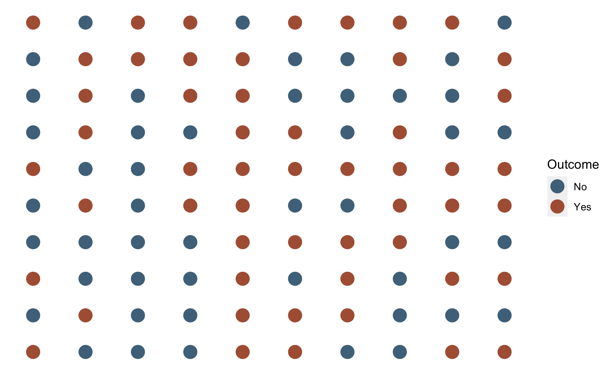
Notes:
This one was created with ggplot in /Users/bradcannell/Dropbox/02 Teaching/R4Epi Textbook/r4epi/chapters/10_part_intro_epi/_02_measures_of_occurrence.Rmd.

Slide 19
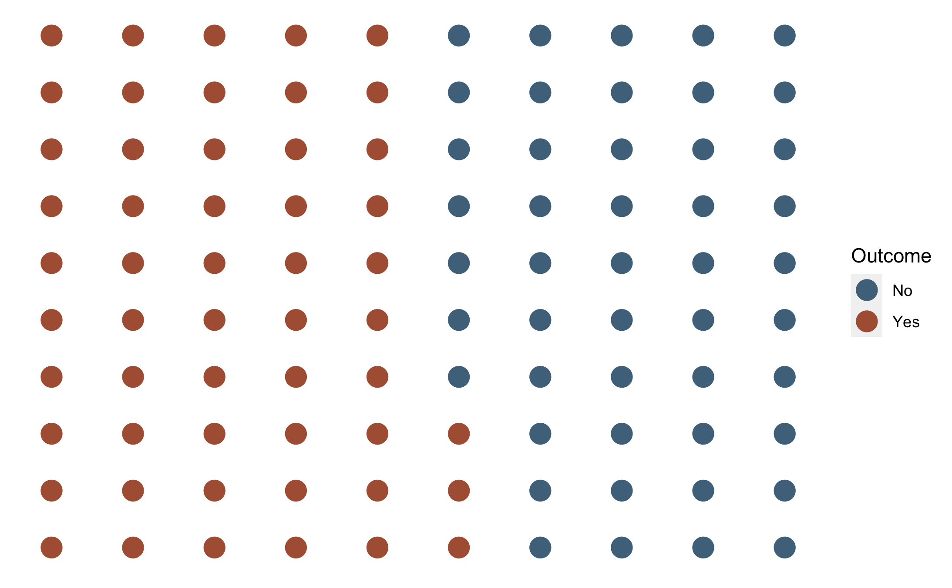
Notes:
This one was created with ggplot in /Users/bradcannell/Dropbox/02 Teaching/R4Epi Textbook/r4epi/chapters/10_part_intro_epi/_02_measures_of_occurrence.Rmd.

Slide 20
Notes:
10x10 = 100
50/50 orange and blue
30/70 blue to orange

Slide 21
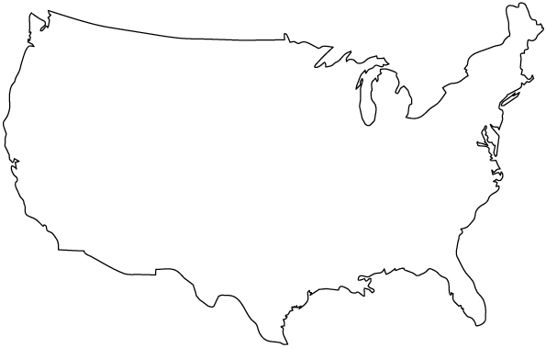
Blue = Event
Orange = No Event
Notes:
30 blue and 70 orange
How might we describe the occurrence of events in this population?

Slide 22
Triangle = Event/Outcome
Circle = No Event/Outcome
Notes:
30 triangles and 70 circles

Slide 23
1
2
3
7
6
4
8
9
5
10
11
12
19
17
13
16
18
14
15
20
21
22
24
23
30
29
26
27
28
25
Blue = Event
Orange = No Event
Notes:
One way would be to simply count the number of events and report them. In this case, there are 30 events

Slide 24
1
2
3
7
6
4
8
9
5
10
11
12
19
17
13
16
18
14
15
20
21
22
24
23
30
29
26
27
28
25
Triangle = Event/Outcome
Circle = No Event/Outcome
Notes:
One way would be to simply count the number of events and report them. In this case, there are 30 events

Slide 25
Basic experimental study design
Outcome Measured
in Exposed
👩🏽‍⚕️👨‍🔬
Exposure Status Assigned by Researchers
Unexposed Cohort - Free of Outcome of Interest
Incidence Proportion
Compare Incidence Proportion
Outcome Measured
in Unexposed
Incidence Proportion
Where:
Orange = Exposed
Blue = Unexposed
Circle = No Outcome
Triangle = Outcome
Time
Notes:
We’ve already talked about experimental studies where we start with a cohort of people who are have not yet been exposed to our primary exposure of interest and who have not yet experienced our outcome of interest.
For example, if our outcome of interest was the flu and and our exposure of interest was the flu vaccine, then our initial study cohort would include only people who had not yet received the flu vaccine (probably within some window of time) and who didn’t have the flu (probably within some window of time).
The researchers would then choose who gets the flu vaccine and who doesn’t -- ideally at random. The study participants do NOT choose their own exposure value. We then follow the cohort of people for some meaningful period of time, then we compare the occurrence of the outcome – in this case the flu – between our exposure groups – in this case, those who did and did not get vaccinated.
Where:
Orange = Exposed to vaccine
Blue = Unexposed to vaccine
Circle = No Flu
Triangle = Flu

Slide 26
Basic cohort study design
Outcome Measured
in Exposed
👩🏽‍⚕️👨‍🔬
Cohort Identified
Exposure Measured
Incidence Proportion
Exposure Occurrence
Compare Incidence Proportion
Outcome Measured
in Unexposed
Incidence Proportion
Where:
Orange = Exposed
Blue = Unexposed
Circle = No Outcome
Triangle = Outcome
Time
Notes:
In a cohort study
Where:
Orange = Exposed
Blue = Unexposed
Circle = No outcome
Triangle = Outcome
Placeholder

Slide 27
Basic case-based case-control study design
Population of interest
Cases Identified
Exposure Measured
Calculate Odds
Compare Odds
Controls Identified
Exposure Measured
Calculate Odds
Time
Notes:
In a case-control study
Use Rothman’s example – figure 5.3

Slide 28
 | Outcome + | Outcome -
Exposure + | a | b
Exposure - | c | d
 | Outcome + | Outcome -
Exposure + | a | b | a + b
Exposure - | c | d | c + d
 | a + c | b + d | a + b + c + d

Slide 29
Chi-square test for 2x2 tables
Observed
 | Case | Control | Total
Exposure + | 180 | 982 | 1,162
Exposure - | 30 | 997 | 1,027
Total
Notes:
﻿For testing H 0 : OR = 1, the usual chi-square or Fisher’s exact test for 2 × 2 contingency tables can be used.
Szklo, Moyses,Nieto, F. Javier. Epidemiology (Kindle Locations 12930-12931). Jones & Bartlett Learning. Kindle Edition.
Compare observed vs. expected under the null hypothesis (OR = 1)

Slide 30
Sample size/quality matrix
Population
Big Data
Not Feasible
Sample Size
DANGER!!!
Traditional Statistics
0
Low
High
Data Quality (Bias)

Slide 31
Common citations
Source: Porta M, ed. A Dictionary of Epidemiology. Oxford University Press; 2008.
Source: Lash TL, VanderWeel TJ, Haneuse S, Rothman KJ. Modern Epidemiology. fourth. Wolters Kluwer; 2021.
Source: Westreich D. Epidemiology by Design. Oxford University Press; 2019
Source: https://www.r-project.org/logo/
Source: Hernán MA. Causal Diagrams: Draw Your Assumptions Before Your Conclusions. edX. Accessed September 27, 2022. https://learning.edx.org/course/course-v1:HarvardX+PH559x+2T2022/home

