Slide 1
This slide deck is not a presentation. It’s to export diagrams and images in an image format for use in markdown files.

Slide 2
Instructions
Create the graphic on a blank slide
Select the slide
Click File -> Export
Name the file, select the directory to export it to
lesson_number order_brief description.png
Change the file format to PNG
Set the dimensions to 2160 x 1215

Slide 3
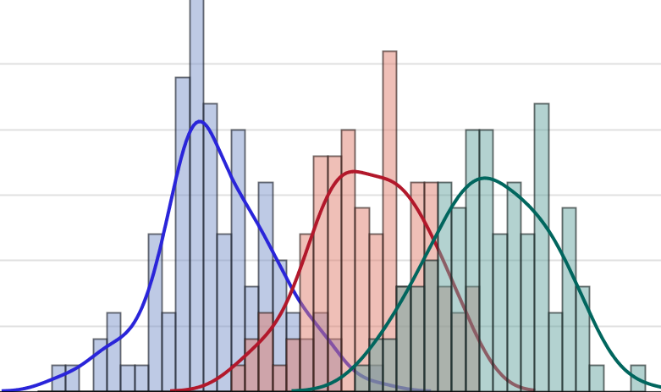

If-Then-Else Statements
Introduction to Data Management and Statistical Computing
Notes:
Play intro music for 5 sec.

Slide 4
ID
Age
Gender
10001
20
F
10002
26
F
10003
35
M
10004
22
F
10005
20
M
10006
31
M
10007
27
M
Notes:
As SAS programmers there will often be times that we want to modify our data or our analysis in some way based on the value of one or more variables.

Slide 5
ID
Age
Gender
10001
20
F
10002
26
F
10003
10004
35
22
M
F
10005
20
M
10006
31
M
10007
27
M
Notes:
For example, maybe we only want to look at female participants in our dataset, or individuals of a certain age. Perhaps we decide that we want to create a variable that represents the region of the country someone is from, based on knowledge of the state they are from.

Slide 6
Condition
Yes
No
Execute
Execute
Don’t
Execute
Don’t
Execute
Notes:
These are just a couple of examples of an almost infinite number of ways in which you can use conditional processing in SAS. It’s called conditional processing because we type in a set of conditions,
SAS evaluates these conditions and then executes or does not execute some process or procedure based on whether or not the condition is met.

Slide 7



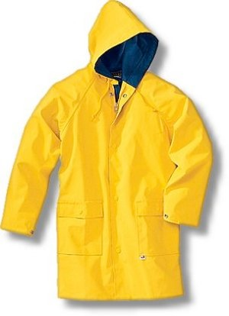
Conditional Processing
Notes:
As a silly example, let’s say that I want my daughter to wear a raincoat if it’s raining outside. So I give her a command: “If it’s raining outside, make sure to wear your raincoat please.”
In this hypothetical fantasy world, she then says, “yes, dad,” and goes to the window to see if it’s raining.
Then she either puts on, or does not put on her raincoat depending on if the condition (raining) is met.

Slide 8
If-Then-Else Statements
If ‘it is raining outside’ then ‘put on a raincoat’
If ‘it is not raining outside’ then ‘do not put on a raincoat’

Slide 9
IF expression THEN statement;
Notes:
More generally, the IF-THEN statement can be written in this way. The IF-THEN statement executes a SAS statements for observations that meet certain conditions. In the IF-THEN statement the expression is a sequence of operands and operators. It defines a condition for selecting observations. The statement after the keyword THEN can be any executable SAS statement, such as the assignment statement.
First, you’ll see an example of an IF-THEN statement. Then we will have a more in-depth discussion of operands and operators, then we will follow it up with a discussion of assignment statements.

Slide 10
if sysbp >= 140 and diabp >= 90 then hypertension = 1;
Notes:
For example, this expression tests the values of two variables - systolic blood pressure and diastolic blood pressure. The statement after the keyword THEN assigns a value to the variable hypertension.

Slide 11
Operands
Variables | job_title ht_in
Character Constants | ‘Married’ ‘Single’
Numeric Constants | 5000 -386

Slide 12
Comparison Operators
Symbol(s) | Mnemonic | Definition
= | EQ | Equal to
^= ~= | NE | Not equal to
> | GT | Greater than
< | LT | Less than
>= | GE | Greater thann or equal to
<= | LE | Less than or equal to
 | IN | Equal to one of a list
Notes:
These are examples of commonly used comparison operators. Comparison operators compare a variable with a constant or another variable.You can use either the symbol or the mnemonic in your code.

Slide 13
Comparison Operators
Symbol(s) | Mnemonic | Definition
= | EQ | Equal to
^= ~= | NE | Not equal to
> | GT | Greater than
< | LT | Less than
>= | GE | Greater thann or equal to
<= | LE | Less than or equal to
 | IN | Equal to one of a list
if gender = ‘M’ then…;
if gender eq ‘M’ then…;
if gender ne . then…;
if count > 1500 then…;
if count lt 1500 then…;
if count >= 1500 then…;
if loc in (‘DL’, ’T’) then…;
Notes:
Look over these examples of comparison operators used in IF-THEN statements.

Slide 14
Arithmetic Operators
Symbol | Definition
** | Exponentiation
* | Multiplication
/ | Division
+ | Addition
- | Subtraction
if count / 12 < 200 then…;
if count / 12 * 1.10 >= 3000 then…;
if (count / 12) * 1.10 >= 3000 then…;
if count_1 + count_2 < 5000 then…;
Notes:
Here is a list of commonly used arithmetic operators, and some examples of how they may be used in IF-THEN statements. As these examples demonstrate, both comparison and arithmetic operators can be used in the same statement.

Slide 15
Logical Operators
Symbol(s) | Mnemonic | Definition
& | AND | logical and
| | OR | logical or
^ ~ | NOT | logical not
if gender ne ‘M’ & count < 200 then…;
if gender ne ‘M’ or count < 200 then…;
if loc = ‘DL’ | loc = ’T’ then…;
if loc not in (‘C’, ‘DN’) then…;
Notes:
Logical operators combine or modify expressions. You can use either the symbol or the mnemonic in your code. Here you can see the logical operators that are available, and a few examples of how the may be used in a IF-THEN statement.

Slide 16
if X and Y or Z
==
if (X and Y) or Z
if X and (Y or Z)
Notes:
When using Boolean operators , remember that the “and” operator has precedence over the or operator.
That is, a statement such as the following:
If x and y or z
Is equivalent to:
If (x and y) or z
If you want to perform the “or” operation before the “and” operation, use parentheses like this:
If x and (y or z)
As a side note: the “not” operator, which wasn’t demonstrated here, has the highest precedence of all.

Slide 17
variable = expression
Notes:
You were already introduced to assignment statements in the last module. As a reminder, you can use an assignment statement in any DATA step to transform variables, create variables, calculate new values for variables, and more. To do this, the assignment statement evaluates an expression and assigns the resulting value to a variable. The general form of the assignment statement is shown here.

Slide 18
data example;
set ntrhd.mosquito;
if trap = 121109 then type = 1;
if trap = 121094 then type = 1;
if trap = 121082 then type = 1;
run;
Program Data Vector
trap | First | Last | Type
121137 | Dennis | Lansberry | 2
Notes:
In this example, let’s say that you discover that three mosquito traps were misclassified as light traps when they were actually chemical attractant traps. You write a SAS program to change trap type from 2 to 1 for these three traps.
When you run this program, the IF-THEN statement will execute for each observation in the data set. If the trap number doesn’t equal the specified value, the value of type doesn’t change for that observation. In this case, the value of trap in the program data vector does not match the value in the first IF-THEN statement, so the value of type remains 1. The expression in the next two IF-THEN statements are also false, so type continues to have a value of 1 for this observation. Next SAS reaches the RUN statement, writes the observation currently in the program data vector out to the temporary SAS data set called example,

Slide 19
data example;
set ntrhd.mosquito;
if trap = 121109 then type = 1;
if trap = 121094 then type = 1;
if trap = 121082 then type = 1;
run;
Program Data Vector
trap | First | Last | Type
121136 | Dennis | Lansberry | 1
Notes:
and then reads in the next observation from ntrhd.mosquito into the PDV. All the expressions are false for this observation as well.

Slide 20
data example;
set ntrhd.mosquito;
if trap = 121109 then type = 1;
if trap = 121094 then type = 1;
if trap = 121082 then type = 1;
run;
Program Data Vector
trap | First | Last | Type
121109 | Dennis | Lansberry | 2
Notes:
Eventually SAS gets to this observation. This time, the condition in the first IF-THEN statement is true

Slide 21
data example;
set ntrhd.mosquito;
if trap = 121109 then type = 1;
if trap = 121094 then type = 1;
if trap = 121082 then type = 1;
run;
Program Data Vector
trap | First | Last | Type
121109 | Dennis | Lansberry | 1
Notes:
So SAS changes the value of type to two for this observation. The remaining IF-THEN statements are false for this observation. Notice that these IF-THEN statements are mutually exclusive. No more than one of them can be true at a time. Therefore, once SAS encounters a true statement, checking the other statements is a waste of time and computing power.

Slide 22
data example;
set ntrhd.mosquito;
if trap = 121109 then type = 1;
else if trap = 121094 then type = 1;
else if trap = 121082 then type = 1;
run;
Program Data Vector
trap | First | Last | Type
121109 | Dennis | Lansberry | 1
Notes:
Adding the keyword ELSE is more efficient. When you specify else, and one condition is true, SAS skips the remaining conditions.

Slide 23
Demonstration
Importing and Modifying Class Survey Data Using IF-THEN-ELSE Statements

Slide 24
Practice: Using the IF-THEN-ELSE Statement
In this practice, you use two DATA steps to create a new temporary SAS data set that contains a modifications to the data set ntrhd.mosquito.
Steps:
Open a new editor window
Use a data step to create a temporary SAS data set called practice1. With an IF-THEN-ELSE statement to change the value for traps 121136, 121100, and 121095 from 1 to 2.
Generate and view a list report of work.practice1.
In a separate DATA step, create a temporary SAS data set called practice2. Use an IF-THEN statement to create a new variable called avg_count whose value is 1622 for every observation where loc is DL.
Generate and view a list report of work.practice2.
Notes:
Now you practice opening SAS in windows.

Slide 25
References
SAS Institute. SAS Programming 1: Essentials [e-learning course]. Cary, NC: SAS Institute Inc.; 2012. Accessed: December, 2013
Cody R. Learning SAS by Example: A Programmer’s Guide. Cary, NC: SAS Institute Inc.; 2007.

