Slide 1
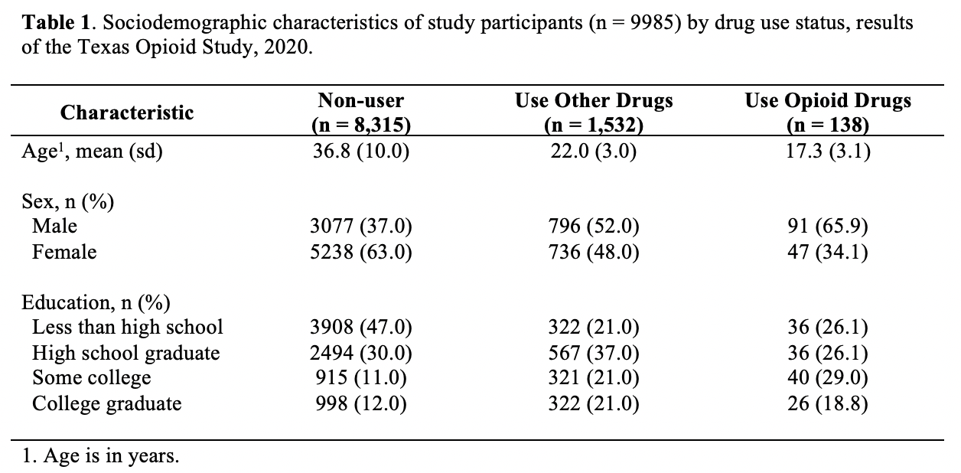
Notes:
table1

Slide 2
Notes:
row_header

Slide 3
Notes:
subgroups

Slide 4
Notes:
title

Slide 5
Notes:
column_header

Slide 6
Notes:
variables

Slide 7
Notes:
footer

Slide 8
Notes:
sample_size

Slide 9
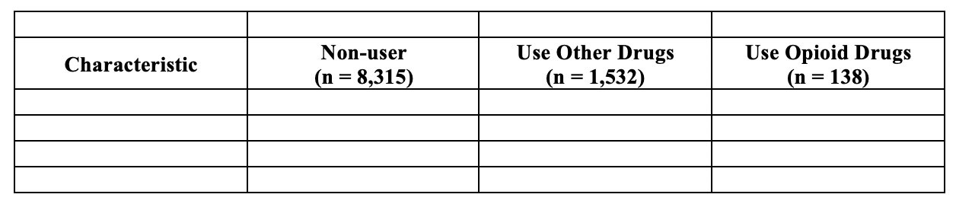
Notes:
make_column_headers

Slide 10
Notes:
what_stats

Slide 11
Notes:
identify_stats

Slide 12
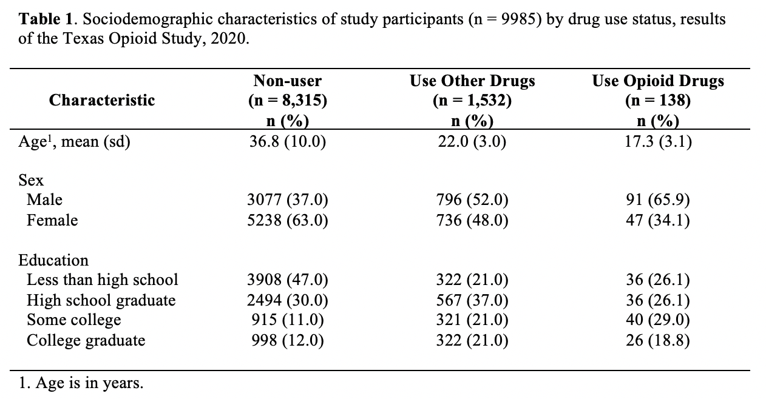
Not n (%)
Not n (%)
Not n (%)
Notes:
bad_stat_labels

Slide 13
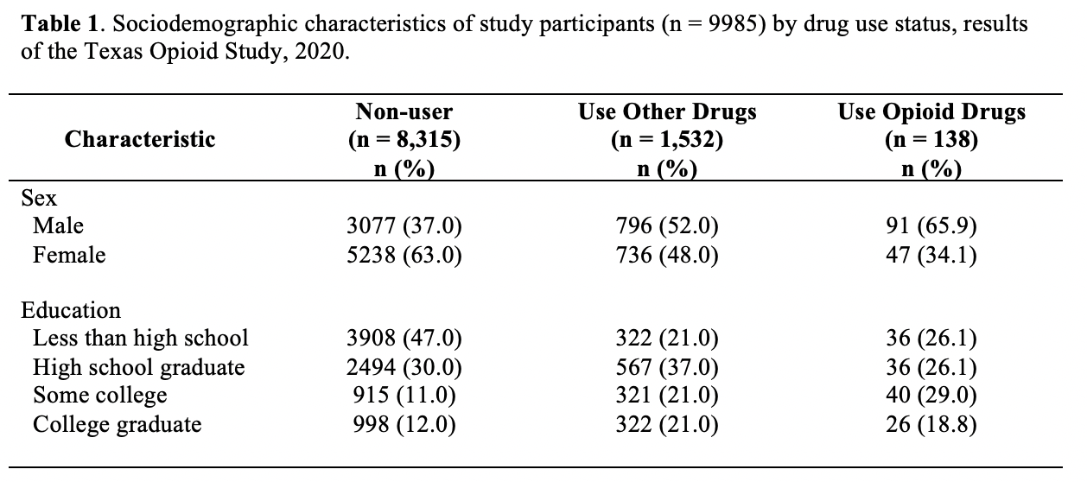
All n (%)
Notes:
good_stat_labels

Slide 14
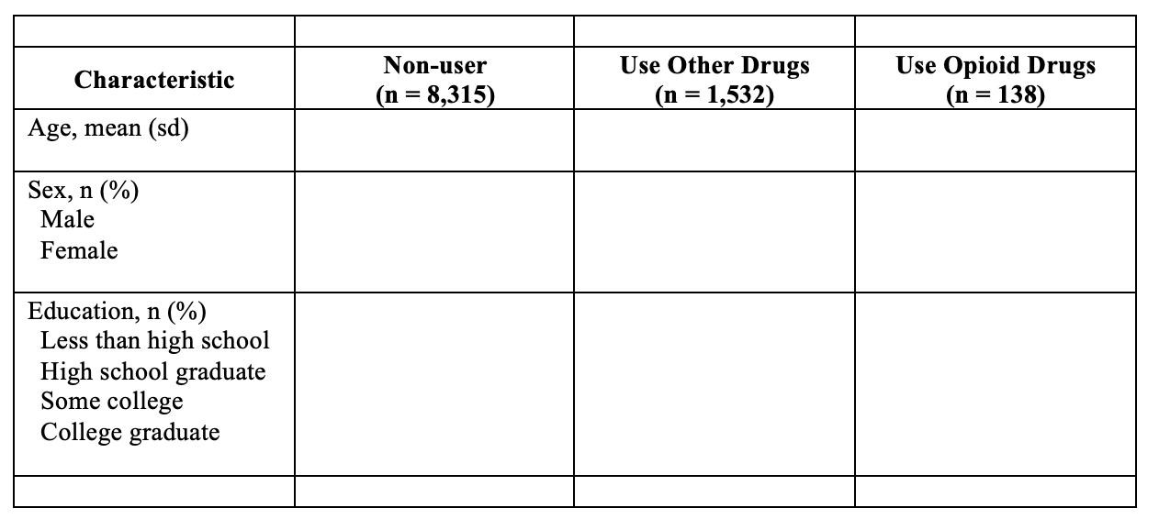
Notes:
make_row_headers

Slide 15
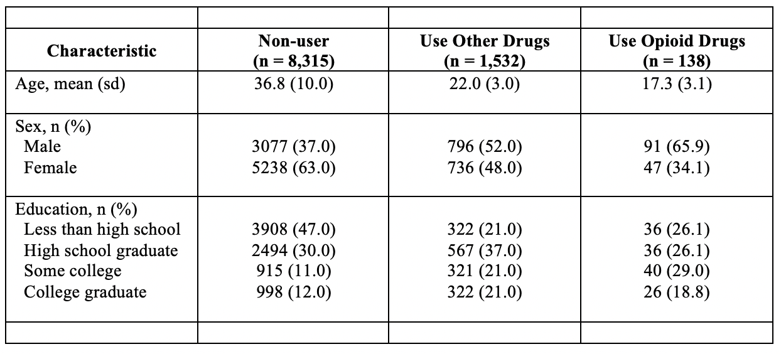
Notes:
make_data_values

Slide 16
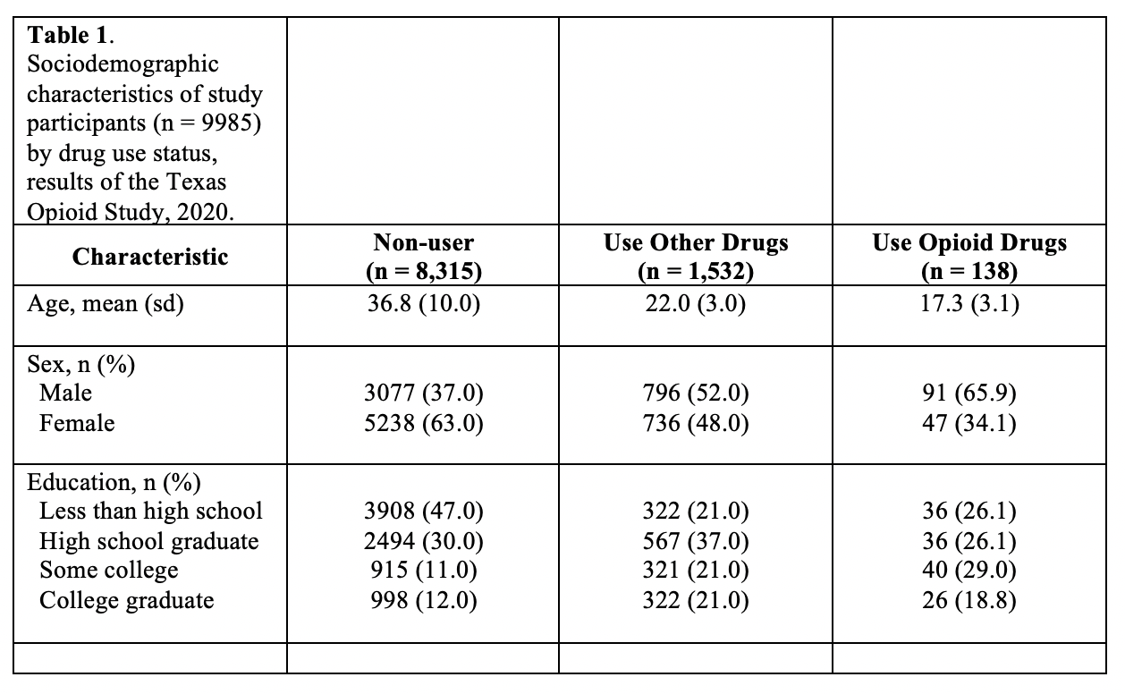
Notes:
make_title

Slide 17
Notes:
number_footnotes

Slide 18
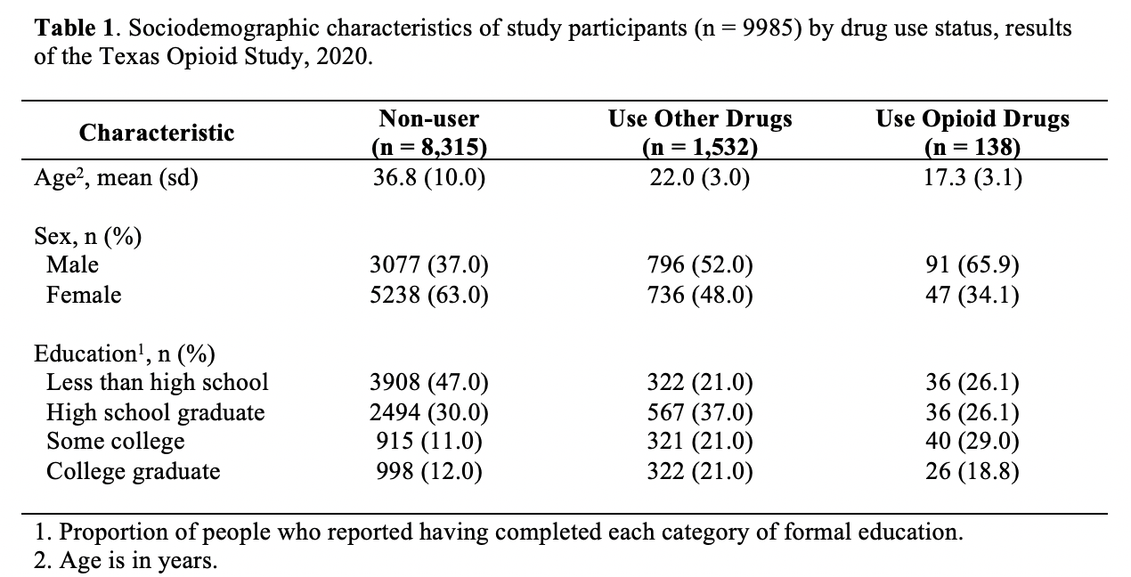
Notes:
bad_footnote_1

Slide 19
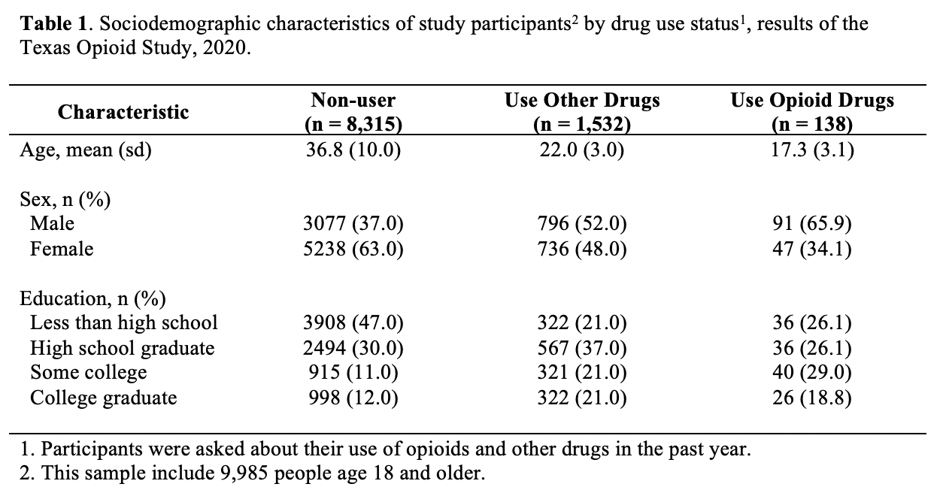
Notes:
bad_footnote_2

Slide 20
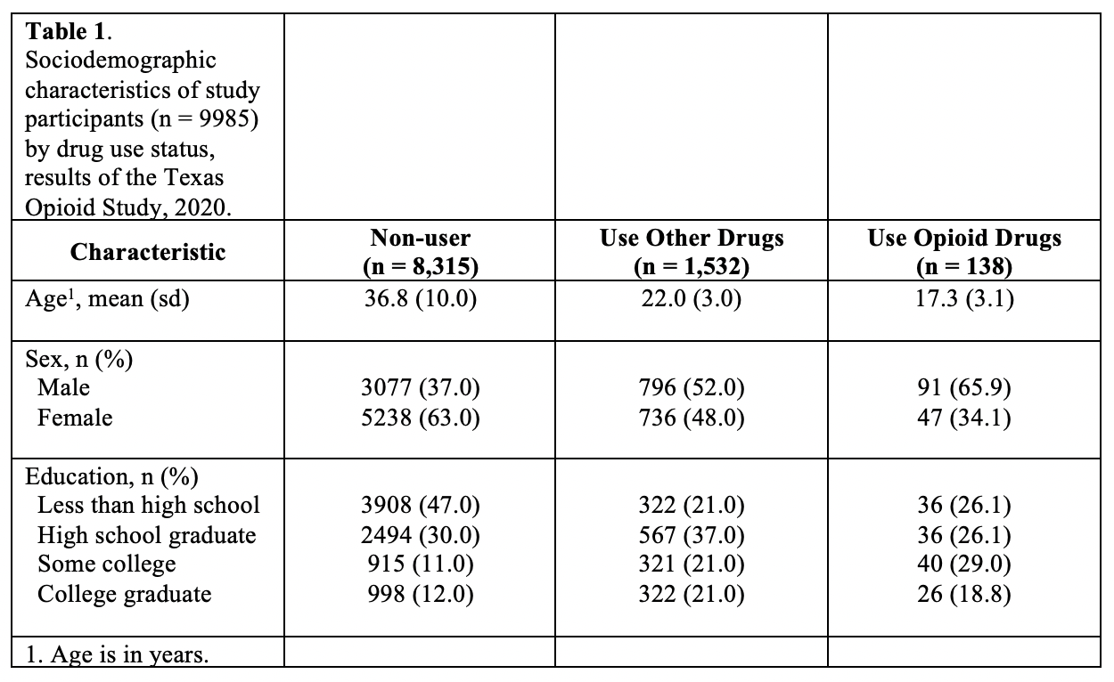
Notes:
make_footnotes

Slide 21
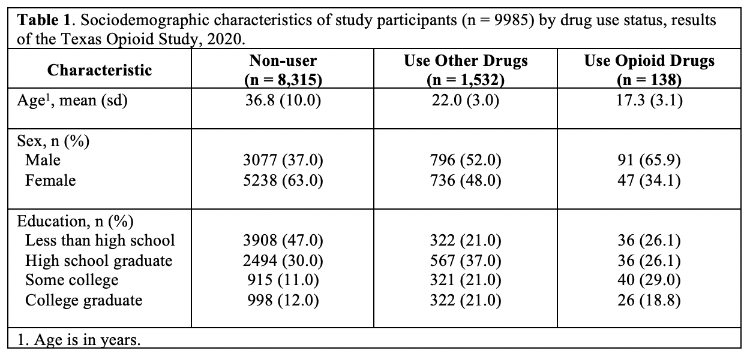
Notes:
make_merged

