Slide 1




Stata
.txt
.csv
Spreadsheet
SAS
obs | X1 | X2 | X3
1 | 1 | 0 | 1
2 | 0 | 1 | 0
3 | 1 | 0 | 1
4 | 0 | 1 | 0
Notes:
files

Slide 2
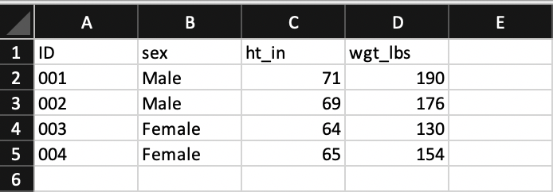
Notes:
excel

Slide 3
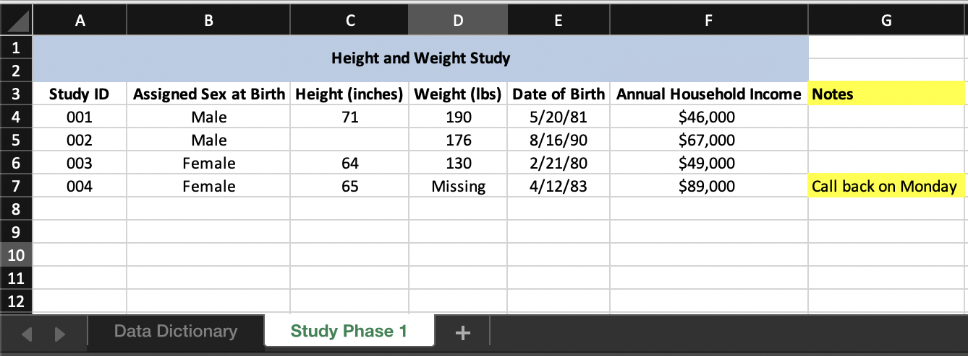
Notes:
excel_complex

Slide 4
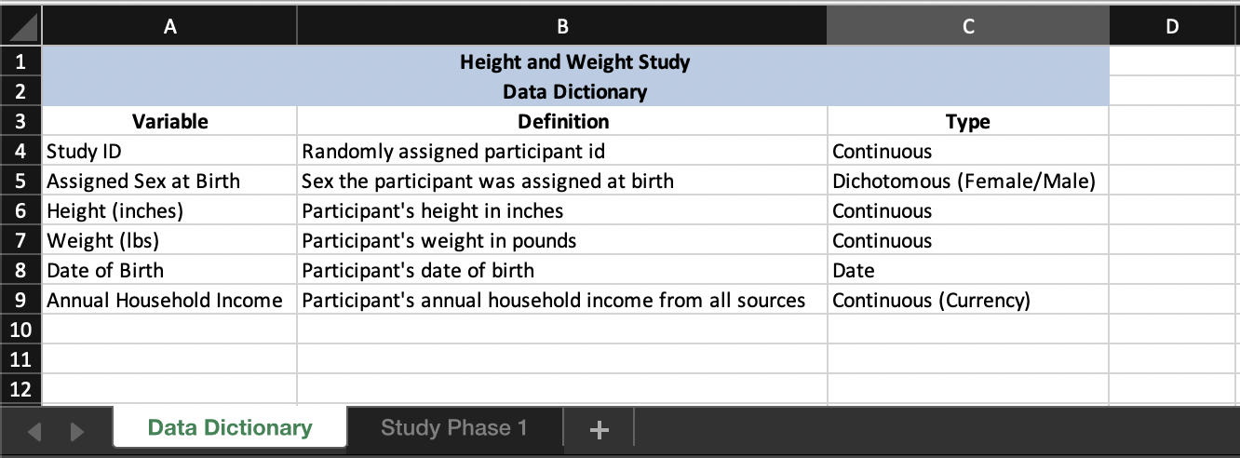
Notes:
data_dictionary

Slide 5
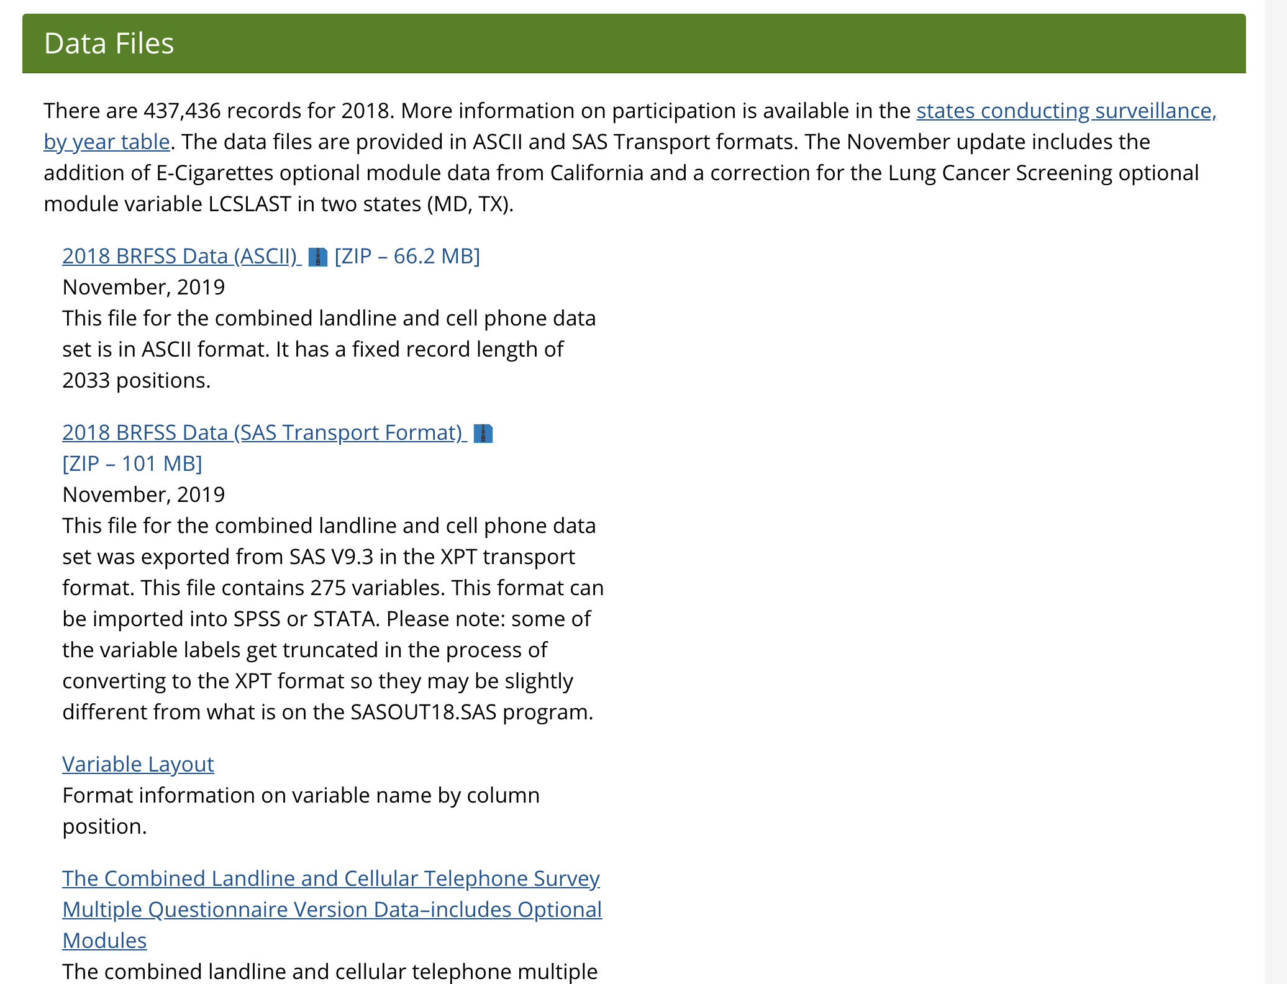
Notes:
download_brfss

Slide 6
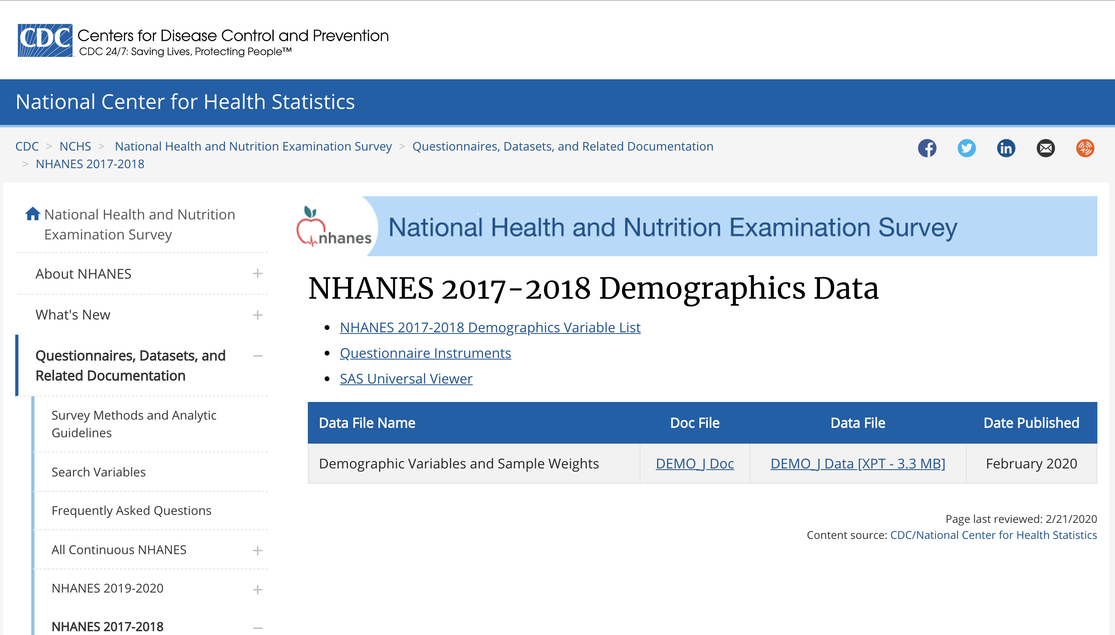
Notes:
nhanes_link

Slide 7
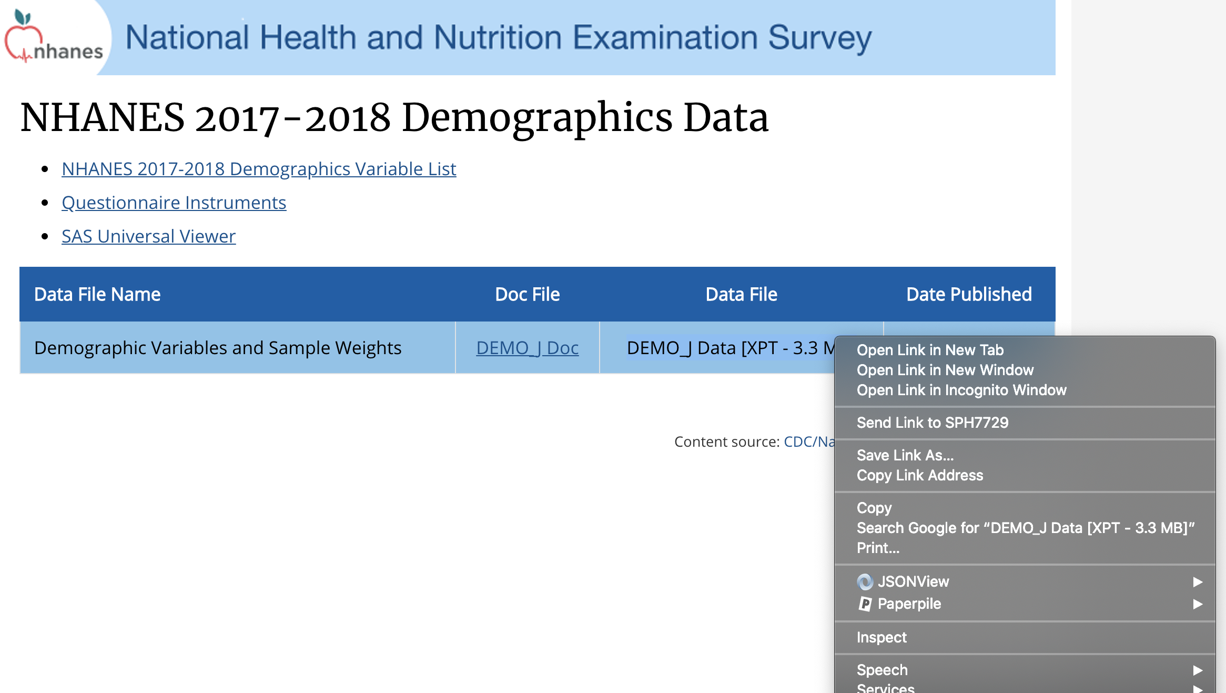
Notes:
copy_link_address

