Slide 1
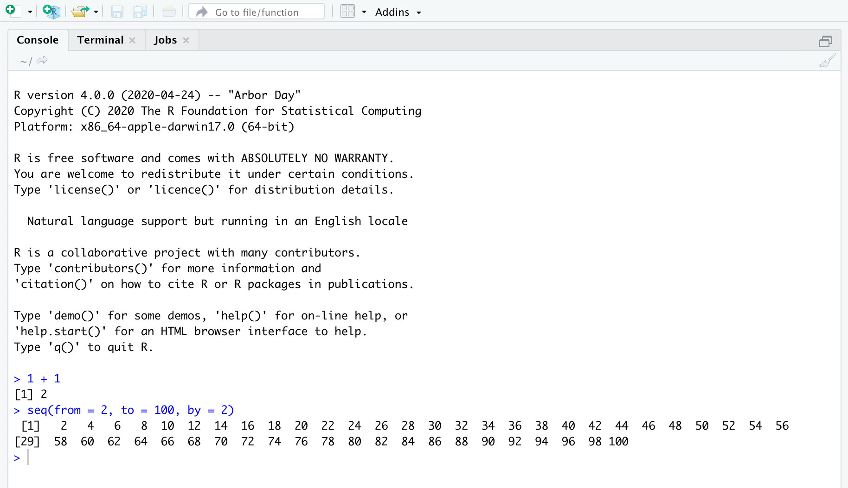
Notes:
using_console

Slide 2
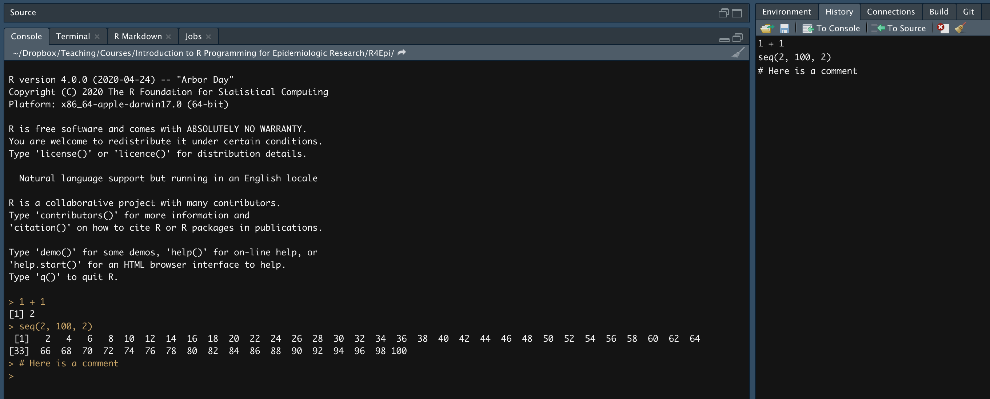
Notes:
history

Slide 3
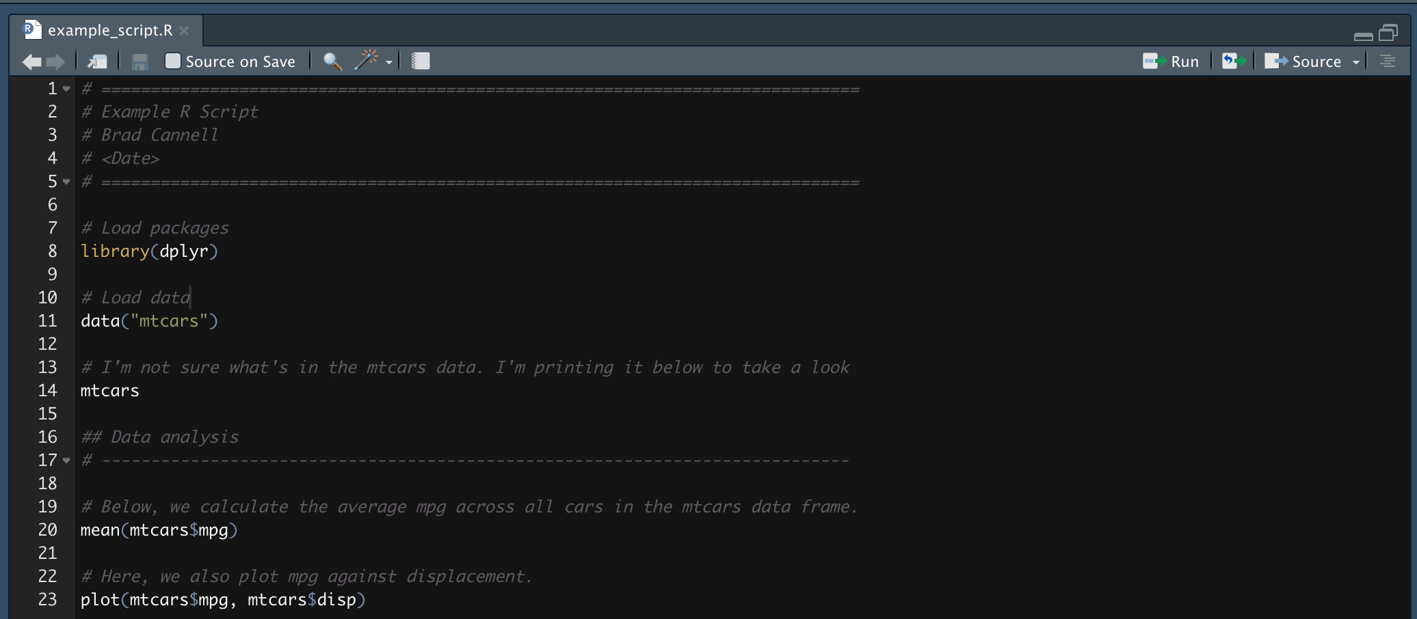
Decorate with comments
Header
Load packages at the top of the script
80 characters per line
Decorate with comments
Notes:
example_script

Slide 4
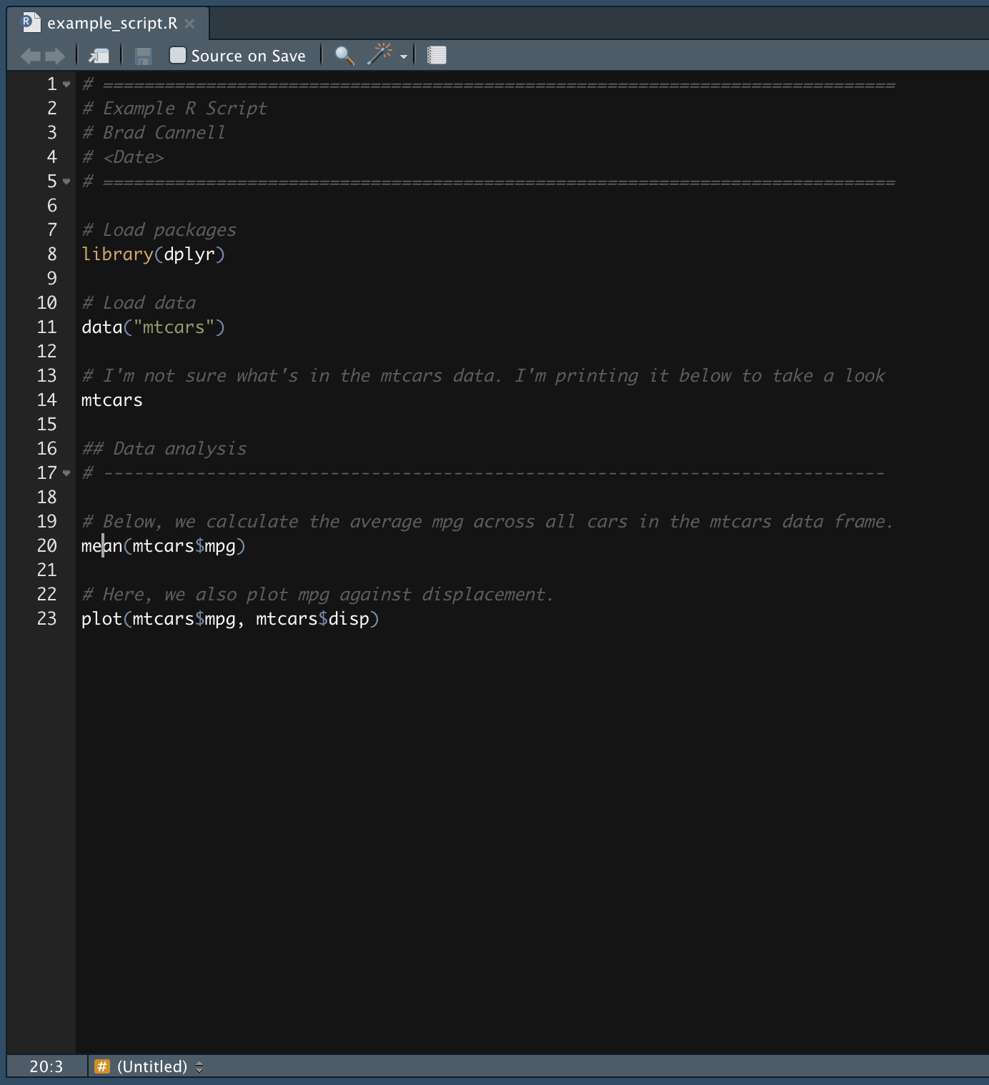
Notes:
counter

Slide 5
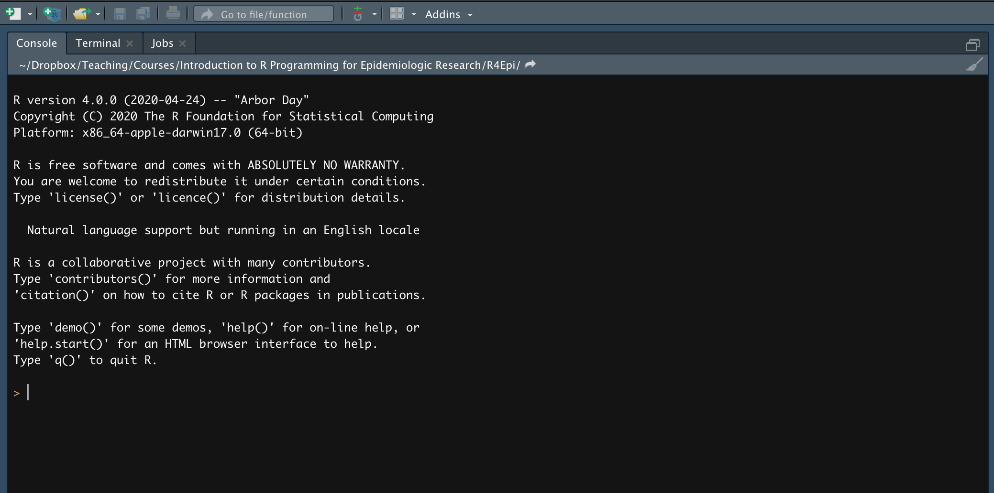
Notes:
new_r_script1

Slide 6
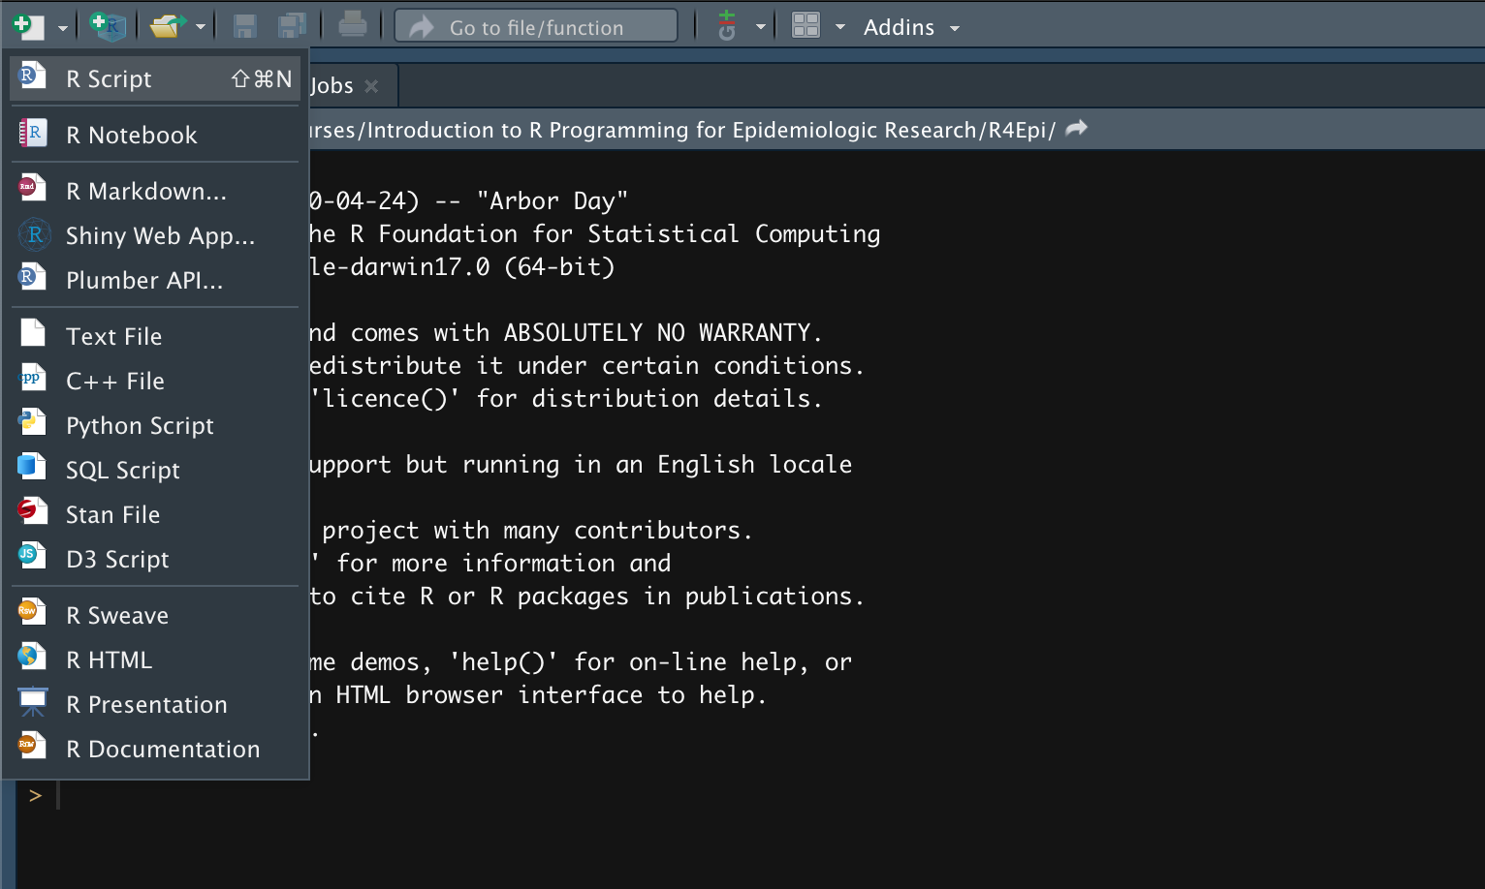
Notes:
new_r_script2

Slide 7
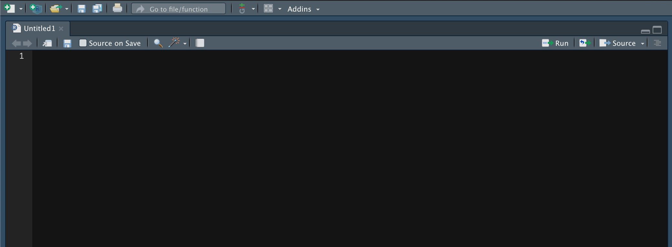
Notes:
new_r_script3

