Slide 1
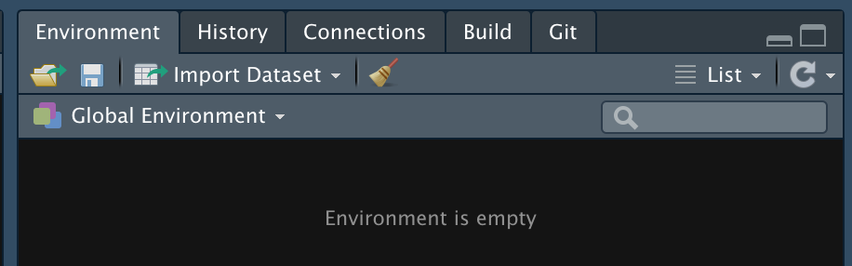
Notes:
import_button

Slide 2
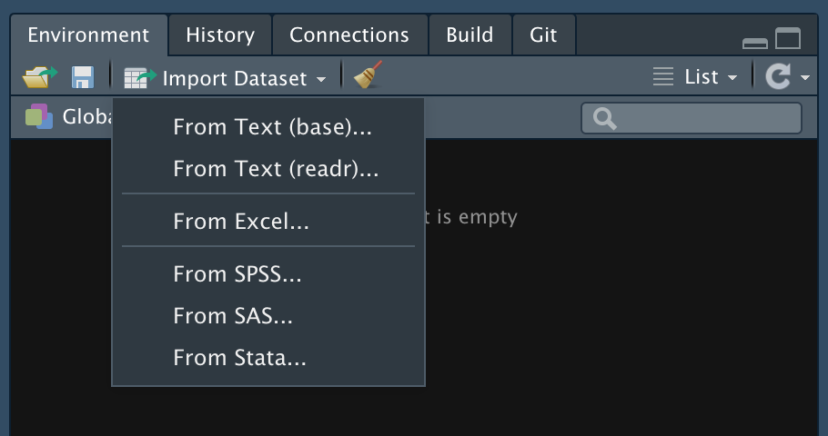
Notes:
readr

Slide 3
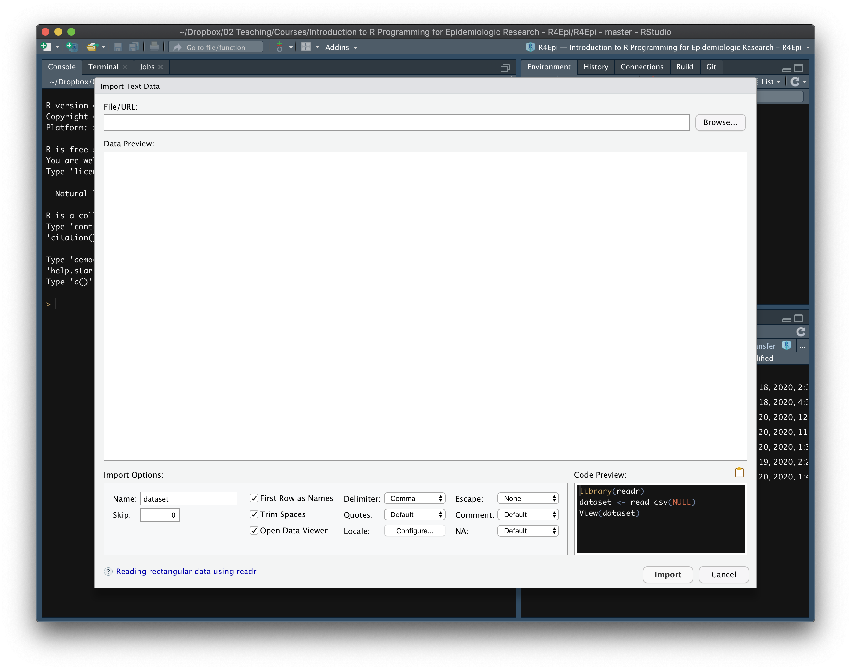
Notes:
import_window

Slide 4
Notes:
browse

Slide 5
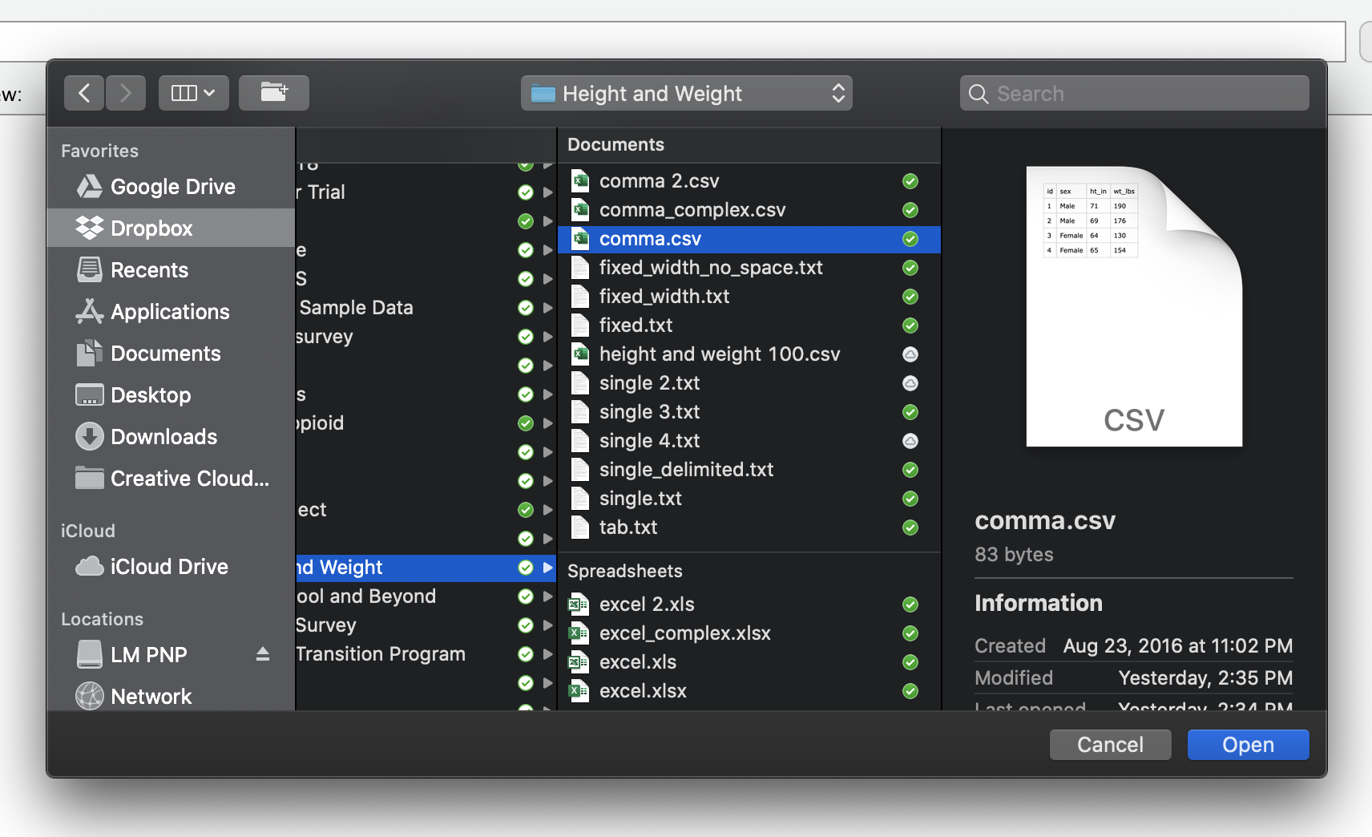
Notes:
select_file

Slide 6
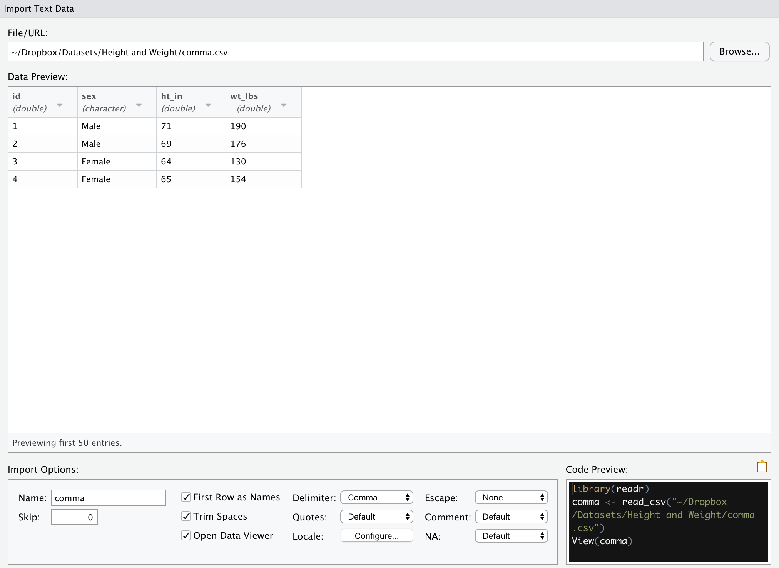
File path
Preview the
data
Copy code to clipboard
Code Preview
Import Options
Notes:
overview

Slide 7
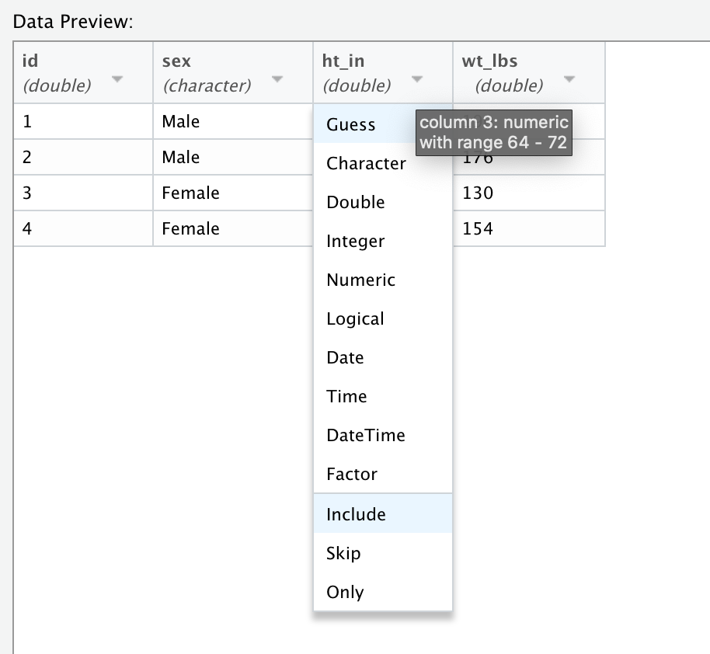
Notes:
integer

Slide 8
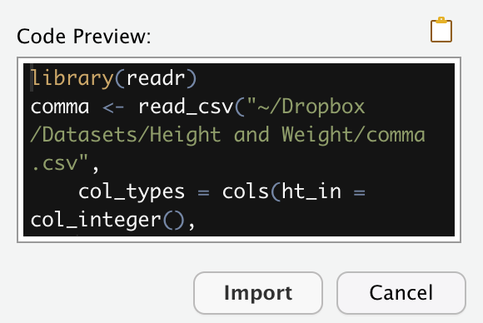
Notes:
copy_and_paste

