Slide 1
This slide deck is not a presentation. It’s to export diagrams and images in an image format for use in markdown files.

Slide 2
Instructions
Create the graphic on a blank slide
Select the slide
Click File -> Export
Name the file, select the directory to export it to
lesson_number order_brief description.png
Change the file format to PNG
Set the dimensions to 1800 x 1013

Slide 3
Descriptive Analysis
Numerical
Categorical
Continuous
Discrete
Numerical
Graphical
Numerical
Graphical
Ordinal
Nominal
Numerical
Graphical
Numerical
Graphical
Notes:
flowchart_num_and_cat.png
I added an empty child item to each “Numerical” box and made it transparent. That coerces PowerPoint to stack the ”Numerical and Graphical Boxes Horizontally instead of vertically.

Slide 4
Descriptive Analysis
Numerical
Categorical
Continuous
Discrete
Numerical
Graphical
Numerical
Graphical
Ordinal
Nominal
Numerical
Graphical
Numerical
Graphical
Notes:
flowchart_num_only.png
I added an empty child item to each “Numerical” box and made it transparent. That coerces PowerPoint to stack the ”Numerical and Graphical Boxes Horizontally instead of vertically.

Slide 5
Descriptive Analysis
Numerical
Categorical
Continuous
Discrete
Numerical
Graphical
Numerical
Graphical
Ordinal
Nominal
Numerical
Graphical
Numerical
Graphical
Notes:
flowchart_num_numerical.png
I added an empty child item to each “Numerical” box and made it transparent. That coerces PowerPoint to stack the ”Numerical and Graphical Boxes Horizontally instead of vertically.

Slide 6
Descriptive Analysis
Numerical
Categorical
Continuous
Discrete
Numerical
Graphical
Numerical
Graphical
Ordinal
Nominal
Numerical
Graphical
Numerical
Graphical
Notes:
flowchart_num_graphical.png
I added an empty child item to each “Numerical” box and made it transparent. That coerces PowerPoint to stack the ”Numerical and Graphical Boxes Horizontally instead of vertically.

Slide 7
Descriptive Analysis
Numerical
Categorical
Continuous
Discrete
Numerical
Graphical
Numerical
Graphical
Ordinal
Nominal
Numerical
Graphical
Numerical
Graphical
Notes:
flowchart_cat_only.png
I added an empty child item to each “Numerical” box and made it transparent. That coerces PowerPoint to stack the ”Numerical and Graphical Boxes Horizontally instead of vertically.

Slide 8
Descriptive Analysis
Numerical
Categorical
Continuous
Discrete
Numerical
Graphical
Numerical
Graphical
Ordinal
Nominal
Numerical
Graphical
Numerical
Graphical
Notes:
flowchart_cat_numerical.png
I added an empty child item to each “Numerical” box and made it transparent. That coerces PowerPoint to stack the ”Numerical and Graphical Boxes Horizontally instead of vertically.

Slide 9
Descriptive Analysis
Numerical
Categorical
Continuous
Discrete
Numerical
Graphical
Numerical
Graphical
Ordinal
Nominal
Numerical
Graphical
Numerical
Graphical
Notes:
flowchart_cat_graphical.png
I added an empty child item to each “Numerical” box and made it transparent. That coerces PowerPoint to stack the ”Numerical and Graphical Boxes Horizontally instead of vertically.

Slide 10
Descriptive Analysis
Numerical
Categorical
Continuous
Discrete
Numerical
Graphical
Numerical
Graphical
Ordinal
Nominal
Numerical
Graphical
Numerical
Graphical
Notes:
flowchart_full.png
I added an empty child item to each “Numerical” box and made it transparent. That coerces PowerPoint to stack the ”Numerical and Graphical Boxes Horizontally instead of vertically.

Slide 11




Male
Female
Asian
African-American
White
Graduate School
College
High School
Source: http://blogs-images.forbes.com/glennllopis/files/2012/04/Diversity-Profit-Center.jpg
Notes:
categorical_variables_01.jpeg

Slide 12
0
1
1
2
3
3
2
1
Source: http://blogs-images.forbes.com/glennllopis/files/2012/04/Diversity-Profit-Center.jpg
Notes:
categorical_variables_02.jpeg

Slide 13
Count /
n
Proportion /
Percent
Asian
2
0.4
40%
African-American
1
0.2
20%
White
2
0.4
40%
Notes:
categorical_variables_03.jpeg

Slide 14
Numerical Variables and Measures of Central Tendency
Mean
Median
Mode
Notes:
central_tendency_01.png

Slide 15
Numerical Variables and Measures of Central Tendency
Mean
Median
Mode
Simple
Only one
Susceptible to extreme values
Not necessarily observed in data
Simple
Only one
Not susceptible to extreme values
Not necessarily observed in data
Simple
May be none
May be more than one
Observed in data by definition
Notes:
central_tendency_02.png
Boxes and lines are set to “no fill” and “no line” respectively. If I delete content, then the sizes change.

Slide 16
Numerical Variables and Measures of Central Tendency
Mean
Median
Mode
Simple
Only one
Susceptible to extreme values
Not necessarily observed in data
Simple
Only one
Not susceptible to extreme values
Not necessarily observed in data
Simple
May be none
May be more than one
Observed in data by definition
Notes:
central_tendency_03.png
Boxes and lines are set to “no fill” and “no line” respectively. If I delete content, then the sizes change.

Slide 17
Numerical Variables and Measures of Central Tendency
Mean
Median
Mode
Simple
Only one
Susceptible to extreme values
Not necessarily observed in data
Simple
Only one
Not susceptible to extreme values
Not necessarily observed in data
Simple
May be none
May be more than one
Observed in data by definition
Notes:
central_tendency_04.png

Slide 18



68.4 Inches
5’ 8”
68.4 Inches
5’ 8”
68.4 Inches
5’ 8”

Slide 19
71 Inches
5’ 11”
68.4 Inches
5’ 8”
64 Inches
5’ 4”

Slide 20
Measures of Dispersion
Range
Variance
Standard Deviation
Notes:
central_tendency_01.png

Slide 21
58”
68”
78”
Heights of Students

Slide 22
58”
68”
78”
Heights of Students

Slide 23
58”
68”
78”
Heights of Students

Slide 24
-10”
10”
-10”
10”
-10”
10”
58”
68”
78”
Heights of Students

Slide 25
100
100
100
100
100
100
58”
68”
78”
Heights of Students

Slide 26
Variance ($s^{2}$) = 100 + 100 + 100 + 100 + 100 + 100 = 600
100
100
100
100
100
100
58”
68”
78”
Heights of Students

Slide 27
Variance ($s^{2}$) = 600 / (6-1) = 120
100
100
100
100
100
100
58”
68”
78”
Heights of Students

Slide 28
Standard Deviation ($s$) = $\sqrt{σ^{2}}$ = $\sqrt{600}$ = 10.95
100
100
100
100
100
100
58”
68”
78”
Heights of Students

Slide 29
Standard Deviations | Approximate Percent of Values
1 | 68%
2 | 95%
3 | 99%
58”
68”
78”
Heights of Students

Slide 30
Outcome Vs. Predictor
Predictor Variable
Outcome Variable
=
Independent Variable
Explanatory Variable
Dependent Variable
Response Variable

Slide 31
Outcome Vs. Predictor
Continuous Outcome Variable
Continuous Predictor Variable
=

Slide 32
Pearson Correlation Coefficient
rho (r)
-1
0
+1
Notes:
Pearson’s Correlation Coefficient is a parametric measure of the linear relationship between two numerical variables.
The Pearson Correlation Coefficient can take on values between -1 and 1, including zero.
A value of 0 indicates that there is no association between the two variables.
A negative value indicates that there is a negative correlation between the two variables. In other words, as the value of X goes up, the value of Y goes down. Or, as the value of X goes down, the value of Y goes up.
A positive value indicates that there is a positive correlation between the two variables. As the value of X increases, the value of Y increases. Or as the value of X decreases, the value of Y decreases.
Caution: When the relationship between two variables is nonlinear or when outliers are present, the correlation coefficient might incorrectly estimate the strength of the relationship. Plotting the data enables you to verify the linear relationship and to identify the potential outliers.

Slide 33
Pearson Correlation Coefficient
rho (r)
-1
0
+1
No Correlation
Notes:
Pearson’s Correlation Coefficient is a parametric measure of the linear relationship between two numerical variables.
The Pearson Correlation Coefficient can take on values between -1 and 1, including zero.
A value of 0 indicates that there is no association between the two variables.
A negative value indicates that there is a negative correlation between the two variables. In other words, as the value of X goes up, the value of Y goes down. Or, as the value of X goes down, the value of Y goes up.
A positive value indicates that there is a positive correlation between the two variables. As the value of X increases, the value of Y increases. Or as the value of X decreases, the value of Y decreases.
Caution: When the relationship between two variables is nonlinear or when outliers are present, the correlation coefficient might incorrectly estimate the strength of the relationship. Plotting the data enables you to verify the linear relationship and to identify the potential outliers.

Slide 34
Pearson Correlation Coefficient
rho (r)
-1
0
+1
X
Y
Negative Correlation
Notes:
Pearson’s Correlation Coefficient is a parametric measure of the linear relationship between two numerical variables.
The Pearson Correlation Coefficient can take on values between -1 and 1, including zero.
A value of 0 indicates that there is no association between the two variables.
A negative value indicates that there is a negative correlation between the two variables. In other words, as the value of X goes up, the value of Y goes down. Or, as the value of X goes down, the value of Y goes up.
A positive value indicates that there is a positive correlation between the two variables. As the value of X increases, the value of Y increases. Or as the value of X decreases, the value of Y decreases.
Caution: When the relationship between two variables is nonlinear or when outliers are present, the correlation coefficient might incorrectly estimate the strength of the relationship. Plotting the data enables you to verify the linear relationship and to identify the potential outliers.

Slide 35
Pearson Correlation Coefficient
rho (r)
-1
0
+1
X
Y
Positive Correlation
Notes:
Pearson’s Correlation Coefficient is a parametric measure of the linear relationship between two numerical variables.
The Pearson Correlation Coefficient can take on values between -1 and 1, including zero.
A value of 0 indicates that there is no association between the two variables.
A negative value indicates that there is a negative correlation between the two variables. In other words, as the value of X goes up, the value of Y goes down. Or, as the value of X goes down, the value of Y goes up.
A positive value indicates that there is a positive correlation between the two variables. As the value of X increases, the value of Y increases. Or as the value of X decreases, the value of Y decreases.
Caution: When the relationship between two variables is nonlinear or when outliers are present, the correlation coefficient might incorrectly estimate the strength of the relationship. Plotting the data enables you to verify the linear relationship and to identify the potential outliers.

Slide 36
Pearson Correlation Coefficient
-1
0
+1
No Correlation
1
4
3
X
Y
X
Y
2
5
Negative Correlation
Positive Correlation

Slide 37
Outcome Vs. Predictor
Continuous Outcome Variable
Categorical Predictor Variable
=

Slide 38
Categorizing Outcomes
Cognitive Test Score
(Continuous)
Cognitive Impairment
(Categorical)
Participant | Score
1 | 17
2 | 5
3 | 21
4 | 12
5 | 26
Participant | Score | Impaired
1 | 17 | N
2 | 5 | Y
3 | 21 | N
4 | 12 | Y
5 | 26 | N

Slide 39
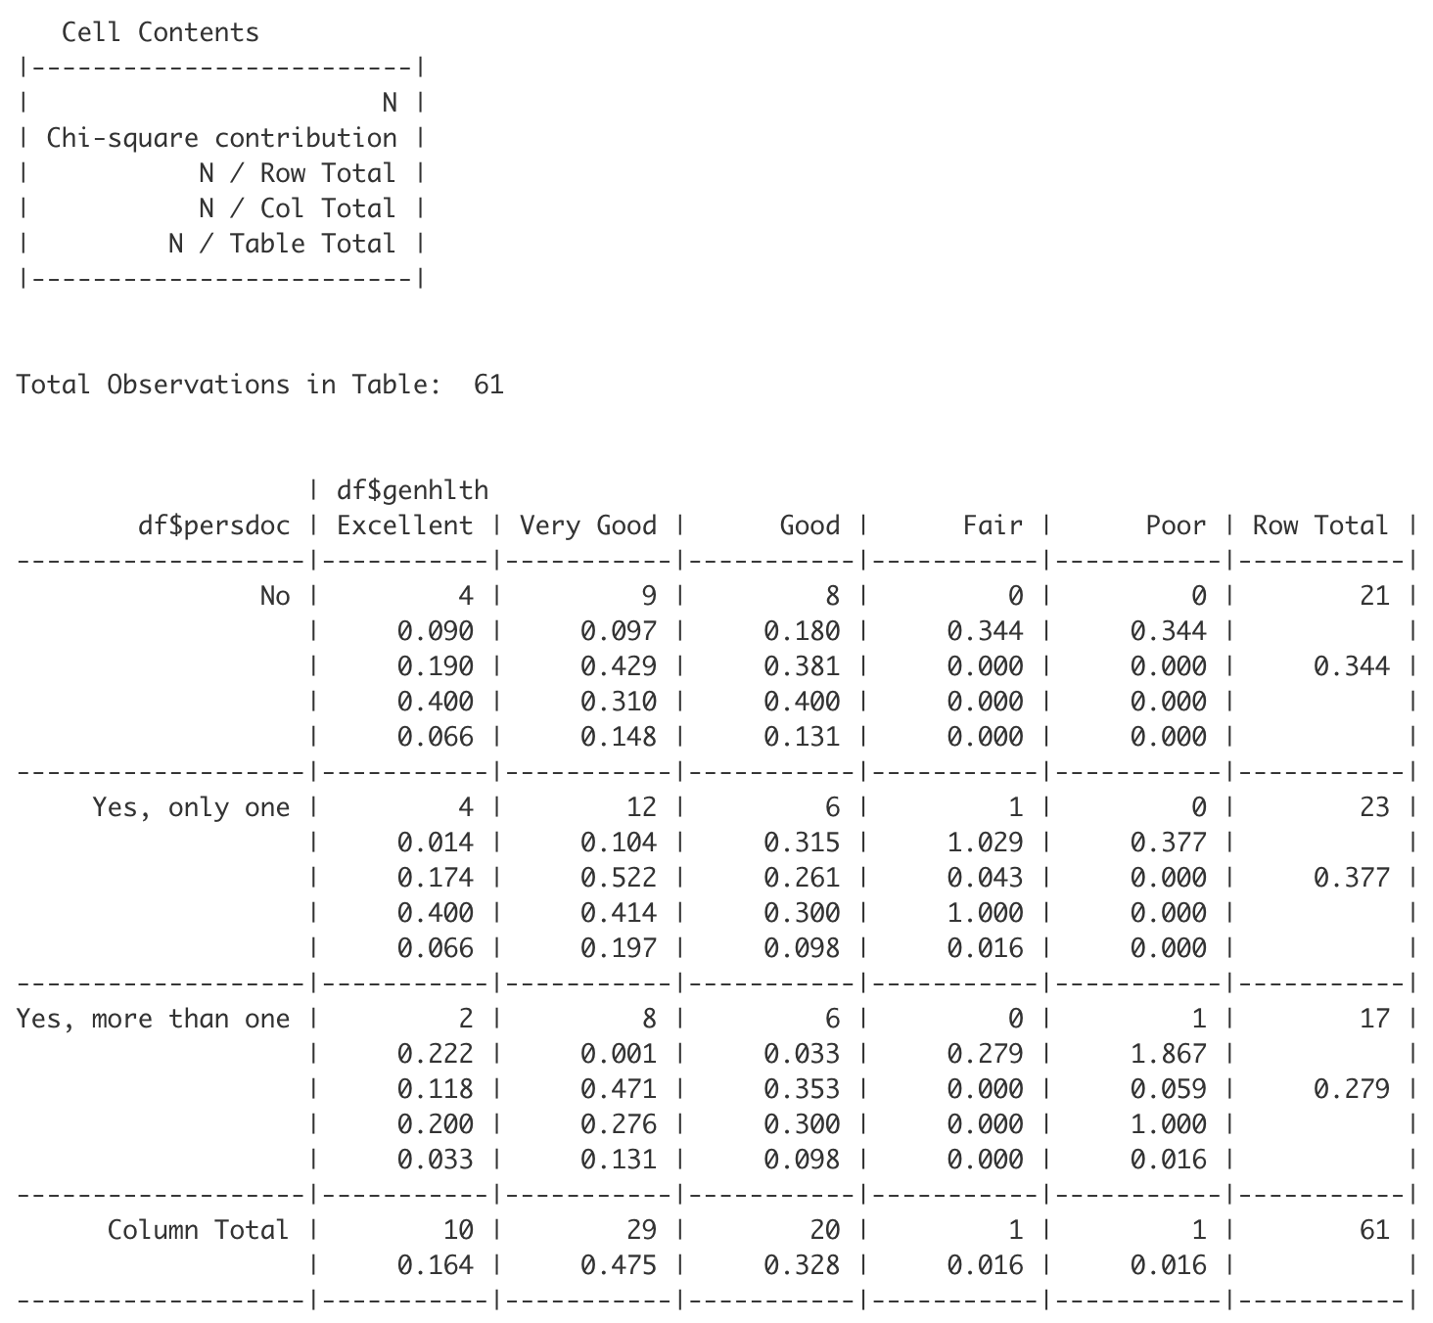

Slide 40
