Slide 1
This slide deck is not a presentation. It’s to export diagrams and images in an image format for use in markdown files.

Slide 2
Instructions
Create the graphic on a blank slide
Select the slide
Click File -> Export
Name the file, select the directory to export it to
lesson_number order_brief description.png
Change the file format to PNG
Set the dimensions to 1800 x 1013

Slide 3

Notes:
store

Slide 4
Start at home
Turn right on Camp Bowie Blvd.
Drive 1 mile
Turn left on Hulen St.
Drive .5 mile
Cross I-30
Turn right at second parking lot entrance
Notes:
directions

Slide 5
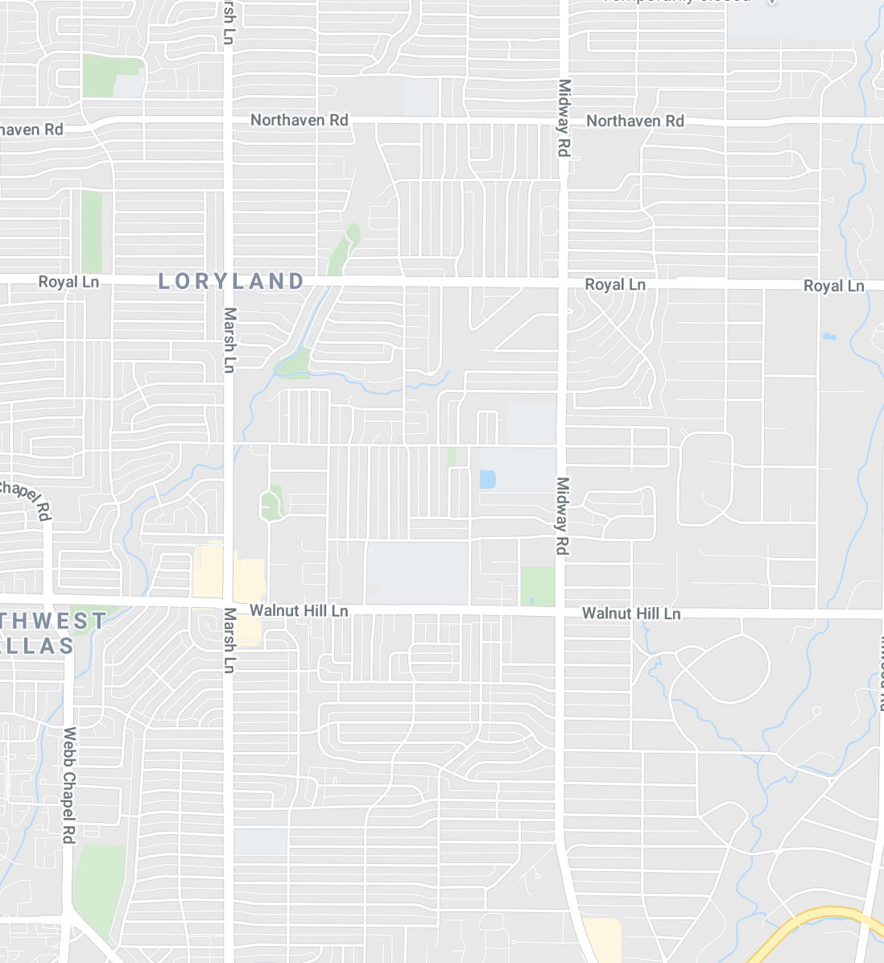

Notes:
locations

Slide 6

Notes:
ntrhd

Slide 7
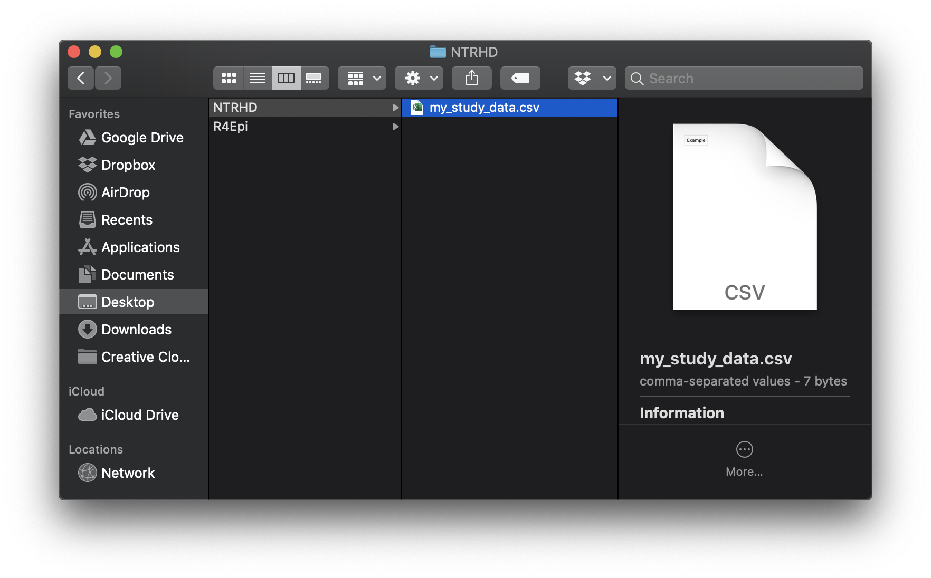
Notes:
my_study_data

Slide 8
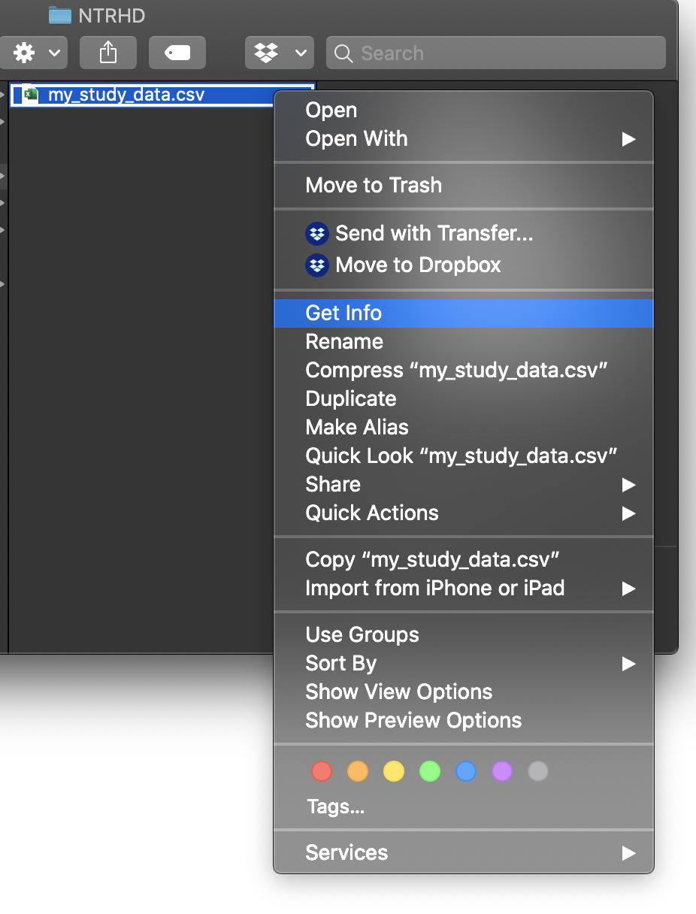
Notes:
get_info

Slide 9
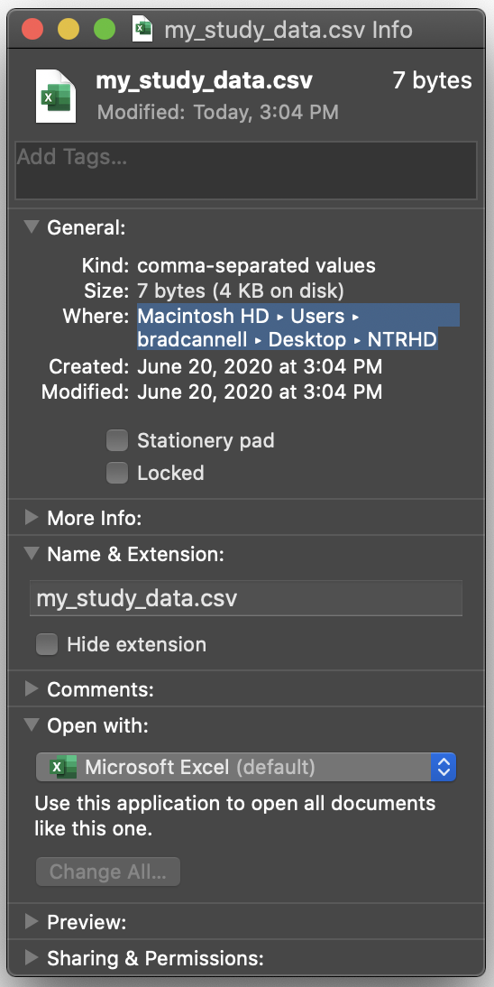
Notes:
where

Slide 10
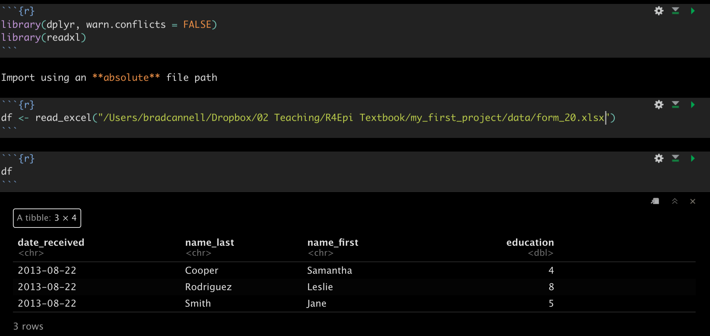
Notes:
relative_file_paths_01_absolute_brad

Slide 11
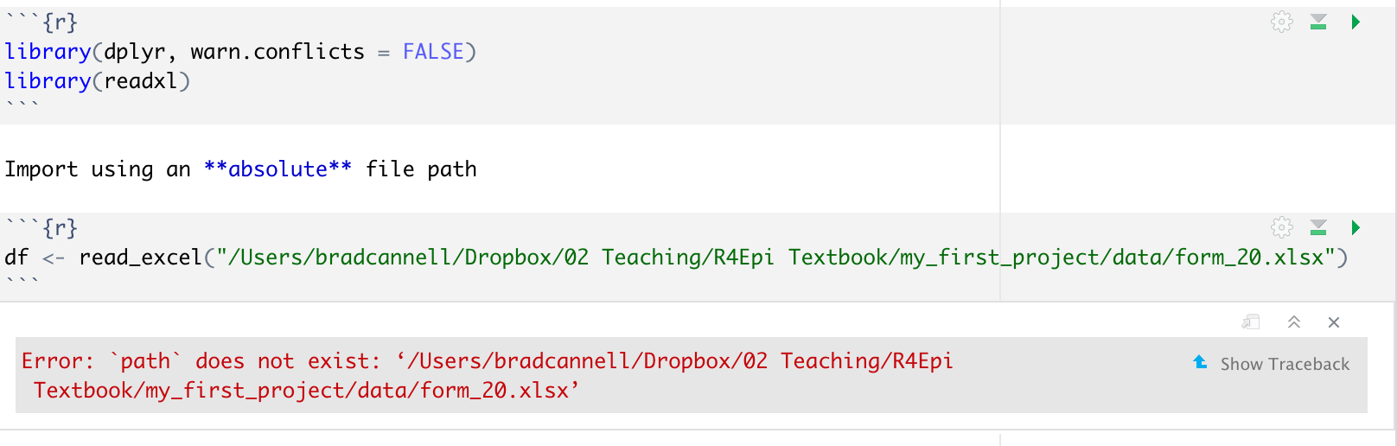
Notes:
relative_file_paths_02_absolute_arthur

Slide 12
Start at the corner of Camp Bowie Blvd. and Hulen St.
Drive .5 mile
Cross I-30
Turn right at second parking lot entrance
Notes:
directions

Slide 13
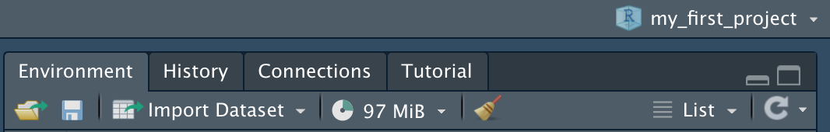
Notes:
relative_file_paths_03_check_project

Slide 14
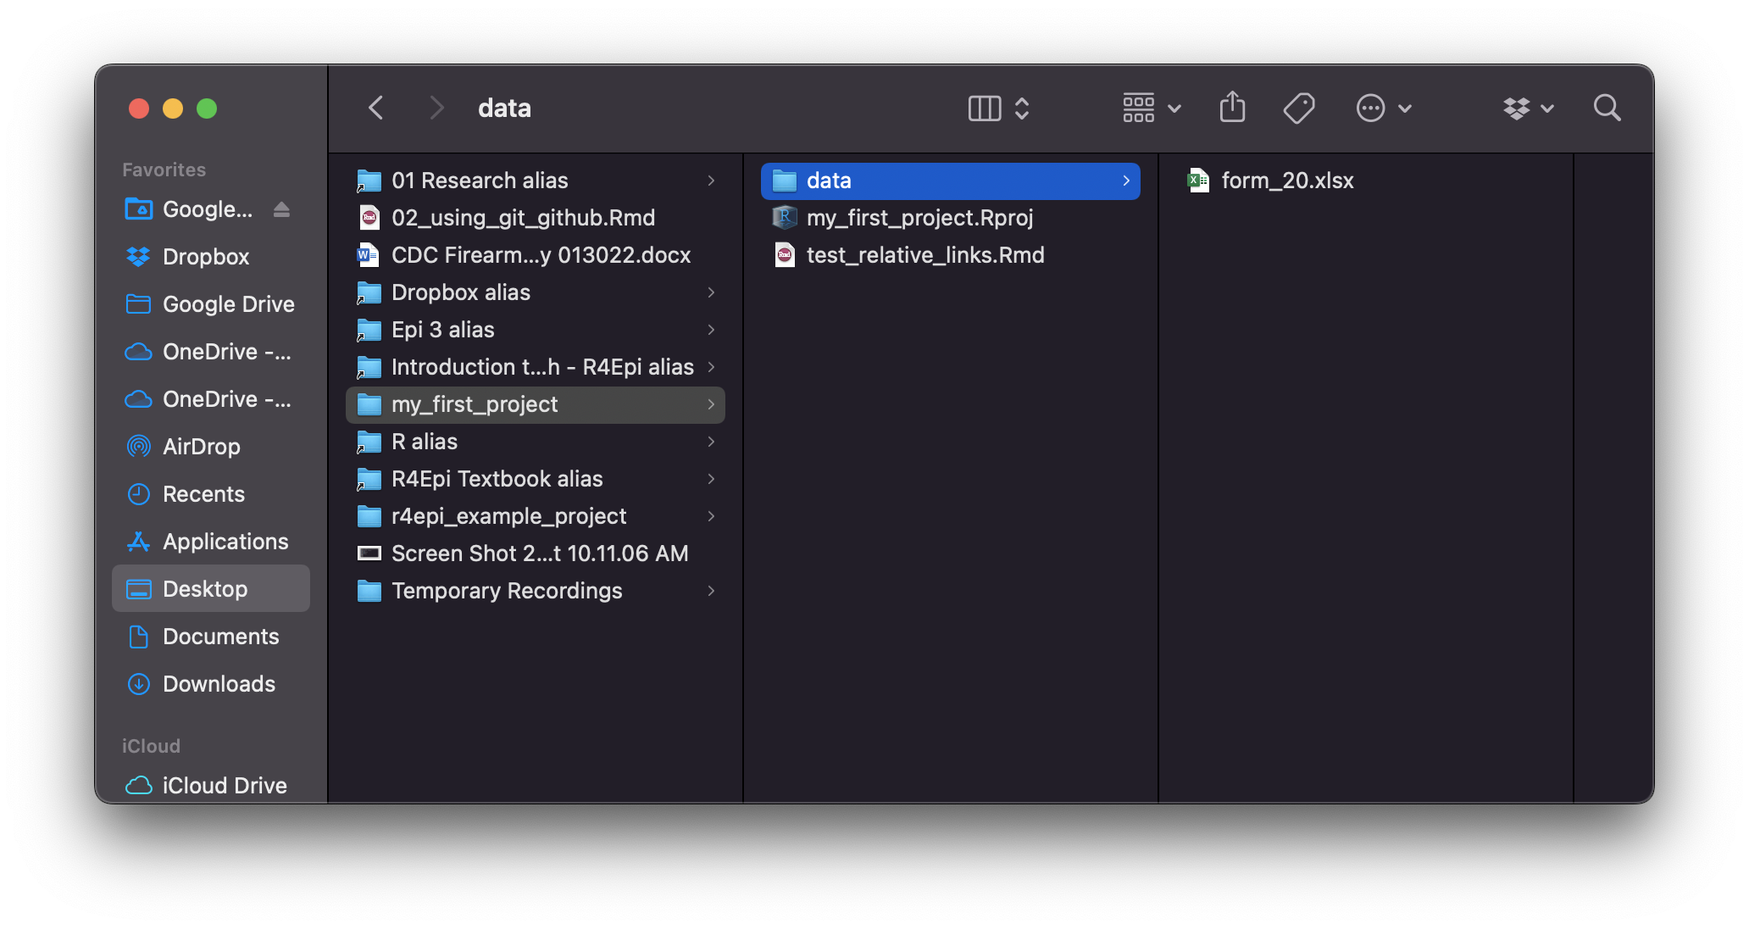
2
3
4
1
Notes:
relative_file_paths_04_check_files

Slide 15
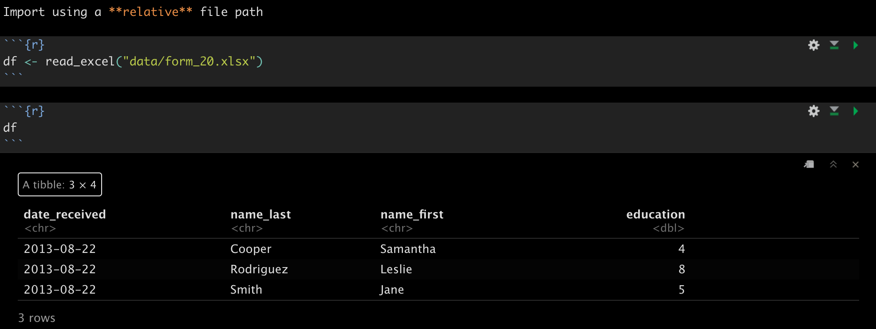
Notes:
relative_file_paths_05_relative_path_brad

Slide 16
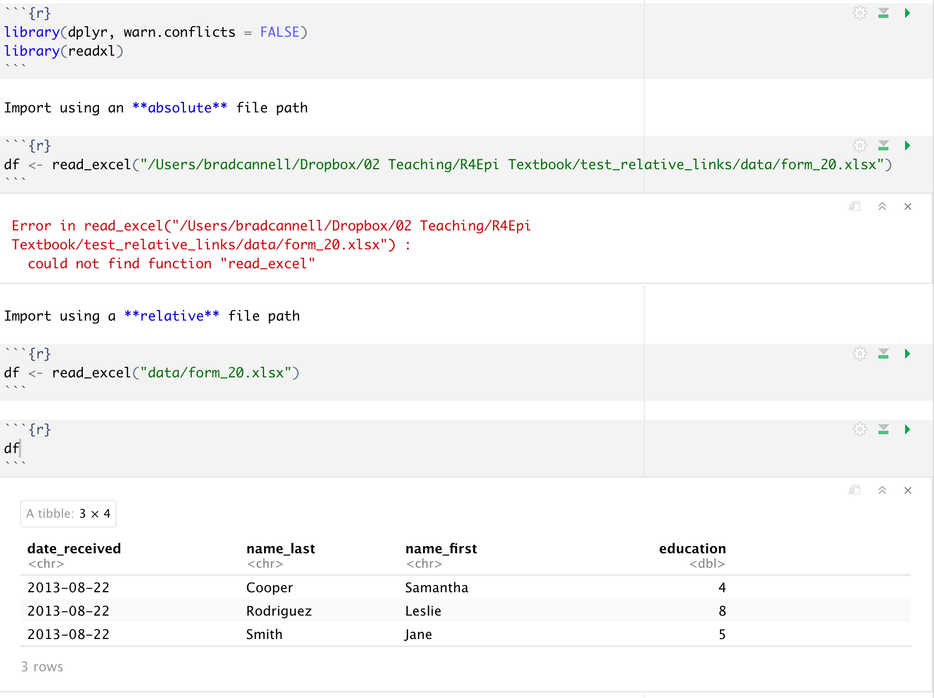
Notes:
relative_file_paths_06_relative_path_arthur

