Slide 1
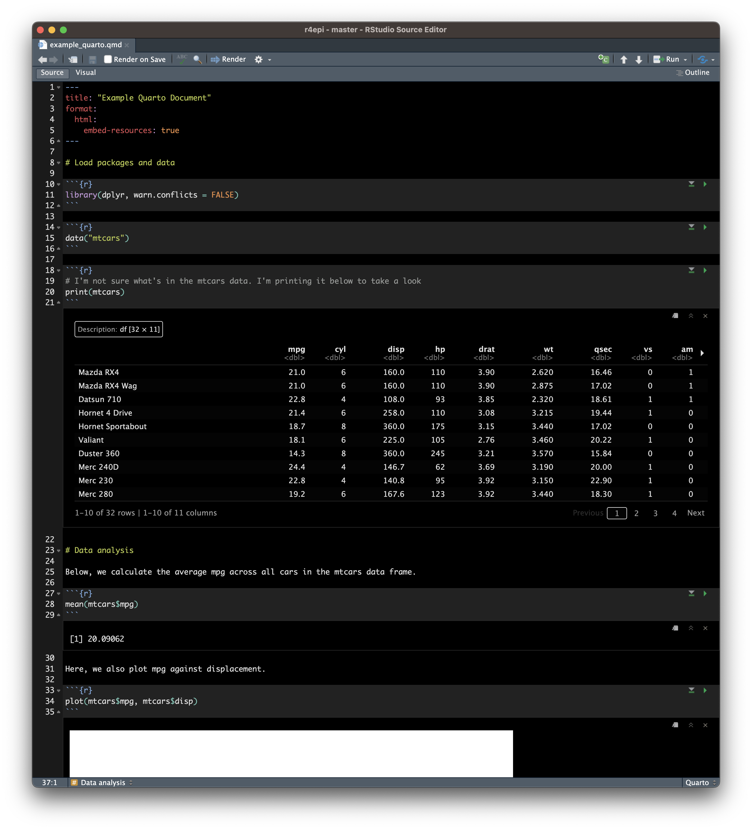
Notes:
example_quarto_file

Slide 2
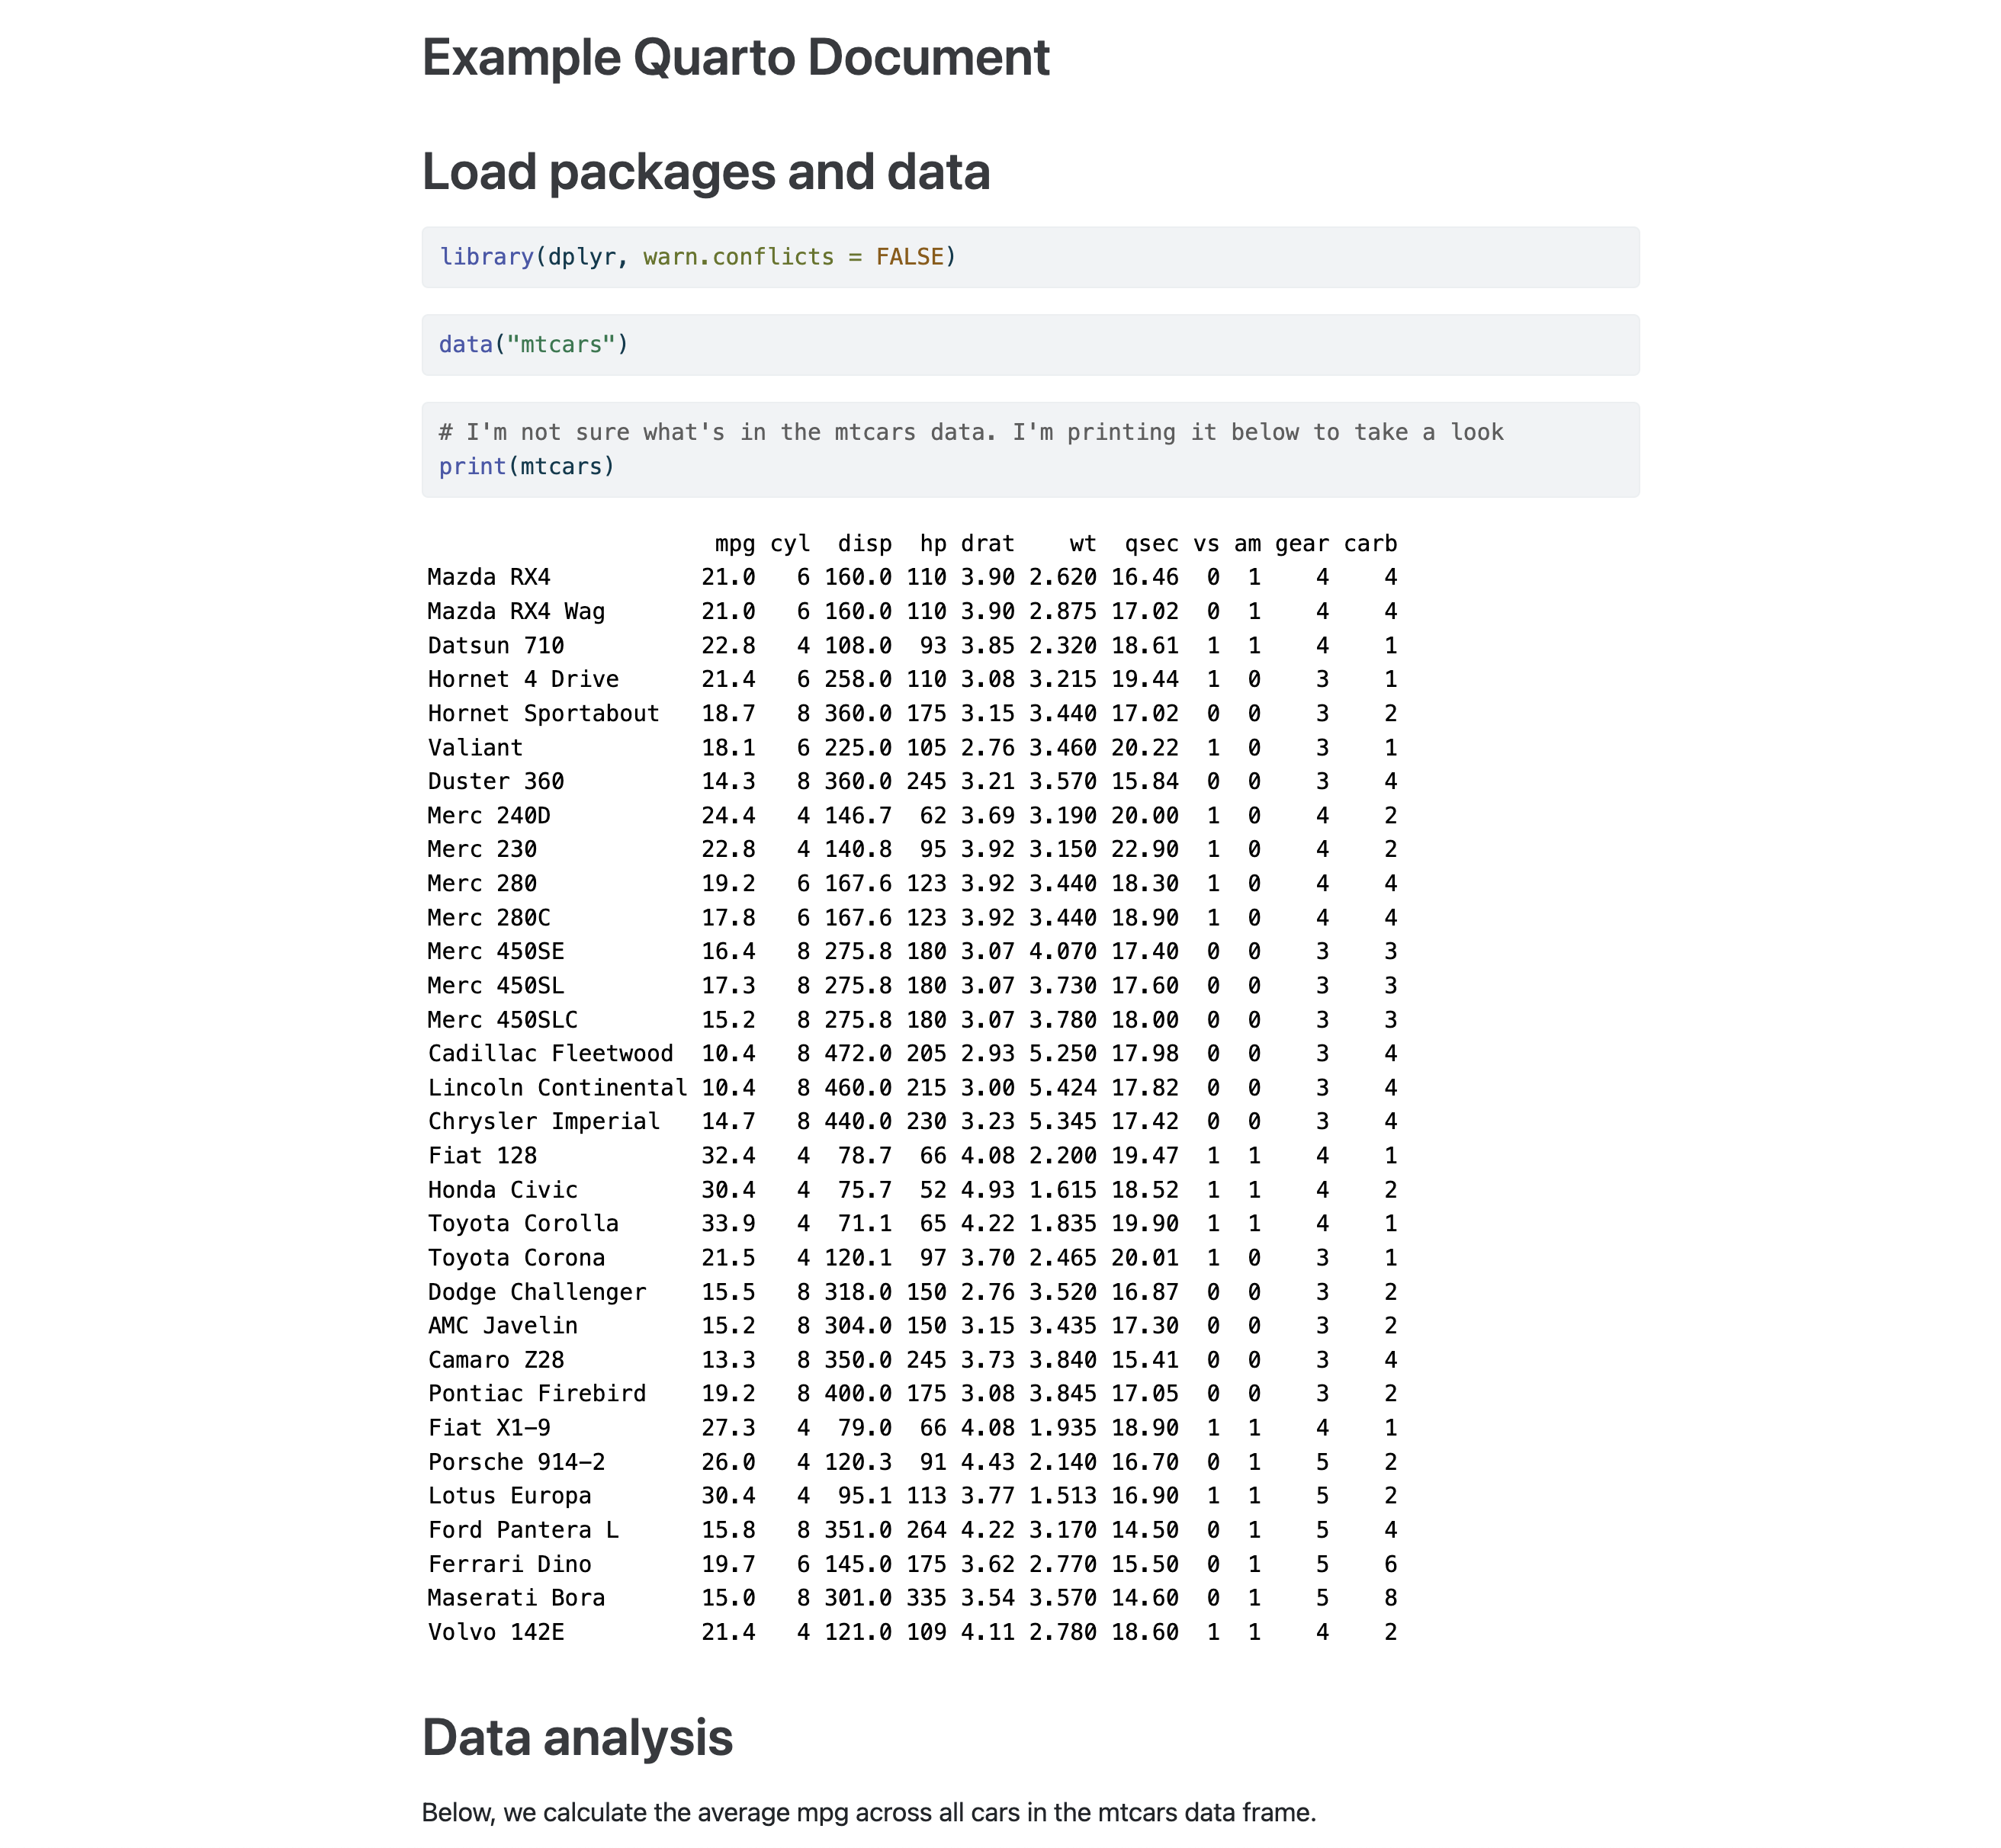
Notes:
rendered_preview

Slide 3
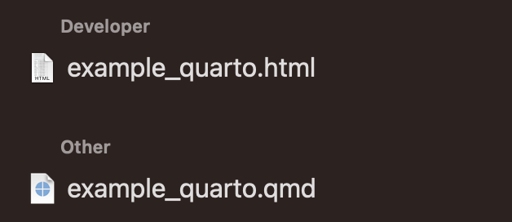
Notes:
quarto_files

Slide 4
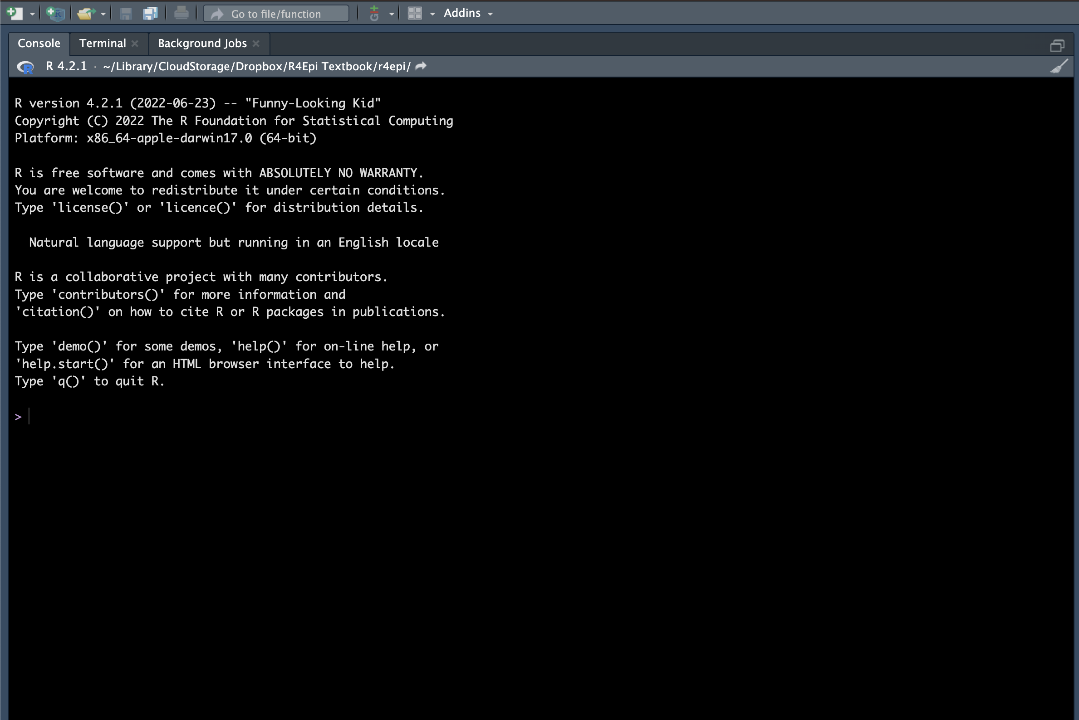
Notes:
new_quarto_document_01

Slide 5
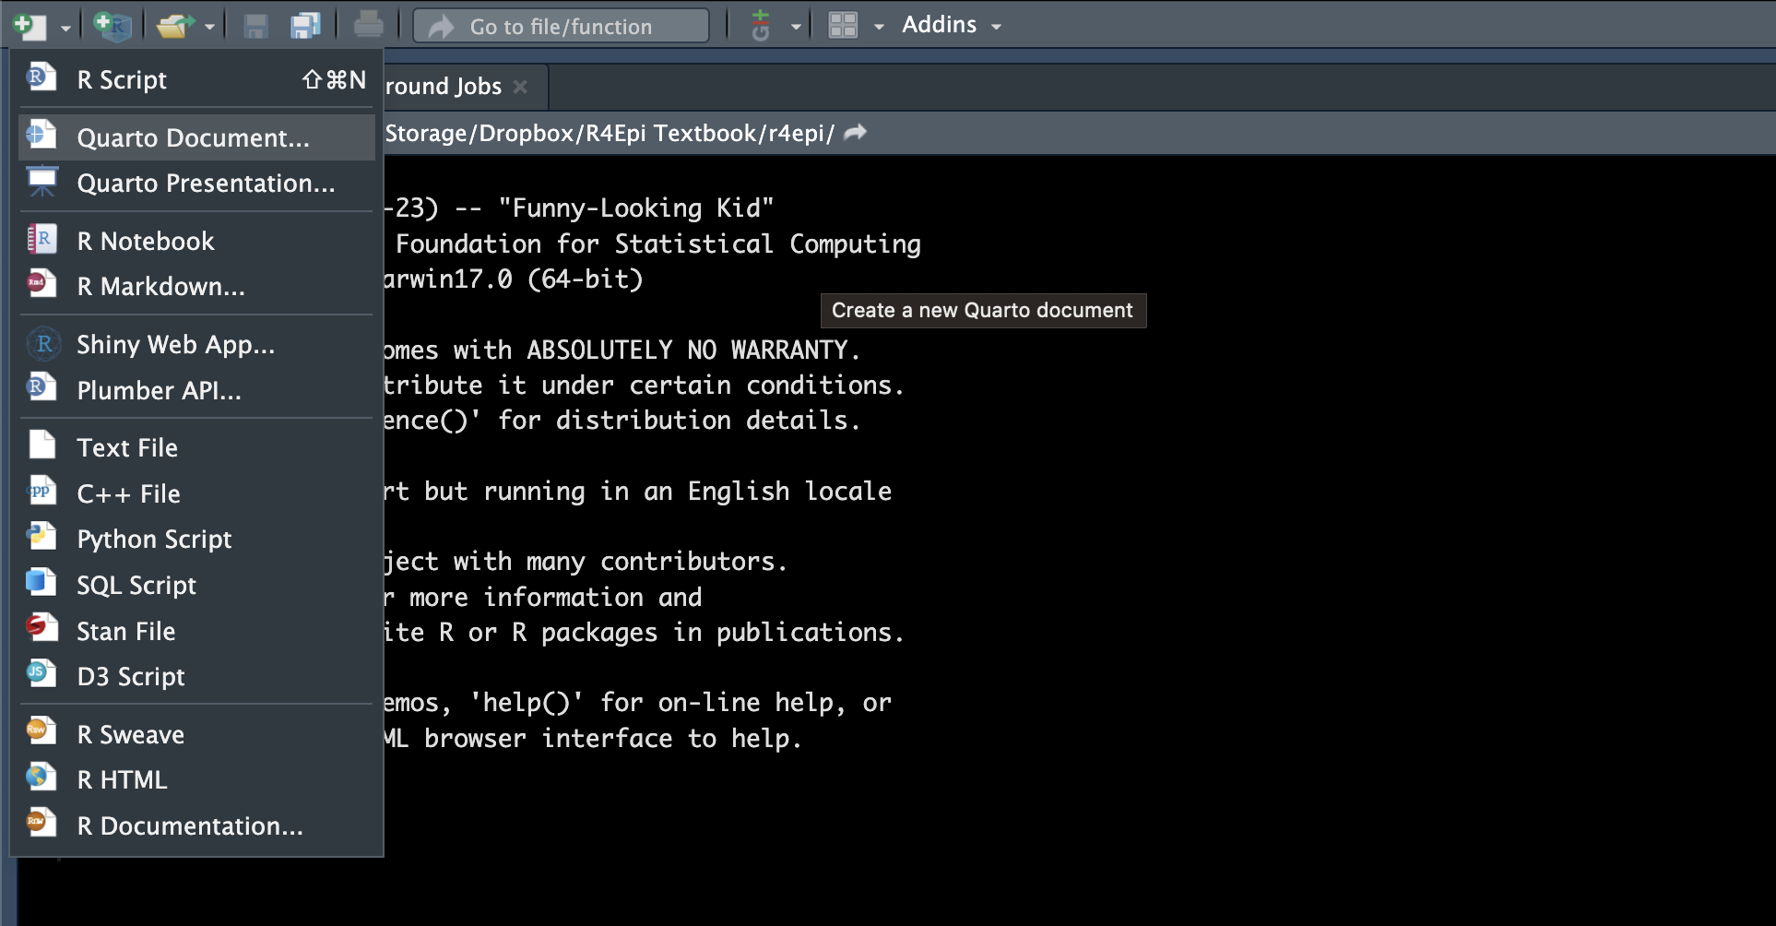
Notes:
new_quarto_document_02

Slide 6
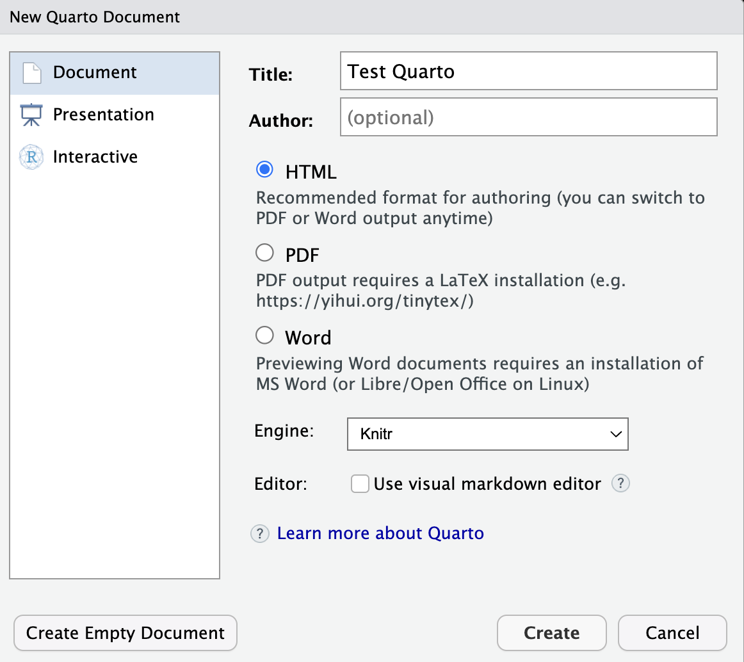
Notes:
new_quarto_document_03

Slide 7
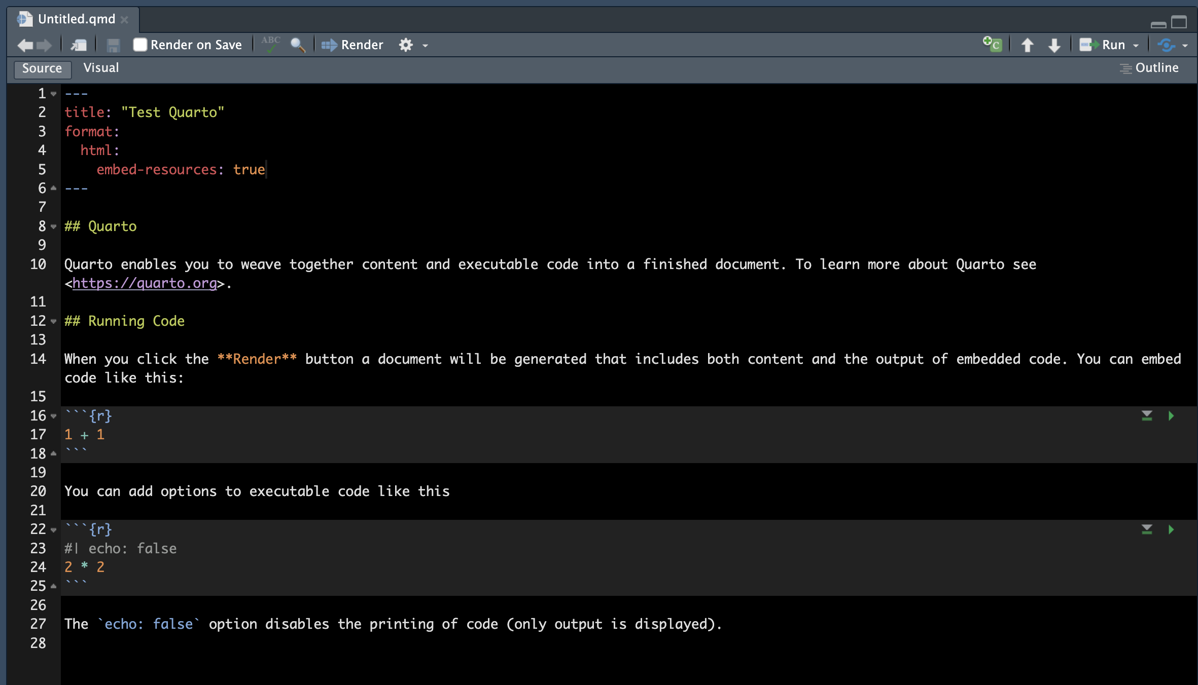
YAML header
Link to a website
Explanatory text
Heading (level 2)
Formatting (Bold)
R code chunk
Play button
Notes:
new_quarto_document_04

Slide 8
Notes:
render

Slide 9
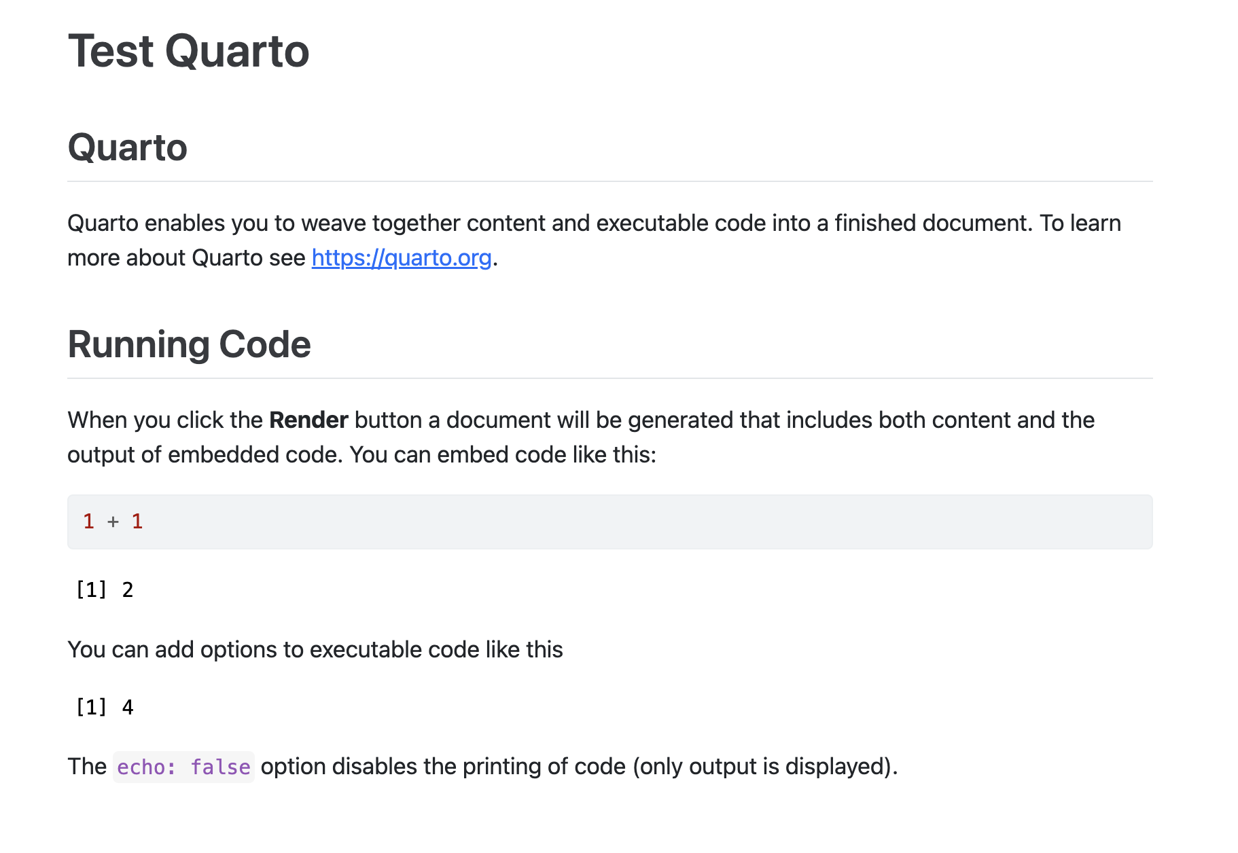
Heading (level 2)
Title from YAML header
Explanatory text
Link to a website
Formatting (Bold)
R code chunk
Result of the R code chunk
Notes:
rendered_quarto_document

Slide 10
Notes:
quarto_run_code_chunks

Slide 11
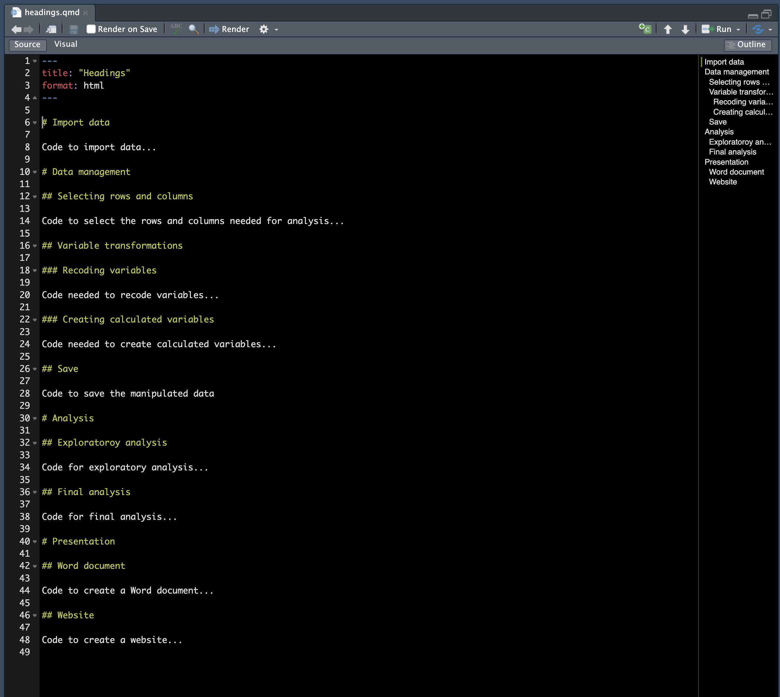
Notes:
quarto_headings

