Slide 1



Functions = Factories
Outputs = Results
(Return Values)
Inputs = Arguments
Notes:
factory1

Slide 2
seq()
Outputs = Results
(Return Values)
from = 2
by = 2
to = 100
[2, 4, 6 … 96, 98, 100]
Notes:
factory2

Slide 3
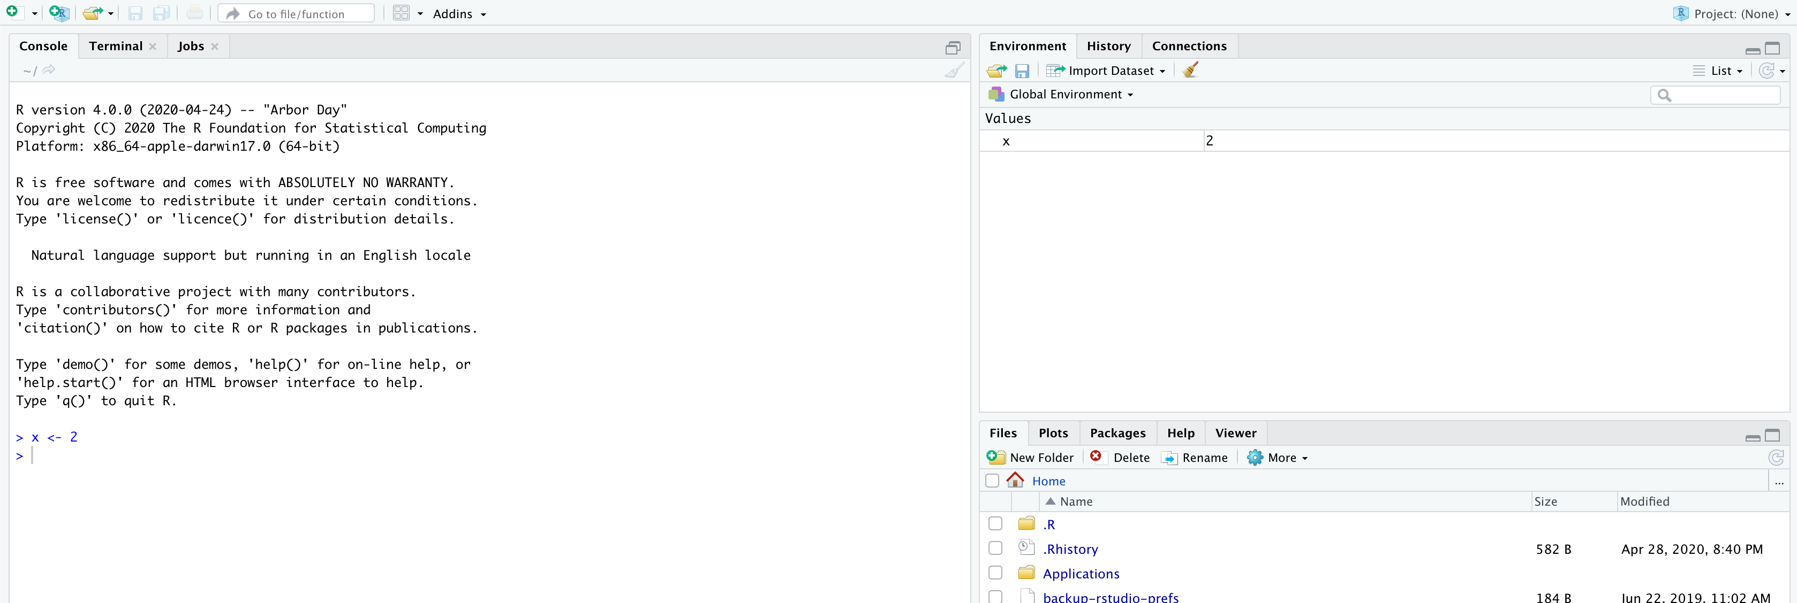
Notes:
Objects

Slide 4
John
is
Funny
Subject
Verb
Adjective
X
←
2
Object
Function
Value
Notes:
language

