Slide 1


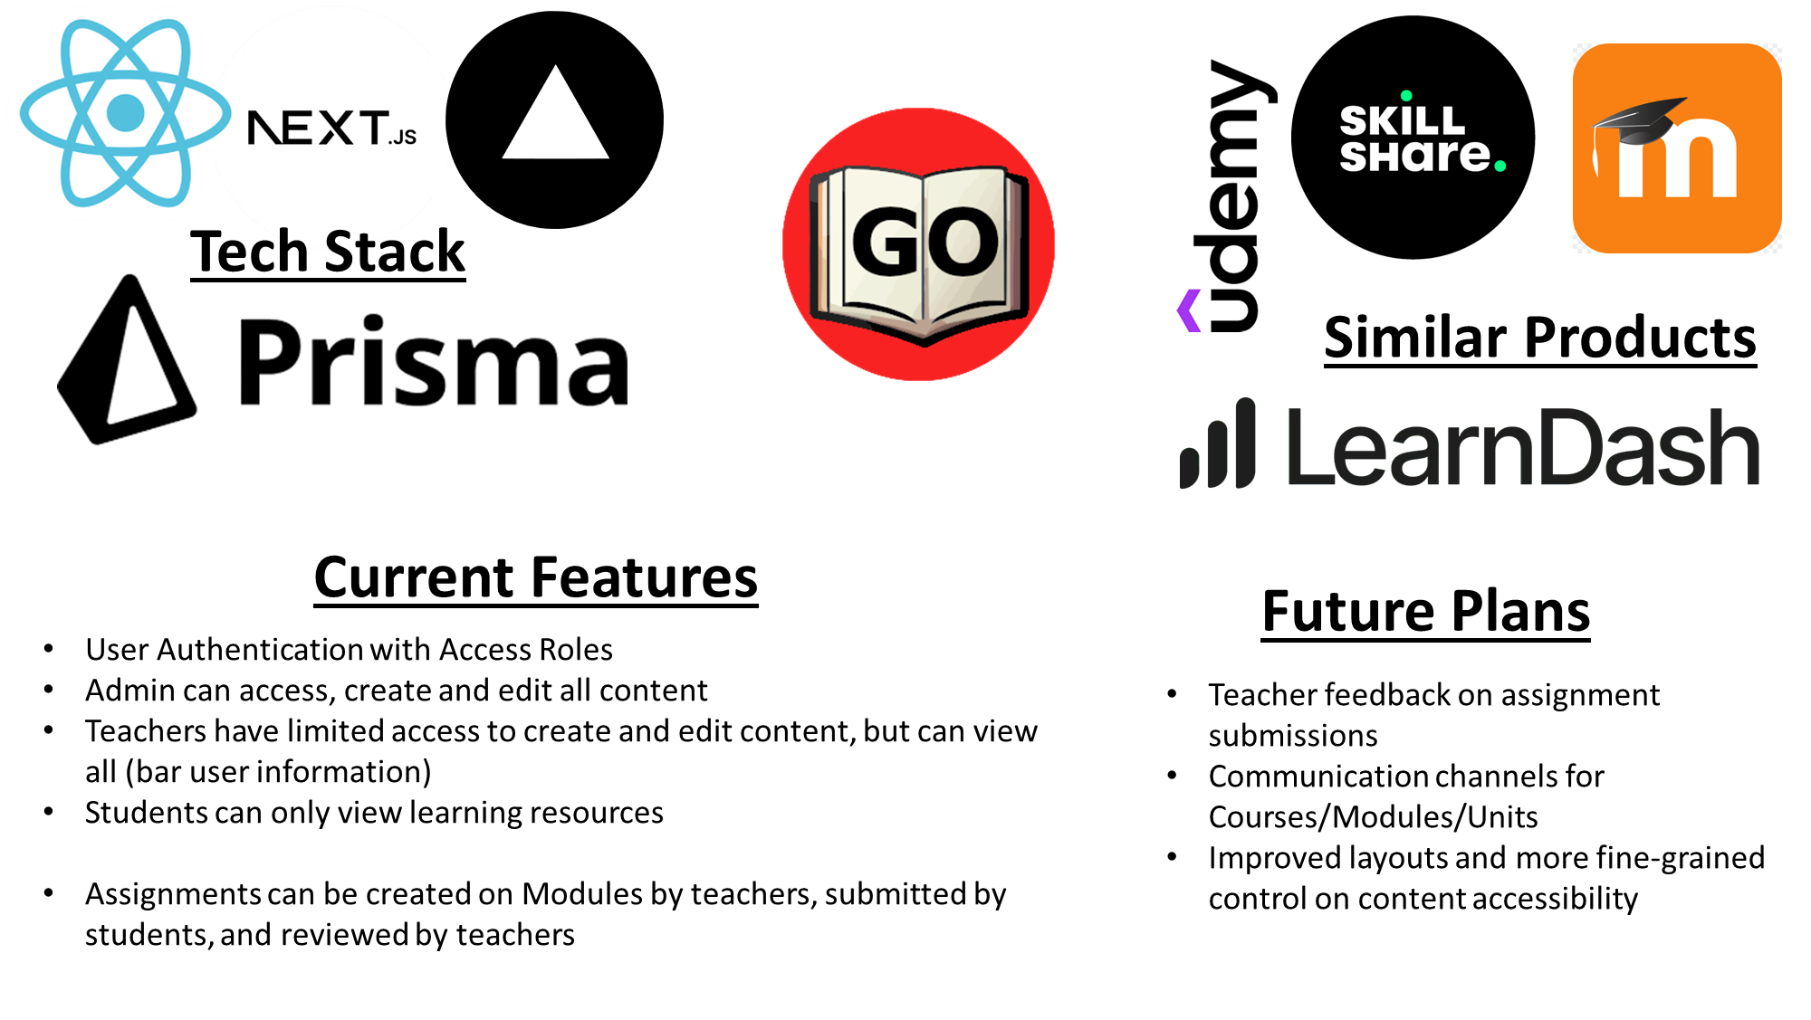
GoLearn – Learning Resource Manager
Bradley Beasley (Supervised by Alexandros Voudoris)

