Slide 1
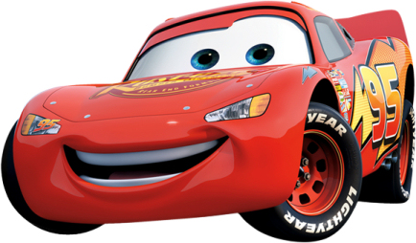

Exploratory Data Analysis
Jan’17 Batch – Group 7

Slide 2

Vutukuru Siva Santosh Kumar
Praveen Kumar S Naidu
Madhu Gurram
Tejomayi Madugula
Venkata Naga Prasad Chinthalapudi
Ananda Sampurna Bharadwaj Tadikonda
Srinivas Pillalamarry
Srinivasa
Radhika Devi Annamgi

Slide 3
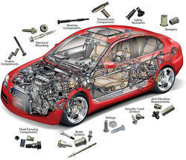
Domain & topic of project
Domain: Automobile
Topic: Automobile data (Cars)

Slide 4

The data contains information about Cars, and comprises of several aspects of automobile design and performance.
This application helps for understanding the dataset by exploring each parameters in the dataset.
Data Set Characteristics: | Multivariate | Number of Instances: | 205
Attribute Characteristics: | Categorical, Continuous | Number of Attributes: | 26
Period of data: | N/A | Missing Values? | Yes

Slide 5
Attribute information
symboling: : -3, -2, -1, 0, 1, 2, 3 (A value of +3 indicates that the auto is risky, -3 that it is probably pretty safe.)
normalized-losses: continuous from 65 to 256.
make: alfa-romero, audi, bmw, chevrolet, dodge, honda, isuzu, jaguar, mazda, mercedes-benz, mercury, mitsubishi, nissan, peugot, plymouth, porsche,renault, saab, subaru, toyota, volkswagen, volvo
fuel-type: diesel, gas.
aspiration: std, turbo.
num-of-doors: four, two.
body-style: hardtop, wagon, sedan, hatchback, convertible.
drive-wheels: 4wd, fwd, rwd.
engine-location: front, rear.
wheel-base: continuous from 86.6 120.9.
length: continuous from 141.1 to 208.1.
width: continuous from 60.3 to 72.3.
height: continuous from 47.8 to 59.8.
curb-weight: continuous from 1488 to 4066.
engine-type: dohc, dohcv, l, ohc, ohcf, ohcv, rotor.
num-of-cylinders: eight, five, four, six, three, twelve, two.
engine-size: continuous from 61 to 326.
fuel-system: 1bbl, 2bbl, 4bbl, idi, mfi, mpfi, spdi, spfi.
bore: continuous from 2.54 to 3.94.
stroke: continuous from 2.07 to 4.17.
compression-ratio: continuous from 7 to 23.
horsepower: continuous from 48 to 288.
peak-rpm: continuous from 4150 to 6600.
city-mpg: continuous from 13 to 49.
highway-mpg: continuous from 16 to 54.
price: continuous from 5118 to 45400.

Slide 6

Business needs identified
Preference in buying – low cost or more cost cars?
Is risk rating impacting the buying ?
Does fuel type play a role in car purchase?
Is mileage better in cities or highway ?
Which body style is preferred ?
Which cars are safe ?
For same mileage cars, which fuel type cars are costlier ?
Which drive wheels is preferred and why ?
What factors impact automobile pricing ?
What factors impact mileage ?
What is the Best car in terms of both price and mileage ?

Slide 7

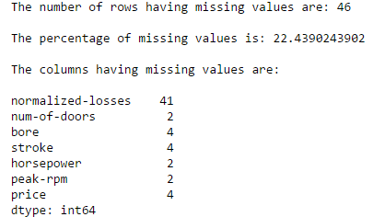
Loading and Cleaning of data
Objective: Handle missing values
Approach:
Identify the columns and rows having missing values
Since the % is 22.43 and hence decided to handle instead of dropping those rows.
The column “normalized-losses” is having the highest number of missing values. This columns is not active part of the hypothesis. So decided to drop the column
“Num-of-doors” is a categorical variable. Hence replaced the missing values with mode corresponding to make and body-style

Slide 8
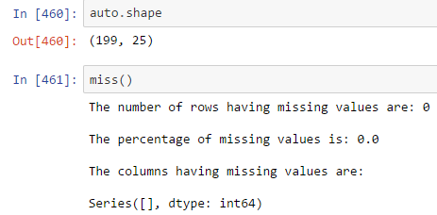
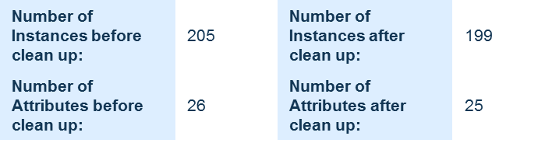
Continued….
Replace missing values in “bore” and “stroke” with mean corresponding to make (as its continuous variable)
“Horsepower” and “peak-rpm” are both having missing values for make 'renault‘. Moreover only 2 observations are corresponding to ‘renault’. Hence dropped the rows.
“Price” has lots of variations and not able to identify a specific pattern in which price is decided. Hence dropped the rows.

Slide 9

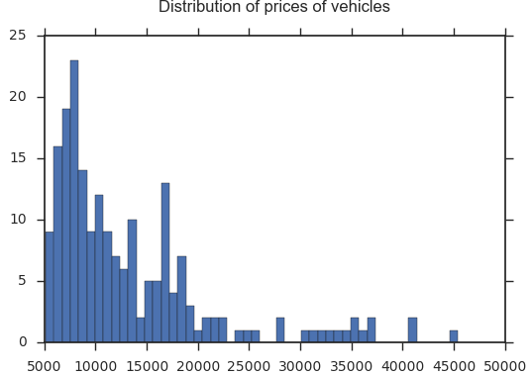
Q1: Preference in buying – low cost or more cost cars
Approach:
To plot a histogram for price which gives the distribution of prices.
Visualizations:
Findings:
We can find that the majority of distribution is around lower price range and can infer that the customer prefer buying low costs cars.

Slide 10

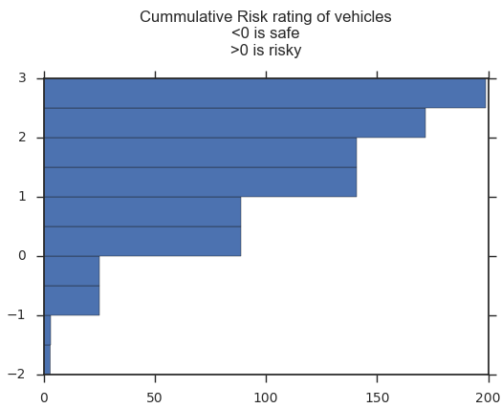
Q2: Is risk rating impacting the buying ?
Approach:
To plot a histogram that gives the “cumulative” risk rating of vehicles
Visualizations:
Findings:
We can find that the count of vehicles that are risky are far more than safe.
We can infer that risk is not a key factor impacting the customer buying.

Slide 11
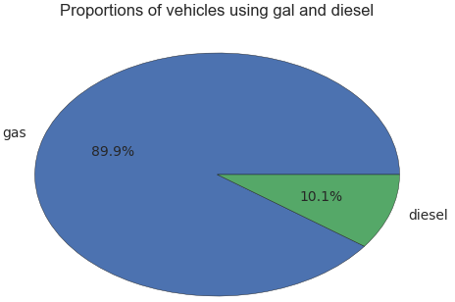
Q3: does fuel type play a role in car purchase?
Approach:
To plot a pie chart that gives info related to the proportions of different fuel types used by vehicles.
Visualizations:
Findings:
We can infer that the customers are quite keen on purchasing gas cars.

Slide 12
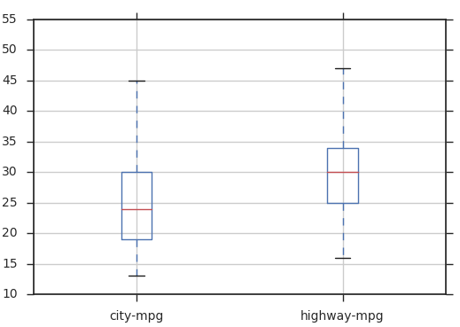
Q4: Is mileage better in cities or highway?
Approach:
To plot a box plot that tells how mileages differ in cities and highways and the way the data is distributed.
Visualizations:
Findings:
Can infer that highway mpg is more than city mpg
There are no outliers (that is no extreme cases of mpg)
Data is well spread out in city mpg compared to highway mpg
City mpg seems to be more normally distributed than highway mpg

Slide 13
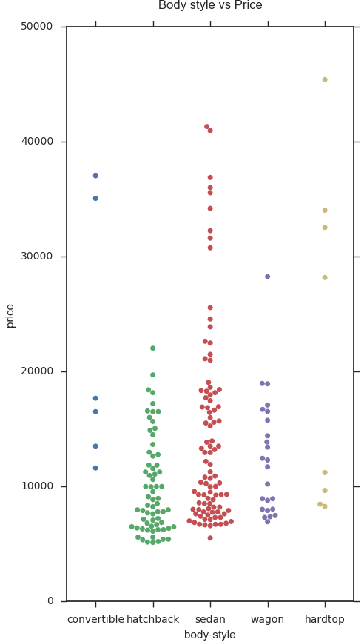
Q5: Which body style is preferred
Approach:
To plot a Swarmplot to find the buying patterns of customers based on body style and price.
Here Swarmplot is used as it enables to plot categorical data and avoids overlapping points to get the actual feel of data.
Visualizations:

Slide 14
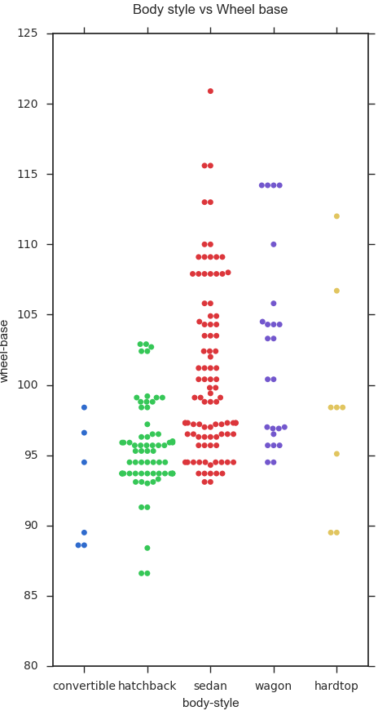
Continued….
Findings:
Sedan seems to be more popular choice with a wide range of price
Hatchback and wagon price range is similar. Hatchback seems popular among these 2. You can fold down the rear seats in nearly all hatchbacks, allowing for significantly more cargo space.
Not many people are preferring convertible and hardtop. These seem to be sports variety with limited customers.
To confirm the second point, we would like to do additional hypothesis of body style against wheel base.

Slide 15
Continued…
Findings:
Can confirm above understanding that even though hatchback and wagon have similar wheel base, the design of hatchbacks allow for flexibility in space and hence is more preferred

Slide 16
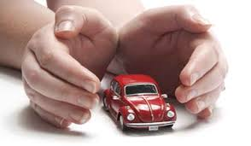
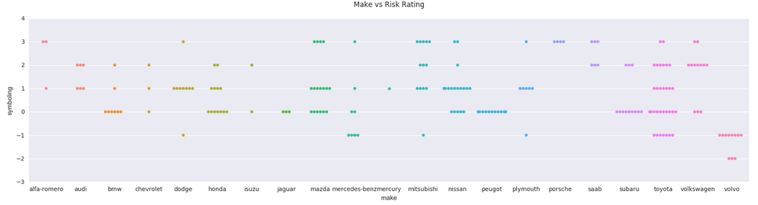
Q6: Which cars are safe ?
Approach:
To plot a Swarmplot to risk ratings of vehicles for various make.
Here Swarmplot is used as it enables to plot categorical data and avoids overlapping points to get the actual feel of data.
Visualizations:
Findings:
Safe cars are Volvo (safest with 11 cars) followed by Peugot (11 cars) and Jaguar (3 cars)
Risky car are Porsche (4 cars) and Saab (3 cars each for risk rating of 2 and 3)

Slide 17
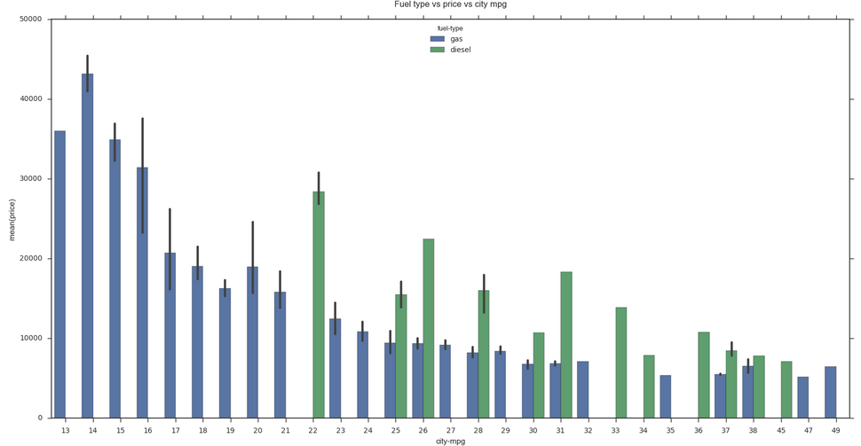
Q7: For same mileage cars, which fuel type cars are costlier ?
Approach:
To plot the bar plot of fuel type, price and city mpg
Visualizations:
Findings:
For high priced vehicles, gas is preferred
For different fuel type cars giving same mileage, diesel vehicles are more costlier than gas vehicles

Slide 18
Q8: Which drive wheels is preferred and why ?
Approach:
To plot a horizontal bar plot of make, curb-weight and drive wheel.
Here horizontal plot is used so as to display the make.
Visualizations:
Findings:
Front wheel drive (fwd) and rear wheel drive (rwd) are preferred compared to four wheel drive(4wd)
The most preferred is rwd. The curb weight of rwd is highest amongst all. Rwd provide better balance and is preferred
Mercedes Benz and jaguar have the highest curb weight. Chevrolet has the least.

Slide 19
Q9: What factors impact automobile pricing ?
Approach:
To plot a scatter plot of price with various variables such as wheel-base, curb-weight and so on.
Visualizations:
Findings:
- Positive relationship of price with:
Wheel base (though there are some outliers that doesn’t fit nicely)
Length
Width
Curb weight
horsepower (though there are some outliers that doesn’t fit nicely)
- Negative relationship of price with:
mpg
- No relationship of price with rest all variables

Slide 20
Q10: What factors impact mileage?
Approach:
To plot a scatter plot of city mpg with various variables such as wheel-base, curb-weight and so on.
Visualizations:
Findings:
- Negative relationship of city mpg with:
wheel base
Length (though there are some outliers that doesn’t fit nicely)
Width
Curb weight
Engine-size
horsepower
price
- No relationship of city mpg with rest all variables

Slide 21
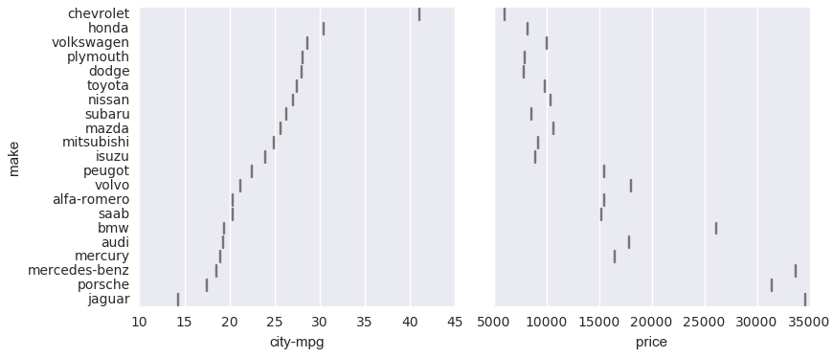
Q11: What is the Best car in terms of both price and mileage ?
Approach:
To plot a PairGrid plot of city mpg and price with make
PairGrid is chosen as it enables to plot pair wise relationships between different variables.
Visualizations:
Findings:
Chevrolet is best car in terms of price and mileage
Jaguar is on the other end of spectrum in terms of price and mileage

Slide 22
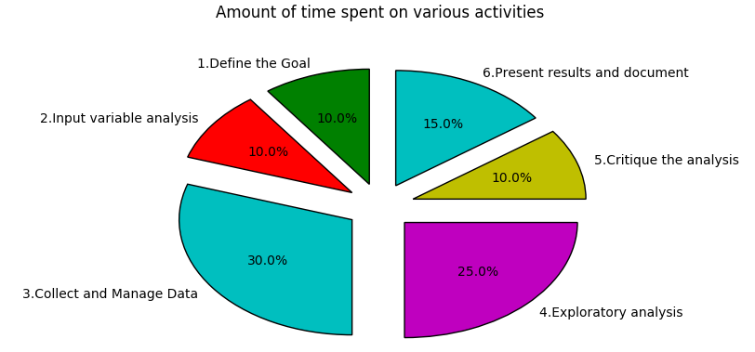
Appendix

Slide 23
Continued…
Code:
https://nbviewer.jupyter.org/github/brad678/Automobile_EDA-project/blob/master/auto.ipynb
Video:
https://app.hyfy.io/v/ab2w9GAIJu/?p=1

Slide 24
Thank you….

